Slide 1
CS 5187: Vision and Image Lecture 9 Stereo Vision
Dr. Dapeng Oliver Wu
City University of Hong Kong
Department of Computer Science
Semester A, 2025/26

Slide 2
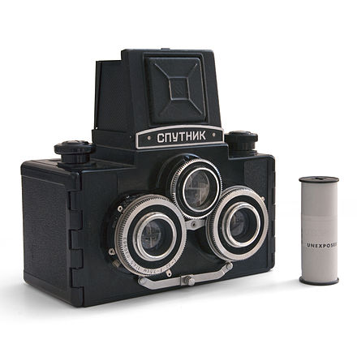

Slide 3
Amount of horizontal movement is …
…inversely proportional to the distance from the camera

Slide 4





Depth from Stereo
Goal: recover depth by finding image coordinate x’ that corresponds to x
X
X
x
z
x
x’
x'
f
f
C
Baseline B
C’

Slide 5
Optic axes of 2 cameras are parallel
image planes
z
camera L
f
Z
O
xl
baseline
camera R
b
f
xr
x-b
P=(x,z)
Y-axis is perpendicular to the page.
X
z f
x xl
z f
x-b z
xr f
y yl
y yr
=
=
=
=
(from similar triangles)
Notes:
x = zxl/f
zxr = (x-b)f
zxr = (zxl/f-b)f
zxr = zxl – fb
z(xl-xr) = fb
z = fb/(xl-xr)

Slide 6
3D from Stereo Images
For stereo cameras with parallel optical axes, focal length f, baseline b, corresponding image points (xl,yl) and (xr,yr), the location of the 3D point can be derived from previous slide’s equations:
Depth z = f*b / (xl - xr) = f*b/d
x = xl*z/f or b + xr*z/f
y = yl*z/f or yr*z/f
Note that depth is inversely proportional to disparity

Slide 7
Quiz
Assume: 1) the optical axes of 2 cameras are parallel;
2) the intrinsic parameters of both cameras are unknown.
If the corresponding positions of scene points in two images are known,
which of the following are true?
Enough to estimate the distance of the scene points to the camera
Enough to estimate the relative distance (disparity) between scene points in two images
Enough to estimate the baseline of two cameras

Slide 8
Depth from Stereo
Goal: recover depth by finding image coordinate x’ that corresponds to x
Sub-Problems
Calibration: How do we recover the relation of the cameras (if not already known)?
Correspondence: How do we search for the matching point x’?
X
x
x'

Slide 9
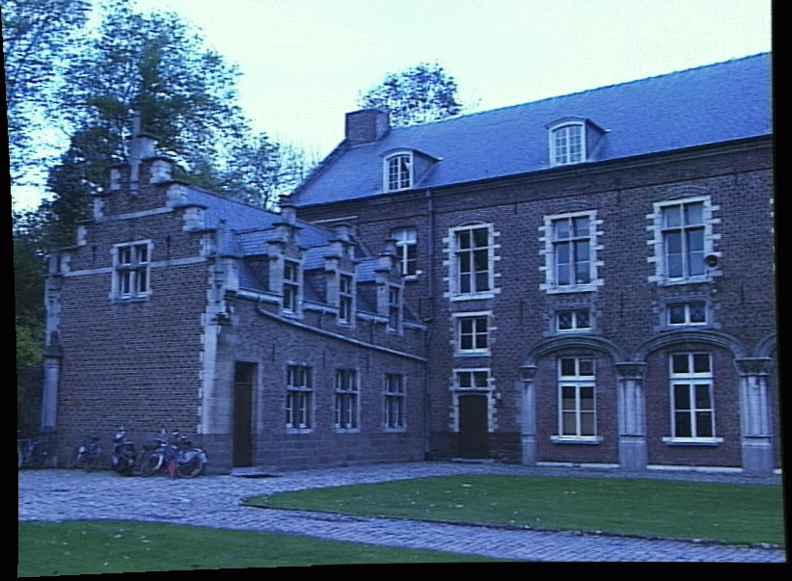
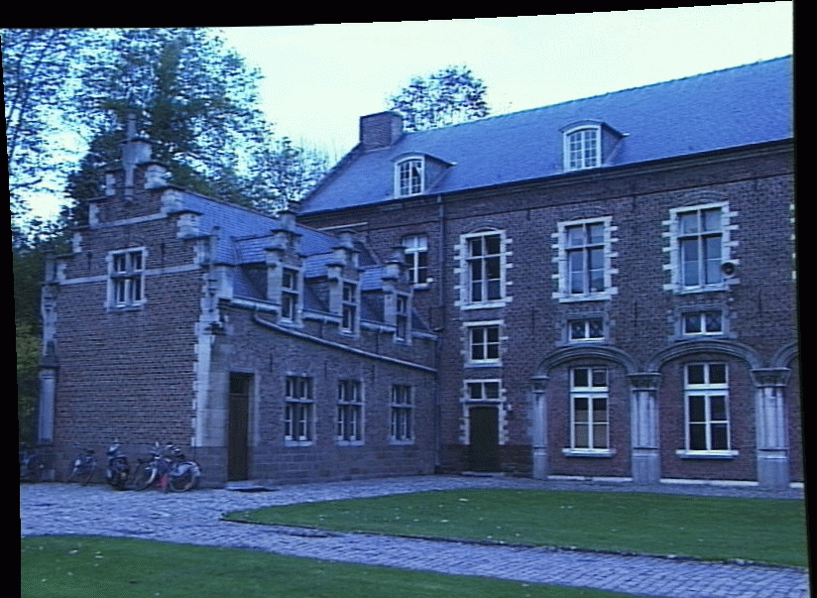
Correspondence Problem
x
?
We have two images taken from cameras with different intrinsic and extrinsic parameters
How do we match a point in the first image to a point in the second? How can we constrain our search?

Slide 10
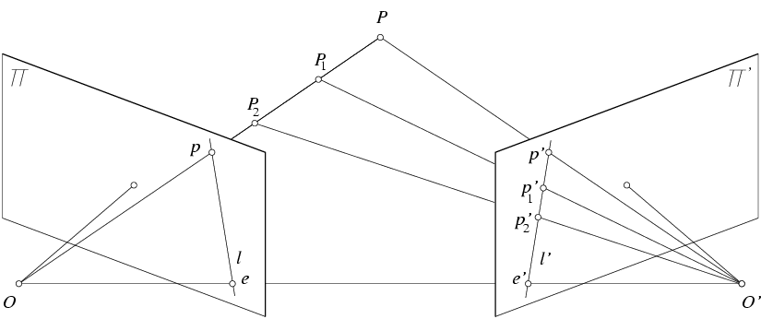
Key idea: Epipolar constraint
X
X
X
x
x’
x’
x’
Potential matches for x have to lie on the corresponding line l’.
Potential matches for x’ have to lie on the corresponding line l.
Notes:
1)Two points are needed
2) When find the matching, just search the l’ is enough
X scene point
Any points along this ray to X projects to this image
Central: principle point and optical axis
Search all pixels along this line.
X: image point
X: point in the intersection is the scene point

Slide 11
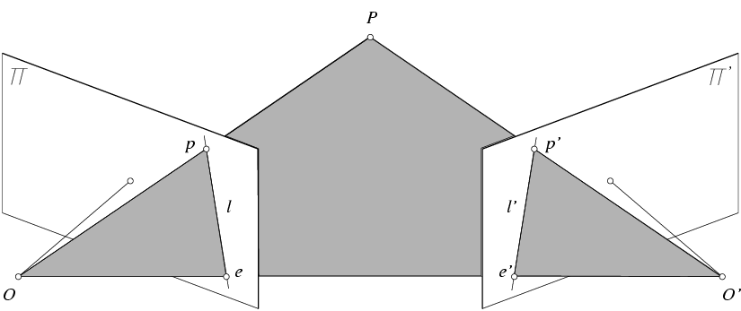
Epipolar geometry: terminology
X
x
x’
Baseline – line connecting the two camera centers
Epipoles
= intersections of baseline with image planes
= projections of the other camera center
Epipolar Plane – plane containing baseline (1D family)

Slide 12
Epipolar geometry: notation
X
x
x’
Baseline – line connecting the two camera centers
Epipoles
= intersections of baseline with image planes
= projections of the other camera center
Epipolar Plane – plane containing baseline (1D family)
Epipolar Lines - intersections of epipolar plane with image planes (always come in corresponding pairs)

Slide 13
Epipolar constraint
X
x
x’
If we observe a point x in one image, where can the corresponding point x’ be in the other image?

Slide 14
Epipolar constraint
X
X
X
x
x’
x’
x’
Potential matches for x have to lie on the corresponding
epipolar line l’.
Potential matches for x’ have to lie on the corresponding
epipolar line l.

Slide 15
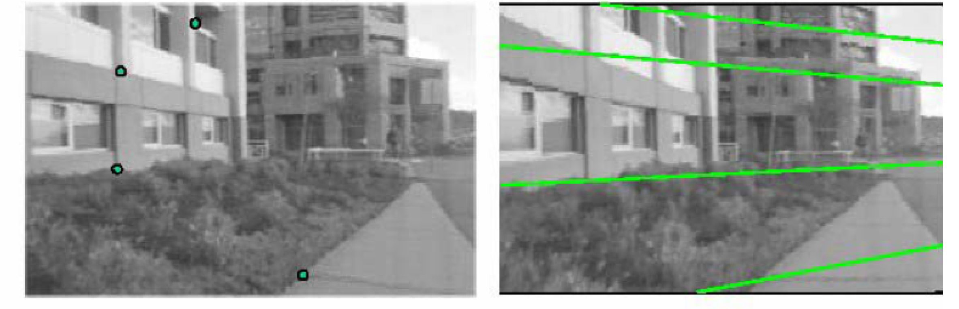
Epipolar constraint example

Slide 16
The Cross Product
Given two nonzero vectors a = ⟨a₁, a₂, a₃⟩ and b = ⟨b₁, b₂, b₃⟩, it is very useful to be able to find a nonzero vector c that is perpendicular to both a and b.
If c = ⟨c₁, c₂, c₃⟩ is such a vector, then a  c = 0 and b  c = 0.
c = a × b
The cross product a × b of two vectors a and b, unlike the dot product, is a vector c.
The vector c is perpendicular to both a and b.

Slide 17
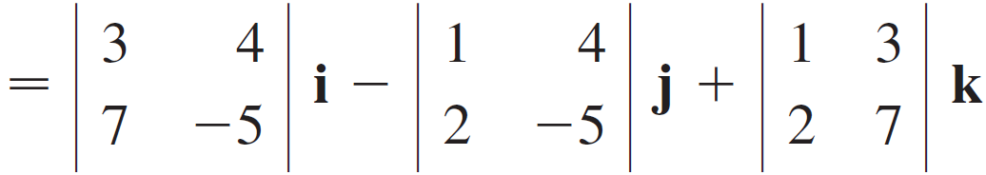
Example 1
If a = ⟨1, 3, 4⟩ and b = ⟨2, 7, –5⟩, then
= (–15 – 28)i – (–5 – 8)j + (7 – 6)k
= –43i + 13j + k

Slide 18

The Cross Product
We can also represent the cross product of two vectors in matrix-vector multiplication:
$$a×b=\left[\begin{matrix}\begin{matrix}0 \\ a_{3}\end{matrix} & \begin{matrix}\begin{matrix}{−a}_{3} \\ 0\end{matrix} & \begin{matrix}a_{2} \\ {−a}_{1}\end{matrix}\end{matrix} \\ {−a}_{2} & \begin{matrix}a_{1} & 0\end{matrix}\end{matrix}\right]\left[\begin{matrix}\begin{matrix}b_{1} \\ b_{2}\end{matrix} \\ b_{3}\end{matrix}\right]=\left[a_{×}\right]b$$
Notes:
1 3 4
2 7 -5
[ 0 -4 3
4 0 -1 * [ 2 7 -5] =-43 13 1
-3 1 0]

Slide 19
Epipolar constraint: Calibrated case
X
x
x’
Assume that the intrinsic and extrinsic parameters of the cameras are known
Pixel locations are in normalized image coordinate
We can set the world coordinate system to the coordinate system of the first camera. Then the projection matrices of the two cameras can be written as [I | 0] and [R | t]

Slide 20

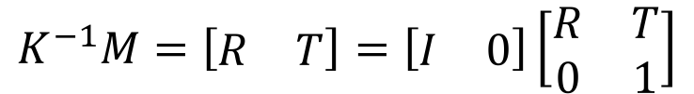
Normalized Image Coordinate
The image coordinate is “normalized” to be independent of camera parameters
extrinsic parameters
$$P^{′}=K\left[\begin{matrix}R & T\end{matrix}\right]P_{w}=MP_{w}$$
intrinsic parameters
$$K^{−1}P^{′}=\left[\begin{matrix}R & T\end{matrix}\right]P_{w}$$
$$K^{−1}M=\left[\begin{matrix}R & T\end{matrix}\right]=\left[\begin{matrix}I & 0\end{matrix}\right]\left[\begin{matrix}R & T \\ 0 & 1\end{matrix}\right]$$
normalized
image coordinate
projection matrix
for normalized camera

Slide 21



Epipolar constraint: Calibrated case
X
x
x’
$$\hat{x}$$
$${\hat{x}}^{′}$$
t
R
The vectors R$\hat{x}$, t, and $\hat{x}′$are coplanar

Slide 22

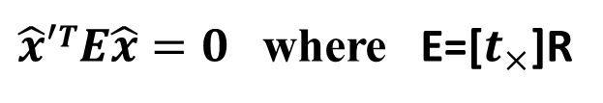
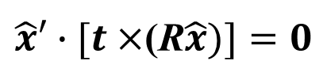

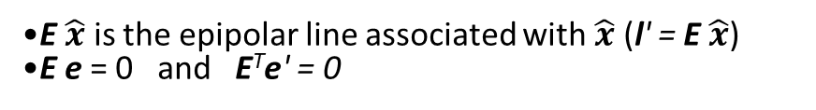
Epipolar constraint: Calibrated case
X
x
x’
$$\hat{x}$$
$$\hat{x}′$$
$\hat{x}′∙[t×$(R$\hat{x})]=0$
$\hat{x}′TE\hat{x}=0$ where E=[$t_{×}$]R
E $\hat{x}$ is the epipolar line associated with $\hat{x}$ (l' = E $\hat{x}$)
E e = 0 and E^{T}e' = 0
Essential Matrix E
(Longuet-Higgins, 1981)
The vectors R$\hat{x}$, t, and $\hat{x}′$are coplanar
Notes:
1.
[tx]: a 3x3 matrix of
0 -tz ty
tz 0 -tx
-ty tx 0
Note that the matrix is skew-symmetric, which must have two singular values which are equal and another is 0. Multiplication with the rotation matrix does not change this property.
2.
x’ is on the line l’. So, x’^T l’ = 0. Given x’^T E x = 0, then l’ = Ex.
Similarly, l^Tx = 0, implies l^T=x’TE, so l=E^Tx’
l’^Te’ = 0
==> (Ex)^T e’= 0
==> x^TE^Te’ = 0
x is not 0, so E^Te’ = 0
l^Te = 0
(E^Tx’)^T e = 0
X’TEe = 0
e’^T l’ = 0. So, e’^T Ex = 0. So, e’^TE = 0.
3.
The essential matrix has five or six degrees of freedom, depending on whether or not it is seen as a projective element. The rotation matrix {\displaystyle \mathbf {R} } and the translation vector {\displaystyle \mathbf {t} } have three degrees of freedom each, in total six. If the essential matrix is considered as a projective element, however, one degree of freedom related to scalar multiplication must be subtracted leaving five degrees of freedom in total.

Slide 23


Epipolar constraint: Uncalibrated case
X
x
x’
$$\hat{x}$$
$$\hat{x}′$$
The calibration matrices K and K’ of the two cameras are unknown
We can write the epipolar constraint in terms of unknown normalized coordinates:
Un-normalized
image coordinate
$${\hat{x}}^{′}={K′}^{−1}x′$$
$$\hat{x}=K^{−1}x$$
Normalized
image coordinate

Slide 24
Epipolar constraint: Uncalibrated case
X
x
x’
Fundamental Matrix
(Faugeras and Luong, 1992)

Slide 25


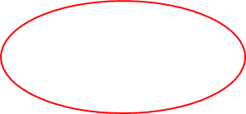
Epipolar constraint: Uncalibrated case
X
x
x’
F x is the epipolar line associated with x (l' = F x)
F is defined in terms of pixel coordinates

Slide 26

The eight-point algorithm
x$=\left(u,v,1\right)T$
x’$=\left(u\text{’},v\text{’},1\right)T$
A
Smallest eigenvalue of A^{T}A
Minimize:
under the constraint ||F||²=1
Notes:
The degree of freedom for fundamental matrix is 7. Minus 2 d.o.f because of homogeneous coordinate (the matrix is up to a scale factor) and that F is a singular matrix (determinant is 0).

Slide 27





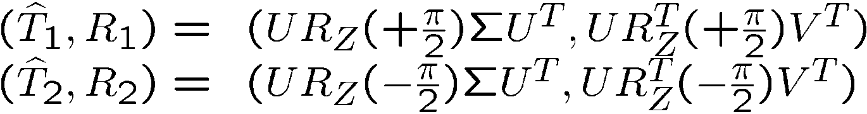
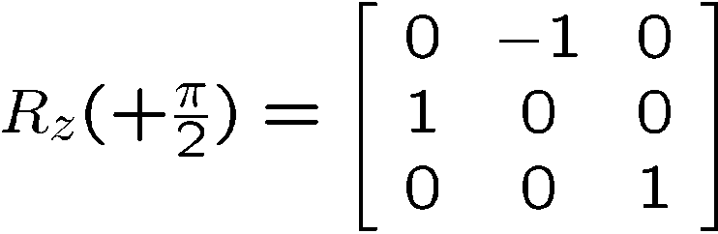


Pose Recovery from the Essential Matrix
Essential matrix
Theorem 1a (Pose Recovery)
There are two relative poses with and
corresponding to a non-zero matrix essential matrix.
Twisted pair ambiguity

Slide 28
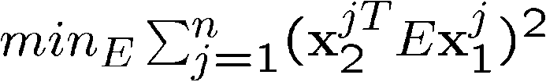










Estimating Essential Matrix
Solution
Eigenvector associated with the smallest eigenvalue of
if degenerate configuration
F is a matrix in the null space of X
Projection on to Essential Space
Theorem 2a (Project to Essential Manifold)
If the SVD of a matrix is given by
then the essential matrix which minimizes the
Frobenius distance is given by
with

Slide 29
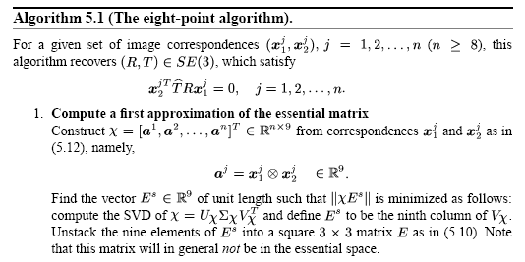
Pose recovery: eight-point algorithm

Slide 30
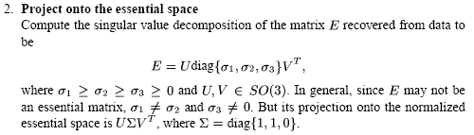

Slide 31
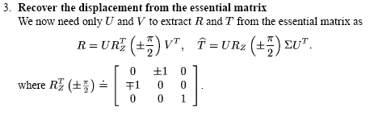

Slide 32
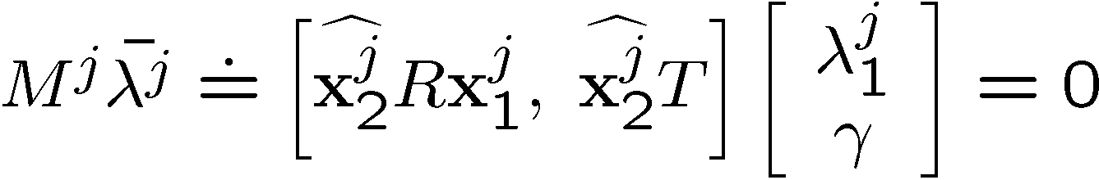
3D structure recovery
Eliminate one of the scale’s
Solve LLSE problem
If the configuration is non-critical, the Euclidean structure of then points and motion of the camera can be reconstructed up to a universal scale.

Slide 33
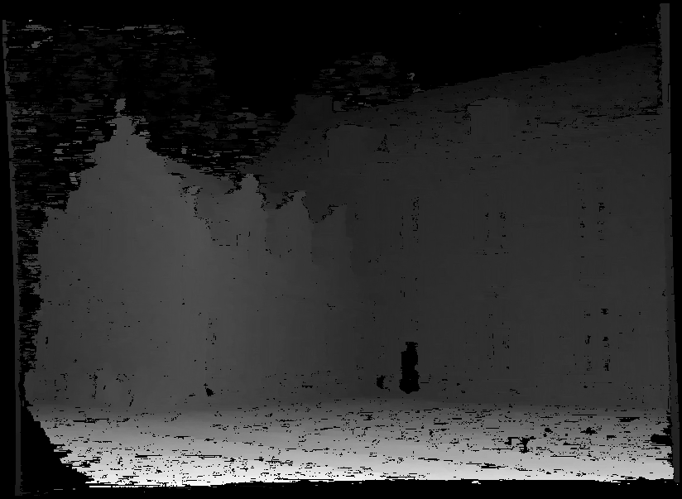
Moving on to stereo…
Fuse a calibrated binocular stereo pair to produce a depth image
image 1
image 2
Dense depth map

Slide 34
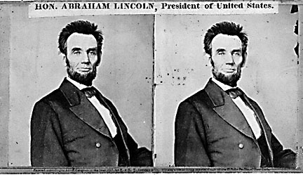
Basic stereo matching algorithm
If necessary, rectify the two stereo images to transform epipolar lines into scanlines
For each pixel x in the first image
Find corresponding epipolar scanline in the right image
Search the scanline and pick the best match x’
Compute disparity x-x’ and set depth(x) = fB/(x-x’)
Notes:
Rectification makes the epipolar line as the horizontal line. Comparisons can be done easily.

Slide 35


Simplest Case: Parallel images
Epipolar constraint:
$$E=\left[t_{×}\right]R$$
R = I t = (T, 0, 0)
x
x’
$$E=\left[t_{×}\right]R$$
t
The y-coordinates of corresponding points are the same
Notes:
[u v 1] [0 –T Tv’]^T = 0
-Tv + Tv’ = 0
v = v’

Slide 36
Stereo image rectification

Slide 37
Stereo image rectification
Reproject image planes onto a common plane parallel to the line between camera centers
Pixel motion is horizontal after this transformation
Two homographies (3x3 transform), one for each input image reprojection
C. Loop and Z. Zhang. Computing Rectifying Homographies for Stereo Vision. IEEE Conf. Computer Vision and Pattern Recognition, 1999.
Notes:
The homographies can be computed through fundamental matrices:
From fundmental matrices and corresponding points, we know epipolar lines
Find epipoles as the intersection of epipolar lines
Find homographies that project epipoles to point at infinity

Slide 38
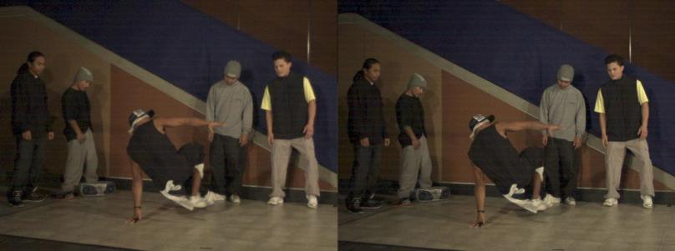
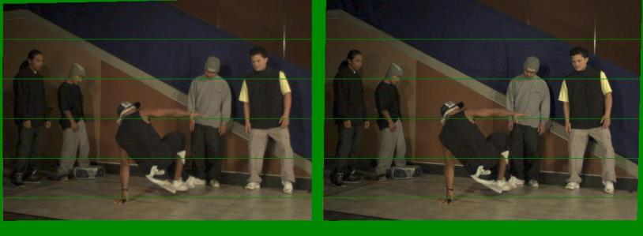
Example
Unrectified
Rectified

Slide 39
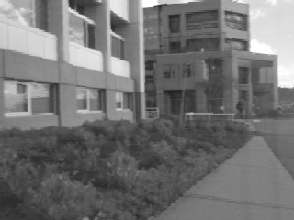
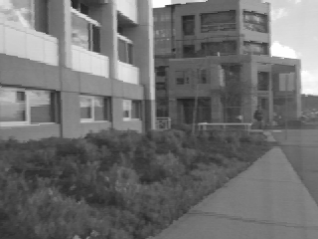
Left
Right
scanline
Matching cost
disparity
Slide a window along the right scanline and compare contents of that window with the reference window in the left image
Matching cost: SSD, SAD, or normalized cross correlation

Slide 40
Correspondence search
Left
Right
scanline
SSD

Slide 41
Correspondence search
Left
Right
scanline
NCC

Slide 42
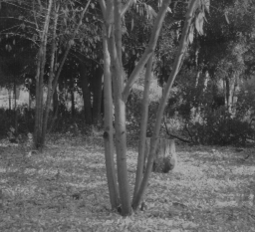
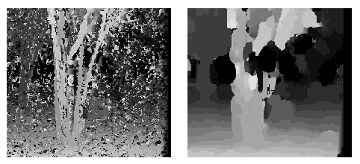
Effect of window size
Disparity map for W = 3
Disparity map for W = 20
Smaller window
+ More details
More noise
Larger window
+ Smoother disparity maps
Less details
Fails near boundaries
Notes:
smaller window: more detail, more noise
bigger window: less noise, more detail

Slide 43
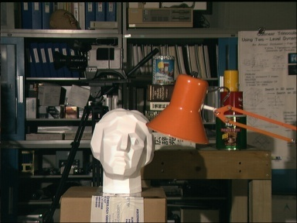
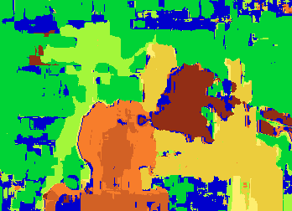

Depth map with window-based matching
Data
Depth map (window-based matching)
Ground truth for depth map

Slide 44
How can we improve window-based matching?
So far, matches are independent for each point
What constraints can we add?

Slide 45
Constraints
Uniqueness
For any point in one image, there should be at most one matching point in the other image
Smoothness
We expect disparity values to change slowly (for the most part)

Slide 46
Stereo as energy minimization
What defines a good stereo correspondence?
Match quality
Want each pixel to find a good match in the other image
Smoothness
If two pixels are adjacent, they should (usually) move about the same amount

Slide 47



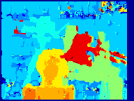



Matching windows:
Similarity Measure | Formula
Sum of Absolute Differences (SAD)
Sum of Squared Differences (SSD)
Normalized Cross Correlation (NCC)
Depth map
SAD
SSD
NCC
Ground truth
http://siddhantahuja.wordpress.com/category/stereo-vision/
Notes:
smaller window: more detail, more noise
bigger window: less noise, more detail

Slide 48
Stereo reconstruction pipeline
Steps
Calibrate cameras
Rectify images
Compute disparity
Estimate depth
What will cause errors?
Camera calibration errors
Poor image resolution
Occlusions
Violations of brightness constancy
Low-contrast image regions

Slide 49
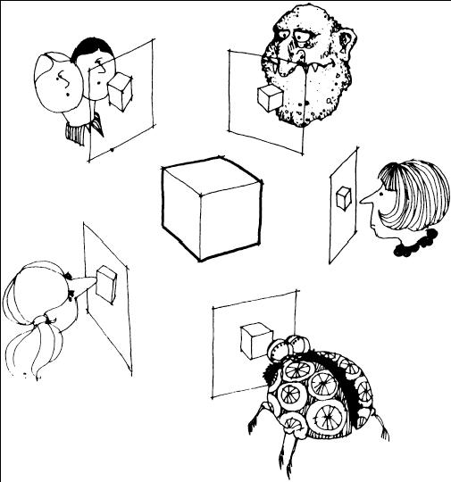
Multi-view stereo ?

Slide 50
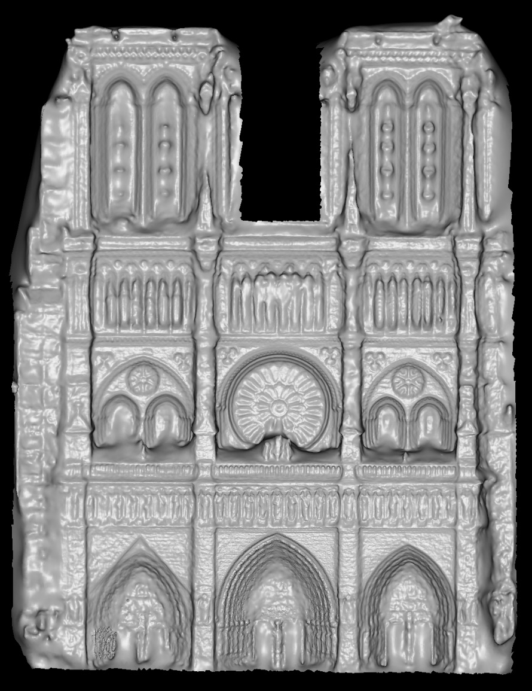
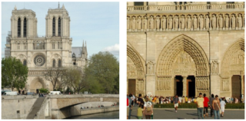
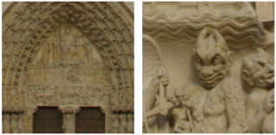
Using more than two images
Multi-View Stereo for Community Photo Collections M. Goesele, N. Snavely, B. Curless, H. Hoppe, S. Seitz Proceedings of ICCV 2007,

