Slide 1

Introduction to OpenCV
Notes:
Hello, everyone,

Slide 2
OpenCV
OpenCV (Open Source Computer Vision Library) is an open source computer vision and machine learning software library
3.4.0 / 2.4.13.5 (Latest version: OpenCV 4.8 )
OpenCV-Python is the Python API of OpenCV
Cross-platform (Windows, Mac, Linux, Android, iOS, etc )
Open Source and free (May have some commercial packages)
Documentation: http://docs.opencv.org/modules/core/doc/intro.html
Notes:
Today, I will introduce how to use OPENCV to achieve interesting examples, as we all know, opencv is a powerful open source computer vision and machine learning software library.
Opencv has several strengths:
It can be used in different platform like xxx
Besides, it is open source and free, you can employ it to do whatever you want.
By the way, If you are interested in OpenCV, you can click this link to read their documentations, so that you can understand a little bit further.

Slide 3
Installation
Install OpenCV-Python in Windows (site)
Install Anaconda
Anaconda is essentially a nicely packaged Python IDE that is equipped with very useful packages, such as NumPy, Pandas, IPython Notebook, etc.
Installation: https://docs.anaconda.com/anaconda/install/
Install python virtual environment on Anaconda
https://docs.conda.io/projects/conda/en/latest/user-guide/tasks/manage-environments.html
Install opencv-python:
Install Jupyter Notebook:
Test:
Open Python IDLE and type following codes in Python terminal
$ pip install opencv-python
$ conda install jupyter notebook
>>> import cv2
>>> print(cv2.__version__)
Notes:
So, you have to install opencv library using the given links.
First you should install anaconda, if you click this link, you can find this webpage with download anaconda on the top, click it and skip registration, and you can download it.
We suggest you create a virtual environment in anaconda follow this user guide in this link.
If you succeed, you can enter the python terminal, and use pip or conda to install opencv-python.
And if you dont see Jupyter Notebook is available on your Anaconda, use this command to install one.
I remember the latest version of Anaconda has already included an available Jupyter, you could skip this step.
If you want to know what the opencv version is, you can type the following codes to check your opencv version.
Ok,fine, Now, you can use the jupyter notebook in your laptop, click the launch button in anaconda, it will jump out a new webpage.
Create a new python file with the ”plus” button, and we will use jupyter notebook to complete the following programing tasks.

Slide 4
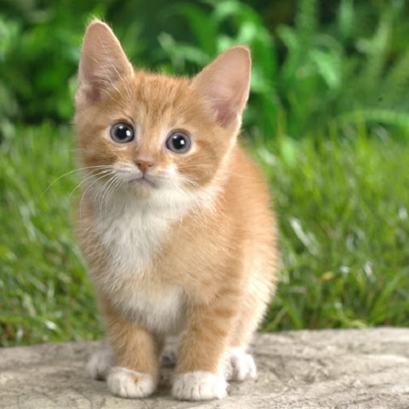
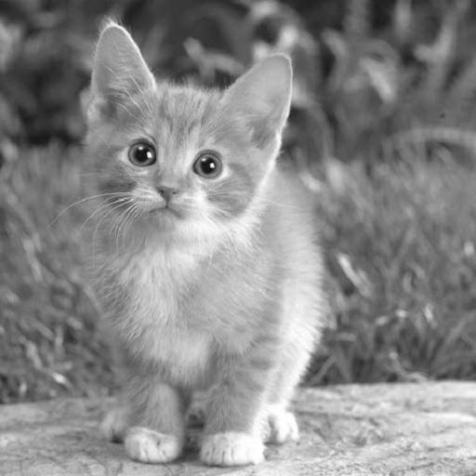
Reading, Colorspace Changing:
import cv2
# reading image:
image = cv2.imread('cat.jpg') # default, colorful
image = cv2.imread('cat.jpg', 1) # colorful, BGR
image = cv2.imread('cat.jpg', 0) # gray-scale
image = cv2.imread('cat.jpg', -1) # unchanged, e.g., images include alpha channel
Notes:
First, We will try a simple example, to read and change colorspace of a cat image.
Open your jupyter webpage, and copy or type the codes in your cell. Don’t forget to click run button,
And then, you will read this cat image as colorful image or gray image, it depends on the second parameter you give.
OK

Slide 5
Reading, Colorspace Changing:
import cv2
# change image colorspace:
image = cv2.imread('cat.jpg') # default, BGR
flag = cv2.COLOR_BGR2RGB # Change colorspace BGR->RGB
image2 = cv2.cvtColor(image, flag)
flag:
BGR->Gray: cv2.COLOR_BGR2GRAY
BGR->RGB: cv2.COLOR_BGR2RGB
BGR->HSV: cv2.COLOR_BGR2HSV
Notes:
Let’s move on, you can also use the flag to convert the colorspace of picture you have read.
You could define your flag in many ways, like BGR2GRAY, BGR2RBG and so on.
To be mentioned, opencv reads image in BGR as default.
And here we define a flag as COLOR_BGR2RGB,
and use cvtColor() function to adapt the change on this image.
You could use matplotlib library to visualize the images you read.

Slide 6
Image Segmentation
K-means Clustering
It clusters the given data into k-clusters or parts based on the k-centroids
The motivation behind image segmentation using k-means is that we try to assign labels to each pixel based on the RGB (or HSV) values
OpenCV
cv2.kmeans(data, K, bestLabels, criteria, attempts, flags [, centers]) → retval, bestLabels, centers
Input parameters
data: np.float32 data type, and each feature should be put in a single column
K : Number of clusters required at end
bestLabels : Input/output integer array that stores the cluster indices for every sample
criteria : It is the iteration termination criteria
attempts: Flag to specify the number of times the algorithm is executed
flags: how initial centers are taken
Output parameters
retval: the sum of squared distance from each point to their corresponding centers
bestLabels: the label array where each element marked ‘0’, ‘1’,......, ‘K-1’
centers: array of centers of clusters
Notes:
In next part, we will use opencv to conduct image segmentation experiments.
Image segmentation refers to decomposing an image into a set of disjoint regions.
Clustering is a technique to classify a bunch of objects based on some criteria.
Actually, image segmentation can be regarded as a process of clustering pixel based on its RGB value.
So, we can use K-means clustering method in opencv to achieve this goal.
The cv2.kemans function have several arguments, data is the image you want to read,
and K is the number of clusters you require.And this function will return the result of clustering.
You could read the detail description from opencv official documentation to learn more about it.
https://docs.opencv.org/3.4/d1/d5c/tutorial_py_kmeans_opencv.html

Slide 7
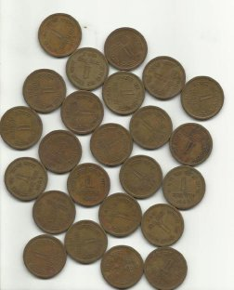

Image Segmentation
Preprocessing
Convert the MxNx3 image into a Kx3 vector (K=MxN)
import numpy as np
import cv2
from matplotlib import pyplot as plt
image = cv2.imread('coins.jpg')
# reduce noise and make the image smoother
image = cv2.GaussianBlur(image, (7, 7), 0)
# each row is now a vector in the 3-D space of RGB
vectorized = image.reshape(-1, 3)
# convert the unit8 values to float (cv2.kmeans requirement)
vectorized = np.float32(vectorized)
Input
Noise Removal
Notes:
Here we focus on this code example.
First, we will take some preprocessing techniques to filter the image.
Here we choose the guassianblur filter to do this, and the effect of filter is shown in the bottom picture.
You can also use different filters with different kernel sizes.
After that, you should convert the image into the vector in order to feed to the kmeans function.
And here we convert the image to a K by 3 vector using the reshape().

Slide 8
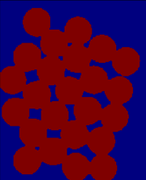
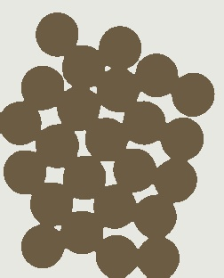
Image Segmentation
k-means algorithm
# define number of segments
segments = 2
# define stopping criteria
criteria = (cv2.TERM_CRITERIA_EPS + cv2.TERM_CRITERIA_MAX_ITER, 10, 1.0)
# OpenCV k-means function
ret, label, center = cv2.kmeans(vectorized, segments, None, criteria, 10, cv2.KMEANS_RANDOM_CENTERS)
# assign every pixel with a color based on the label map
res = center[label.flatten()]
# reshape to image size
segmented_map = res.reshape((image.shape))
result = segmented_map.astype(np.uint8)
cv2.imwrite("segmented.jpg", result)
Label map
Segmentation map
Notes:
https://github.com/rcrespocano/opencv-python/issues/5
We choose the number 2 to define the number of segments.
Because this coin image has clear foreground and background, they can be easily distinguished.
Then, we should define the stopping criteria. Here the max iteration times is 10 and threshold of expected accuracy is 1.0.
Next, we can call the kmeans function to achieve the image segmentation.
And the result is shown in the bottom figure, you can see coins and the background are separated correctly.

Slide 9
Feature Matching
SIFT
OpenCV 3 came a big push to move many of these “non-free” modules out of the default OpenCV install and into the opencv_contrib package
To get access to the original SIFT and SURF implementations found in OpenCV 2.4.X, you need to pull down both the opencv and opencv_contrib repositories from GitHub and then compile and install OpenCV 3 from source
ORB
An efficient alternative to SIFT or SURF
A fusion of FAST keypoint detector and BRIEF descriptor
Notes:
In the third example, we will try the feature matching algorithm.
Feature matching is the process of comparing two images based on their respective keypoints.
Keypoints also can be called as interest points. They are a set of spatial points in the image.
Keypoints are invariant to image rotation, shrinkage, translation, distortion, and so on.
There are many feature matching methods are developed to find keypoints, like SIFT or ORB.
SIFT is not free, so the installed Opencv doesn’t include SIFT module.
And ORB is a alternative to SIFT, it’s free, and consisted in opencv.

Slide 10
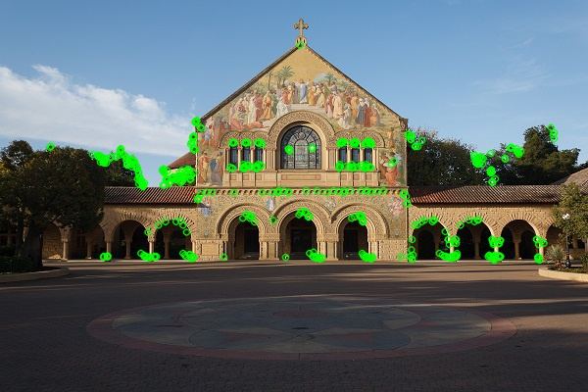
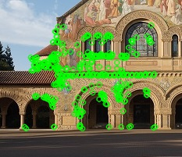
Feature Matching
Example
import numpy as np
import cv2
img1 = cv2.imread('church.jpg’,1) # queryImage
img2 = cv2.imread('church_part.jpg’,1) # trainImage
# Initiate detector
orb = cv2.ORB_create()
# find the keypoints and descriptors
kp1, des1 = orb.detectAndCompute(img1,None)
kp2, des2 = orb.detectAndCompute(img2,None)
Notes:
Feature matching consists of two key steps.
First, we should get the keypoints in an image, so, we use ORB method to do it.
The green circles are keypoints we detected.

Slide 11
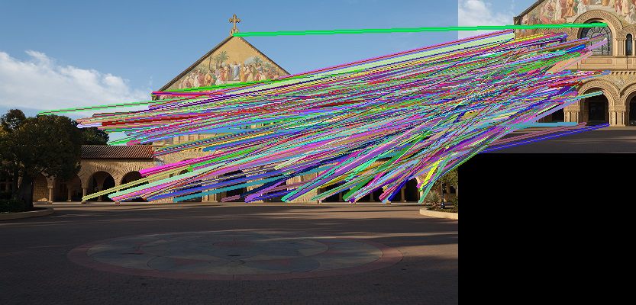
Feature Matching
Brute-Force matcher
It takes the descriptor of one feature in first set and matches it with all other features in second set using some distance calculation
The closest one is returned
# create BFMatcher object
bf = cv2.BFMatcher(cv2.NORM_HAMMING, crossCheck=True)
# Match descriptors
matches = bf.match(des1,des2)
# Sort them in the order of their distance
matches = sorted(matches, key = lambda x:x.distance)
Notes:
Then, we match these keypoints from these two images by using some feature matching matchers.
Here we use the Brute-force matcher, it will return the closest keypoint after conducting each search.
In this figure, these lines are pairs of close keypoints found by the matcher.

Slide 12
Feature Matching
# Draw first 10 matches using random colors
h1, w1 = img1.shape[:2]
h2, w2 = img2.shape[:2]
img3 = np.zeros((max(h1, h2), w1 + w2, 3), np.uint8)
img3[:h1, :w1, :] = img1
img3[:h2, w1:, :] = img2
for m in matches[:10]:
# draw the keypoints
color = tuple([np.random.randint(0, 255) for _ in range(3)])
cv2.line(img3, (int(kp1[m.queryIdx].pt[0]), int(kp1[m.queryIdx].pt[1])),
(int(kp2[m.trainIdx].pt[0] + w1),
int(kp2[m.trainIdx].pt[1])), color, 3)
cv2.imwrite("result.jpg", img3)
Notes:
This is the remaining part of code.
We use sort algorithm to select the first 10 closest matches, and draw them using random colors, and visualize them in the result image.

Slide 13
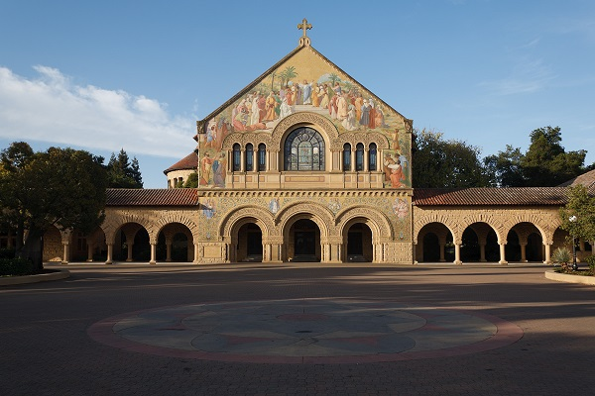
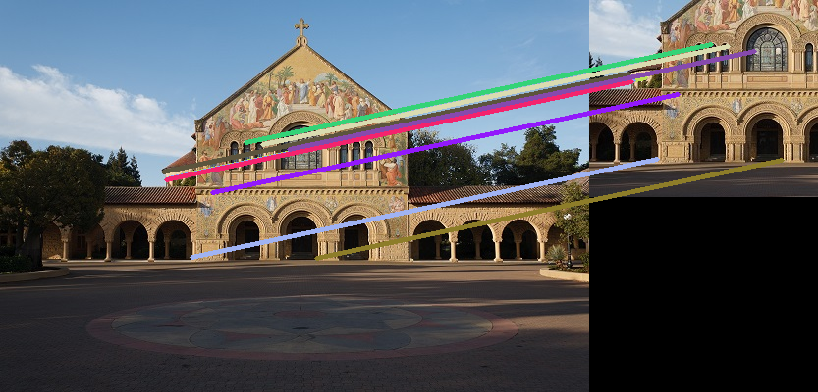
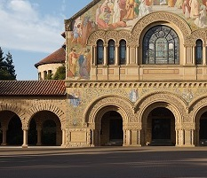
Feature Matching
Input
Output
Notes:
In this way, we can get the feature matching results of church images.
You could check your own output image.
The result may be a little bit different, that's okay

Slide 14
Face Tracking
Haar feature-based cascade classifiers is an effective object detection method
Group the features into different stages of classifiers and apply one-by-one
If a window fails the first stage, discard it.
If it passes, apply the second stage of features and continue the process
The window which passes all stages is a face region
OpenCV contains many pre-trained classifiers for face, eyes, smile etc.
Those XML files are stored in opencv/data/haarcascades/ folder
Notes:
And the last example, face tracking.
Face Tracking Technology can detect and track the human face in a digital video.
In this part, we use Haar feature-based cascade classifiers to achieve this goal.
Opencv contains many pre-tranined classifiers for different tracking tasks, Haar is on of them.
Those model files are stored in this directory, you could check it out.

Slide 15
Face Tracking
Example
import cv2
# load the face detector
faceCascade = cv2.CascadeClassifier(cv2.data.haarcascades
+ "haarcascade_frontalface_default.xml")
# use camera
# video_capture = cv2.VideoCapture(0)
# use input video
video_capture = cv2.VideoCapture('input.mp4’)
# Define the codec and output video
fourcc = cv2.VideoWriter_fourcc(*'XVID')
out = cv2.VideoWriter('output.mp4',fourcc, 20.0, (160,112))
Notes:
https://github.com/opencv/opencv/tree/17234f82d025e3bbfbf611089637e5aa2038e7b8/data/haarcascades
We first load the face detector from opencv and the input video.
And define the encoding standard for the output video.

Slide 16
Face Tracking
while True:
# Capture frame-by-frame
ret, frame = video_capture.read()
if frame is None:
break
gray = cv2.cvtColor(frame, cv2.COLOR_BGR2GRAY)
faces = faceCascade.detectMultiScale(gray, 1.3, 5)
# Draw a rectangle around the faces
for (x, y, w, h) in faces:
cv2.rectangle(frame, (x, y), (x+w, y+h), (0, 255, 0), 2)
# write frame to video
out.write(frame)
# When everything is done, release the capture
video_capture.release()
out.release()
Notes:
https://docs.opencv.org/3.4.0/d1/de5/classcv_1_1CascadeClassifier.html
Then, we use the detector to track the human face in the input video.
In this while-true iterator, we treat each frame in this video as image,
and use Haar classifier to detect human face on each frame.
And we use a rectangle to denote the detected face.
Following these steps, we will obtain the desired result.

Slide 17
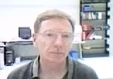
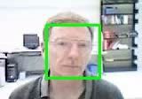

Face Tracking
Result
Input
Output
Notes:
And this is the expected result you may see after running this code.
Ok, The part of tutorial is over, that’s all, thank you!
Now you guys could run these examples by your own, so that you could understand these further.
These jobs are very interesting and easy, you can try them on your own data.
If you have any problems, feel free to contact with me by email or publish a discussion on canvas.

