Slide 1
Experimental Setup and Methodology
Core Model Architecture
Evaluation Dataset Configuration
Prompt Reasoning Strategies
GSM8K
01. CoT (Chain-of-Thought)
Qwen2.5-Math-1.5B
Contains 500 high-quality primary school math word problems, focusing on basic arithmetic operations and simple logic.
Guides the model to decompose problems step-by-step and output detailed reasoning paths.
A small language model (SLM) optimized specifically for mathematical reasoning tasks, which maintains excellent logical reasoning capabilities while remaining lightweight.
02. Least-to-Most
MATH500
Decomposes difficult problems into a sequence of solvable sub-problems, progressing step by step.
500 carefully selected competition-level difficult problems, covering high school and college mathematics knowledge, challenging the upper limit of the model's complex reasoning.
03. Self-Consistency (k=5)
Generates multiple reasoning paths and determines the final answer through a "majority voting" mechanism.

Slide 2
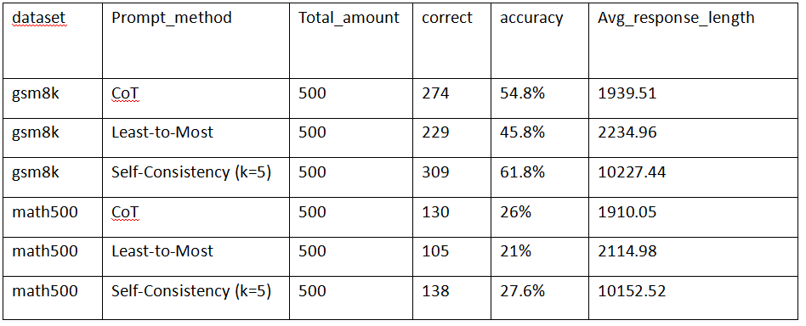
RESULTS
Experimental Results
Accuracy
Avg_response_length
05

Slide 3
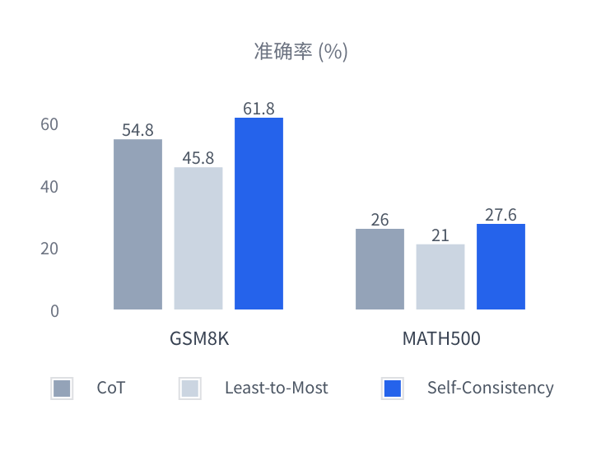
ANALYSIS
Analysis and Discussion of Results
Performance of Prompt Strategies on Different Datasets
SC Method Achieves Significant Advantages
61.8%
Best Performance on the GSM8K Dataset
Significantly outperforms CoT (54.8%) and Least-to-Most (45.8%), with obvious gains in moderately difficult reasoning tasks.
27.6%
Maintaining the Lead on the MATH500 Dataset
Still leading with an accuracy of 27.6% on high-difficulty competition-level questions, proving the robustness of the multi-path voting mechanism.
06

Slide 4
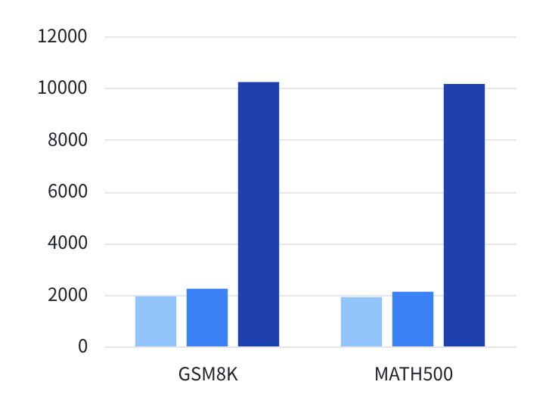

ANALYSIS
Key Results: Response Length Comparison
Comparison of Average Response Length Across Different Prompt Methods (Number of Characters)
Cost Analysis
Average Response Length of Self-Consistency
~ 10200 Characters
The comparison shows that the average response length of CoT and Least-to-Most is only around 2,000 characters. In contrast, the response length of Self-Consistency is more than 5 times longer. This significant increase is the inevitable cost of achieving high accuracy by generating multiple reasoning paths.
The Cost of High Accuracy: Significant Consumption of Computational Resources and Time
06

Slide 5




Conclusion and Analysis
Self-Consistency is the Optimal Strategy
Trade-off between Accuracy and Computational Cost
On small-scale models, the multi-path reasoning and voting mechanism significantly improve the solution accuracy across mathematical problems of varying difficulty.
The high accuracy of Self-Consistency comes at the cost of exponentially increased response length. In practical applications, a careful balance between accuracy and resource consumption is required.
Limitations of the Least-to-Most Method
Correlation between Model Capacity and Dataset Difficulty
This method performed poorest in the experiment. Its complex problem-decomposition strategy may be too difficult for a 1.5B parameter small model, failing to demonstrate its theoretical advantages.
All methods showed significant performance degradation on the high-difficulty MATH500 dataset, indicating that the current model's capability is limited by its parameter size, making it difficult to tackle high-level mathematical competition problems.

