Slide 1
Part 4: DeepSeek Main Experiments
Experiment Scope
01 Datasets
MATH-500: 500 questions
GSM8K: 800 questions
02 Prompting Methods
CoT, LtM, and SC (k = 5)
03 Metrics
Accuracy, response length,
and generation time
04 Main Observation
Self-Consistency achieves the best accuracy on both datasets, but it is also the most expensive setup.
DeepSeek-R1-Distill-Qwen-1.5B on MATH-500 and GSM8K
This section evaluates one math reasoning model under three prompting strategies.
It reports accuracy, response length, and runtime trade-offs using the final result files.

Slide 2
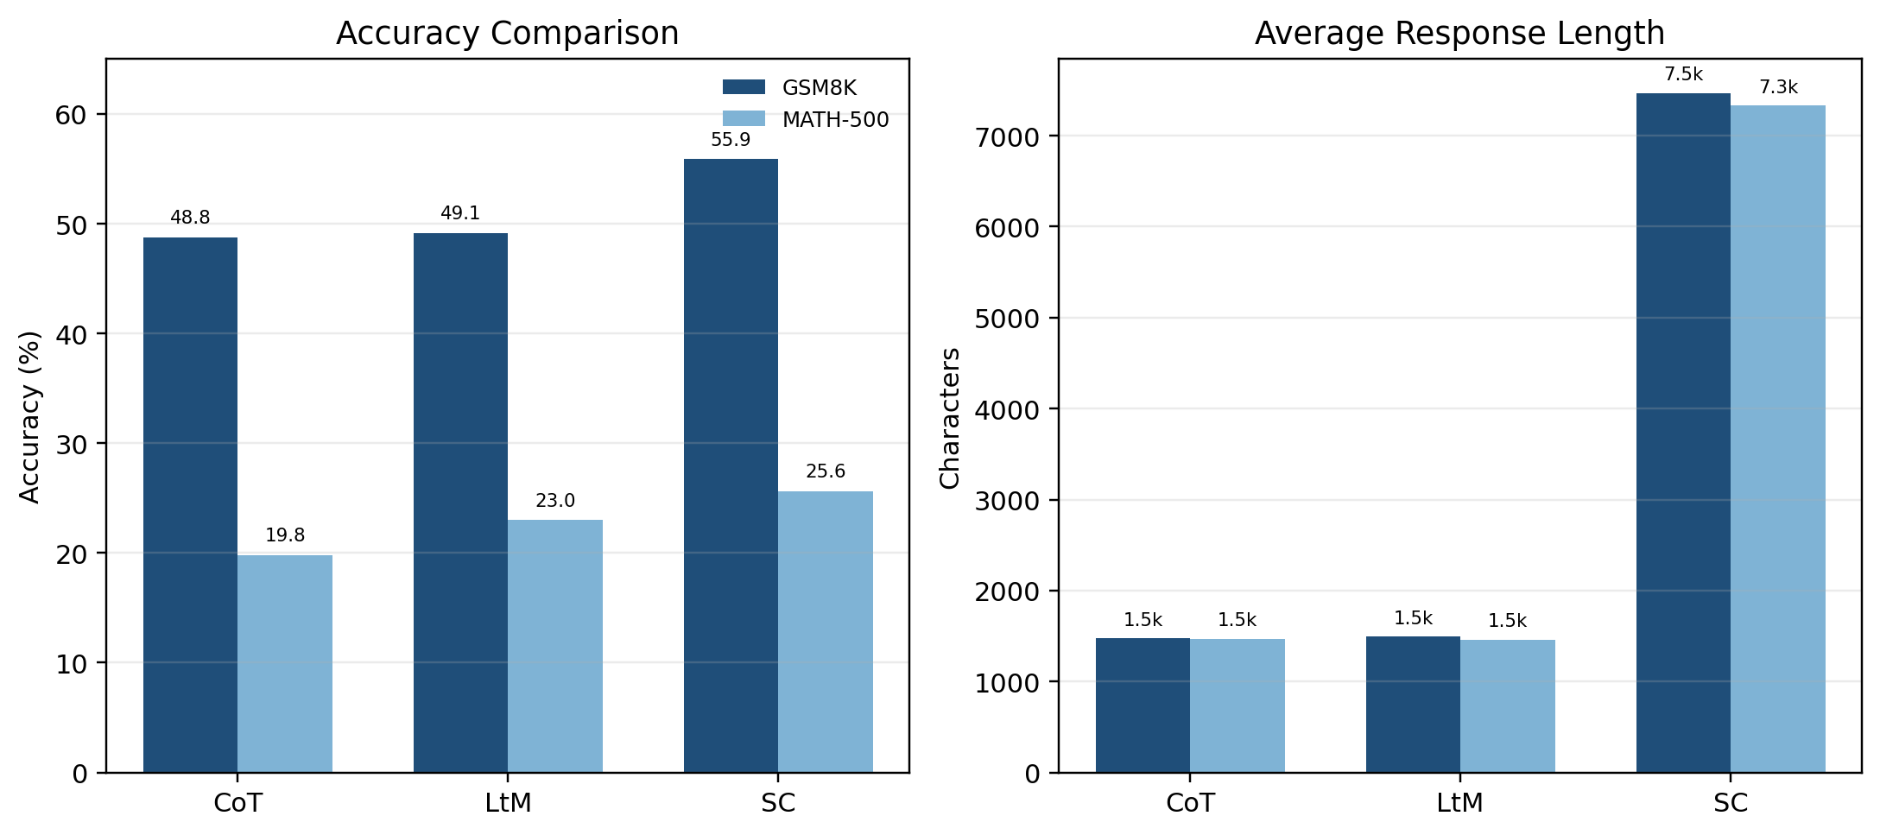
RESULTS
Final Results
The chart compares method-level accuracy and response length using the final summary file.
Result Overview
Best GSM8K
55.87%
Self-Consistency delivers the highest GSM8K accuracy.
Best MATH-500
25.60%
The same method also ranks first on MATH-500.
Dataset | CoT | LtM | SC | Best | Avg Time
GSM8K | 48.75% | 49.13% | 55.87% | SC | 90.44s
MATH-500 | 19.80% | 23.00% | 25.60% | SC | 102.10s
Cost Signal
7.47k
SC produces much longer outputs, which explains the runtime increase.
Key takeaway: the most accurate method is also the most expensive one in both output length and runtime.
05

Slide 3
ANALYSIS
Analysis and Discussion
Key Findings
Discussion
Self-Consistency is the most accurate method on both datasets.
GSM8K is much easier than MATH-500 for this 1.5B model.
Many MATH-500 failures come from incomplete endings or unstable final formatting.
Accuracy gains come with much longer outputs and slower inference.
The model often reasons for a long time but still fails to end with a clean final answer.
That weakens automatic evaluation, especially on symbolic MATH-500 outputs.
A stricter final-answer format would likely improve extraction and scoring stability.
Overall, DeepSeek is useful for basic math reasoning, but still weak on harder symbolic tasks.
Takeaway: DeepSeek shows meaningful reasoning ability, but the strongest setup still depends on a much more expensive generation process.
06

