Slide 1

Mathematical Reasoning Ability of Large Language Models
Group:Lakers
1. LiXianlin 60003835
2. ZhangKaige 60065468
3. WangBoheng 59624730
4. Ho Ka Chun 55216809
5. HaoJiacheng59931279
6. Huangdehao 60021619
7. XieYi 59658209
FINAL PRESENTATION

Slide 2
01
Data Preprocessing
FINAL PRESENTATION

Slide 3
Overview
Developed a preprocessing pipeline that converts multiple mathematics benchmarks into a unified JSONL format
Integrates GSM8K, Hendrycks MATH, MATH-500, and AIME 2024 datasets
Produces timestamped outputs to ensure the latest results
FINAL PRESENTATION

Slide 4
Pipeline Structure
Supports execution through both a command-line script and a Jupyter notebook
Both modes follow identical preprocessing logic
Allows full execution or step-by-step inspection of the pipeline
FINAL PRESENTATION

Slide 5
Answer Normalization
Applies helper functions to standardize numeric answers
Recovers final answers from solution text and LaTeX boxed formats
Handles common inconsistencies such as spacing and number separators
FINAL PRESENTATION

Slide 6
Dataset Handling
Processes GSM8K, Hendrycks MATH, and MATH-500 using dedicated functions
Assigns consistent subject and difficulty tags where applicable
Handles AIME 2024 via local CSV input due to AoPS access restrictions
FINAL PRESENTATION

Slide 7
Result
Creates a consistent and repeatable preprocessing workflow
Unifies multiple public math benchmarks under a single schema
Ensures completeness while respecting anti-scraping constraints
FINAL PRESENTATION

Slide 8
02
Prompt
FINAL PRESENTATION

Slide 9
METHOD
Prompt
01
02
03
04
Designed and implemented prompting strategies
Unified prompt templates
Standardized answer format
Ensured reproducibility and extensibility
Implemented and standardized multiple prompting methods to support consistent and comparable experiments.
FINAL PRESENTATION
04

Slide 10
METHOD
Prompting Strategies
Direct
CoT
LtM
Baseline
Step-by-step reasoning
Decompose problems
Self-Consistency
Plan-and-Solve
Multiple sampling and voting
Make a plan then solve
FINAL PRESENTATION
07

Slide 11
METHOD
System Design
01
02
03
The system is built around a unified interface that integrates all prompting methods.
It handles prompt construction, model generation, and answer extraction in a consistent pipeline.
This modular design improves reproducibility and allows easy extension for future methods.
Overall, prompt design is a critical factor in enhancing reasoning ability.
FINAL PRESENTATION
04

Slide 12
03
Qwen experiment
FINAL PRESENTATION

Slide 13
Experimental Setup and Methodology
Core Model Architecture
Evaluation Dataset Configuration
Prompt Reasoning Strategies
GSM8K
01. CoT (Chain-of-Thought)
Qwen2.5-Math-1.5B
Contains 500 high-quality primary school math word problems, focusing on basic arithmetic operations and simple logic.
Guides the model to decompose problems step-by-step and output detailed reasoning paths.
A small language model (SLM) optimized specifically for mathematical reasoning tasks, which maintains excellent logical reasoning capabilities while remaining lightweight.
02. Least-to-Most
MATH500
Decomposes difficult problems into a sequence of solvable sub-problems, progressing step by step.
500 carefully selected competition-level difficult problems, covering high school and college mathematics knowledge, challenging the upper limit of the model's complex reasoning.
03. Self-Consistency (k=5)
Generates multiple reasoning paths and determines the final answer through a "majority voting" mechanism.
FINAL PRESENTATION

Slide 14
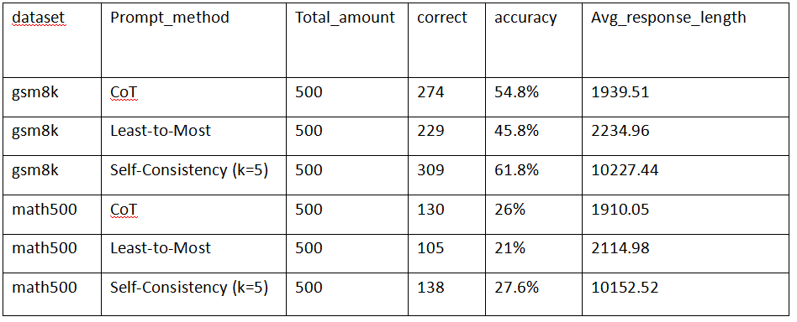
RESULTS
Experimental Results
Accuracy
Avg_response_length
FINAL PRESENTATION
05

Slide 15
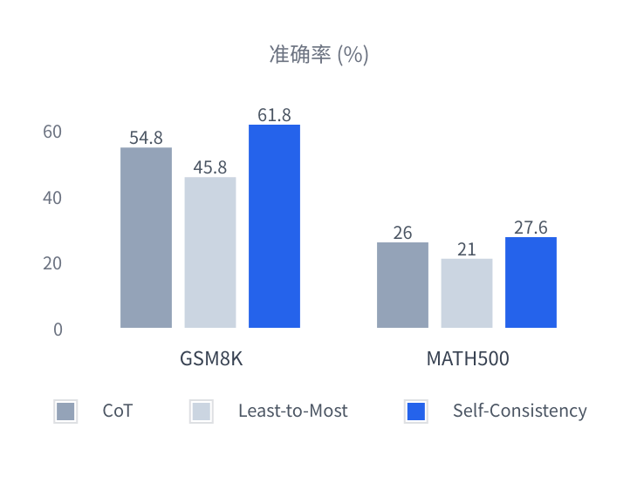
ANALYSIS
Analysis and Discussion of Results
Performance of Prompt Strategies on Different Datasets
SC Method Achieves Significant Advantages
61.8%
Best Performance on the GSM8K Dataset
Significantly outperforms CoT (54.8%) and Least-to-Most (45.8%), with obvious gains in moderately difficult reasoning tasks.
27.6%
Maintaining the Lead on the MATH500 Dataset
Still leading with an accuracy of 27.6% on high-difficulty competition-level questions, proving the robustness of the multi-path voting mechanism.
FINAL PRESENTATION
06

Slide 16
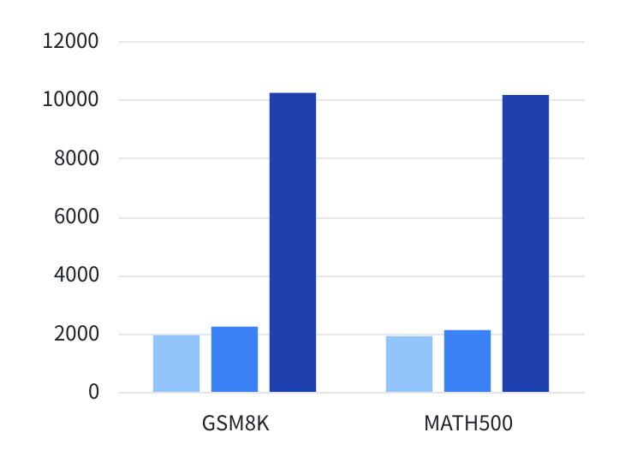

ANALYSIS
Key Results: Response Length Comparison
Comparison of Average Response Length Across Different Prompt Methods (Number of Characters)
Cost Analysis
Average Response Length of Self-Consistency
~ 10200 Characters
The comparison shows that the average response length of CoT and Least-to-Most is only around 2,000 characters. In contrast, the response length of Self-Consistency is more than 5 times longer. This significant increase is the inevitable cost of achieving high accuracy by generating multiple reasoning paths.
The Cost of High Accuracy: Significant Consumption of Computational Resources and Time
FINAL PRESENTATION
06

Slide 17




Conclusion and Analysis
Self-Consistency is the Optimal Strategy
Trade-off between Accuracy and Computational Cost
On small-scale models, the multi-path reasoning and voting mechanism significantly improve the solution accuracy across mathematical problems of varying difficulty.
The high accuracy of Self-Consistency comes at the cost of exponentially increased response length. In practical applications, a careful balance between accuracy and resource consumption is required.
Limitations of the Least-to-Most Method
Correlation between Model Capacity and Dataset Difficulty
This method performed poorest in the experiment. Its complex problem-decomposition strategy may be too difficult for a 1.5B parameter small model, failing to demonstrate its theoretical advantages.
All methods showed significant performance degradation on the high-difficulty MATH500 dataset, indicating that the current model's capability is limited by its parameter size, making it difficult to tackle high-level mathematical competition problems.
FINAL PRESENTATION

Slide 18
04
Deepseek experiment
FINAL PRESENTATION

Slide 19
Part 4: DeepSeek Main Experiments
Experiment Scope
01 Datasets
MATH-500: 500 questions
GSM8K: 800 questions
02 Prompting Methods
CoT, LtM, and SC (k = 5)
03 Metrics
Accuracy, response length,
and generation time
04 Main Observation
Self-Consistency achieves the best accuracy on both datasets, but it is also the most expensive setup.
DeepSeek-R1-Distill-Qwen-1.5B on MATH-500 and GSM8K
This section evaluates one math reasoning model under three prompting strategies.
It reports accuracy, response length, and runtime trade-offs using the final result files.
FINAL PRESENTATION

Slide 20
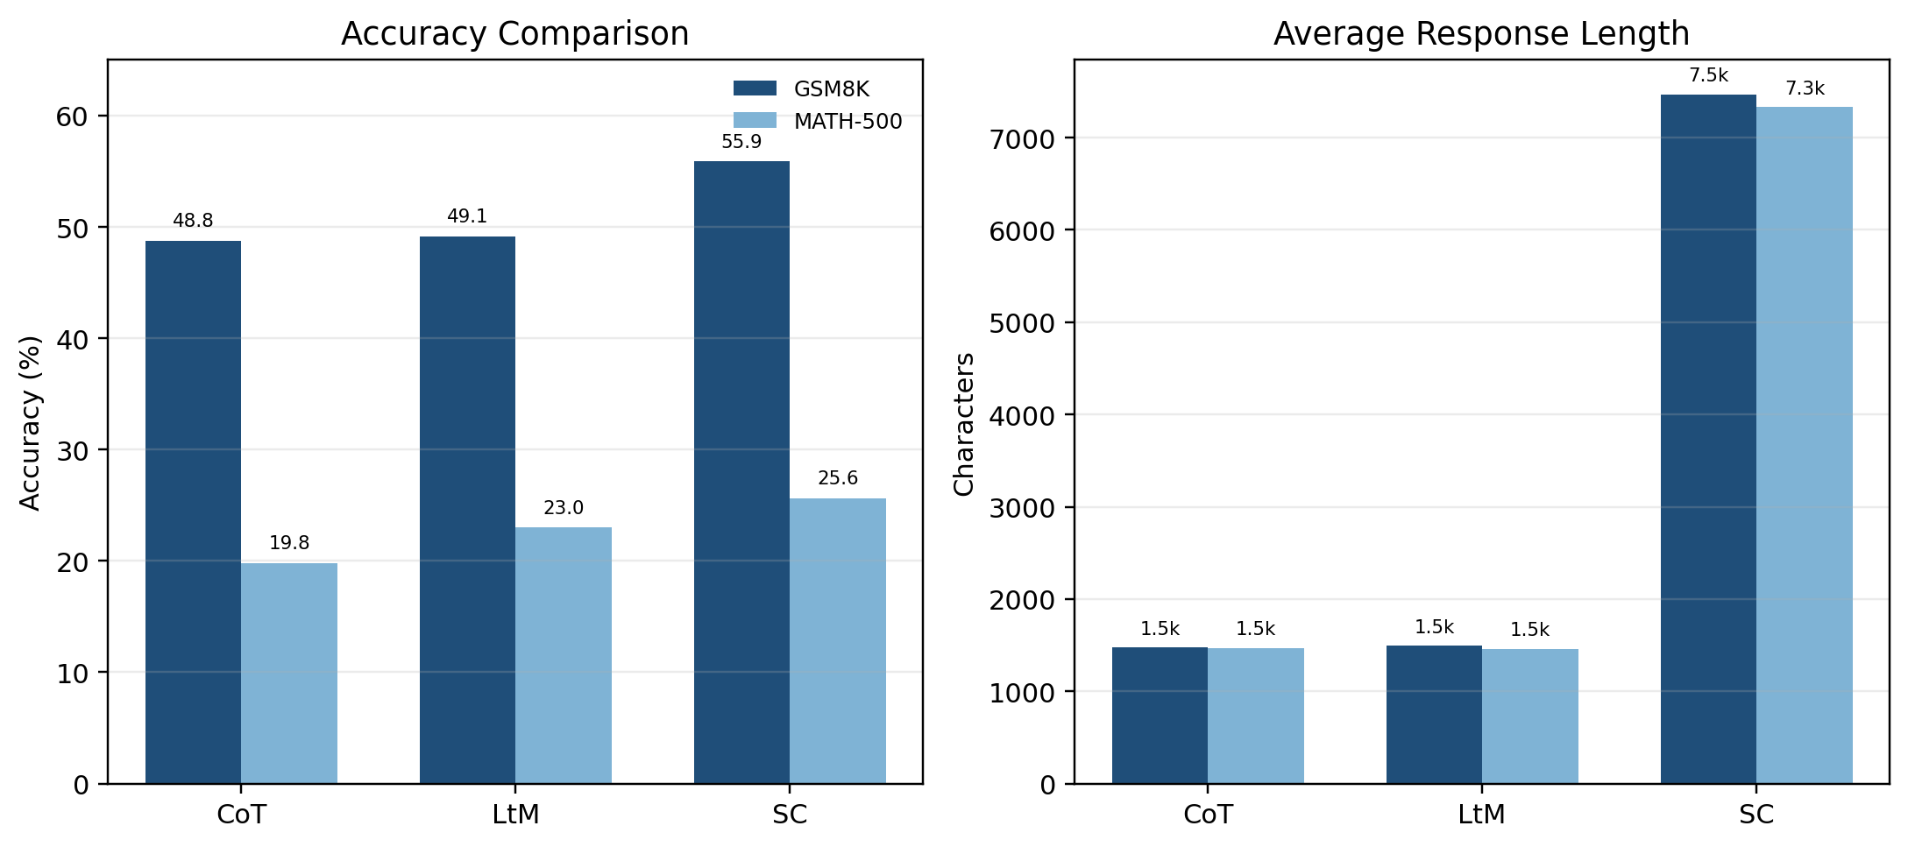
RESULTS
Final Results
The chart compares method-level accuracy and response length using the final summary file.
Result Overview
Best GSM8K
55.87%
Self-Consistency delivers the highest GSM8K accuracy.
Best MATH-500
25.60%
The same method also ranks first on MATH-500.
Dataset | CoT | LtM | SC | Best | Avg Time
GSM8K | 48.75% | 49.13% | 55.87% | SC | 90.44s
MATH-500 | 19.80% | 23.00% | 25.60% | SC | 102.10s
Cost Signal
7.47k
SC produces much longer outputs, which explains the runtime increase.
Key takeaway: the most accurate method is also the most expensive one in both output length and runtime.
FINAL PRESENTATION
05

Slide 21
ANALYSIS
Analysis and Discussion
Key Findings
Discussion
Self-Consistency is the most accurate method on both datasets.
GSM8K is much easier than MATH-500 for this 1.5B model.
Many MATH-500 failures come from incomplete endings or unstable final formatting.
Accuracy gains come with much longer outputs and slower inference.
The model often reasons for a long time but still fails to end with a clean final answer.
That weakens automatic evaluation, especially on symbolic MATH-500 outputs.
A stricter final-answer format would likely improve extraction and scoring stability.
Overall, DeepSeek is useful for basic math reasoning, but still weak on harder symbolic tasks.
Takeaway: DeepSeek shows meaningful reasoning ability, but the strongest setup still depends on a much more expensive generation process.
06

Slide 22
05
Aime experiment
FINAL PRESENTATION

Slide 23
METHOD
AIME 2024 High‑Difficulty Experiment Setup
01
02
03
04
Data & Models
Prompting Methods
Execution Environment
Output Records
Dataset:
AIME 2024 (15 problems, three‑digit integer answers)
Models:
Qwen2.5‑Math‑1.5B, DeepSeek‑R1‑Distill‑Qwen‑1.5B
Chain‑of‑Thought (CoT) – step‑by‑step reasoning
Least‑to‑Most (LtM) – decompose into subproblems
Self‑Consistency (SC, k=5) – majority vote over 5 samples
Google Colab (Tesla T4, 16GB)
Generation parameters: max_new_tokens=512, temperature=0.7, top_p=0.9
Unified interface via prompt.py
Each record contains:
raw_output (full generation), final_answer (simple regex extraction), status, generation time, etc.
Saved as JSONL files.
FINAL PRESENTATION
04

Slide 24
06
Aime result
FINAL PRESENTATION

Slide 25
METHOD
result
We tested two models on the AIME dataset: DeepSeek-R1-Distill-Qwen-1.5B and Qwen2.5-Math-1.5B, with a total of 45 questions.
Overall accuracy: 0% for DeepSeek and only 2.22% for Qwen2.5-Math, showing generally low performance.
Response length: Both models averaged about 5,000–6,000 characters and 400–1,000 words, with overly long outputs.
Error distribution: DeepSeek mainly suffered from format/noise issues and no extractable answer; Qwen2.5-Math was dominated by format/noise issues and reasoning/calculation errors, with minor template residue.
Extraction method: Most answers were extracted from the last number at the tail, while standard boxed answers accounted for a small proportion.
Method comparison: The sc method performed slightly better than cot and ltm; Qwen2.5-Math only got 1 correct answer using sc.
Core issues: non-standard answer output, weak reasoning and calculation, and low extraction robustness. I think we can improve extraction rules and model output formatting to boost accuracy.
FINAL PRESENTATION
04

Slide 26
07
Conclusion
FINAL PRESENTATION

Slide 27
Self-Consistency (SC) achieves the highest accuracy across all datasets and models for the two lightweight 1.5B math-specialized LLMs, yet it brings about five times higher costs in response length and inference time. Chain-of-Thought (CoT) offers the best trade-off between accuracy and efficiency, while Least-to-Most (LtM) underperforms CoT probably due to insufficient problem-decomposition capacity. Both models struggle severely with advanced Olympiad problems in AIME 2024, showing near-zero accuracy. The dominant error sources include format noise, unextractable answers and calculation mistakes, rather than purely deep reasoning failures.
FINAL PRESENTATION
04

Slide 28
Thank you
Group:Lakers
FINAL PRESENTATION

