Slide 1

1
最后两部分

Slide 2
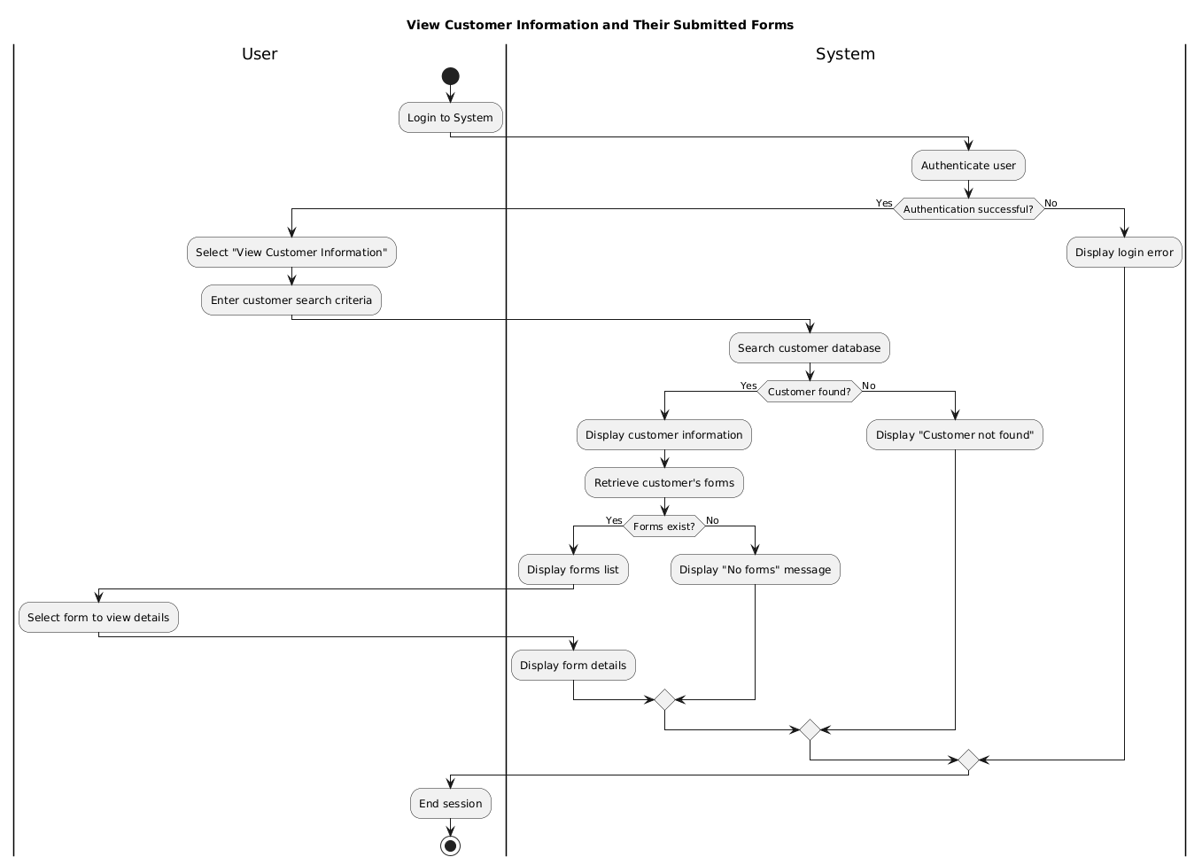
Activity Diagram:
view customer information and their submitted forms
This activity diagram illustrates the complete process for admins to view customer information and their submitted forms. The process involves two main participants: Admin and System.

Slide 3
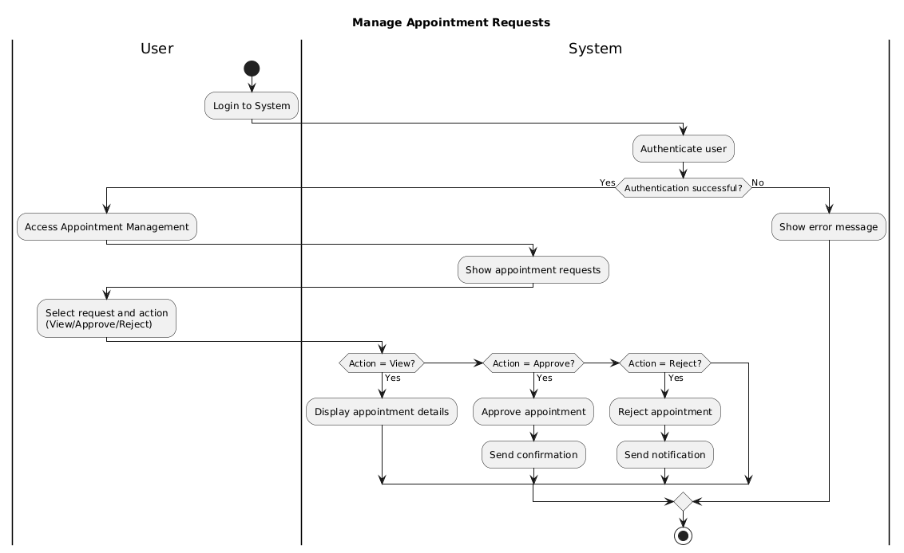
Activity Diagram:
manage appointment requests
This diagram illustrates the workflow for managing appointment requests, including viewing details, and approving or rejecting requests with system notifications.

Slide 4
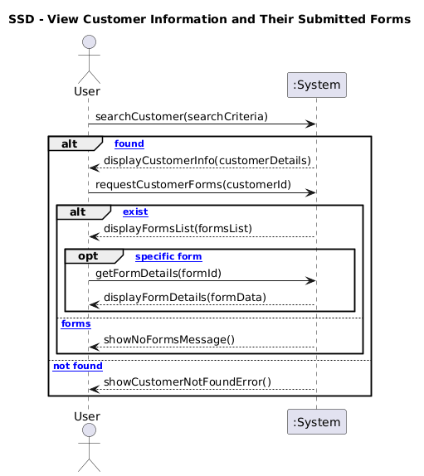
Sequence Diagram:
view customer information and their submitted forms
This sequence diagram illustrates the process for retrieving customer profiles and their associated forms, including search, display, and detailed viewing interactions.

Slide 5
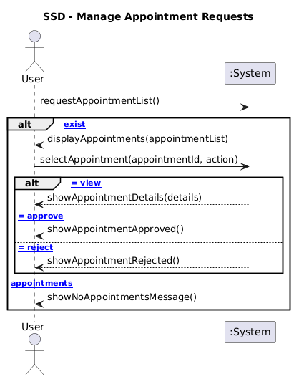
Sequence Diagram:
manage appointment requests
This sequence diagram models the interaction for managing appointments, showing how users view lists, select specific requests, and approve or reject them.

