Slide 1
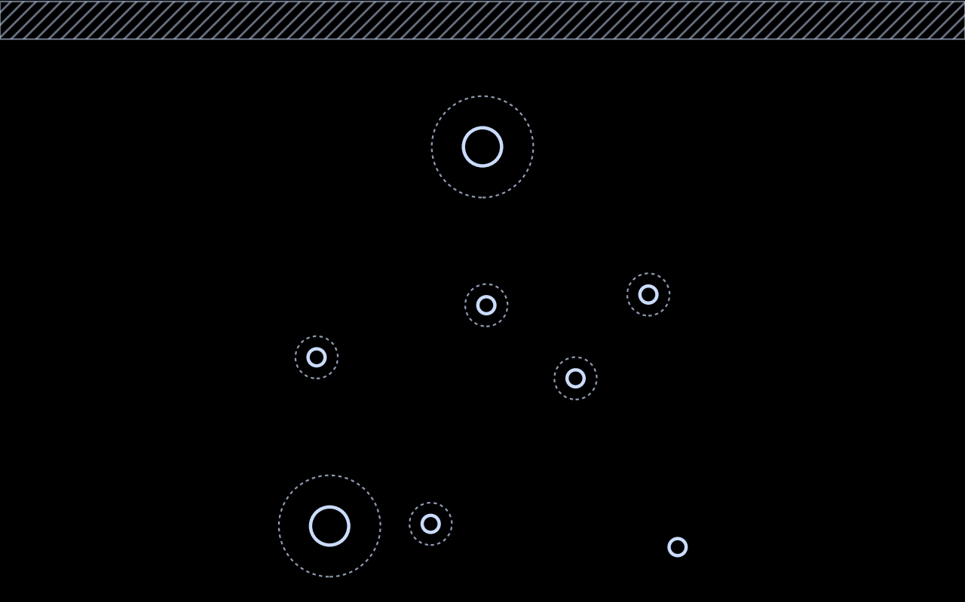
CrossMEP: A Tiered Synthetic
Dataset of Multi-Trade MEP
Cross-Sections
A support-design problem distribution for learning-based structural support assembly synthesis
a generated C8 context: eight services on three rows
Lavinia Pedrollo ¹ · David Gvadzabia ² · Torben Graeber ³ · Martin Fischer ¹
¹ Stanford University, CIFE ² Lafayette College ³ Hilti AG
43rd International CIB W78 Conference · IT in Construction · New Delhi, 6–8 October 2026
Notes:
Hello everyone, I'm Lavinia Pedrollo, from Stanford. Every pipe, duct and cable tray in a building hangs from a support that an engineer designs by hand, from the section at that spot. We want to teach machines to do some of that work, and the first thing we found missing was data: there was no public set of support-design problems. So, with David Gvadzabia, Torben Graeber and Martin Fischer, we built one. It's called CrossMEP. (0:00)

Slide 2
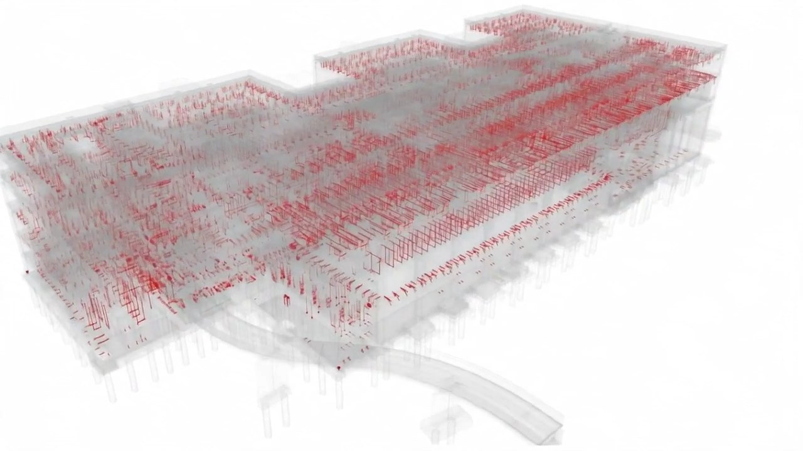
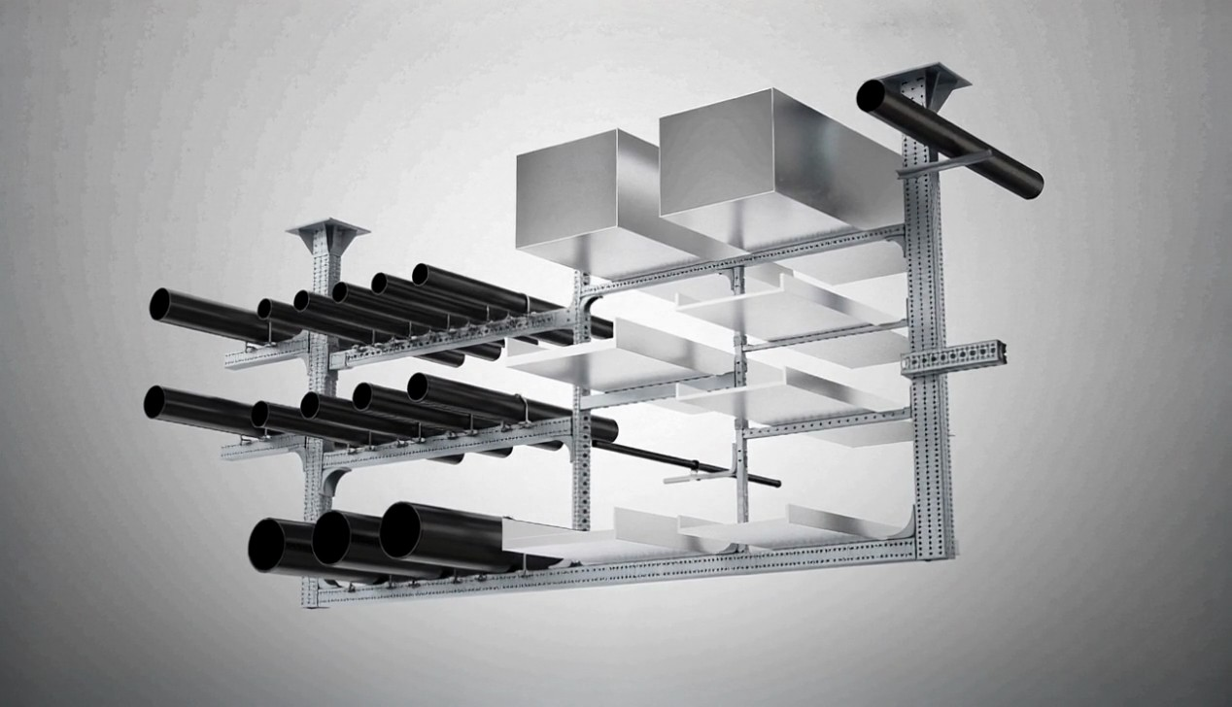
A hospital needs about 10,000 support assemblies, each designed by hand
1 unit = 1 structural support assembly (SSA)
≈ 10,000
20 min – 2 h
≈ ¼
support assemblies in one 200,000 sq ft hospital
of engineering for each assembly, designed one by one
of MEP design effort; on the order of $600K per project
Approximate practitioner estimates.
Notes:
Here's what that looks like. In this hospital, every red mark is a place where pipes, ducts or cable trays hang from the structure. A modular support system groups several services onto one prefabricated frame, installed as a single unit: a structural support assembly. A hospital of two hundred thousand square feet needs about ten thousand of them. Each takes twenty minutes to two hours to design by hand, roughly a quarter of the whole MEP design effort. These are practitioner estimates. (0:30)

Slide 3
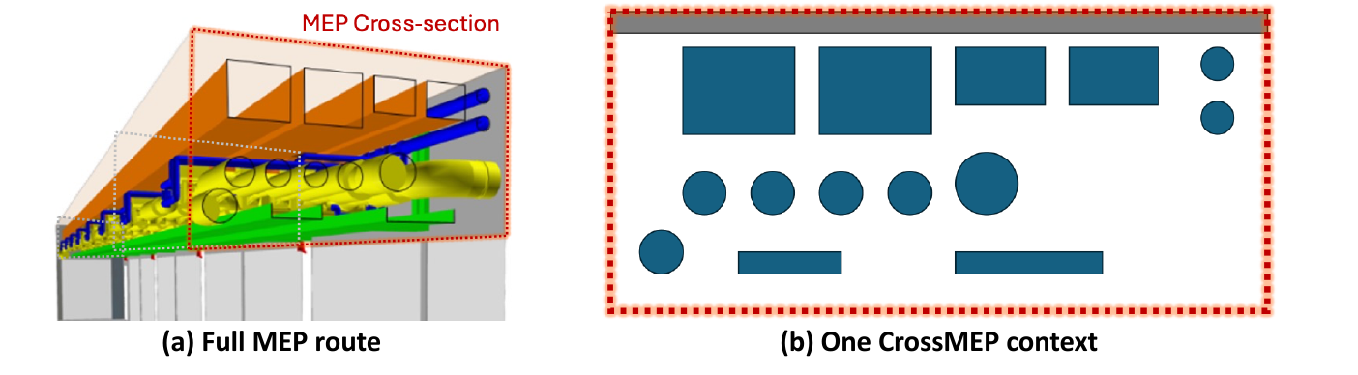
Synthesizing an assembly from a catalog and a section has resisted automation
The synthesis problem
Given a fixed catalog of components and the MEP context: the services crossing the hanger and the surface they hang from.
Find a feasible assembly that carries the services to the structure.
Tools coordinate the model and check a design; choosing the topology and the parts is still done by hand.
Design starts after coordination: at each hanger the designer works from the section across the run, not from the whole model.
1. Geometric judgment
2. Rule explosion
3. Catalog volatility
Engineers choose an assembly’s topology from experience.
Code, load and material constraints interact across thousands of combinations.
Catalogs change faster than rule-based systems can be rewritten.
Notes:
So what is the task? At ISARC we defined it like this. You're given a fixed catalog of components and the context: which services cross the hanger, and what they hang from. You must find a feasible assembly that carries them to the structure. Designers don't work from the whole model. They work from one section at each hanger, like this one. Today's tools coordinate and check; choosing the layout and the parts is still manual. That section is the unit of this work, and the unit of our dataset. (1:05)

Slide 4
One section in, verified supports out: learnable, given problems to learn from
Context
structure, services, loads
Rules
which actions are legal in a state; each action adds parts
Approach
a black box that chooses the next action
rule table · search · learned policy
Verifier
judges every finished design: statics, anchors, connectors, buildability
Verified designs
up to ten, ranked by installed cost
legal actions
finished design
Catalog
parts, sizes, unit costs
chosen action
pass or fail, fed back
Input
Rules
Approach (black box)
Verifier
Output
Whatever sits in the black box, it needs problems to learn from, a fixed set to compare on and problems that look like practice.
Notes:
What would a method look like? Think of it as a pipeline. On the left, the brief: the context, and a catalog of parts with prices. The rules say which actions are legal in a given state; each action adds parts. In the middle, a black box chooses the next action. It could be a rule table, a search, or a learned policy; the pipeline doesn't care. A verifier judges every finished design, statics, anchors, buildability, and feeds pass or fail back. Out come verified designs, ranked by cost. Whatever sits in that black box, it needs problems to learn from, a fixed set to compare on, and problems that look like practice. (1:40)

Slide 5



Learning to design supports needs many problems, and none were public
Why it has to be synthetic
CrossMEP at a glance
Scarcity
7,000
31,484
C1–C8
Project models are proprietary; the few open ones are not organised around supports and often export no element sizes.
contexts in four splits on disjoint seeds
elements: pipes, cable trays, ducts and conduits; six trades
eight difficulty tiers by exact element count
Coverage
One project is one narrow slice: one building type, one trade mix. A method tuned to it measures fit to that project.
0 labels
Traced
Open
Control
A seeded generator gives unlimited problems with a known distribution, difficulty by construction and held-out seeds.
the brief, not the answer: no support-assembly information
every constant with its source, or declared a design choice
data CC BY 4.0, code MIT; a seeded, deterministic generator
Notes:
And there were none. Project models are proprietary, the open ones aren't organized around supports, and any one project is a narrow slice. So we built CrossMEP: seven thousand contexts, about thirty-one and a half thousand elements, in eight difficulty tiers. They are deliberately unlabeled: you get the problem, never the answer. Every constant is sourced or declared a design choice, and everything is open. (2:30)

Slide 6
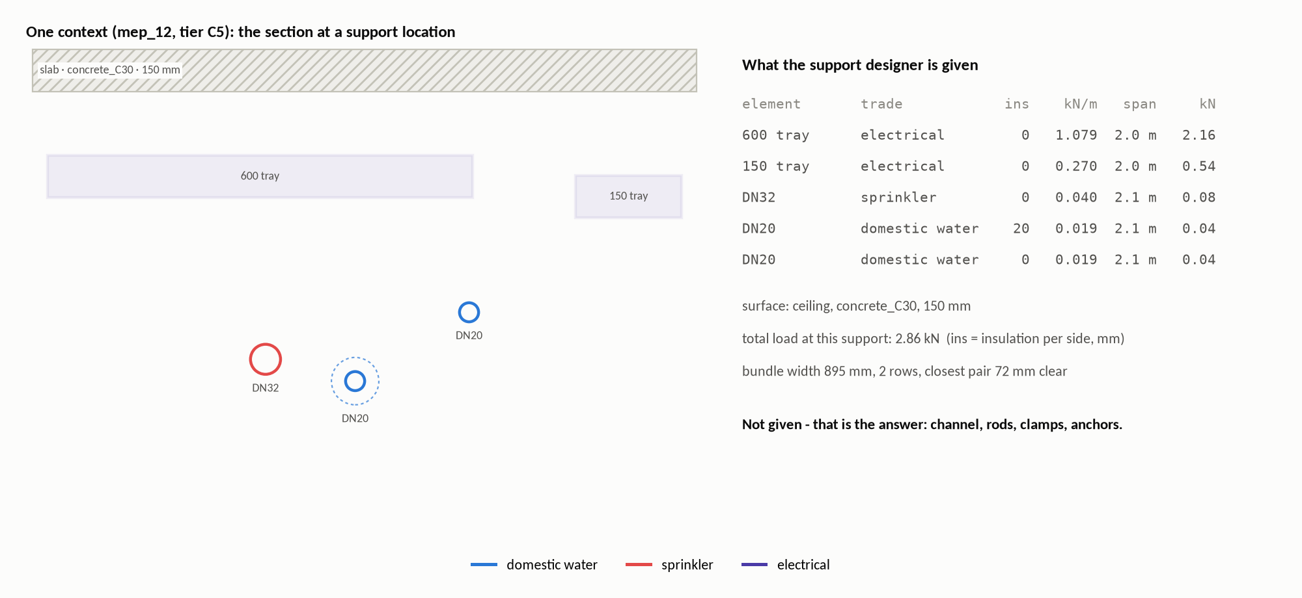
We generate what a designer receives: the section at one hanger
Per element: kind, service and trade · bare size · insulation per side · load per metre × the span it was sized at = load at the support · position along and out from the surface. Per context: slab or wall, substrate, thickness. Absent by design: channel, rods, clamps, anchors — and any “correct” answer, since a feasible support depends on the catalog you build from.
Notes:
Here's one context: a two-dimensional section at one support location. Each element has its kind, service and trade, its size, its insulation, and its load, which is weight per metre times the span it was sized at, plus its position. Add the surface, a slab or a wall, and that's all. What you won't find is the support: no channel, no rods, no anchors, and no correct answer, because a feasible support depends on the catalog you build from. The context is the brief. The assembly is the answer. (2:55)

Slide 7
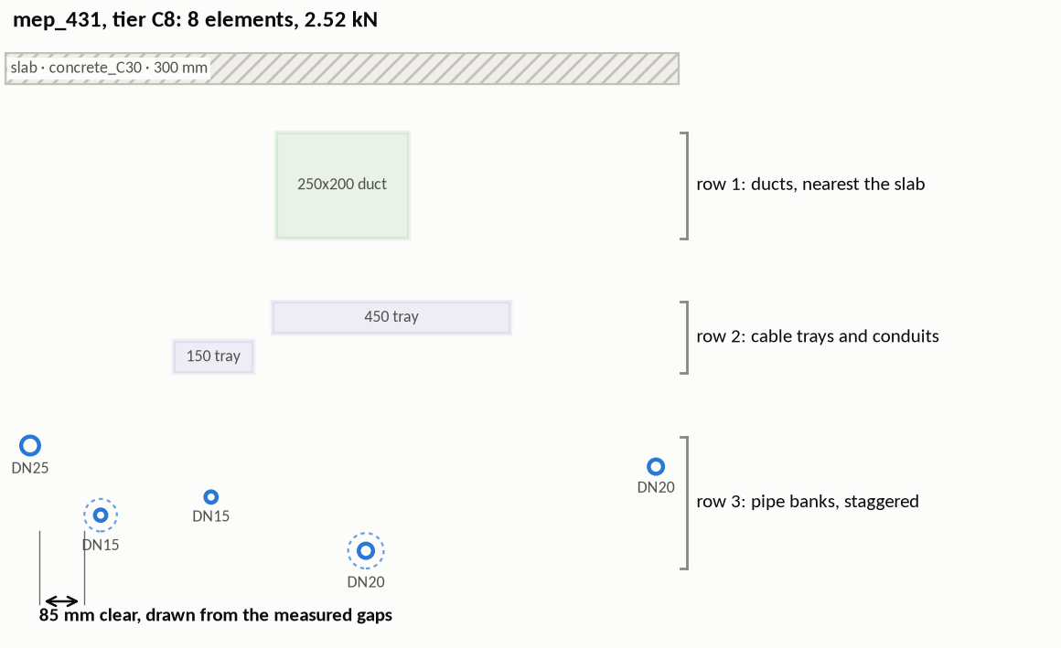
Sections follow trade practice and measured spacing, not random shapes
1
Tier. Cn fixes the exact element count, n = 1 … 8.
2
Surface. Ceiling or wall (78 / 22 %); concrete slab or wall, 150–300 mm thick.
3
Services. Grouped as trades run: hot + cold pairs, flow + return, chilled banks, sprinkler mains, 1–2 trays, ducts, conduit groups of 2–6.
4
Rows. Bulky first: ducts nearest the surface, then trays and conduits, then pipes.
5
Spacing. Gaps drawn from gaps measured on a built project (at least 25 mm); stagger within rows; electrical above wet on walls.
One generated benchmark context, three rows by priority; the gap marked is one draw from the measured distribution. Every context is seeded: the same seed gives the same file, byte for byte.
6
Check. Every pair at least 25 mm clear; rows centred; sizes, insulation, loads and positions recorded.
Notes:
How do we make a context? Not by free randomness, but by rules an engineer would recognize. The tier fixes how many elements there are. We pick the surface and fill it the way trades really run services: hot and cold together, flow and return together, conduits in groups, bulky services nearest the slab. Gaps between neighbors are drawn from gaps measured on a built project, never below twenty-five millimeters. On walls, electrical stays above water. Every context is checked, and it's seeded: the same seed gives the same file, byte for byte. (3:35)

Slide 8
Sizes, spans and loads come from standards; the choices are declared
Element | Sizes | Load basis
Pipes DN15–100 | EN 10220 / EN 10255 medium series | steel + water × ASME B31.1 water-service span (published points only)
Insulation | GEG Anlage 8 (heated); 30/50 mm condensation control (chilled) | —
Cable trays 150–600 | IEC 61537 systems, NEMA VE 1 widths | full tray: 50 kg/m at 300 mm datum, × 2.0 m (NEMA VE 1 class span)
Ducts | EN 1505 rectangular; EN 1506 round | manufacturer duct-weight table incl. flanges, × 2.4 m (SMACNA)
Conduits Ø20–50 | IEC 61386-1, parallel groups of 2–6 | steel tube + 40 %-of-bore cable fill, × 2.0 m (IET / BS 7671)
Layout conventions
Bulky services nearest the slab: ducts, then containment, then pipes
Trades run in banks: hot + cold pairs, flow + return, conduit groups
Electrical kept above wet services on walls (drip; BS 7671 528.3.2)
Clear gaps drawn from a distribution measured on a built project; 25 mm minimum
Within-row stagger calibrated to measured elevation spread
Three kinds of ground: standards (what each element is and weighs), measured open buildings (how close neighbours sit) and declared design choices (trade mix, surface mix, number of rows). Every constant carries its source and status in the repository, and the log says why each standard was chosen over its alternatives.
Notes:
Where do the numbers come from? Three places. Sizes, weights and spans come from standards: European steel pipe and duct standards, IEC for conduits and trays, ASME for spans, the German GEG for insulation. How close neighbors sit comes from measured open buildings. And a few things are simply our choices, like the trade mix, and we label them that way. Loads are computed in code from all of this. (4:10)

Slide 9
7,000 contexts in four splits; the test seeds are never trained on
split | contexts | elements | seed
train | 5,000 | 22,500 | 1000
validation | 500 | 2,242 | 2000
test | 500 | 2,242 | 3000
benchmark | 1,000 | 4,500 | 42
total | 7,000 | 31,484
Tiers assigned round-robin: 625 per tier in train, 125 in the benchmark
Four in five contexts hang from a ceiling, one in five from a wall
Six trades: electrical 10,494, domestic water 5,725, heating 5,788, chilled water 3,987, sprinkler 2,073, ventilation 3,417 elements
Plain JSON, with a JSON Schema, Croissant metadata and a datasheet
Notes:
The release has four splits on disjoint seeds, so a method is never tested on what it trained on: five thousand contexts for training, five hundred each for validation and test, and a benchmark of one thousand, a hundred and twenty-five per tier. Everything is plain JSON with a schema and a datasheet. (4:40)

Slide 10
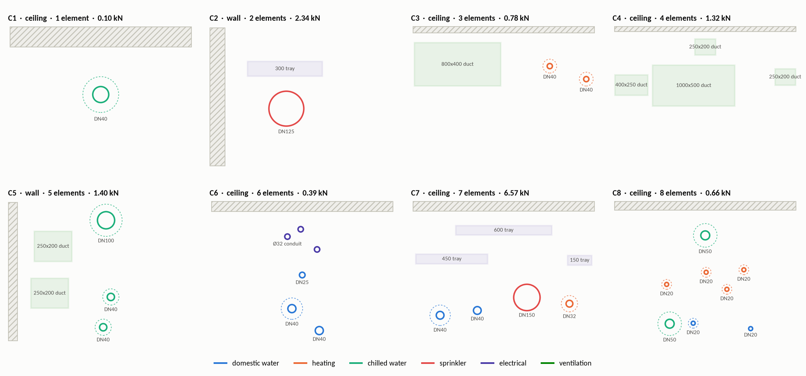
Difficulty is one number: tier Cn holds exactly n elements
One benchmark context per tier; dashed rings are insulation. Within a tier, kinds, trades, services, surfaces and stacking all vary, so element count is the one controlled difficulty axis. C1 is the most common support in any building; C8 is a congested rack.
Notes:
Here's one benchmark context per tier. C1 is a single element, the most common support in any building. By C8 you have eight services on three rows. Within a tier everything else varies: kinds, trades, surfaces, stacking. So the element count is the one controlled axis of difficulty. And notice the walls: the section rotates, and electrical sits above water. (5:00)

Slide 11
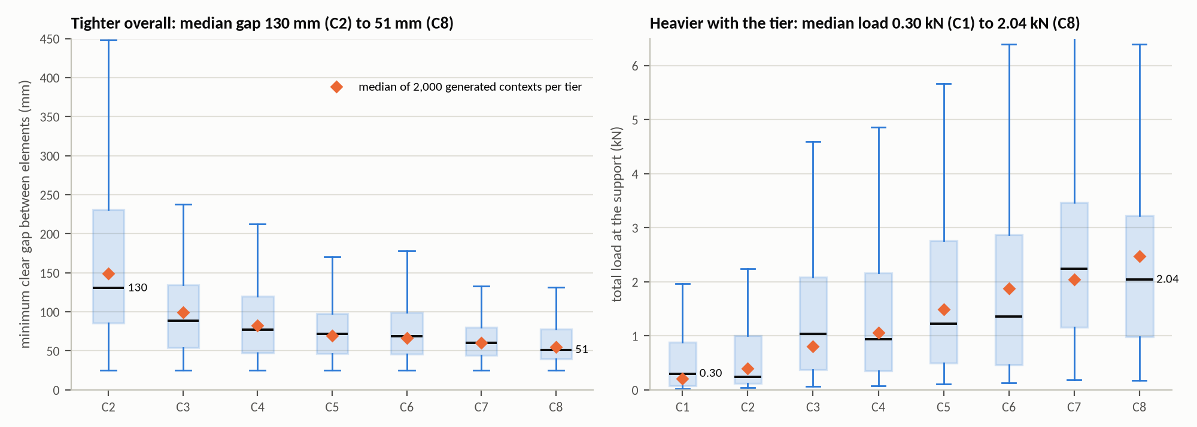
Higher tiers are heavier and tighter, as designed
A check that the dataset behaves as designed: the tier fixes the element count; load and congestion follow from the rules. Boxes: benchmark, 125 contexts per tier (IQR, whiskers 1.5 IQR); diamonds: medians of 2,000 generated contexts per tier. Load rises with the tier (rank correlation +0.46; the population medians rise at every step) and the closest gap narrows at every step (−0.38; 149 → 55 mm in the population).
Notes:
Now three analyses. The first is a design check, not a discovery: does difficulty grow with the tier? The count is fixed by construction, and load and congestion follow from the rules, so this shows the dataset behaves as designed. The load at the support rises with the tier, from about 0.3 to 2.0 kilonewtons. The closest gap narrows at every step, from 130 to about 51 millimeters. So: report methods tier by tier. (5:25)

Slide 12
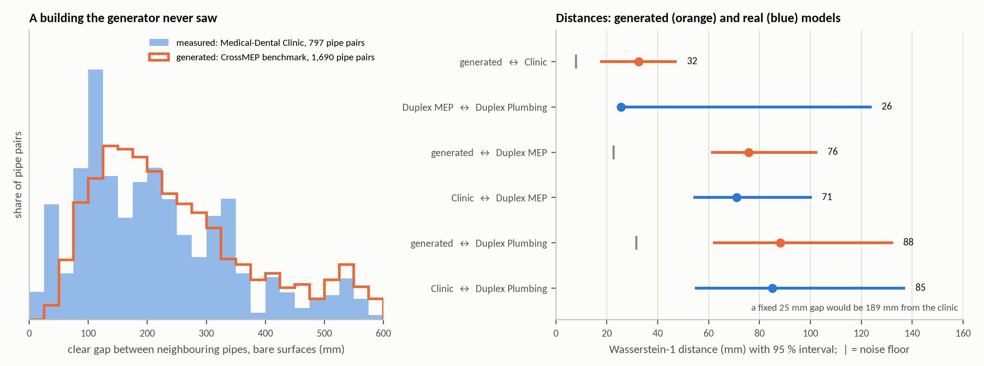
Spacing holds up on a clinic the generator never saw
The gap distribution was fitted on the duplex; the clinic was held out. Clear gaps between side-by-side pipes, on sections every 250 mm. Clinic (797 pipe pairs): 32 mm from the generated gaps (95 % CI 17–48), more than the 8 mm a perfect generator would show, and about as close as the duplex’s own two models are to each other (26 mm). Models: buildingSMART Duplex Apartment and Medical-Dental Clinic, CC BY 4.0.
Notes:
The second analysis is the one the generator could fail. Is the spacing realistic in a building it has never seen? The gap distribution was fitted on a residential duplex. We kept a second open building aside, a medical-dental clinic, cut it into sections every 250 millimeters, the way a context is defined, and measured the gaps between pipes running side by side. On the left, the clinic: generated gaps are close to measured ones, though not identical. On the right, the distances. Generator to clinic: 32 millimeters. That is above the 8 a perfect generator would show, so not a perfect match, but about as close as the duplex's own two models are to each other. A fixed 25-millimeter gap would be about 190 off. (6:00)

Slide 13
A two-size catalog attaches 1 pipe in 7; the dataset shows what to cover
14.5 %
38.1 %
0 of 2,012
of benchmark pipes attachable with the paper’s two sizes (95 % CI 12.7–16.2); every one is DN40
with two sizes placed where the pipes are; 76 % with six, and every pipe with 15
trays, ducts and conduits: a pipe-clamp catalog defines no attachment. Load never binds (1.97 vs 2.5 kN)
Notes:
The third analysis is a use of the dataset, not a test of it: what must a catalog of clamps cover? Our paper's two-size catalog attaches 14.5 percent of the pipes, with an interval of 13 to 16, all one size, DN40. Load is never the limit, and trays, ducts and conduits aren't covered at all. On the right is what the dataset asks of any catalog: two well-placed sizes could attach 38 percent, six sizes 76, fifteen sizes every pipe. So 'what should the catalog contain' becomes a measurement. (6:50)

Slide 14
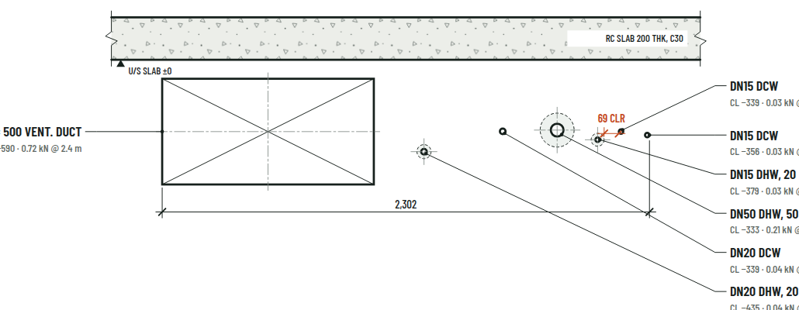
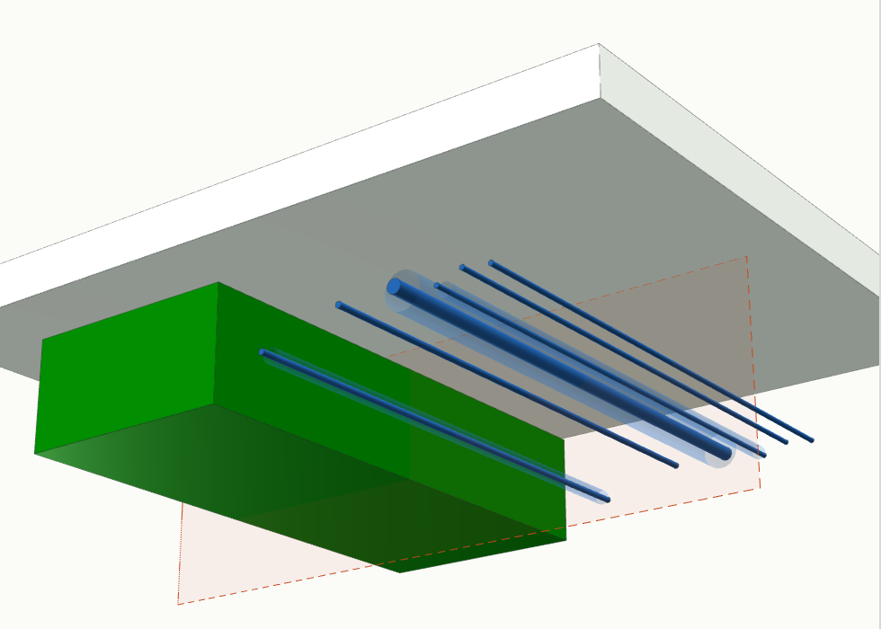

Set the parameters and the generator returns the designer’s brief
In: the parameters (tier C7, seed 0). Out: section A–A at the support, as the support designer receives it (scale 1:20), and the same run in 3D. Every section is a stored output of the released generator, with the Python call that reproduces it.
Scan to open the studio
Notes:
Let me show it. This is the Generator Studio. I choose what crosses the hanger, a tier or an exact mix, and a seed. Out comes the section a support designer receives, drawn the way an engineer would issue it: every service at true size, its level below the slab, its load, the closest clear gap, and the same run in 3D. Every section is a stored output of the released generator, with the Python call that reproduces it. Scan the code to try it yourself. [Live: switch to the studio, click C3, then Generate another twice, then Exact mix with a duct. If the demo fails, stay on this slide; slide 18 shows two more sections. Before the talk: open the studio once with internet, set its link sharing to public, scan the QR from a phone not logged in.] (7:25)

Slide 15
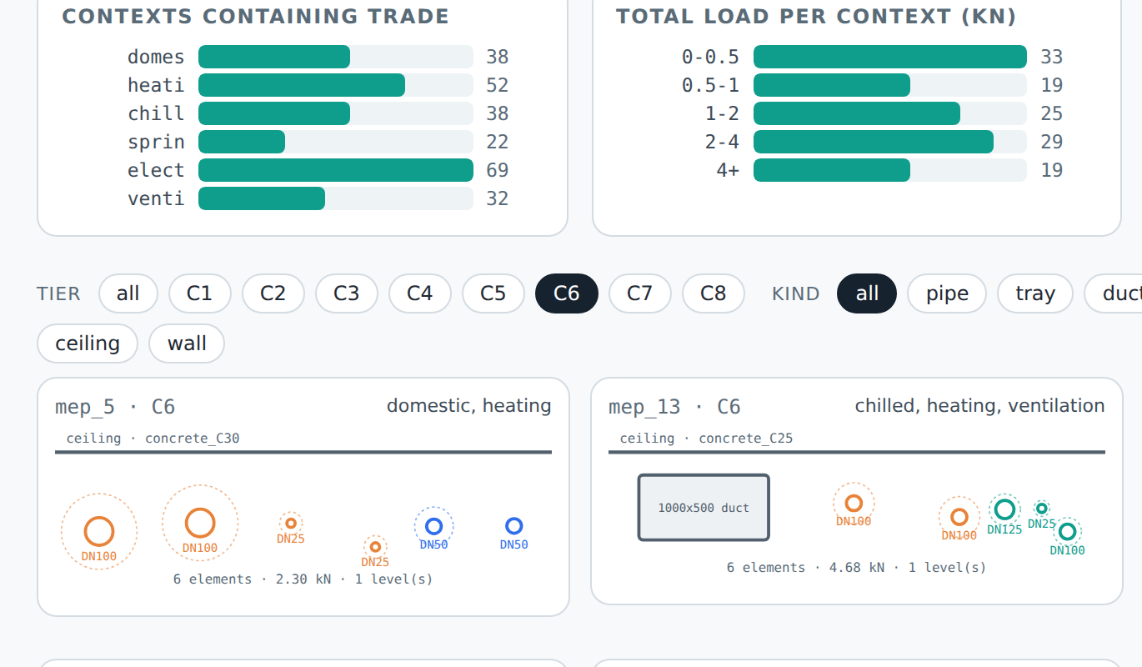
Train on the generator, evaluate on the benchmark, report per tier
import crossmep.tasks as cm
data = cm.load("benchmark") # 1,000 contexts
cm.filter_contexts(data, pipes=2, trays=1)
from crossmep.evaluate import score, compare
score(my_results, data) # per tier, 95 % CI
compare(mine, baseline, data) # paired test
Loading, metrics and scoring need only the Python standard library; the generator needs NumPy. Command line: python -m crossmep generate | validate | evaluate.
Interactive gallery: filter the benchmark by tier, kind, trade and surface.
Train
Evaluate
Report
on the generator: unlimited seeds, a curriculum from C1 up to C8
on the benchmark: 125 held-out contexts per tier, the same for every method
per tier with 95 % intervals, paired tests between methods
Notes:
Using it takes a few lines: load a split, filter by composition, or generate your own mix. Because there are no labels, the same files serve reinforcement learning, constraint programming, and benchmarking people. We ship the scoring too. Train on the generator, from C1 up to C8. Evaluate on the benchmark, the same 125 contexts per tier for every method. Report per tier, with 95 percent intervals and paired tests. (8:35)

Slide 16

One section at one support today; a checker and real data come next
Scope
Next
One cross-section at one support: routing, branches and elevation changes are outside it; so is support spacing — the span is recorded per element, so a method can vary it
Realism checked on sections of two open buildings, a residential duplex and a medical clinic; congested racks rest on coordination practice and standards
Trade mix and tier composition are design choices, not survey results
Synthetic: not for the structural design of real installations
A public checker for support designs, with best-known costs from an exact solver on the small tiers
The catalog as an input: generated catalogs, and tests on catalogs a method has never seen
A real test set: sections from commercial projects with supports designed by engineers
If you coordinate services or design supports, open the gallery, filter for the scenes you know, and tell us what looks wrong. Every rule is one documented constant away from being changed.
Notes:
A word on scope. CrossMEP is one section at one support. Routing and branches are outside it, but the span is recorded, so a method can vary it. Pipe spacing was checked on two open buildings; the rest rests on practice and standards, and the trade mix is a design choice. It's not for structural design of real installations. Next: a public checker, with best-known costs, so we can compare methods on the answer; the catalog as an input; and a real test set from commercial projects, with supports designed by engineers. That's where I'd value your eye. (9:05)

Slide 17
Support design now has open problems to learn from
7,000 support-design problems · every constant sourced or declared
pipe gaps checked on two open buildings · open data and code
Data CC BY 4.0, code MIT. Not for the structural design of real installations.
github.com/lavinia-ped/CrossMEP_Dataset
laviniap@stanford.edu
Notes:
To sum up: CrossMEP is the brief, not the answer. Seven thousand support-design problems, every constant sourced or declared a design choice, pipe spacing checked on two open buildings, and all of it open. If you coordinate services or design supports, try the studio and tell me what looks wrong. Thank you. (9:45)

Slide 18
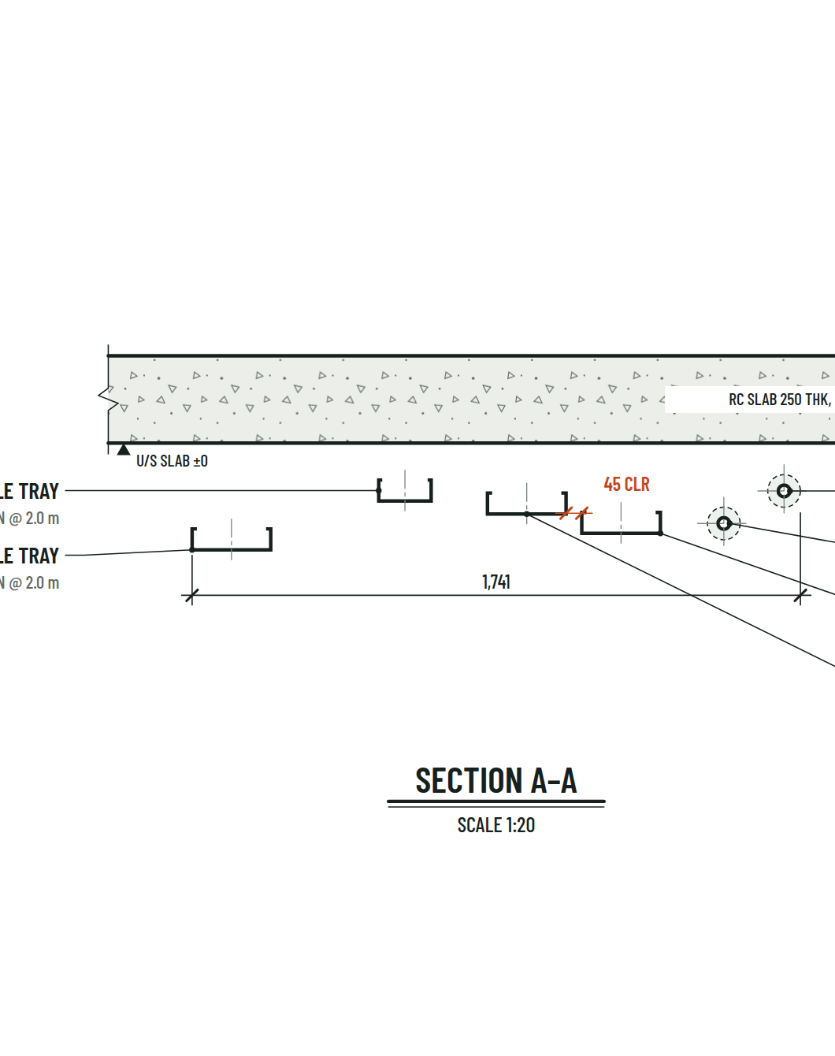
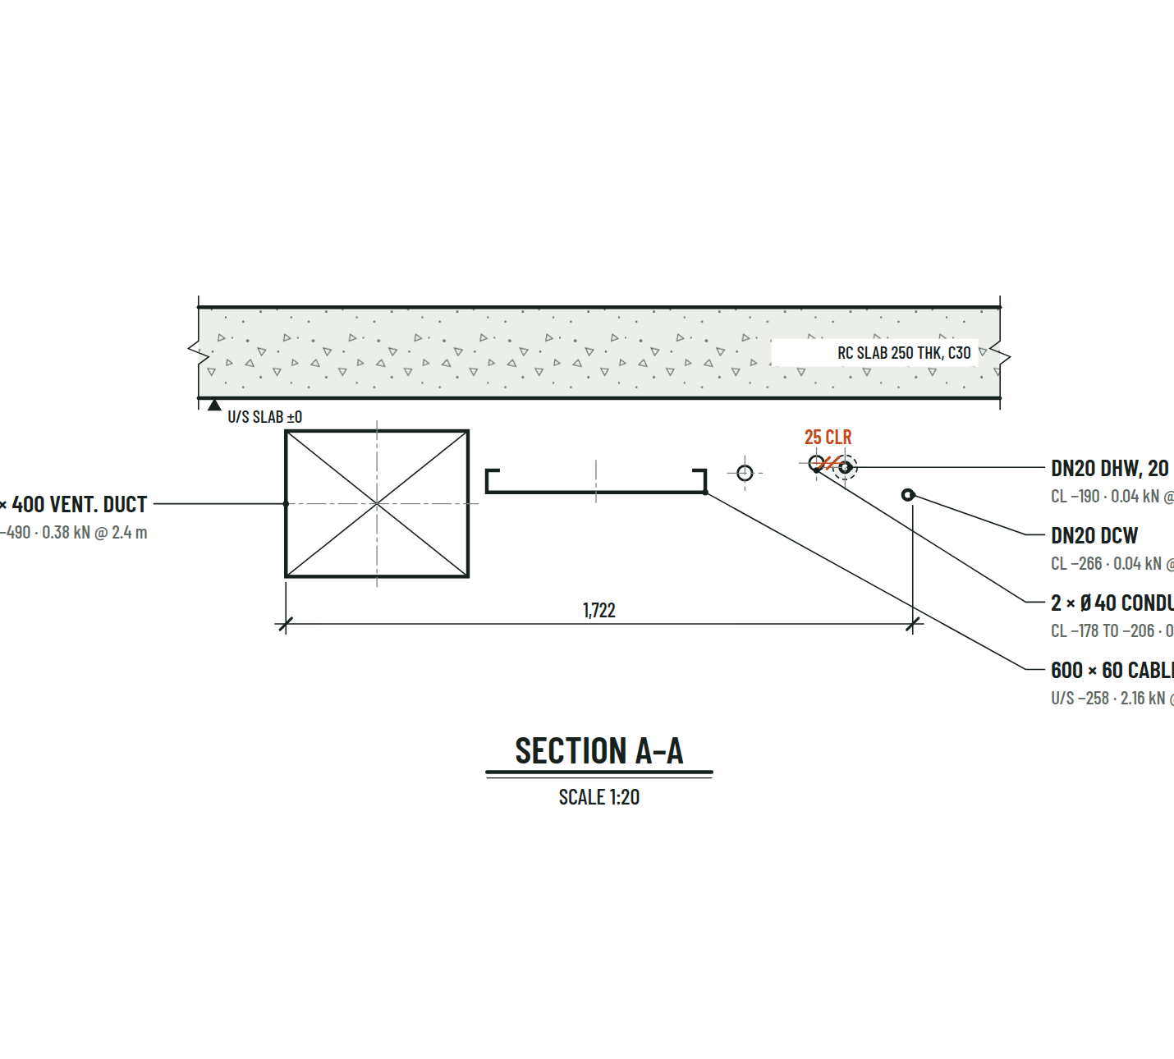
A wall with six pipes, and a slab with a duct, a tray and conduits
Tier C6, seed 0, section 5: six pipes fixed to a wall; offsets from the wall face, the closest clear gap 25 mm.
Exact mix: 2 pipes, 1 tray, 1 duct, 2 conduits on a slab; levels below the soffit and the load at the support.
Notes:
Backup for the live demo. Left: a wall section, six pipes in two rows, each labelled with its size, trade, insulation, offset from the wall and load at the support. Right: an exact mix on a slab, with a duct, a tray, conduits and pipes, their levels below the soffit and the closest clear gap.

Slide 19
Median load rises from 0.30 kN at C1 to 2.04 kN at C8 as the gap narrows
tier | contexts | median clear gap (mm) | median load (kN) | median width (mm)
C1 | 125 | — | 0.30 | 140
C2 | 125 | 130 | 0.24 | 431
C3 | 125 | 89 | 1.04 | 776
C4 | 125 | 77 | 0.94 | 1037
C5 | 125 | 72 | 1.22 | 1275
C6 | 125 | 69 | 1.36 | 1494
C7 | 125 | 61 | 2.24 | 1861
C8 | 125 | 51 | 2.04 | 2225
4,500 elements
2,488 pipes · 968 conduits · 559 trays · 485 ducts
32 mm
Wasserstein-1, generated to measured pipe gaps of the clinic (95 % CI 17–48)
−0.38 / +0.46
rank correlation of tier with the closest gap / with the load
Notes:
Backup: per-tier medians on the benchmark split, the distance to the held-out building, and the trend statistics behind experiment 1.

Slide 20
Against the clinic the generator is 32 mm off; the small duplex is 76 to 88
pipe gaps | pairs | sections | median (mm) | < 25 mm
generated (benchmark) | 1,690 | — | 216 | 0 %
Clinic, Plumbing | 797 | 3,833 | 203 | 2 %
Duplex, MEP | 74 | 204 | 177 | 23 %
Duplex, Plumbing | 41 | 112 | 114 | 32 %
Wasserstein-1 (mm) | by length | each pair once | noise floor
generated ↔ Clinic | 32 (17–48) | 18 (13–27) | 8
generated ↔ Duplex MEP | 76 (61–103) | 97 (78–120) | 23
generated ↔ Duplex Plumbing | 88 (62–132) | 104 (89–127) | 32
Clinic ↔ Duplex MEP | 71 (54–101) | 88 (70–118) | —
Clinic ↔ Duplex Plumbing | 85 (55–137) | 94 (77–121) | —
Duplex MEP ↔ Duplex Plumbing | 26 (24–124) | 25 (21–108) | —
Sections every 250 mm; runs within 400 mm of height form a row; gaps between bare pipe surfaces, below 600 mm
Robust: across 11 settings of the cut (spacing, row band, axis tolerance, run length) generated ↔ clinic stays at 31–41 mm
Noise floor: the distance a perfect generator would still show at that sample size
The duplex samples are small, hence the wide intervals
Intervals: 95 % bootstrap over contexts (generated) and pipe pairs (measured). Models: buildingSMART Duplex Apartment and Medical-Dental Clinic, CC BY 4.0; derived measurements and attribution in verify/measured/.
Notes:
Backup for questions on experiment 2: sample sizes, both weightings, the noise floor and the sensitivity of the result to the way the sections are cut.

Slide 21
The diameter rule moves catalog coverage more than tier or split does
tier | pipes | benchmark % (95 % CI) | population % (95 % CI)
C1 | 66 | 16.7 (8.3–26.6) | 12.7 (10.7–14.7)
C2 | 132 | 11.4 (5.0–18.4) | 13.5 (11.8–15.4)
C3 | 212 | 15.6 (10.5–21.1) | 13.8 (12.4–15.2)
C4 | 284 | 16.9 (11.8–22.1) | 13.2 (12.0–14.4)
C5 | 365 | 11.5 (7.3–16.0) | 14.7 (13.5–15.9)
C6 | 366 | 10.7 (7.2–14.5) | 14.3 (13.3–15.4)
C7 | 517 | 17.2 (13.4–21.1) | 14.9 (13.9–16.0)
C8 | 546 | 15.2 (11.7–19.1) | 14.4 (13.5–15.4)
split | pipes | % attachable (95 % CI)
train | 12,590 | 14.4 (13.7–15.2)
val | 1,295 | 13.2 (11.2–15.6)
test | 1,200 | 13.8 (11.5–16.4)
benchmark | 2,488 | 14.5 (12.7–16.2)
Intervals: cluster bootstrap over contexts (2,000 resamples), because the elements of one context are correlated
Population: 2,000 freshly generated contexts per tier; overall 14.3 % (95 % CI 13.8–14.7)
Only size and capacity are tested, so coverage is an upper bound on what can be installed
Best possible share with k sizes: exact optimum over the distinct attach diameters
attach diameter rule | bins ±0 mm | bins ±0.5 mm | bins ±1 mm
service (paper) | 14.5 | 19.8 | 19.8
bare | 14.5 | 22.0 | 22.0
insulated | 7.2 | 8.2 | 8.2
% of benchmark pipes attachable when both bin edges are widened by the stated amount. DN100 (114.3 mm) lies 0.3 mm above the 108–114 mm bin, so the headline moves with the diameter rule and the edge tolerance.
Notes:
Backup for questions on experiment 3. Per tier, the benchmark has only 125 contexts, so its intervals are wide; the population estimate from two thousand generated contexts per tier shows the tiers are about equal. The headline depends on the attach-diameter rule and on bin-edge tolerance because one nominal size, DN100, sits 0.3 millimetres outside a bin. Only size and capacity are tested - clearance, insert orientation and anchors are not - so the coverage is an upper bound on what can be installed.

Slide 22
A context is stored as plain JSON: elements, sizes, loads, positions
{"context_id": "mep_9", "tier": "C2",
"surface": {"kind": "ceiling", "substrate": "concrete_C25", "thickness_mm": 200.0},
"n_elements": 2, "n_levels": 1, "total_load_kN": 0.76, "bundle_width_mm": 1527.0,
"elements": [
{"kind": "duct", "service": "duct", "trade": "ventilation", "shape": "rect",
"label": "1000x500 duct", "width_mm": 1000.0, "height_mm": 500.0, "insulation_mm": 0.0,
"load_kN": 0.72, "span_m": 2.4, "load_kN_per_m": 0.3002,
"level": 0, "along_mm": -263.5, "out_mm": 340.0},
{"kind": "pipe", "service": "domestic_cold", "trade": "domestic", "shape": "round",
"label": "DN20", "width_mm": 26.9, "height_mm": 26.9, "insulation_mm": 0.0,
"load_kN": 0.04, "span_m": 2.1, "load_kN_per_m": 0.0189,
"level": 0, "along_mm": 750.0, "out_mm": 341.3}
]}
Units: millimetres, kilonewtons, metres (span)
Widths are bare; insulation_mm is per side
load_kN = load_kN_per_m × span_m
along_mm, out_mm: position along and out from the surface
level: the generative row (metadata)
Notes:
Backup: what one stored context looks like - plain JSON, one object per context.

