Slide 1
POWER BI · CORPORATE PROJECT REPORT
E-Commerce Sales
Dashboard
A single interactive view of revenue, orders, customers, and delivery
performance — built to support faster, data-driven decisions.
Prepared By
Lavi Kumar
E-COMMERCE SALES DASHBOARD
1

Slide 2






01 · BUSINESS PROBLEM
What the Business Needed to See
Leadership needed one place to monitor how the business is really performing — from revenue and customers down to how reliably orders get delivered — instead of piecing it together from separate reports.
Monitor Revenue
Track Orders & Customers
Identify Top Products
Track total sales as they happen
Volume and base growth over time
See what categories & SKUs win
Analyze Payment Methods
Evaluate Delivery
Support Decisions
Understand how customers pay
On-time vs. late performance
Give management a data-driven view
E-COMMERCE SALES DASHBOARD
2

Slide 3
02 · DATASET & DATA MODEL
Six Tables, One Connected Model
SOURCE TABLES
RELATIONSHIP FLOW
customer_Sheet Customer profile & ID
order_Sheet Order header records
Customer
→
Order
→
Transaction
transaction_Sheet Payment & amount detail
product_Sheet Product & category master
Product
Delivery
Rating
delivery_Sheet Delivery time & status
linked by Order ID / Product ID
rating_Sheet Customer satisfaction scores
E-COMMERCE SALES DASHBOARD
3

Slide 4
03 · DAX MEASURES
The Formulas Behind the Numbers
Total Customers
DISTINCTCOUNT( customer_id )
Total Orders
DISTINCTCOUNT( order_id )
Total Revenue
SUM( amount )
Average Order Value
Revenue / Orders
Average Delivery Time
AVERAGE( delivery_time_mins )
On-Time Delivery %
Delivery <= 25 mins / Total Deliveries
Late Delivery %
Delivery > 25 mins / Total Deliveries
E-COMMERCE SALES DASHBOARD
4

Slide 5
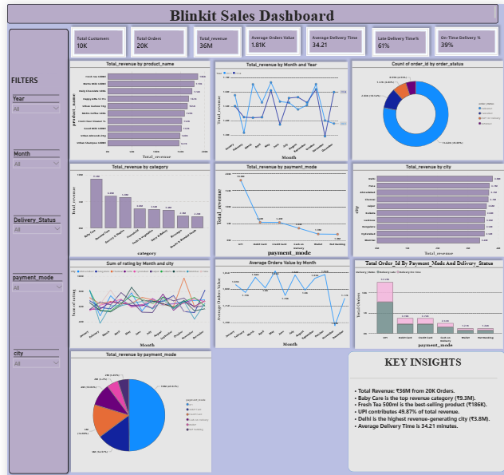
04 · DASHBOARD
Blinkit Sales Dashboard — Full View
E-COMMERCE SALES DASHBOARD
5

Slide 6



05 · VISUAL ANALYSIS
What Each Visual Tells Us
KPI Cards
Revenue Trend
Product Analysis
Category Analysis
Monitor revenue, orders, customers, AOV and delivery KPIs at a glance.
Compare monthly sales performance across years.
Identify best-selling products by revenue.
Measure each category's contribution to sales.
Payment Analysis
City Analysis
Rating Trend
Delivery Analysis
Understand customer payment preferences.
Find top-performing cities by revenue.
Monitor customer satisfaction over time.
Compare on-time vs. late delivery performance.
E-COMMERCE SALES DASHBOARD
6

Slide 7
06 · KEY INSIGHTS
The Numbers That Matter
₹36M
20K
10K
34.21
TOTAL REVENUE
TOTAL ORDERS
TOTAL CUSTOMERS
AVG. DELIVERY TIME (MINS)
Baby Care leads category sales
Fresh Tea 500ml is the best-seller
UPI drives half of all revenue
Delhi is the top revenue city
The top-performing category by total revenue.
Highest revenue single product at ₹186K.
UPI contributes roughly 49.87% of total sales.
Highest-earning city at ₹3.8M in sales.
E-COMMERCE SALES DASHBOARD
7

Slide 8
07 · RECOMMENDATIONS
Where the Business Should Act
Increase inventory for top-performing products
Promote low-performing categories to lift their share
01
02
Improve delivery efficiency to reduce late deliveries
Investigate the November sales decline
03
04
Expand marketing campaigns in high-performing cities
Encourage adoption of alternative payment methods
05
06
E-COMMERCE SALES DASHBOARD
8

Slide 9
08 · TOOLS & SKILLS
Built With
A complete Power BI workflow: shaping data with Power Query, modeling relationships, writing DAX measures, and designing an interactive dashboard for business intelligence reporting.
Power BI
Power Query
DAX
Excel
Data Modeling
KPI Design
Dashboard Development
Business Intelligence
E-COMMERCE SALES DASHBOARD
9

Slide 10

CONCLUSION
One Dashboard. Faster Decisions.
This dashboard gives management a single interactive view of sales and operations — replacing scattered reports with one connected model that supports faster, better business decisions.
Lavi Kumar · Power BI Corporate Project Report
E-COMMERCE SALES DASHBOARD
10

