Slide 1














STOCK MARKET PREDICTION
ZOMATO

Slide 2

INTRODUCTION: OVERALL PROJECT OBJECTIVE
we will learn how to predict a signal that indicates whether buying a particular stock will be helpful or not by using ML. We use the zomato dataset available on internet for free. By using several Machine model we will predict the stock prices.

Slide 3
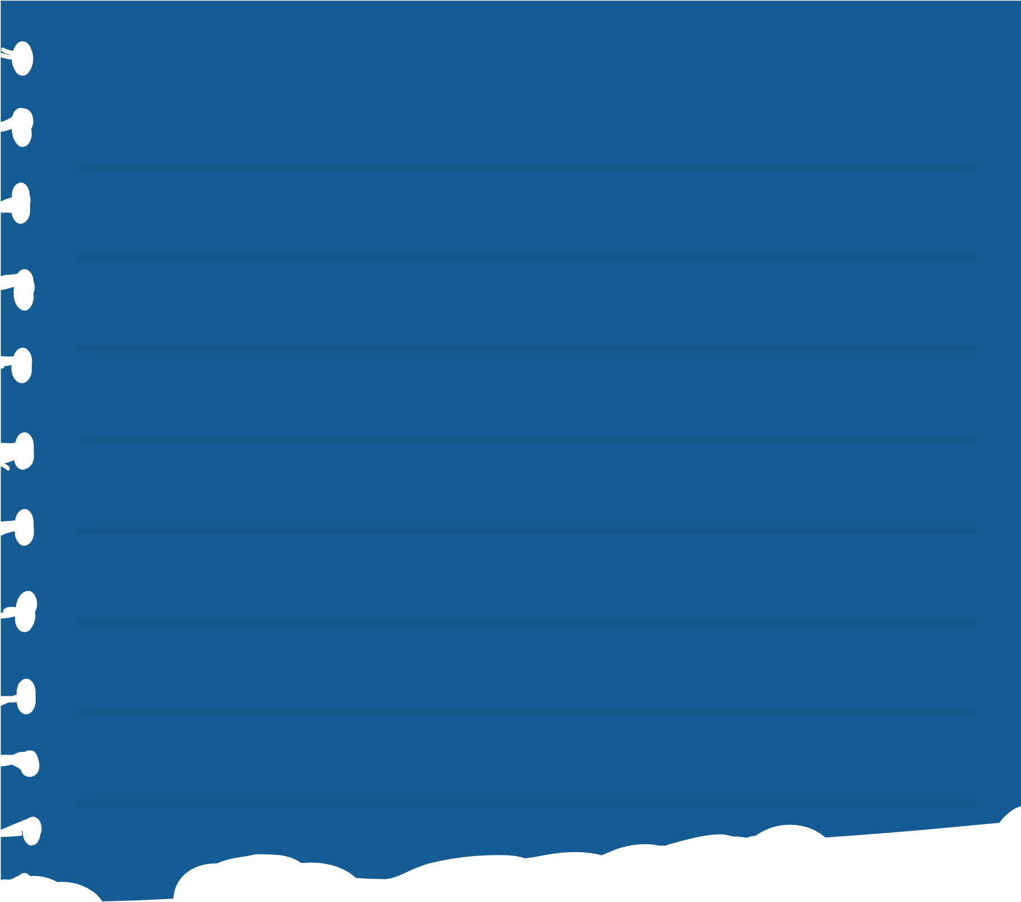

LIBRARIES
PANDAS
NUMPY
This library helps to load the data frame in a 2D array format and has multiple functions to perform analysis tasks in one go.
This library helps to load the data frame in a 2D array format and has multiple functions to perform analysis tasks in one go.

Slide 4
Matplotlib/seabprn
XGBOOST
This library is used to draw visualizations.
Sklearn – This module contains multiple libraries having pre-implemented functions to perform tasks from data preprocessing to model development and evaluation.
This contains the eXtreme Gradient Boosting machine learning algorithm which is one of the algorithms which helps us to achieve high accuracy on predictions.

Slide 5
OUTPUT
SCREENSHOTS

Slide 6
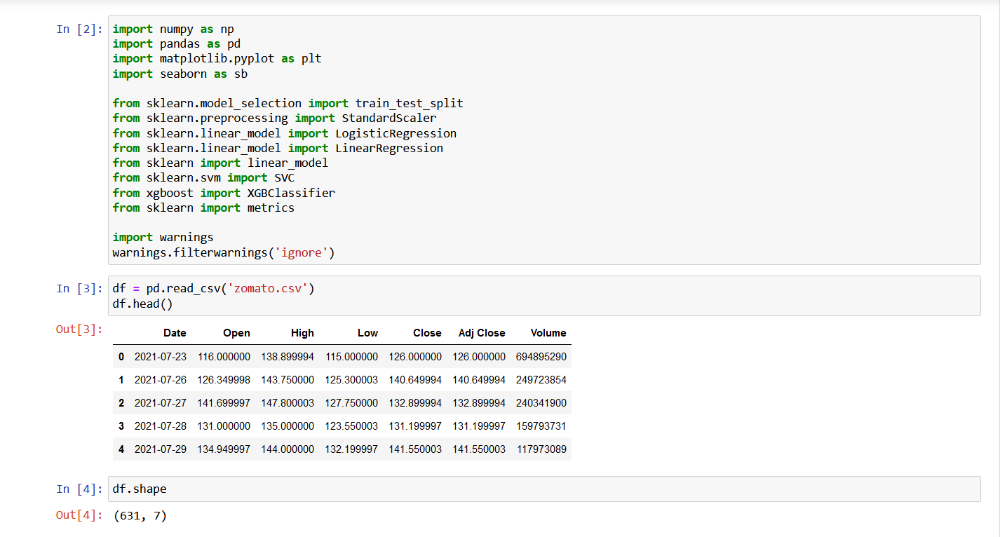
READ CSV

Slide 7
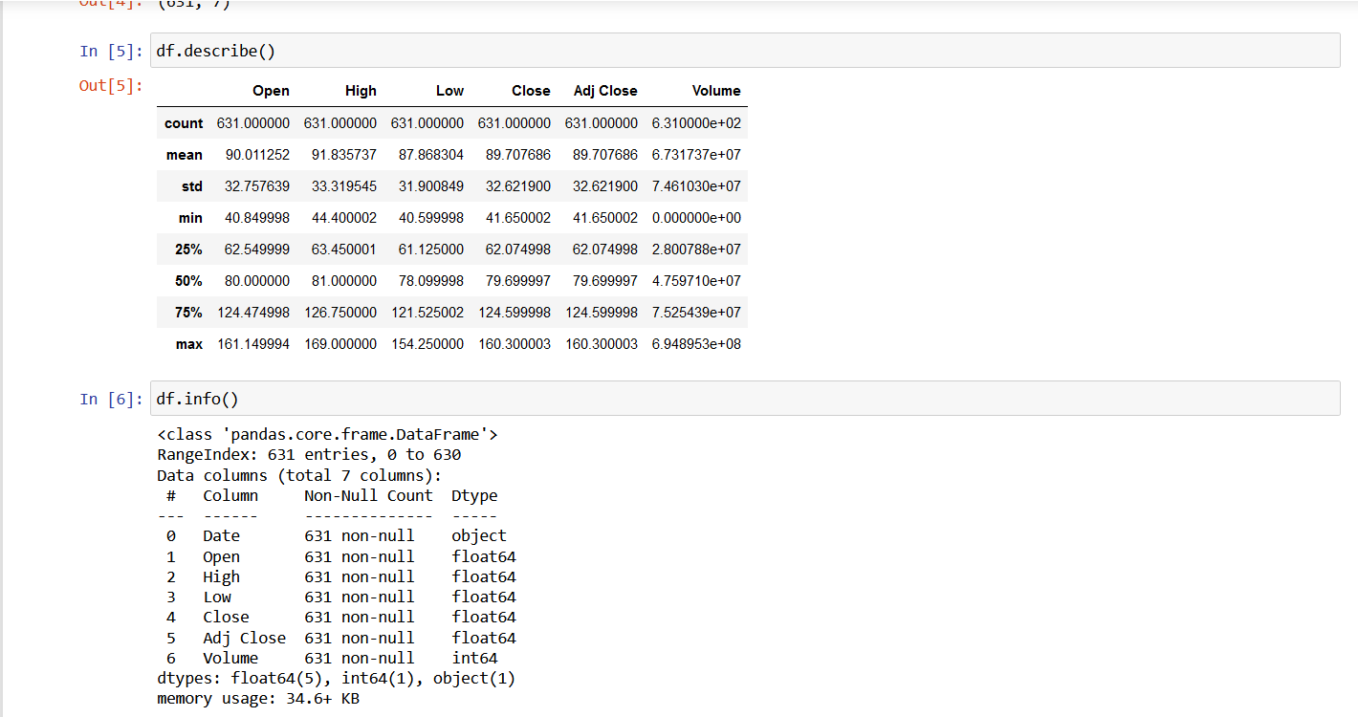
INFO & DESCRIBE
.

Slide 8
EXPLORATORY DATA ANALYSIS

Slide 9
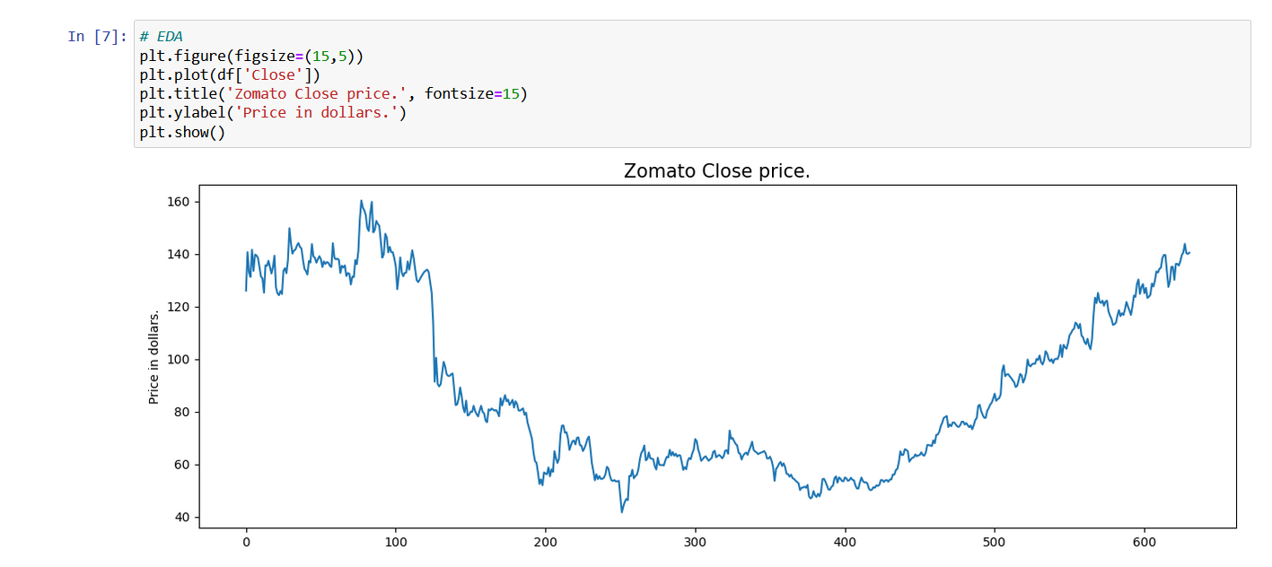

Slide 10
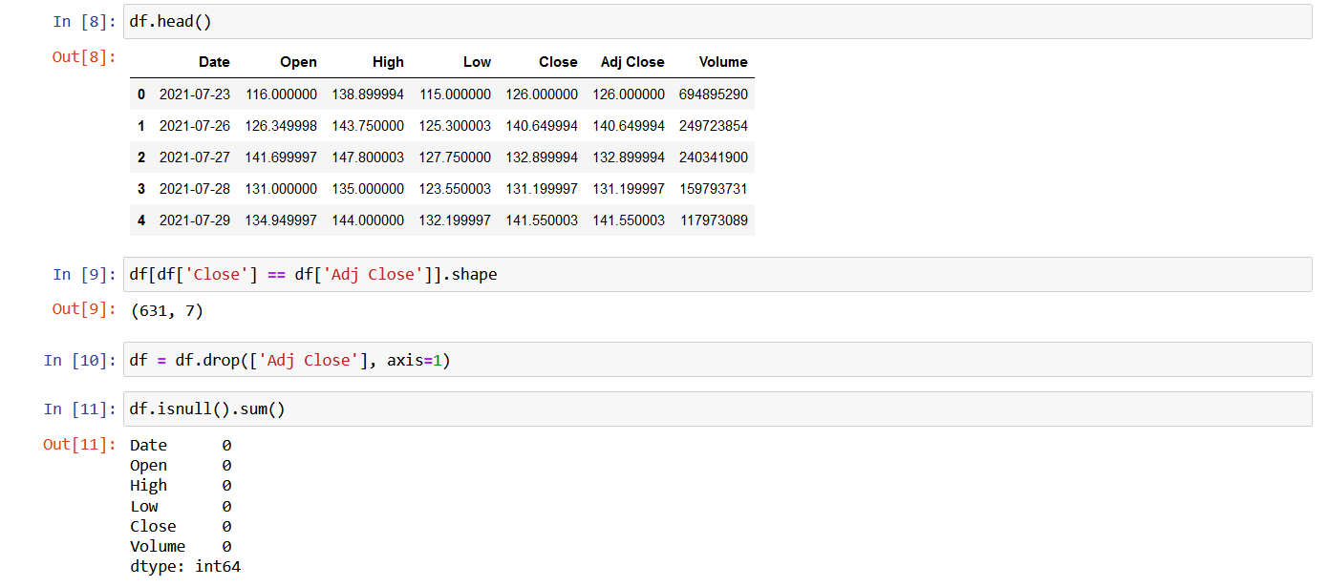

Slide 11
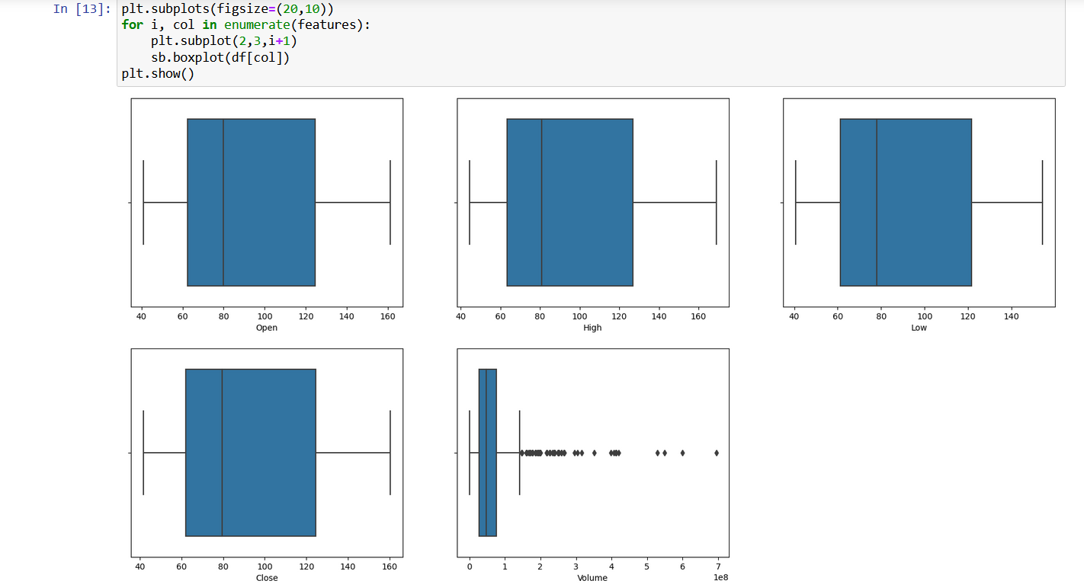

Slide 12
MODELS

Slide 13
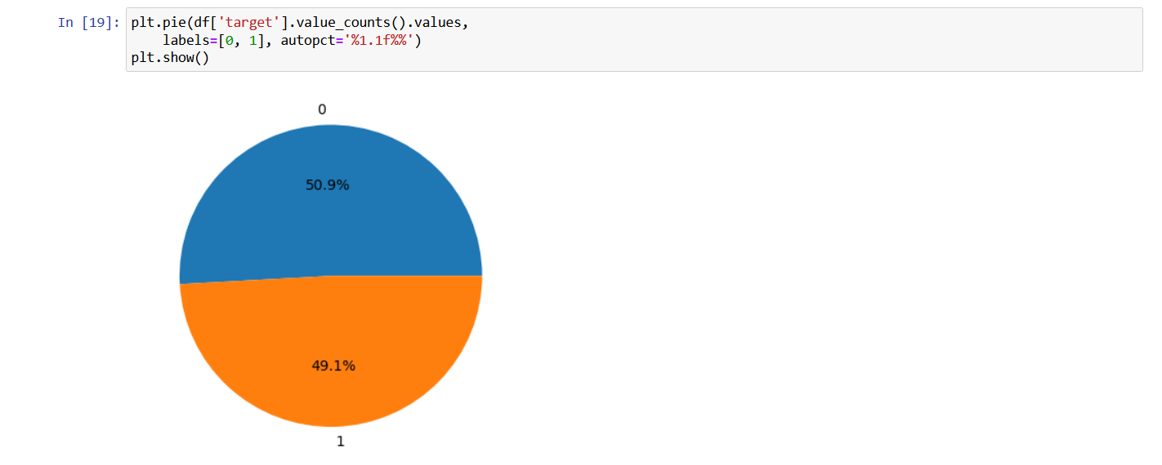

Slide 14
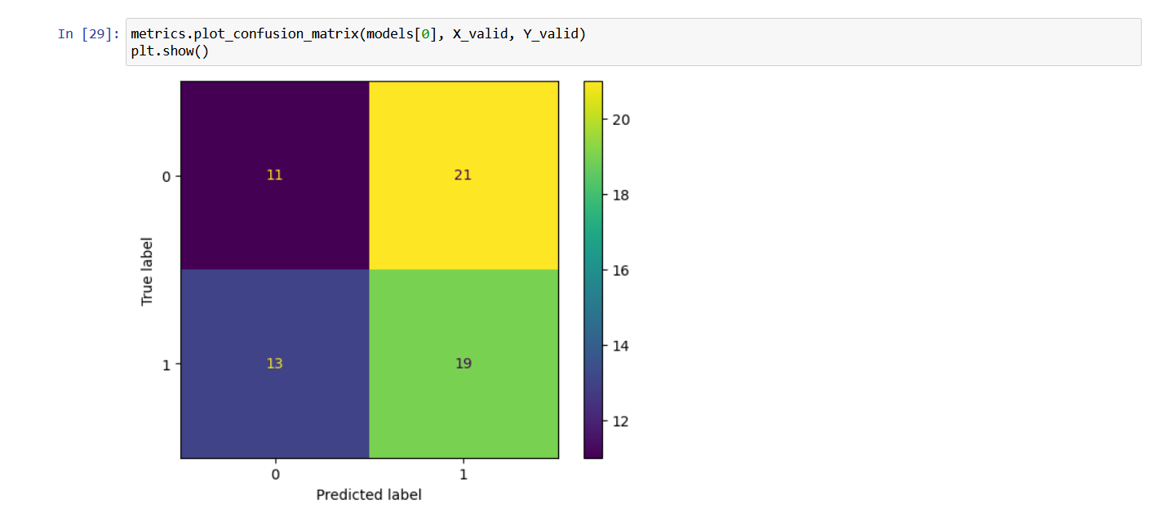

Slide 15
THANK YOU !

