Slide 1

Educational Qualifications:
Masters in Computing 2020
Big Data Analytics and Artificial Intelligence
Bachelor of Technology 2014
Computer Science and Engineering
AISSCE 2010
Computer Science, Mathematics, Physics and Chemistry
Experience:
5 years full-time experience in Software Design and Development
3.5 years in Siemens Technologies
1.5 years in TAVANT Technologies
1+ year of part-time and internship experience
1 year in PurpleWire Technologies
3 months in KoreData Systems
Awards:
Tech Expert – SIEMENS Excellence Awards 2018
Siemens ‘U’ Make a Difference Award 2018
Champion Award– SIEMENS DF PD Awards 2017
Siemens Puraskaar Spot Award 2016
Rookie of the Year, Tavant Excellence Awards 2015
Software Engineer
MSc in Big Data Analytics and Artificial Intelligence
+353-894934334
lavishthomas@gmail.com
www.linkedin.com/in/lavishthomas
www.github.com/lavishthomas/
Writers Square, Port Road Letterkenny,
Co Donegal, Ireland, F92 V2NH

Slide 2
Projects Types Worked in:
Research
Proof of Concept
Product Development
Service-based development
Responsibilities Handled:
Solutions Architect
Team Lead
Scrum Master
Proxy-Product Owner
End-To-End Product Delivery
Interested Areas:
IoT
Edge Analytics
Solutions Architecture
Use case Extensions
ETL and Analytics
2008
C++, OOPS
2009
MySQL
2010
C
2011
Java
2012
PHP, HTML, C#, MS SQL
2013
Embedded C, Linux
2014
PL/SQL, Oracle SQL, ETL
2015
Shell, Java, Hive, Framework Development
2016
PCS7, SCL, C, PLC
2017
Angular, Typescript, C#, MS SQL
2018
NodeJS, Node-RED, JavaScript, SQLite
2019
Solutions Architecture, Linux, MQTT, RestAPI
2020
Kafka, Spark, ML, DNN, RL, Python

Slide 3
Hobbies :
Sports
Dance
Photography
Public/Motivational speaking
Adjectives Describes me:
Innovative
Intuitive
Inquisitive
Empathetic
Reasonable
Trades:
Philosopher
Polymath
Radical

Slide 4
Languages Familiar:
Python, JavaScript, TypeScript, Shell Script, C, C++, C#, JAVA, JSON, XML.
Databases Familiar:
SQLite, MySQL, Oracle SQL, MS SQL, HIVE- HADOOP.
Tools and platforms Familiar:
IoT, AWS, Azure, Node RED, REST-API, Kafka, Spark
Interested Areas:
IoT , Cloud, Solutions Architecture, Use case Extensions, ETL and Analytics

Slide 5

Table loading
~15 min
Oracle ETL
Raw
1 Week
5 hours
Normalized
2 months
2 hours
Production
6 months
Oracle BI
C++
Raw
1 hours
Production
Platfora
MR/Spark
Table loading
~10 min
Notes:
Issues:
Multiple pipeline for each type of dashboard
Advantages:
New metrics derived directly from raw data.
Cater growing data size

Slide 6

ERP
IoT
MES
Data Flow
Decision Flow
Sensors 1
SCADA, PCS, DCS
Sensors 1
Shield 1
Shield 8
Sensors 2
Sensors 2
PLC
Shield 2
Shield 7
Sensors
Actuators
Sensors 8
Sensors 8
Shield 3
Shield 6
Shield 4
Shield 5
Notes:
Time
Data Segregation
Data loss

Slide 7
PLC
Remote
SP (20 degree)
Sensor
PV(25 degree)
MV(1000rpm)
Actuator
Actuator
Process
Room

Slide 8
Data Tapping
PLC
Shield
Sensor
Actuator
Process

Slide 9
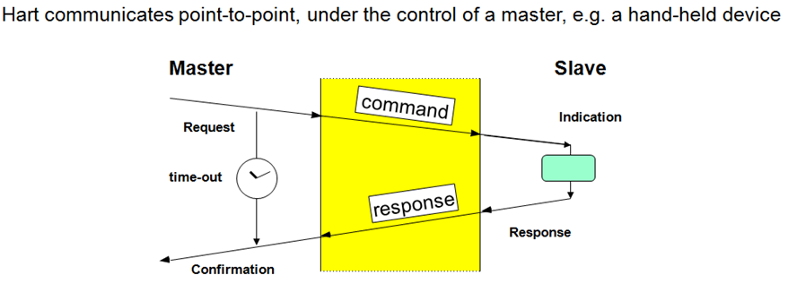
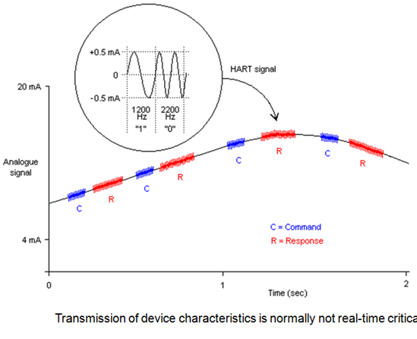
HART

Slide 10
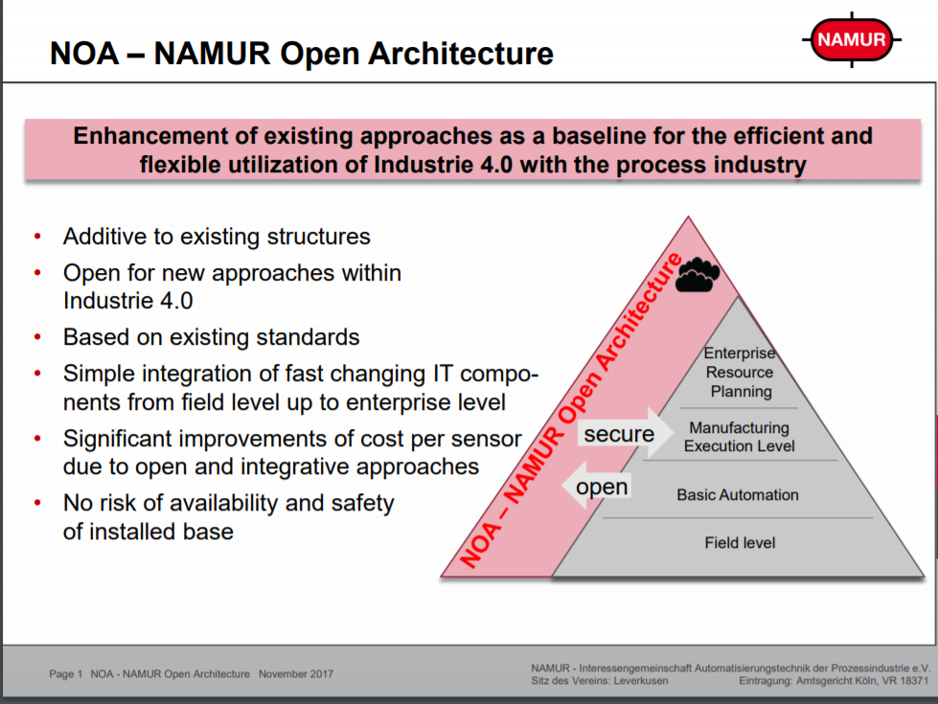
https://www.namur.net/en/focus-topics/namur-open-architecture/

Slide 11
Client Machine
Client Machine
MindSphere
Web Browser
UA Expert
Mind App
HTTP
OPC-UA
HTTP
IoT2040
HTTP Server
Nginx
OPC-UA Server
MindConnect
C Library
Read
Subscription
REST
MQTT
REST
MQTT
MQTT
Back End Services (NodeJS)
SqLite
AuthServices
Publisher Services
DataLogger
ConfigServices
DeviceServices
HealthMonitor
MQTT
Modbus Agent
C program
Serial Modbus
SITRANS DB Shield 1
SITRANS DB Shield 8
SITRANS DB Shield 1
SITRANS DB Shield 7

Slide 12
Web App Interaction
SQL connections
MQTT
REST
Web App
Login
User Management
List View
Detail View
Network Setting
Shield Channel Access
Data Logger Config
Mind Connect Config
Task Manager
Backend Services
AuthServices
(User Management)
Port : xxxx
NodeJS Program
DeviceServices
Port : xxxx
NodeJS Program
ConfigServices
Port : xxxx
NodeJS Program
HealthMonitor
Port : xxxx
NodeJS Program
/ Consul Program
User Management Tables
Decode Tables (HART)
Configuration Tables
ModBusService
C Program

Slide 13
Core Services Interaction
SQL connections
MQTT
REST
HealthMonitor
Port : xxxx
NodeJS Program
/ Consul Program
Configuration Tables
ConfigServices
Port : xxxx
NodeJS Program
Data Logger
DataLogger
Port : xxxx
NodeJS Program
AuthServices
(User Management)
Port : xxxx
NodeJS Program
MindConnectAgent
C Program
Publisher Services
Port : xxxx
NodeJS Program
OPC-UA
OPC-UA Sub
C Program
User Management Tables
Decode Tables (HART)
DeviceServices
Port : xxxx
NodeJS Program
OPC-UA Read
C Program
ModBusService
C Program

Slide 14
Device Services Flow
Command Queue Shield 1
http
scan
External requests
REST API’s
Segregate request based on shield
Executioner loop through 1-8 shields CQ
Command Queue
Shield 2
Check execution status()
Modbus write
Request processor
if (false) { pop() } else { skip }
http
Write ()
Processor loop through 1-8 shields
Modbus requests
Command Queue
Shield 8
Check shield status()
Internal execution requests
if (false) { read () } else { skip }
Modbus read
Sent results ()
Results holder indexed on shield, channel, command
CMD response decoder

Slide 15
Mod-bus Lifecycle for one shield
Shield
Write
Register
1
IoT 2040
2
>2
Device
3,5
Shield Status
4,6
7
<7
Read Register
1 – mod bus write request : Hart Request
2 – mod bus write response : write success
3 – Check Status busy
4 – Busy =1
5 – Check Status busy
6 – Busy =0
7 – mod bus read request
8 – mod bus read response : Hart Response
8
HART Request
>2 starts after the step 2 is completed
---------------------------------------------------
HART response
<7 finishes before step 7

Slide 16
Shield Life Cycle (mod bus slave)
Quassi-Parallel SITRANS
IoT Life Cycle
(mod bus master)
Write to shield 1
Write to shield 2
If Shield has completed execution,
the reading register will be read (busy =0)
3) Read
Write to shield 8
IoT Box
2) Check Shield Status
1) write
Check Shield 1 Status
Read shield 1
Check Shield 2 Status
Checks whether the shield
is executing any current command
before reading the read register
If Shield has completed execution
And IoT has completed reading
of the register,
if (busy =0 & exe =0)
The new command to be executed
will be put in the write register
exe =1 (IoT variable)
Each Modbus request
(Read/Write gets
a response from the slave)
Read shield 2
Check Shield 8 Status
Read shield 8

Slide 17
Solution Architecture
Inter Device Communication
REST API
MQTT
SQL
Clients/ Data Destination
Client Machine
Client Machine
MindSphere
Browser (E.g. Chrome)
UA Expert
MindApp
HTTP
OPC-UA
HTTP
IoT2040
HTTP Server
Typescript Nginx
OPC-UA Server
C Program
MindConnect
C program
Data logger
Node JS
Angular Components
OPC-UA Information Model
MindConnect SDK
Reader and saver
Angular Services
Rest API Interface
MQTT sub Interface
MQTT sub Interface
REST
REST
MQTT
MQTT
NodeJS
Back End
Services
sqLite
UM
CM
Command trigger / Scan
Publisher Module
CMD
UM
DL
CM
SS
HM
Command Queue / Synchronization
Serial Encoder/Decoder
Command Decode
MQTT
C program
Modbus Agent
Serial/Modbus Port
Hart Shield
HART Protocol
Devices/Data Source
Device
Device

