Slide 1

Notes:
This is a reproduction of a 2023 SOSP paper on cache eviction. The title is deliberately provocative: for thirty years the field has assumed you need LRU plus something clever on top. I re-ran their experiments on two of their datasets, completely, and I will show you where it held up and where it did not.

Slide 2
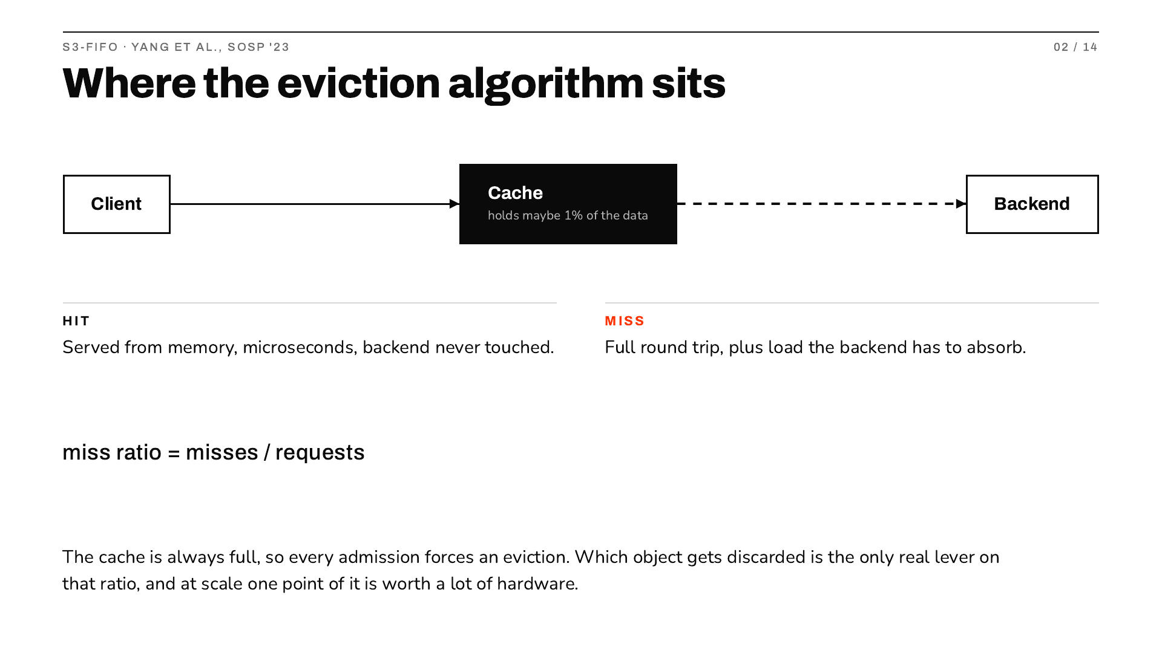
Notes:
Grounding, keep it short. A cache holds a small slice of the data. A hit is microseconds; a miss is a full round trip plus extra load on the backend you were trying to protect. Because the cache is always full, admitting anything means discarding something, and the rule that picks the victim is the only real control you have over the miss ratio.

Slide 3
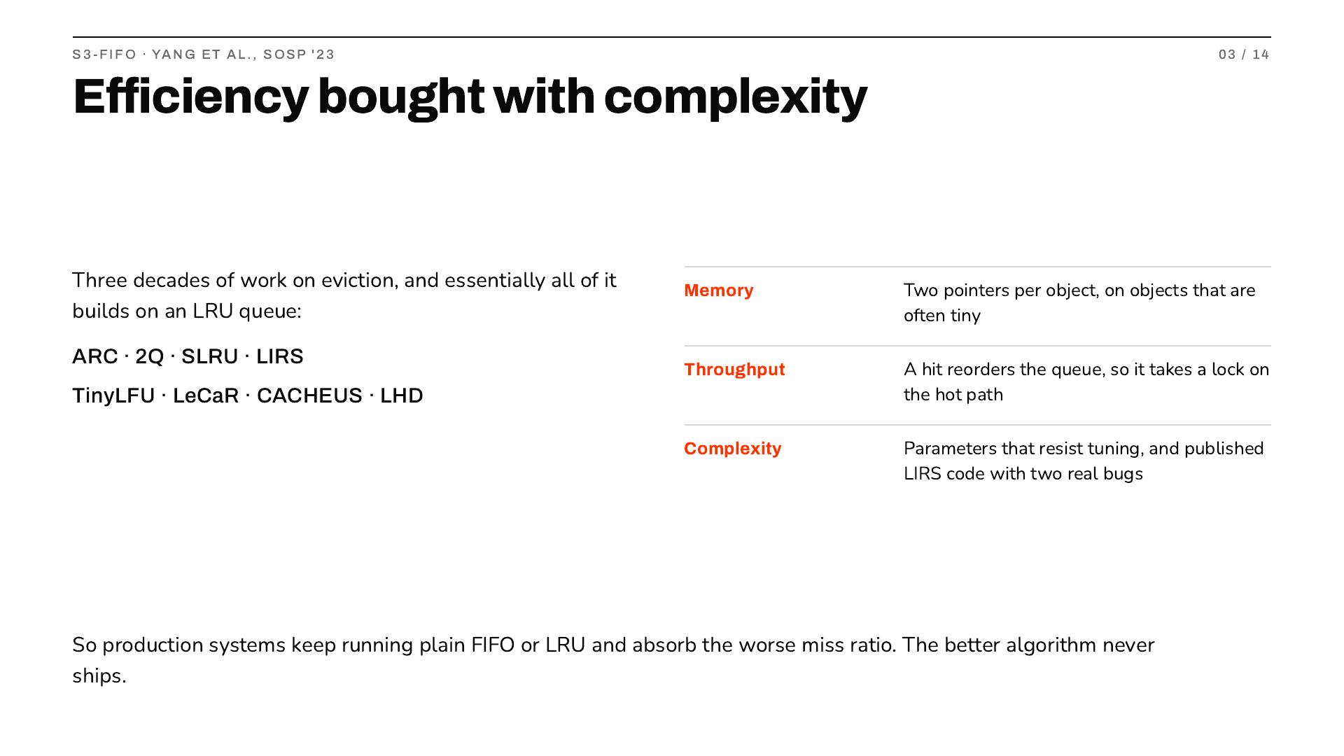
Notes:
The setup for the whole paper. Over three decades people built smarter eviction algorithms and essentially all sit on LRU queues. That buys efficiency and costs memory, throughput and simplicity. The authors note that LIRS implementations in prior published work contained two separate bugs. The practical result is the last line: engineers do not deploy these, they run FIFO or LRU and eat the difference.

Slide 4
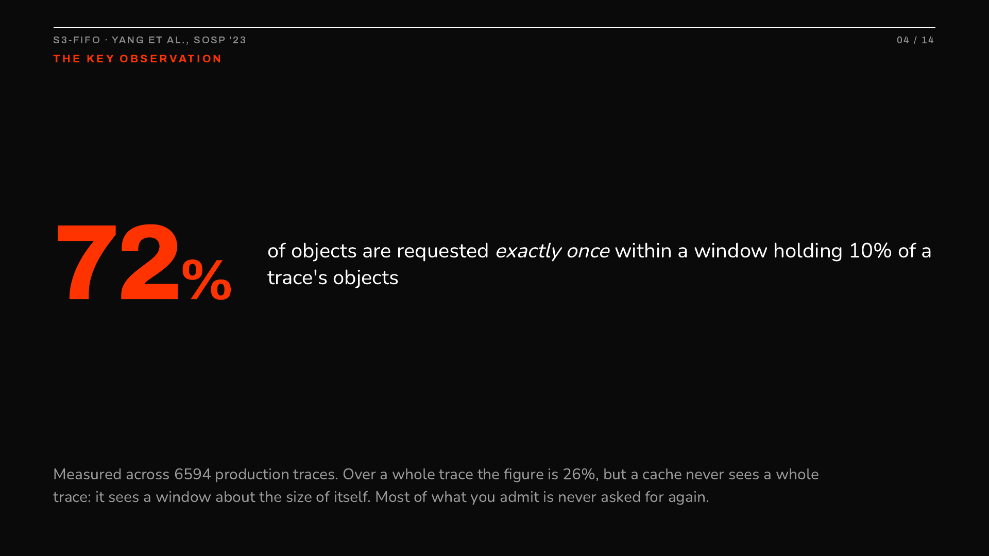
Notes:
This is the insight the algorithm falls out of, so spend a moment. People have long measured what fraction of objects are requested only once, and across whole traces it is about a quarter. The authors point out that is the wrong measurement, because a cache never sees the whole trace. Over a window holding ten percent of the objects, 72 percent are one-hit wonders. So most of what you admit is garbage, and the job is to get rid of it fast. They call that quick demotion.

Slide 5

Notes:
Frame it as a question rather than a data structure, because that is what is new. Every other algorithm is trying to rank objects by value, which is expensive to maintain. S3-FIFO asks a cheaper question: has this been requested even once since we admitted it? Walk the table. Then the last line, which should be the surprising part: conventional wisdom says FIFO is what you settle for. Here it wins.

Slide 6
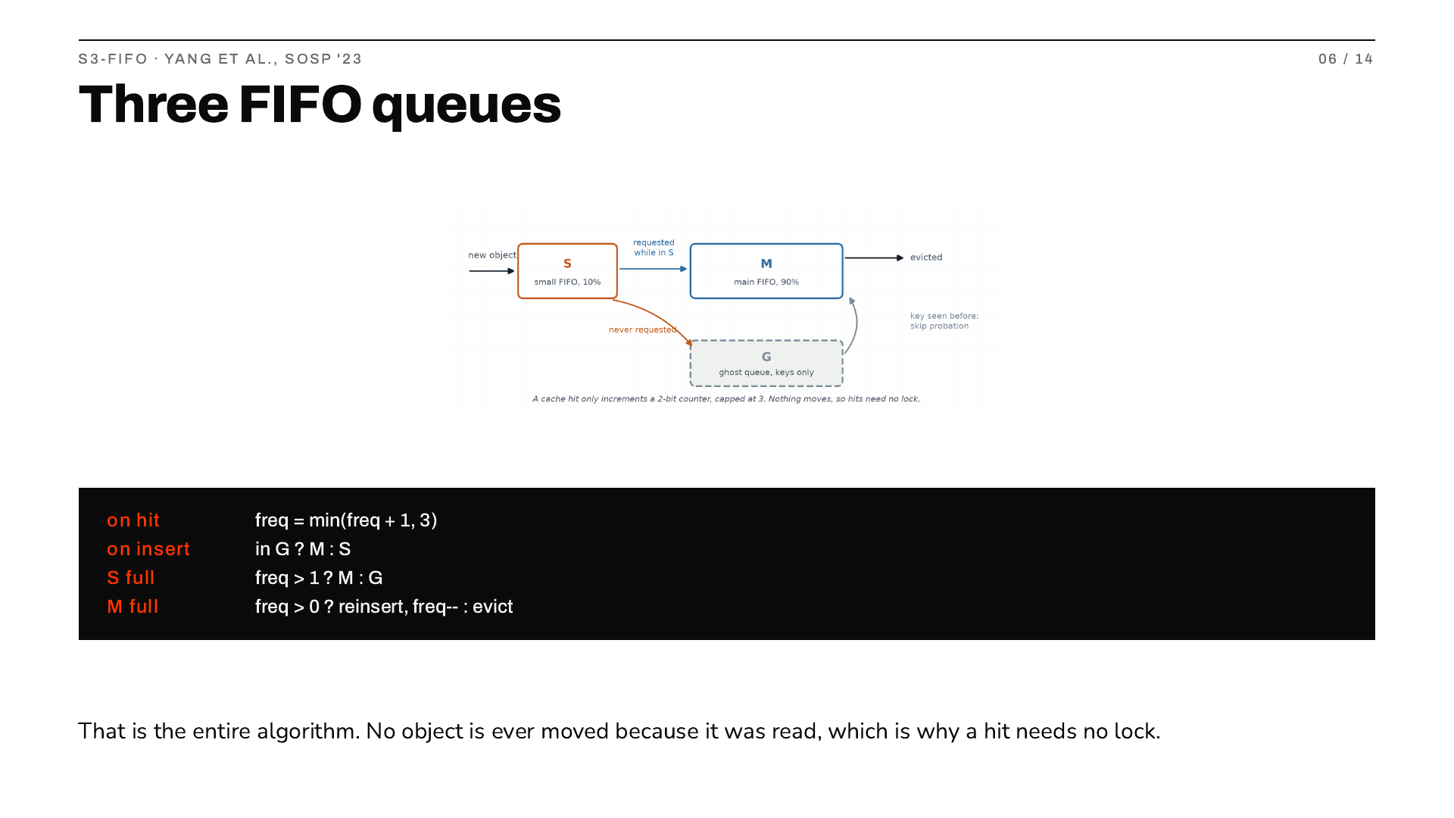
Notes:
Walk the diagram left to right, then the code. A new object goes into S, a tenth of the cache. When S fills the tail leaves: promoted to M if it was requested, otherwise dropped with only its key kept in G. If that key turns up again we know it is not a one-hit wonder, so it goes straight to M and skips probation. M evicts like a clock sweep. The four lines are genuinely all of it. Nothing moves on a read, which is where the scalability comes from.

Slide 7
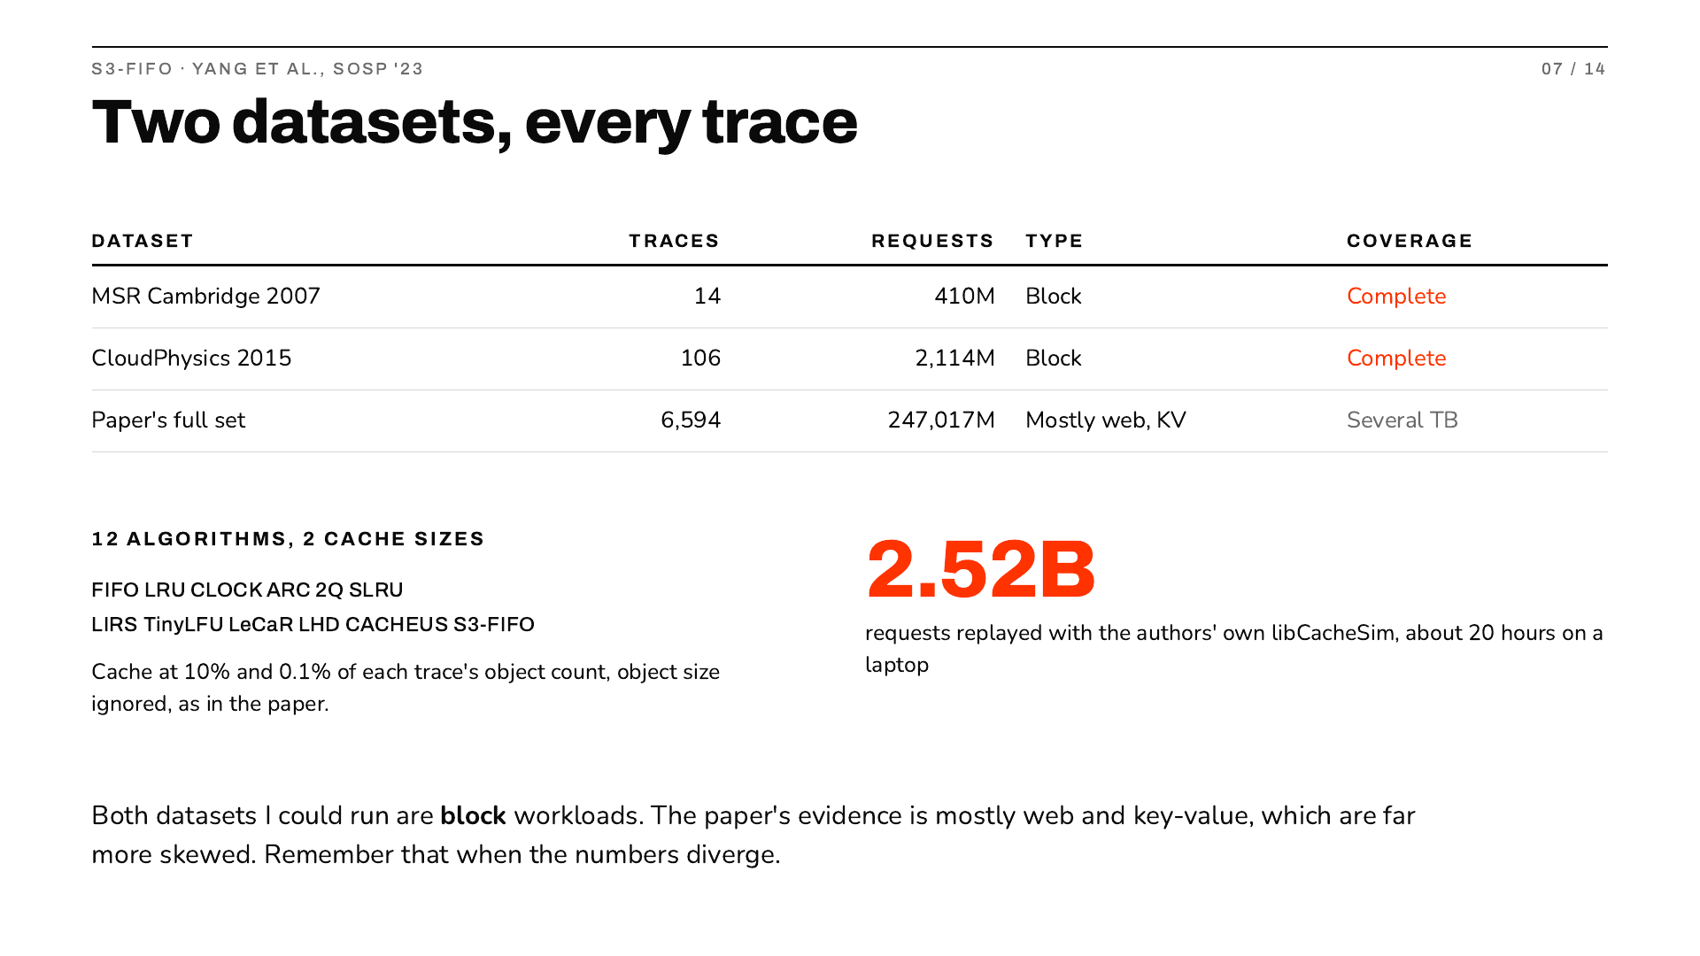
Notes:
Be upfront about scope. The paper runs 6594 traces across fourteen datasets, several terabytes, which a laptop cannot do. I took the two that fit and ran them completely, every trace, not a sample. The algorithms are the authors' own through libCacheSim, so what I wrote is the harness. Land hard on the last line, because it explains every disagreement later: both my datasets are block storage, and block traces are much less skewed than the web traces that dominate the paper. Skew is what this algorithm exploits.

Slide 8
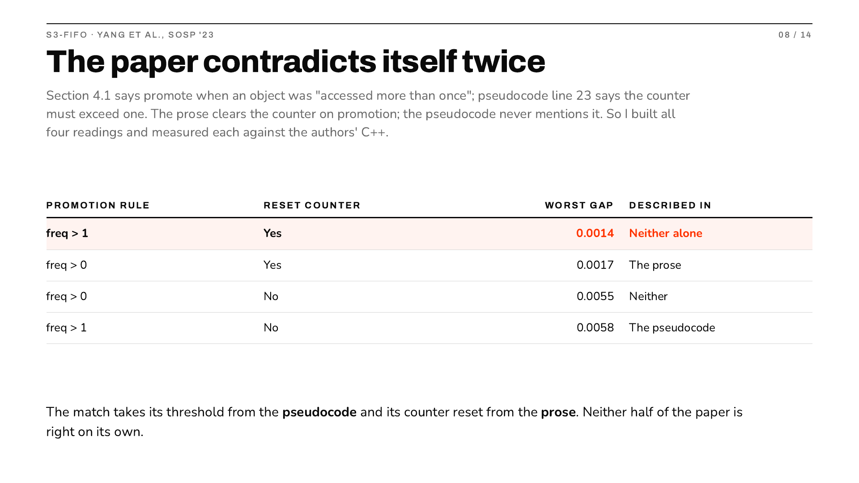
Notes:
This is what I would lead with if asked what I learned. Two details differ between the prose and the pseudocode, and rather than guess I implemented all four combinations and measured each against the authors' own C++ on the same trace. The highlighted row matches to fourteen ten-thousandths of a miss ratio, and it takes one detail from each half of the paper. Anyone implementing from only the pseudocode, or only the prose, gets a measurably different algorithm.

Slide 9
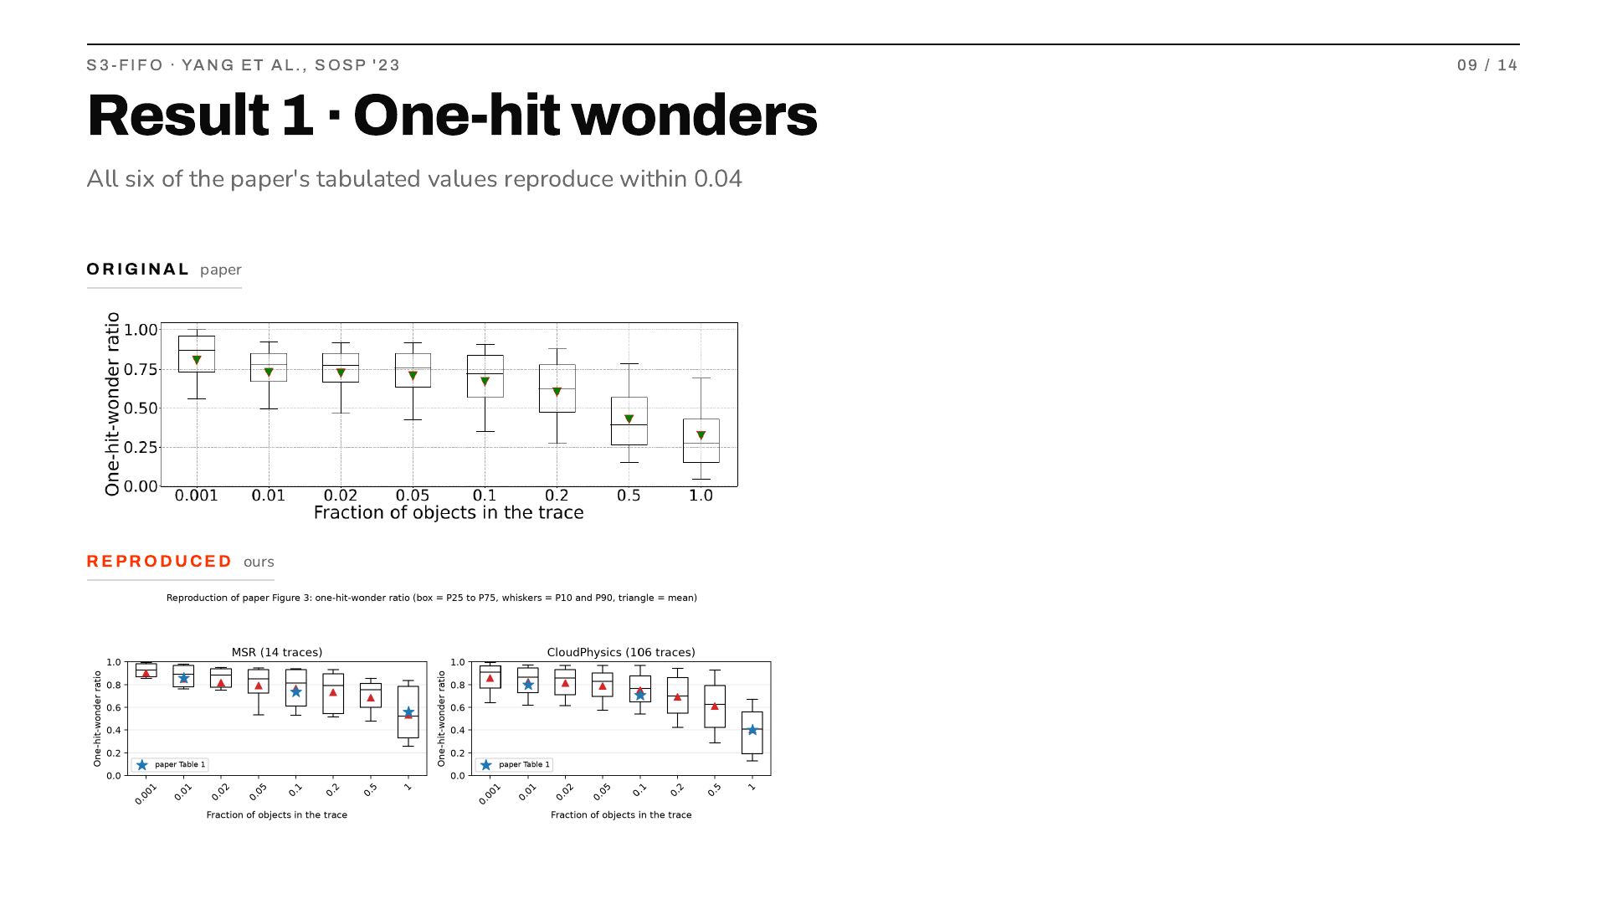
Notes:
This needs no cache simulation at all, just counting, so it validates the trace decoding before anything else depends on it. The blue stars on my panels are the paper's own published numbers, and they sit on my means at all three sequence lengths for both datasets. My MSR traces also total 409.8 million requests against their stated 410 million, so I am confident it is the same data.

Slide 10
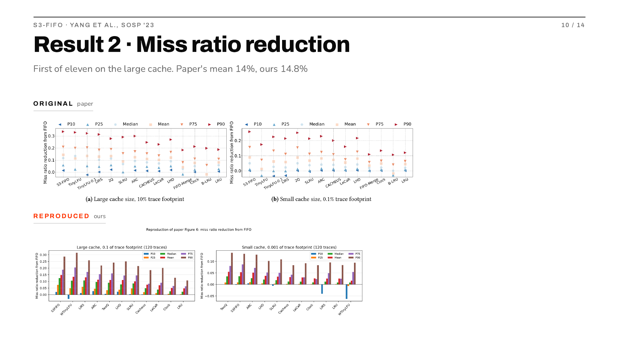
Notes:
The headline. On the large cache size S3-FIFO is first of eleven algorithms and my mean reduction over FIFO is 14.8 percent against the 14 percent stated in their text. Point at the P10 bars too: S3-FIFO stays positive while TinyLFU and LIRS go negative, meaning on the worst tenth of traces those are beaten by plain FIFO. On the small cache my ordering differs, and the next slides explain why.

Slide 11
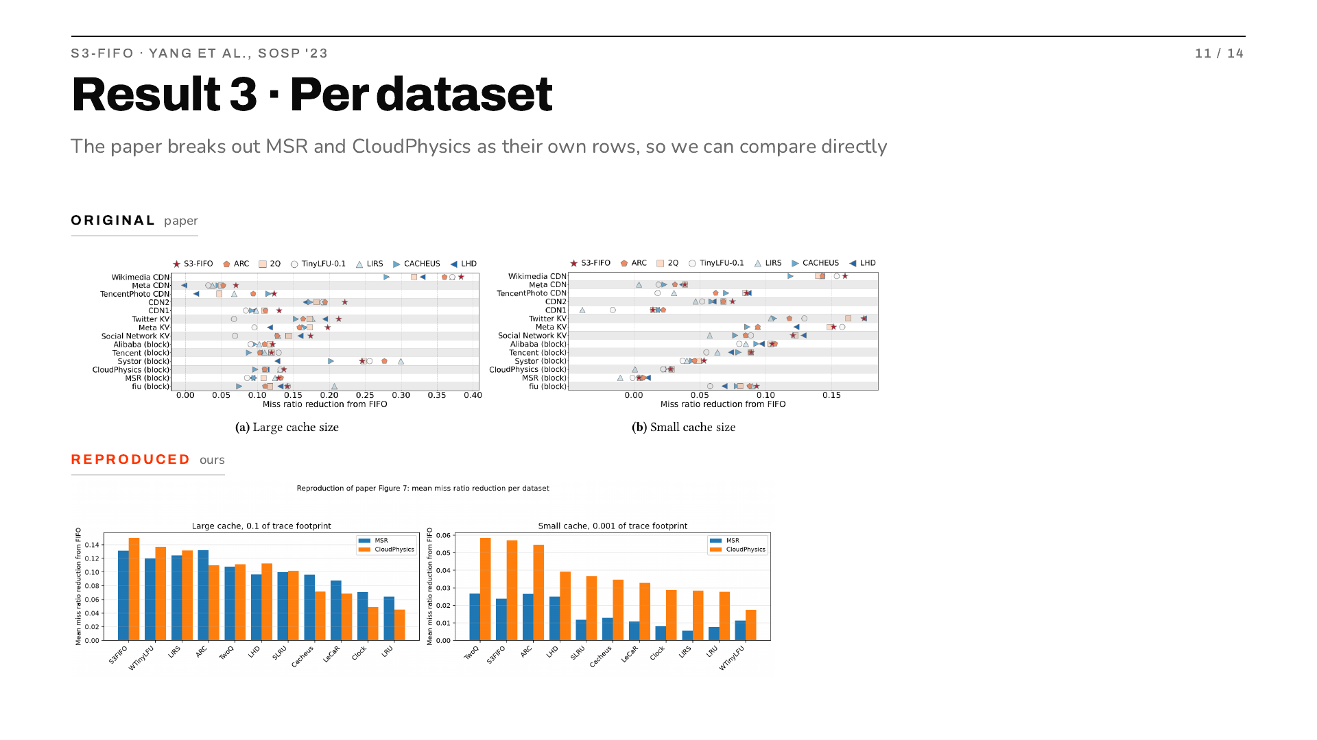
Notes:
Useful because the paper publishes my two datasets as separate rows, so I can check them individually rather than against a pooled average. The win is carried by CloudPhysics: on MSR alone ARC very slightly beats S3-FIFO, 0.132 against 0.131, while on CloudPhysics S3-FIFO is well ahead, 0.151 against 0.110. The paper's own rows for those datasets show the same pattern.

Slide 12
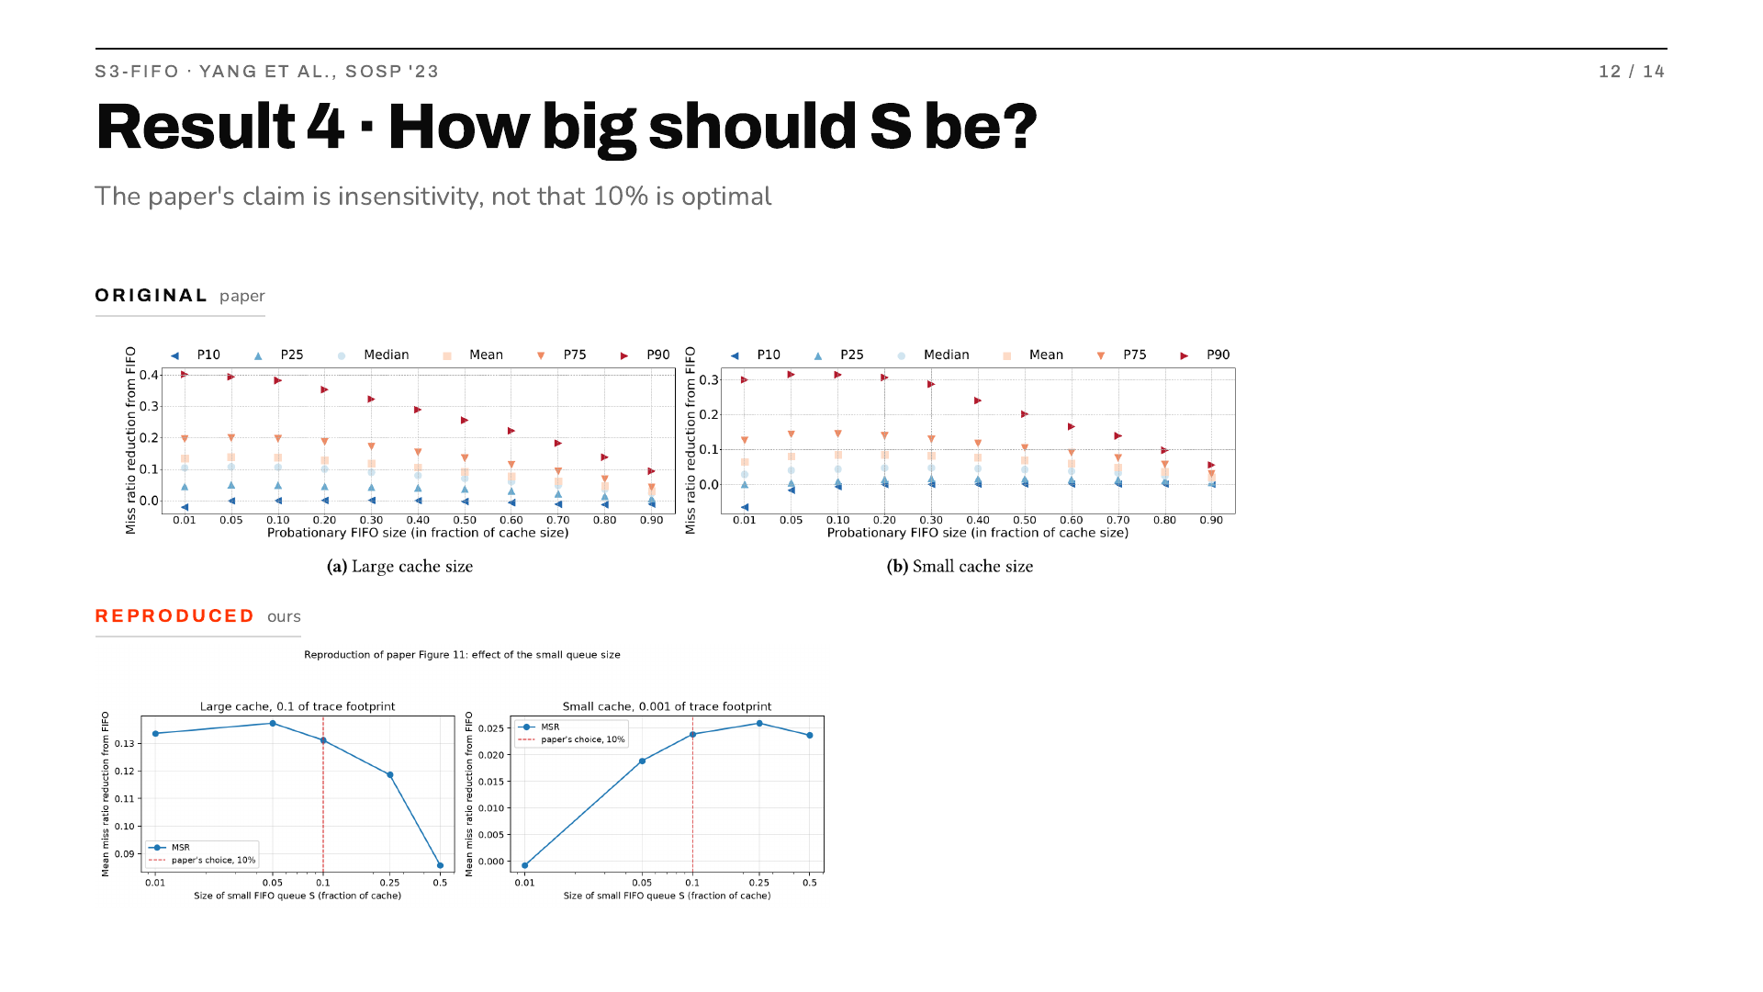
Notes:
I nearly reported this as a disagreement and then realised it is not one. My best setting is 5 percent on the large cache and 25 on the small, not the paper's 10, so at first glance they look wrong. But section 6.2 claims S3-FIFO is not sensitive to the size of S, and their own figure shows a nearly flat mean. They never claim 10 is the argmax. My curve is flat too and 10 is within half a point of the best at both sizes. Check what was claimed before calling something a failed reproduction.

Slide 13
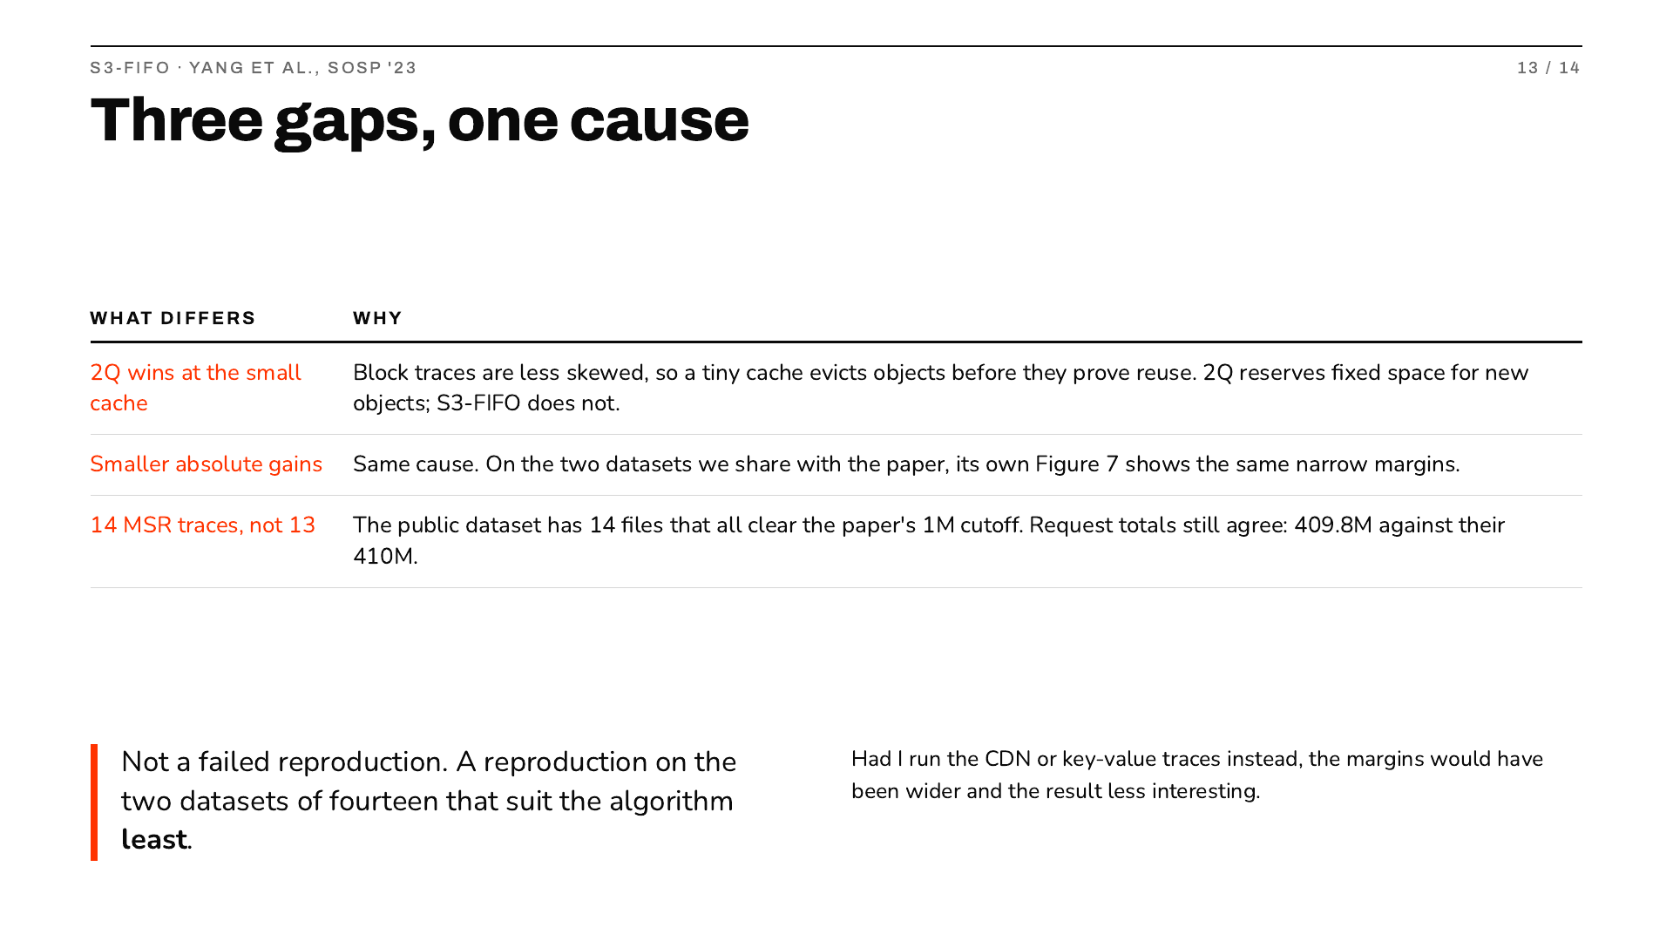
Notes:
Be direct rather than defensive. Every difference traces back to one decision: only two datasets were small enough to run, and both are block storage. The paper's evidence is dominated by web and key-value traces, which are much more skewed, and skew is exactly where quick demotion pays. So I tested the algorithm on its worst ground. If I had picked the CDN traces the numbers would look better and prove less.

Slide 14
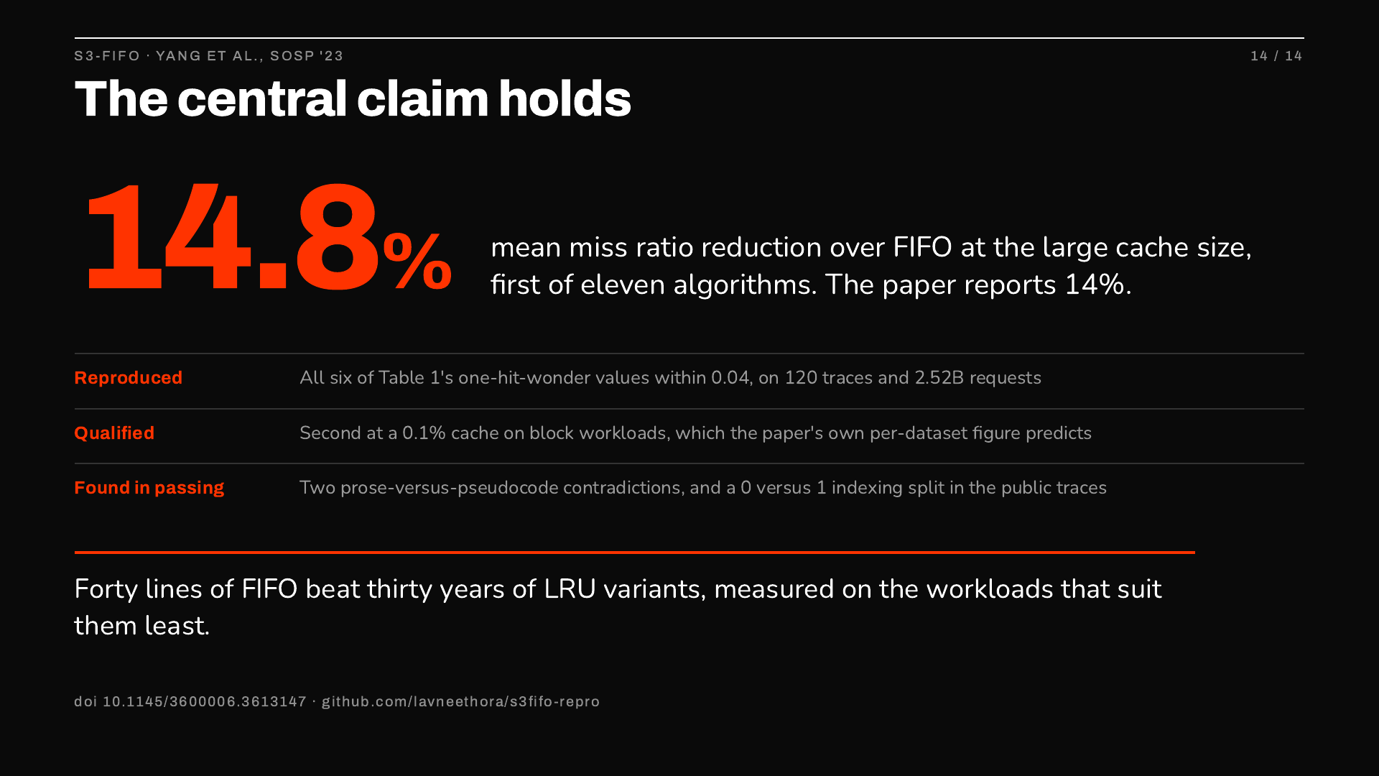
Notes:
Close on the big number: my mean is 14.8 and the paper's own text says 14. Then the three lines. Reproduced on every value I could check. Qualified at a tiny cache on block workloads, predicted by their own data, so a scope limit rather than a contradiction. And the reproduction turned up two places where the paper contradicts itself plus an indexing inconsistency in the public traces. Finish on the last line and take questions.

