Slide 1
Talent Management: Attrition in the Workforce
An analysis of employee turnover, primary contributing factors, and
recommendations for talent management
December 3, 2018
Stars data science inc.
Andrew wilkins
Samuel Kadyebo
Faiz Ikramulla
https://github.com/lavos84/MSDS-6306-Second-Case-Study.git

Slide 2
Introduction
“STARS” Interactive Visualization Tool
Job Role Specific Trends
Unique Observations
Robust Modeling & Test
Top 3 Factors
“LIME” ML for Analytics
Recommendations
With a real-world employee data set, we will apply our proprietary data science and analytics techniques to analyze attrition in the workforce:
Attrition
Data Exploration
Key Factors
Trends & Observations
Modeling
Machine Learning (ML)

Slide 3

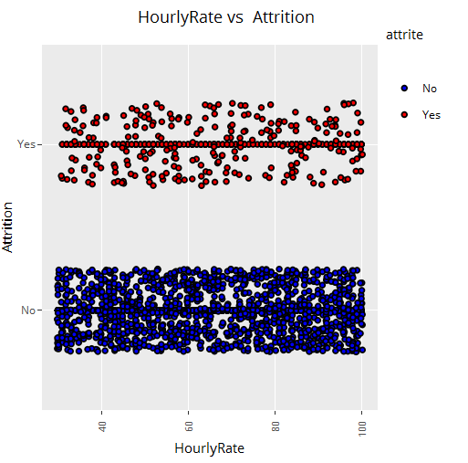
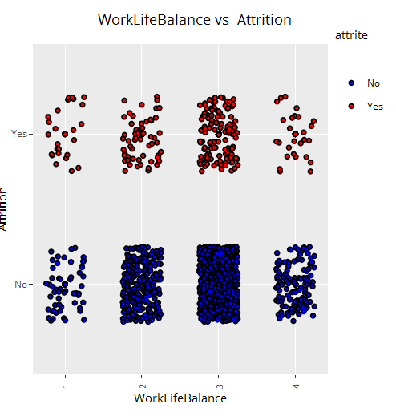
Data Analysis
“STARS” Interactive Tool
Test Cases:
Hourly Rate?
Work-Life Balance?
Live Demo of “STARS”

Slide 4
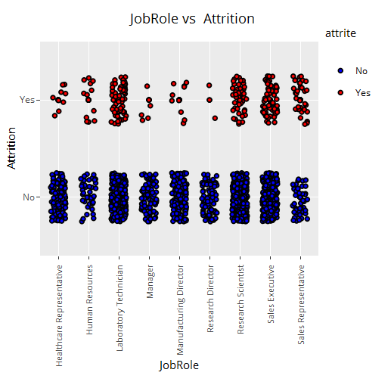
Job Role Specific Trends
“STARS” Interactive Tool
Findings:
Ljdf
Ljdfkld
ljdfd

Slide 5
Unique Trends
“STARS” Interactive Tool
Obervations of Note:
1.
2.

Slide 6
Logistic Modeling
3 Runs
Confidence Interval Testist – (“P”-Values)
Results
(from Drew’s Logistic.R)

Slide 7
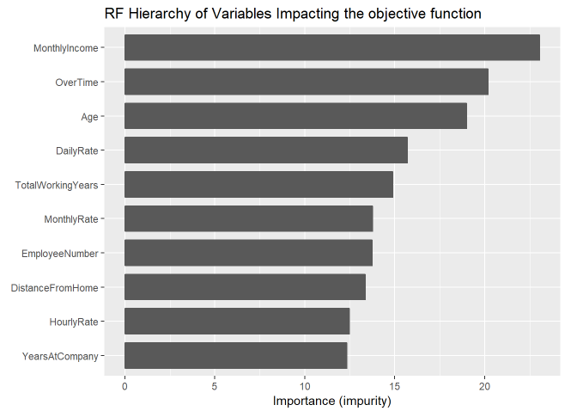
Machine Learning
Advanced Analytics
LIME
Ranger Model

Slide 8
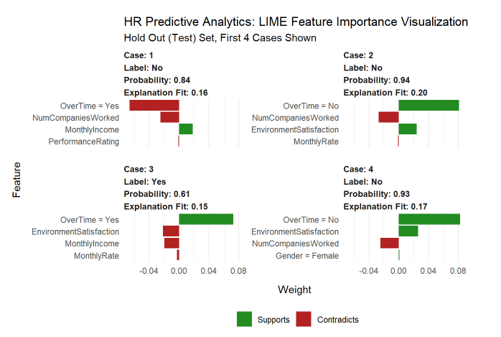
Machine Learning
Advanced Analytics
LIME
H20 Binomial w/ Training Set
Test against our Prediction

Slide 9
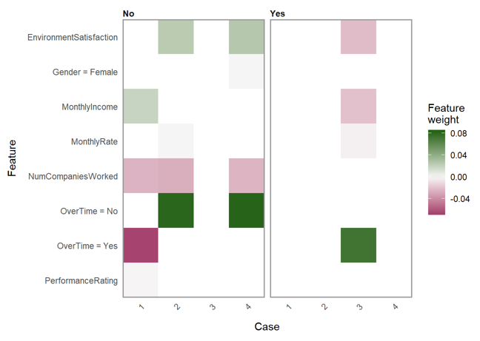
Machine Learning
Advanced Analytics
LIME
???
Test cases against our Prediction
Weights of Features

Slide 10
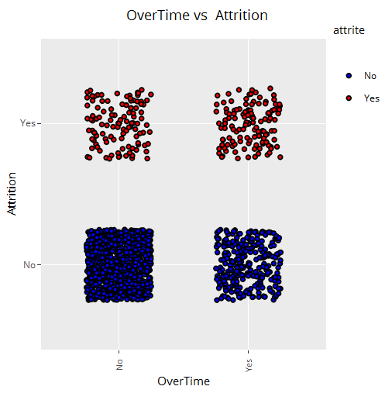
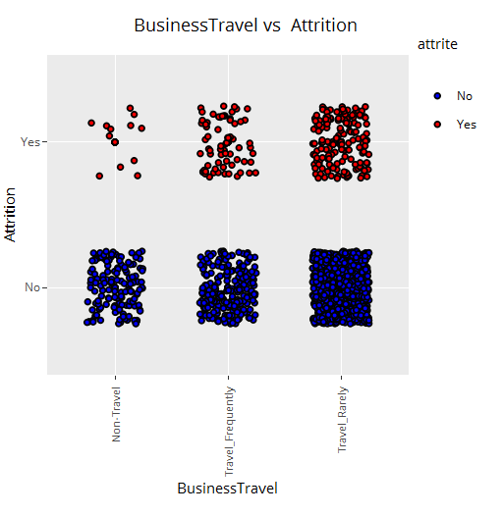
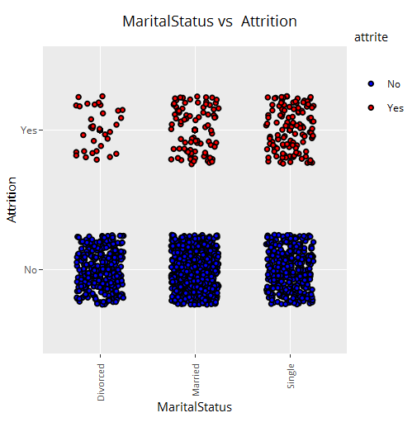
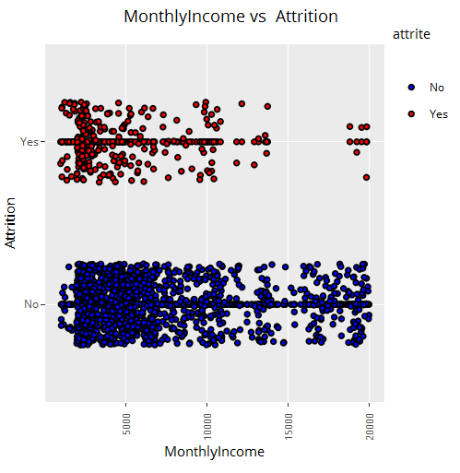
Top Factors
Business Travel
Overtime
Marital Status
Monthly Income
Age
xx
xxx

Slide 11
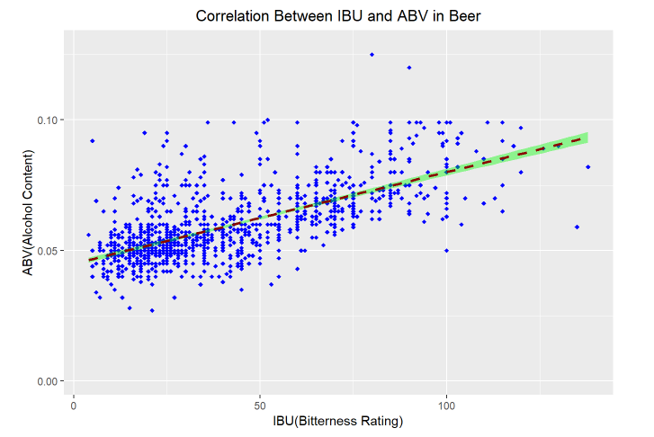
Correlation Analysis
ABV vs. IBU
Scatter Plot
Local polynomial regression fitting
“line-of-best-fit” approach
There appears to be an overall linear correlation between ABV and IBU.
Too much variance across the range to conclude a “direct correlation”
Cluster near low end

Slide 12
Conclusions
The Pacific Northwest has a high concentration of breweries.
The Upper Midwest has a high concentration of breweries.
Colorado – “The State of Craft Beer”
https://coloradobeer.org/why-colorado-is-a-breeding-ground-for-craft-beer/
Americans tend to prefer lower levels of bitterness and alcohol content.
ABV and IBU are apparently linearly, but not directly, correlated.
Americans love beer!
Provided raw market data, we provided an analysis of:
Breweries per state
Median ABV/IBU per state
State with highest ABV beer - Colorado
State with highest IBU beer - Oregon
Summary statistics for ABV
Mean – 0.060
Median – 0.056
Correlation in ABV & IBU
Linearly correlated
High variance

