Slide 1
Talent Management: Attrition in the Workforce
An analysis of employee turnover, primary contributing factors, and
recommendations for talent management
December 3, 2018
Stars data science inc.
Andrew wilkins
Samuel Kadyebo
Faiz Ikramulla
https://github.com/lavos84/MSDS-6306-Second-Case-Study.git

Slide 2
Introduction
“STARS” Interactive Visualization Tool
Job Role Specific Trends
Unique Observations
Robust Modeling
Enhanced ML
Top Factors
Insights & Actions
We will demonstrate our proprietary data science and analytics techniques to help DDSAnalytics understand attrition in the workforce.
We will provide robust and enhanced data-driven insights for your team.

Slide 3

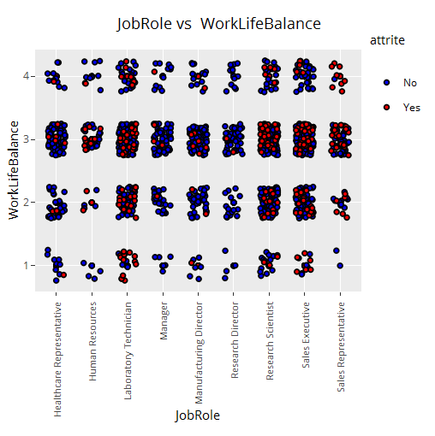
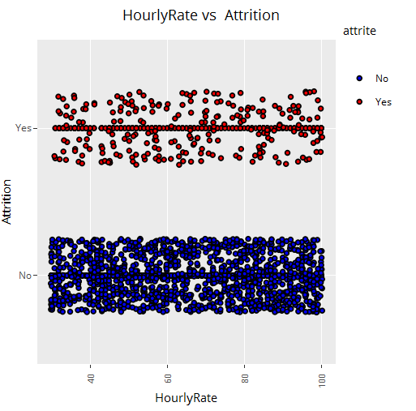
“STARS” Interactive Tool
Data Visualization
Exploratory Examples:
Hourly Rate?
Work-Life Balance?
ALL 1-to-1 combinations
Live Demo …

Slide 4
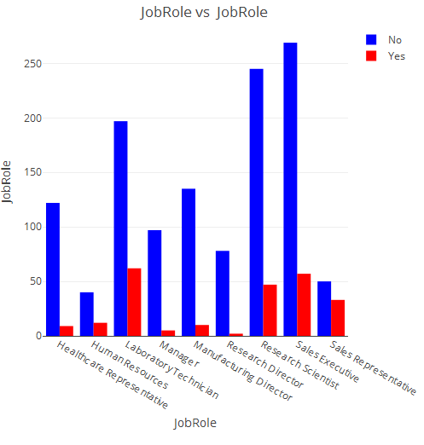
Job Role Specific Trends
Higher Attrition:
Sales Exec
Sales Rep
Research Scientist
Higher Attrition Rate within Field:
Laboratory Technician
Lower Attrition Rate within Field:
HR Representative

Slide 5
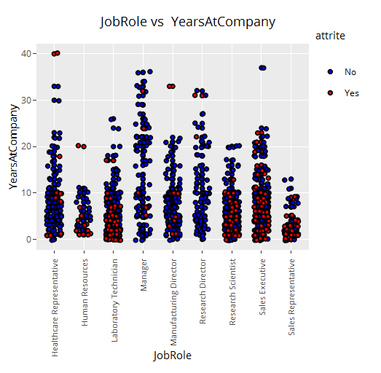
Job Role Specific Trends
Ex: Years at Company
Interesting Trends:
Managers tend to stay longer
Sales Reps tend to quit sooner
Sales Execs distributed evenly across both
“STARS” tool is very powerful and customizable…

Slide 6
Logistic Modeling
Produces binary outcome from dataset
Gives log of the odds of being a success
Model - 3 Runs to “drill” down to key factors
Statistics at-work:
Confidence interval testing – 0.001 significance
Results:
Bus Travel - Freq | Bus Travel - Rare | Overtime - Yes | Marital Status - Single | Satisfaction - High
393% | 150% | 376% | 265% | -28%

Slide 7
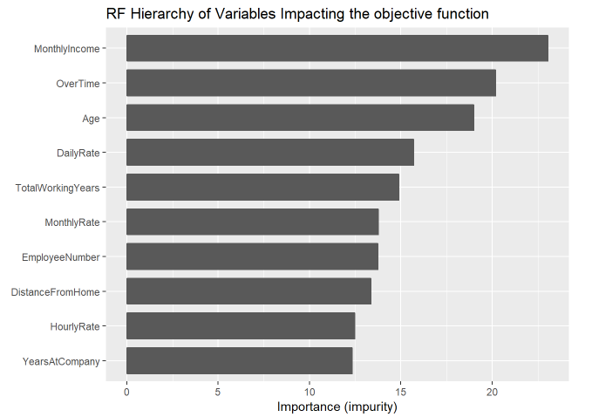
Machine Learning
Enhanced Analytics
Random Forest Model
500 permutations
15 sec. time interval
Deeper level of abstraction for advanced learning
Main factors that show up in samples as “important”:

Slide 8
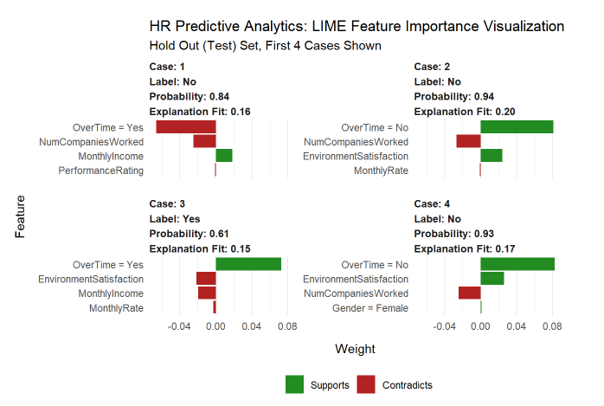
Machine Learning
Enhanced Analytics
H20 Binomial
“Cases” Identified
“Features” Learned
Weighting Associated

Slide 9
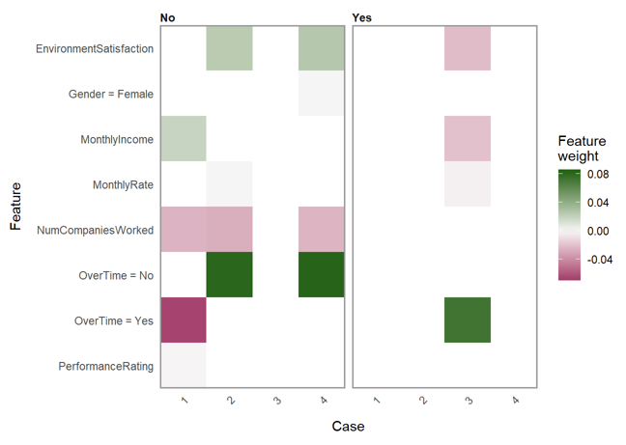
Machine Learning
Enhanced Analytics
Heat Map
What factors affect turnover?
Overtime
What factors help employees stay?
Satisfaction
Income
What has little affect?

Slide 10
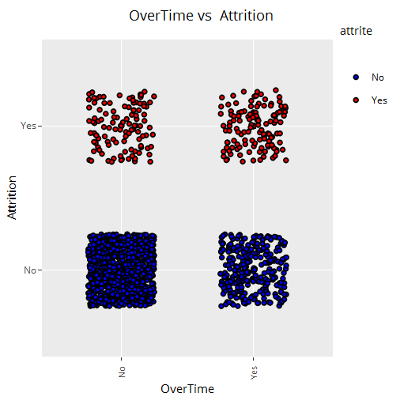
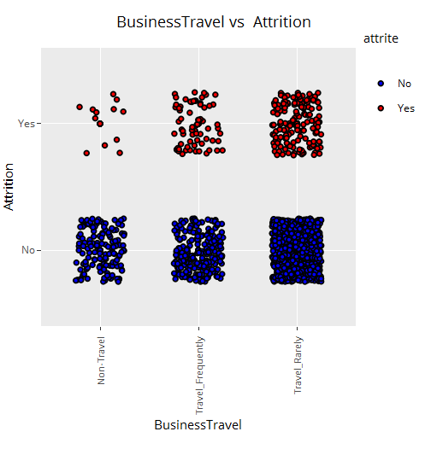
Top Factors
Overtime
Business Travel
Marital Status
Environmental Satisfaction
Income
# of companies worked for – low feature weight

Slide 11
Conclusions
What makes people want to leave?
What can be done to help people stay?
What factors don’t matter much at all?
Our analysis attacks the problem from two diffent directions:
Similar observations
Both broad and narrow insights
Reinforced and proven to be robust with customization
Turn insights into actions to help companies reduce turnover
We have demonstrated our proprietary data science and analytics techniques to help DDSAnalytics understand attrition in the workforce.
We have provided robust and enhanced data-driven insights for your team.

