Slide 1
ChocAn Data Center
Lav Patel - 300149807
Mohd Irfan Shaikh - 300149671
Pawan Pandey - 300130719
Notes:
NOTE:
To change the image on this slide, select the picture and delete it. Then click the Pictures icon in the placeholder to insert your own image.

Slide 2
INTRODUCTION

Slide 3
Project Summary
Purpose
Scope
Objectives
Deliverables

Slide 4
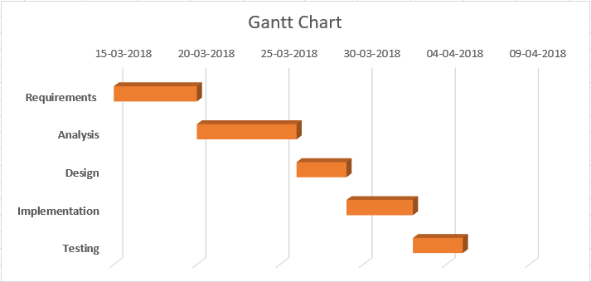
Schedule

Slide 5
What have we used?
The Graphical User Interface will be manufactured utilizing Java with the Swing structure to make it speedier and less demanding.
The reports and messages containing data on expenses and administrations will load data from databases.
Our item will be installed at an endpoint gadget, for example, in a workstation at the front work area of Chocoholics Anonymous.
The MySQL database will be kept in a database server introduced on premises.
We will be using Hibernate ORM which is an object-relational mapping tool for the Java programming language.
It helps us to provides a framework for mapping an object-oriented domain model to a relational database.

Slide 6
Project Glossary
Primary roles
Responsibilities

Slide 7
Functional Requirements
Validate Login
Insert Appointment Data
Validate Service Code
Generate Provider Directory
Generate Reports

Slide 8
Non-Functional Requirements
Performance
Availability
Recoverability
Security
Usability

Slide 9
USE case diagram

Slide 10
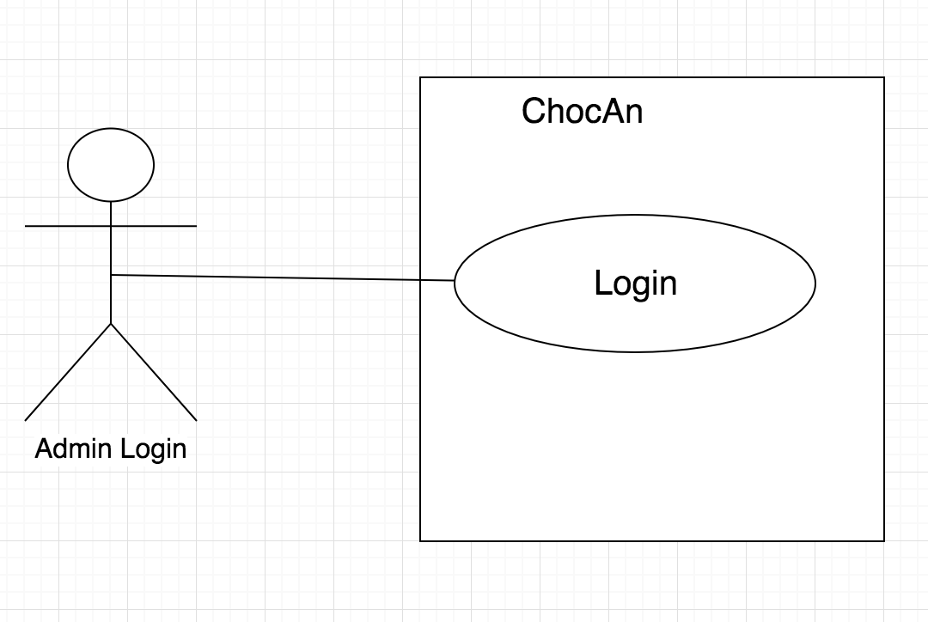
Admin login

Slide 11
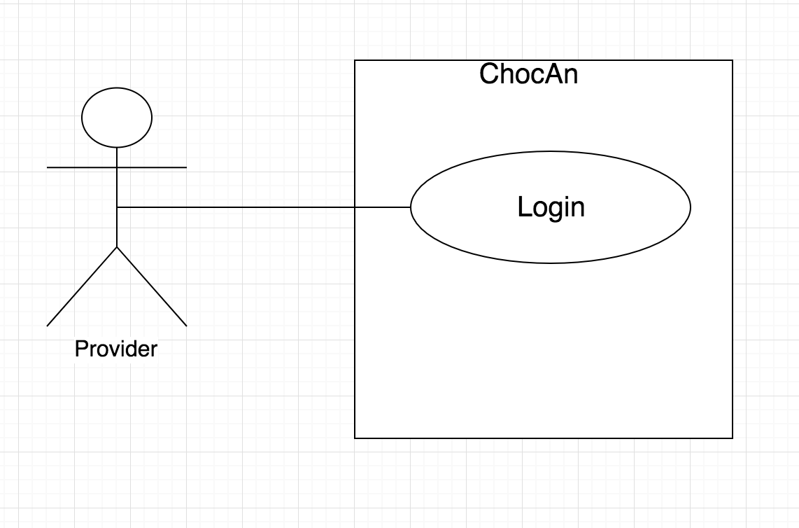
Provider login

Slide 12
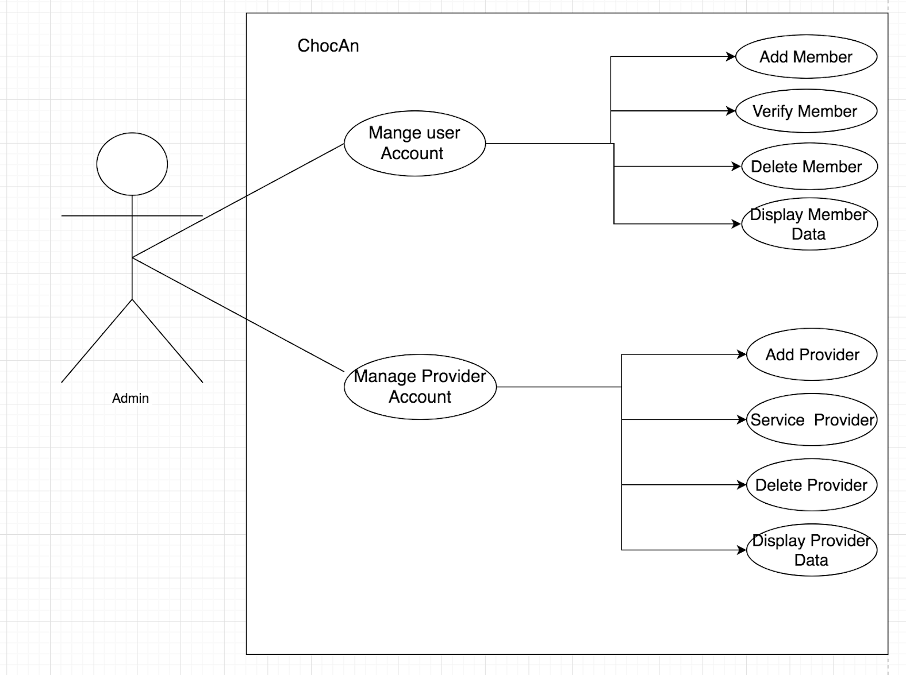
Admin performing various actions

Slide 13
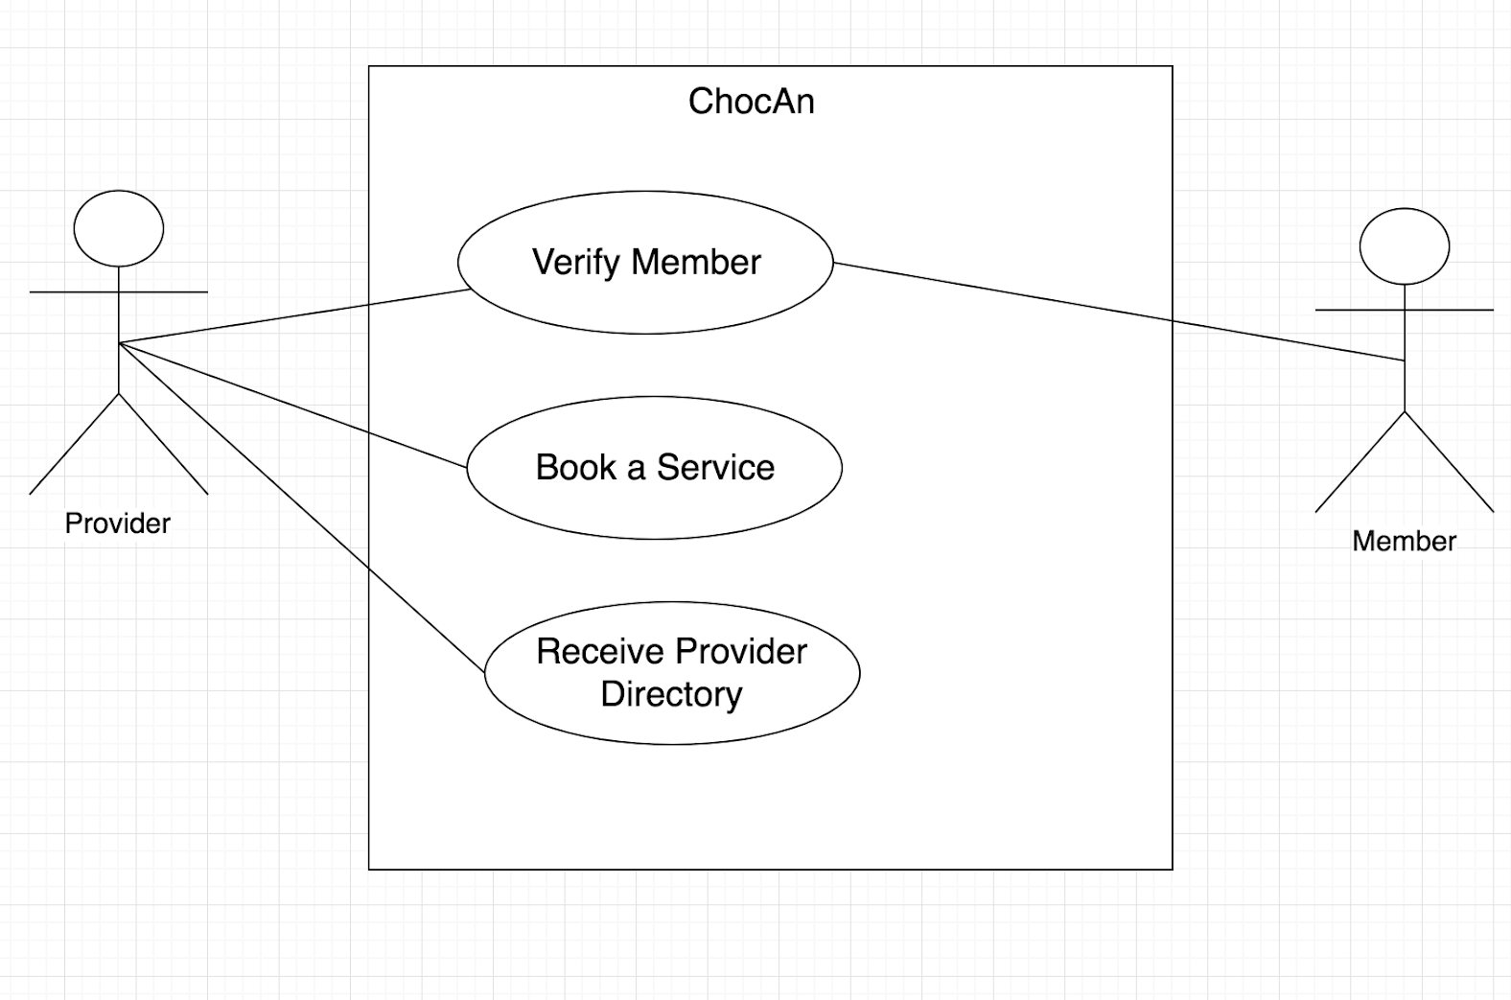
Provider verifying a member

Slide 14
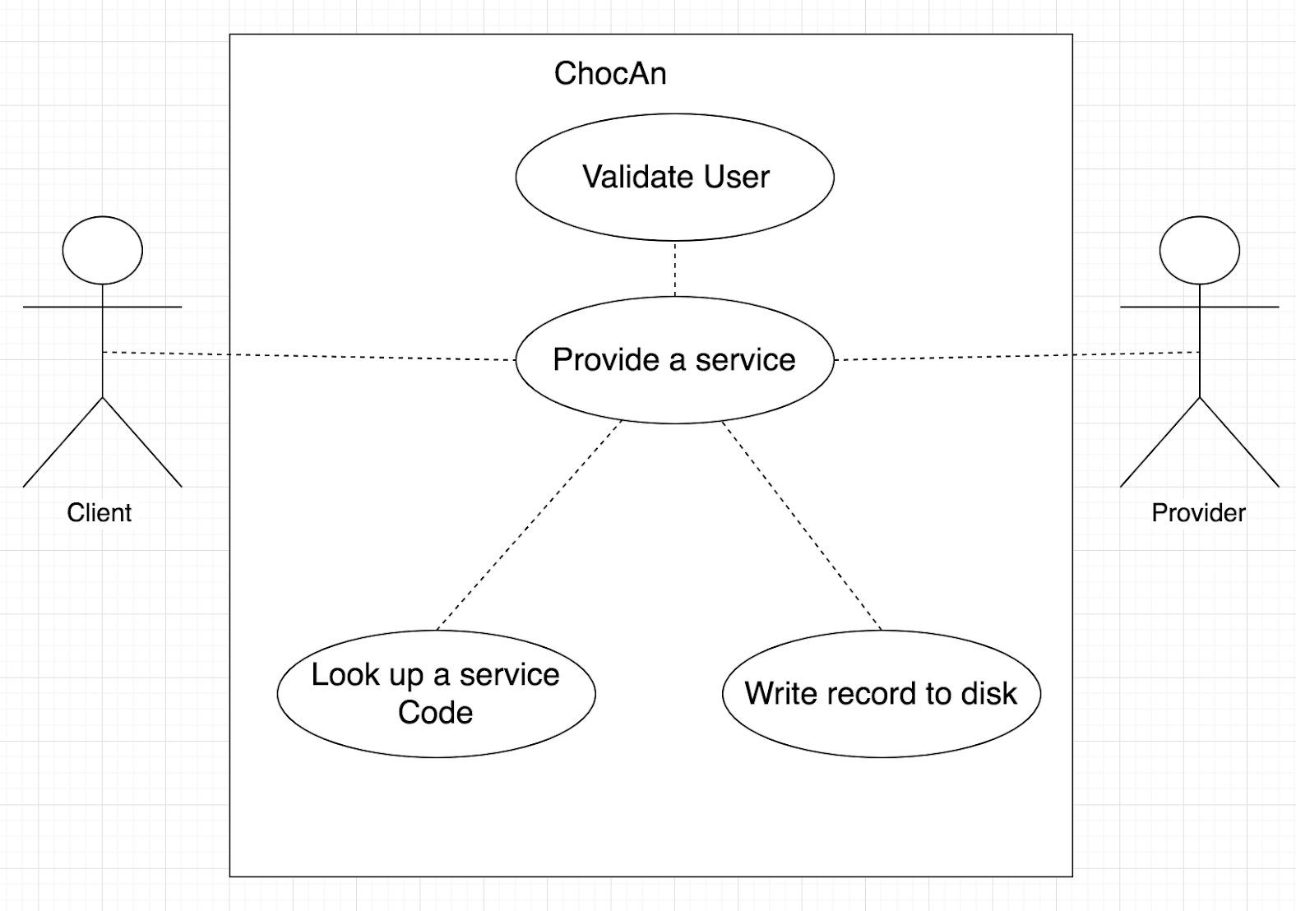
Provider providing services

Slide 15
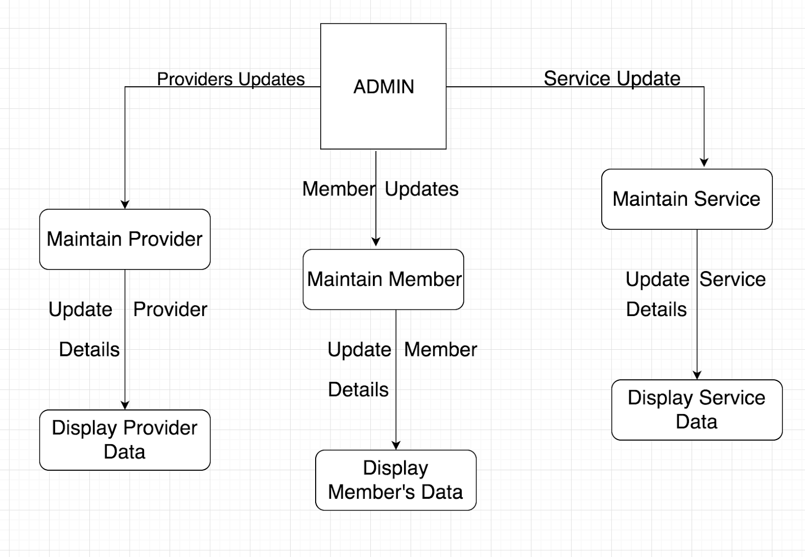
admin Data Flow Analysis

Slide 16
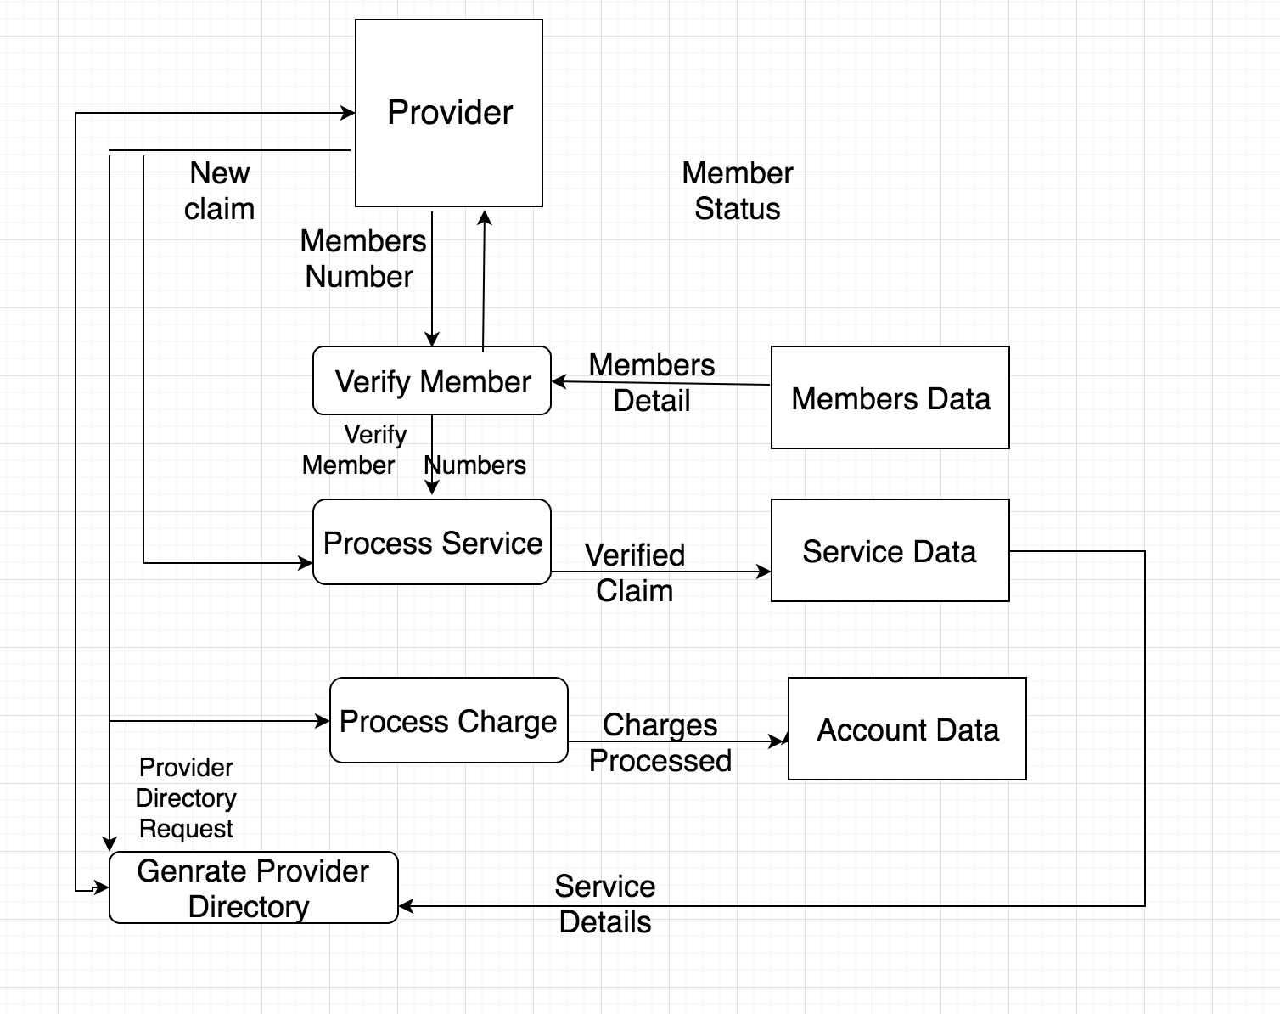
Provider Data Flow Analysis

Slide 17
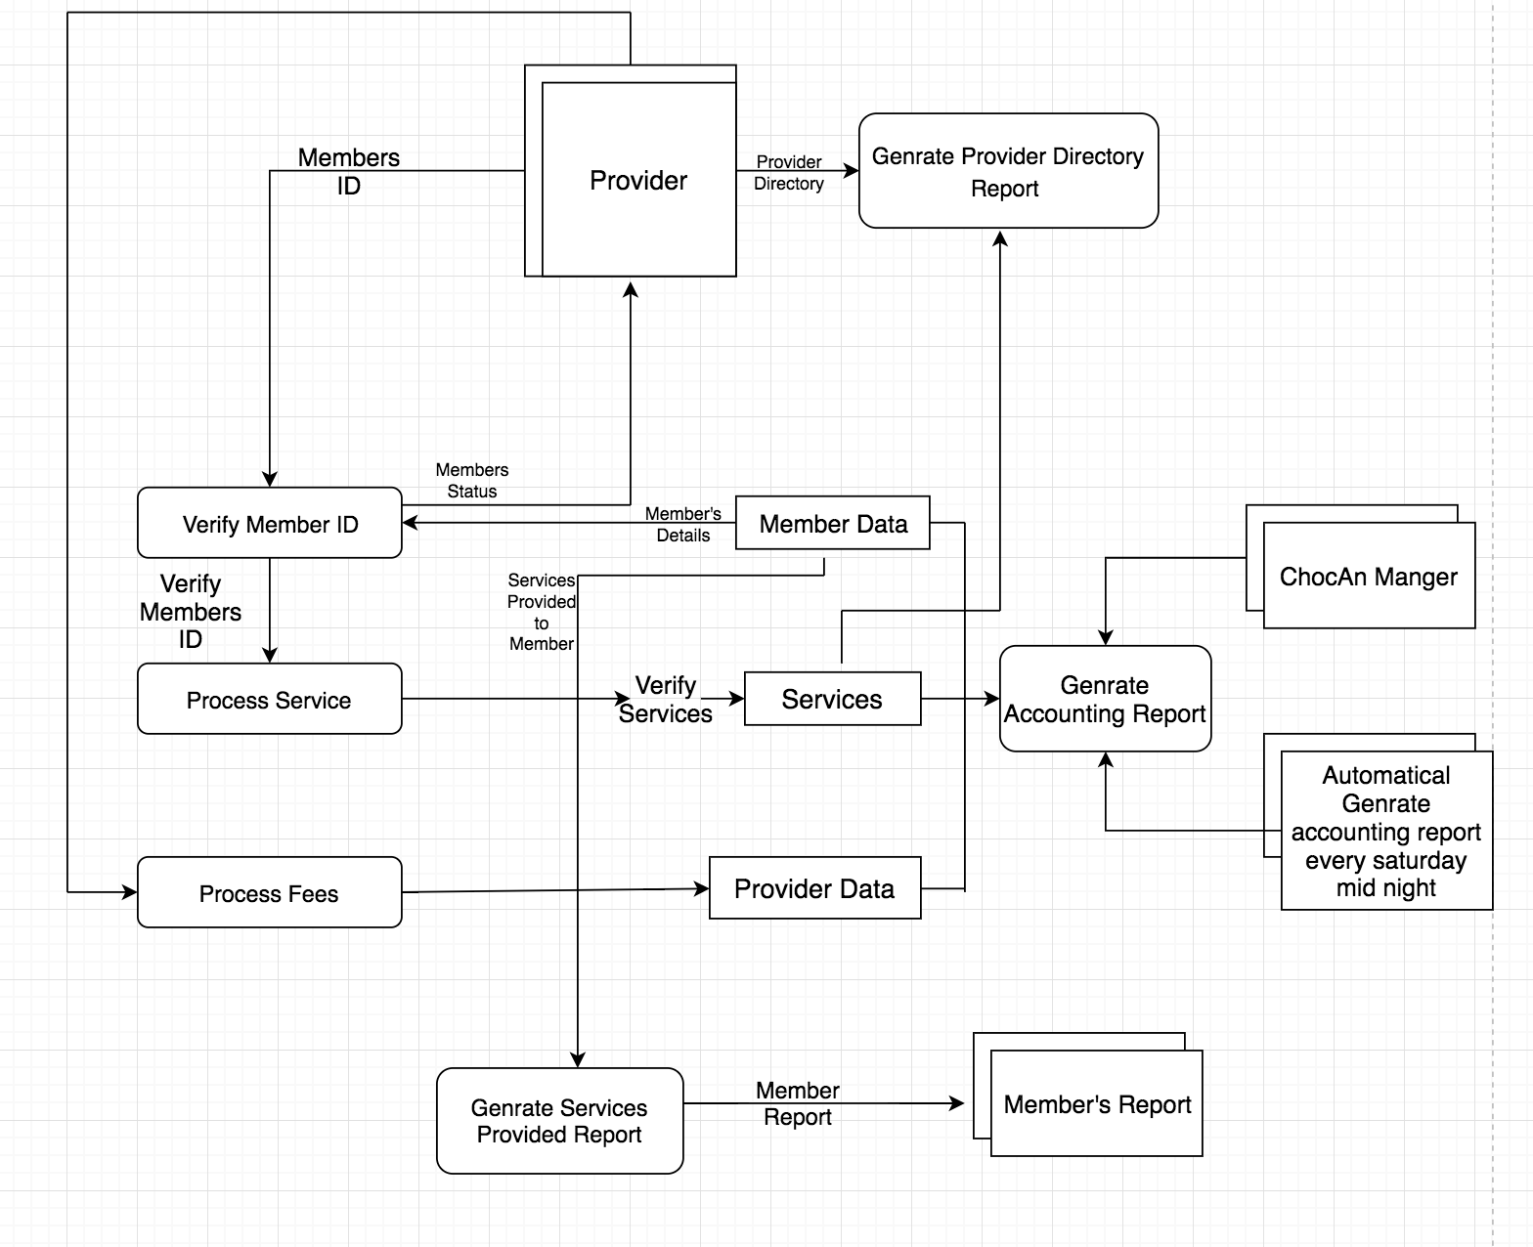

Slide 18
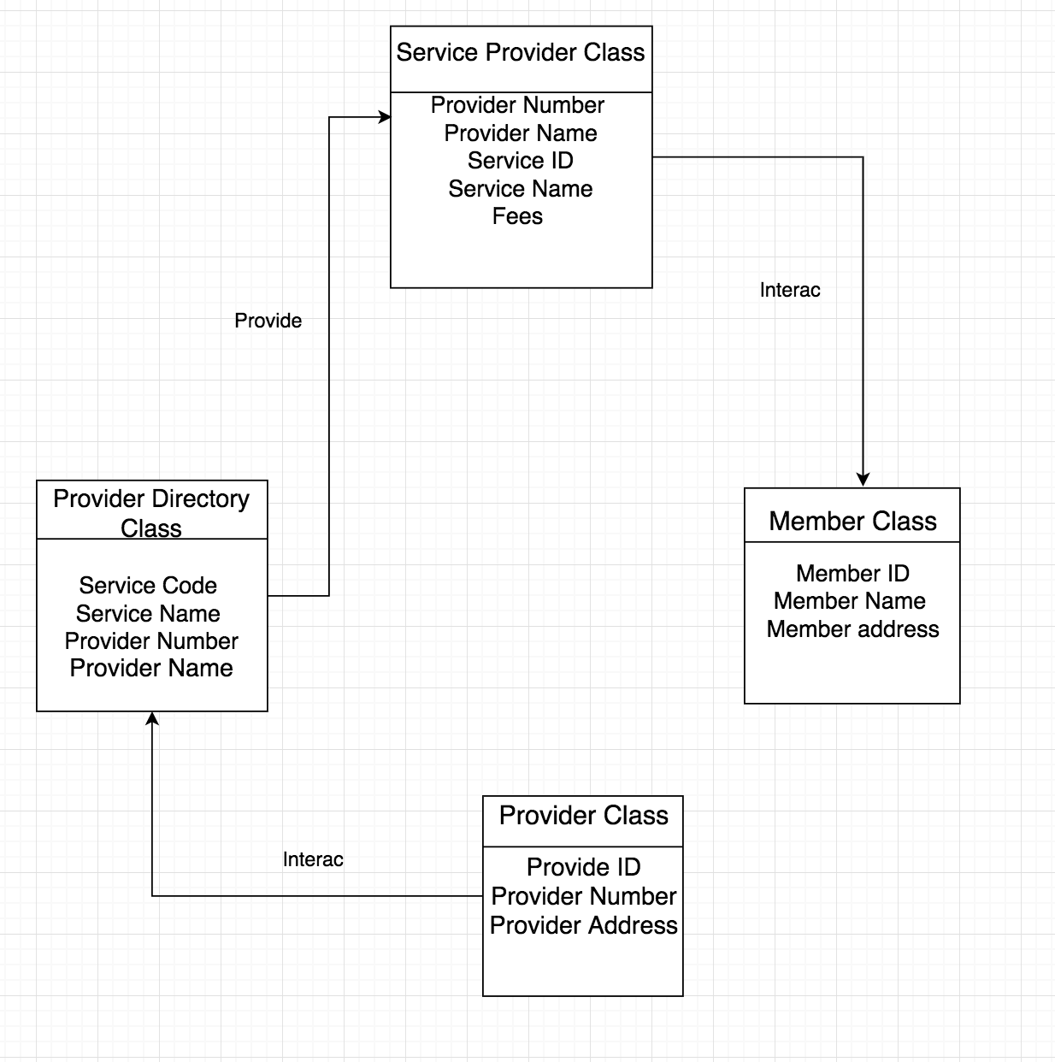
Class Diagram

Slide 19
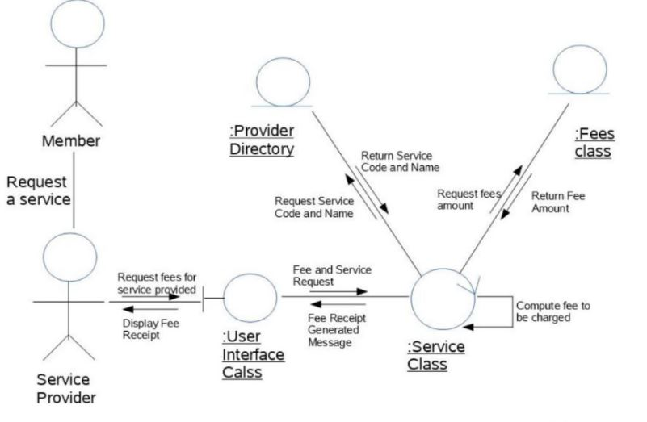
Provider Collaboration Diagram

Slide 20
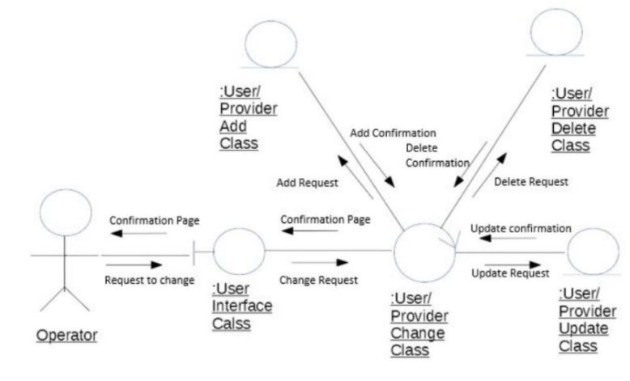
Manager Collaboration Diagram

Slide 21
DATABASE DESIGN

Slide 22
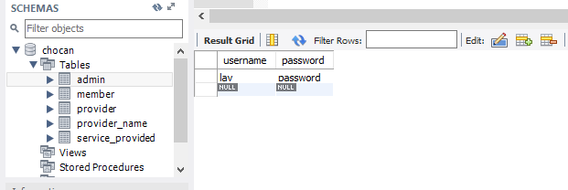
Admin

Slide 23
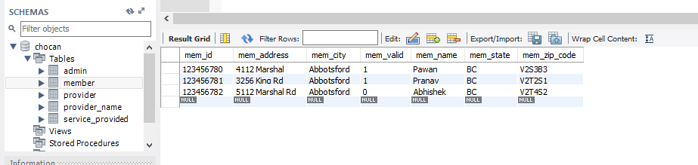
Member

Slide 24
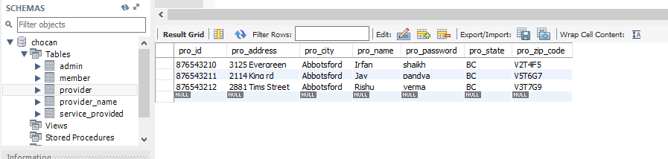
Provider

Slide 25
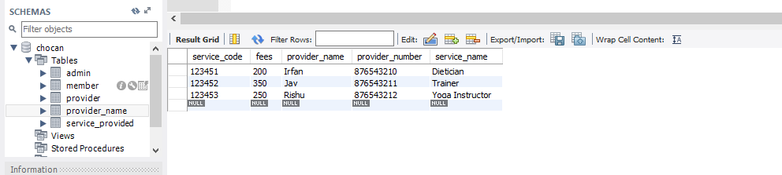
Provider Directory

Slide 26
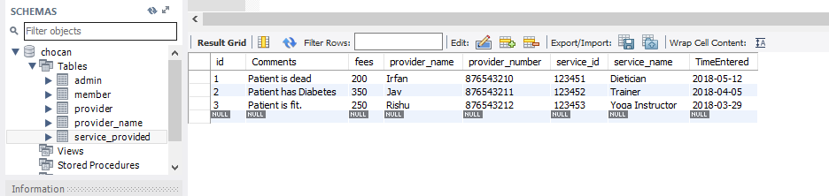
Services Provided

Slide 27
Implementation & Testing

