Slide 1

AIRTEL SYNC 2026 · DIGITAL TRACK (ENTERPRISE TRACK A)
Team Name: Aura
Team Members: Lavanya & Mehul Perimal
Project Udyam Digital
India's MSME Connectivity Journey, Simplified.
Product Vision: Connecting MSMEs in a Single Sitting (~10 Minutes)
THE SINGLE-SITTING ONBOARDING JOURNEY (PRODUCT VISION):
1. Rule-Grounded AI Advisor -> Vernacular needs discovery (Hindi & English)
2. Right-Fit Bundling -> Broadband, SIMs, Cloud & CCTV in one bill
3. Instant Smart KYC -> Sub-second GSTIN lookup with local vision QA
4. Provisioning Tracker -> 5-stage milestone simulation (demonstration model)
Designed for India's 6.3 Crore MSME Ecosystem | Addressing 17.6-day sales cycle via digital self-serve

Slide 2

THE MSME ACQUISITION BOTTLENECK
Current MSME Acquisition: High Friction, Low Conversion
Forensic analysis of 5,000 SMB leads reveals a broken sales cycle where 92.6% of generated leads do not activate
7.36% ACTIVATION RATE
Only 368 of 5,000 leads activate
Rs. 15,053 BLENDED CAC
Rs. 5.54M total sales spend across cohort
17.62 DAYS VELOCITY
Average 3.01 customer status chase calls
ACTUAL MSME FUNNEL PROGRESSION
(5,000 LEADS)
1. Leads Generated: 5,000 | 100.0% (Starting Cohort)
2. Contacted: 3,406 | 68.1% (-1,594 unreachable / no time)
3. Needs Assessed: 1,974 | 58.0% (-1,432 visit unscheduled)
4. Quote Accepted: 861 | 43.6% (-1,113 STEEPEST DROP!)
5. KYC Complete: 588 | 68.3% (-273 paperwork / doc trap)
6. Fully Activated: 368 | 62.6% (-220 install delay / cancel)
* Steepest drop occurs from Needs Assessed to Quote Accepted (56.4% drop) due to 5-day quote delays & telco jargon.
KEY IDENTIFIED DROP-OFF DRIVERS
Scheduling Friction (827 leads):
Owner had no time for visit (531), visit unscheduled by rep (296).
Quote Delays & Jargon (385 leads):
Quote too complex to decipher (206), took 3-5 days to arrive (179).
KYC Documentation (220 leads):
Missing GST/Udyam doc (94), paperwork too long (79), mismatches (47).
Install Delays & Churn (151 leads):
Install delayed >21 days (98), customer cancelled pre-install (53).
KEY TAKEAWAY:
Scheduling and KYC documentation account for 1,047 identified drop-offs, highlighting significant opportunities for digital self-service.

Slide 3
CORE PRODUCT ARCHITECTURE
Project Udyam Digital: Architecture of Frictionless Acquisition
Replacing multi-week sales cycles with an intelligent, self-service single-sitting onboarding journey.
1. Rule-Grounded AI Advisor
Vernacular Needs Discovery
• Discovers needs in plain Hindi & English
• Translates shopkeeper needs into tech
• Recommends tailored 3-tier bundles
• Deterministic rule engine matching needs
2. Dynamic Bundle Engine
Transparent Pricing & Rules
• Powers 25 enterprise SKUs from catalogue
• Enforces strict dependency graph rules
• Validates GSTIN requirement across 10 SKUs
• Single consolidated monthly bill + setup
3. Instant Smart KYC
Local Vision Pre-Checks
• Instant mock GSTIN & Udyam registry lookup
• Laplacian blur variance filter (K04)
• Freshness validation (<90 days case rule)
• DPDP 2023 affirmative consent & in-memory QA
4. Post-Order Tracker
Proactive Milestone SLA
• 5-stage provisioning state machine simulation
• Simulated technician assignment & slot
• Proposed automated WhatsApp milestone simulation
• Addresses baseline of 3.01 status-chase calls
O2O CHANNEL PARTNER & FIELD FORCE SYNERGY (ASSISTED DIGITAL MODEL)
Instead of competing with local retail dealers and field agents, Project Udyam Digital equips them with digital attribution QR codes and back-office drop-recovery queues. Proposed model: Partners earn recurring commissions while offloading manual documentation, shifting from paper pushers into trusted digital advisors.

Slide 4
USER EXPERIENCE & PROTOTYPE DESIGN
Intuitive, Mobile-First Prototype Experience
Proposed prototype screen designs engineered for 375px mobile viewports with bilingual Hindi/English support.
1. Rule-Grounded Conversational Advisor
Chat-style bilingual advisor interface: 'Namaste! How many staff work at your clinic?' Quick suggestion chips for zero typing.
2. Recommended Bundles
3 transparent cards (Starter Rs. 1,298, Growth Rs. 2,597, Pro Rs. 6,896) with plain-language business rationales.
3. Modular Quote Builder
Interactive toggles for add-ons: Cloud CCTV (+Rs. 249), Static IP (+Rs. 200). Live total updates; zero hidden clauses.
4. Instant Registry Check
GSTIN & Udyam entry triggers sub-second lookup; displays green 'Active' badge and auto-fills business details.
5. Smart KYC Image Quality
Auto-checks orientation (K02); intercepts blurry docs via Laplacian filter (K04) and expired bills (K11 >90-day case rule).
6. Provisioning Tracker
5-stage visual progress timeline simulation with demonstration technician assignment and appointment slot.
* Proposed prototype interface specifications. Designed for zero-training adoption by non-technical Indian proprietors.

Slide 5
SYSTEM ARCHITECTURE & PRIVACY
Modular Monolith Architecture with Privacy-by-Design
Decoupled FastAPI backend, local vision image-quality pre-checks, and DPDP Act 2023 technical alignment.
SYSTEM COMPONENT TOPOLOGY
Presentation Tier: React 18, TypeScript, Tailwind CSS, Bilingual i18n
API Gateway Tier: Python FastAPI, CORS middleware, Pydantic validation
Core Service Modules: Advisor Adapter (deterministic rule mapping), Catalog Engine (25 SKUs), Smart KYC Orchestrator, Order State Machine Simulation
Offline Registry Engines: Indexed Mock GSTIN (3,534 records), Mock Udyam (2,723 records), Local Computer Vision Pre-Checks (Laplacian blur variance + aspect QA)
Persistence & Privacy: SQLite (Local MVP) / PostgreSQL (Cloud), Ephemeral in-memory document processing, ISO 8601 UTC audit logging
DPDP ACT, 2023 PRIVACY ALIGNMENT CONTROLS
Affirmative Consent (Sec 6): Unbundled, explicit checkboxes in Hindi & English; recorded UTC consent timestamp and SHA-256 IP hash logging.
Notice & Purpose Specification (Sec 5): KYC data processed strictly for statutory telecom provisioning; zero secondary commercial monetization.
Data Minimisation (Design Principle): No GSTIN required for retail broadband; only minimum statutory ID and supply address captured.
Third-Party AI Data Sharing: Server-side ephemeral in-memory processing; customer documents are not transmitted to external third-party AI APIs.
Storage Limitation (Sec 8): Ephemeral in-memory verification model without persistent storage of unnecessary sensitive document images.
PII Masking & Sanitation: Synthetic records used in the demo; production-grade masking and role-based access controls require further hardening.

Slide 6
UNIT ECONOMICS & VALUE CREATION
Sustainable Unit Economics & Quantified Business Impact
Targeting customer acquisition cost optimization while accelerating self-serve conversion and recurring ARPU.
BASELINE FUNNEL (ACTUAL DATASET) VS. PROJECT UDYAM DIGITAL TARGETS
Funnel Conversion Rate: | Base: 7.36% (368 / 5,000 leads) -> Target: 18.5% – 22.0% (Projected) | Removes visit scheduling friction & 5-day quote wait
Blended CAC per Activated SMB: | Base: Rs. 15,053 per activation -> Target: Rs. 4,200 – Rs. 4,500 (Target) | Shifts from feet-on-street to zero-touch digital self-serve
Average Activation Velocity: | Base: 17.62 Days (Median: 17d) -> Target: 2.5 – 3.5 Days (Target) | Sub-second digital KYC pass-through & instant scheduling
Status Chasing Inbound Calls: | Base: 3.01 Calls per customer -> Target: < 0.5 Calls (Target) | Proposed visual milestone tracker & notification updates
6-Month Customer Churn: | Base: 15.22% (56 / 368 churned) -> Target: < 7.5% (Projected) | Needs-based right-fit recommendation vs sales quota pitching
Recurring ARPU Expansion
Broadband + SaaS Subscriptions
Generates predictable monthly cash flows: Micro retail averages Rs. 2,470/mo, professional offices average Rs. 6,796/mo, multi-site businesses reach Rs. 31,233/mo on a single bill.
High-Margin Cross-Selling
SaaS, Security & CCTV Add-ons
Modular upsells like Cloud Backup (P17), Endpoint Security (P20), and Cloud CCTV (P23) Projected gross margin: >70%, with zero incremental field visit costs.
Assisted Digital O2O Synergy
Channel Partner Commissioning
Proposed model: Local retail dealers and field agents earn a 12% recurring revenue share on digital QR sign-ups. Projected payback period: 1.8 months (vs. 6.1-month baseline).

Slide 7
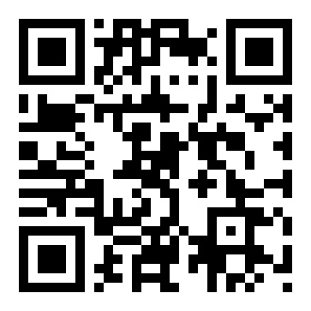
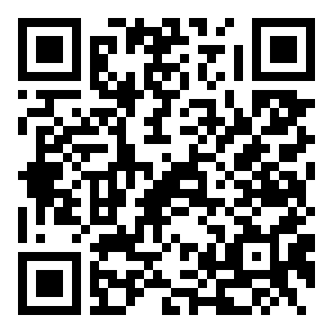
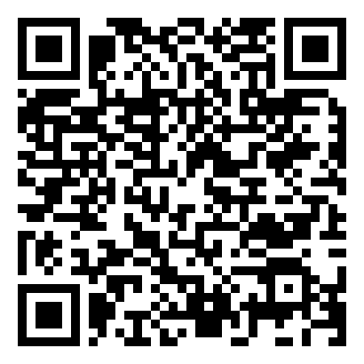
ROADMAP & STRATEGIC VISION
90-Day Execution Roadmap & Vision for India's MSMEs
Structured rollout roadmap delivering enterprise-scale digital adoption across Tier 1 and Tier 2 clusters.
Phase 1: Days 1–30
Core MVP Foundation
• Deploy FastAPI modular backend
• Ingest 25 SKUs & dependency rules
• Index mock GSTIN & Udyam registries
• Build mobile React wizard with i18n
Phase 2: Days 31–60
Smart KYC & Vision
• Local blur detection (Laplacian QA)
• In-memory ephemeral verification
• Pass K01-K12 synthetic test harness
• Order state machine simulation API
Phase 3: Days 61–90
Pilot & Partner Co-Pilot
• 2-city pilot (Jaipur Tier 2 & Kolkata)
• Deploy Partner attribution QR console
• Drop-recovery queue for field reps
• Measure self-serve adoption & lift
WHY PROJECT UDYAM DIGITAL MATTERS
Project Udyam Digital is designed to bridge enterprise telecom services with India's 6.3 crore MSME ecosystem. By replacing paper friction with conversational discovery and multi-week delays with instant digital trust, our vision is to turn high-friction acquisition into a simplified single-sitting digital journey.
Strategic Priorities: [ Designed for India's 6.3 Cr MSME ecosystem] [ Product Vision: ~10-Min Onboarding ] [ Rule-Grounded Needs Mapping ] [ DPDP Act 2023 Technical Alignment ]
PROJECT RESOURCES
Scan QR code or click resource label to access live assets.
LIVE APPLICATION
SOURCE CODE
PRODUCT DEMO
Explore the Live Prototype
Explore the GitHub Repository
Watch the 3-Minute Product Demo

