Slide 1

Healthcare Data Analytics & Insights
Tools used: Tableau, Power BI, SQL, Excel
Group Members :
Lav Dubey
Dev Jyoti Chand
Abhishek Gupta
Ayush Sonar

Slide 2
Agenda
1
Introduction
Scope, dataset, timeline
2
KPI Analysis
Seven focused KPIs with visualizations
3
Key Findings
Operational and clinical insights
4
Recommendations
Actionable next steps
5
Dashboard
Interactive view of all KPIs
6
Conclusion
Summary and priorities

Slide 3
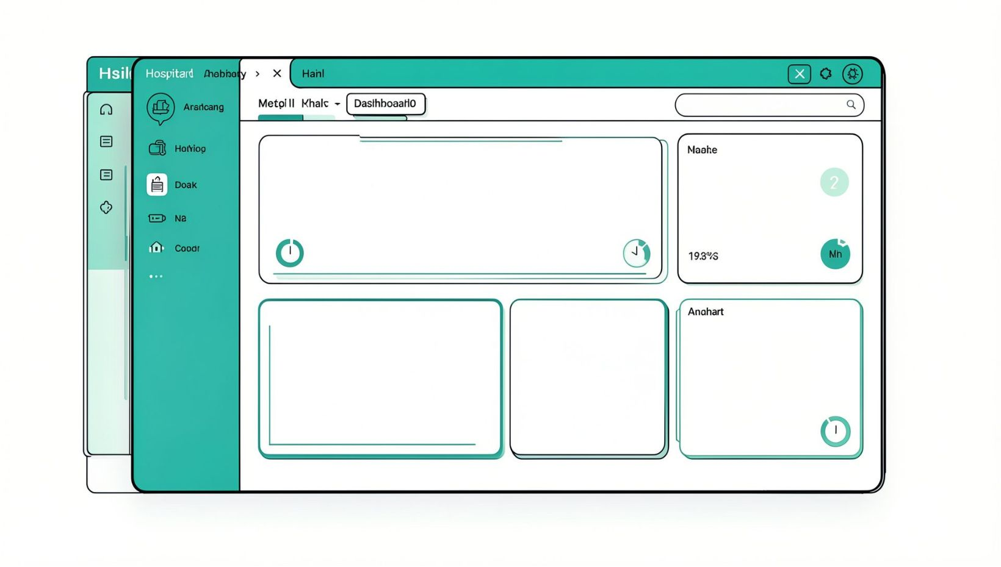
Introduction
• Dataset: 10,000 unique patients across 2023–2025
• Focus: patient volume, diagnoses, billing, test outcomes, follow-ups
• Scope: five departments — General Medicine, Cardiology, Pediatrics, Neurology, Orthopedics
• Deliverables: 7 KPIs, visualizations, interactive dashboard, recommendations
• Objective: drive care quality, operational efficiency, and cost control

Slide 4

KPI 1 — Total No. of Patients
Key points
Base population: 10,000 patients (foundation for all KPIs)
Diagnosis counts and monthly visits each sum to 10,000 — one diagnosis and one visit recorded per patient
Action: enable identifiers for repeat visits to measure retention and chronic-care burden
Use case: capacity planning for clinicians, beds, labs, and outpatient slots
10,000
Patients

Slide 5
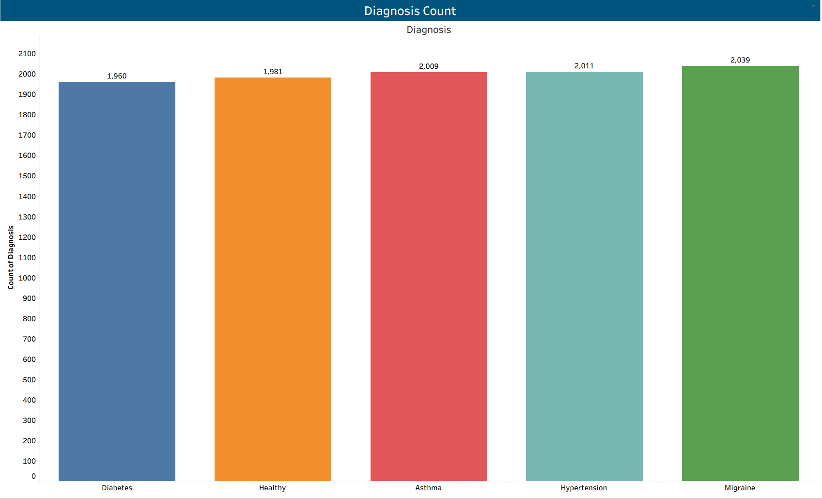
KPI 2 — Diagnosis Count
Key points
Counts: Migraine 2,039; Hypertension 2,011; Asthma 2,009; Healthy 1,981; Diabetes 1,960
Distribution: nearly equal across five categories (~20% each)
Long-term conditions (Diabetes, Asthma, Hypertension) total 5,980 patients (60%)
Recommendation: chronic-care programs, scheduled check-ups, targeted outreach

Slide 6
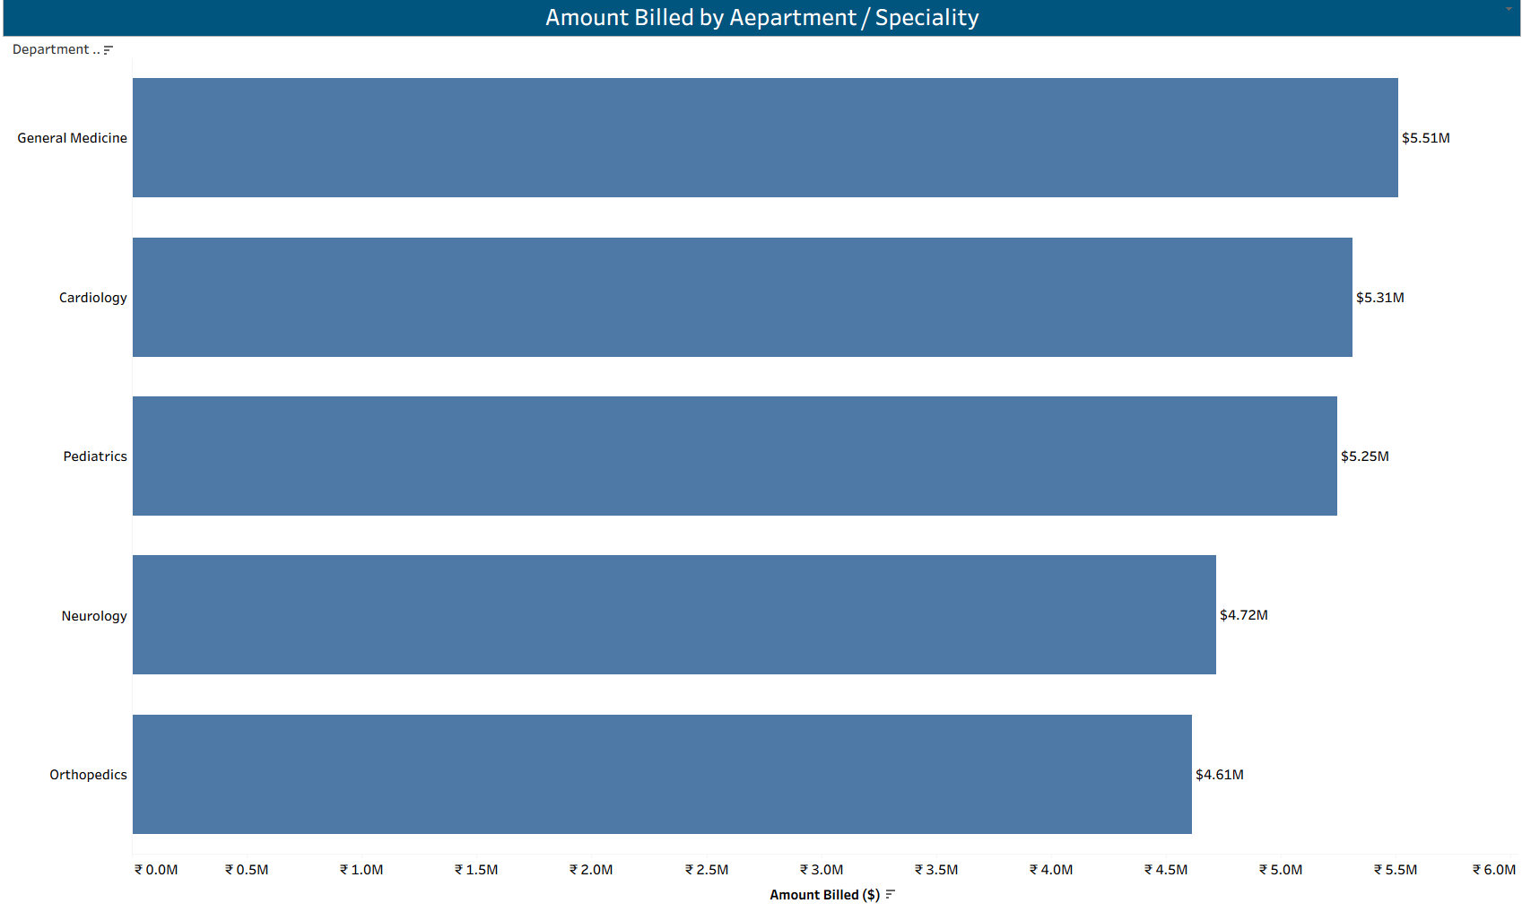
KPI 3 — Amount Billed by Department
Key points
Billing totals: General Medicine $5.51M; Cardiology $5.31M; Pediatrics $5.25M; Neurology $4.72M; Orthopedics $4.61M
Top three departments ≈ 63% of total billing (total ≈ $25.4M)
Investigate whether lower billing reflects volume or pricing differences
Opportunity: promote Neurology & Orthopedics through service bundles and referral pathways

Slide 7
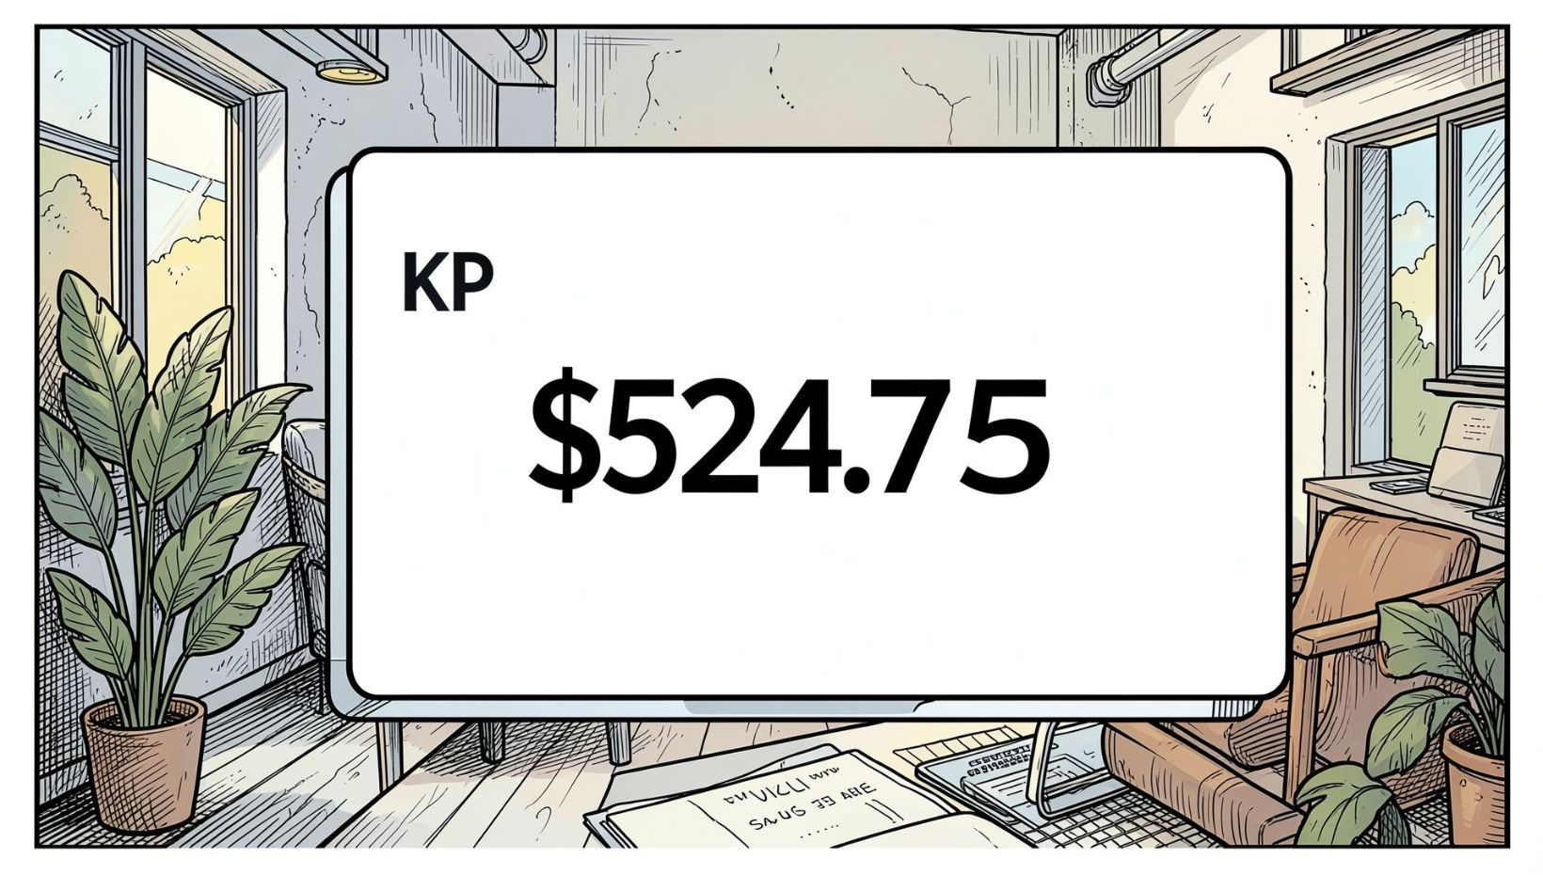
KPI 4 — Average Treatment Cost
Key points
Average treatment cost: $524.75 per patient
Use as benchmark for cost control and pricing reviews
Action: decompose by department and diagnosis to identify high-cost drivers
Cross-check outcomes vs cost to preserve care quality while reducing waste

Slide 8
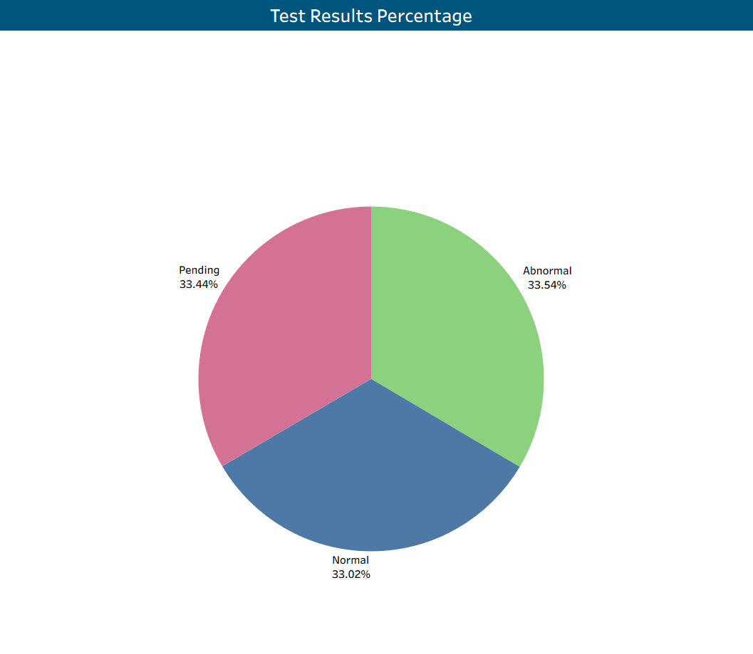
KPI 5 — Test Results Percentage
Key points
Distribution: Abnormal 33.54% (3,354); Pending 33.44% (3,344); Normal 33.02% (3,302)
One-third of results pending — delays risk treatment deferral and lower satisfaction
One-third abnormal — requires prioritized clinician review and care pathways
Recommend automated alerts, SLAs for lab turnaround, and prioritization for abnormal results

Slide 9
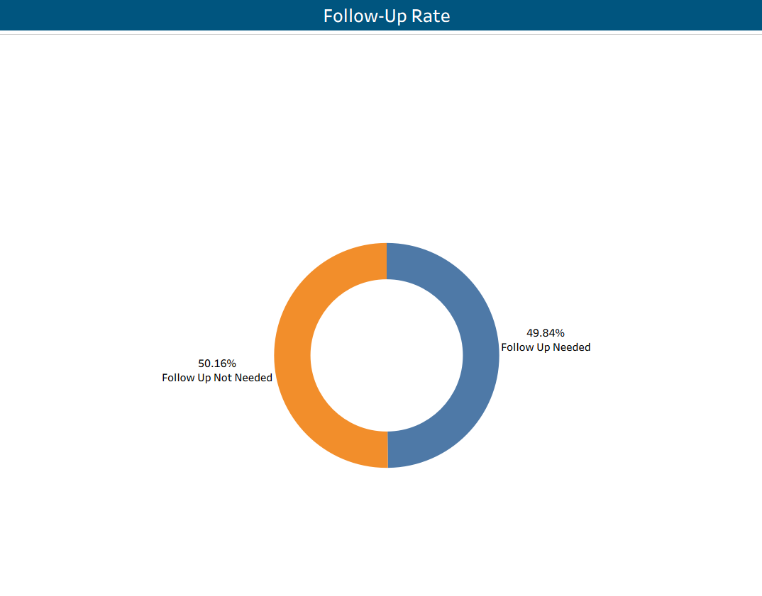
KPI 6 — Follow-up Rate
Key points
Follow-up required: 49.84% (~4,984 patients); No follow-up: 50.16%
Half the population needs continued care — impacts scheduling and outpatient demand
Missed follow-ups risk complications and lost revenue
Improvement: automated reminders (SMS/WhatsApp/Email), track completions, flag pending/abnormal results for outreach

Slide 10
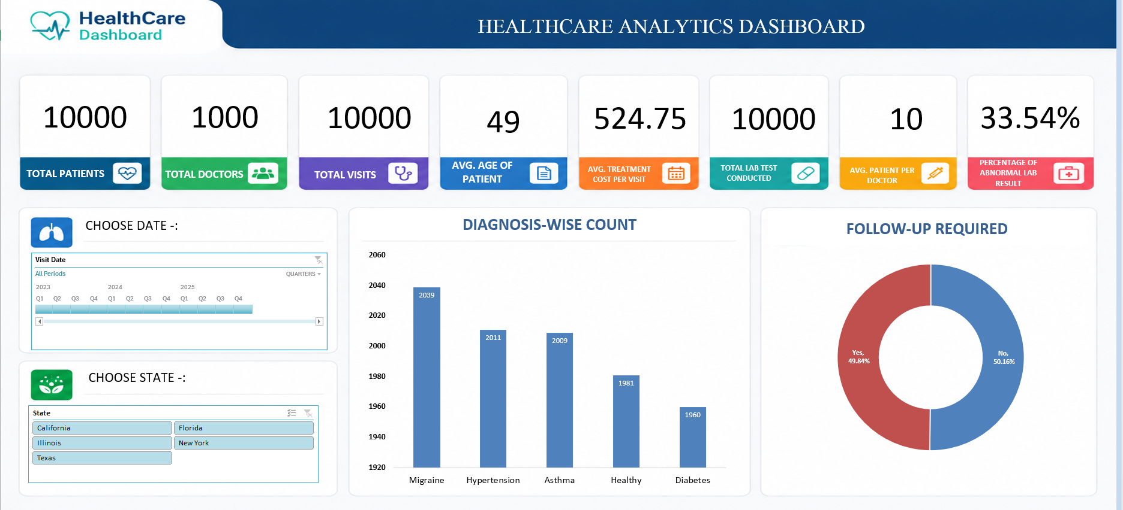
EXCEL DASHBOARD

Slide 11
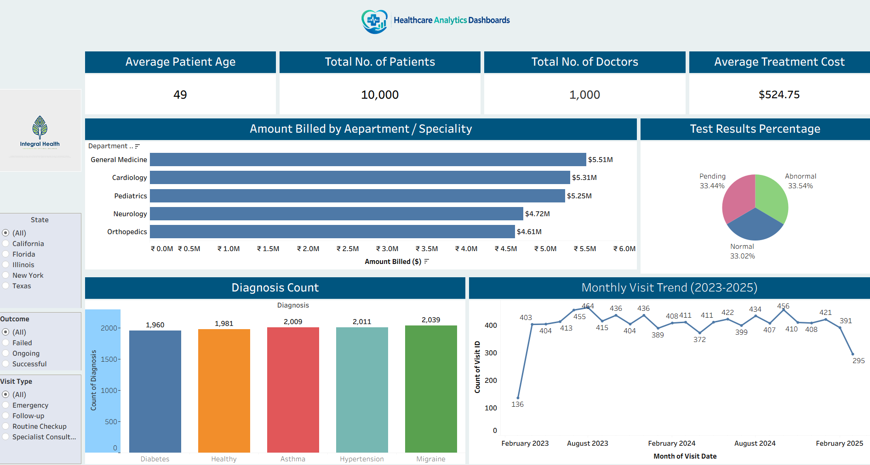
TABLEAU DASHBOARD

Slide 12
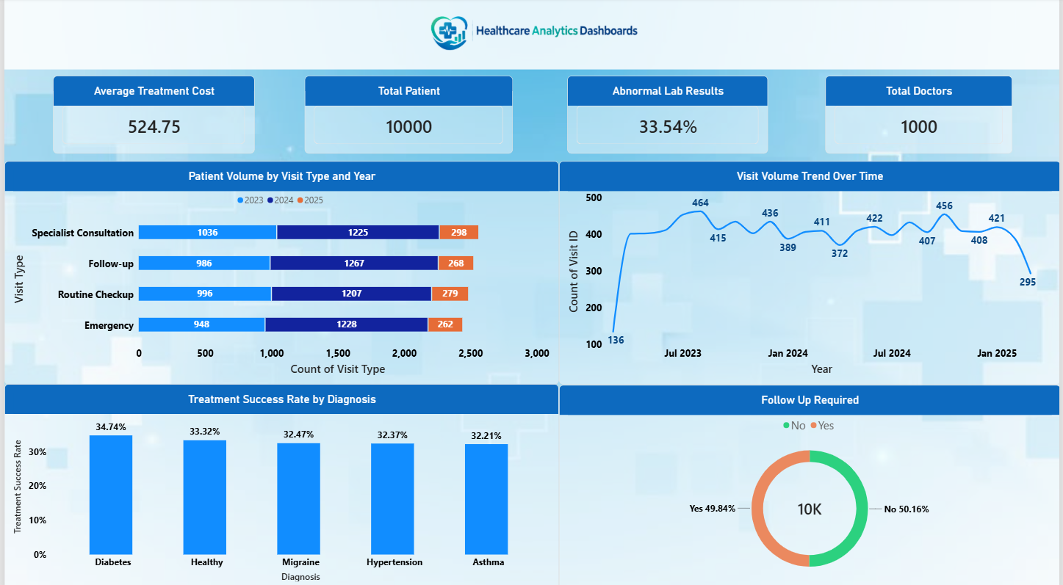
POWER-BI DASHBOARD

Slide 13
SQL Queries
-- 1. Data Count Validation
-- Total Patient
SELECT COUNT(*) FROM Patient_details;
-- Total Visits
SELECT COUNT(*) FROM Visit_details;
-- Total Treatmment Count
SELECT COUNT(*) FROM Treatment_details;
-- Total Lab Results
SELECT COUNT(*) FROM Lab_Results;
-- 2. Data Completeness Check
-- Identify missing or null values in key columns.
SELECT * FROM Patient_details WHERE First_Name IS NULL OR LastName IS NULL;
SELECT * FROM Visit_details WHERE Visit_Type IS NULL OR Visit_Date IS NULL;
SELECT * FROM Treatment_Details WHERE Treatment_Name IS NULL OR Status IS NULL;
SELECT * FROM Lab_Results WHERE Test_Name IS NULL OR Test_Result IS NULL;
-- 3. Data Consistency Check
-- Ensure data relationships are consistent across tables.
SELECT visit_details.Visit_ID, visit_details.Patient_ID, patient_details.Patient_ID
FROM Visit_details
LEFT JOIN Patient_details ON visit_details.Patient_ID = patient_details.Patient_ID
WHERE patient_details.Patient_ID IS NULL;
SELECT treatment_details.Treatment_ID, treatment_details.Visit_ID, visit_details.Visit_ID
FROM Treatment_details
LEFT JOIN Visit_details ON treatment_details.Visit_ID = visit_details.Visit_ID
WHERE visit_details.Visit_ID IS NULL;
-- 4. Duplicate Records Check
-- Identify duplicate entries in key tables.
SELECT Patient_ID, COUNT(*)
FROM Patient_details
GROUP BY Patient_ID
HAVING COUNT(*) > 1;
SELECT Visit_ID, COUNT(*)
FROM Visit_details
GROUP BY Visit_ID
HAVING COUNT(*) > 1;

Slide 14
Next Steps & Recommendations
Data & Tracking
Clinical Prioritization
Operational Efficiency
Revenue Optimization
Enable patient IDs for repeat visits; track longitudinal care and readmissions.
Auto-alerts for abnormal and pending tests; fast-track diagnostics.
Use patient-volume forecast for staffing and lab capacity planning.
Analyze Neurology/Orthopedics pricing & volumes; design targeted service bundles.
Patient Engagement
We can implement automated reminders for patients and use a completion dashboard
to track whether they have completed their follow-up activities.
Priority: reduce pending test rate and improve chronic-care outreach in first 90 days

Slide 15
Conclusion
Analysed 10,000 patients, with about $25.4M billed and an average treatment cost of $524.75.
The patient base is steady, and diagnoses are evenly spread across all categories.
General Medicine, Cardiology and Pediatrics generate about 63% of total billing.
One-third of test results are still pending, and one-third are abnormal.
Almost half of the patients (49.84%) need follow-up care.
Monthly visits are stable at about 400 to 460 but not growing.
Neurology and Orthopedics bill the least, so they have the most room to improve.
Speeding up test reports, strengthening follow-ups, focusing on chronic-care patients and promoting the lower-billing departments will improve patient care, control costs and support steady growth.

Slide 16

THANK YOU

