Slide 1
JohnRMcCravyIII-chatbot
Luke Watson

Slide 2
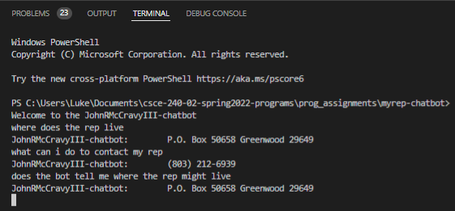
Project Presenter Name: Luke Watson
Student Name: Luke Watson
Queries Snapshot:
Scope: District 13, Java
Data: The program takes data from a downloaded file of the representative's page.
Code Organization: The program is organized as the following.
PA1: extractor
PA2: processor
PA3: ui
PA4: userintent2querymapper
PA5: sessionlogger
My experience implementing the chatbot:
- Design

