Slide 1
TractorTEK
Funmilayo Lawal

Slide 2
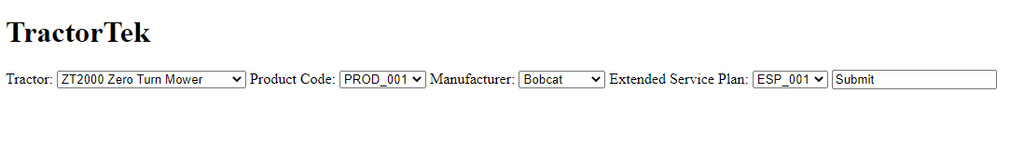
Web App UI
Captures Sales orders in real time
Choose type of tractor/product code/manufacturer/extended service plan
Prices not included due to unknown values for 2021 fiscal year

Slide 3
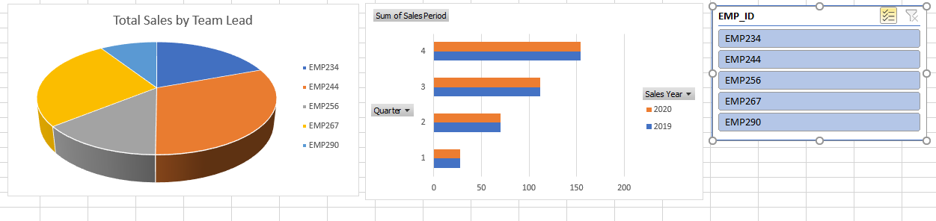
Sales Dashboard
Sales by Team (2019-2020)
Top Ranking Salesperson: Gina Evans
Sales by Quarter (2019-2020)
Employee ID

Slide 4
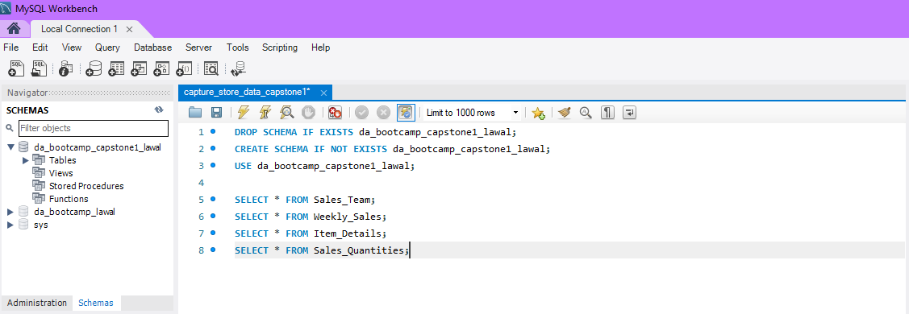
Database Design
MySQL Workbench (imported from backup/real time sales)
OLAP/OLTP (Time permitting)

Slide 5
Analysis Findings
Jupyter Notebook (Time permitting)
Excel Dashboard

