Slide 1

TractorTek
Data Analysis: Capstone 1
Presented by Funmilayo Lawal
April 14th, 2021

Slide 2
Table of Contents
Who am I?
Dilemma
Solution
Web App UI – Data Entry Functionality​
Sales Dashboard
Back end – Database Design​
Analysis Findings​
Design choices & justifications​
Value to the customer

Slide 3

Who am I?
Funmilayo Lawal
Data Analyst (In-Training)
Tasked with helping TractorTEK rebuild system
Operation Retreival

Slide 4
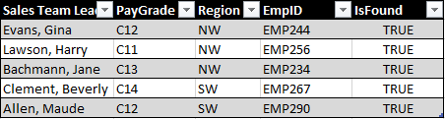
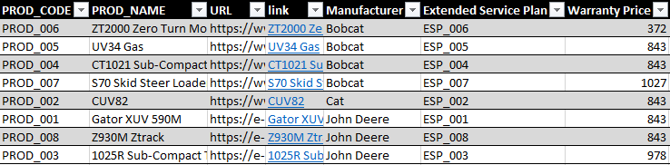
Dilemma
What happened?
TractorTEK’s utility division unfortunately had their Sales Tracking System crash
Left with only back up data

Slide 5
Solution
Create new UI to capture real-time sales orders
Create database to capture and store historical & real-time data
Confirm database runs smoothly
Create Sales Dashboard for insights on company methods
Share personal insights reached during Operation Retreival

Slide 6
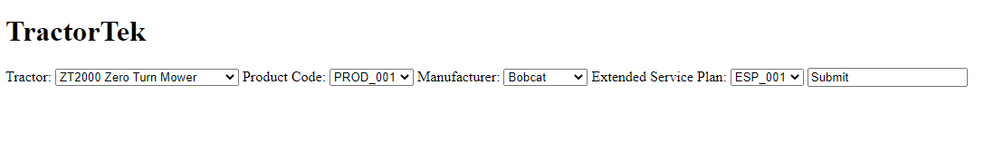
Web App UI
Capture Sales orders in real-time
Choose type of tractor/product code/manufacturer/extended service price
Prices not included due unknown values for 2021 fiscal year

Slide 7
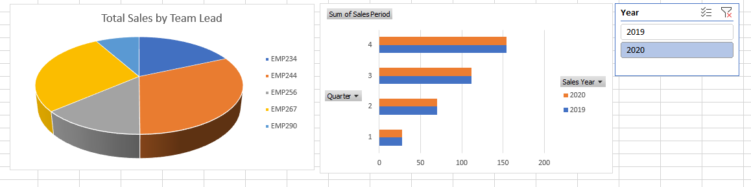
Sales Dashboard
Sales by Team (2019-2020)
Top Ranking Sales Team Lead: Gina Evans
Sales by Quarters 1-4 (19-20)
Slicer: Year

Slide 8
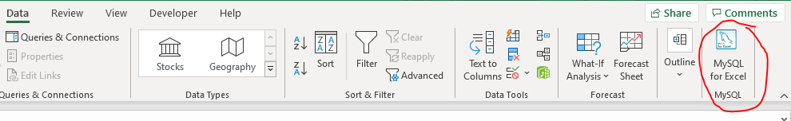
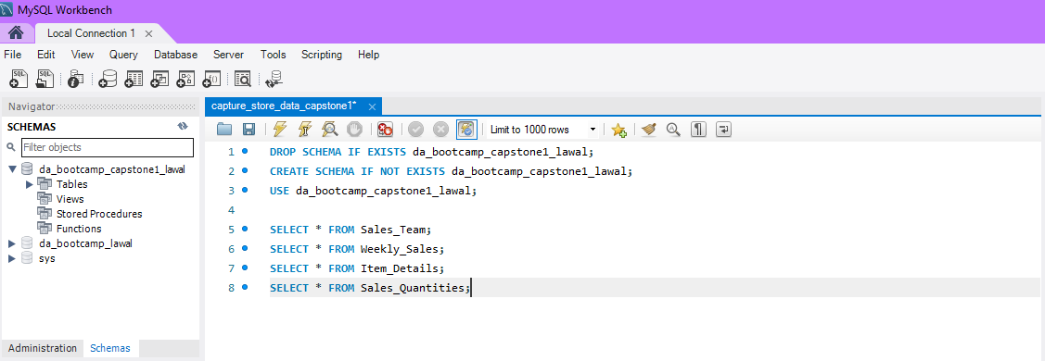
Database Design
MySQL Workbench (imported from backup)
OLAP/OLTP (Time permitting)

Slide 9
Analysis Findings
Jupyter Notebook (Time Permitting)
Use Python Pandas
Design Choices & Justifications
Kept it Simple (Due to Time Constraints)

Slide 10
Value to Customer/Improvements
Take Away? Create a more stable Sales tracking System
Insights? Reach out to highest ranking Sales Team Lead to share their successes
Make Better? With more time, I’d improve upon the Front End, dive further into star vs snowflake schema, and verify with Jupyter notebook

Slide 11
The End
Any Questions?

