Slide 1

Von Lawand Allo

Slide 2
Agenda
What is Protractor?
Why do We need E2E testing?
Architecture of Protractor
Why Protractor?
Demo

Slide 3
What is Protractor?
Protractor is an end-to-end test framework for Angular and AngularJS applications
Notes:
End-to-end (E2E) testing: testing application workflow from start to end with all its components, simulating a real user scenario.

Slide 4
Why do I need E2E Tests?
Notes:
We need e2e tests to:
validate the behaviour of our App as a whole
test all the components consedring all the dependencies between these components
Expand test coverage

Slide 5
What is Protractor?
Protractor is an end-to-end test framework for Angular and AngularJS applications
Protractor is a wrapper around WebDriverJS
Notes:
WebDriverJS is the binding of the Selenium Webdriver API for Node.js. Through the Webdriver API we can interact with the browser

Slide 6
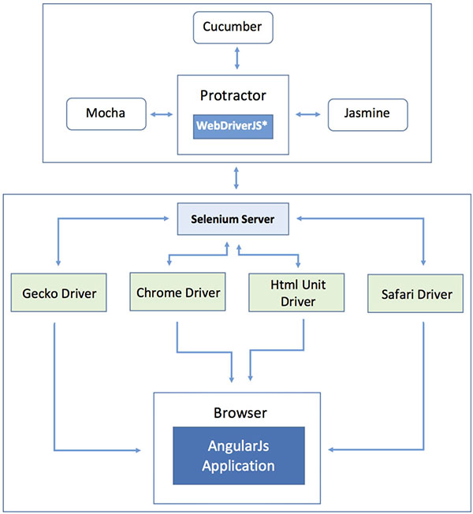

Slide 7
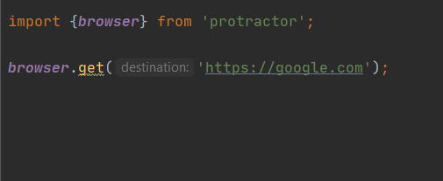
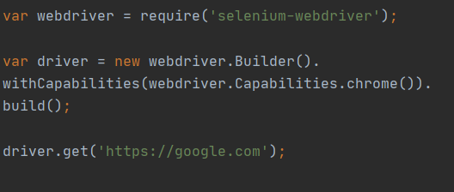
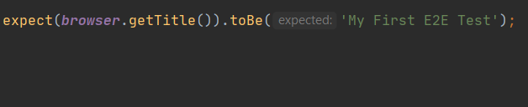
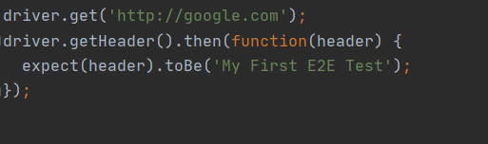
Why Protractor?
Protractor
WebDriverJS
Notes:
With Protractor it‘s easier to get a page object
Protractor supports Angular-specific locators
Most significant difference to WebDriverJS: While Using Protractor you don’t habe to worry about asynchronous calls, no need for waits or sleeps for the task to finish.

Slide 8
Demo

