Slide 1
Museum Slack Study: Initial Tasks
April 2023
Blackbox Lab
Digital, Data, and Design Institute
Harvard Business School

Slide 2
TASK 1: Investigate MoMA Data

Slide 3
Overview
The MoMA dataset has four spreadsheets
Artist: One row for each artist, with columns giving information about each artist
Collections: One row for each artwork, with columns giving information about each artwork
Exhibitions: One row for each person involved in an exhibition, with columns giving information about each person and the exhibition
Directors: One row for each tenure, with columns giving information about the tenure (i.e. title, holder, dates held, etc.)

Slide 4
Summary
Most complete available source for information on the artwork, artists, exhibitions of the museum.
Has information in most of the preliminary categories: institutions, artists, artworks, curators, supporters, older exhibitions, and dates.
Lacks information in some of preliminary categories of information. There is no information on ticket sales, critical acclaim or donations.
Many fields are not 100% complete or may not be standardized

Slide 5
1. Institutions
The data set gives information on a single institution: The Modern Museum of American Art (MoMA)

Slide 6
2. Artists
15,243 artists in MoMA data set
The dataset includes a thorough (v.i.) listing of artists with artworks in the MoMA. For most, the artist’s name, nationality, gender, birth year, and death year are in the data set.

Slide 7
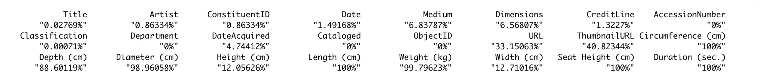
3. Artworks
140,048 artworks in MoMA dataset. For comparison, Museum website has ~98k records.
For most artworks, the title of the work, the artist, the date, classification, medium, some form of dimensions, credit line department and date of acquisition are available in the data set.

Slide 8

Artworks by Artist
Over 50% of artists have only one work of art in the MoMA

Slide 9
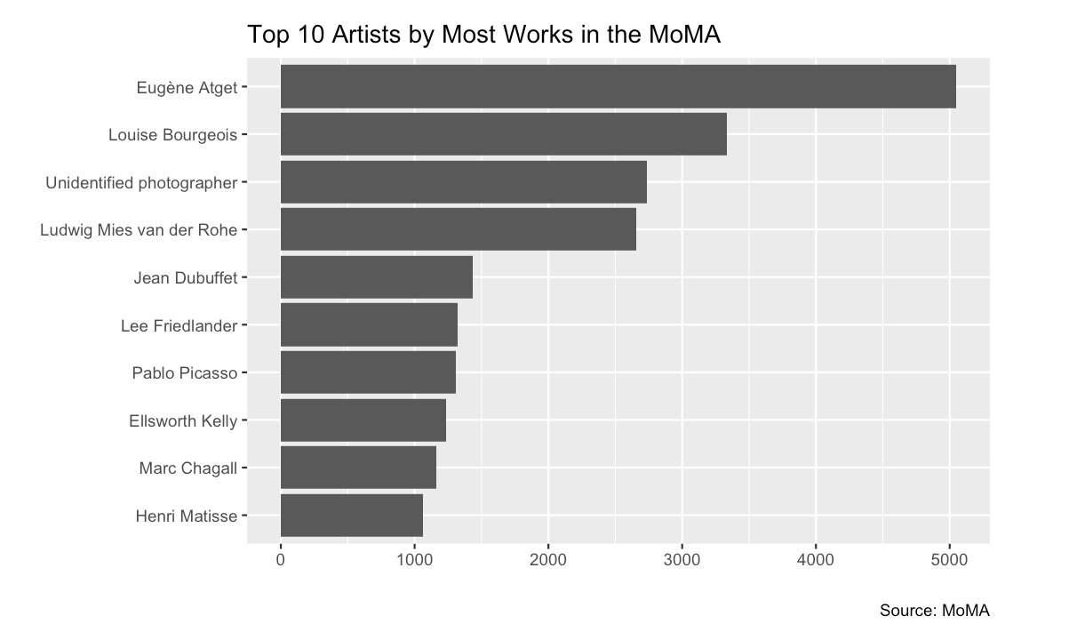
Artworks by Artist (cont.)
Top 1% of artists account for 41% of artworks in the MoMA

Slide 10
4. Curators
There is someone listed in the role of curator for about 75% of the 1,735 exhibitions in the dataset. For most of these, a role as described in the press release are available in the data set.
For roughly half of these, nationality, gender, birth year, and death year are available in the data set.
For a minority of these, senior titles at the museum, dates of tenure of those titles are available in the data set.

Slide 11
5. Collections
The only subsample in the dataset as it is given is Department.
One could, based on other information in the dataset, create and describe characteristics of a subsample or “collection” of works, e.g. works by American artists.

Slide 12
6. Supporters
About 99% of artworks in the MoMA have a listed credit line.
About 82% of artworks have a credit line that point to an individual donor or foundation (i.e. NOT “Purchase” or “Gift of the artist”)

Slide 13
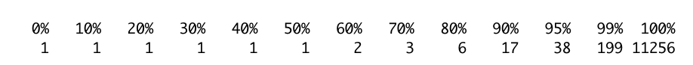
6. Supporters (cont.)
Over 50% of credit lines that do point to an individual donor have only one work of art in the museum

Slide 14
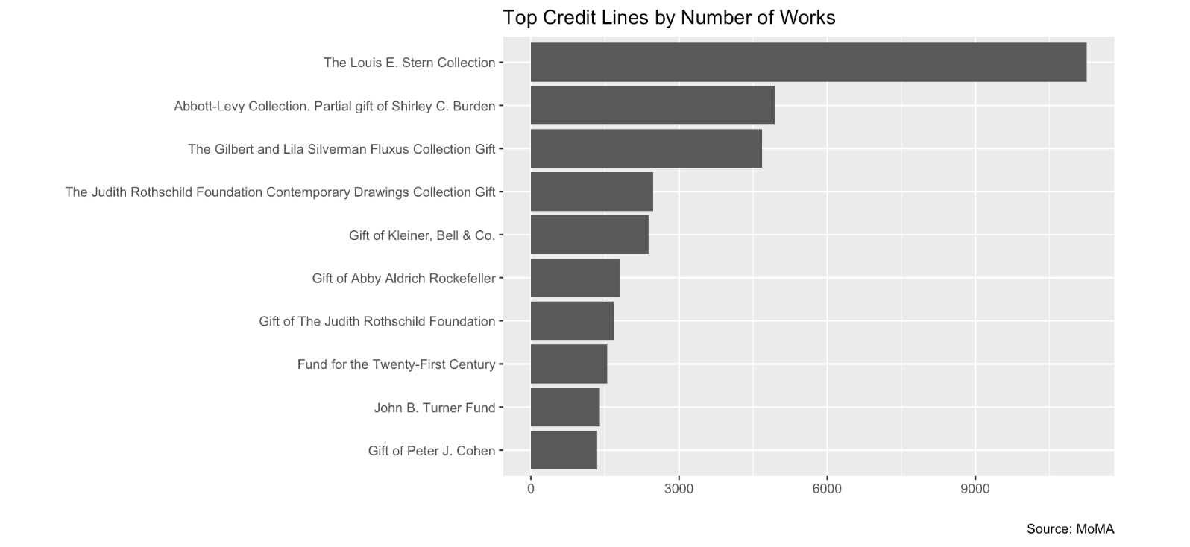
6. Supporters (cont.)
Top 10% of individual credit lines account for 65% of works in the MoMA

Slide 15
6. Supporters (cont.)
Over 80% of credit lines are only “active” for one year
The length of time for which a credit line is active is a measure obtained by subtracting the year in which the credit line's last work was acquired from the year in which the credit line's first work was acquired, then adding 1.

Slide 16
7. Exhibitions
There are 1,735 exhibitions in the dataset
The dataset provides a list of all MoMA exhibitions from 1929 to 1989. For most of these, the title of the exhibition, the opening and closing dates are available.

Slide 17
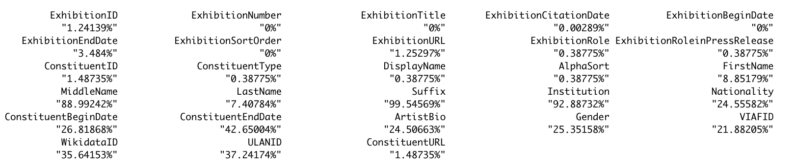
7. Exhibitions (cont.)
For most exhibitions, the title of the exhibition, the opening and closing dates are available.
People and institutions involved in each exhibition, their roles (e.g. artists, curators, designers), and other information (v.s.) are available.

Slide 18
8. Ticket Sales
The dataset contains no information on tickets sold by exhibitions.

Slide 19
9. Critical Acclaim
The dataset contains no information on critical acclaim of exhibitions or other events.

Slide 20
10. Dates
The following is a list of all dates available in the dataset:
Artist Birth Year and Death Year
Year of Creation of Artwork (not standardized)
Year of Acquisition of Artwork
Opening and Closing Date (MDY) of Exhibition
Birth and Death Year of Entity involved in Exhibition
Start and End Year of Tenure of Museum Directors and Department Heads
Birth and Death Year of Museum Directors and Department Heads

Slide 21
11. Donations
Outside of the names of credit lines associated with specific works, there is no information on specific contributions to the institution.

