Slide 1
Indy Civic Hack 2021
Team name: UIndyHackers_21
Team members: Lawrence Bukenya, Todd Albin
Team advisor: Dr. Allison Snyder
Application name: IndyConnect

Slide 2
IndyConnect
Problem Statement: Create a mobile platform where hosiers can find information about the existing organizations that are serving their neighborhoods. IndyConnect will be the platform (app) name
Benefits:
Information about the service in one place
Within the app, new service providers can fill in the form to request to be paired with an existing provider
App should be accessible via a computer or mobile devices

Slide 3
Data Used
Data used from the Indiana government management performance hub includes;
Temporary Assistance for Needy Families (TANF) services location data
Supplemental Nutrition Assistance Program (SNAP) services location data
Opioid Treatment Programs (OTP) location data
Adult Mental Health Habilitation Service location data
Vocational Rehabilitation (VR) service location data
Problem Gambling service location data
From the census.gov website
Small Area Income and Poverty Estimate (SAIPE) data.
From U.S. Census Bureau, Small Area Estimates Branch
Supplemental Nutrition Assistance Program Beneficiaries (SNAPB)

Slide 4
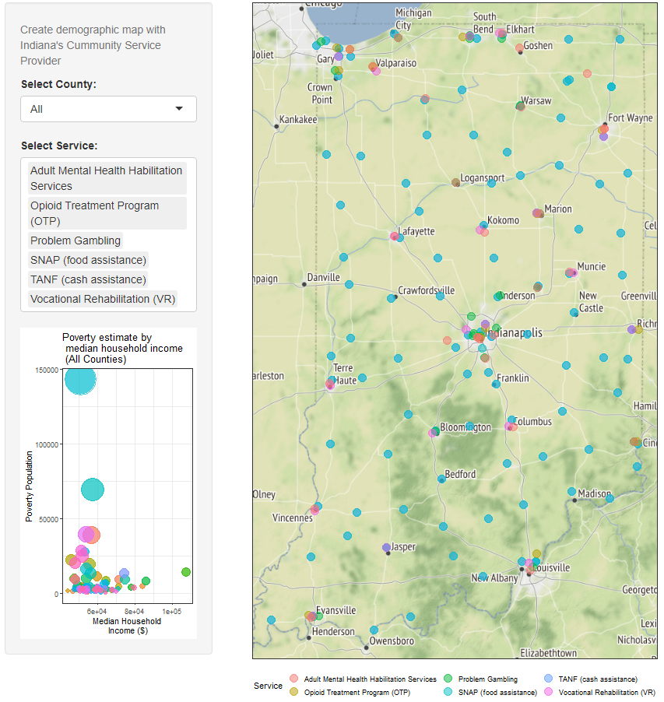
IndyConnect
Solution Integrations
Services location maps
Solution can be built with the use of tech that can is easily integrate with the existing service provide sites or mobile apps. Here, a sample was build using Shinny App
Easily links to the data from the trusted sources

Slide 5
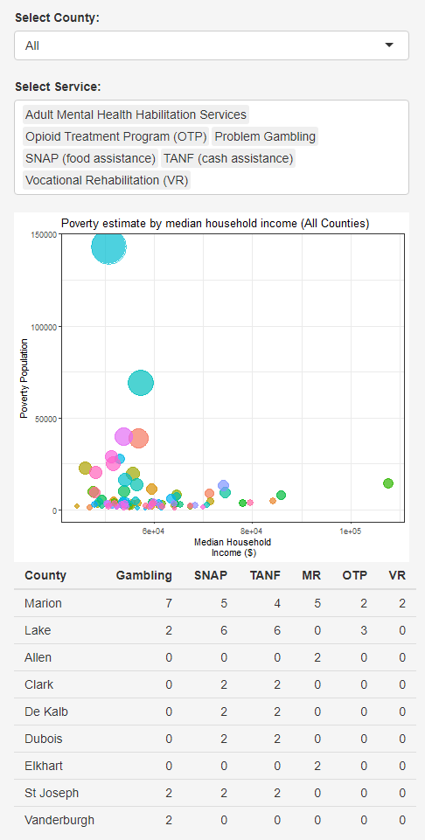
Service locations
App functionality
Alibility to select counties with services
List of services available, can be filtered based of the interest
Poverty and household income. Bubble size represent the number of people who benefited from SNAP (food stamps services)
Summary of the counties with at least two service locations.
Marion county has the biggest gambling problems , where as Lake count has a lot food stamps and cash services. This can be a sign for a poor neighborhood.

Slide 6
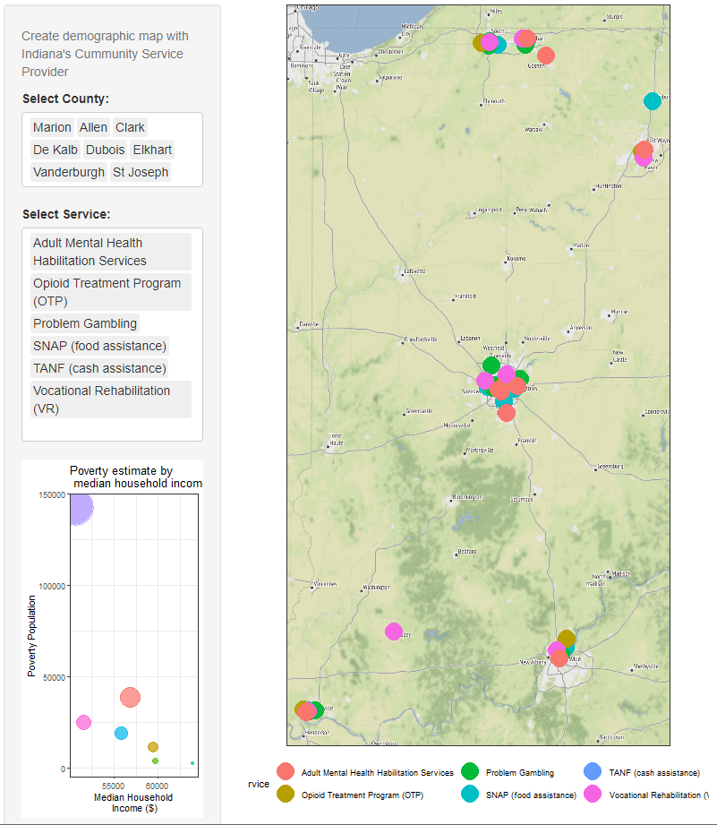
Service Locations
Counties with various services
Locations with more than one service.
The new service provider can choose to work in these areas or work completely new neighborhood

Slide 7
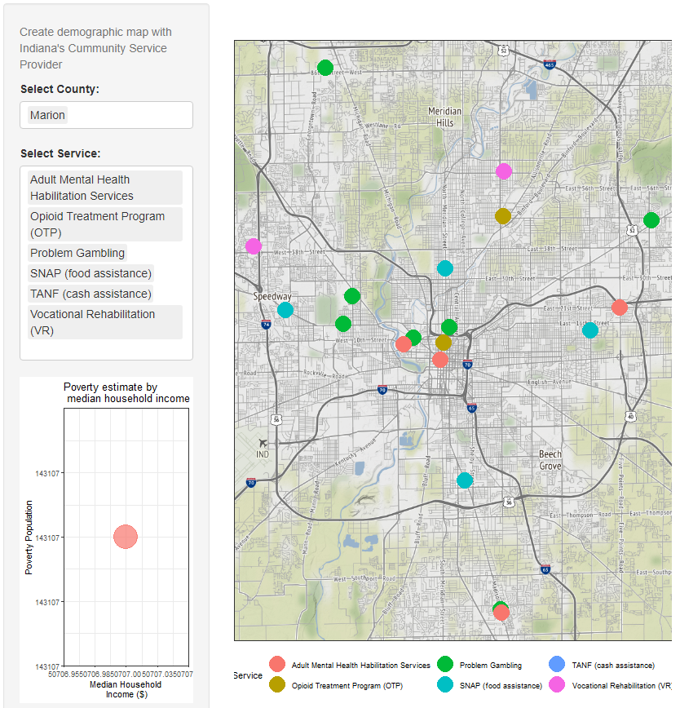
Service Locations
Detailed
The plans show have an interactive map with services locations where zooming is possible.
Other selections options like use of google location, Zip Code or address can be used to look at the location of interest

Slide 8
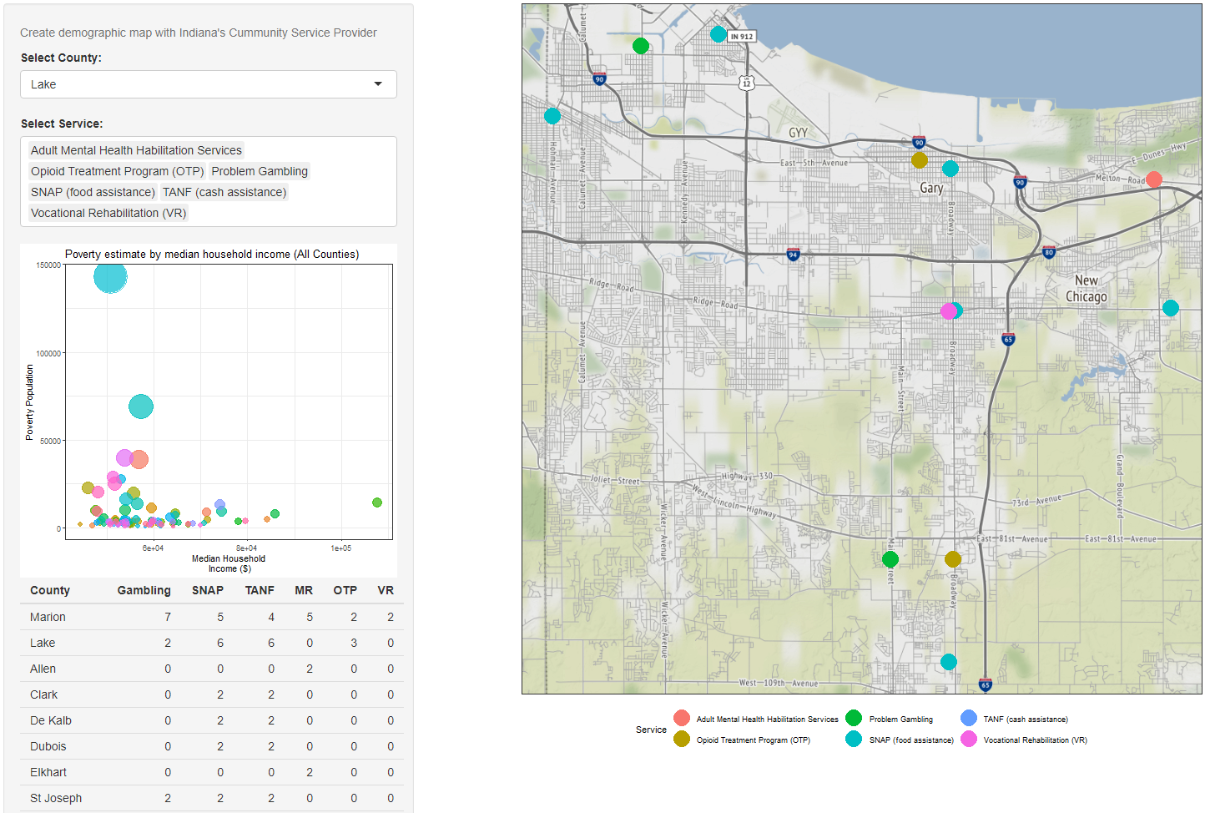
Service Location
Details
Lake county has the most food and temporary cash services’ locations.

Slide 9
Additional Functions
More service providers can be added
Population information can be added to the dashboard in addition to the poverty, education and housing market (real estate)
Can integrate with the precinct information can be integrated so that the community and service providers know how to reach their community law enforcement.

Slide 10
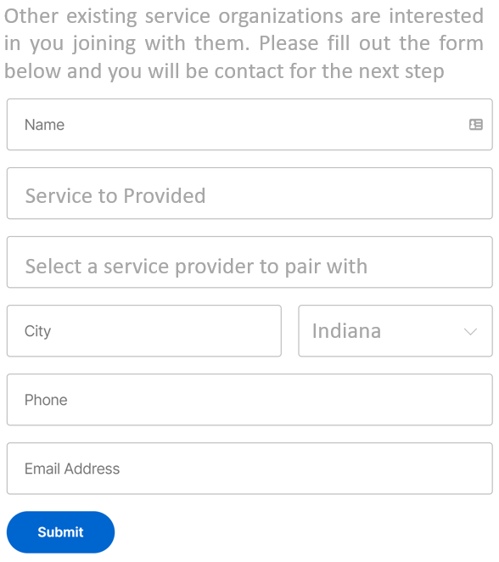
Connecting New Service Providers
Application and vetting the new applicant
There will be a form where new service providers can submit the information to partner with other providers
Once form submitted, an automatic email and/or text will be sent to the organizations the applicant want to partner with. That organizations is responsible for vetting the submitted information
For completely new services, the applicant should be directed where to go to registers in the interested county

Slide 11
Sample App
The solution will be built with a tool that allow interaction with google maps.
Here is the sample app our app https://lawbuk.shinyapps.io/indyconnect/
More information and optimizing to work with mobile among ither devices will be added during the development

Slide 12

Thank You
Team name: UIndyHackers_21
Team members: Lawrence Bukenya, Todd Albin
Team advisor: Dr. Allison Snyder

