Slide 1






Data Visualization NASA Astronauts 1959-2013
Edgardo Panza
Lucas Whitmire
Federico Rueda Luna
Master of Data Science – SuSe 2020

Slide 2
Agenda
Introduction to Dataset (1 min.)
Stages in Exploratory Analysis (collection-process-cleansing-communicate)
Develop Approach 1 (4 min.)
Develop Approach 2 (4 min.)
Develop Approach 3 (4 min.)
Key Findings on Dataset (1 min.)
Conclusions from process (1 min.)
2
Notes:
Total time: 20 mins.
Erase the time in each bullet point

Slide 3

Introduction to Dataset
Characteristic 1: information
Characteristic 2: information
Characteristic 3: information
Characteristic 4: information
3

Slide 4
Stages in exploratory analysis
Platform Challenges addressed by ML models:
Information …
4
Notes:
4

Slide 5
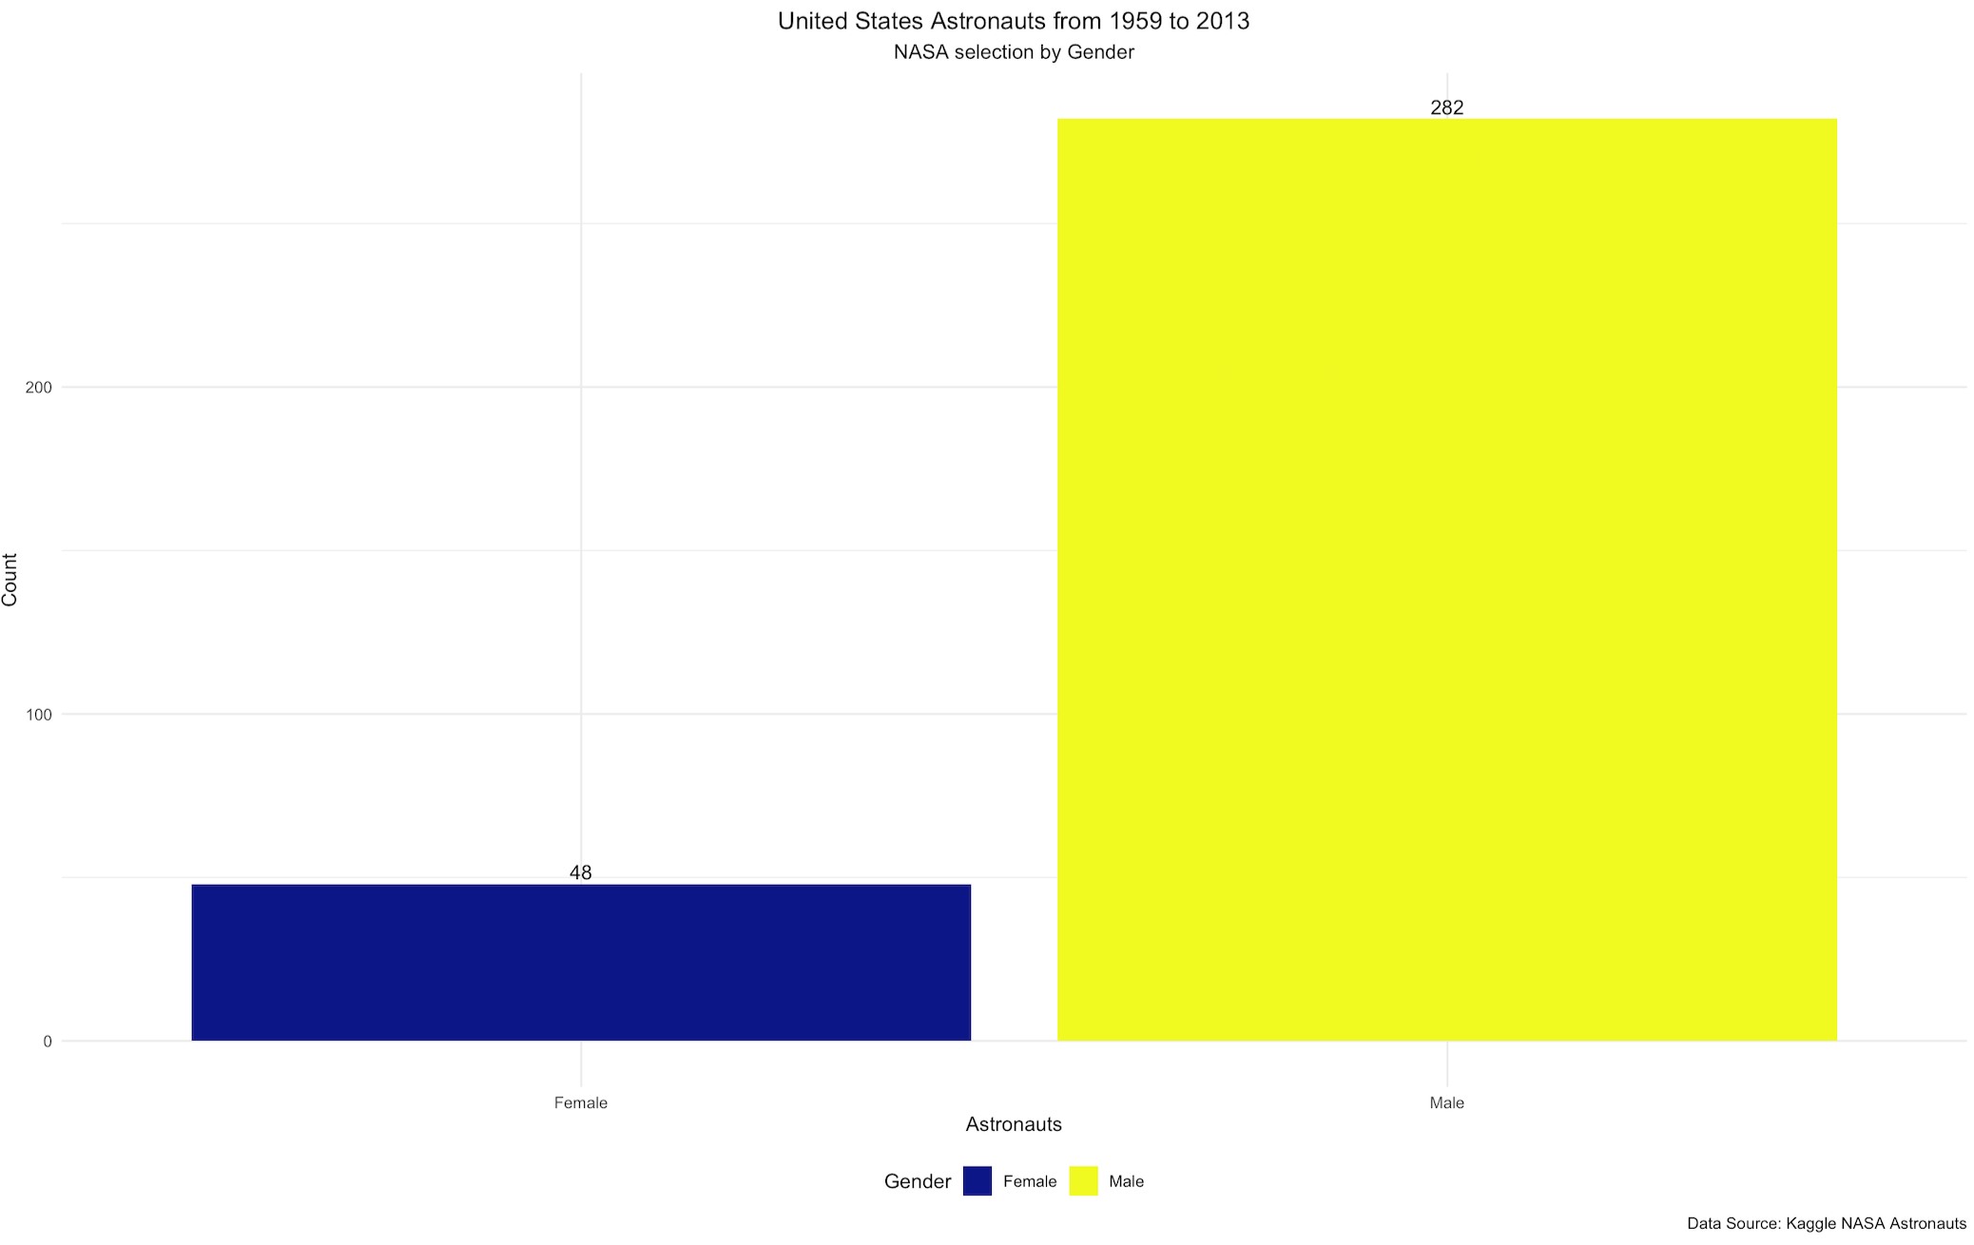
Career of women in space
Let´s start with the proportion of male/female NASA astronauts from 1959 to 2013:
Speech …
5
Notes:
5

Slide 6
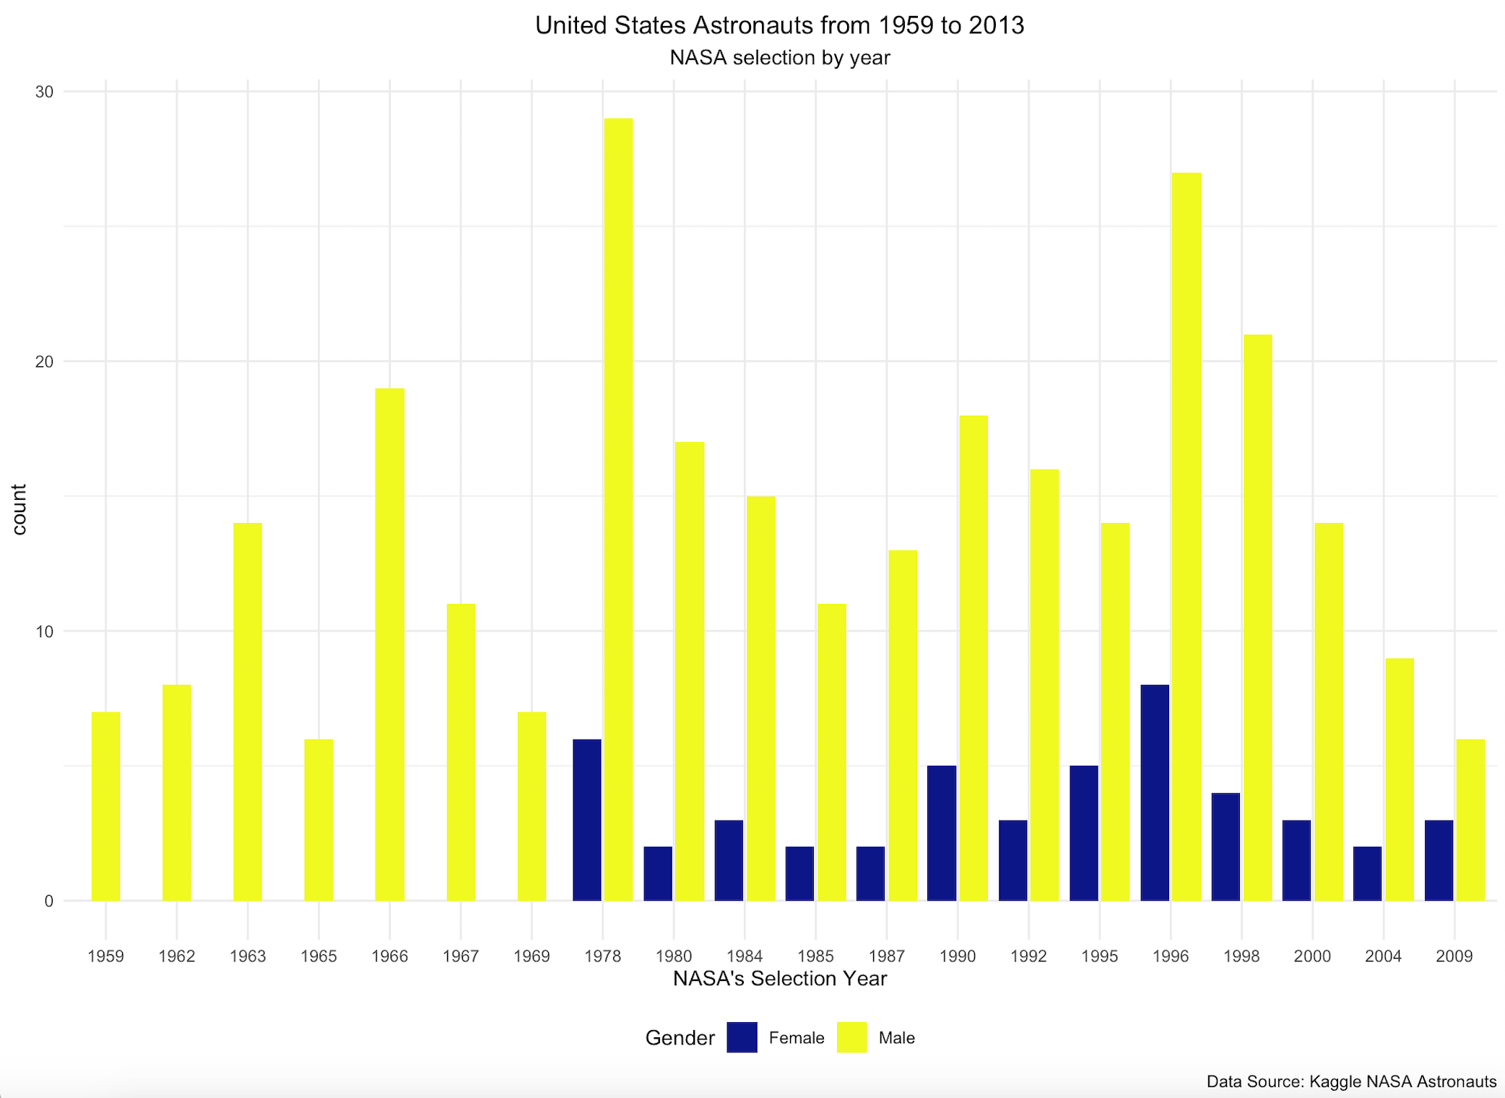
Career of women in space
What about the gender distribution of US astronauts from 1959-2013?
Speech …
Interesting Facts:
Fact 1
Fact 2
6
Notes:
6

Slide 7
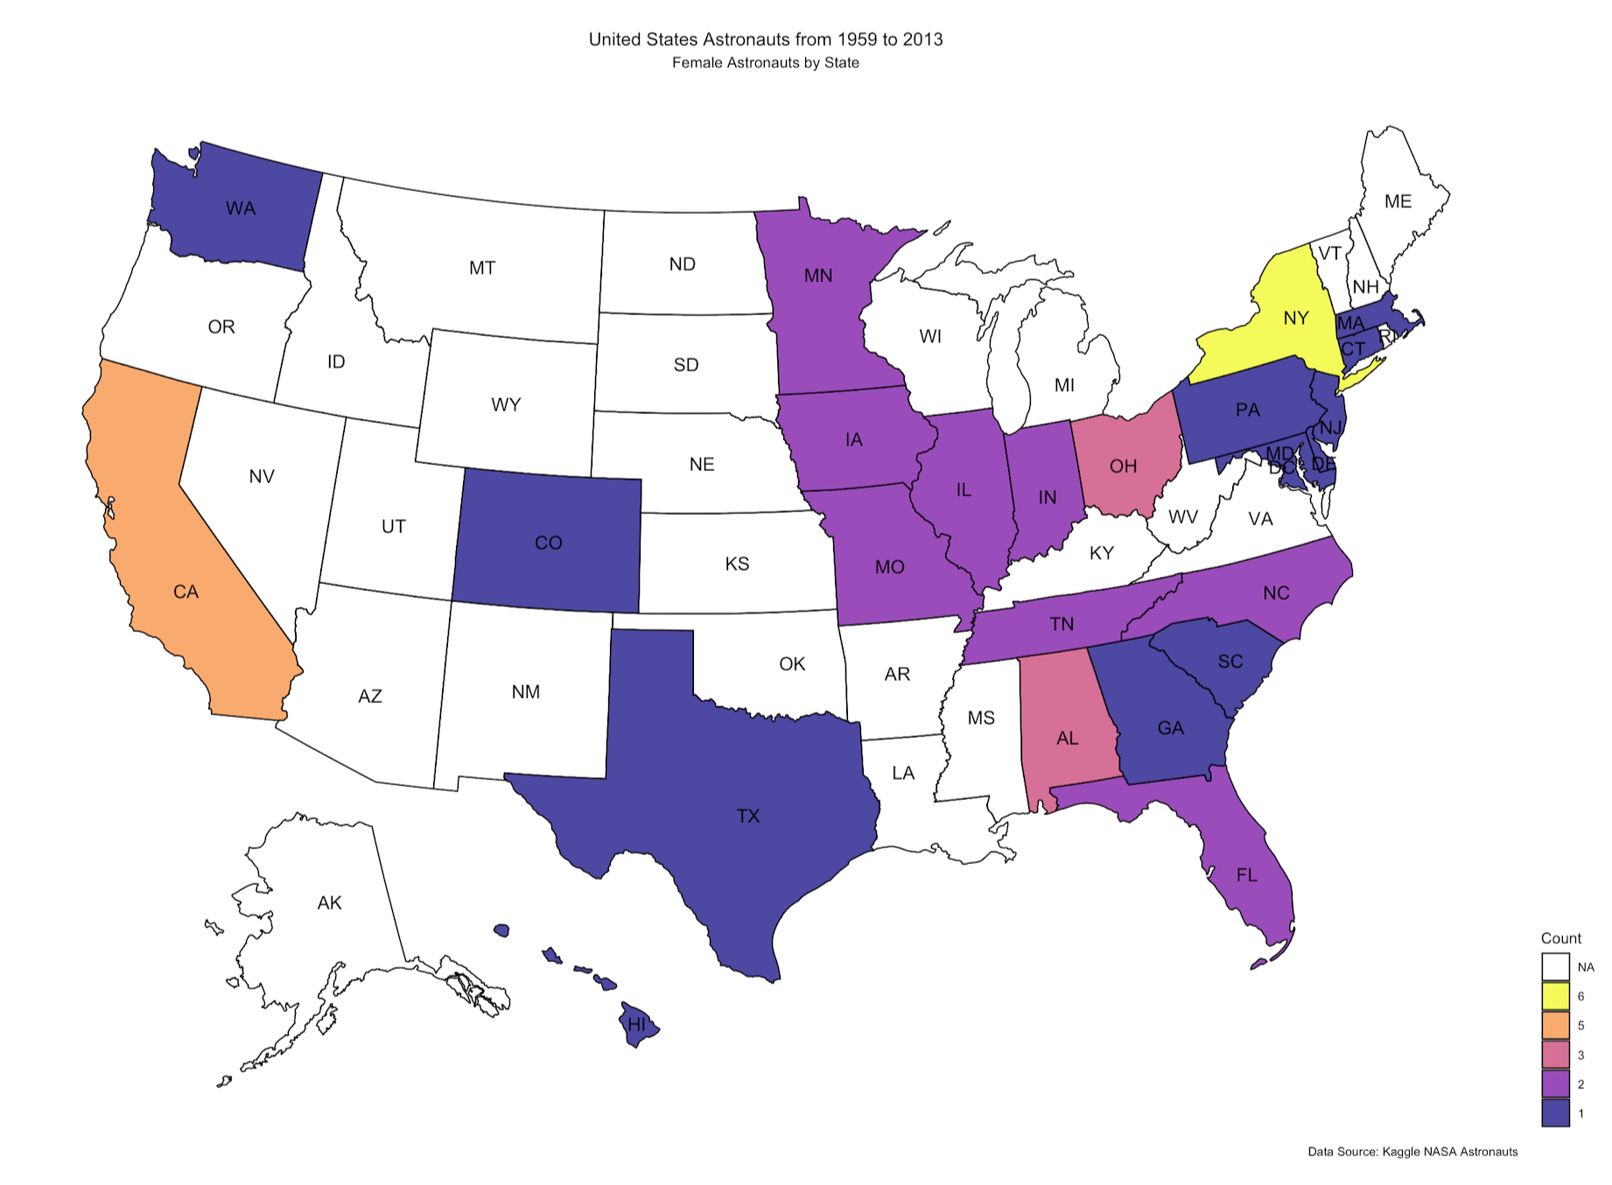
Career of women in space
Which are the US regions with more female astronauts?
Speech …
7
Notes:
7

Slide 8
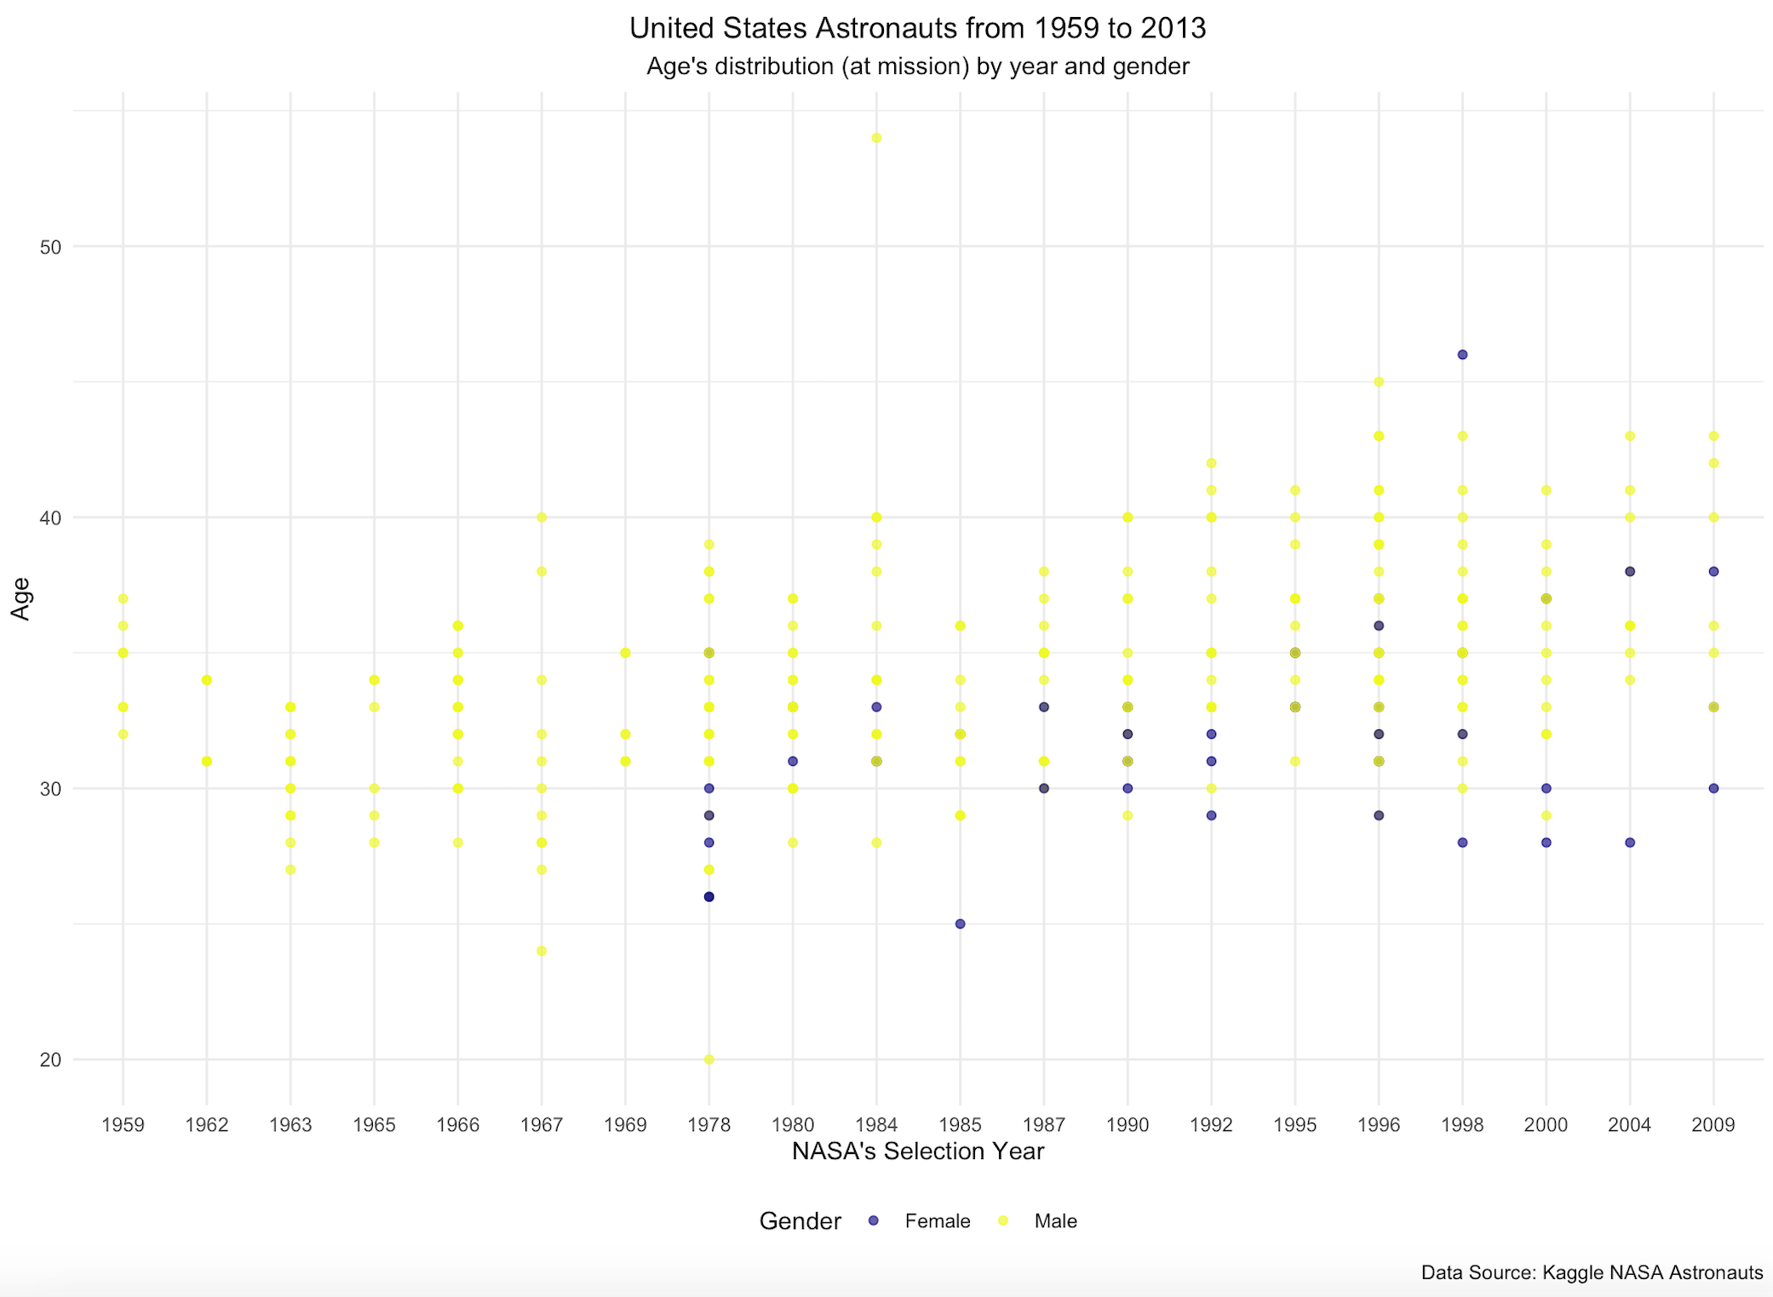
Career of women in space
What about the age at time of NASA’s selection?
Speech …
Interesting Facts:
Fact 1
Fact 2
8
Notes:
8

Slide 9
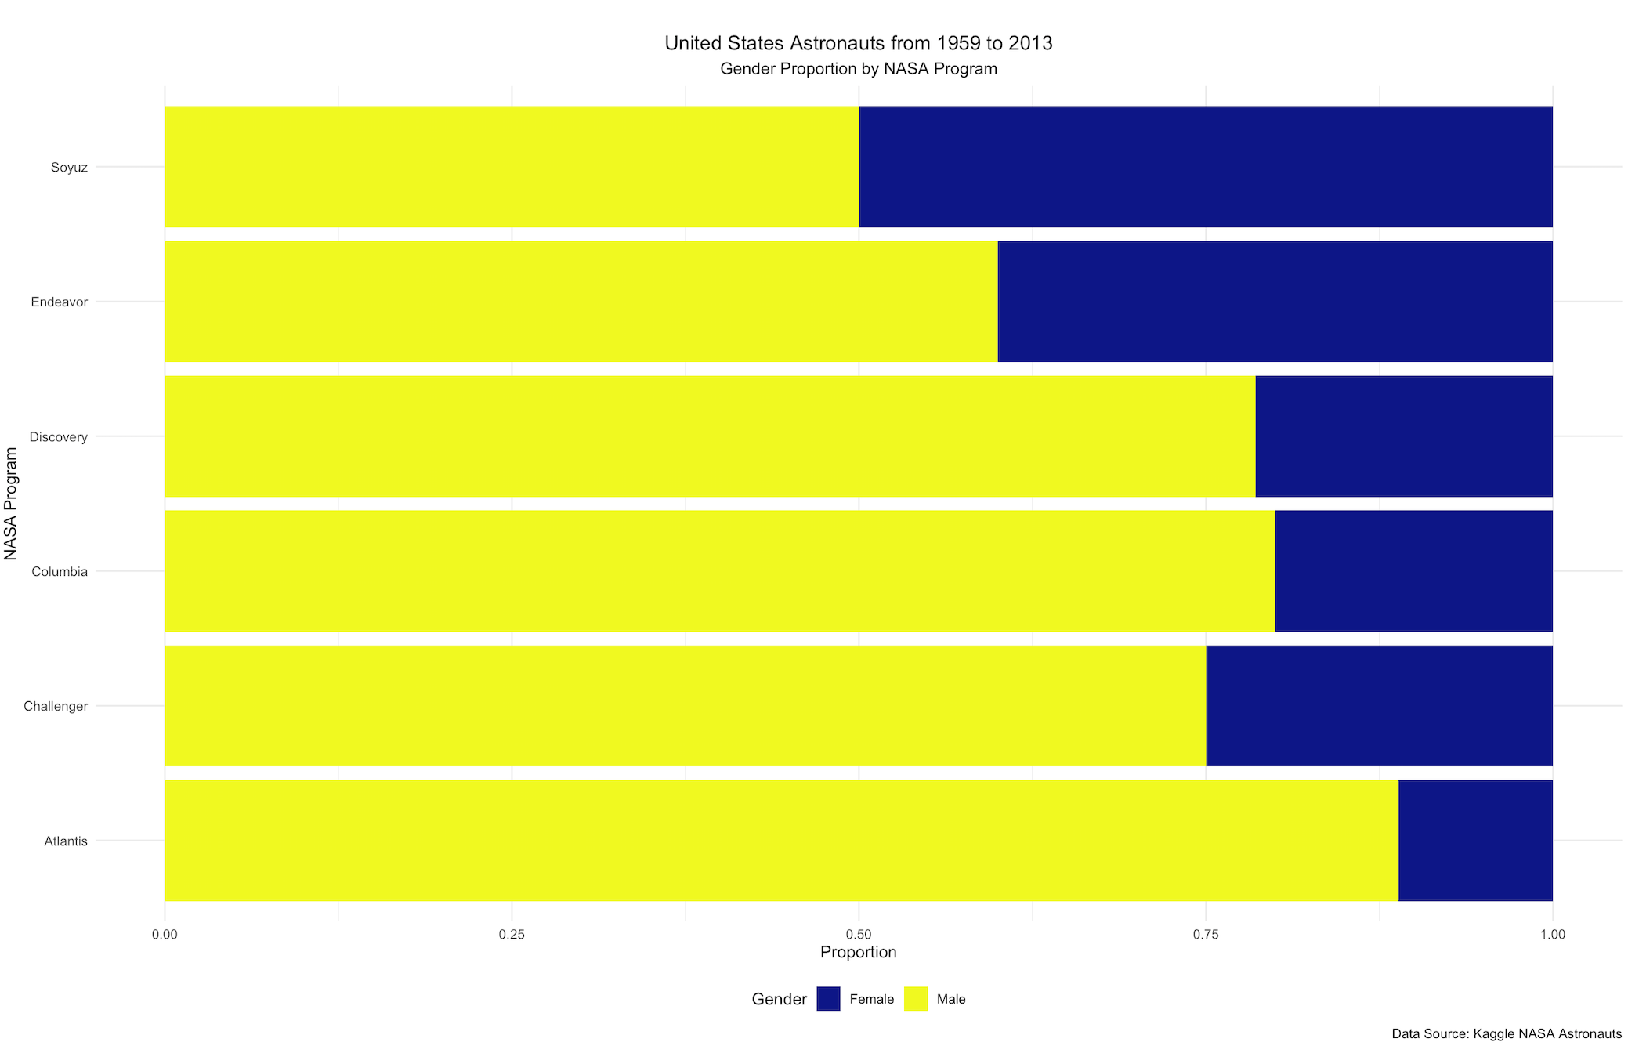
Career of women in space
Which is the program with more female astronauts' participation?
Speech …
Interesting Facts:
Fact 1
Fact 2
9
Notes:
9

Slide 10
KEY FINDINGS
Part 1:
Info…
10
Notes:
10

Slide 11
CONCLUSIONS
Part 1:
Info…
11
Notes:
11

Slide 12
QUESTIONS?
THANKS!
12
Notes:
12

