Slide 1






Data Visualization NASA Astronauts 1959-2013
Edgardo Panza
Lucas Whitmire
Federico Rueda Luna
Master of Data Science – SuSe 2020

Slide 2
Facts
Women were not eligible to be astronauts: all astronauts were required to be military test pilots, a career not available to women at the time.
The Astronaut Class of 1978, otherwise known as the "Thirty-Five New Guys," was NASA's first new group of astronauts since 1969. This class was notable for many reasons, including having the first African-American, the first Asian-American astronauts and especially recognizes as being the first to recruit women.
Sally Kristen Ride became the first American woman in space in 1983.
2
Notes:
https://www.nasa.gov/topics/history/features/flats.html
https://history.nasa.gov/40thann/define.htm
2

Slide 3
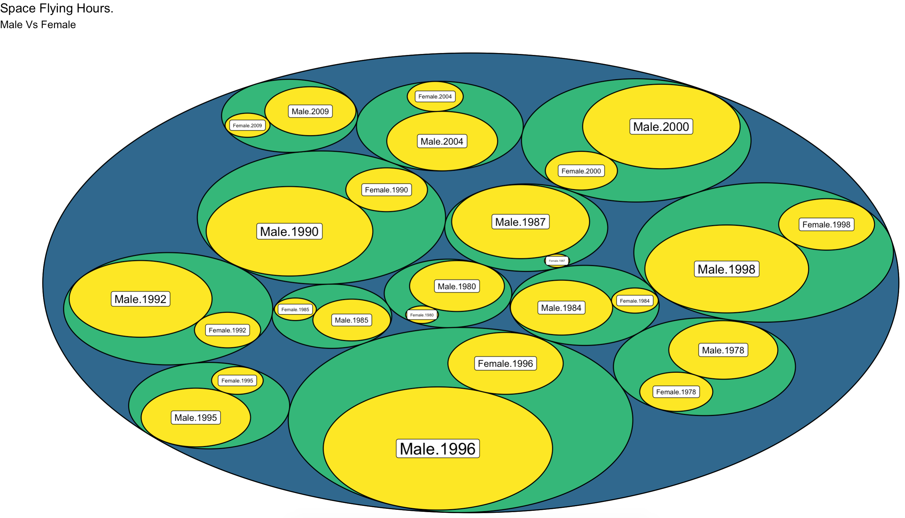
Women in space
3
Notes:
Here we can see some space flights even there are no records of missions, but there was a lot of training so we assume they count that time. https://www.nasa.gov/centers/johnson/news/releases/1978_1980/index.html
3

Slide 4
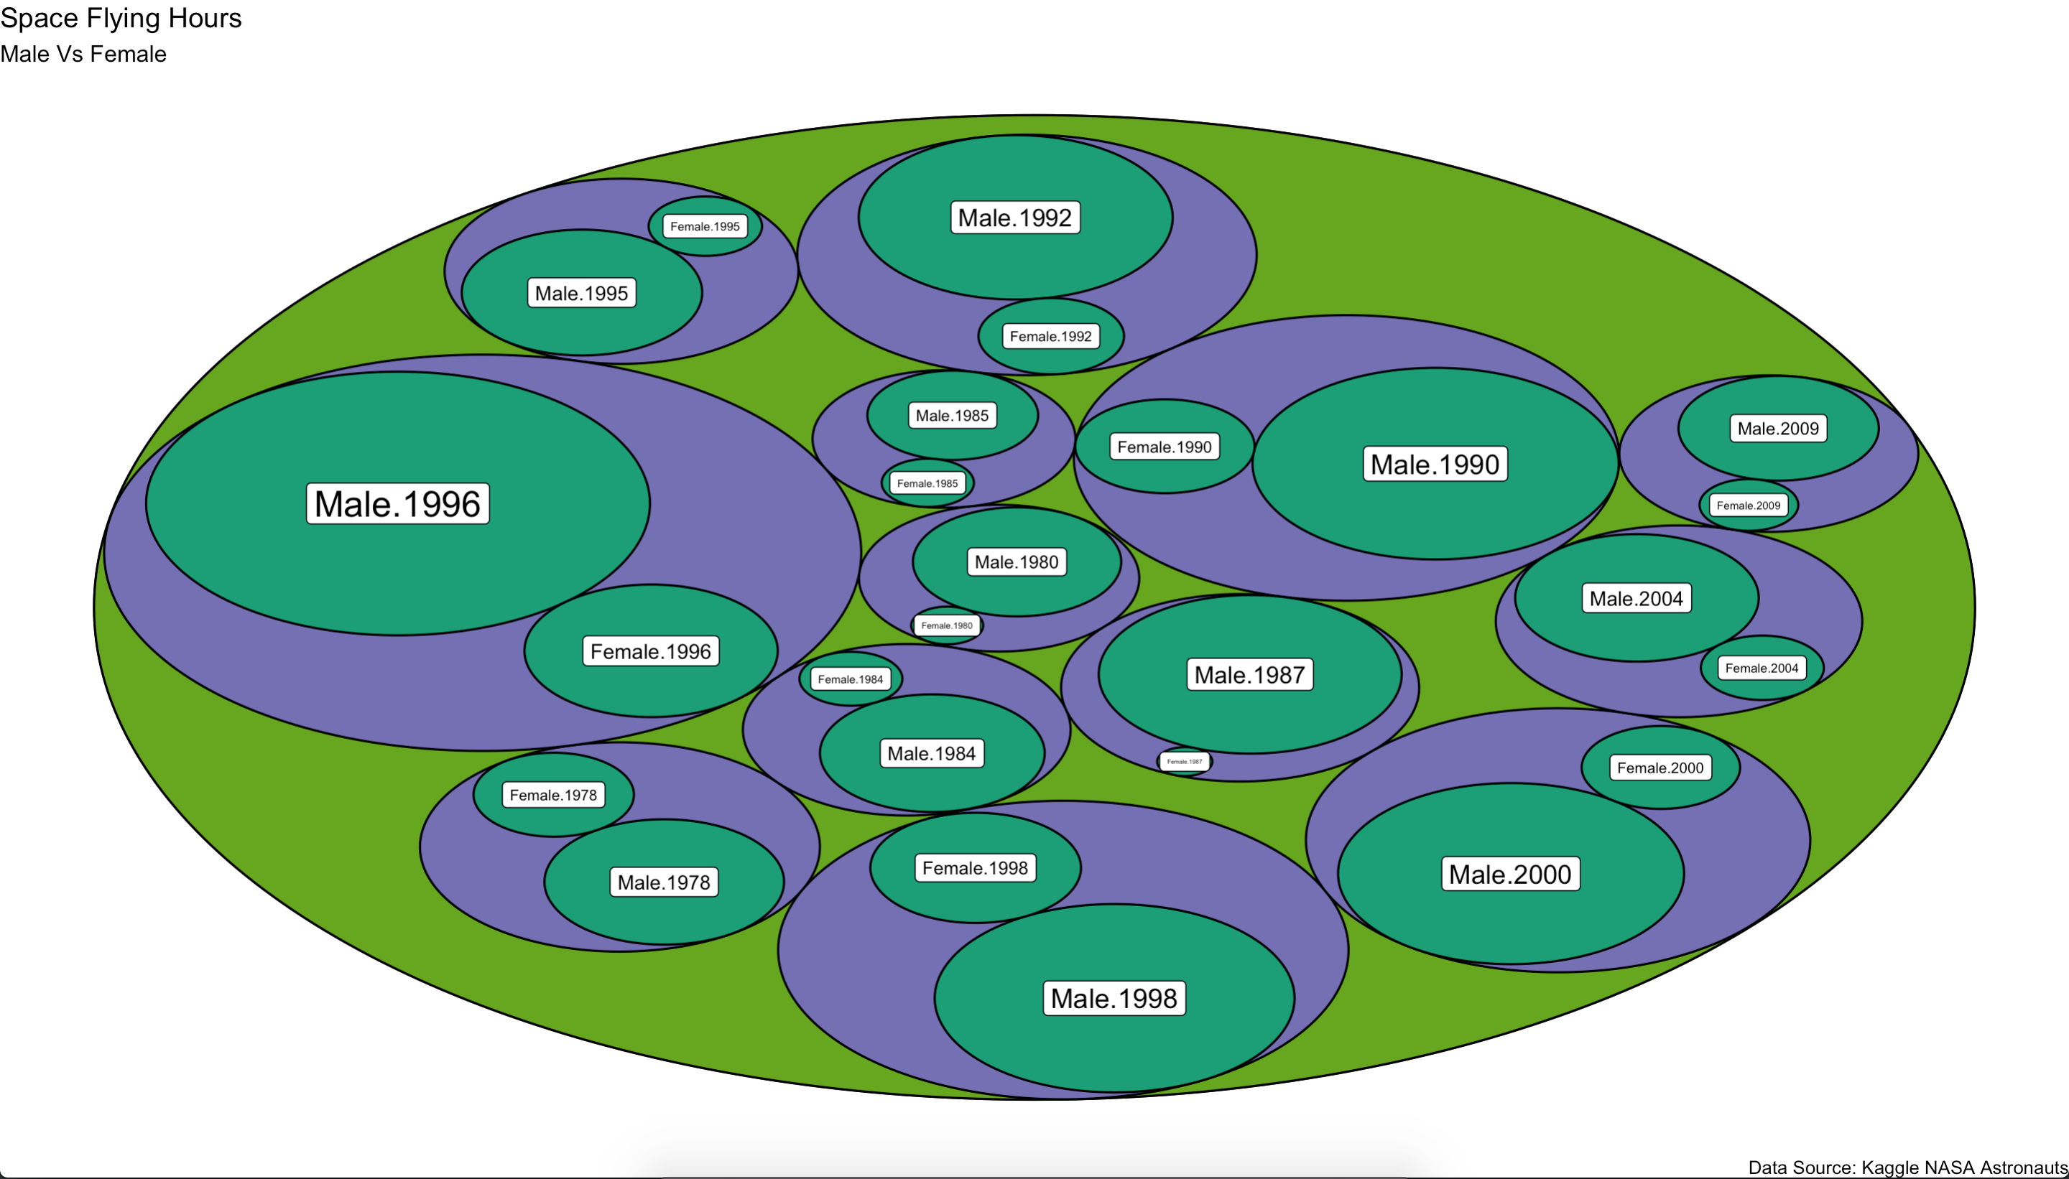
Women in space
4
Notes:
Here we can see some space flights even there are no records of missions, but there was a lot of training so we assume they count that time. https://www.nasa.gov/centers/johnson/news/releases/1978_1980/index.html
4

Slide 5
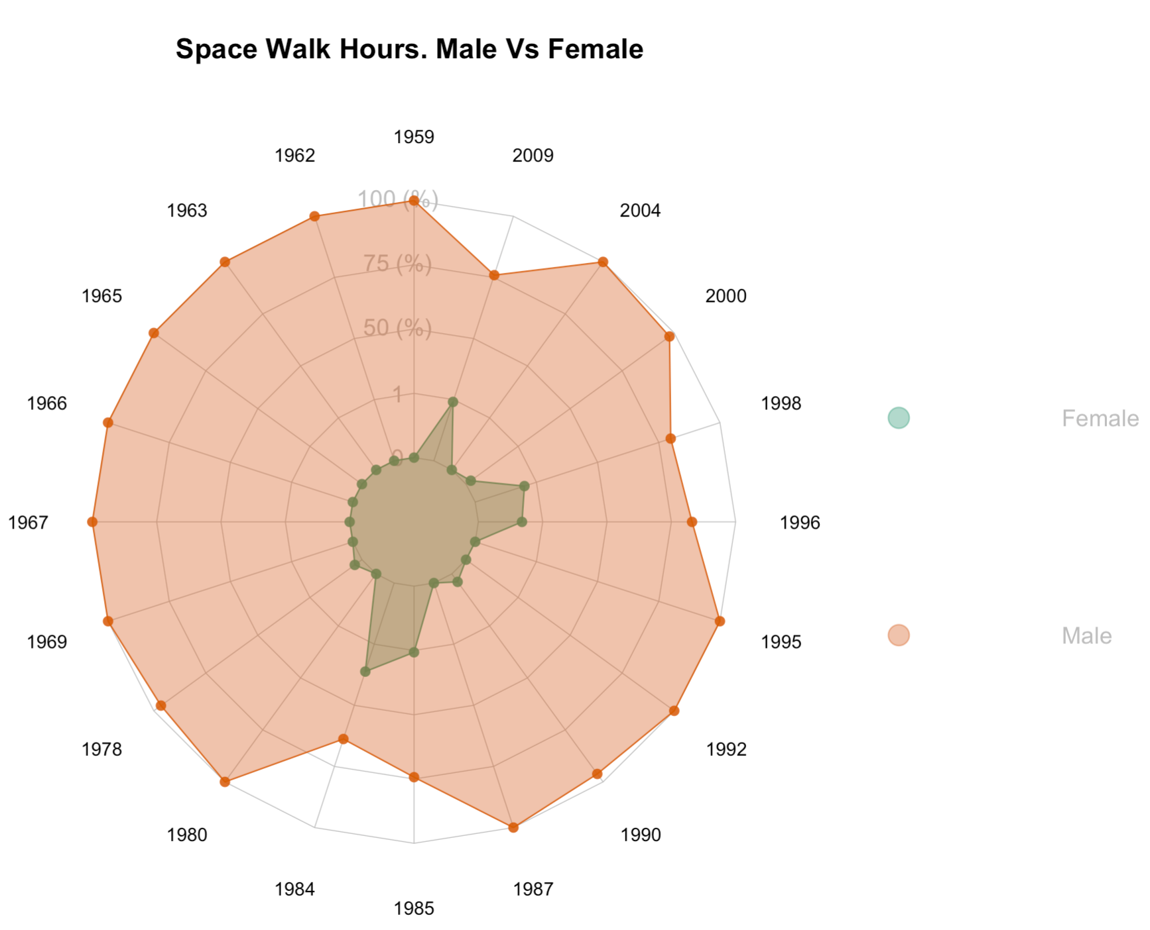
Women in space
5
Notes:
Even after the inclusion of women in space programs we can see that even they started to flying on missions on 1983 there isn’t an inclusion in the space walks.
5

Slide 6
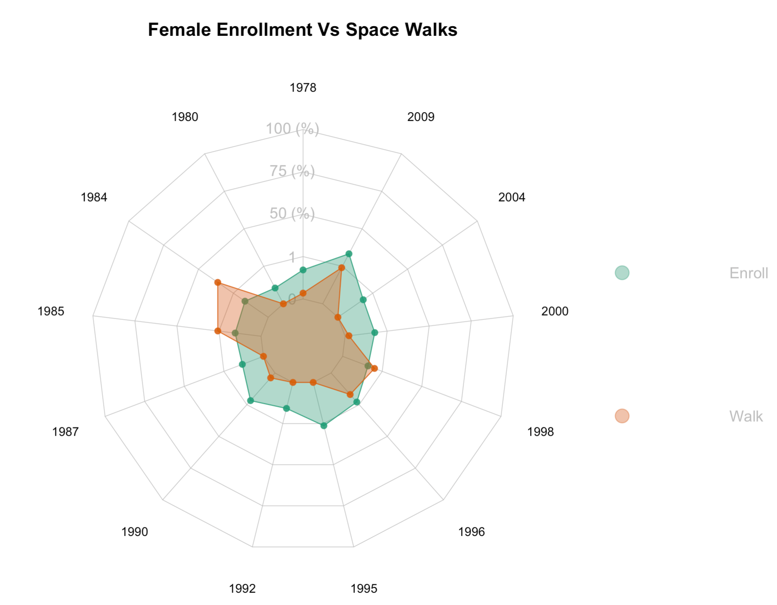
Women in space
6
Notes:
Even after the inclusion of women in space programs we can see that even they started to flying on missions on 1983 there isn’t an inclusion in the space walks.
6

