Slide 1
Final Project of ITWS database

Slide 2
Overview
In our project, we intend to combine some databases in New York from the angle of tourists. The core attribute of all the databases is their location both geographic coordinate system (longitude and latitude) and neighborhoods. Based on it, when people arrive at a certain landmark, they can get the surroundings including the
nearest subway entrance, some good restaurants nearby and free public wifi they can access to. Also, according to the distance of landmarks, people can find their next goal. So, it is like a map that focuses on the landmarks which can bring convenience to the visitors.

Slide 3
Data
Subway entrance Data:
Link: https://data.cityofnewyork.us/Transportation/Subway-Entrances/drex-xx56
Description: It provides the location, name and its line of New York subway entrance
Public Wi-Fi Location Data:
Link: https://data.cityofnewyork.us/Social-Services/NYC-Wi-Fi-Hotspot-Locations/a9we-mtpn
Description: It provides the location, name, provider and the type(free or not) of Wi-Fi in New York
Restaurant Inspection:
Link:: https://data.cityofnewyork.us/Health/DOHMH-New-York-City-Restaurant-Inspection-Results/43nn-pn8j/data
Description: It provides name, location, cuisine, phone numbers of restaurants in New York
Landmarks and Historic Building stuff:
Link: https://data.cityofnewyork.us/Housing-Development/Individual-Landmark-Sites/ts56-fkf5
Description: It provides the location, name, type, designated date of landmarks in New York.

Slide 4
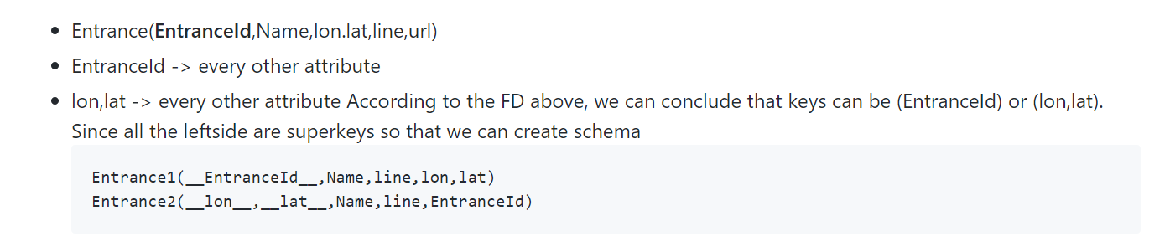
Schema- Entrance

Slide 5
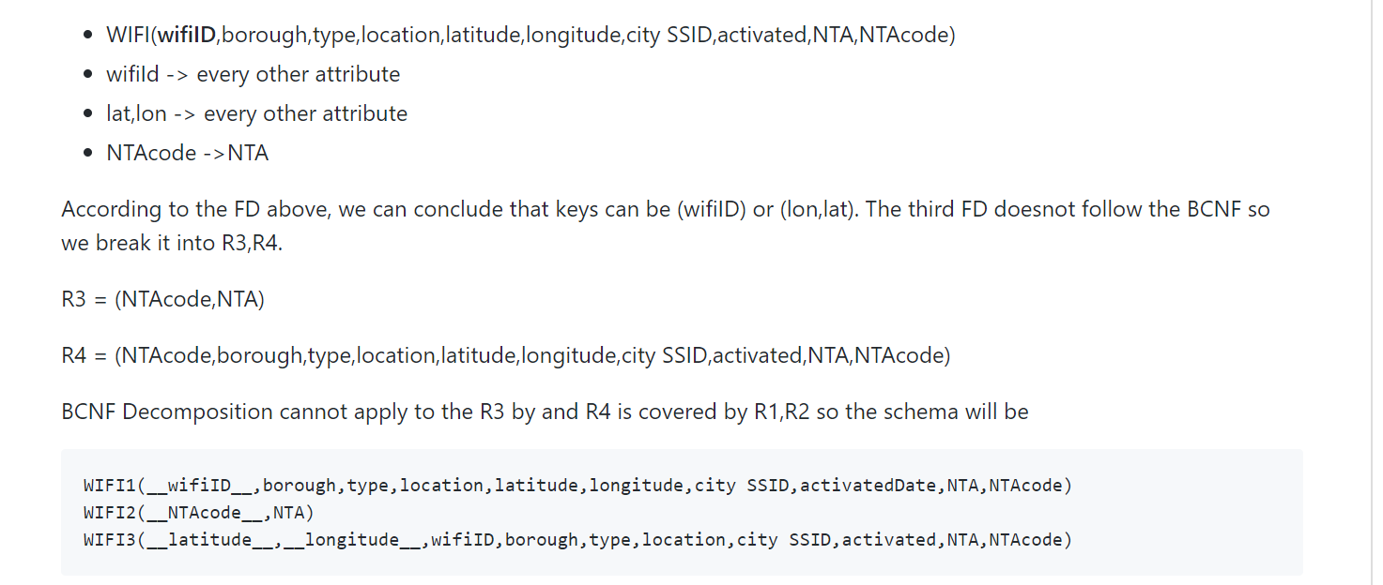
Schema-Wifi

Slide 6
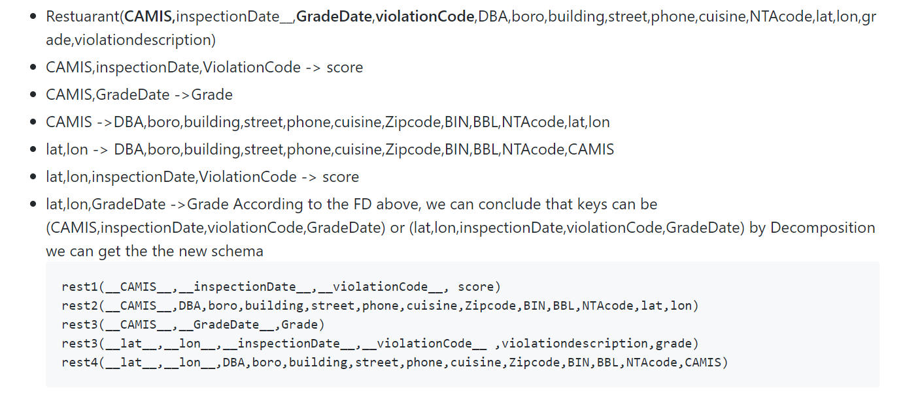
Schema-restaurant

Slide 7
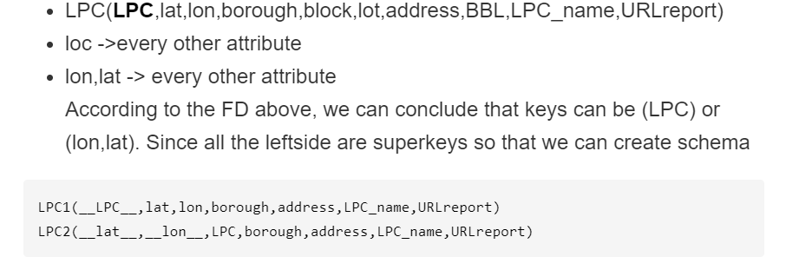
Schema-landmark

Slide 8
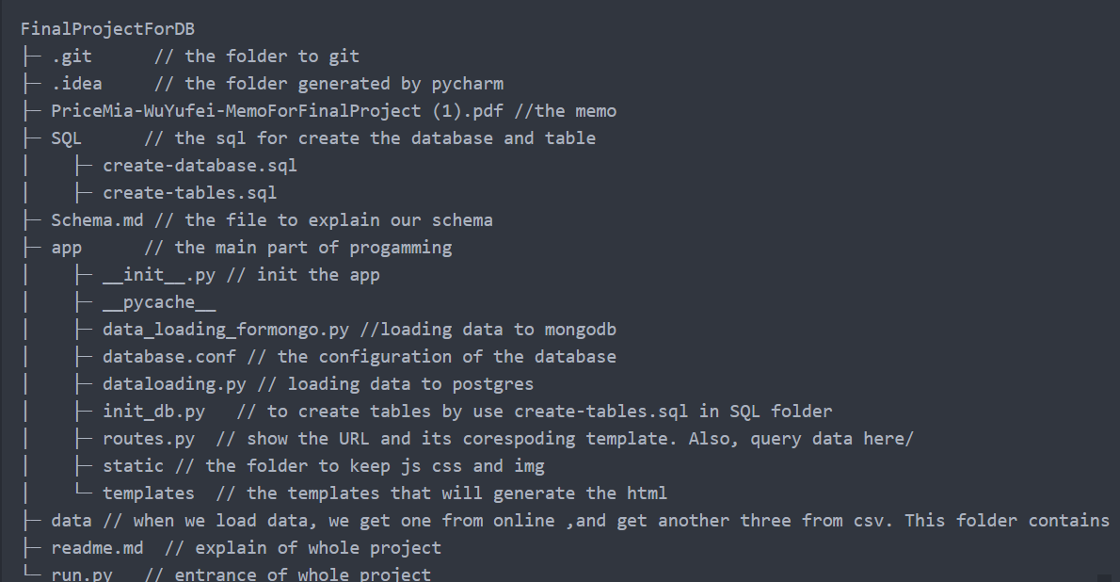
Application
Flask framework,
the structure of the whole applications

