Slide 1


Slide 2
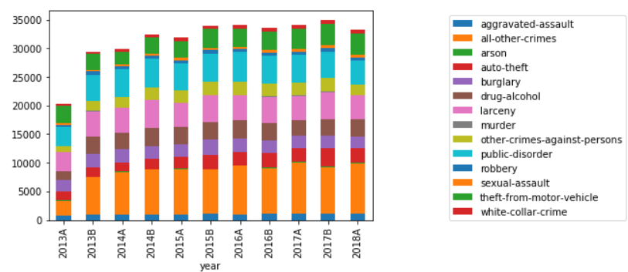
Semi Year Crime By Type

Slide 3
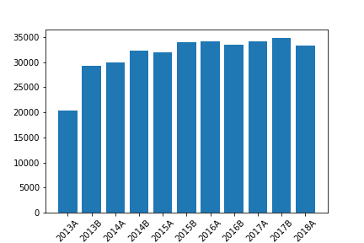
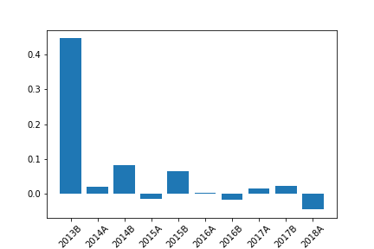
Semi Year Crime Rate

Slide 4
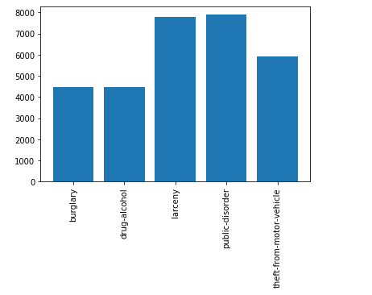
Top Five Crimes

Slide 5
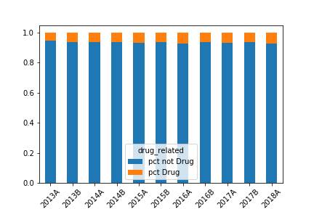
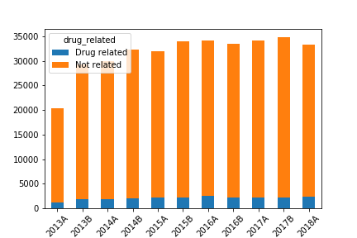
Drug Related

Slide 6
Top Five Crimes By Year

Slide 7
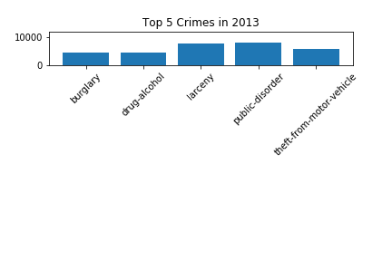
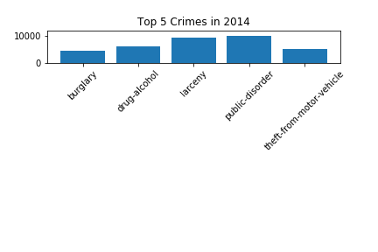
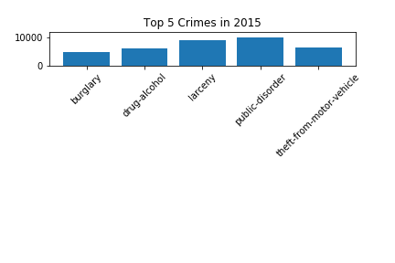
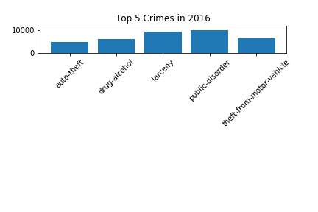
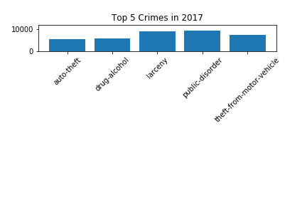
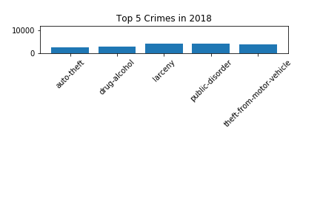

Slide 8
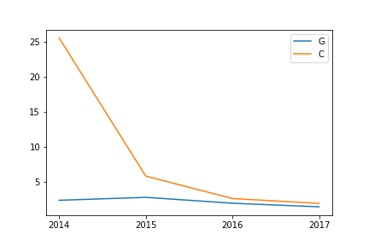
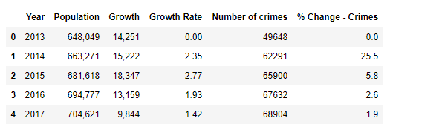
Crime Rate vs Population Growth

Slide 9
Top Five Neighborhoods by Crime

Slide 10
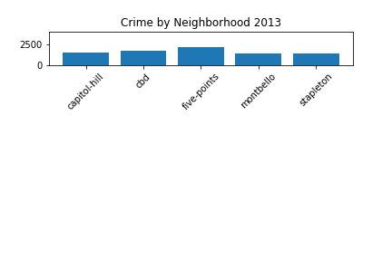
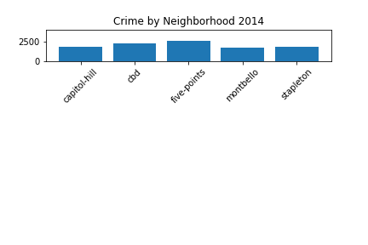
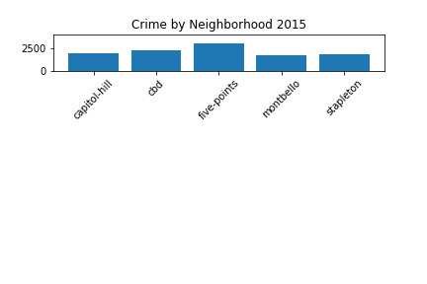
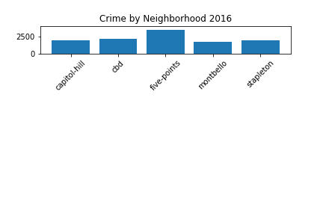
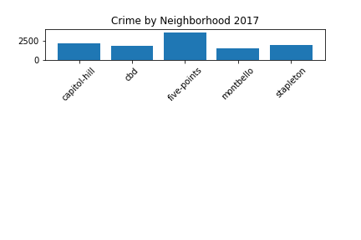
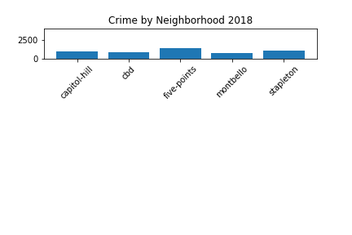

Slide 11
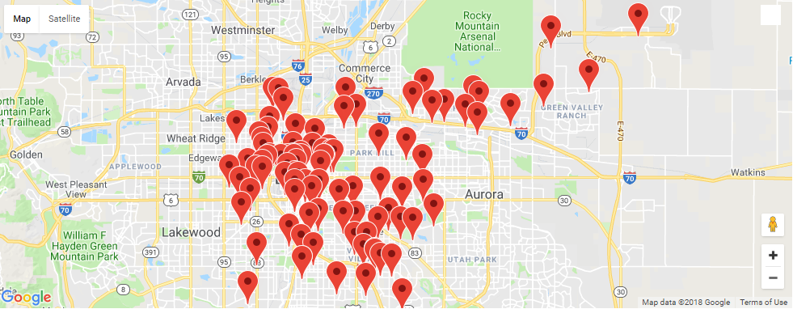

Slide 12
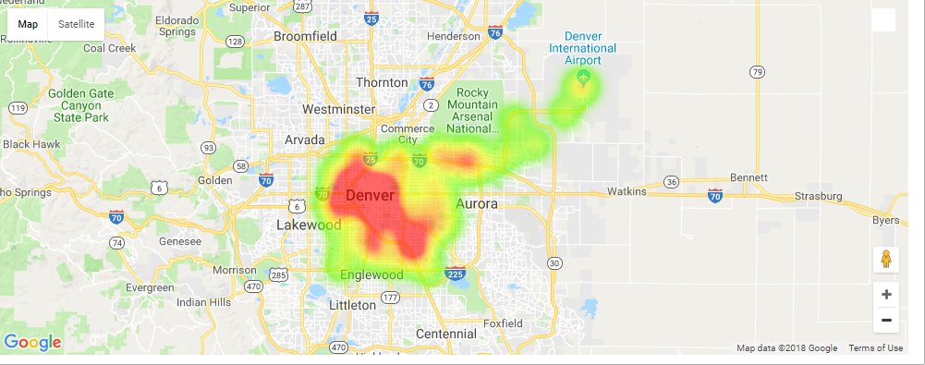
Crime Saturation

Slide 13
Hemp and Cannabis
Businesses in Denver

Slide 14
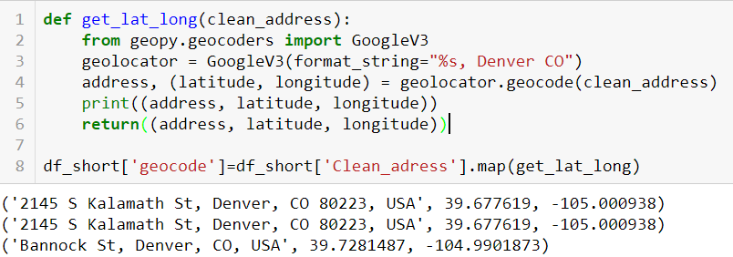
1126 MJ Business Licenses were analyzed:
get_lat_long function converts an address to latitude and longitude using geocode in gmaps API

Slide 15
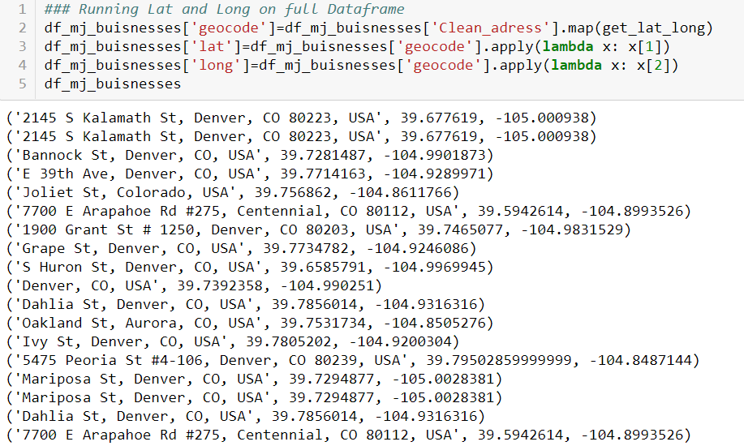
Rate Limitations of
API Key...

Slide 16
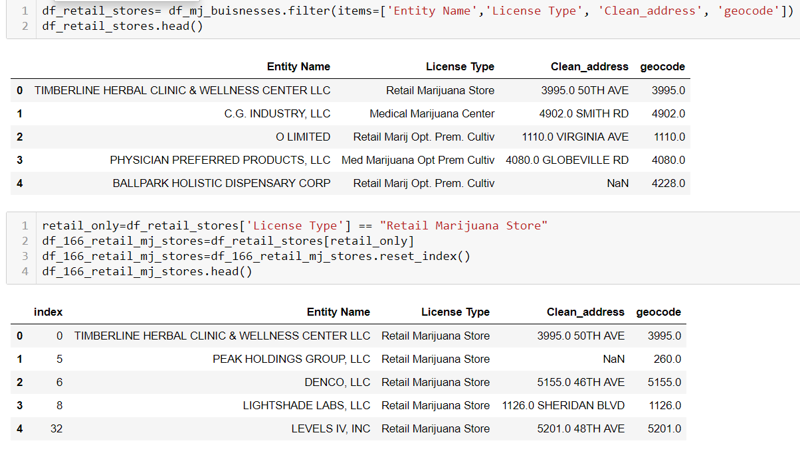
Limited API requests using a shorter list containing only Retail MJ Stores.... (1126 → 116 addresses)

Slide 17
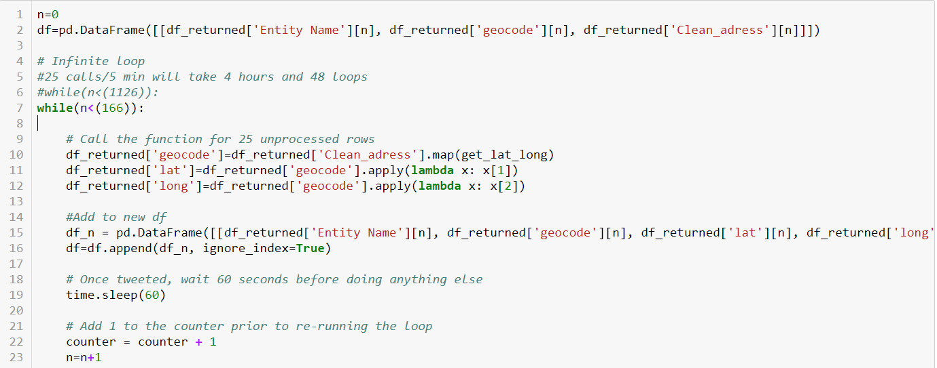
Limited API rate using a sleep timer within a loop calling the function one row at a time...

Slide 18
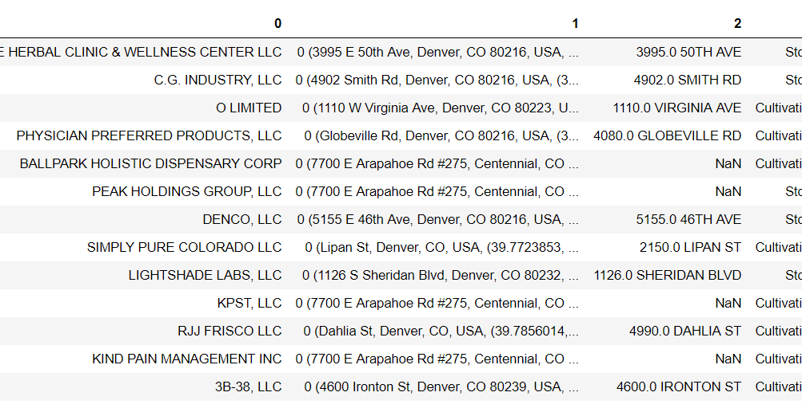
This worked!!
But when attempting to apply to the shorter list....
I learned to create back ups of each version of code. A full run of getting coordinates was not able to be processed in time.

Slide 19
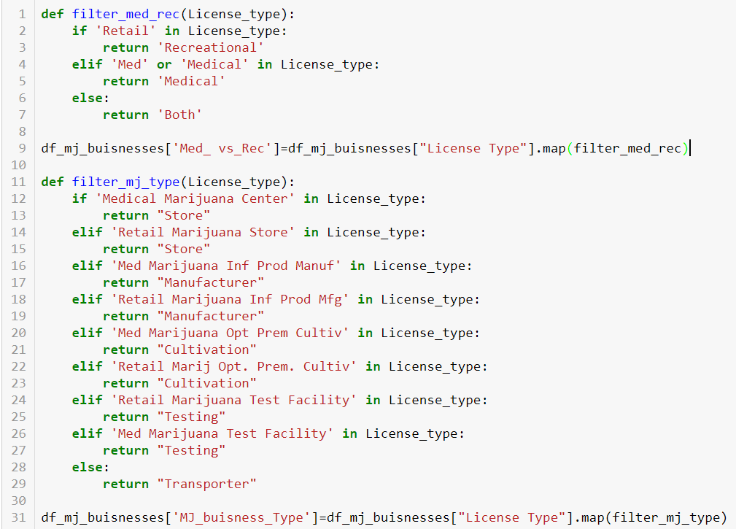
Let’s get an idea for the MJ industry in Denver anyways!

Slide 20
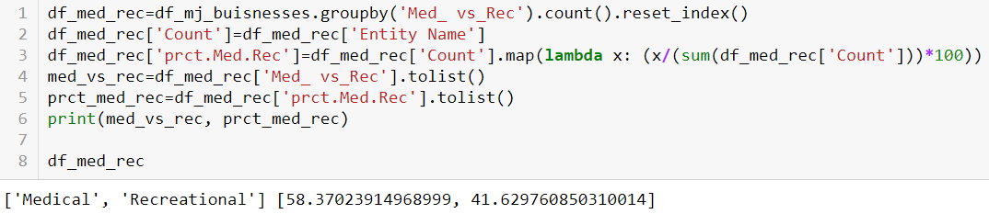
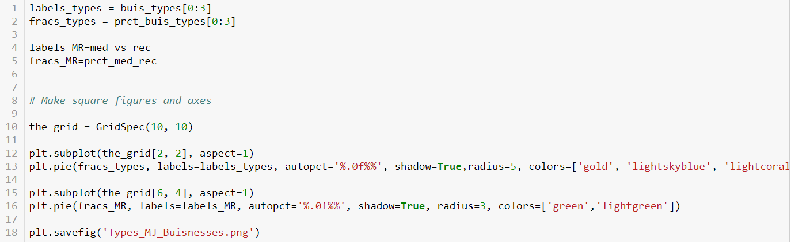
Pie Charts were created for your visual entertainment ☺

Slide 21
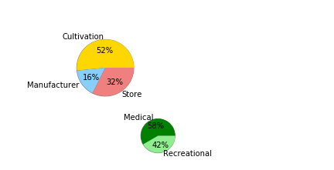
Hemp and Cannabis business Licenses in Denver since 2014

Slide 22
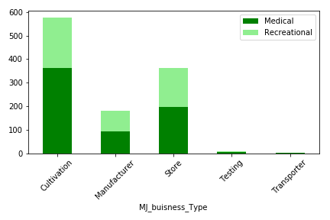
Hemp and Cannabis Businesses in Denver since 2014
represented more accurately through a bar chart

