Slide 1
Credit Scoring, Lending, Fraud Alerts and Risk Management Project
A real-time, scalable data engineering project for credit risk analysis, fraud alerting, and lending decisions.

Slide 2
Project Overview End-to-end real-time credit risk platform
Core Goals:
Automate credit scoring.
Detect fraud in real time.
Inform data-driven lending decisions.
Tools:
Kafka
Flink
Spark
PostgreSQL
MongoDB
Power BI

Slide 3
Business Use Cases
Approve/reject loan applications using automated scoring.
Detect suspicious loan applications (e.g. repeated identities, sudden spikes).
Alert fraud/risk teams instantly.
Empower executives with real-time dashboards.

Slide 4
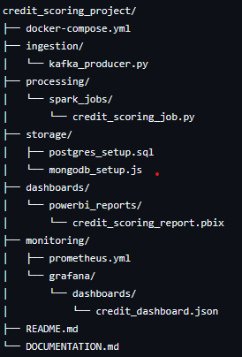
High-Level Architecture
[Kafka Producer]
[Kafka Topic: credit applications]
↓ ↓
[Flink Fraud Job] [Spark Risk Job]
↓ ↓
[MongoDB Alerts] [PostgreSQL DW]
↘ ↙
[Power BI Dashboards]

Slide 5
Data Pipeline
1. Loan application ingested via Kafka.
2. Flink detects fraud and stores alerts in MongoDB.
3. Spark batch job calculates credit risk and stores in PostgreSQL.
4. Power BI connects to DW for analytics.
5. Monitoring via Prometheus + Grafana.

Slide 6
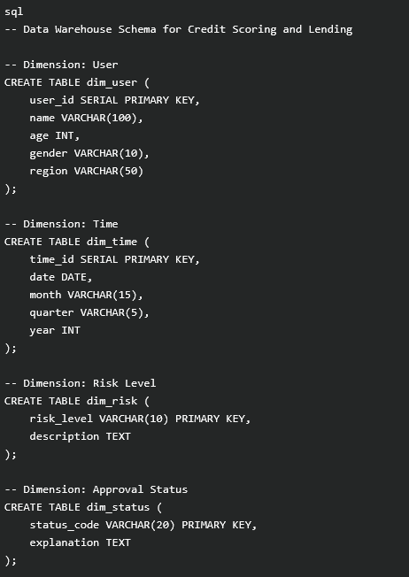
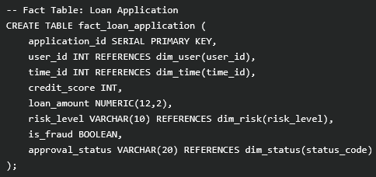
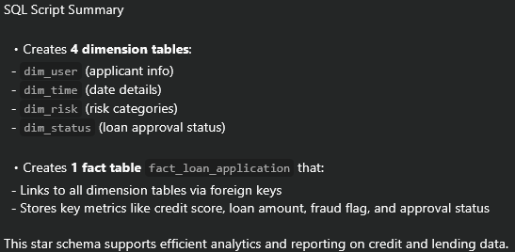
Data warehouse schema - star

Slide 7
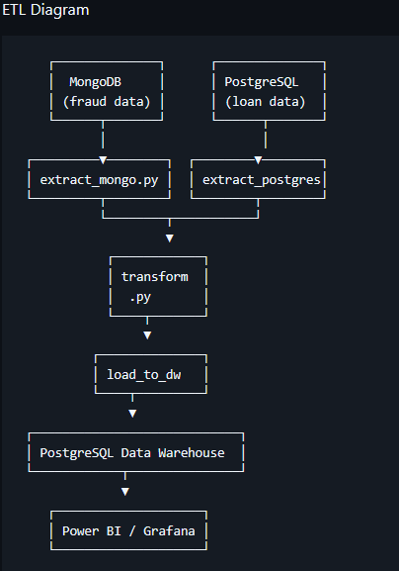
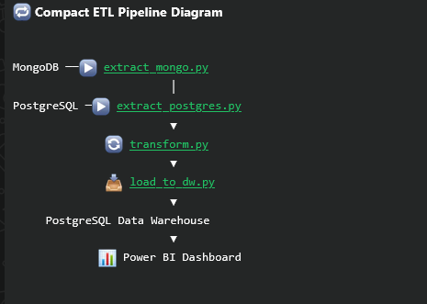
Etl & pipeline diagrams

Slide 8
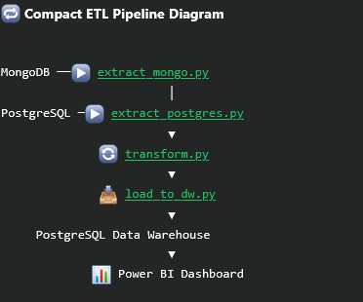
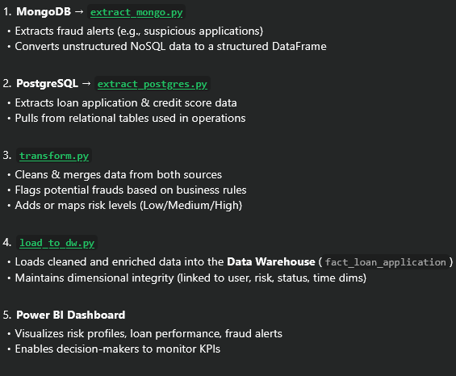
Data integration and etl process

Slide 9
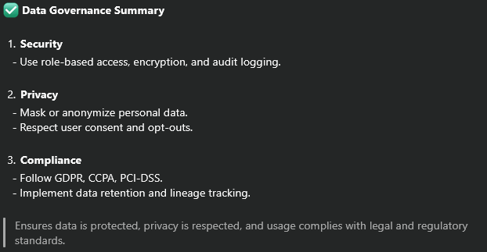
Data Governance
PostgreSQL and MongoDB secured with roles and passwords
Metadata tracking via Spark & SQL inserts
Policy management: min credit score, loan caps
Auditing: logs, dashboards, and job history

Slide 10
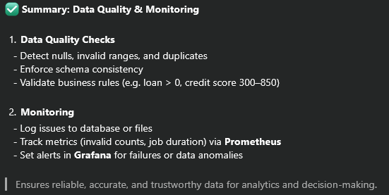
Data Quality Control
Schema validation on Kafka ingestion.
Spark cleans and logs invalid records.
Monitoring:
Dropped messages .
Fraud spikes.
Data inconsistencies.
Alerts via Grafana thresholds.

Slide 11
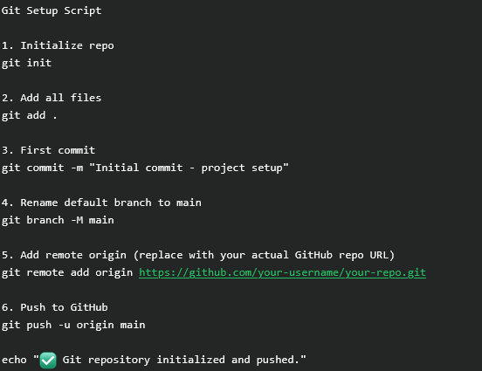
Version control - git
Initialize Git and connect to a remote repo
Use branches: main, dev, feature/*, bugfix/*
Track changes with git add, commit, push, merge
Tag versions (e.g., v1.0.0) for releases
Helps manage code history, collaboration, and rollback safely.

Slide 12
Dashboards & Monitoring
Power BI:
Real-time credit risk insights.
fraud distribution.
approval rates.
Grafana:
Job health.
fraud volume.
message lag.
Prometheus:
Monitors all processing pipelines.

Slide 13
Business Outcomes
Faster loan decisions with automated credit scoring.
Real-time fraud detection reduces financial risk.
Scalable and modular data platform.
Accurate, real-time reporting to key stakeholders.

Slide 14
Next Steps
Integrate machine learning for dynamic risk models.
API gateway for external loan systems.
CI/CD for data jobs- Cloud deployment (e.g., AWS + Kubernetes).

Slide 15
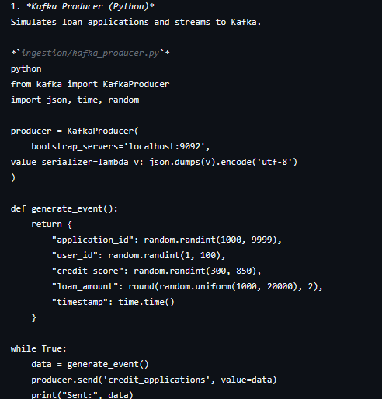
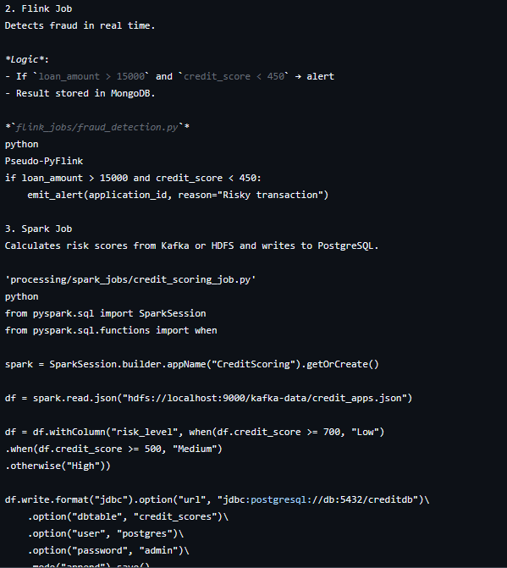
CODE SNIPPETS COMPONENTS AND SCRIPTS

Slide 16
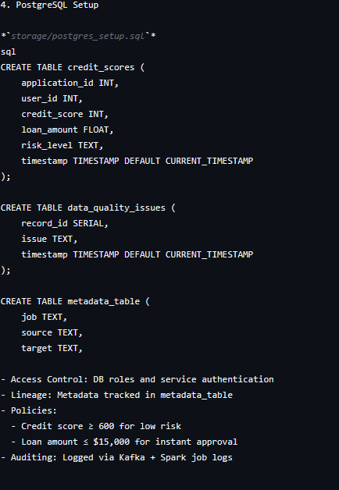
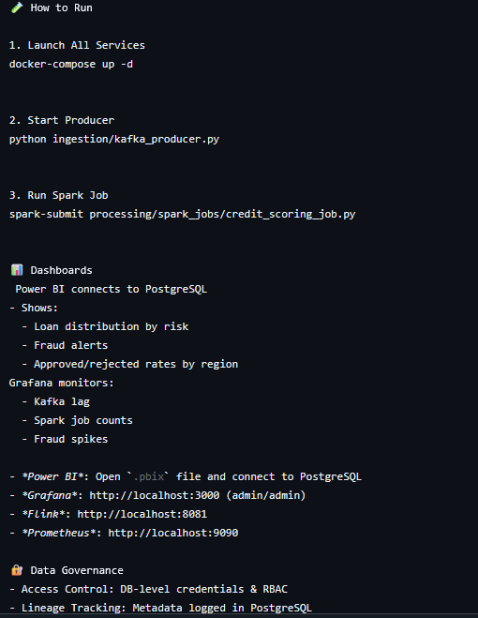
CODE SNIPPETS COMPONENTS AND SCRIPTS

Slide 17
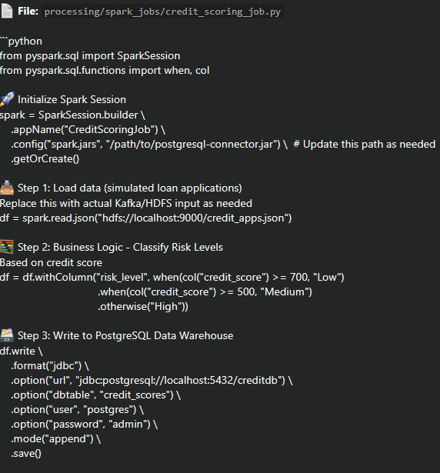
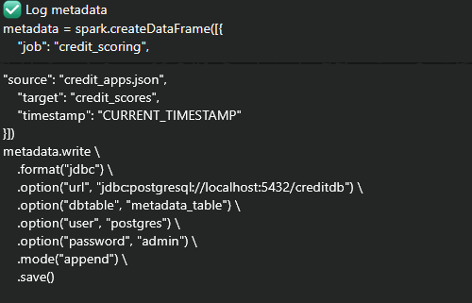

Credit scoring job

Slide 18
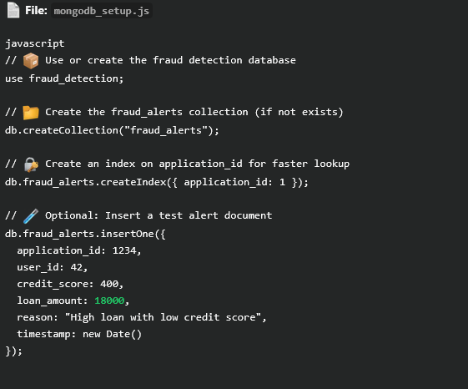
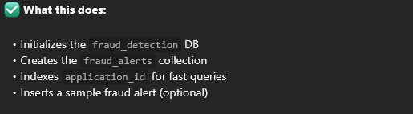
MONGODB.Js

Slide 19
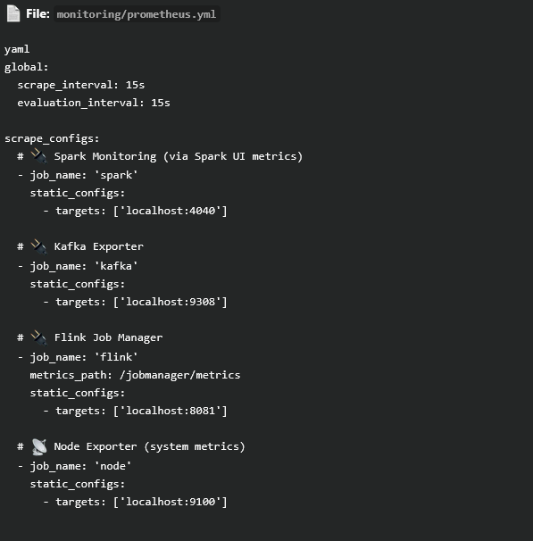

PROMETHEUS.YML

Slide 20
THE END
THANK YOU

