Slide 1
Case Study 2 Talent management
By :Ololade Awodipe

Slide 2

Contents
Introduction
Problem Statement
Data Overview and Cleaning
Salary Prediction
Salary Variable Importance
Attrition Prediction
Attrition Variable Importance
Conclusion

Slide 3
Introduction
DDS Analytics would like to use Data Science to predict employee attrition in hopes of retaining high performing employees from leaving.
DDS Analytics would also like to reduce the cost and resources of having to search and hire new employees due to attrition and a reduction in work force.

Slide 4
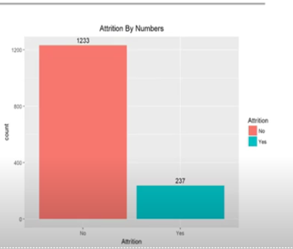
Data Overview
Traindata.csv - dataset with 870 Observations and 36 Variables
TestSalary.csv - dataset of 300 Observations and 35 Variables. Same information as Traindata, but with Salary information removed for testing
TestAttrition - dataset of 300 Observations and 35 Variables. Same w information as Traindata, but with Attrition information removed
No Missing Values

Slide 5
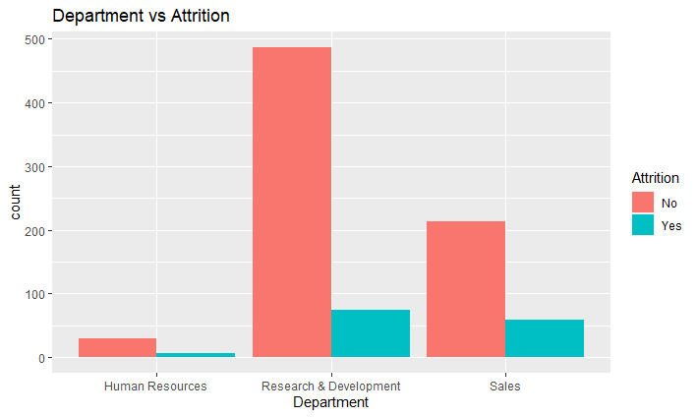
Attrition Rate of the Departments
The highest turnover rate belongs to the sales department where 20.6% have recorded attrition

Slide 6
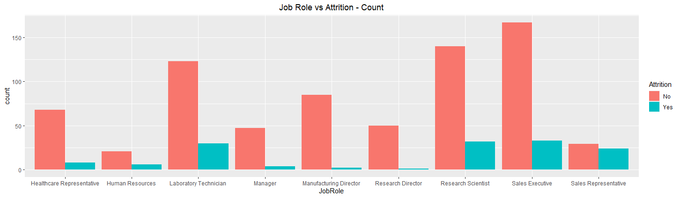
Job Role Vs Attrition Analysis
Attrition is the highest among Sales Executives and Laboratory Technicians.

Slide 7
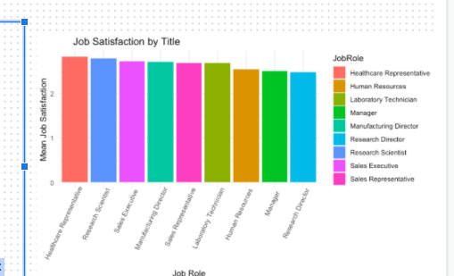
Overtime Analysis
Healthcare Representative and Research Scientists have the highest Job satisfaction while managers have the lowest.

Slide 8
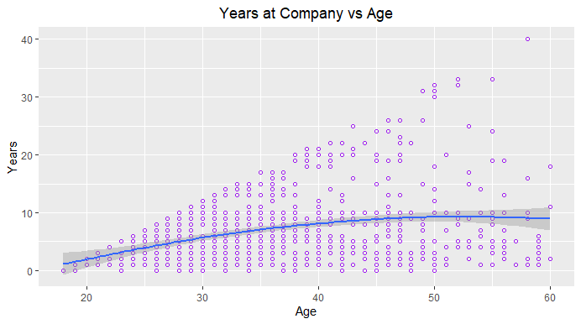

Slide 9
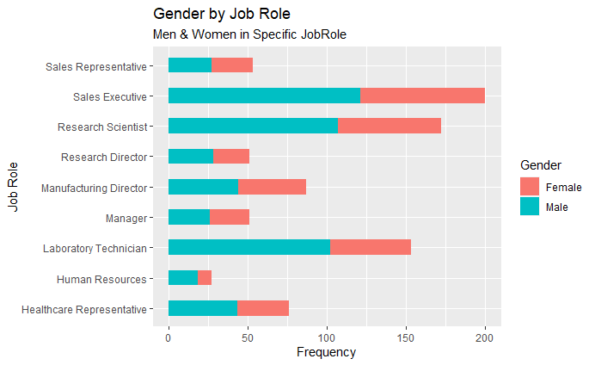

Slide 10
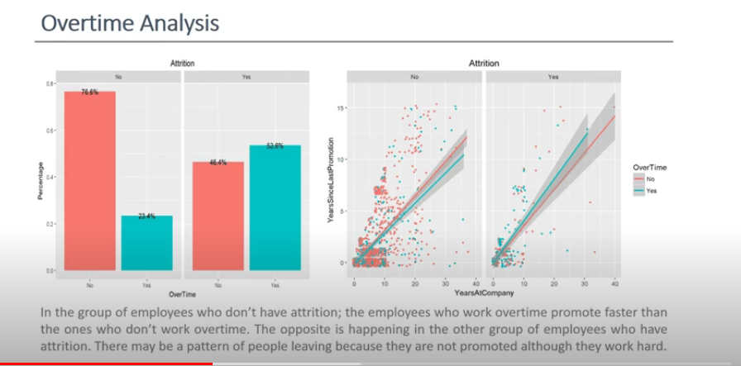

Slide 11
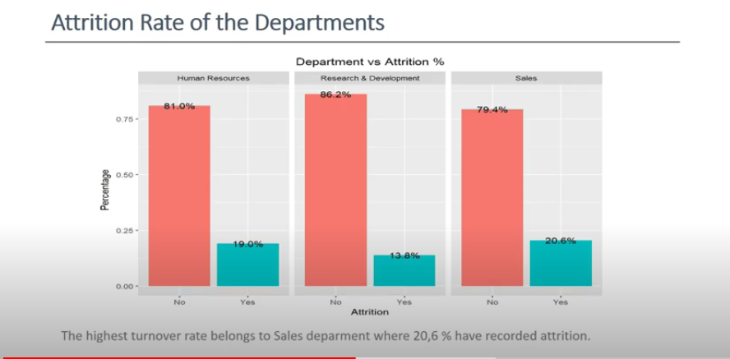

Slide 12
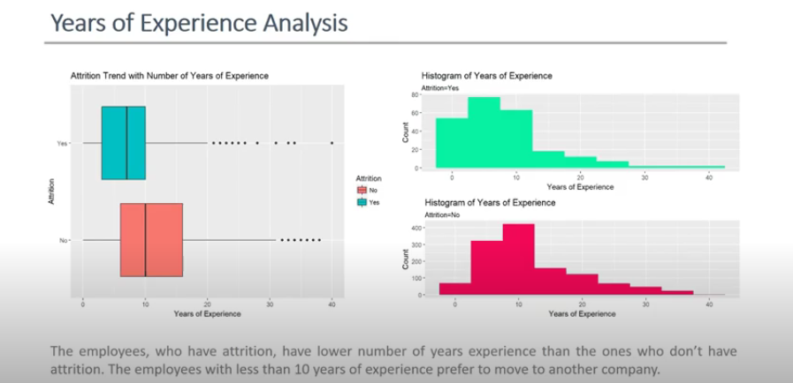

Slide 13
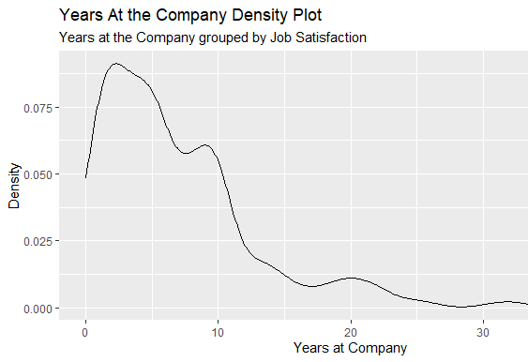

Slide 14
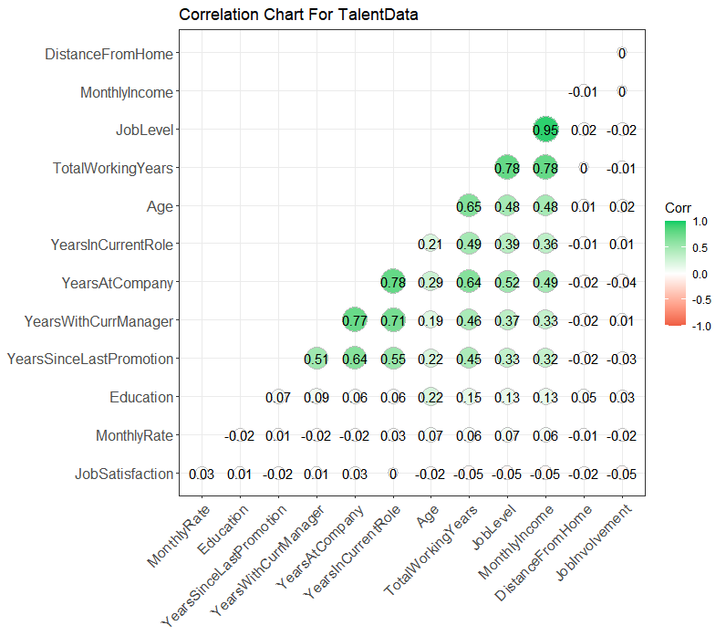
#Positively Correlated Features: ➢
Monthly Income vs Job level -> .95
Total Working Years vs Job Level -> .78
Total Working Years vs Monthly Income -> .78
Years at Current Role vs Years at Company -> .78
Years With Current Manager vs Years At Company - > .77
Years With Curr Manager vs Years In Current Role -> .71
#Low Correlated Features
Job Satisfaction Vs Age -> .22
Years in current role vs Age -> .13
Job Level vs Education -> .13

Slide 15
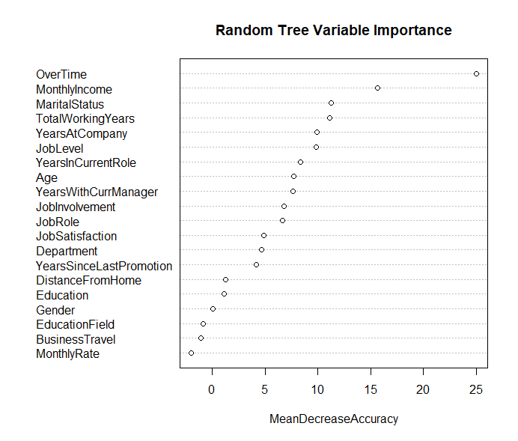

Slide 16
Models
 | Linear Regression | KNN Model
Attrition Prediction
Accuracy | 88% | 84%
sensitivity / specificity rate |  | .98/.09
 | Linear Regression | KNN Model
Salary Prediction
RMSE | 2299.51 | 1951.66

Slide 17
Conclusion
However, we were able to distinguish the most important factors that lead to attrition with a prediction accuracy of 88%.

