Slide 1
JPA Tutorial Part III. Integration with Spring Transaction Management
2018/11/12

Slide 2
Enviorment
Java 8
tomcat 7.x
spring 4.3
hibernate 4.3 + jpa 2.1
postgresql 8.4

Slide 3
Introduction to Spring Transaction Management
Consistent programming model across different transaction APIs such as Java Transaction API (JTA), JDBC, Hibernate, Java Persistence API (JPA), and Java Data Objects (JDO).
Support for both declarative and programmatic transaction management.
Simpler API for programmatic transaction management than complex transaction APIs such as JTA.
Excellent integration with Spring’s data access abstractions.

Slide 4
Transaction Abstraction
PlatformTransactionManager Interface
service provider interface (SPI)
The key to the Spring transaction abstraction
can be easily mocked or stubbed as necessary
TransactionException Interface
can be thrown by any of the PlatformTransactionManager interface’s methods
unchecked exception(that is, it extends the java.lang.RuntimeException class).
TransactionStatus Interface
Representation of the status of a transaction

Slide 5
Transaction Abstraction
TransactionDefinition Interface
Propagation
specifying the behavior of a transactional method
Isolation
The degree to which this transaction is isolated from the work of other transactions.
Timeout
How long this transaction runs before timing out and being rolled back automatically by the underlying transaction infrastructure.
Read-only status
A read-only transaction can be used when your code reads but does not modify data.

Slide 7
Configuration for TransactionManager
exmaple for JDBC DataSource
<bean id="dataSource" class="org.apache.commons.dbcp.BasicDataSource" destroy-method="close">
<property name="driverClassName" value="${jdbc.driverClassName}" />
<property name="url" value="${jdbc.url}" />
<property name="username" value="${jdbc.username}" />
<property name="password" value="${jdbc.password}" />
</bean>
<bean id="txManager" class="org.springframework.jdbc.datasource.DataSourceTransactionManager">
<property name="dataSource" ref="dataSource"/>
</bean>

Slide 8
exmaple for JTA
<?xml version="1.0" encoding="UTF-8"?>
<beans xmlns="http://www.springframework.org/schema/beans"
xmlns:xsi="http://www.w3.org/2001/XMLSchema-instance"
xmlns:jee="http://www.springframework.org/schema/jee"
xsi:schemaLocation=" http://www.springframework.org/schema/beans
http://www.springframework.org/schema/beans/spring-beans.xsd
http://www.springframework.org/schema/jee
http://www.springframework.org/schema/jee/spring-jee.xsd">
<jee:jndi-lookup id="dataSource" jndi-name="jdbc/jpetstore"/>
<bean id="txManager" class="org.springframework.transaction.jta.JtaTransactionManager" />
<!-- other <bean/> definitions here -->
</beans>

Slide 9
example for Hibernate
<bean id="sessionFactory" class="org.springframework.orm.hibernate5.LocalSessionFactoryBean">
<property name="dataSource" ref="dataSource"/>
<property name="mappingResources">
<list>
<value>org/springframework/samples/petclinic/hibernate/petclinic.hbm.xml</value>
</list>
</property>
<property name="hibernateProperties">
<value> hibernate.dialect=${hibernate.dialect} </value>
</property>
</bean>
<bean id="txManager" class="org.springframework.orm.hibernate5.HibernateTransactionManager">
<property name="sessionFactory" ref="sessionFactory"/>
</bean>

Slide 10
Declarative transaction management
The Spring Framework’s declarative transaction management is made possible with Spring aspect-oriented programming (AOP).
It can work with JTA transactions or local transactions using JDBC, JPA, Hibernate or JDO by simply adjusting the configuration files.
Unlike EJB CMT, which is tied to JTA.
You can apply the Spring Framework declarative transaction management to any class, not merely special classes such as EJBs.
It can customize transactional behavior, by using AOP.
With EJB CMT, you cannot influence the container’s transaction management except with setRollbackOnly().

Slide 11
the Spring default behavior:
roll back is automatic only on unchecked exceptions
The concept of rollback rules is important:
they enable you to specify which exceptions (and throwables) should cause automatic rollback.
You specify this declaratively, in configuration, not in Java code.
So, although you can still call setRollbackOnly() on the TransactionStatus object to roll back the current transaction back, most often you can specify a rule that MyApplicationException must always result in rollback.

Slide 12
17.5.1 Understanding the Spring Framework’s declarative transaction implementation
The most important concepts to grasp with regard to the Spring Framework’s declarative transaction support
this support is enabled via AOP proxies,
and that the transactional advice is driven by metadata (currently XML- or annotation-based).
The combination of AOP with transactional metadata yields an AOP proxy that uses a TransactionInterceptor in conjunction with an appropriate PlatformTransactionManager implementation to drive transactions around method invocations.

Slide 13
Example of declarative transaction implementation
<!-- this is the service object that we want to make transactional -->
<bean id="fooService" class="x.y.service.DefaultFooService"/>
<!-- the transactional advice (what 'happens'; see the <aop:advisor/> bean below) -->
<tx:advice id="txAdvice" transaction-manager="txManager">
<!-- the transactional semantics... -->
<tx:attributes>
<!-- all methods starting with 'get' are read-only -->
<tx:method name="get*" read-only="true"/>
<!-- other methods use the default transaction settings (see below) -->
<tx:method name="*"/>
</tx:attributes>
</tx:advice>
<!-- ensure that the above transactional advice runs for any execution
of an operation defined by the FooService interface -->
<aop:config>
<aop:pointcut id="fooServiceOperation" expression="execution(* x.y.service.FooService.*(..))"/>
<aop:advisor advice-ref="txAdvice" pointcut-ref="fooServiceOperation"/>
</aop:config>

Slide 14
17.5.3 Rolling back a declarative transaction
The recommended way to indicate to the Spring Framework’s transaction infrastructure that a transaction’s work is to be rolled back is
to throw an Exception from code that is currently executing in the context of a transaction.
In its default configuration, the Spring Framework’s transaction infrastructure code only marks a transaction for rollback in the case of runtime, unchecked exceptions;
when the thrown exception is an instance or subclass of RuntimeException. ( Errors will also - by default - result in a rollback).
Checked exceptions that are thrown from a transactional method do not result in rollback in the default configuration

Slide 15
You can also indicate a required rollback programmatically.
public void resolvePosition() {
try {
// some business logic...
}
catch (NoProductInStockException ex) {
// trigger rollback programmatically
TransactionAspectSupport.currentTransactionStatus().setRollbackOnly();
}
}

Slide 16
17.5.5 <tx:advice/> settings
The default <tx:advice/> settings are:
Propagation setting is REQUIRED.
Isolation level is DEFAULT.
Transaction is read/write.
Transaction timeout defaults to the default timeout of the underlying transaction system, or none if timeouts are not supported.
Any RuntimeException triggers rollback, and any checked Exception does not.

Slide 17
Attribute | Required? | Default | Description
name | Yes |  | Method name(s) with which the transaction attributes are to be associated. The wildcard (*) character can be used to associate the same transaction attribute settings with a number of methods; for example, get*, handle*, on*Event, and so forth.
propagation | No | REQUIRED | Transaction propagation behavior.
isolation | No | DEFAULT | Transaction isolation level. Only applicable to propagation REQUIRED or REQUIRES_NEW.
timeout | No | -1 | Transaction timeout (seconds). Only applicable to propagation REQUIRED or REQUIRES_NEW.
read-only | No | false | Read/write vs. read-only transaction. Only applicable to REQUIRED or REQUIRES_NEW.
rollback-for | No |  | Exception(s) that trigger rollback; comma-delimited. For example,com.foo.MyBusinessException,ServletException.
no-rollback-for | No |  | Exception(s) that do not trigger rollback; comma-delimited. For example,com.foo.MyBusinessException,ServletException.

Slide 18
17.5.6 Using @Transactional
In addition to the XML-based declarative approach to transaction configuration, you can use an annotation-based approach.
Declaring transaction semantics directly in the Java source code puts the declarations much closer to the affected code.
// the service class that we want to make transactional
@Transactional
public class DefaultFooService implements FooService {
Foo getFoo(String fooName);
Foo getFoo(String fooName, String barName);
void insertFoo(Foo foo);
void updateFoo(Foo foo);
}

Slide 19
<!-- from the file 'context.xml' -->
<?xml version="1.0" encoding="UTF-8"?>
<beans xmlns=http://www.springframework.org/schema/beans
xmlns:xsi=http://www.w3.org/2001/XMLSchema-instance
xmlns:aop=http://www.springframework.org/schema/aop
xmlns:tx=http://www.springframework.org/schema/tx
xsi:schemaLocation=" http://www.springframework.org/schema/beans
http://www.springframework.org/schema/beans/spring-beans.xsd
http://www.springframework.org/schema/tx
http://www.springframework.org/schema/tx/spring-tx.xsd
http://www.springframework.org/schema/aop
http://www.springframework.org/schema/aop/spring-aop.xsd">
<!-- this is the service object that we want to make transactional -->
<bean id="fooService" class="x.y.service.DefaultFooService"/>
<!-- enable the configuration of transactional behavior based on annotations -->
<tx:annotation-driven transaction-manager="txManager"/>
<!-- a PlatformTransactionManager is still required -->
<bean id="txManager" class="org.springframework.jdbc.datasource.DataSourceTransactionManager">
<!-- (this dependency is defined somewhere else) -->
<property name="dataSource" ref="dataSource"/>
</bean>
<!-- other <bean/> definitions here -->
</beans>

Slide 20
You can omit the transaction-manager attribute in the <tx:annotation-driven/> tag if the bean name of the PlatformTransactionManager that you want to wire in has the name transactionManager

Slide 21
Method visibility and @Transactional
When using proxies, you should apply the @Transactional annotation only to methods with public visibility.
If you do annotate protected, private or package-visible methods with the @Transactional annotation, no error is raised, but the annotated method does not exhibit the configured transactional settings.
Consider the use of AspectJ (see below) if you need to annotate non-public methods.

Slide 22
You can place the @Transactional annotation
before an interface definition,
a method on an interface,
a class definition,
or a public method on a class.
However, the mere presence of the @Transactional annotation is not enough to activate the transactional behavior. The <tx:annotation-driven/> element switches on the transactional behavior.

Slide 23
@Transactional settings
Property | Type | Description
value | String | Optional qualifier specifying the transaction manager to be used.
propagation | enum: Propagation | Optional propagation setting.
isolation | enum: Isolation | Optional isolation level. Only applicable to propagation REQUIRED or REQUIRES_NEW.
timeout | int (in seconds granularity) | Optional transaction timeout. Only applicable to propagation REQUIRED or REQUIRES_NEW.
readOnly | boolean | Read/write vs. read-only transaction. Only applicable to REQUIRED or REQUIRES_NEW.
rollbackFor | Array of Class objects, which must be derived from Throwable. | Optional array of exception classes that must cause rollback.
rollbackForClassName | Array of class names. Classes must be derived from Throwable. | Optional array of names of exception classes that must cause rollback.
noRollbackFor | Array of Class objects, which must be derived from Throwable. | Optional array of exception classes that must not cause rollback.
noRollbackForClassName | Array of String class names, which must be derived from Throwable. | Optional array of names of exception classes that must not cause rollback.

Slide 24
Multiple Transaction Managers with @Transactional
public class TransactionalService {
@Transactional("order")
public void setSomething(String name) { ... }
@Transactional("account")
public void doSomething() { ... }
}
<tx:annotation-driven/>
<bean id="transactionManager1" class="org.springframework.jdbc.datasource.DataSourceTransactionManager">
...
<qualifier value="order"/>
</bean>
<bean id="transactionManager2" class="org.springframework.jdbc.datasource.DataSourceTransactionManager">
...
<qualifier value="account"/>
</bean>

Slide 25
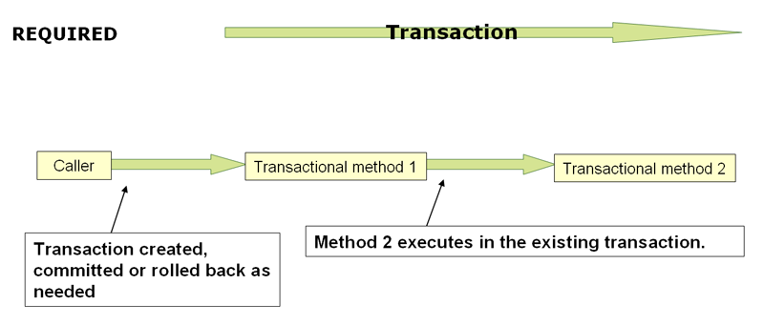
17.5.7 Transaction propagation

Slide 26
When the propagation setting is PROPAGATION_REQUIRED,
a logical transaction scope is created for each method upon which the setting is applied.
Each such logical transaction scope can determine rollback-only status individually, with an outer transaction scope being logically independent from the inner transaction scope.
all these scopes will be mapped to the same physical transaction.
So a rollback-only marker set in the inner transaction scope does affect the outer transaction’s chance to actually commit (as you would expect it to).
However, in the case where an inner transaction scope sets the rollback-only marker, the outer transaction has not decided on the rollback itself
A corresponding UnexpectedRollbackException is thrown at that point.
The outer caller needs to receive an UnexpectedRollbackException to indicate clearly that a rollback was performed instead.

Slide 27
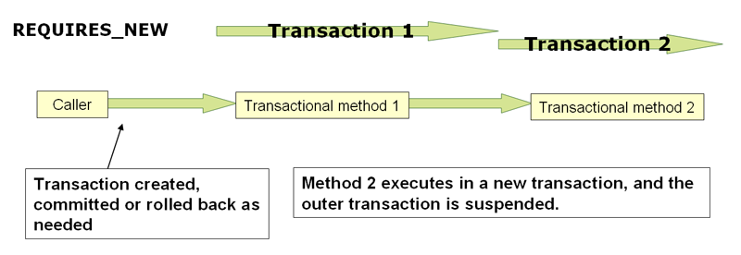
PROPAGATION_REQUIRES_NEW
always uses an independent physical transaction for each affected transaction scope, never participating in an existing transaction for an outer scope.
In such an arrangement, the underlying resource transactions are different and hence can commit or roll back independently, with an outer transaction not affected by an inner transaction’s rollback status.

Slide 28
Nested
PROPAGATION_NESTED uses a single physical transaction with multiple savepoints that it can roll back to.
Such partial rollbacks allow an inner transaction scope to trigger a rollback for its scope, with the outer transaction being able to continue the physical transaction despite some operations having been rolled back.
This setting is typically mapped onto JDBC savepoints, so will only work with JDBC resource transactions.

Slide 29
18. DAO support
18.2 Consistent exception hierarchy
Spring provides a convenient translation from technology-specific exceptions like SQLException to its own exception class hierarchy with the DataAccessException as the root exception.
These exceptions wrap the original exception so there is never any risk that one might lose any information as to what might have gone wrong.
In addition to JDBC exceptions, Spring can also wrap Hibernate-specific exceptions, converting them to a set of focused runtime exceptions (the same is true for JDO and JPA exceptions).
This allows one to handle most persistence exceptions, which are non-recoverable, only in the appropriate layers, without having annoying boilerplate catch-and-throw blocks and exception declarations in one’s DAOs. (One can still trap and handle exceptions anywhere one needs to though.)
As mentioned above, JDBC exceptions (including database-specific dialects) are also converted to the same hierarchy, meaning that one can perform some operations with JDBC within a consistent programming model.

Slide 30
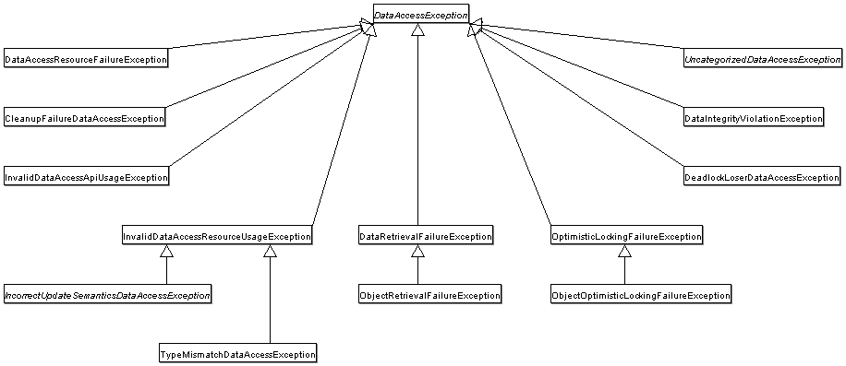

Slide 31
18.3 Annotations used for configuring DAO or Repository classes
The best way to guarantee that your Data Access Objects (DAOs) or repositories provide exception translation is to use the @Repository annotation.
allows the component scanning support to find and configure your DAOs and repositories without having to provide XML configuration entries for them.
@Repository
public class SomeMovieFinder implements MovieFinder {
// ...
}

Slide 32
Any DAO or repository implementation will need to access to a persistence resource, depending on the persistence technology used;
Here is an example for a JPA repository:
@Repository
public class JpaMovieFinder implements MovieFinder {
@PersistenceContext
private EntityManager entityManager;
// ...
}

Slide 33
Application Design Pattern
Service Layer
DAO Layer
JPA Entity
MyApp
Service
Interface
Dao
Interface
Entity
ServiceImpl
DaoImpl

Slide 34
DAO Layer
add @Repository annotation
@Repository
public class PersonDAOImpl<T> extends AbstractJpaDAO<Person> implements PersonDAO {
private static final Logger logger = LoggerFactory.getLogger(PersonDAOImpl.class);
public PersonDAOImpl() {
setClazz(Person.class);
}
public Person findByName(String name) {
Query query = entityManager.createNamedQuery("Person.findByName");
query.setParameter("name", name);
Person person = (Person) query.getSingleResult();
return person;
}
//(略)…………

Slide 35
Servcie Layer
add @Service annotation
@Service
public class PersonServiceImpl implements PersonService {
private final static Logger logger= LoggerFactory.getLogger(PersonServiceImpl.class);
@Autowired
private PersonDAO personDAO;
public void setPersonDAO(PersonDAO personDAO) {
this.personDAO = personDAO;
}
public Person findByName(String name) {
Person person = this.personDAO.findByName(name);
return person;
}
//(略)…………

Slide 36
Spring Configuration
add following lines in the spring configuration file
<context:component-scan base-package="cht.hioss.jpatutorial.dao" />
<context:component-scan base-package="cht.hioss.jpatutorial.service" />
<bean id="entityManagerFactory“
class="org.springframework.orm.jpa.LocalContainerEntityManagerFactoryBean">
<property name="persistenceUnitName" value="jpa-tutorial-unit"/>
</bean>
<bean id="transactionManager" class="org.springframework.orm.jpa.JpaTransactionManager">
<property name="entityManagerFactory" ref="entityManagerFactory" />
</bean>
<tx:annotation-driven transaction-manager="transactionManager" />
<bean id="persistenceExceptionTranslationPostProcessor" class="org.springframework.dao.annotation.PersistenceExceptionTranslationPostProcessor" />

Slide 37
references
Hibernate ORM 5.3.7.Final User Guide
http://docs.jboss.org/hibernate/orm/5.3/userguide/html_single/Hibernate_User_Guide.html
JPA Tutorial
https://www.tutorialspoint.com/jpa/index.htm
JPA Tutorial
https://www.javatpoint.com/jpa-tutorial
JPA Tutorial
http://www.java2s.com/Tutorials/Java/JPA/index.htm
A Guide to JPA with Spring
https://www.baeldung.com/the-persistence-layer-with-spring-and-jpa
Spring Framework reference
https://docs.spring.io/spring/docs/4.3.x/spring-framework-reference/html/index.html

