Slide 1
Energy to GDP per Capita Comparison
Lawrence Haggerty

Slide 2
Agenda
Introduction
Description / Definitions
Initial Comparison
Investigating Change
Technology / Future Growth
Summary

Slide 3
Introduction
There has been a consistent axiom since the beginning of the industrial revolution that energy drives commerce.
This project compares how the production and consumption of energy compares to the gross domestic product (GDP) per capita at the state and national level focused on understanding the trajectory for movement away from fossil fuel as our primary energy source and its alignment to the nation’s leading fiscal metric.
Analysis utilized energy & economic related data sets from the Bureau of Economic Analysis, US Census Bureau, Energy Information Agency, & International Information Agency.
Years Reviewed: 1970, 1980, 1990, 2000, 2010, 2020

Slide 4
Description / Definitions
Description
Definitions
Analysis utilized energy & economic related data sets from the Bureau of Economic Analysis, US Census Bureau, Energy Information Agency, & International Information Agency.
Years Reviewed: 1970, 1980, 1990, 2000, 2010, 2020
GDP: The total monetary value, or market value, of finished goods and services produced within a country during a period.
GDP per capita: Economic metric that breaks down a country's economic output per person.
Fossil Fuels: Includes Coal, Crude Oil, & Natural Gas
Nuclear: Nuclear electric power production in Btu, which also equals consumption, is the nuclear electricity net generation multiplied by the average heat rate of the nuclear power plants.
Renewables: Includes Biofuels, Geothermal, Hydroelectric, Solar, Wind,Wood, & Biomass Waste
Notes:
GDP: https://online.hbs.edu/blog/post/why-is-gdp-important
GDP per Capita: https://www.investopedia.com/terms/p/per-capita-gdp.asp#:~:text=GDP%20per%20capita%20measures%20the,per%20person%20in%20a%20nation.

Slide 5
Initial Comparison
Consumption / Production / GDP per Capita

Slide 6
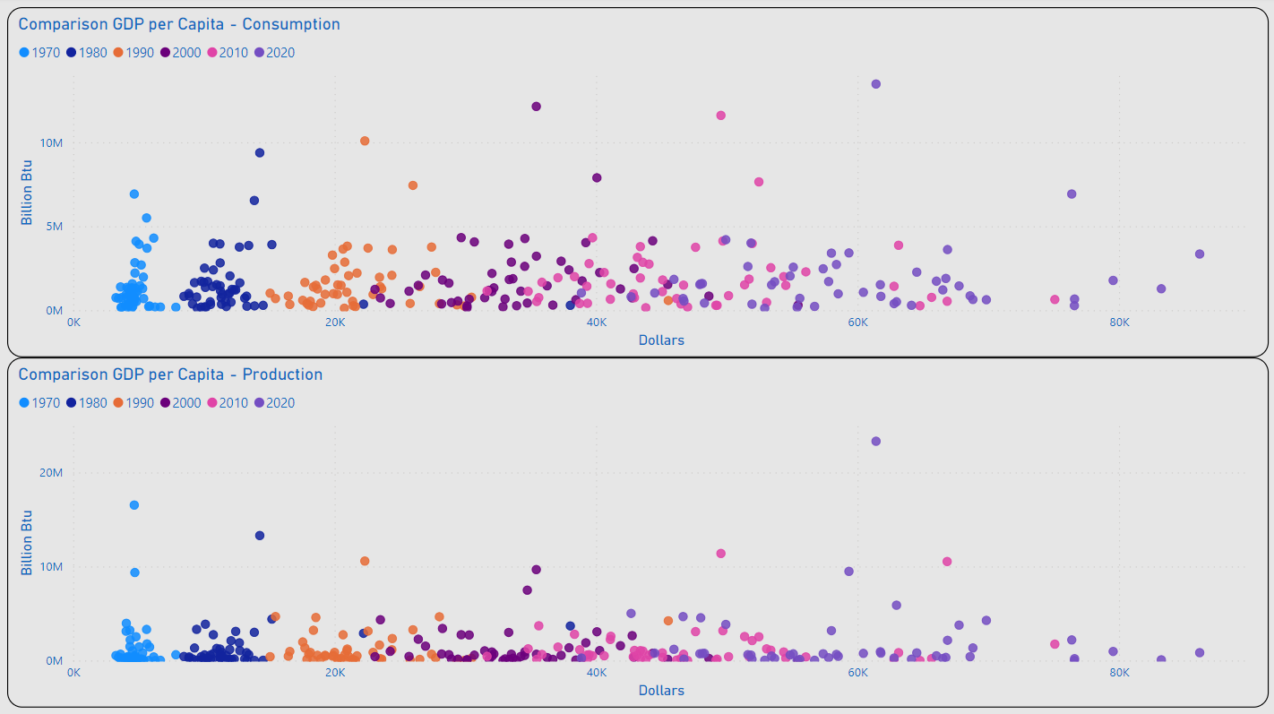
Consumption / Production
TX
Most States Remained Under 5M (BN Btu) for Consumption and Production
The Range of Values for GDP per Capita Appeared to Begin a Wider Dispersion in 2000
2020 Outliers for Consumption: TX & CA
2020 Outlier for Production: TX
Outliers for GDP per Capita Included: MA, NY & WA
CA
NY
WA
MA
TX
WA
MA
NY

Slide 7
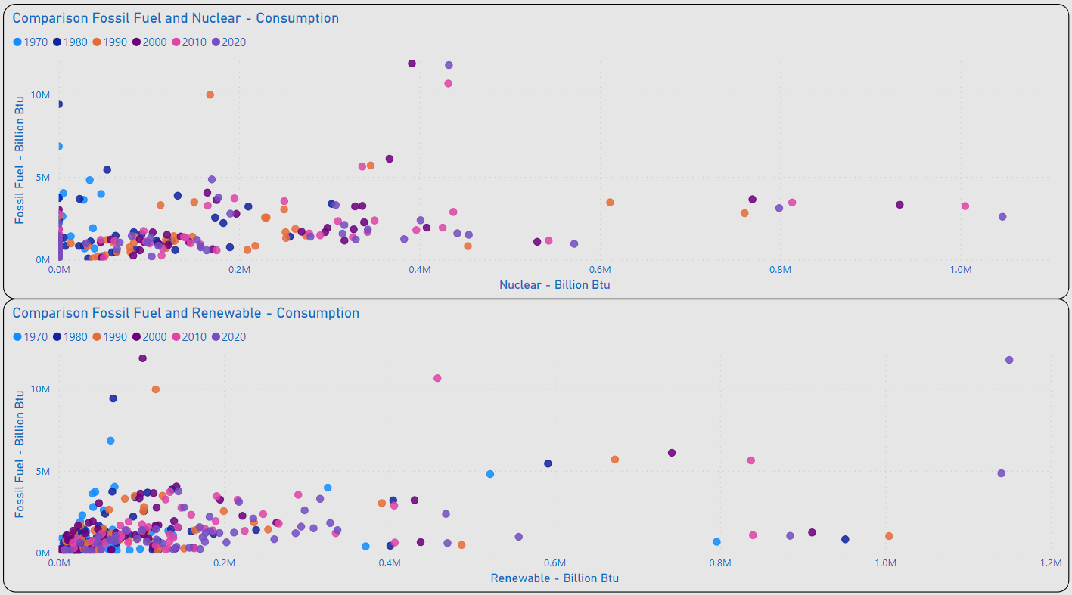
Energy Mix - Fossil Fuel to Alternatives
IL, PA, SC Lead the US in Consumption of Nuclear Energy
As of 2020 Several States Have Not Integrated the Use of Nuclear Energy: IN, MT, OK, SD, WY & VT
As of 2020 TX, CA, & WA Lead the US in Consumption of Renewable Energy
Distribution of Values for the Majority of States Remains < 200K (BN Btu) for Renewable Consumption
PA
IL
SC
TX
CA
WA

Slide 8
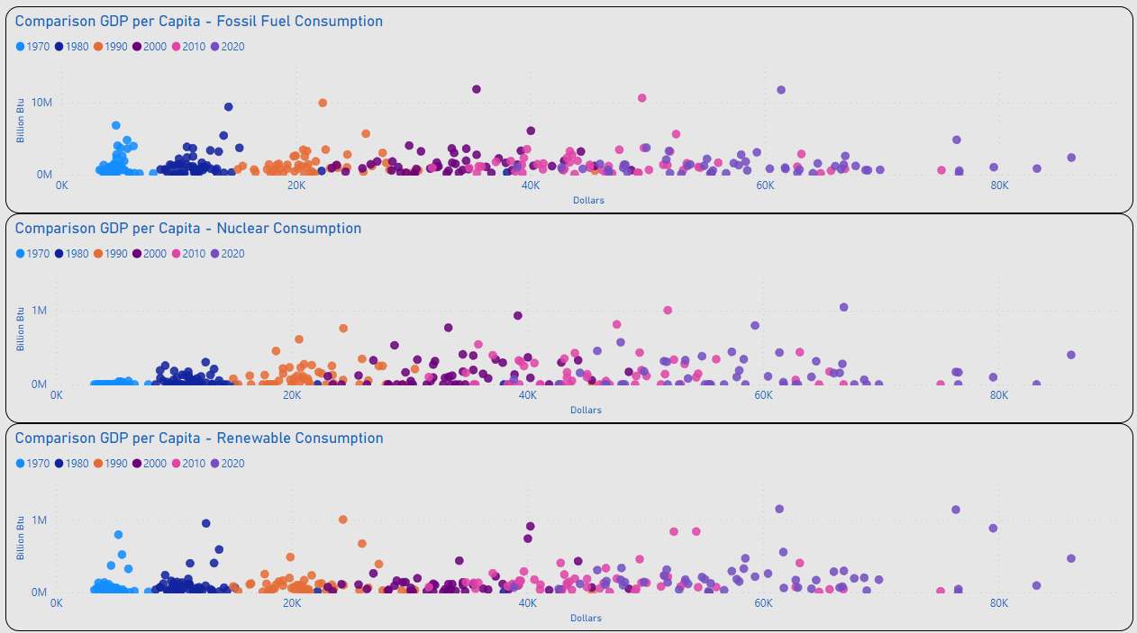
GDP per Capita – Energy Mix
Review of Distribution for Individual Energy Types Remains Generally Consistent with Initial Consolidated View for Consumption / GDP per Capita

Slide 9
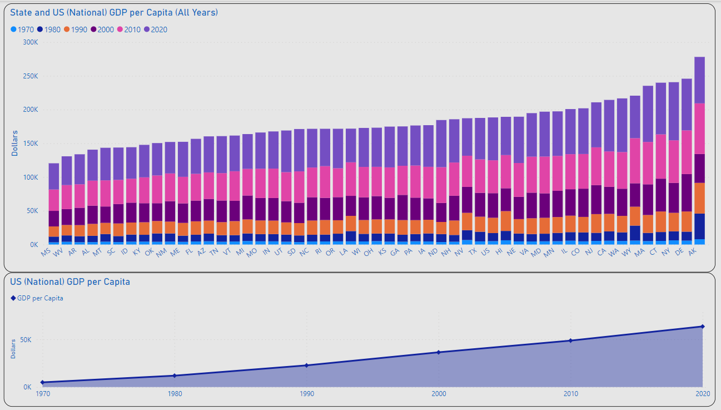
GDP per Capita
MAX: $86.2K
US AVG
US GDP per Capita Ranged from $5K in 1970 to $63.5K in 2020
MAX GDP per Capita: 2020 NY $86.2K
MIN GDP per Capita: 1970 MS $3.3K
Overall Increase Expected to Continue
MIN: $3.3K
US GDP per Capita: $63.5K
US GDP per Capita: 5K

Slide 10
Investigating Change
Consumption / Production / GDP per Capita

Slide 11
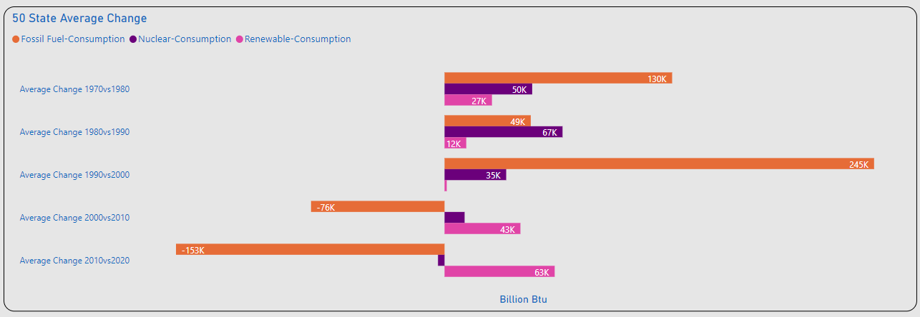
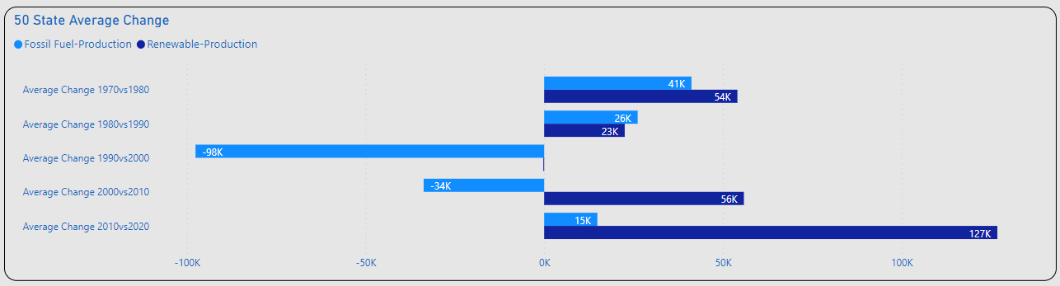
Amount of Change
Significant Changes Consumption
1980vs1990: Nuclear(+)
1990vs2000: Fossil Fuel(+)
2010vs2020: Fossil Fuel(-)
2010vs2020: Renewables(+)
Significant Changes Production
1990vs2000: Fossil Fuel(-)
2010vs2020: Renewable(+)

Slide 12
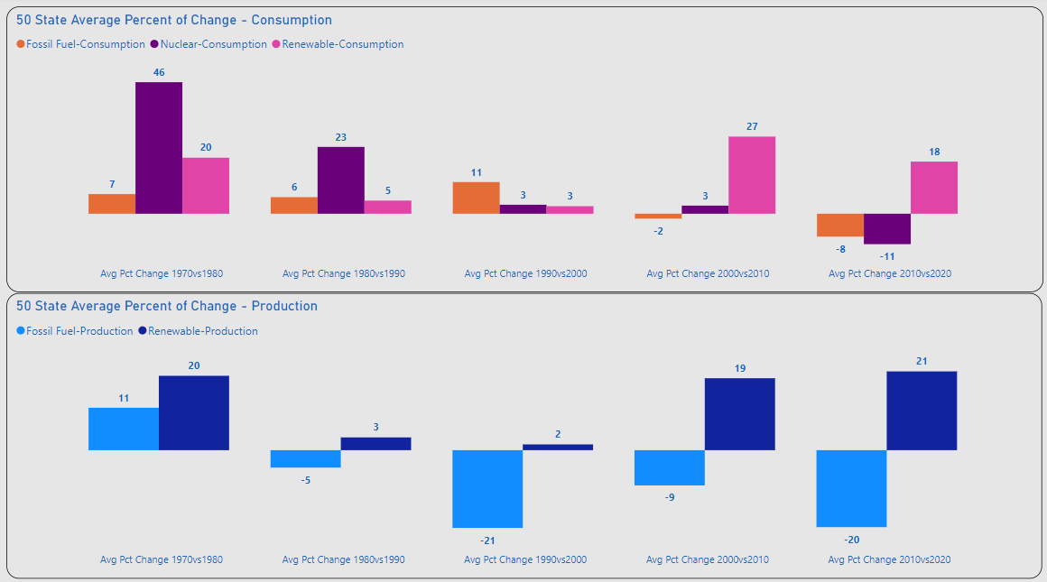
Percent of Change
Consumption
1970vs1980: Nuclear(+)
2000vs2010: Renewable(+)
2010vs2020: Fossil Fuel / Nuclear (-), Renewables(+)
Production
Overall Fossil Fuel(-)
Overall Renewable(+)

Slide 13
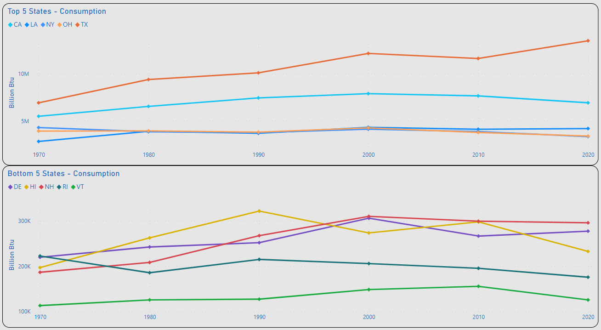
Top 5 / Bottom 5 – Change Consumption
TX: 13.5M
Top 5 Consumption
MAX: TX 6.9M – 13.5M(BN Btu)
Highest Decrease: NY 4.3M – 3.4M (BN Btu)
NY & OH (-) Overall Consumption
Bottom 5 Consumption
MIN: VT 113K – 125K (BN Btu)
RI (-) Overall Consumption
TX: 6.9M
NY: 4.3M
NY: 3.4M
RI: 225K
RI: 176K
VT: 113K
VT: 125K

Slide 14
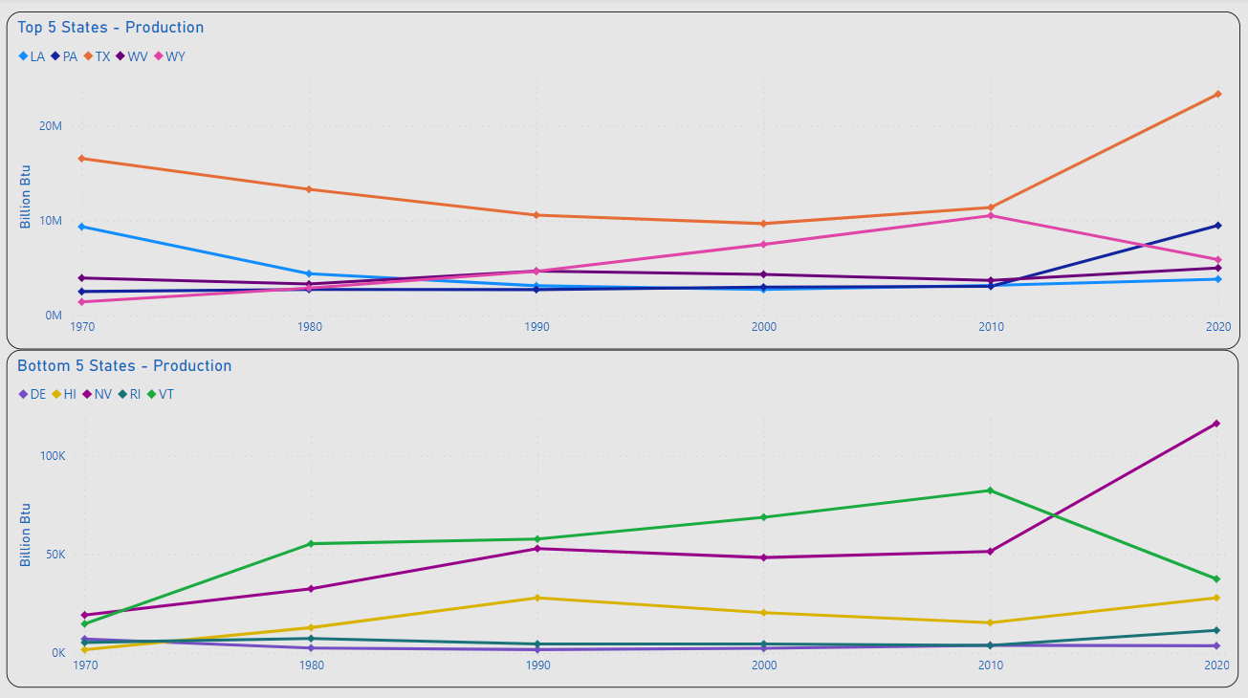
Top 5 / Bottom 5 – Change Production
TX: 23.3M
TX: 16.5M
Top 5 Production
MAX: TX 16.5M – 23.3M(BN Btu)
Highest Decrease: LA 9.4M – 3.8M (BN Btu)
TX, PA, WV, WY(+) Overall Production
Bottom 5 Production
MIN: DE 7K – 3.5K (BN Btu)
HI, NV, RI, VT (+) Overall Production
LA: 9.4M
LA: 3.8M
DE: 7K
DE: 3.5K

Slide 15
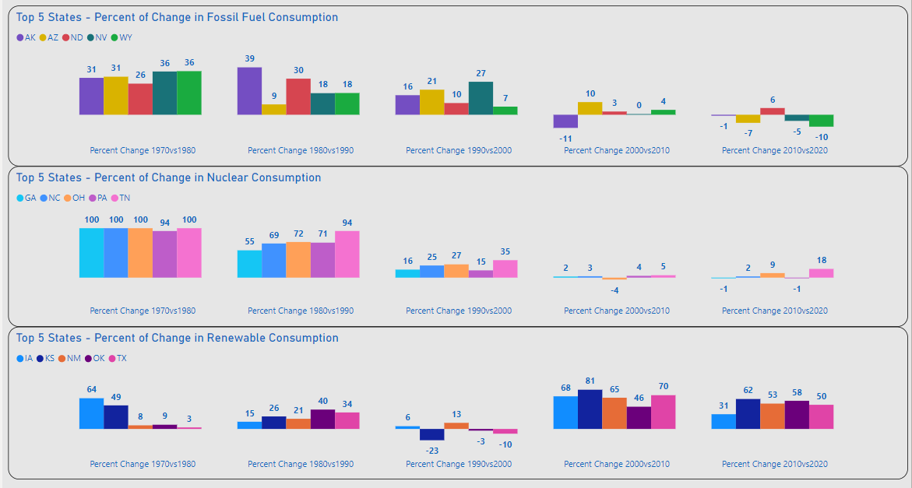
Top 5 Energy Mix - Consumption
Top 5 Energy Mix
Fossil Fuel and Nuclear Displays Highest Volumes of Increases 1970-2000
Renewable Consumption Displays Significant Increases After 2000

Slide 16
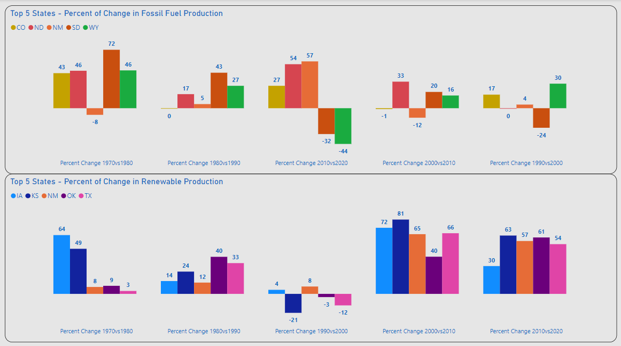
Top 5 Energy Mix - Production
Top 5 Energy Mix
Weakening of Fossil Fuel Production After 2000
Renewable Production Displays Significant Increases After 2000

Slide 17
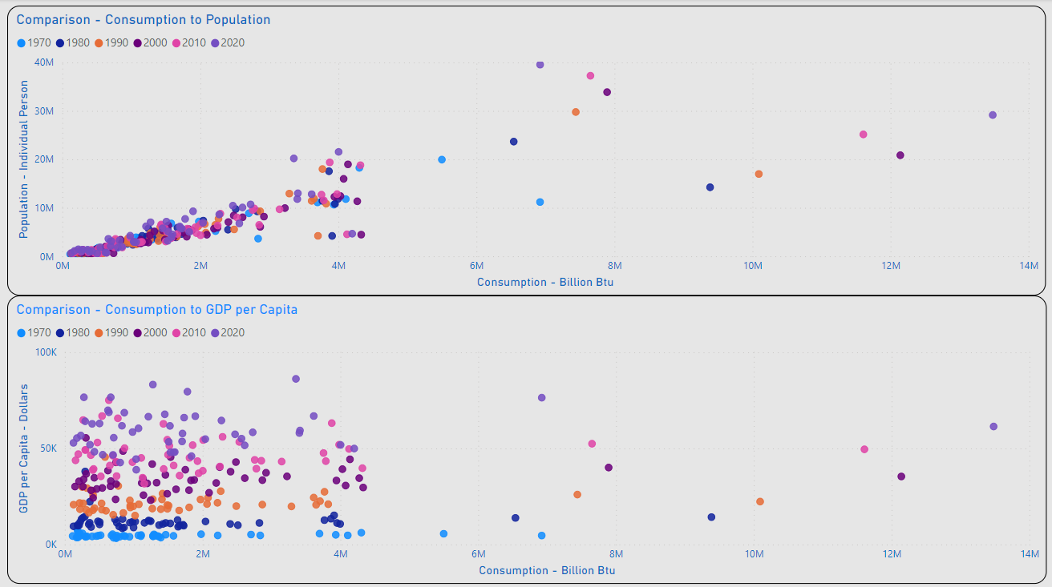
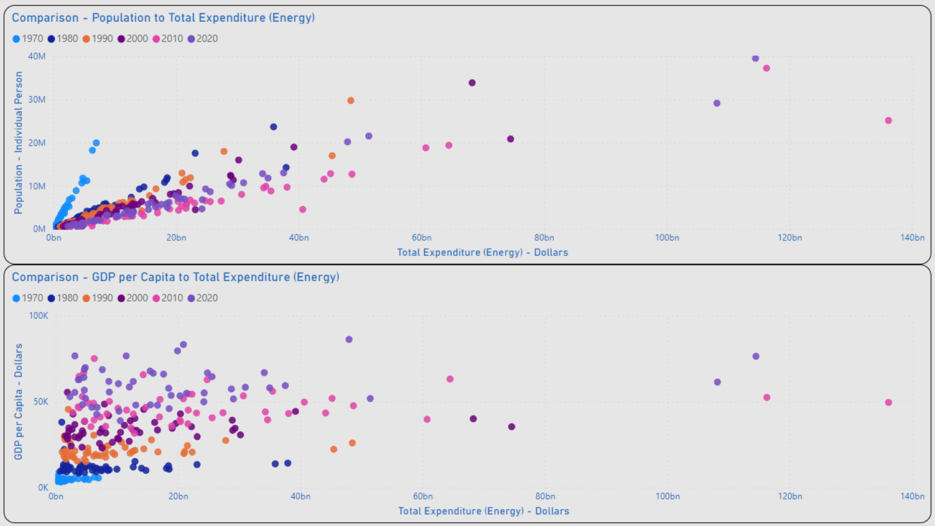
Occam’s Razor
Alignment of Population and Consumption Values Indicates a Strong Correlation
Dispersion of GDP per Capita and Consumption Values Between GDP Indicates Lack of Correlation
Occam’s Razor: The Simplest Explanation is Usually the Best One.

Slide 18
Technology / Future Growth
Consumption / Production / GDP per Capita

Slide 19
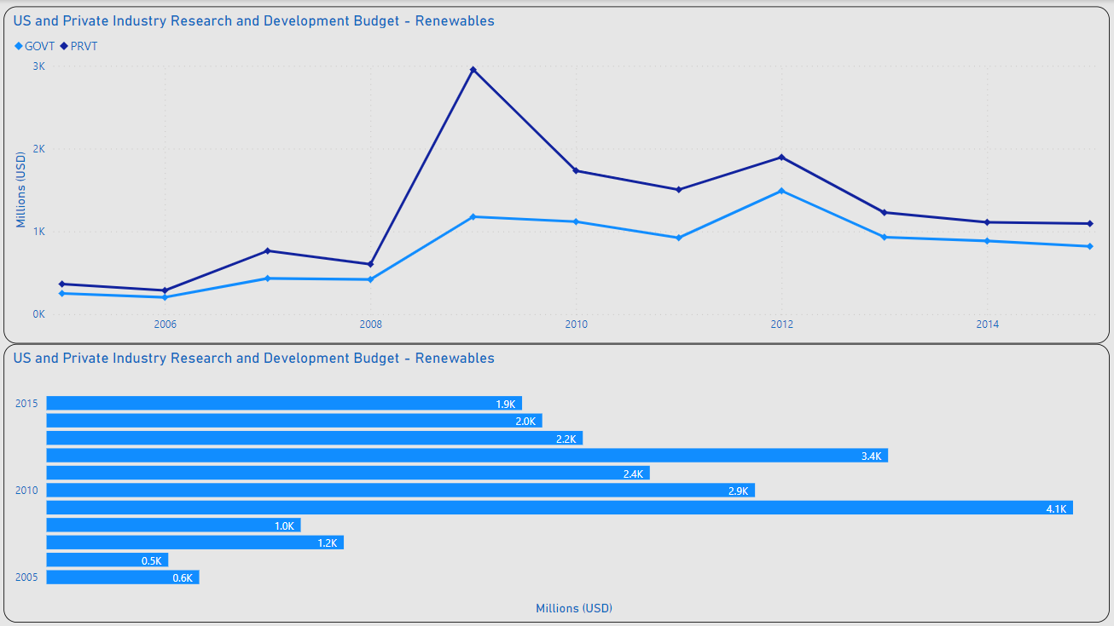
Advancing Renewable Tech
MAX PVT: 3B
R&D Investment
MAX Private Industry: 3B / 2009
MEDIAN Private Industry: 1.2B
MAX US Government: 1.9B / 2012
Median US Government: 786M
~15B Invested in R&D 2005-2015
MAX GOVT:
1.9B

Slide 20
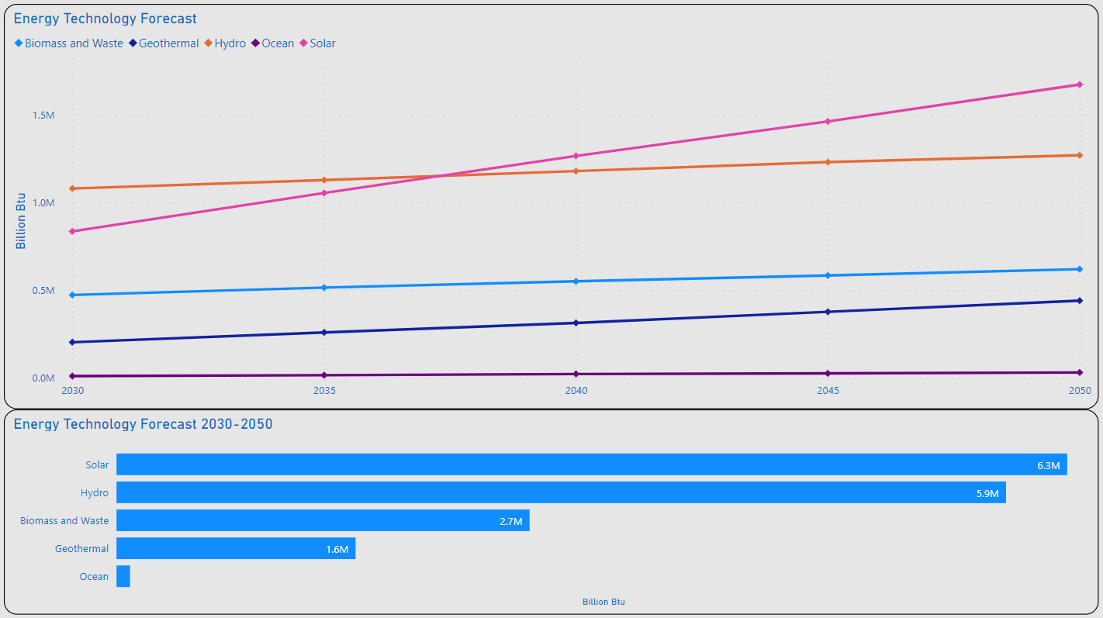
Advancing Renewable Tech
MAX Solar: 1.7M
Tech Projections
Solar Appears to be the Clear Leader in Renewable Advances / New Adoption
Solar MAX: 1.7M (BN Btu) / 2050
Solar MIN: 835K (BN Btu) / 2030
~16.6M (BN Btu) in Renewables Forecasted Between 2030 & 2050
MIN Solar: 835K

Slide 21
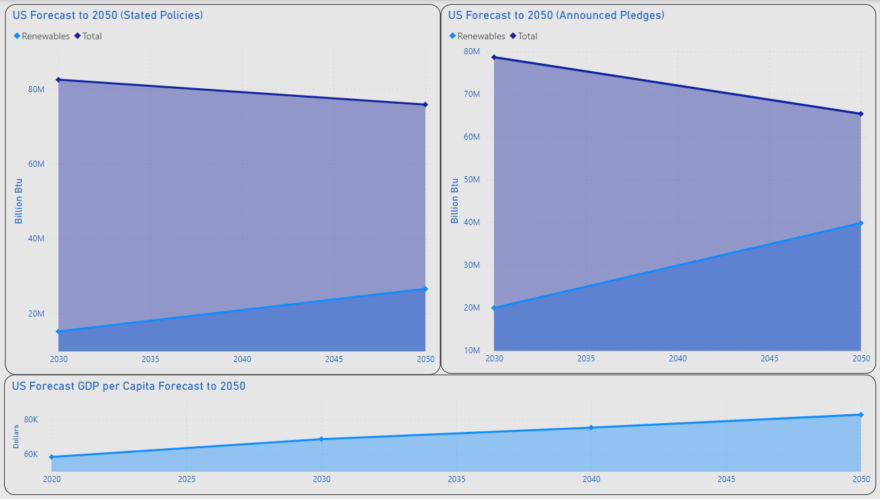
2050....Heading In The Right Direction
Total: 75.8M
Total: 65.4M
Stated Policies:
35% of US Energy Projected for Renewables
74% Increase from 2030
Announced Pledges:
60.9% of US Energy of US Energy Projected for Renewables
100% Increase from 2030
GDP per Capita:
83K
30.7% Increase from 2020
Renewables: 39.8M
Renewables: 26.5M
GDP per Capita: 83K

Slide 22
Summary
Population has the Greater Impact on Consumption vs. GDP per Capita (Occam’s Razor)
Fossil Fuel Expected to Continue Declining
Continued Usage Expected
Renewables Expected to Continue Increasing
Technological Innovation / Availability
Government Policy / Regulation

Slide 23
Thank you
Lawrence Haggerty​
lawrence.c.Haggerty@gmail.com
https://www.linkedin.com/in/lawrence-haggerty/
https://github.com/lawrence-haggerty

Slide 24
Closing Notes
Technology:
Excel: Extract Transform Load, Minor Analysis
PostgreSQL / pgAdmin: Analysis, Prepare Data for Visualization
Microsoft Power BI: Analysis, Visualization
Data Sources:
Energy Information Administration (EIA):
State Energy Data System 1960-2020: https://www.eia.gov/state/seds/seds-data-complete.php?sid=ND#StatisticsIndicators
Bureau of Economic Analysis (BEA):
Regional Data Tools: https://apps.bea.gov/regional/
United States Census Bureau:
Historical Population Change Data (1910-2020): https://www.census.gov/data/tables/time-series/dec/popchange-data-text.html
International Energy Agency (IEA):
Energy Technology RD&D Budgets: https://www.iea.org/data-and-statistics/data-product/energy-technology-rd-and-d-budget-database-2#
World Energy Investment 2023 Datafile: https://www.iea.org/data-and-statistics/data-product/world-energy-investment-2023-datafile-2

