Slide 1
Energy to GDP per Capita Comparison
Lawrence Haggerty

Slide 2
Agenda
Introduction
Description / Definitions
Topic
Topic
Topic
Topic
Topic

Slide 3
Introduction
There has been a consistent axiom since the beginning of the industrial revolution that energy drives commerce.
This project compares how the production and consumption of energy compares to the gross domestic product (GDP) per capita at the state and national level focused on understanding the trajectory for movement away from fossil fuel as our primary energy source and its alignment to the nation’s leading fiscal metric.
Analysis utilized energy & economic related data sets from the Bureau of Economic Analysis, US Census Bureau, Energy Information Agency, & International Information Agency.
Years Reviewed: 1970, 1980, 1990, 2000, 2010, 2020

Slide 4
Description / Definitions
Description
Definitions
Analysis utilized energy & economic related data sets from the Bureau of Economic Analysis, US Census Bureau, Energy Information Agency, & International Information Agency.
Years Reviewed: 1970, 1980, 1990, 2000, 2010, 2020
GDP: The total monetary value, or market value, of finished goods and services produced within a country during a period.
GDP per capita: Economic metric that breaks down a country's economic output per person.
Fossil Fuels: Includes Coal, Crude Oil, & Natural Gas
Nuclear: Nuclear electric power production in Btu, which also equals consumption, is the nuclear electricity net generation multiplied by the average heat rate of the nuclear power plants.
Renewables: Includes Biofuels, Geothermal, Hydroelectric, Solar, Wind,Wood, & Biomass Waste
Notes:
GDP: https://online.hbs.edu/blog/post/why-is-gdp-important
GDP per Capita: https://www.investopedia.com/terms/p/per-capita-gdp.asp#:~:text=GDP%20per%20capita%20measures%20the,per%20person%20in%20a%20nation.

Slide 5
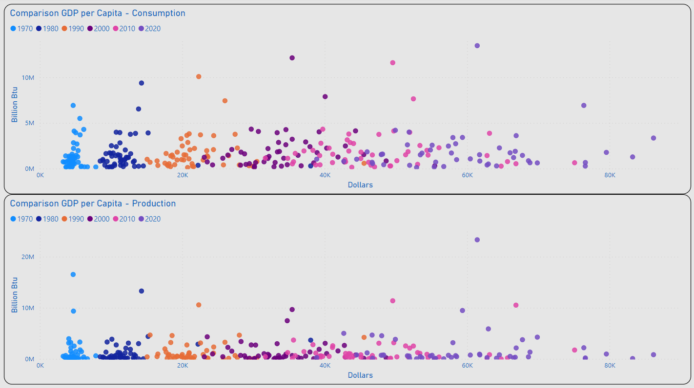
Consumption / Production
TX
Most States Remained Under 5M (BN Btu) for Consumption and Production
The Range of Values for GDP per Capita Appeared to Begin a Wider Dispersion in 2000
2020 Outliers for Consumption: TX & CA
2020 Outlier for Production: TX
Outliers for GDP per Capita Included: MA, NY & WA
CA
NY
WA
MA
TX
WA
MA
NY

Slide 6
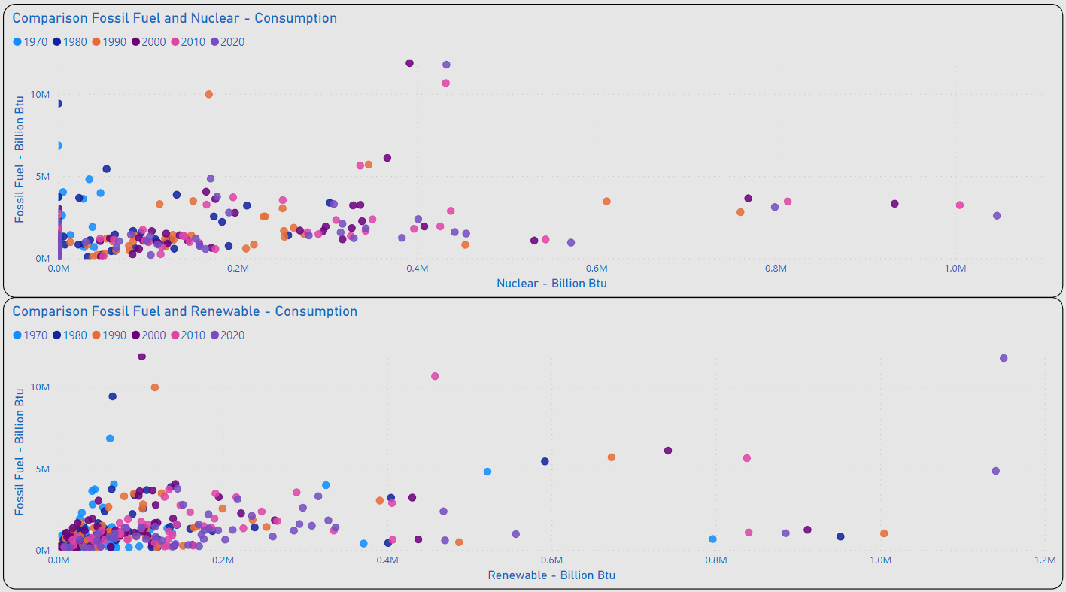
Energy Mix - Fossil Fuel to Alternatives
IL, PA, SC Lead the US in Consumption of Nuclear Energy
As of 2020 Several States Have Not Integrated the Use of Nuclear Energy: IN, MT, OK, SD, WY & VT
As of 2020 TX, CA, & WA Lead the US in Consumption of Renewable Energy
Distribution of Values for the Majority of States Remains < 200K (BN Btu) for Renewable Consumtion
PA
IL
SC
TX
CA
WA

Slide 7
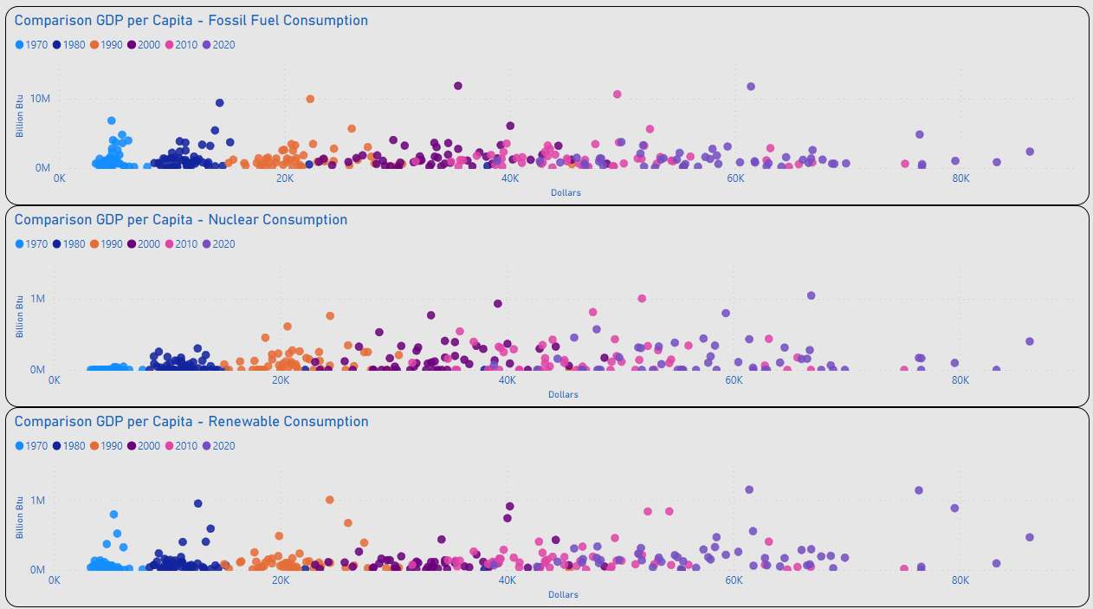
GDP per Capita – Energy Mix
Review of Distribution for Individual Energy Types Remains Generally Consistent with Initial Consolidated View for Consumption / GDP per Capita

Slide 8
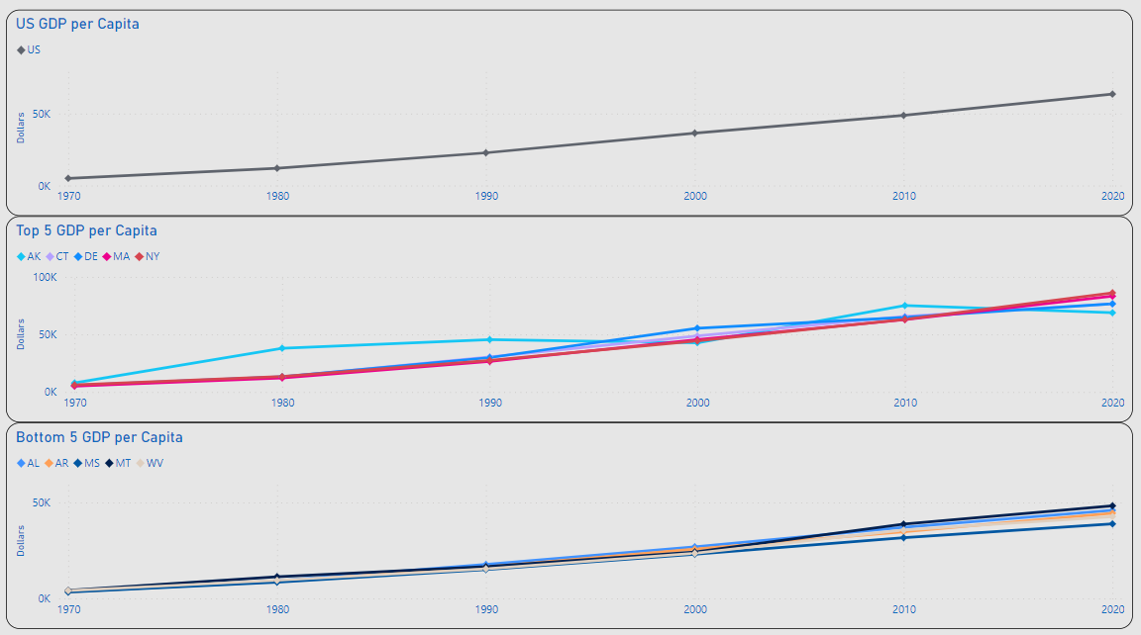
XXXX
US GDP per Capita Ranged from $5K in 1970 to $63.5K in 2020
MAX Top 5 GDP per Capita: 2020 NY $86.2K
MIN Top 5 GDP per Capita: 1970 CT $5.4K
MAX Bottom 5 GDP per Capita: 2020 AL $46K
MIN Bottom 5 GDP per Capita: 1970 MS $3.3K
CHOOSE 1 GDP PER CAPITA SLIDE

Slide 9
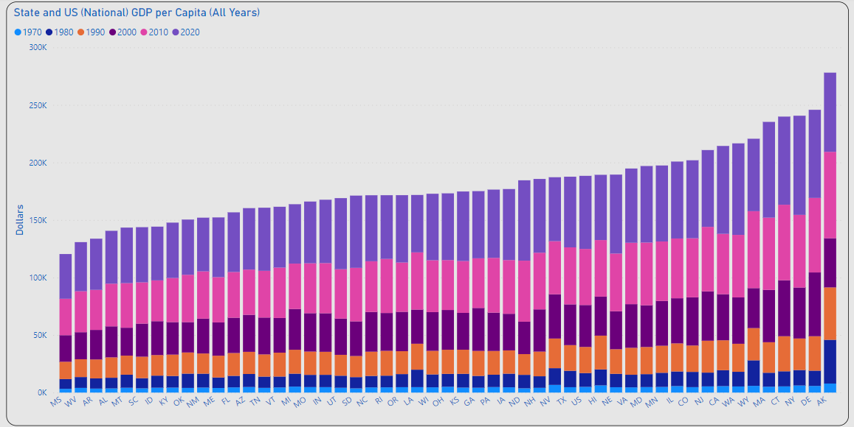
XXXX
MAX: $86.2K
US GDP per Capita Ranged from $5K in 1970 to $63.5K in 2020
MAX GDP per Capita: 2020 NY $86.2K
MIN GDP per Capita: 1970 MS $3.3K
US AVG
CHOOSE 1 GDP PER CAPITA SLIDE
MIN: $3.3K

Slide 10
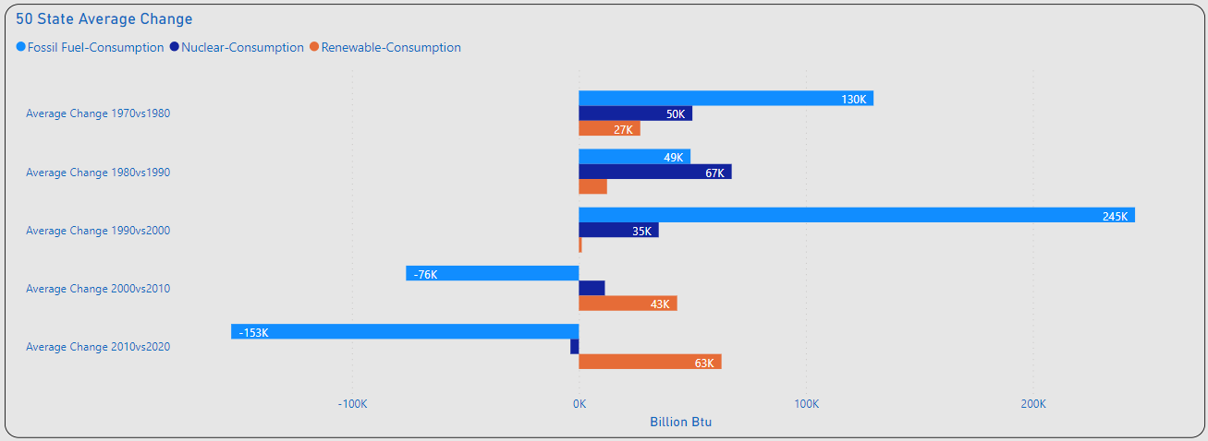
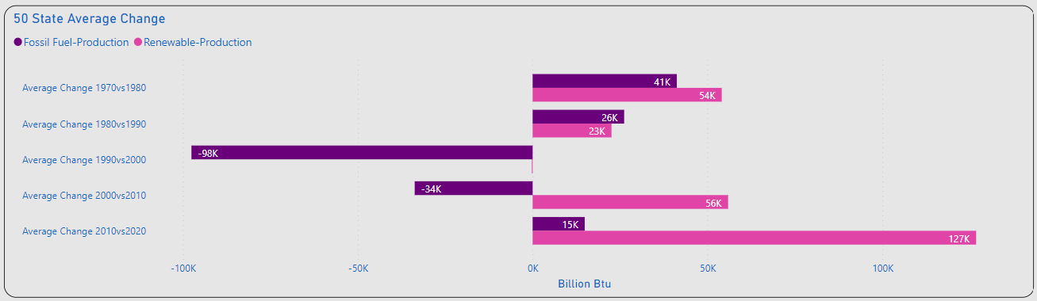
Amount of Change
Significant Changes Consumption
1980vs1990: Nuclear(+)
1990vs2000: Fossil Fuel(+)
2010vs2020: Fossil Fuel(-)
2010vs2020: Renewables(+)
Significant Changes Production
1990vs2000: Fossil Fuel(-)
2010vs2020: Renewable(+)

Slide 11
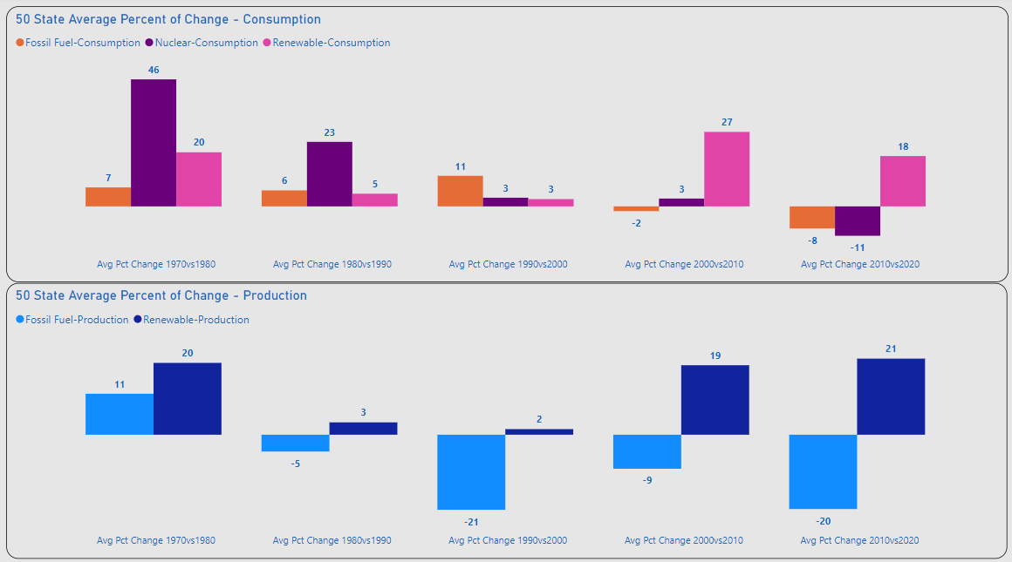
XXXX
Significant Percent of Change Consumption
1970vs1980: Nuclear(+)
2000vs2010: Renewable(+)
2010vs2020: Fossil Fuel / Nuclear (-), Renewables(+)
Significant Changes Production
Overall Fossil Fuel(-)
Overall Renewable(+)

Slide 12
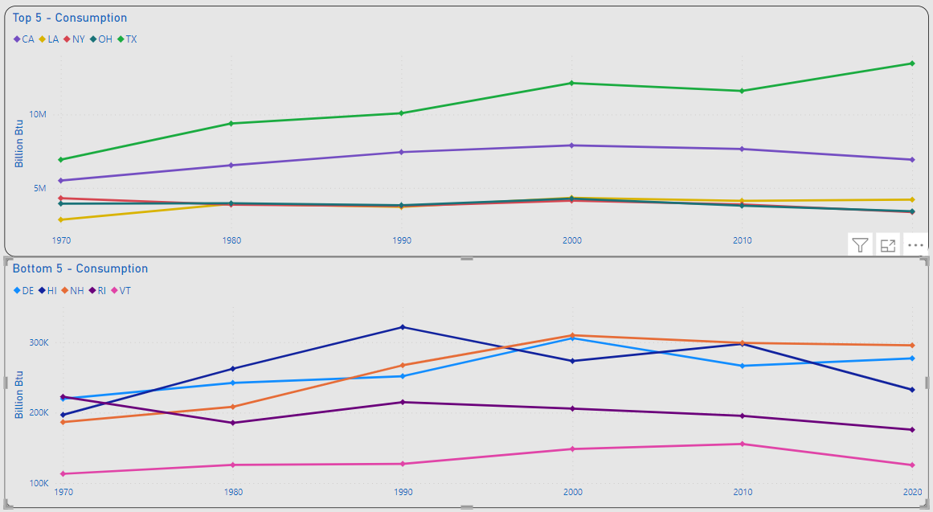
Top 5 / Bottom 5 – Overall Consumption
REVIEW STATS
Most of the Top 5 Changes were Increases < 1M (BN Btu)
TX & FL Made the Most Significant Increases in Overall Consumption
Most of the Bottom 5 Changes were Decreases < 350K (BN Btu)
NY & OH Made the Most Significant Decreases in Overall Consumption

Slide 13
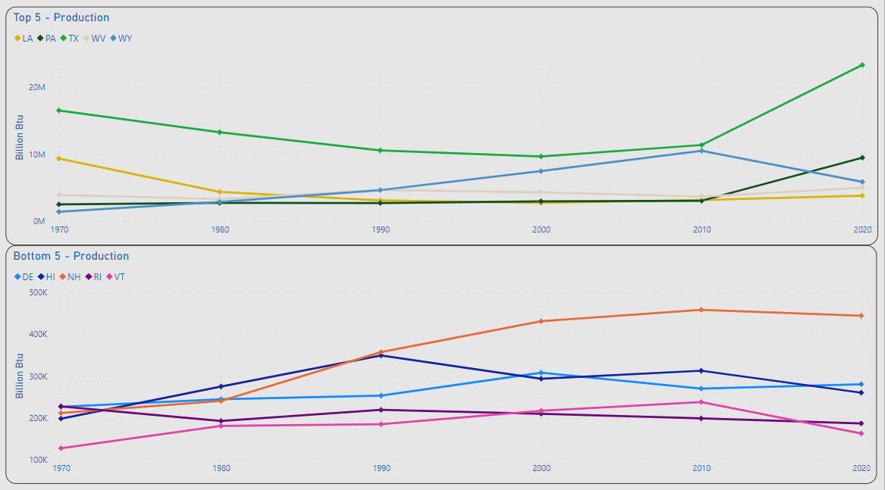
Top 5 / Bottom 5 – Change Production
REVIEW
Almost Equal Shifts in Production are Observed Between TX & WY for 1970 - 2000
TX Made the Most Significant Increase for 2010vs2020
Most of the Bottom 5 Changes were Decreases < 700K (BN Btu)
LA Made the Most Significant Decrease for All Years
KY & WV Made Almost Equal Increases & Decreases for Years Observed

Slide 14
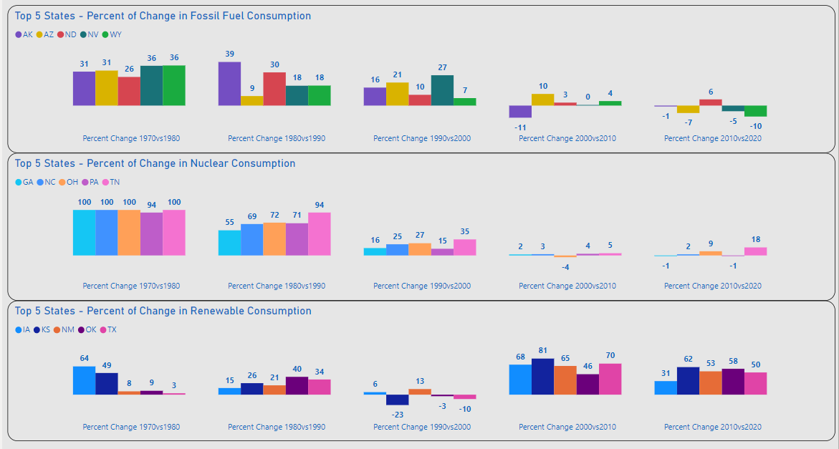
XXXX
REVIEW/REWRITE
TX Displays the Most Significant Increases in Fossil Fuel & Renewable Consumption for Years Observed
Fossil Fuel and Nuclear Displays Highest Volume of Increases 1970-2000
Renewable Consumption Displays Significant Increases After 2000

Slide 15
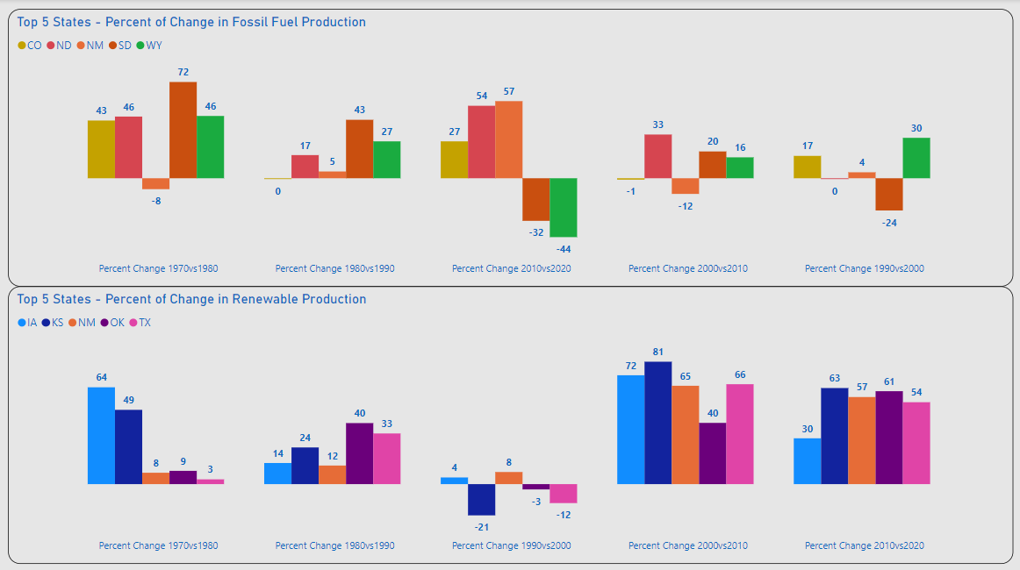
XXXX
REVIEW/REWRITE
Fossil Fuel Chart Closely Mirrors the Overall Production Chart
Renewable Production Displays Significant Increases After 2000

Slide 16
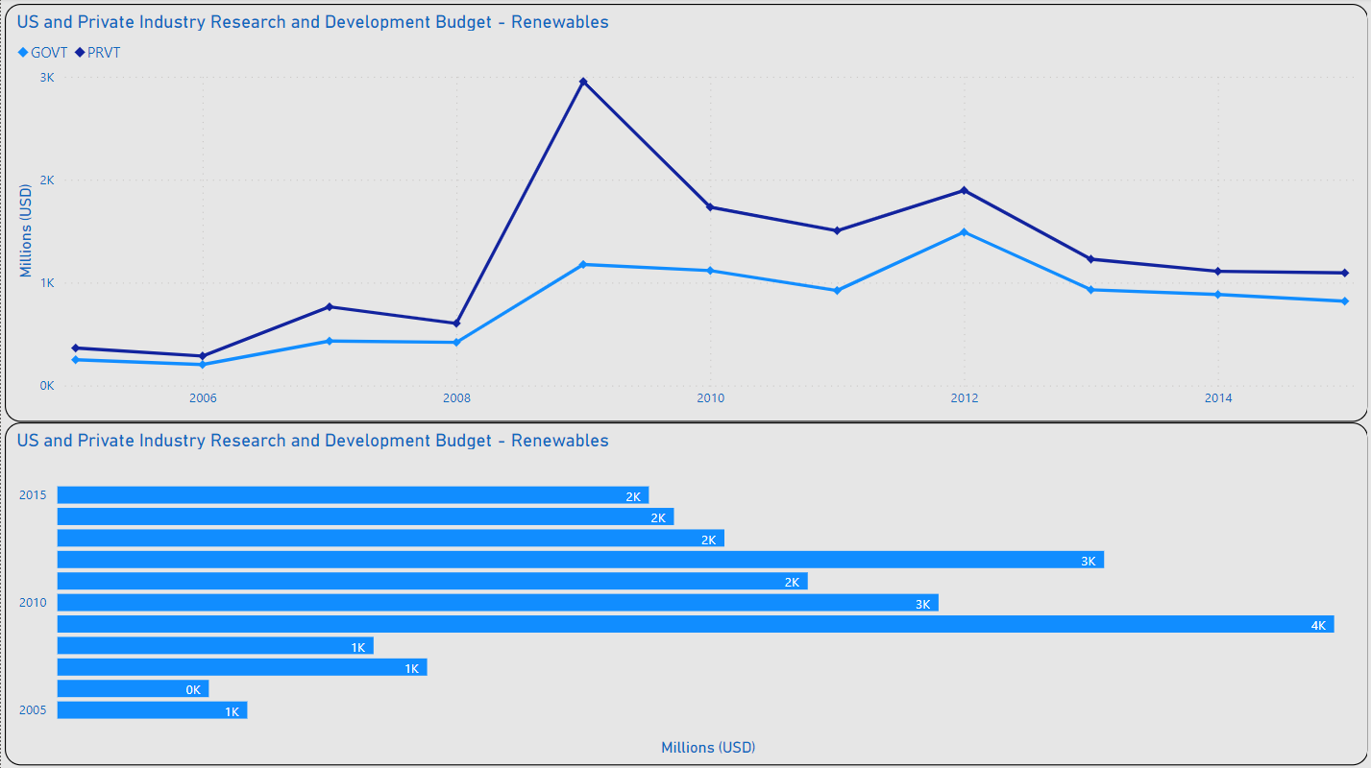
Advancing Renewable Tech
XXXX
XXXX

Slide 17
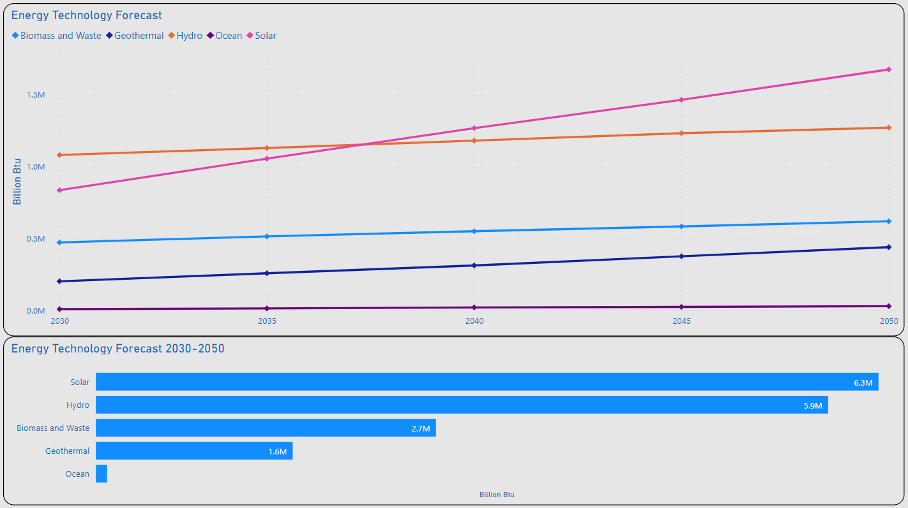
Advancing Renewable Tech
XXXX
XXXX

Slide 18
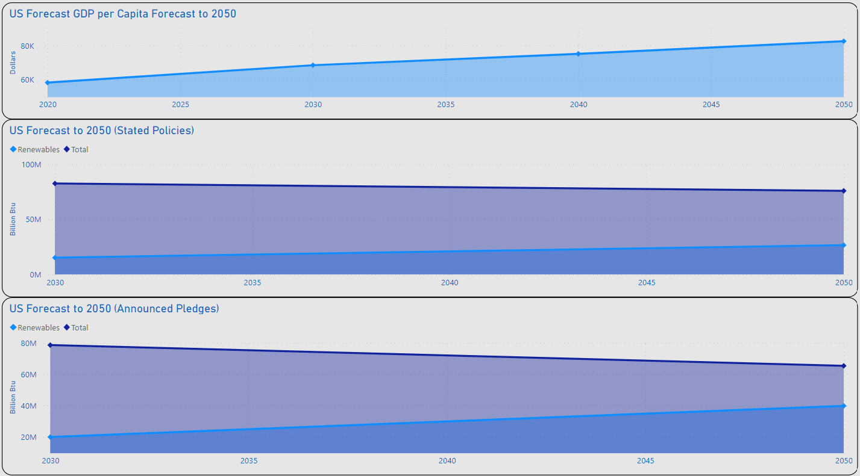
XXXX
XXXX
XXXX
CHOOSE 1 FORECECAST SLIDE

Slide 19
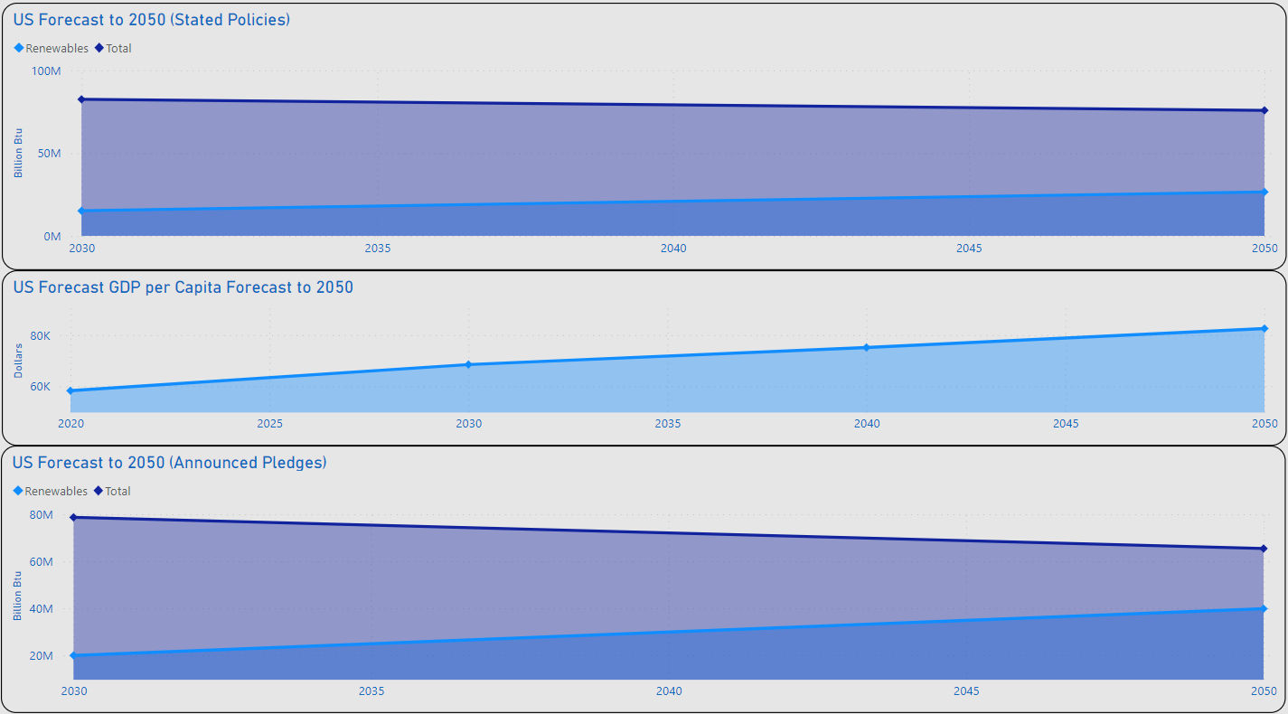
XXXX
XXXX
XXXX
CHOOSE 1 FORECECAST SLIDE

Slide 20
XXXX
XXXX
XXXX

Slide 21
XXXX
XXXX
XXXX

Slide 22
XXXX
XXXX
XXXX

Slide 23
XXXX
XXXX
XXXX
XXXX
XXXX
XXXX
XXXX
XXXX
XXXX

Slide 24
XXXX
XXXX
XXXX
XXXX
XXXX
XXXX
XXXX
XXXX
XXXX
XXXX
XXXX
XXXX
XXXX

Slide 25
Summary
XXXX

Slide 26
Thank you
Lawrence Haggerty​
lawrence.c.Haggerty@gmail.com
https://www.linkedin.com/in/lawrence-haggerty/
https://github.com/lawrence-haggerty

Slide 27
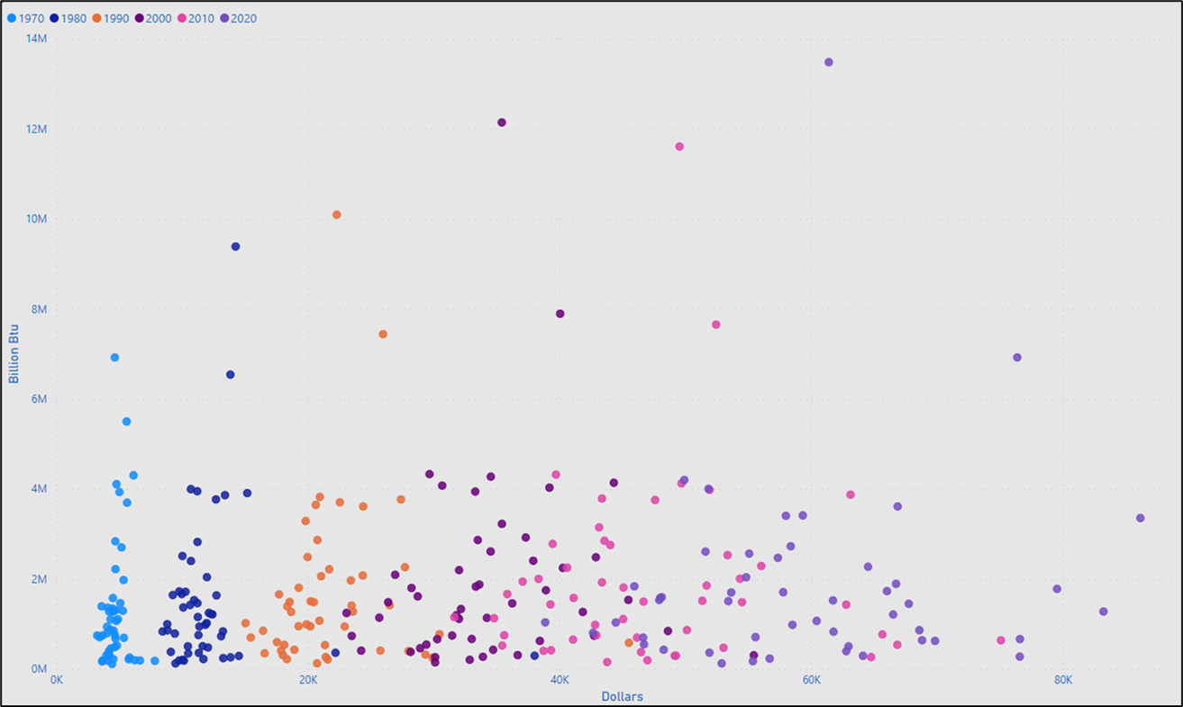
GDP per Capita - Consumption
XXXX
XXXX
XXXXXXXXXX

Slide 28
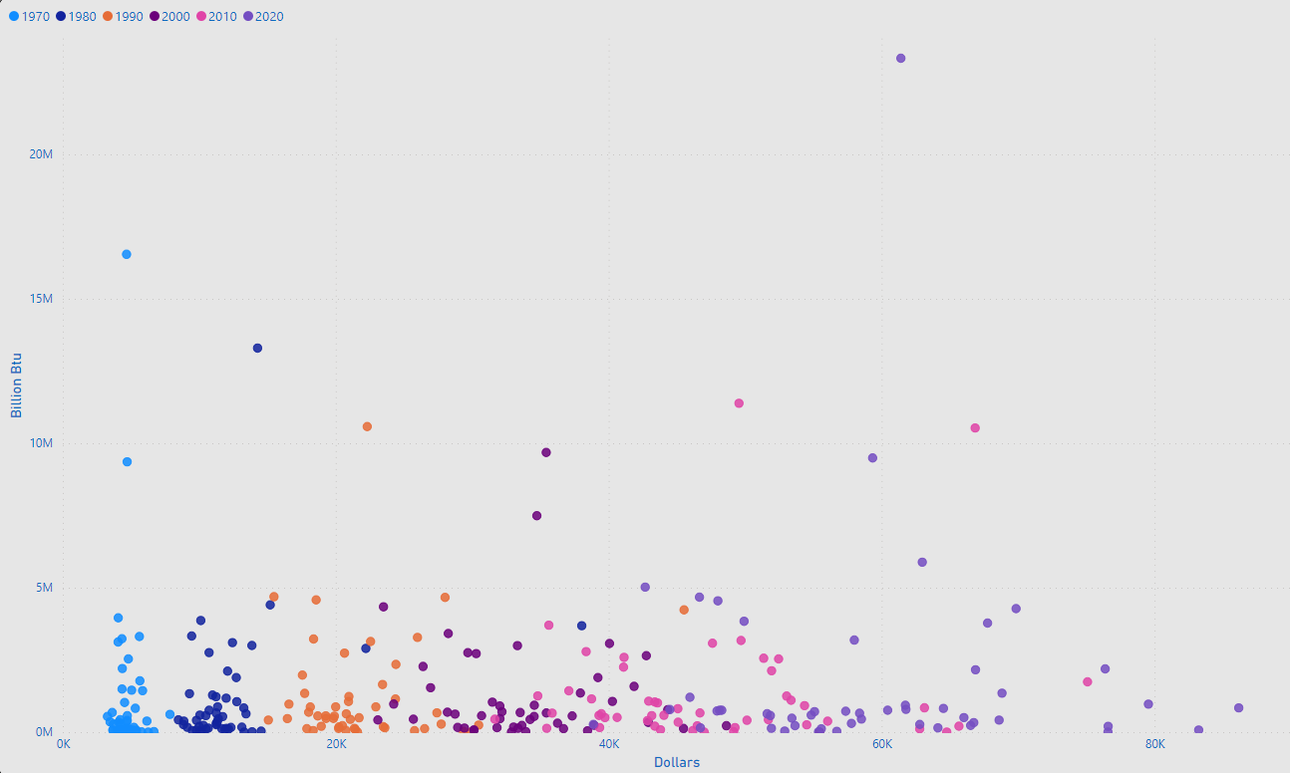
Comparison GDP per Capita - Production
XXXX
XXXX
XXXXXXXXXX

Slide 29
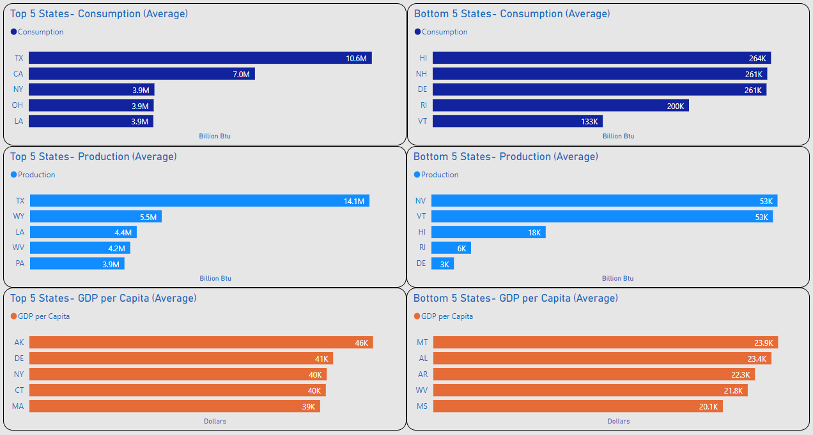
Top 5 / Bottom 5
XXXX
XXXX

Slide 30
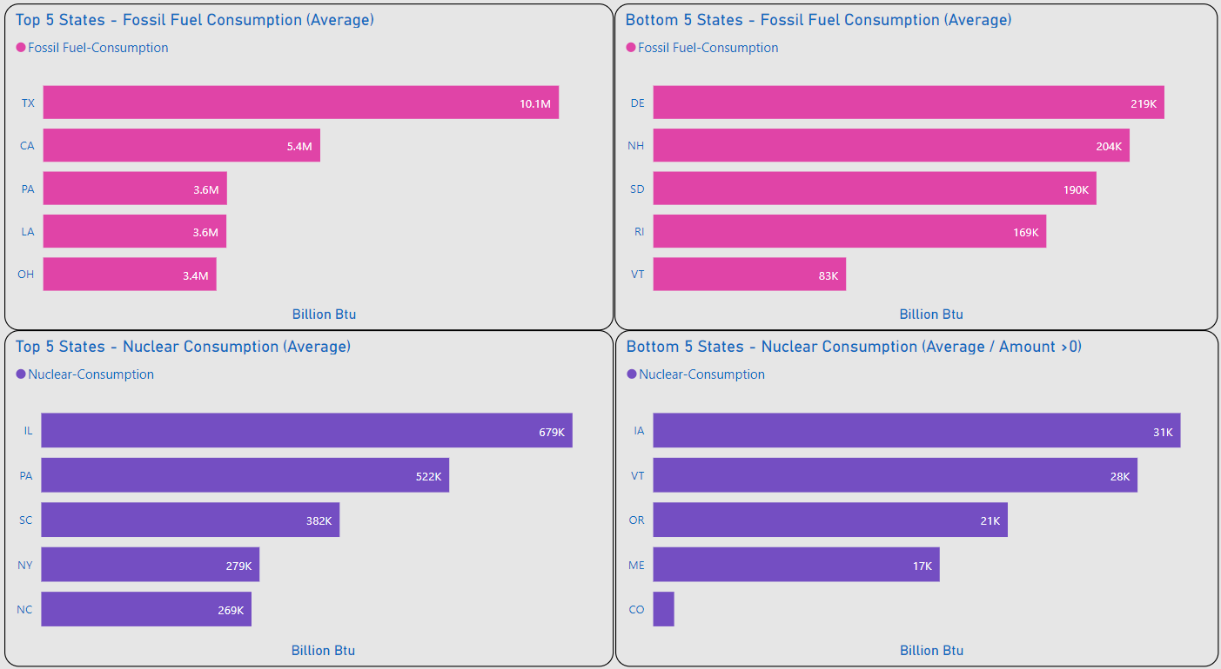
Top 5 / Bottom 5
XXXX
XXXX

Slide 31
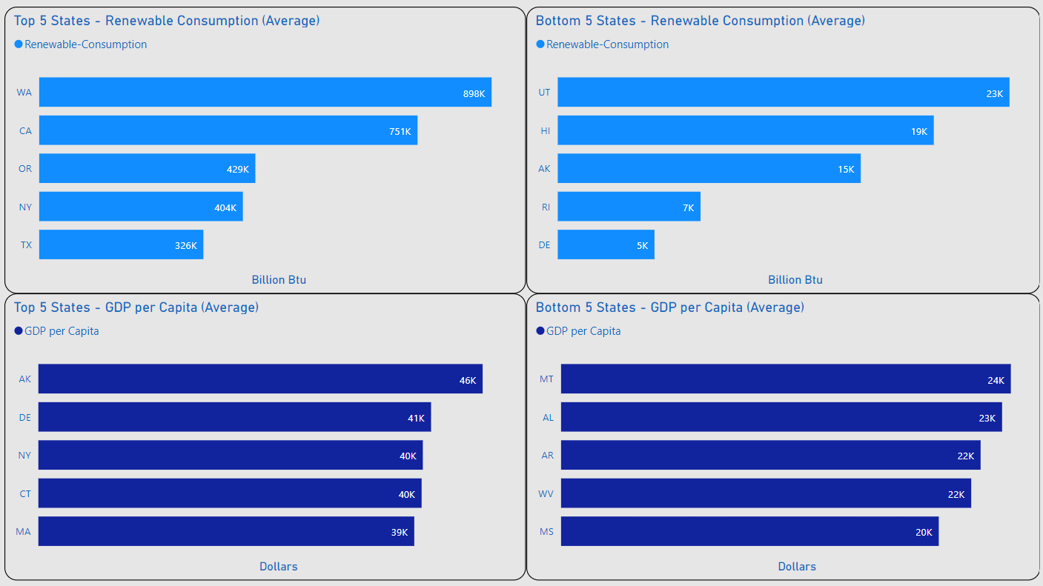
Top 5 / Bottom 5
XXXX
XXXX

Slide 32
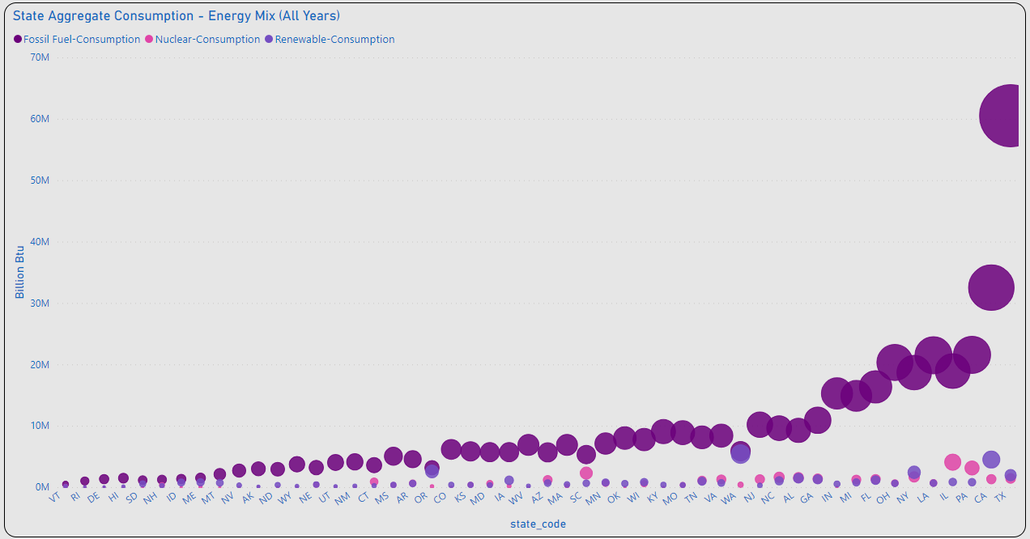
Energy Mix – Aggregate Consumption
XXXX
XXXX
XXXXXXXXXX

Slide 33
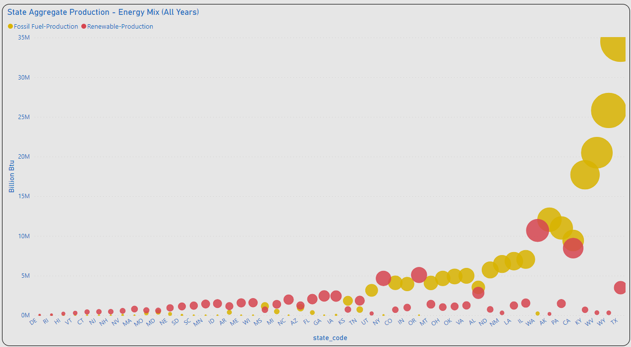
Energy Mix – Aggregate Production
XXXX
XXXX
XXXXXXXXXX

Slide 34
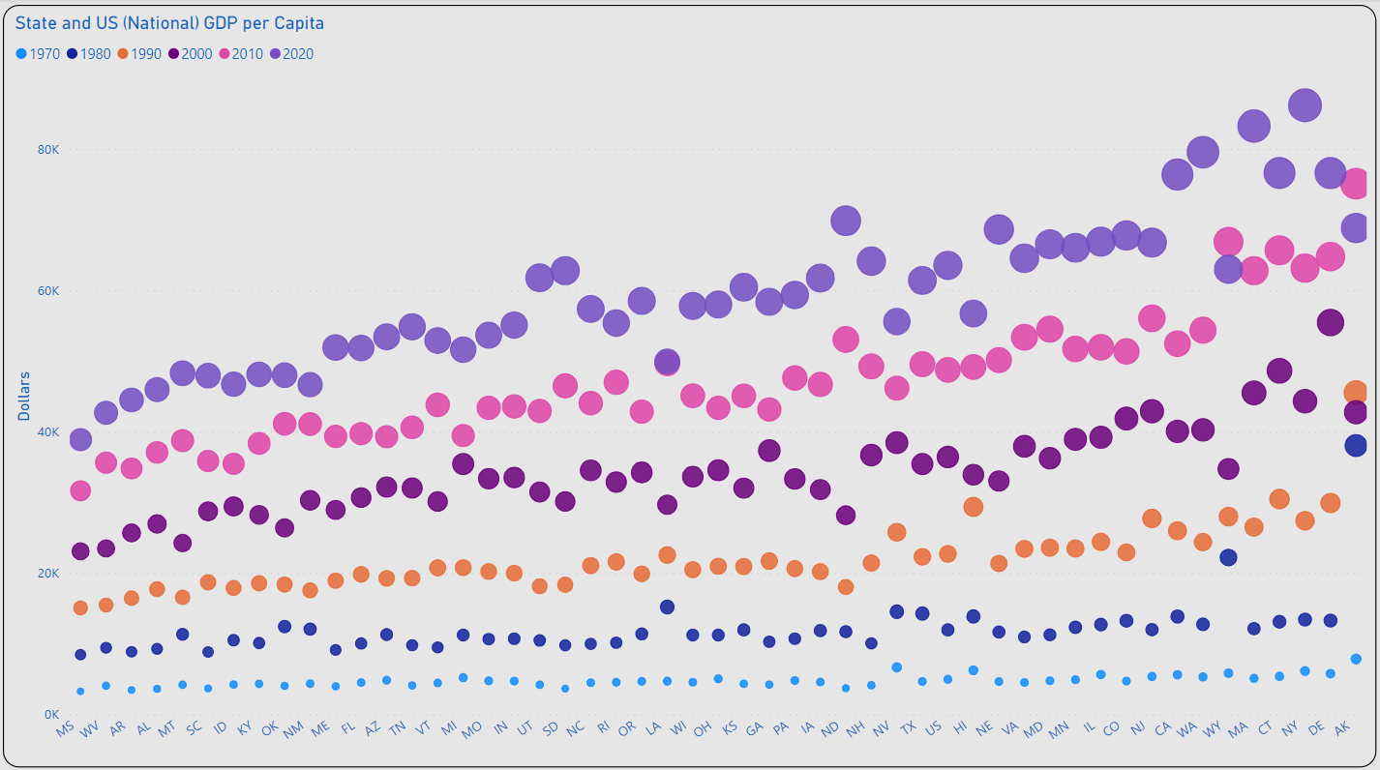
GDP per Capita Growth
XXXX
XXXX
????????????

Slide 35
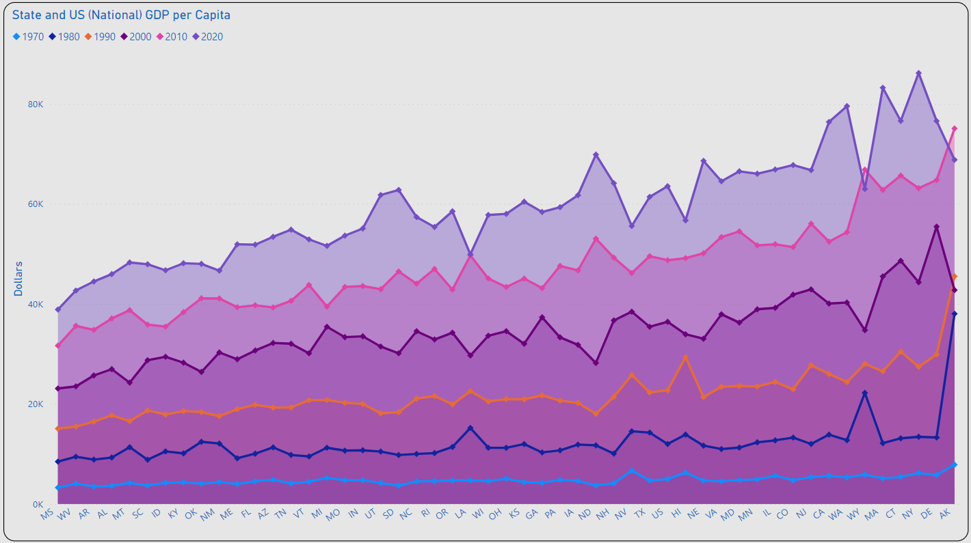
GDP per Capita Change
XXXX
XXXX
????????????

Slide 36
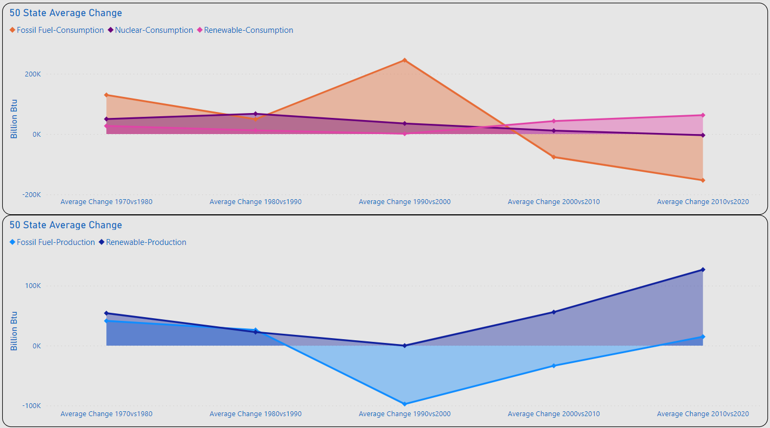
Amount of Change
FF: 245K
N: 67.3K
R: 62.8K
Significant Changes Consumption
1980vs1990: Nuclear: 67.3 (BN Btu)
1990vs2000: Fossil Fuel 245K (BN Btu)
2010vs2020: Renewables 62.8K
FF: 245K
BAD CHART
FF: -153.2K
FF: 245K
FF: 245K

Slide 37
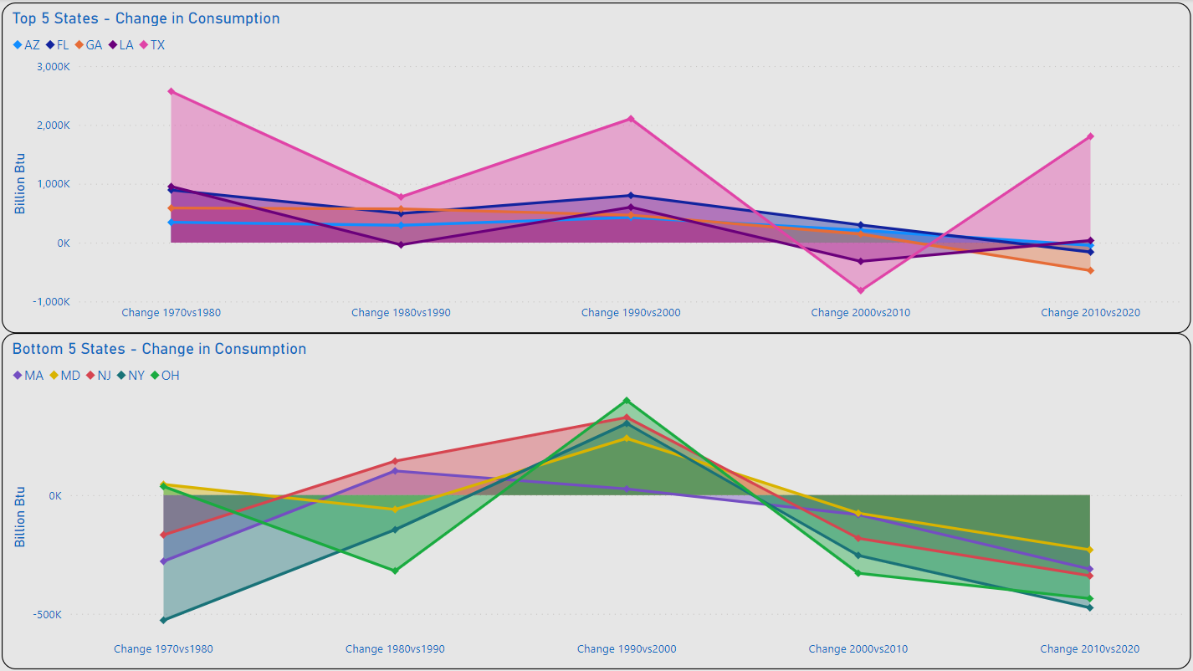
Top 5 / Bottom 5 - Overall
XXXX
XXXX
BAD CHART

Slide 38
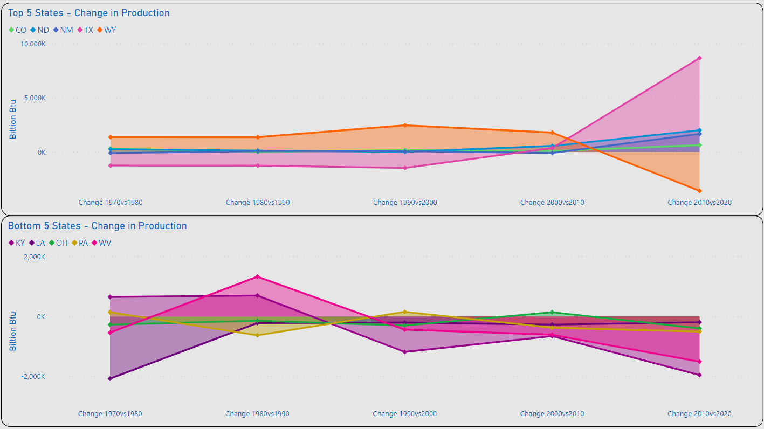
Top 5 / Bottom 5 - Overall
XXXX
XXXX
BAD CHART

Slide 39
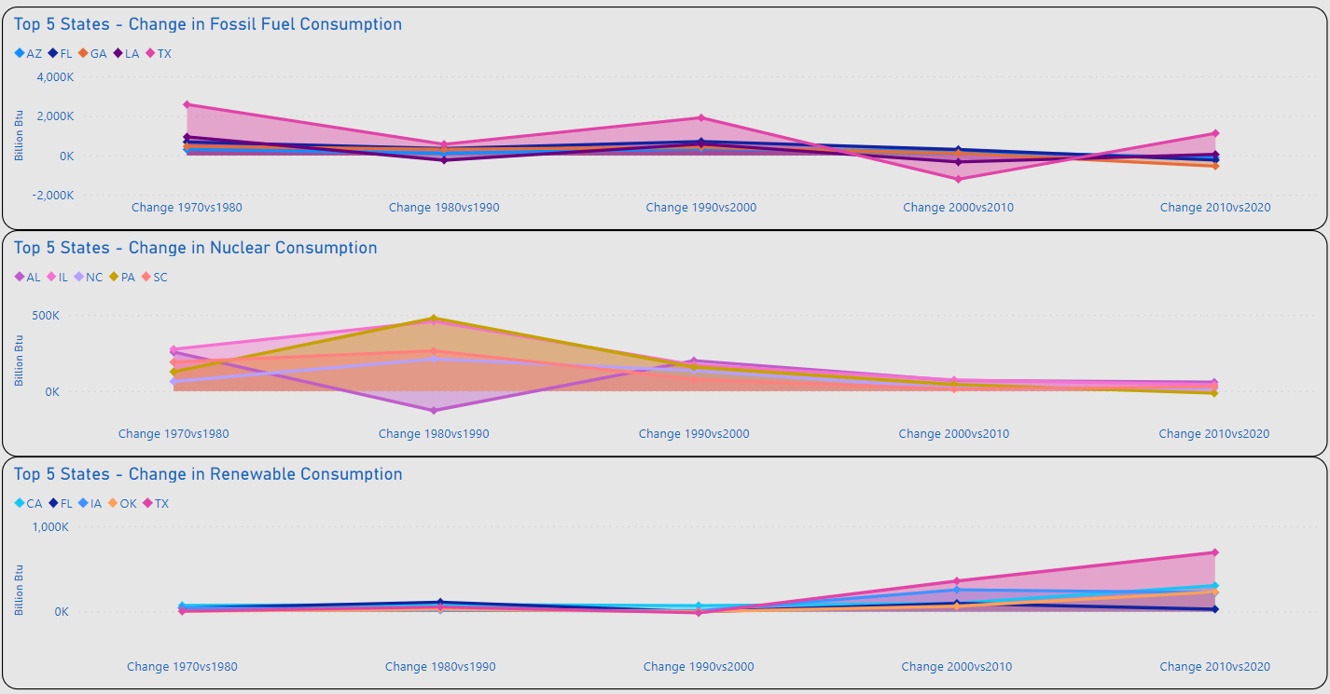
Top 5 / Bottom 5 – Energy Mix
XXXX
XXXX
BAD CHART

Slide 40
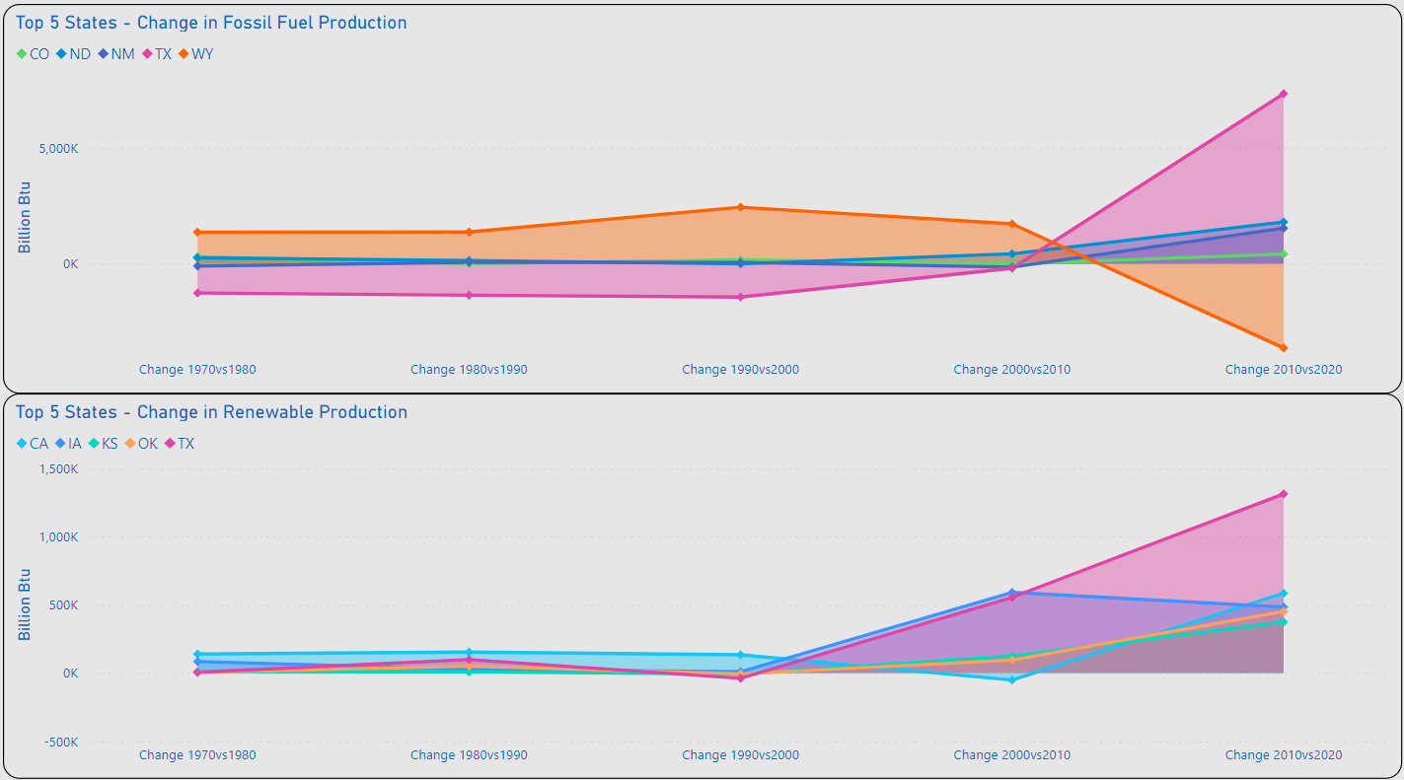
Top 5 / Bottom 5 – Energy Mix
XXXX
XXXX
BAD CHART

Slide 41
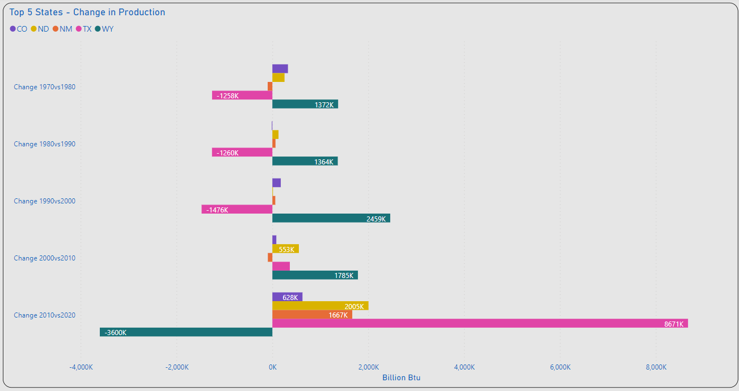
Top 5 - States
XXXX
XXXX

Slide 42
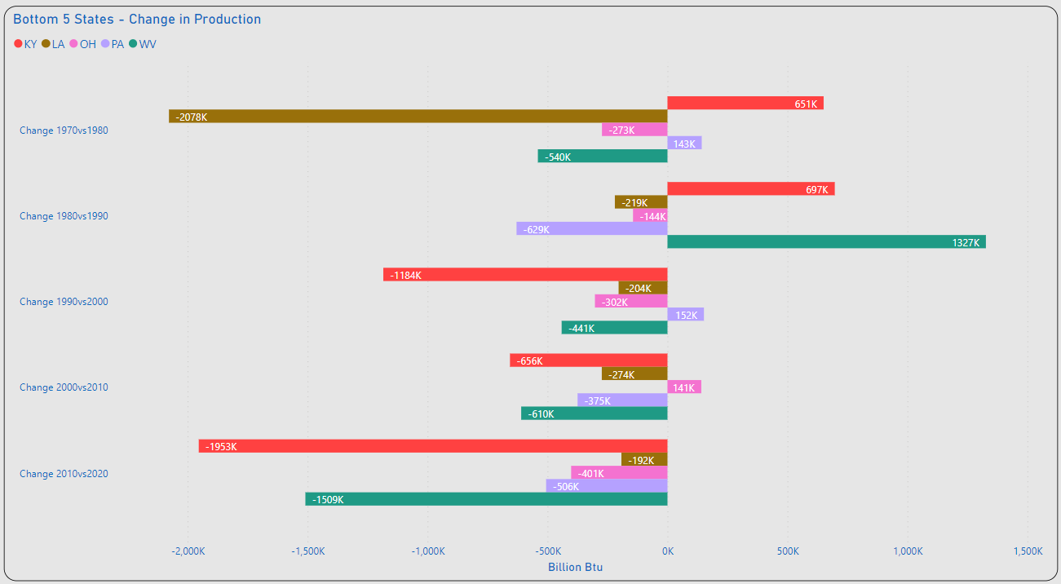
Bottom 5 - States
XXXX
XXXX

Slide 43
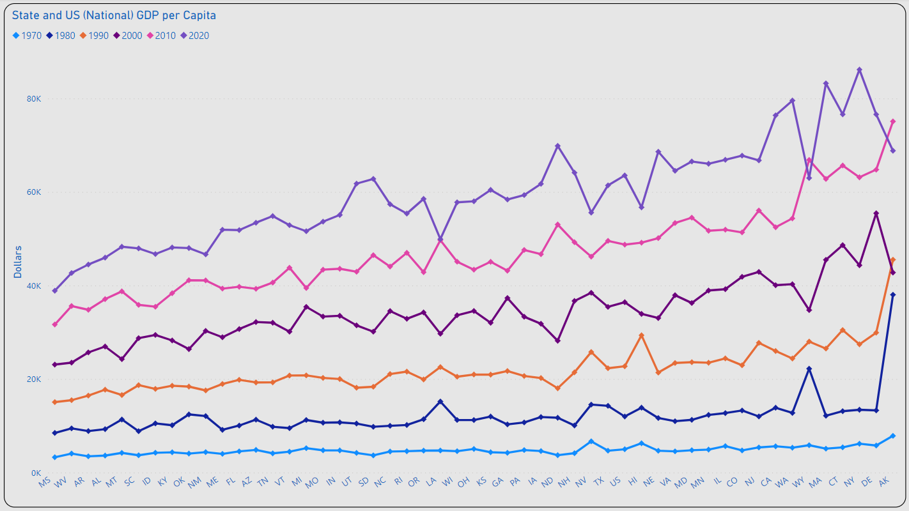
GDP per Capita Change
XXXX
XXXX
????????????

Slide 44

XXXX
XXXX
XXXX
????????????

Slide 45
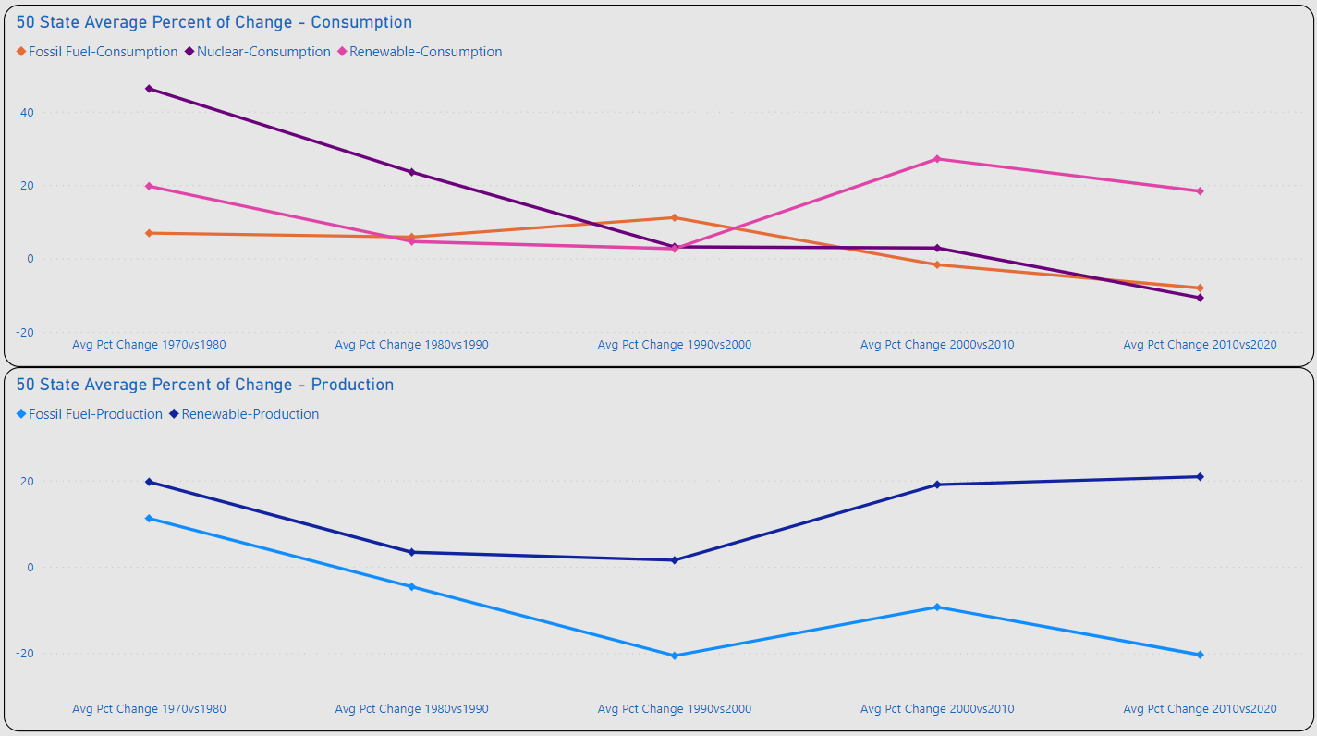
Percent of Change
XXXX
XXXX

Slide 46
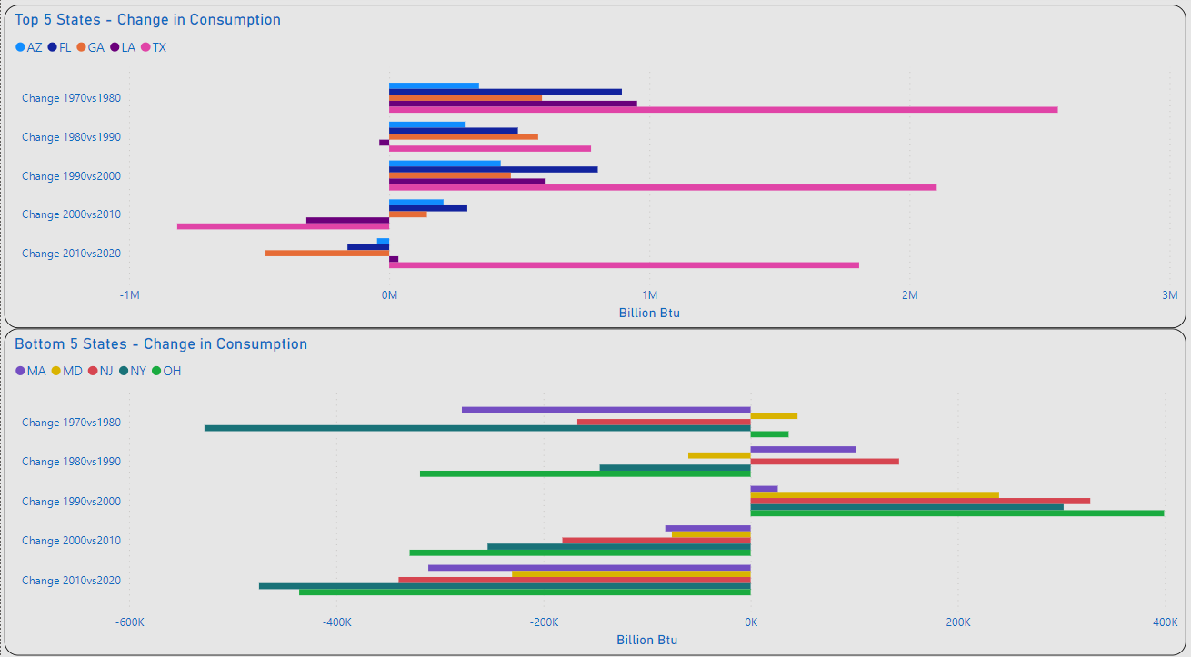
Top 5 / Bottom 5 – Change Consumption
Most of the Top 5 Changes were Increases < 1M (BN Btu)
TX & FL Made the Most Significant Increases in Overall Consumption
Most of the Bottom 5 Changes were Decreases < 350K (BN Btu)
NY & OH Made the Most Significant Decreases in Overall Consumption

Slide 47
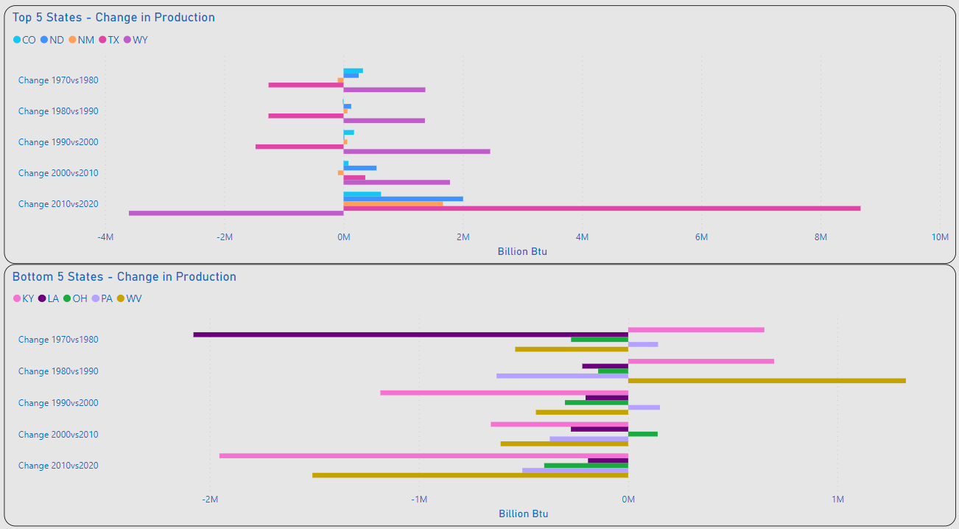
Top 5 / Bottom 5 – Change Production
Almost Equal Shifts in Production are Observed Between TX & WY for 1970 - 2000
TX Made the Most Significant Increase for 2010vs2020
Most of the Bottom 5 Changes were Decreases < 700K (BN Btu)
LA Made the Most Significant Decrease for All Years
KY & WV Made Almost Equal Increases & Decreases for Years Observed

Slide 48
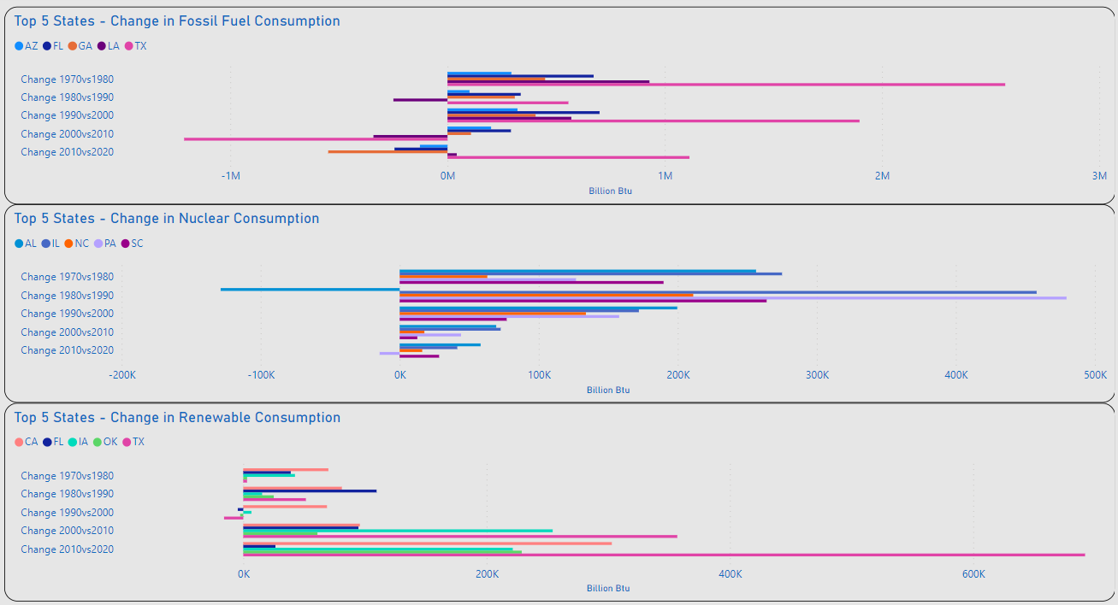
XXXX
TX Displays the Most Significant Increases in Fossil Fuel & Renewable Consumption for Years Observed
Fossil Fuel and Nuclear Displays Highest Volume of Increases 1970-2000
Renewable Consumption Displays Significant Increases After 2000

Slide 49
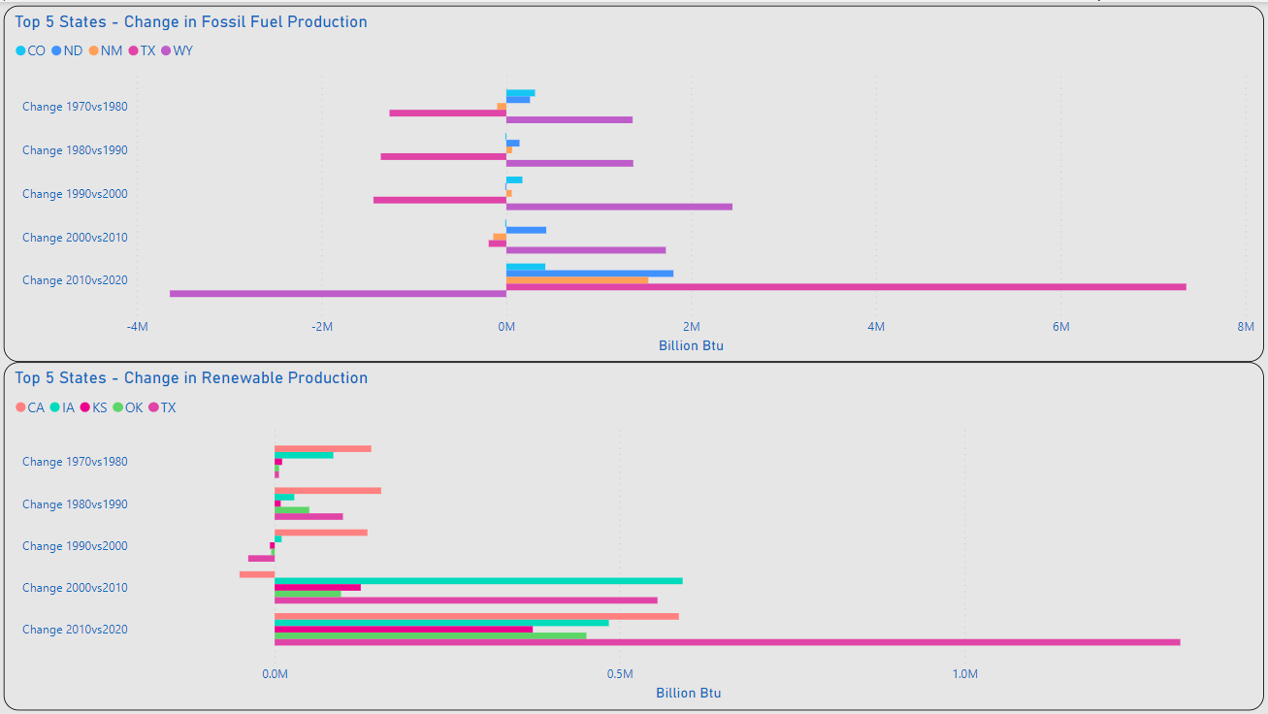
XXXX
Fossil Fuel Chart Closely Mirrors the Overall Production Chart
Renewable Production Displays Significant Increases After 2000

Slide 50
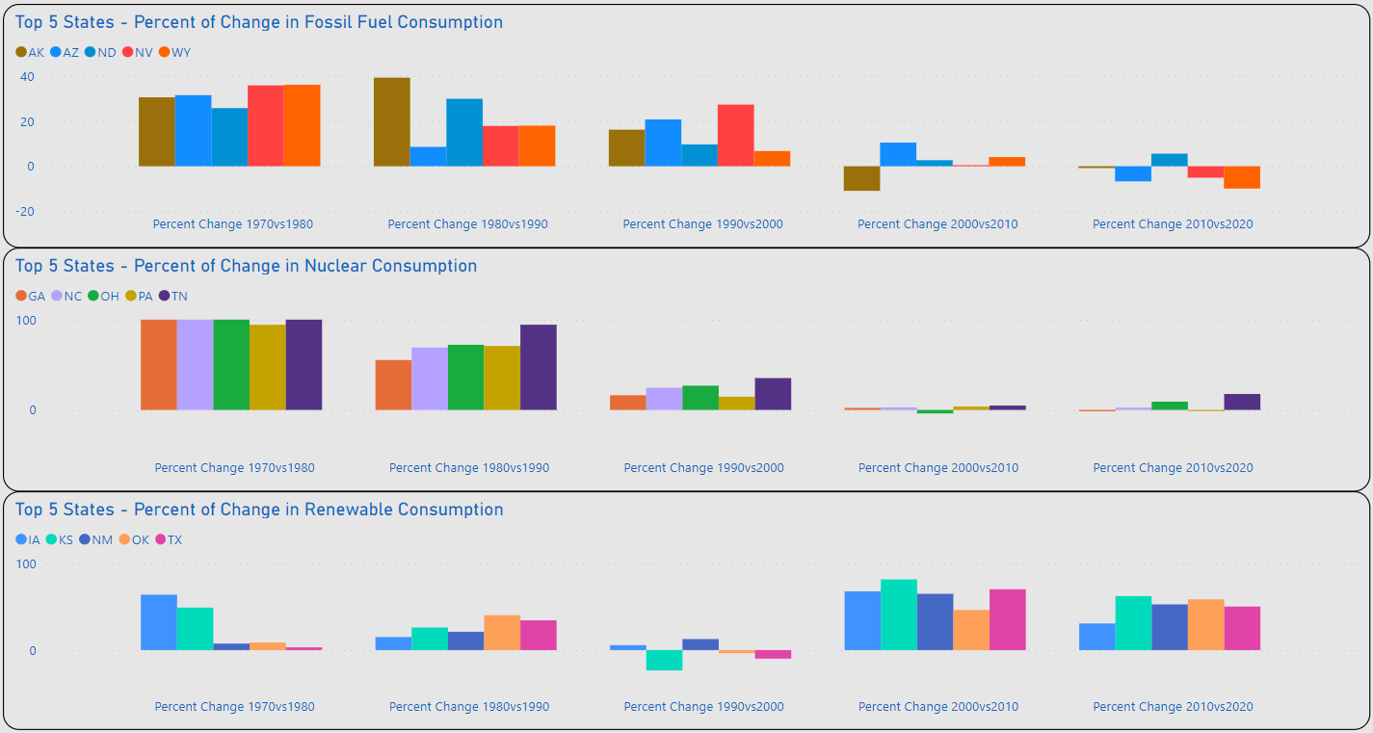
XXXX
REVIEW/REWRITE
TX Displays the Most Significant Increases in Fossil Fuel & Renewable Consumption for Years Observed
Fossil Fuel and Nuclear Displays Highest Volume of Increases 1970-2000
Renewable Consumption Displays Significant Increases After 2000

Slide 51
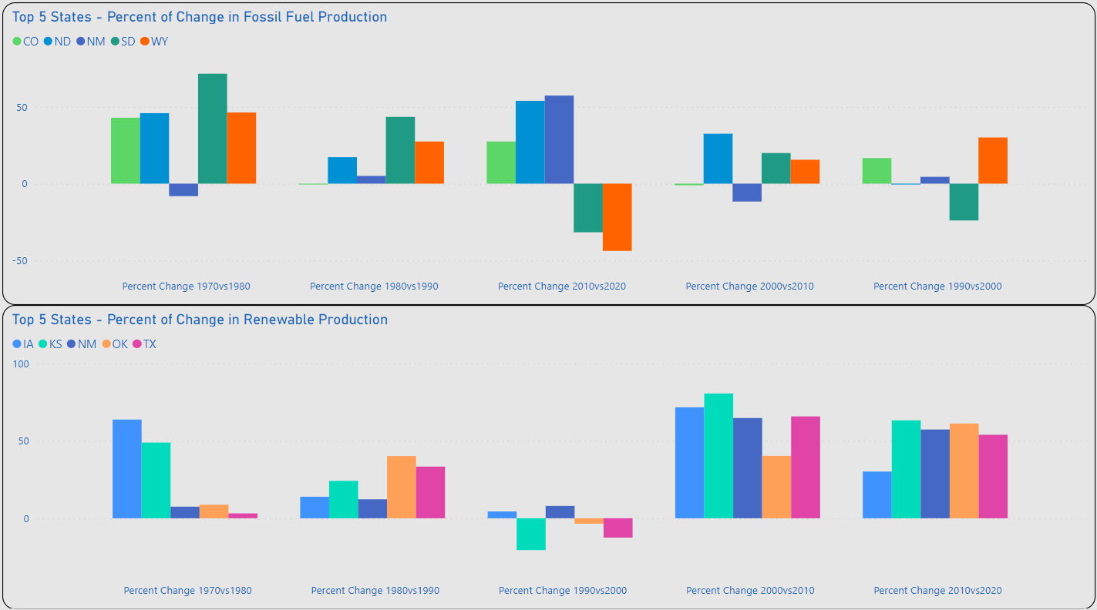
XXXX
REVIEW/REWRITE
Fossil Fuel Chart Closely Mirrors the Overall Production Chart
Renewable Production Displays Significant Increases After 2000

Slide 52
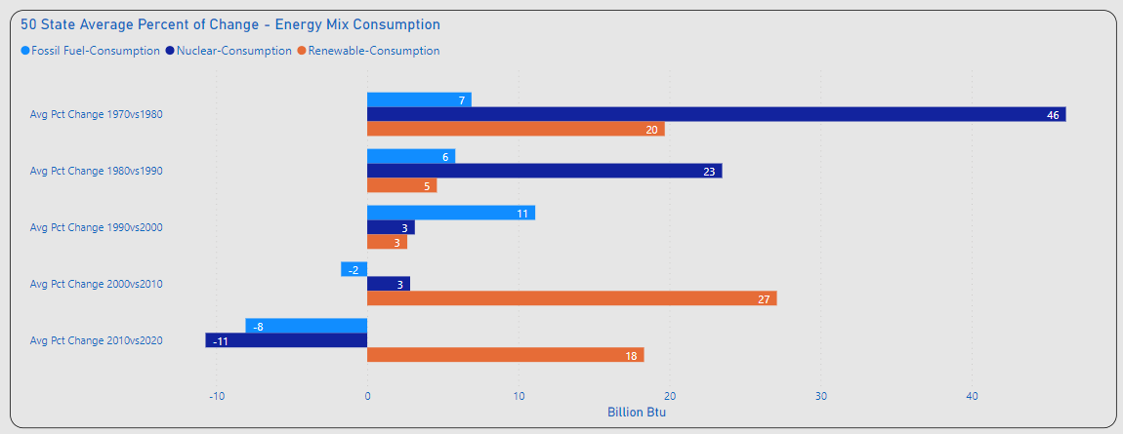
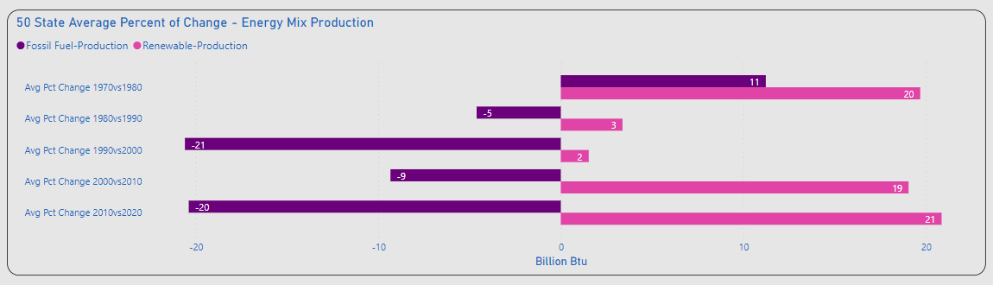
XXXX
Significant Percent of Change Consumption
1970vs1980: Nuclear(+)
2000vs2010: Renewables(+)
2010vs2020: Fossil Fuel / Nuclear (-), Renewables(+)
Significant Changes Production
Overall Fossil Fuel(-)
Overall Renewable(+)

Slide 53
XXXX
Significant Percent of Change Consumption
1970vs1980: Nuclear(+)
2000vs2010: Renewables(+)
2010vs2020: Fossil Fuel / Nuclear (-), Renewables(+)
Significant Changes Production
Overall Fossil Fuel(-)
Overall Renewable(+)

Slide 54
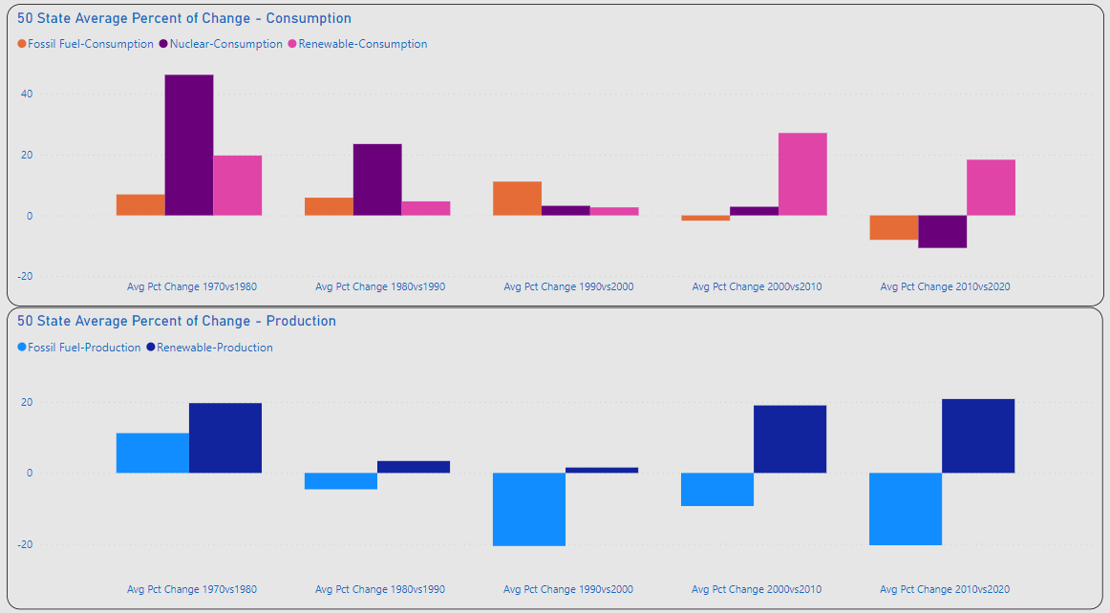
Percent of Change
XXXX
XXXX
XXXX

Slide 56
Title

Slide 57
Timeline
Deploy strategic networks with compelling e-business needs
Sep 20XX
Synergize scalable e-commerce
Nov 20XX
Disseminate standardized metrics
Jan 20XX
Coordinate e-business applications
March 20XX
Foster holistically superior methodologies
May 20XX

Slide 58
Primary goals
Annual revenue growth

