Slide 1
Energy to GDP per Capita Comparison
Lawrence Haggerty
Notes:
Good evening….
My name is Larry Haggerty, Data Analytics Student at Nashville Software School.
My presentation this evening is titled “ENERGY to GDP per CAPITA Comparison”
During this presentation….I would ask that if you have questions….Please hold them until the end and we will address them as time permits.

Slide 2
Agenda
Introduction
Description / Definitions
Initial Comparison
Investigating Change
Technology / Future Growth
Summary
Notes:
AGENDA
This is tonight’s agenda…..I will give everyone a second to look it over before moving on

Slide 3
Introduction
There has been a consistent axiom since the beginning of the industrial revolution that energy drives commerce.
This project compares how the consumption and production of energy compares to the gross domestic product (GDP) per capita at the state and national level focused on understanding the trajectory for movement away from fossil fuel as our primary energy source and its alignment to the nation’s leading fiscal metric.
Notes:
INTRODUCTION
There has been a consistent axiom since the beginning of the industrial revolution that ENERGY drives commerce.
The primary goal of this project was to compare ENERGY CONSUMPTION and PRODUCTION to GDP per CAPITA at the state and national level while understanding the nation’s shift away from FOSSIL FUELS and if / how this relates to the nation’s leading fiscal metric.
My motivation for this project stems from growing up as a child during the “ENERGY Crisis” of the 1970s. I have been impressed with the move away from FOSSIL FUELS and adoption of renewable ENERGY over the last few decades and looked forward to studying the topic for my Capstone.

Slide 4
Description / Definitions
Description
Definitions
Analysis utilized energy & economic related data sets from the Bureau of Economic Analysis, US Census Bureau, Energy Information Agency, & International Energy Agency.
Years Reviewed: 1970, 1980, 1990, 2000, 2010, 2020
GDP: The total monetary value, or market value, of finished goods and services produced within a country during a period.
GDP per capita: Economic metric that breaks down a country's economic output per person.
Fossil Fuels: Includes Coal, Crude Oil, & Natural Gas
Nuclear: Nuclear electric power production in Btu, which also equals consumption, is the nuclear electricity net generation multiplied by the average heat rate of the nuclear power plants.
Renewables: Includes Biofuels, Geothermal, Hydroelectric, Solar, Wind, Wood, & Biomass Waste
Notes:
My analysis included datasets from Bureau of Economic Analysis, US Census Bureau, ENERGY Information Agency, & International Energy Agency and data for the years 1970, 1980, 1990, 2000, 2010, & 2020.
And a few definitions before we get started….. - GDP…..Total value for goods and services for a country / state within a specific period
GDP per CAPITA: GDP / Population
The values listed for FOSSIL FUELS includes Coal, Crude Oil, and Natural Gas combined.
NUCLEAR ENERGY is only counted under CONSUMPTION…..
The values listed for RENEWABLES combines the values for Biofuels, Geo Thermal, Hydro, Solar, Wind, Wood, & Biomass Waste
And with that out of the way we will transition to the INITIAL COMPARISON…..

Slide 5
Initial Comparison
Consumption / Production / GDP per Capita

Slide 6
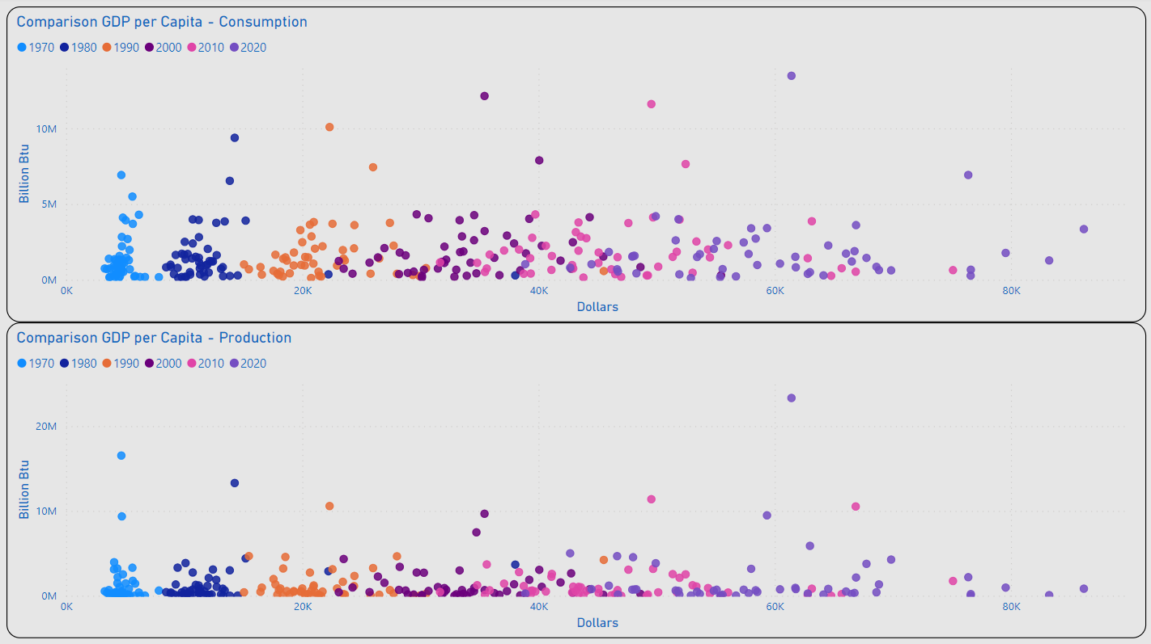
Consumption / Production
TX
Most States Remained Under 5M (BN Btu) for Consumption and Production
The Range of Values for GDP per Capita Appeared to Begin a Wider Dispersion in 2000
2020 Outliers for Consumption: TX & CA
2020 Outlier for Production: TX
Outliers for GDP per Capita Included: MA, NY & WA
CA
NY
WA
MA
TX
WA
MA
NY
Notes:
Utilizing this SCATTER CHART I was able to view the relative values for GDP per CAPITA by year and noticed:
Up to 5M (BN Btu) for CONSUMPTION and PRODUCTION covered most of the states
Considering 2020…..
TX & CA were outliers for CONSUMPTION and WA, MA, & NY had significantly higher GDP per CAPITA than their peers.
And for PRODUCTION I noted TX as my outlier

Slide 7
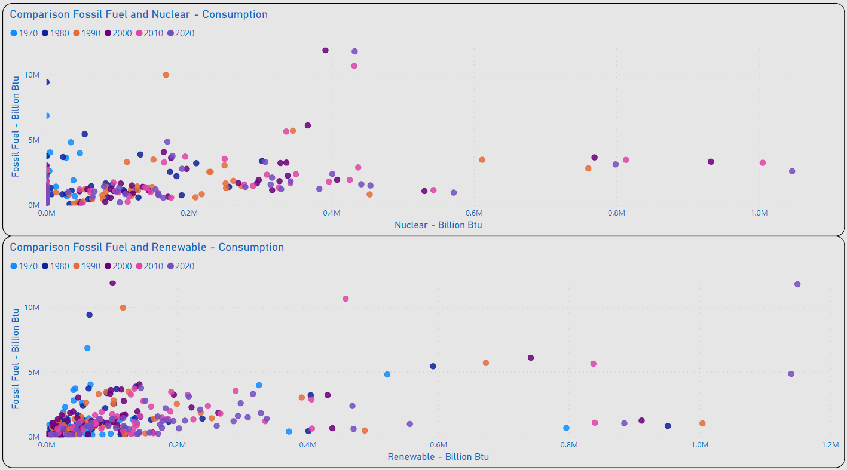
Energy Mix - Fossil Fuel to Alternatives
IL, PA, SC Lead the US in Consumption of Nuclear Energy
As of 2020 Several States Have Not Integrated the Use of Nuclear Energy: IN, MT, OK, SD, WY & VT
As of 2020 TX, CA, & WA Lead the US in Consumption of Renewable Energy
Distribution of Values for the Majority of States Remains < 200K (BN Btu) for Renewable Consumption
PA
IL
SC
TX
CA
WA
Notes:
I also wanted to look at how CONSUMPTION compared among the MIX of ENERGY TYPES….
From the review of FOSSIL FUEL to NUCLEAR it was clear that the greatest CONSUMPTION of NUCLEAR fell to IL, PA, & SC
When reviewing FOSSIL FUEL to RENEWABLES I was surprised to find TX in the lead for RENEWABLE CONSUMPTION
Additionally, I noted most states with less than 200K (BN Btu) across all years considered.

Slide 8
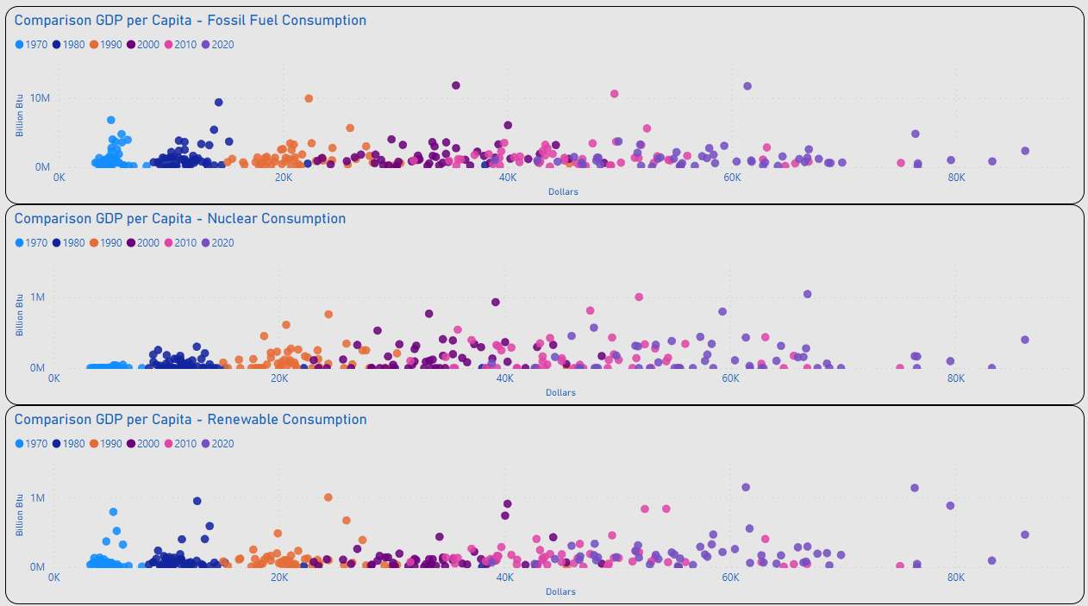
GDP per Capita – Energy Mix
Review of Distribution for Individual Energy Types Remains Generally Consistent with Initial Consolidated View for Consumption / GDP per Capita
Notes:
Taking this a step further I wanted to look compare the MIX of ENERGY to GDP per CAPITA….
These charts remained generally consistent with the overall CONSUMPTION chart

Slide 9
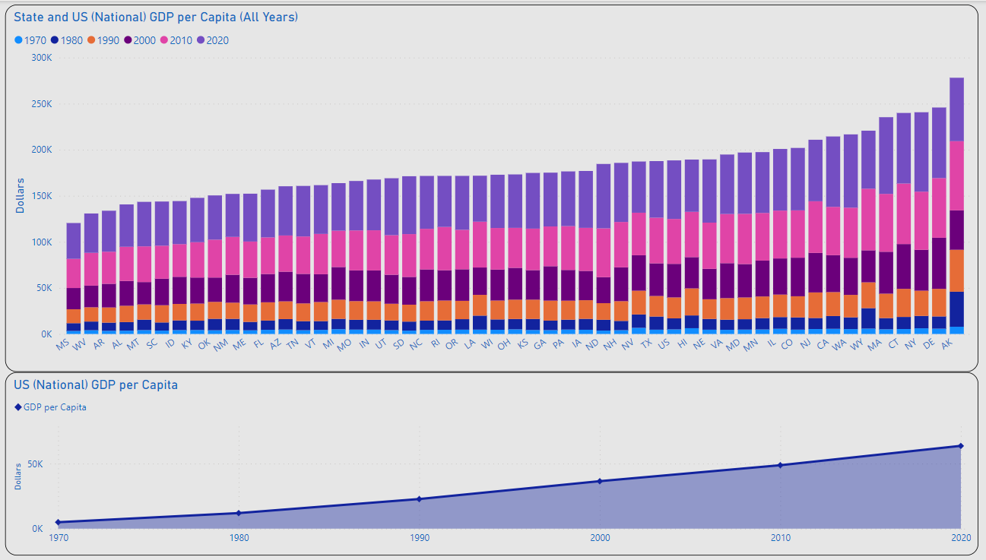
GDP per Capita
MAX: $86.2K
US AVG
US GDP per Capita Ranged from $5K in 1970 to $63.5K in 2020
MAX GDP per Capita: 2020 NY $86.2K
MIN GDP per Capita: 1970 MS $3.3K
Overall Increase can be Expected to Continue
MIN: $3.3K
US GDP per Capita: $63.5K
US GDP per Capita: 5K
Notes:
Next, I wanted to look at GDP per CAPITA across the country…..
Diving into the values I noticed the minimum GDP per CAPITA was MS with $3.3K in 1970 which was approximately $1.7K below the national average of $5K
NY had the highest single GDP per CAPITA with $86.2K in 2020 which was almost 23K higher than the national average.
And from here I wanted to investigate how the values for ENERGY changed over the years…

Slide 10
Investigating Change
Consumption / Production / GDP per Capita

Slide 11
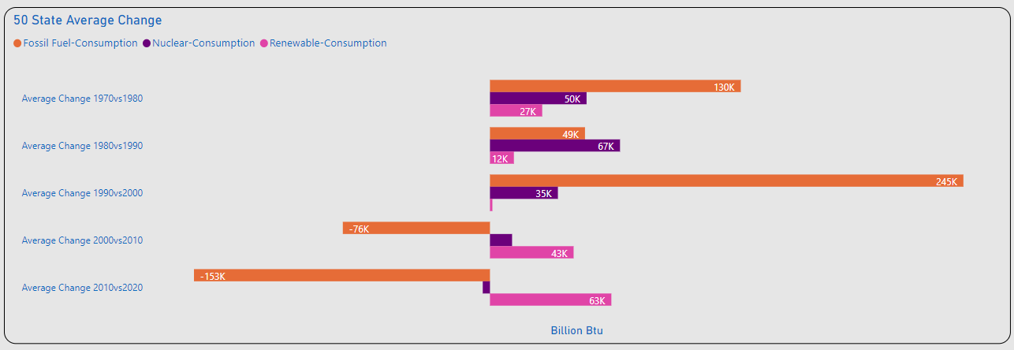
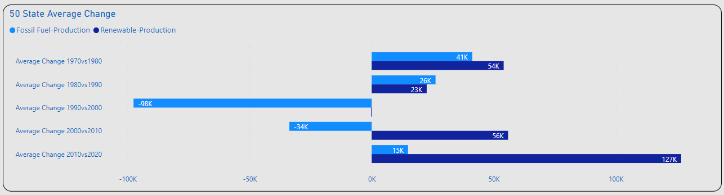
Amount of Change
Significant Changes Consumption
1980vs1990: Nuclear(+)
1990vs2000: Fossil Fuel(+)
2010vs2020: Fossil Fuel(-)
2010vs2020: Renewables(+)
Significant Changes Production
1990vs2000: Fossil Fuel(-)
2010vs2020: Renewable(+)
Notes:
To start my comparison for change I took an average of all 50 states and looked at the shift in AMOUNTS for CONSUMPTION and PRODUCTION….
Considering CONSUMPTION….
It looked like 1980vs1990 was the highest year for NUCLEAR CONSUMPTION
1990vs2000 was the highest year for FOSSIL FUEL with a significant decline after 2000
While RENEWABLES began their increase at the same time
Considering PRODUCTION….
FOSSIL FUEL took its biggest hit for 1990vs2000
RENEWABLES showed increasing gains with 2010vs2020 being the biggest year

Slide 12
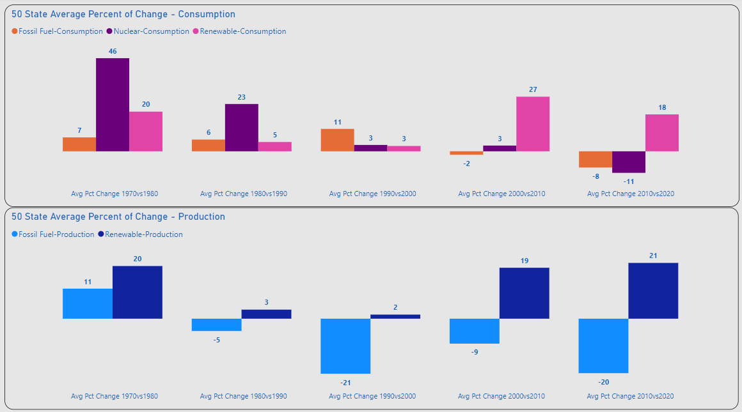
Percent of Change
Consumption
1970vs1980: Nuclear(+)
2000vs2010: Renewable(+)
2010vs2020: Fossil Fuel / Nuclear (-), Renewables(+)
Production
Overall Fossil Fuel(-)
Overall Renewable(+)
Notes:
Next, I wanted to review the changes by PERCENT of CHANGE…..Once again using an average of all 50 states….
Looking at this chart gave me a feeling that there is actually a PARADIGM SHIFT occurring…..
We can see the 70’s and 80’s were good years for NUCLEAR
FOSSIL FUELS indicate an overall decline
While RENEWABLES displays a positive incline over the last twenty years
I also wanted to observe these changes at the state level and reviewed charts for the TOP 5 & BOTTOM 5 across CONSUMPTION, PRODUCTION, and ENERGY MIX….

Slide 13
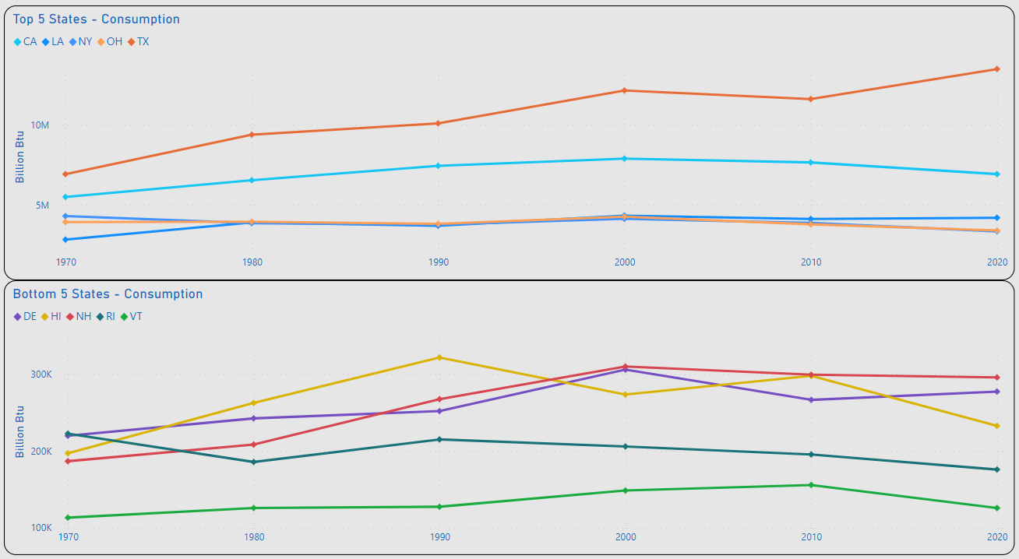
Top 5 / Bottom 5 – Change Consumption
TX: 13.5M
Top 5 Consumption
MAX: TX 6.9M – 13.5M(BN Btu)
Highest Decrease: NY 4.3M – 3.4M (BN Btu)
NY & OH (-) Overall Consumption
Bottom 5 Consumption
MIN: VT 113K – 125K (BN Btu)
RI (-) Overall Consumption
TX: 6.9M
NY: 4.3M
NY: 3.4M
RI: 225K
RI: 176K
VT: 113K
VT: 125K
Notes:
Starting with a review of AMOUNT of CHANGE for the TOP 5 & BOTTOM 5 States for CONSUMPTION
I noted TX as the Top consumer with a MAX of 13.5M (BN Btu)
And of the TOP 5 NY had the greatest decline from 1970 to 2020
For the BOTTOM 5 VT had the lowest overall CONSUMPTION for all years reviewed

Slide 14
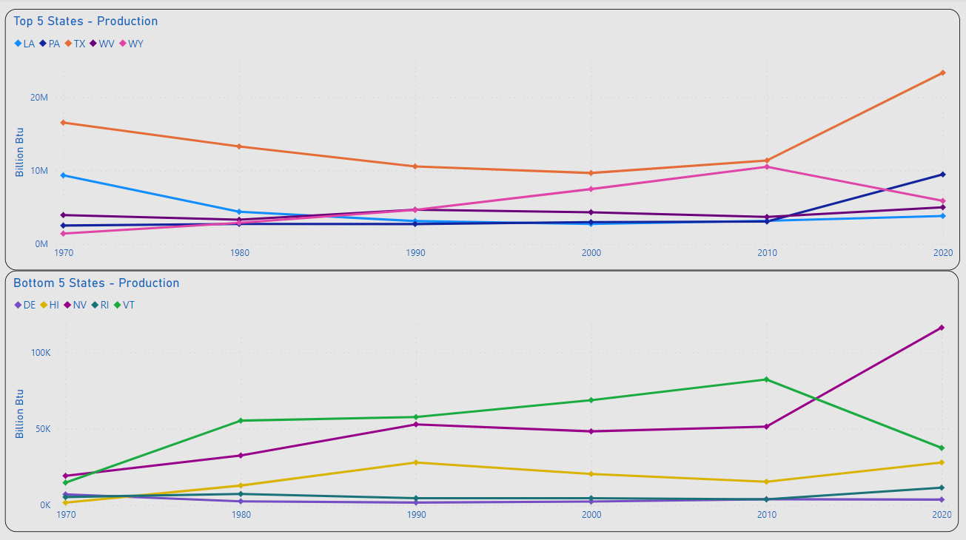
Top 5 / Bottom 5 – Change Production
TX: 23.3M
TX: 16.5M
Top 5 Production
MAX: TX 16.5M – 23.3M(BN Btu)
Highest Decrease: LA 9.4M – 3.8M (BN Btu)
TX, PA, WV, WY(+) Overall Production
Bottom 5 Production
MIN: DE 7K – 3.5K (BN Btu)
HI, NV, RI, VT (+) Overall Production
LA: 9.4M
LA: 3.8M
DE: 7K
DE: 3.5K
Notes:
Moving over to the TOP 5 & BOTTOM 5 for PRODUCTION….
TX remains the King for both PRODUCTION and CONSUMPTION significantly outpacing their peers
LA showed the greatest decline in PRODUCTION capacity with an overall decline 5.6M (BN Btu) from 1970 to 2020
Of the BOTTOM 5 Delaware was the only state with an overall decline in PRODUCTION

Slide 15
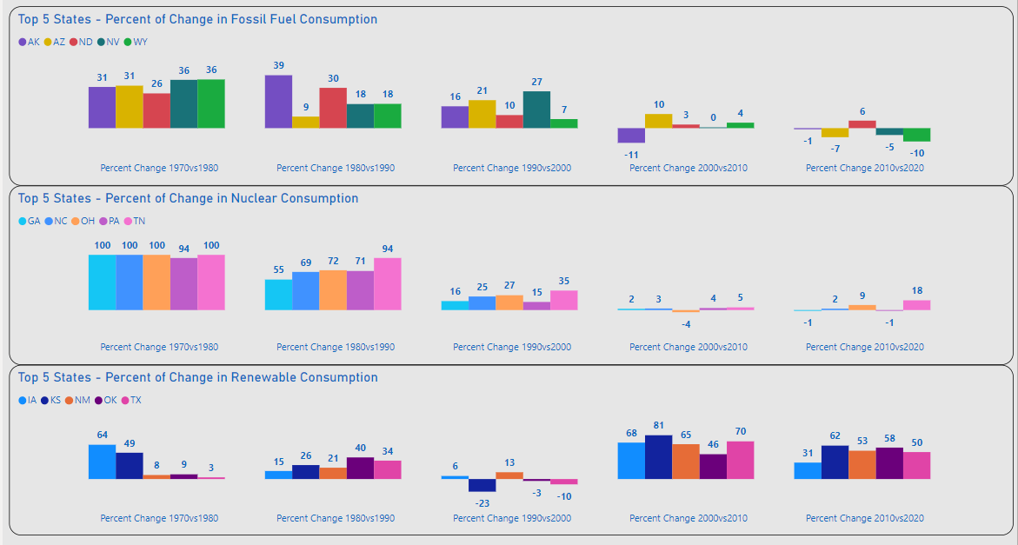
Top 5 Energy Mix - Consumption
Top 5 Energy Mix
Fossil Fuel and Nuclear Displays Highest Volumes of Increases 1970-2000
Renewable Consumption Displays Significant Increases After 2000
Notes:
Now moving to PERCENT CHANGE for the TOP 5 & BOTTOM 5for PRODUCTION….
First, I noticed a shift in the states listed….
Looking at the values the feeling of a “PARADIGM SHIFT” for ENERGY is re-emphasized
Similar to the overall Percent of Change slide….the CONSUMPTION slide demonstrates a similar shift in FOSSIL FUEL and NUCLEAR values vs RENEWABLES.

Slide 16
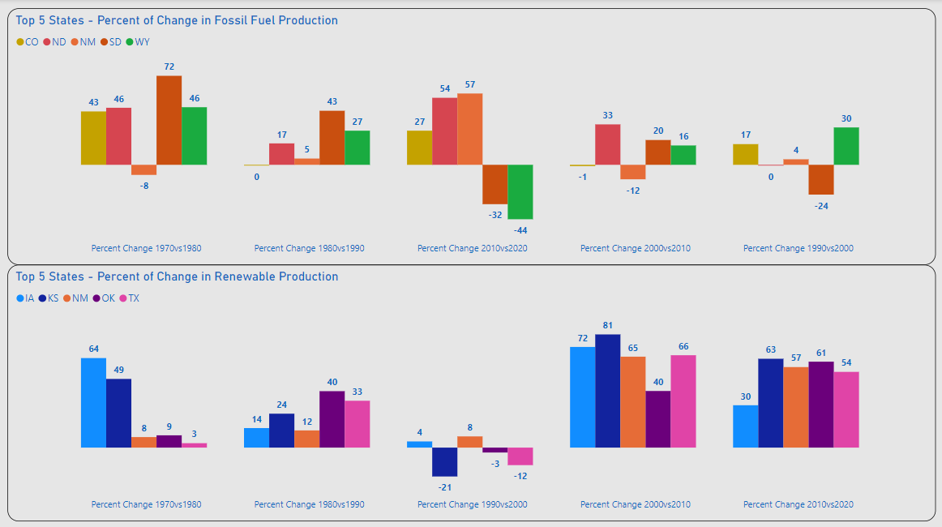
Top 5 Energy Mix - Production
Top 5 Energy Mix
Weakening of Fossil Fuel Production After 2000
Renewable Production Displays Significant Increases After 2000
Notes:
- This shift remains consistent for Percent of Change in RENEWABLES PRODUCTION

Slide 17
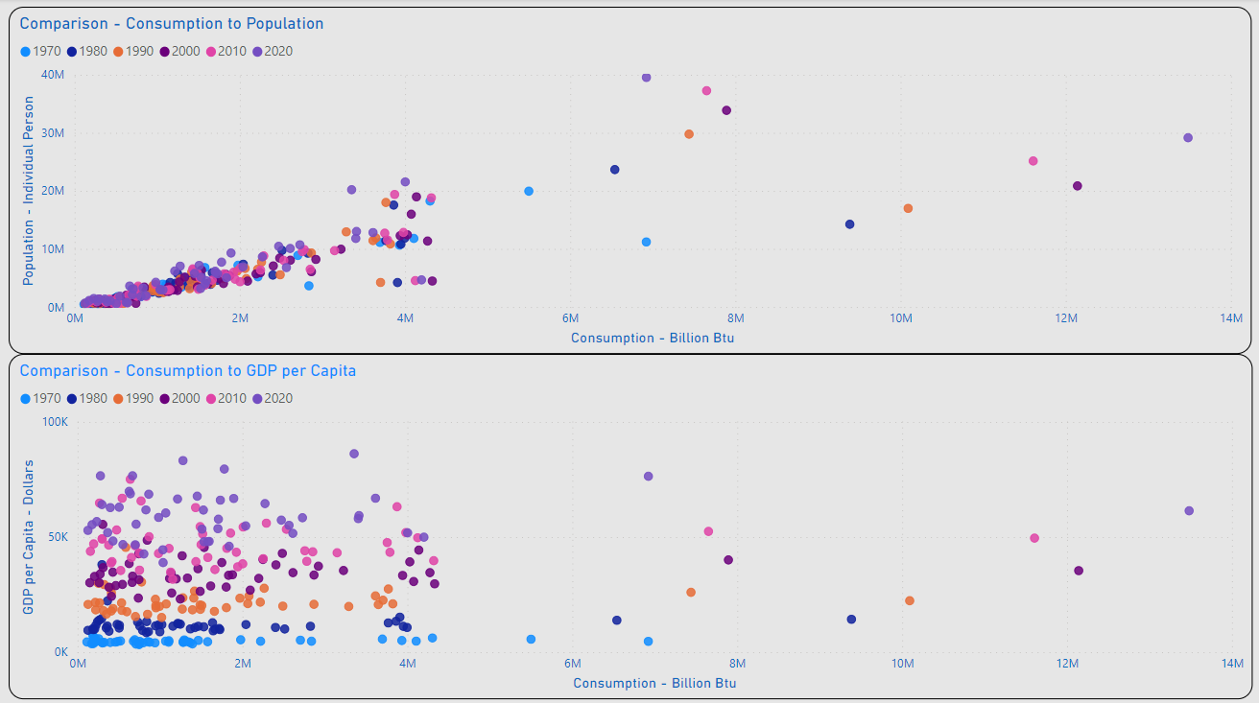
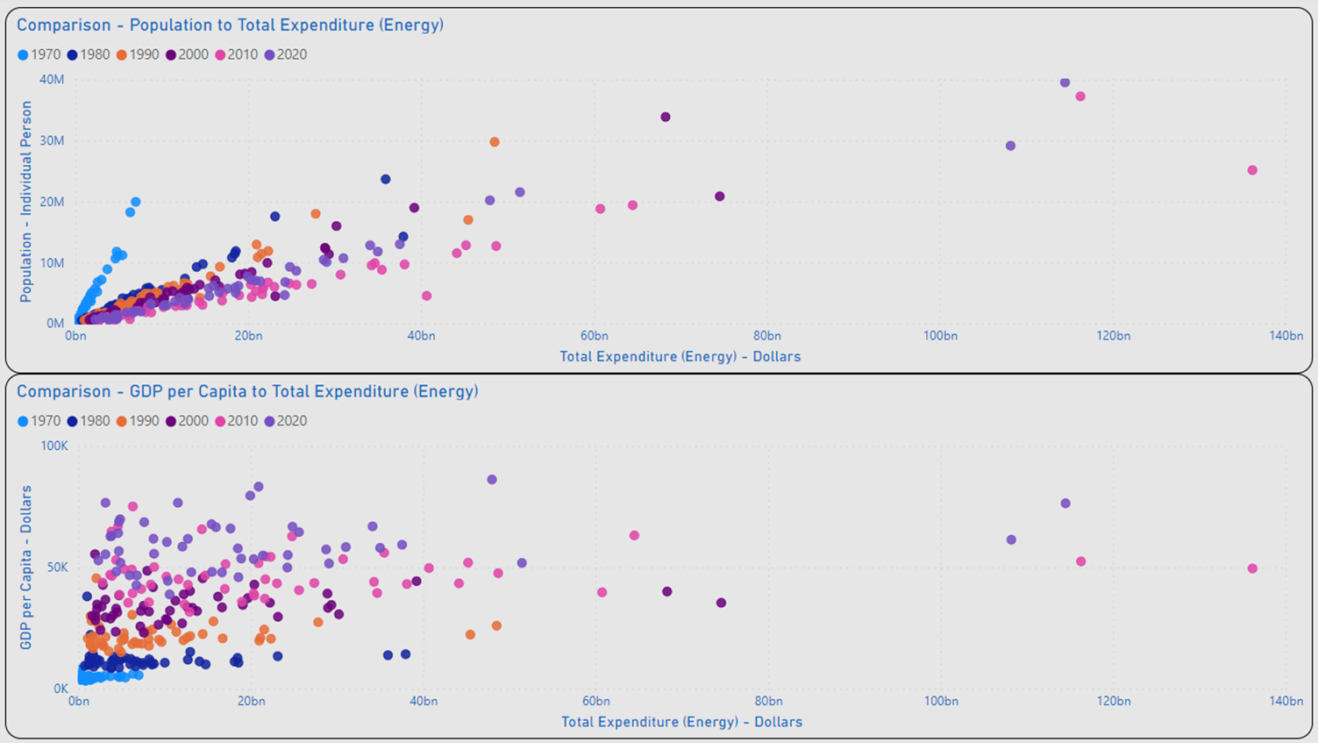
Occam’s Razor
Alignment of Population and Consumption Values Indicates a Strong Correlation
Dispersion of GDP per Capita and Consumption Values Between GDP Indicates Lack of Correlation
Occam’s Razor: The Simplest Explanation is Usually the Best One.
Notes:
My Key Thesis Starting this Project was that I would readily find a correlation between GDP per CAPITA to ENERGY CONSUMPTION…..My thought was that CONSUMPTION means Commerce which means Money, and More Commerce would equal More Money….and a higher GDP per Capita.
However, my assumption was incorrect…
As you can see from the charts….
The wide dispersion of values observed in the charts for GDP per CAPITA to CONSUMPTION Indicates a lack of correlation.
Using the Data, I made the same comparison using Population to CONSUMPTION and realized that this a much stronger correlation than GDP per CAPITA correlation.
Additionally….I conducted a review utilizing the values for Total Expenditure for ENERGY (since this is closely related to CONSUMPTION) and received the same tight groupings indicating a strong correlation
While this was contrary to my thesis it clearly demonstrates “The Simplest Answer is Usually the Best One”
Population not GDP per CAPITA is the better predictor of ENERGY CONSUMPTION.
With this out of the way…..We will look at some stats for…..
TECHNOLOGY / FUTURE GROWTH

Slide 18
Technology / Future Growth
Consumption / Production / GDP per Capita

Slide 19
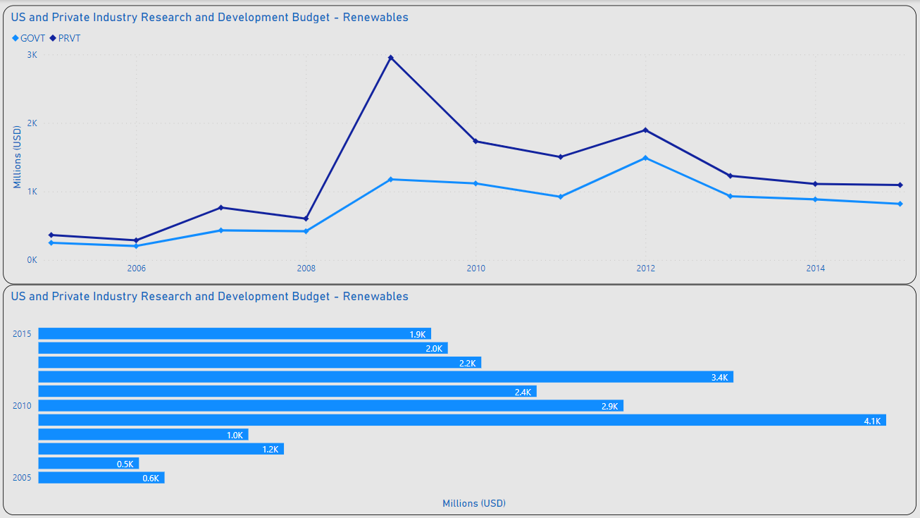
Advancing Renewable Tech
MAX PVT: 3B
R&D Investment
MAX Private Industry: 3B / 2009
MEDIAN Private Industry: 1.2B
MAX US Government: 1.9B / 2012
Median US Government: 786M
~15B Invested in R&D 2005-2015
MAX GOVT:
1.9B
Notes:
A Key Driver for Innovation is Funding….With this thought in mind I conducted a review of Government and Private Industry funding for Renewable Research & Development.
Utilizing a 10-year period from 2005 through 2015 we can see an overall investment of approximately $15B
2009 was the highest year for Private Industry investing $3B and 2012 was the highest year for the US Government investing $1.9B
With the median investment from Private Industry at $1.2B while our Government’s contribution sits at $786M
Now who were the winners from this type of investment?

Slide 20
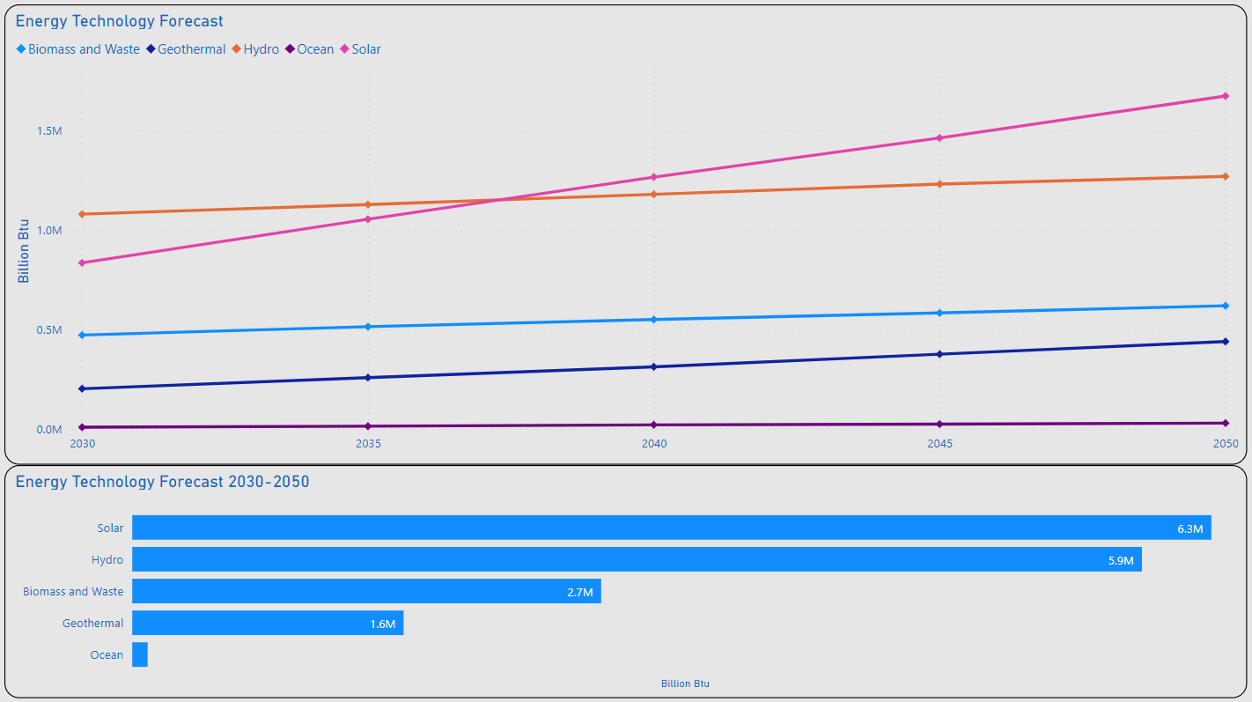
Advancing Renewable Tech
MAX Solar: 1.7M
Tech Projections
Solar Appears to be the Clear Leader in Renewable Advances / New Adoption
Solar MAX: 1.7M (BN Btu) / 2050
Solar MIN: 835K (BN Btu) / 2030
~16.6M (BN Btu) in Renewables Forecasted Between 2030 & 2050
MIN Solar: 835K
Notes:
As we can see from this slide Solar is the clear leader in forecasted adoption with a MAX contribution to the ENERGY market for 2050 forecast at 1.7M (BN Btu)
Overall, we can expect approximately 16.6M (BN Btu) from RENEWABLE ENERGY sources

Slide 21
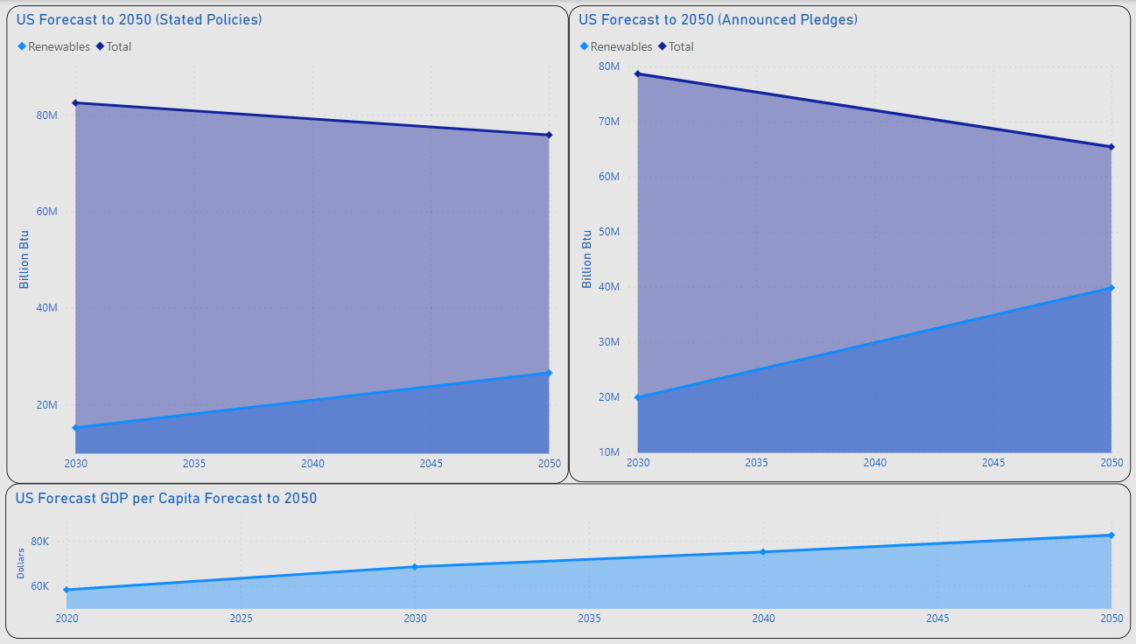
2050....Heading In The Right Direction
Total: 75.8M
Total: 65.4M
Stated Policies:
35% of US Energy Supply Projected for Renewables
74% Increase from 2030
Announced Pledges:
60.9% of US Energy Supply of US Energy Projected for Renewables
100% Increase from 2030
GDP per Capita:
83K
30.7% Increase from 2020
Renewables: 39.8M
Renewables: 26.5M
GDP per Capita: 83K
Notes:
And what about the future….I believe we are heading in the right direction…..
Looking at our current Stated Policies” for ENERGY we can expect our use of RENEWABLES to grow to 35% of our Total ENERGY Supply
If we hold to our “Announced Pledges” we can reach a level of almost 61% of our Total ENERGY Supply coming from RENEWABLES
And as for our GDP per CAPITA it is expected to remain on its current trajectory…

Slide 22
Summary
Population has the Greater Impact on Consumption vs. GDP per Capita (Occam’s Razor)
Fossil Fuel Expected to Continue Declining
Continued Usage Expected
Renewables Expected to Continue Increasing
Technological Innovation / Availability
Government Policy / Regulation

Slide 23
Thank you
Lawrence Haggerty​
lawrence.c.Haggerty@gmail.com
https://www.linkedin.com/in/lawrence-haggerty/
https://github.com/lawrence-haggerty

Slide 24
Closing Notes
Technology:
Excel: Extract Transform Load, Minor Analysis
PostgreSQL / pgAdmin: Analysis, Prepare Data for Visualization
Microsoft Power BI: Analysis, Visualization
Data Sources:
Energy Information Administration (EIA):
State Energy Data System 1960-2020: https://www.eia.gov/state/seds/seds-data-complete.php?sid=ND#StatisticsIndicators
Bureau of Economic Analysis (BEA):
Regional Data Tools: https://apps.bea.gov/regional/
United States Census Bureau:
Historical Population Change Data (1910-2020): https://www.census.gov/data/tables/time-series/dec/popchange-data-text.html
International Energy Agency (IEA):
Energy Technology RD&D Budgets: https://www.iea.org/data-and-statistics/data-product/energy-technology-rd-and-d-budget-database-2#
World Energy Investment 2023 Datafile: https://www.iea.org/data-and-statistics/data-product/world-energy-investment-2023-datafile-2
World Energy Outlook 2022: https://www.iea.org/data-and-statistics/data-product/world-energy-outlook-2022-free-dataset

