Slide 1
Energy to GDP per Capita Comparison
Lawrence Haggerty

Slide 2
Agenda
Introduction
Description / Definitions
Topic
Topic
Topic
Topic

Slide 3
Introduction
There has been a consistent axiom since the beginning of the industrial revolution that energy drives commerce.
The intent of this project to understand the trajectory for movement away from fossil fuel as our primary energy source and its alignment to the nation’s leading fiscal metric.
The comparison focuses on three separate categories within the energy sector: fossil fuels, nuclear, and renewable energy.

Slide 4
Description / Definitions
Description
Definitions
XXXX
XXXX
XXXX
XXXX
XXXX

Slide 5
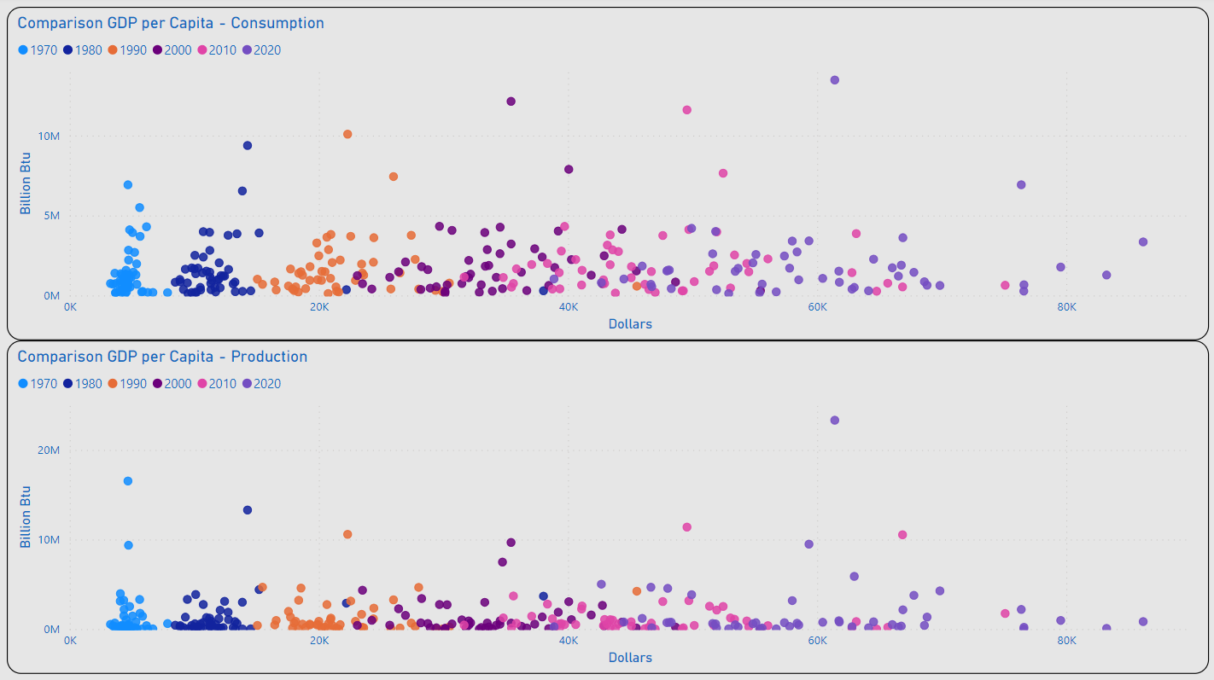
Consumption / Production
Most States Remained Under 5M (BN Btu) for Consumption and Production
The Range of Values for GDP per Capita Appeared to Begin a Wider Dispersion in 2000
2020 Outliers for Consumption: TX & CA
2020 Outlier for Production: TX
Outliers for GDP per Capita Included: MA, NY & WA

Slide 6
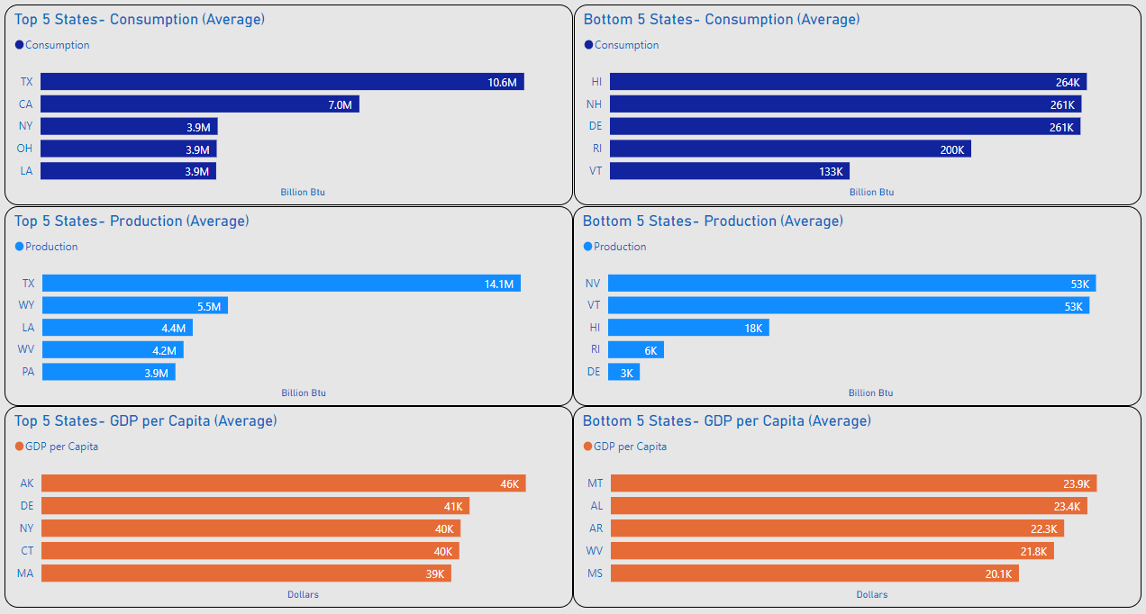
Top 5 / Bottom 5
XXXX
XXXX

Slide 7
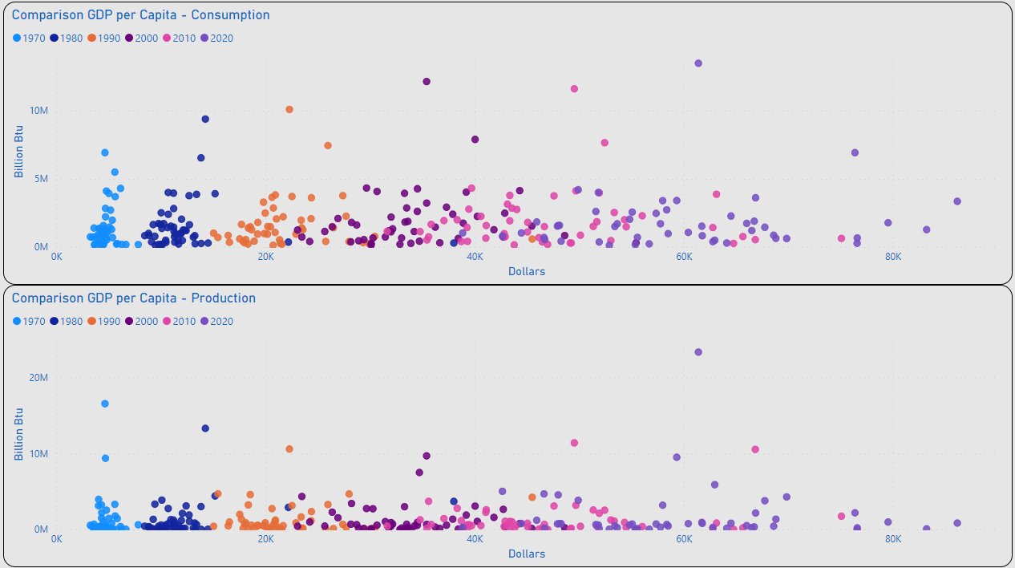
Energy Mix - Comparison
XXXX
XXXX

Slide 8
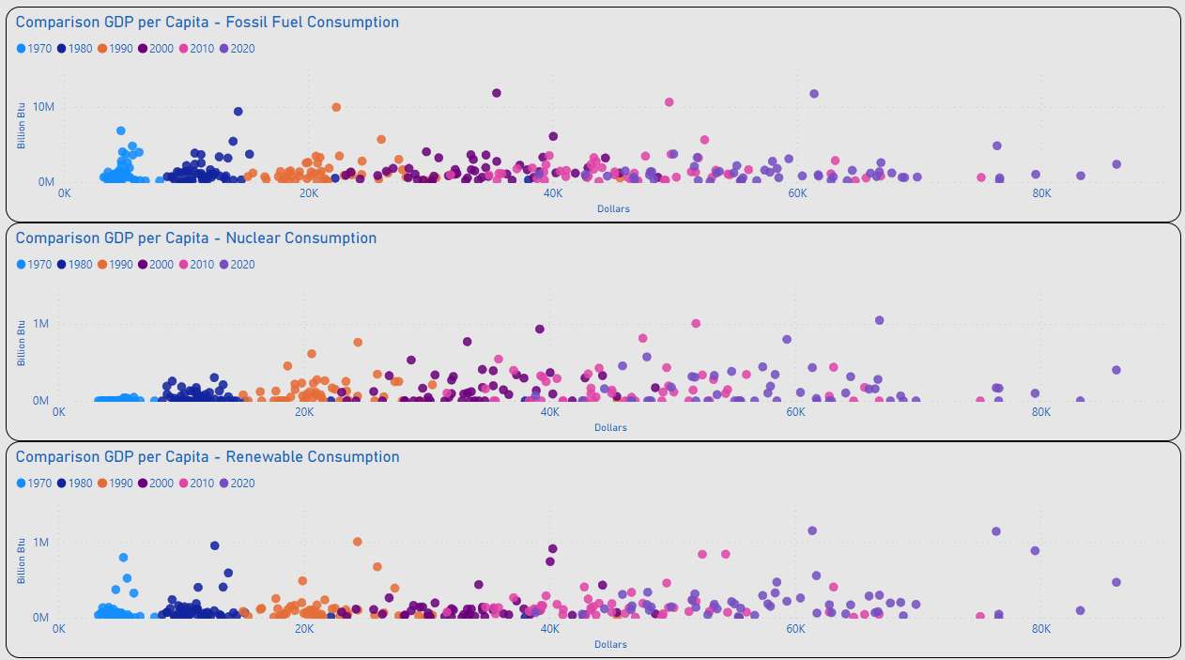
GDP per Capita – Energy Mix
XXXX
XXXX

Slide 9
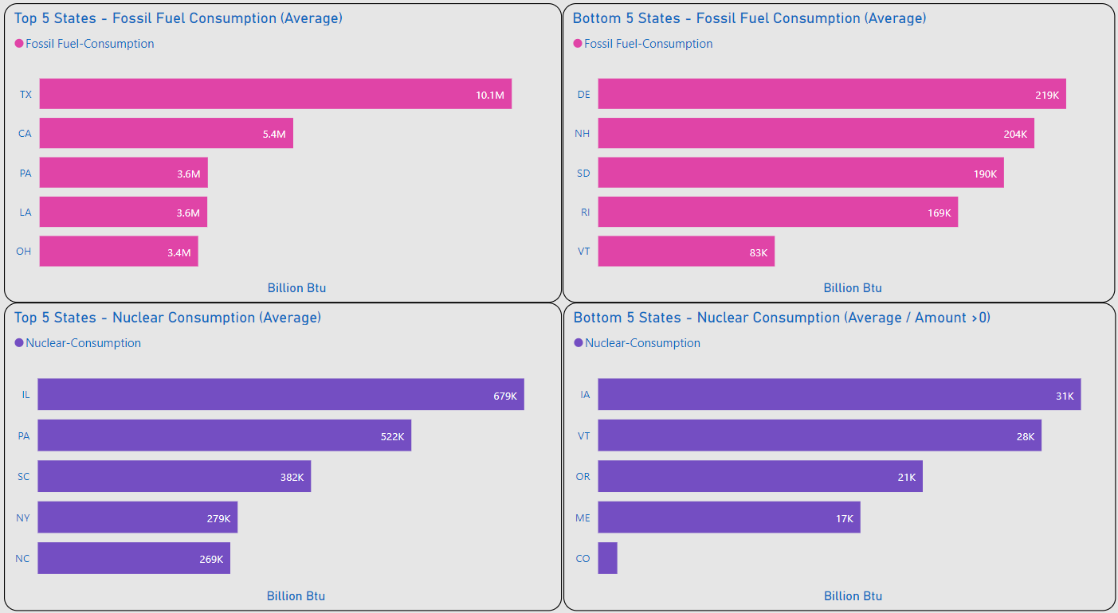
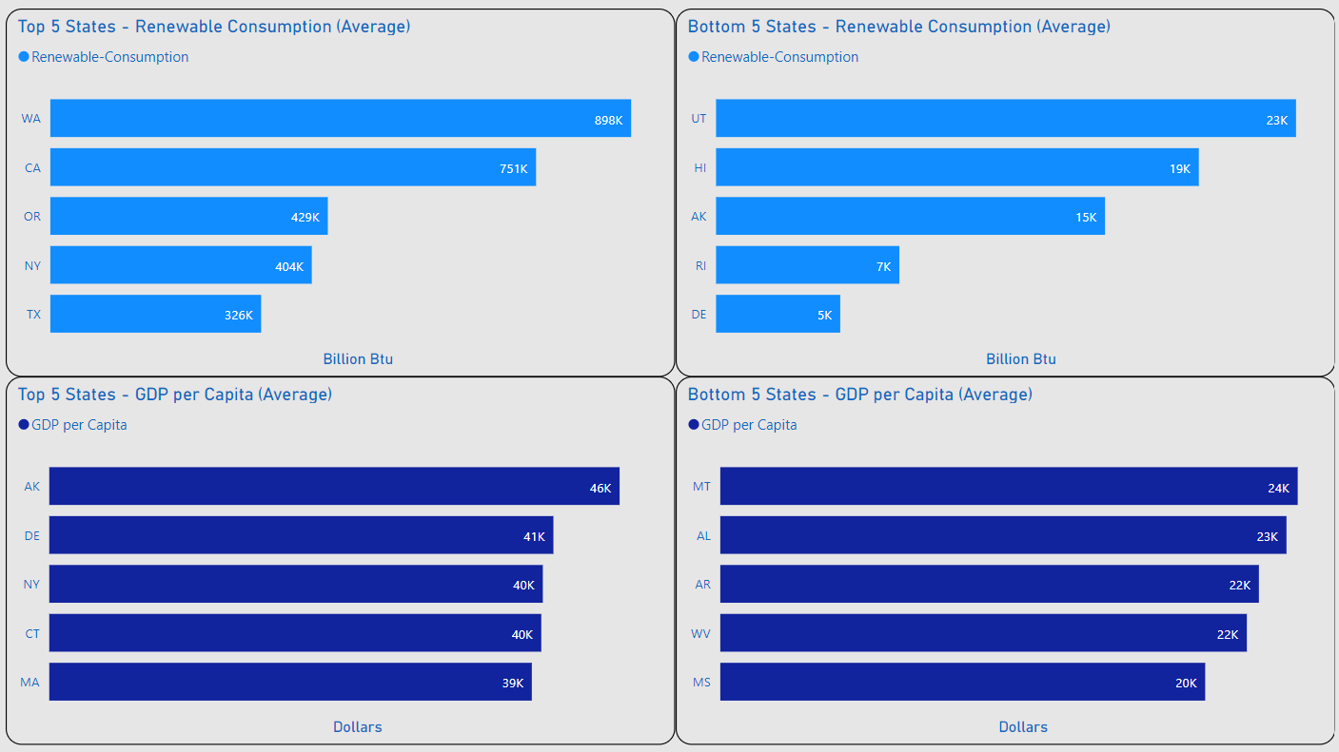
Top 5 / Bottom 5
XXXX
XXXX
XXXX
XXXX

Slide 10
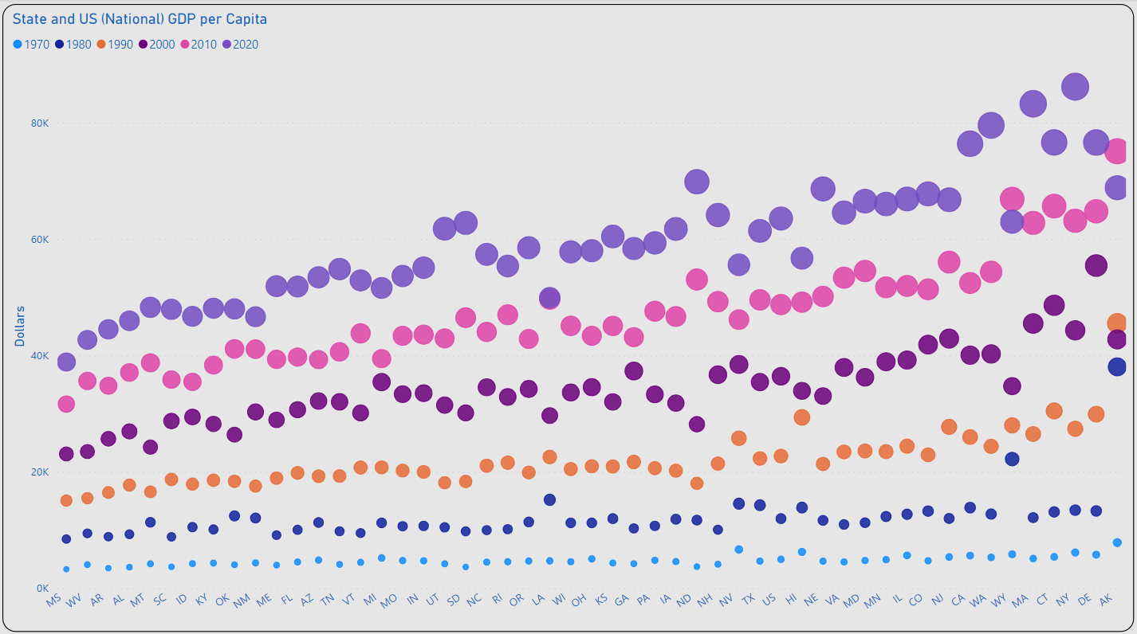
GDP per Capita Growth
XXXX
XXXX

Slide 11
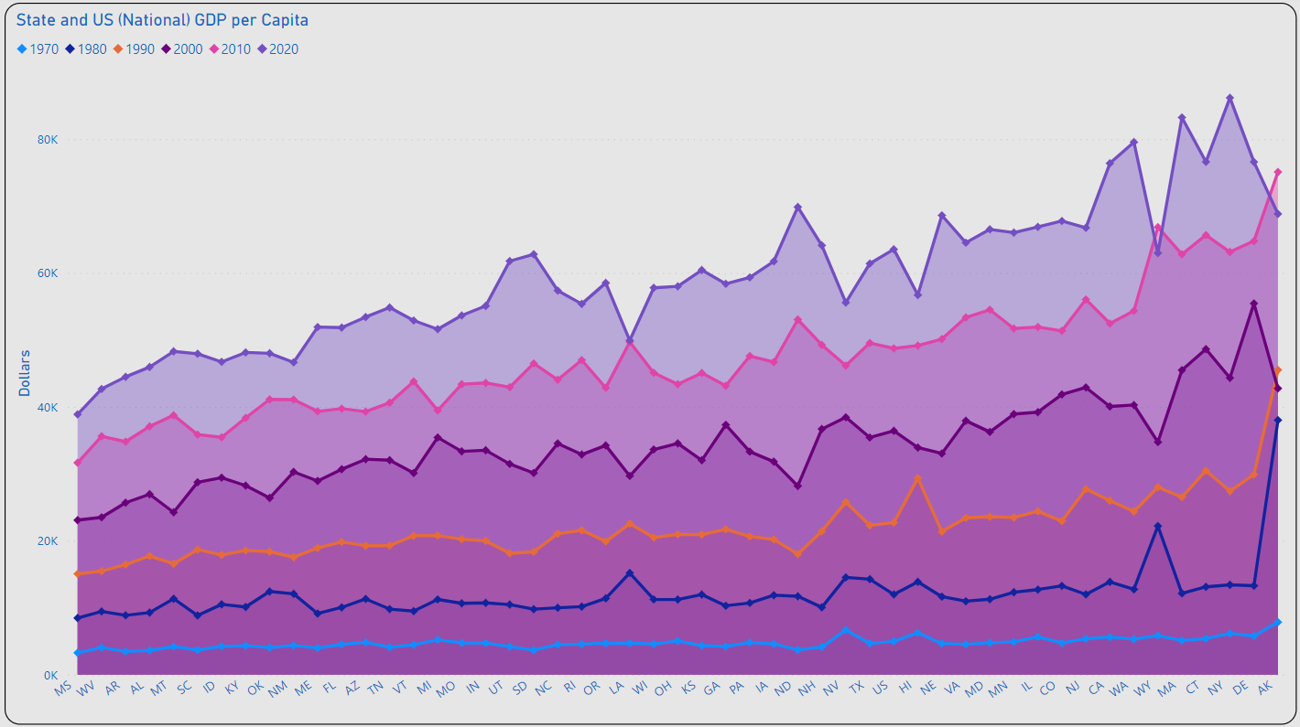
GDP per Capita Change
XXXX
XXXX
????????????

Slide 12
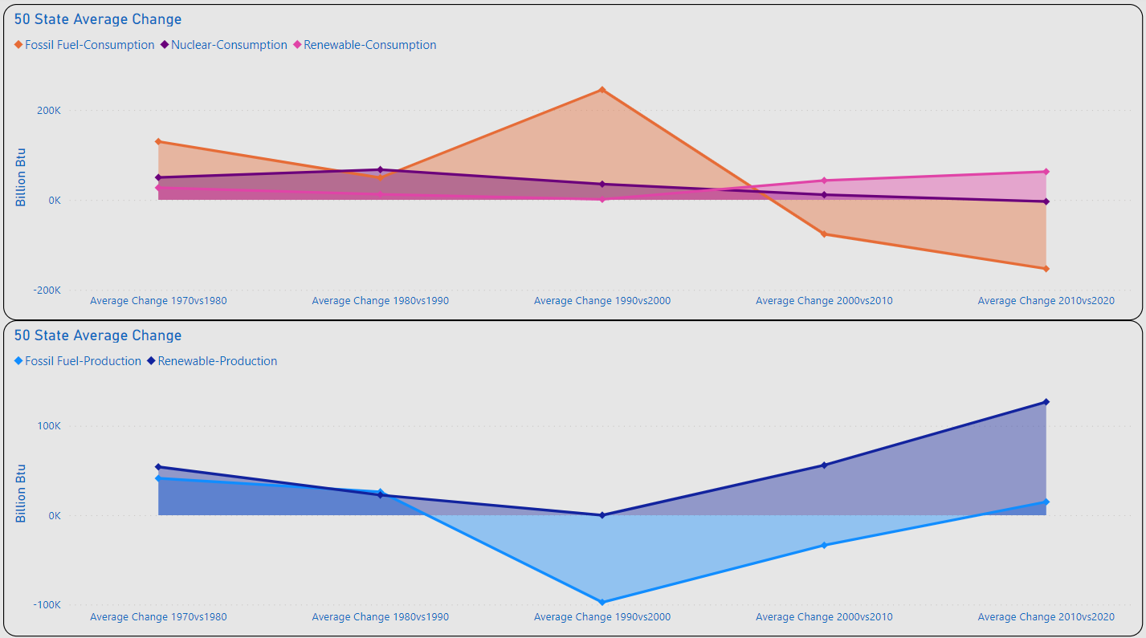
Amount of Change
XXXX
XXXX

Slide 13
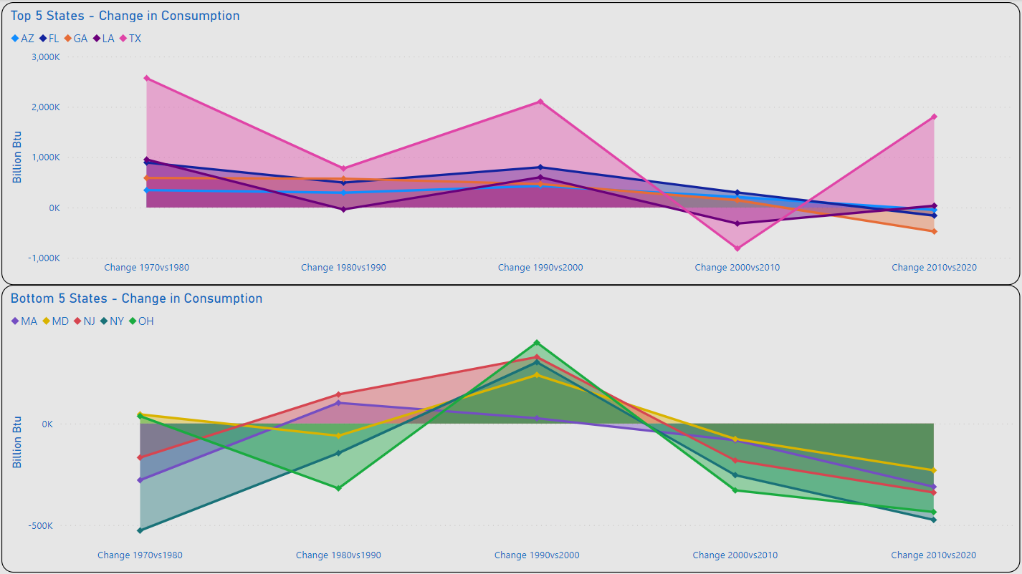
Top 5 / Bottom 5 - Overall
XXXX
XXXX

Slide 14
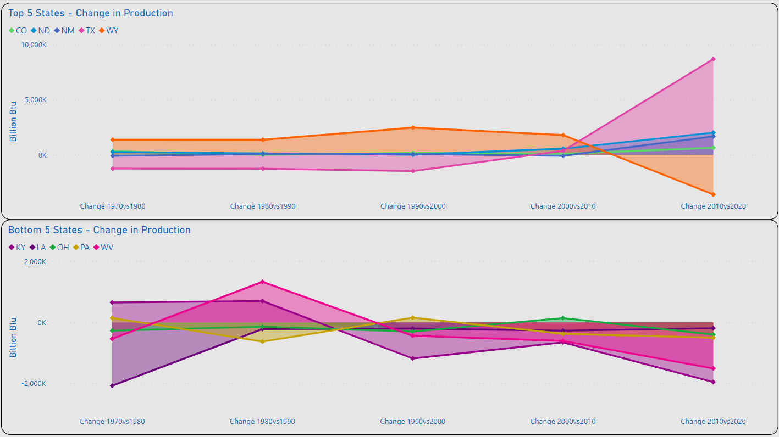
Top 5 / Bottom 5 - Overall
XXXX
XXXX

Slide 15
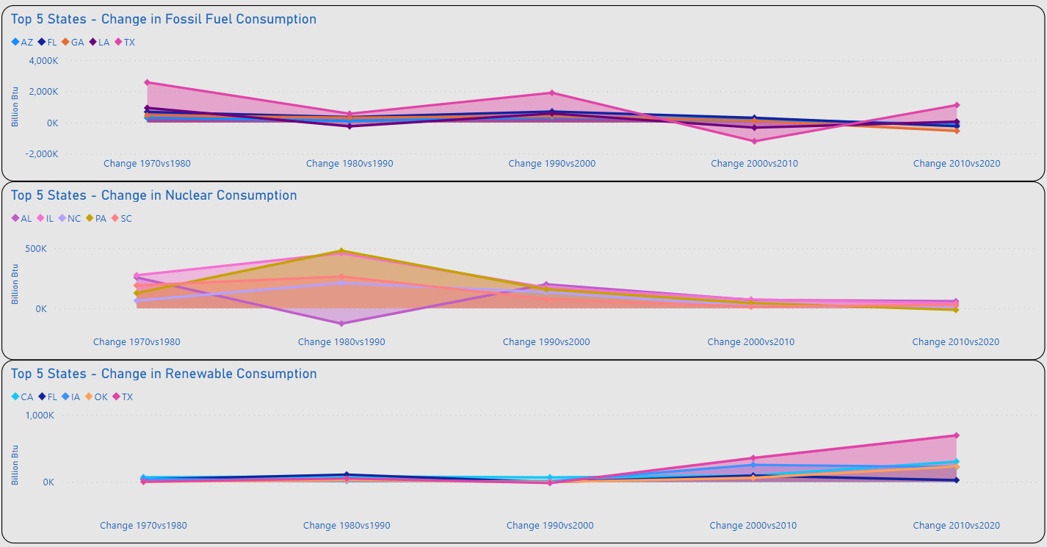
Top 5 / Bottom 5 – Energy Mix
XXXX
XXXX

Slide 16
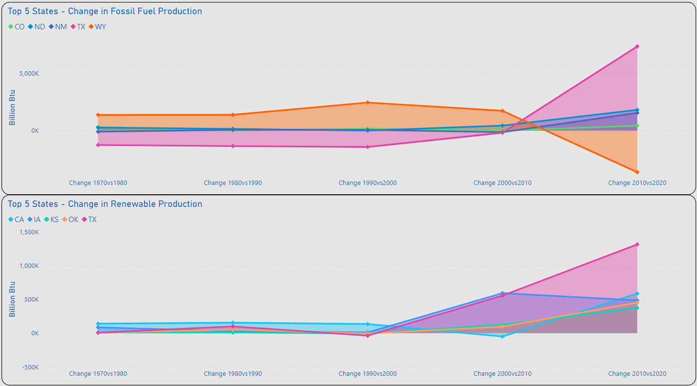
Top 5 / Bottom 5 – Energy Mix
XXXX
XXXX

Slide 17
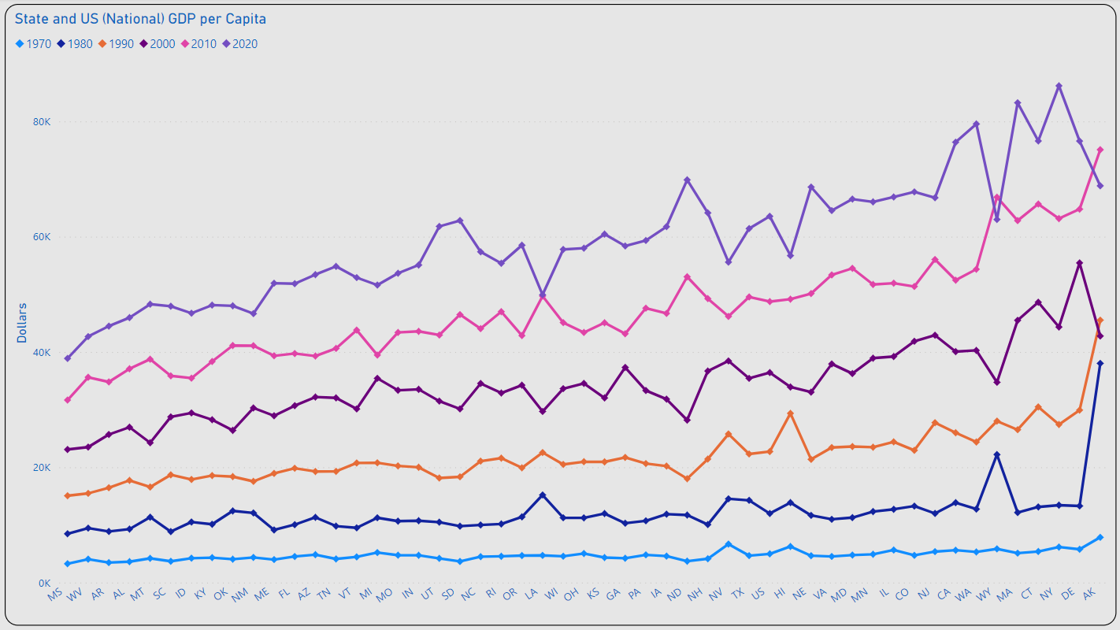
GDP per Capita Change
XXXX
XXXX
????????????

Slide 18
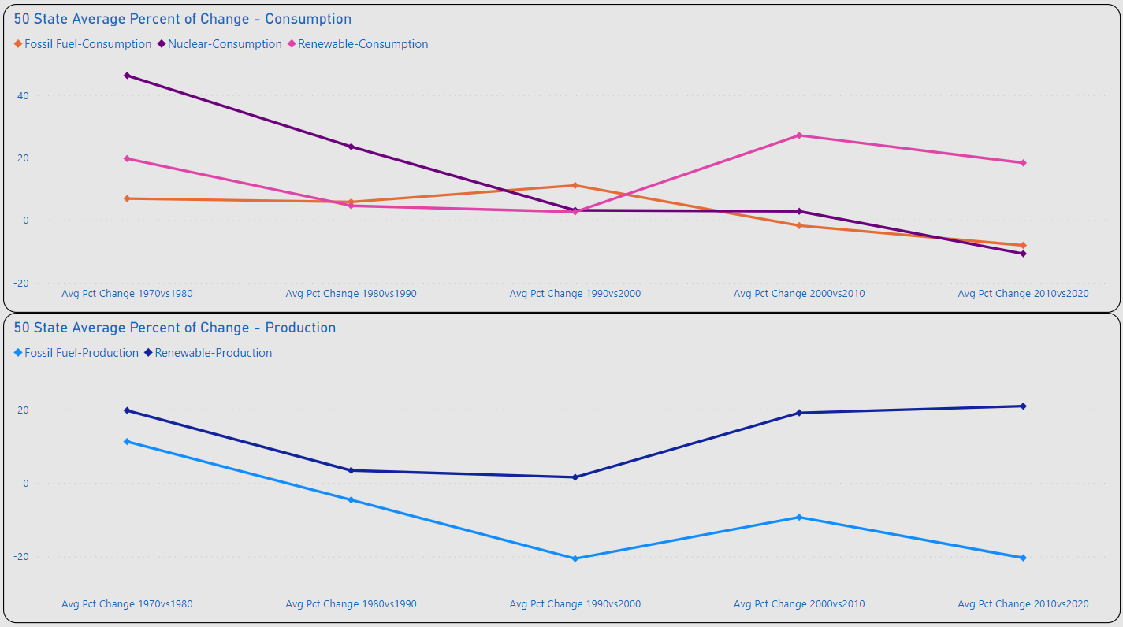
Percent of Change
XXXX
XXXX

Slide 19
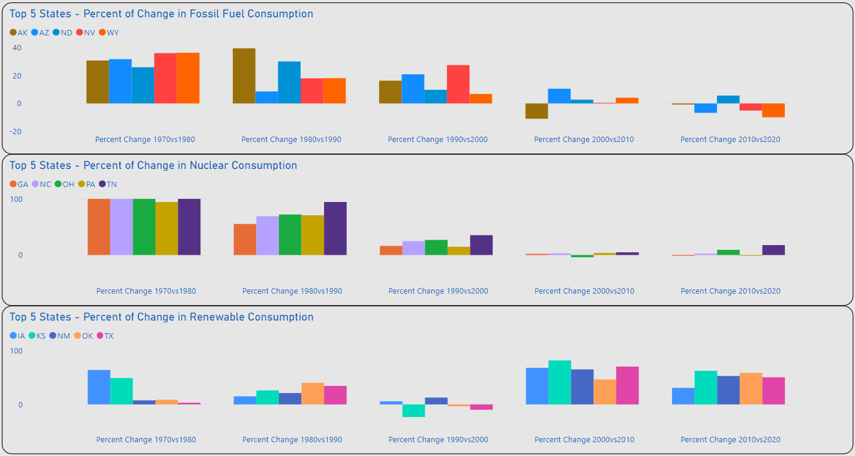
XXXX
XXXX
XXXX

Slide 20
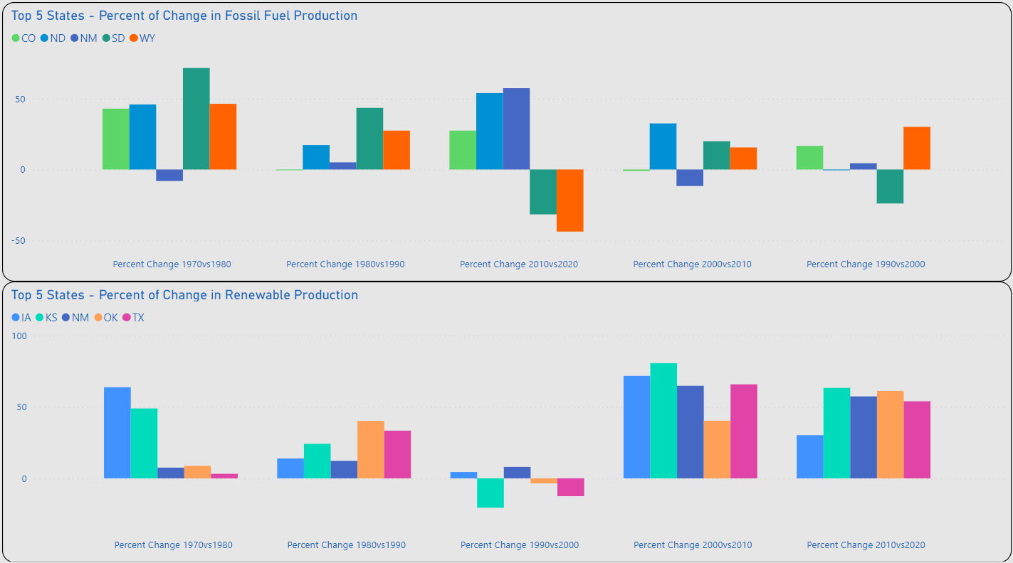
XXXX
XXXX
XXXX

Slide 21
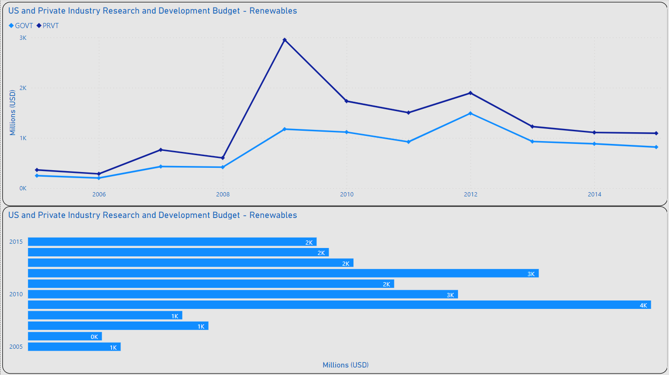
Advancing Renewable Tech
XXXX
XXXX

Slide 22
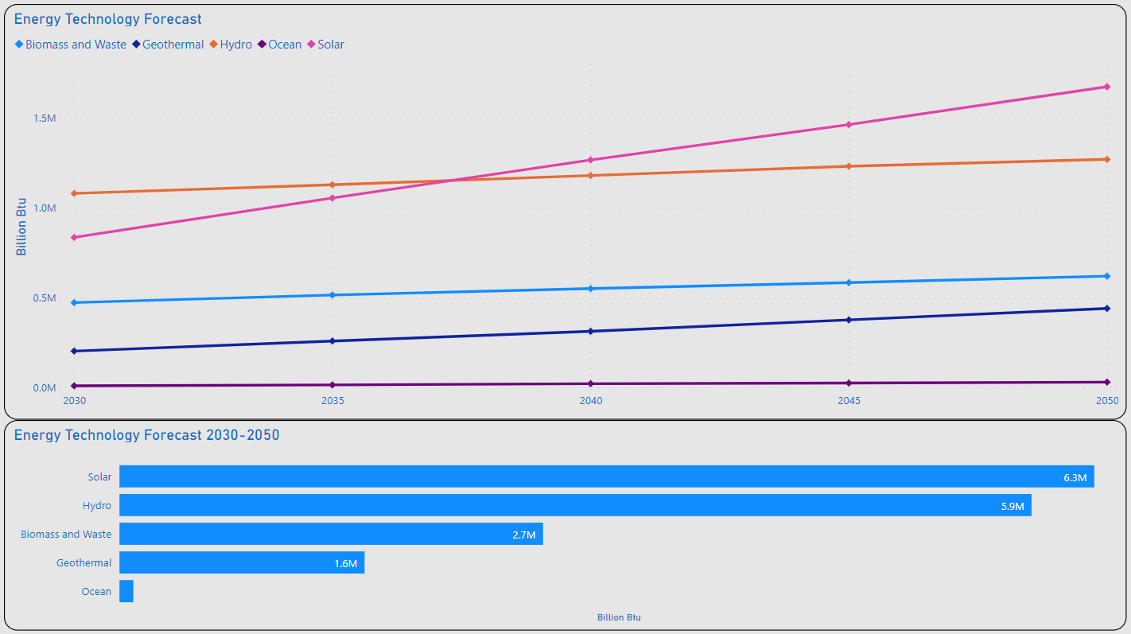
Advancing Renewable Tech
XXXX
XXXX

Slide 23
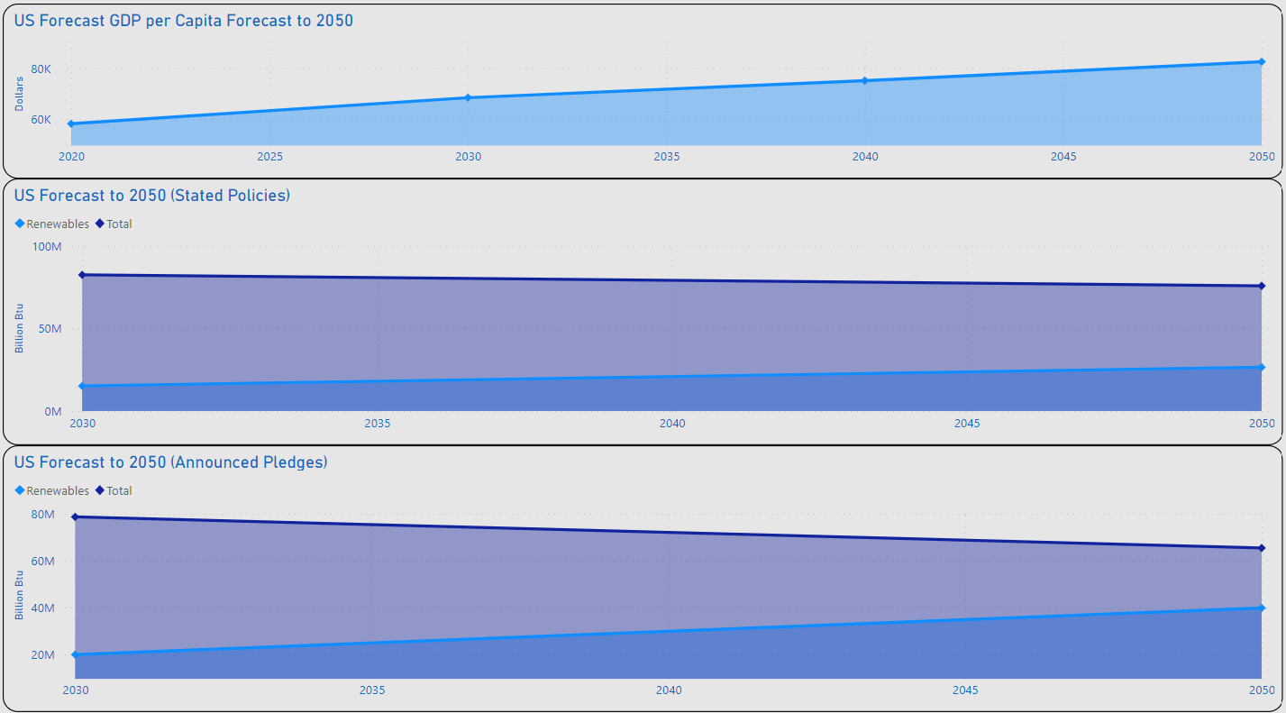
XXXX
XXXX
XXXX

Slide 24
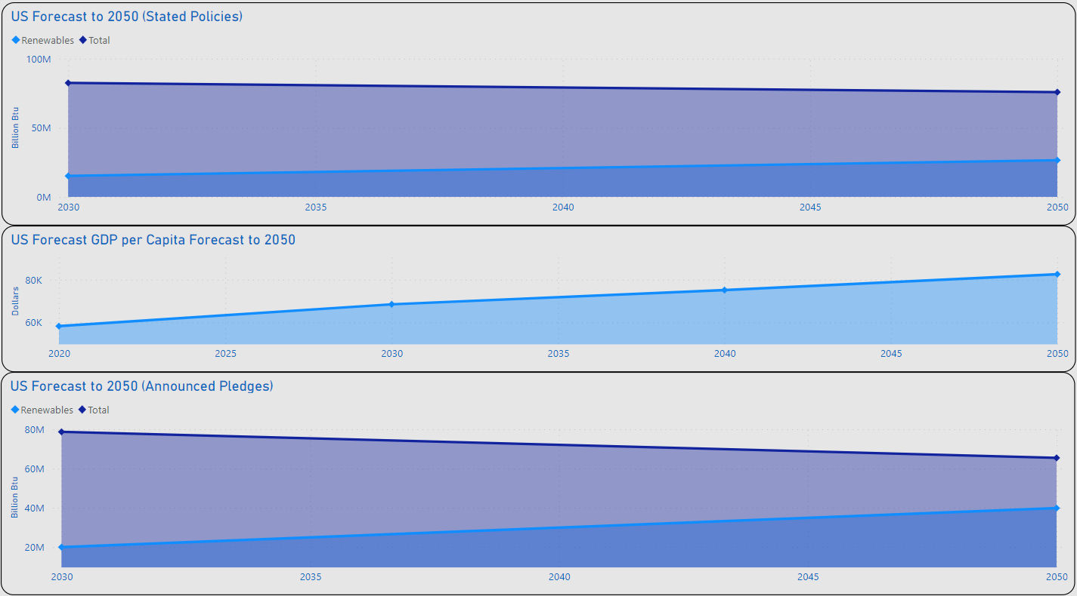
XXXX
XXXX
XXXX

Slide 25
XXXX
XXXX
XXXX

Slide 26
XXXX
XXXX
XXXX

Slide 27
XXXX
XXXX
XXXX

Slide 28
XXXX
XXXX
XXXX

Slide 29
XXXX
XXXX
XXXX

Slide 30
XXXX
XXXX
XXXX
XXXX
XXXX
XXXX
XXXX
XXXX
XXXX

Slide 31
XXXX
XXXX
XXXX
XXXX
XXXX
XXXX
XXXX
XXXX
XXXX
XXXX
XXXX
XXXX
XXXX

Slide 32
Summary
XXXX

Slide 33
Thank you
Lawrence Haggerty​
lawrence.c.Haggerty@gmail.com
https://www.linkedin.com/in/lawrence-haggerty/
https://github.com/lawrence-haggerty

Slide 34
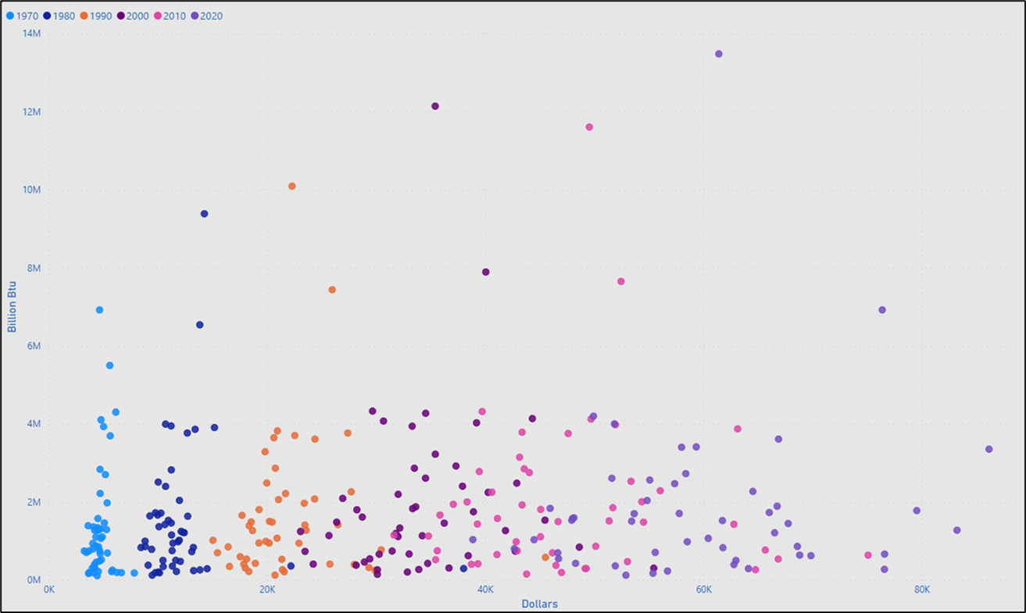
GDP per Capita - Consumption
XXXX
XXXX
XXXXXXXXXX

Slide 35
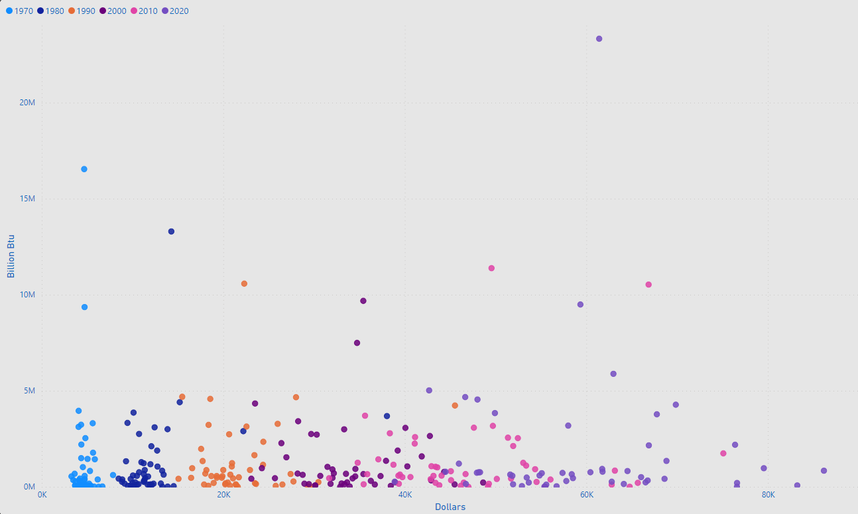
Comparison GDP per Capita - Production
XXXX
XXXX
XXXXXXXXXX

Slide 36
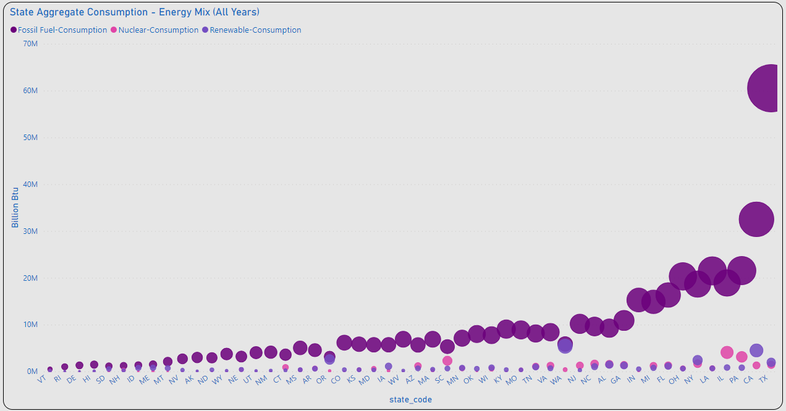
Energy Mix – Aggregate Consumption
XXXX
XXXX
XXXXXXXXXX

Slide 37
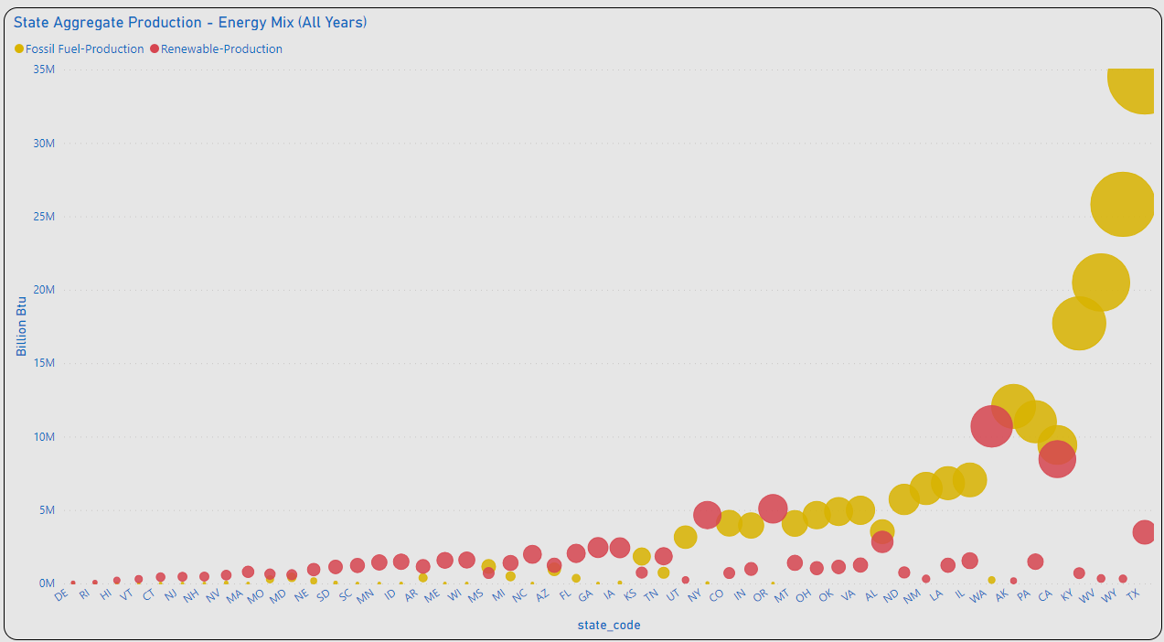
Energy Mix – Aggregate Production
XXXX
XXXX
XXXXXXXXXX

Slide 39
Title

Slide 40
Timeline
Deploy strategic networks with compelling e-business needs
Sep 20XX
Synergize scalable e-commerce
Nov 20XX
Disseminate standardized metrics
Jan 20XX
Coordinate e-business applications
March 20XX
Foster holistically superior methodologies
May 20XX

Slide 41
Primary goals
Annual revenue growth

