Slide 1
MA-SqueezeliteBrowse: menu walkthrough
Screens of the piCorePlayer (JiveLite, 1920x1080) browsing Music Assistant 2.10.5 with the patched Squeezelite provider.
Captured 2026-10-11. The content shown is a moment in time: it follows the library, the presets and the Home Assistant labels.

Slide 2
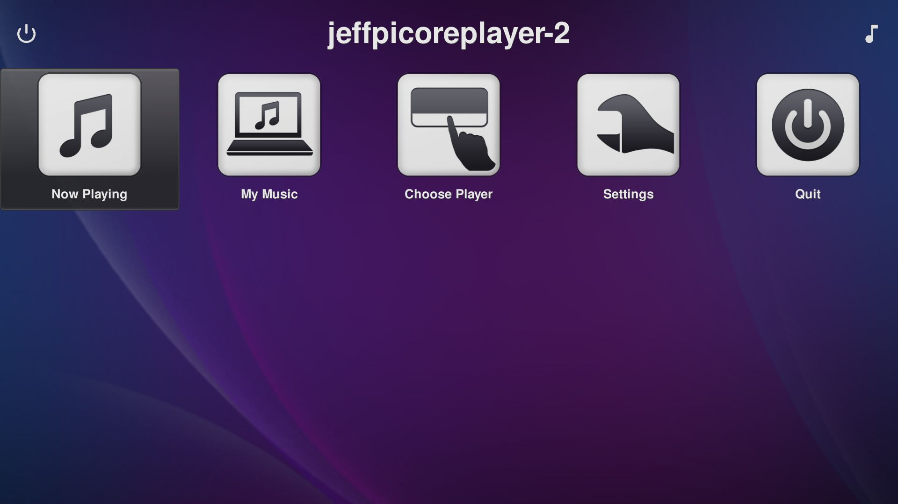
Main Menu
Home screen of the piCorePlayer (JiveLite). Settings holds the HA Extras entry when it is enabled for the device.

Slide 3
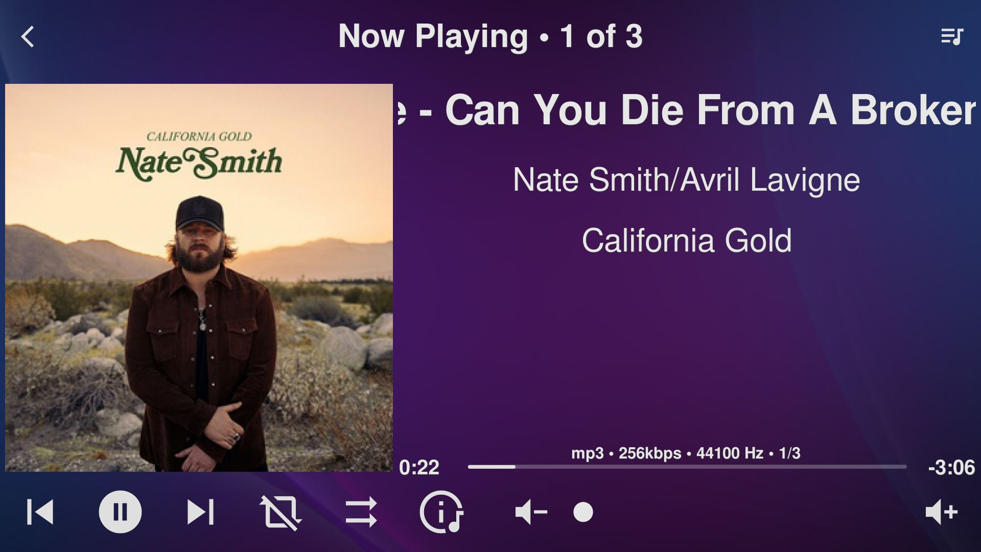
Now Playing
Reached with the Now Playing tile or the [ key. Shows the current track from the Music Assistant queue.

Slide 4
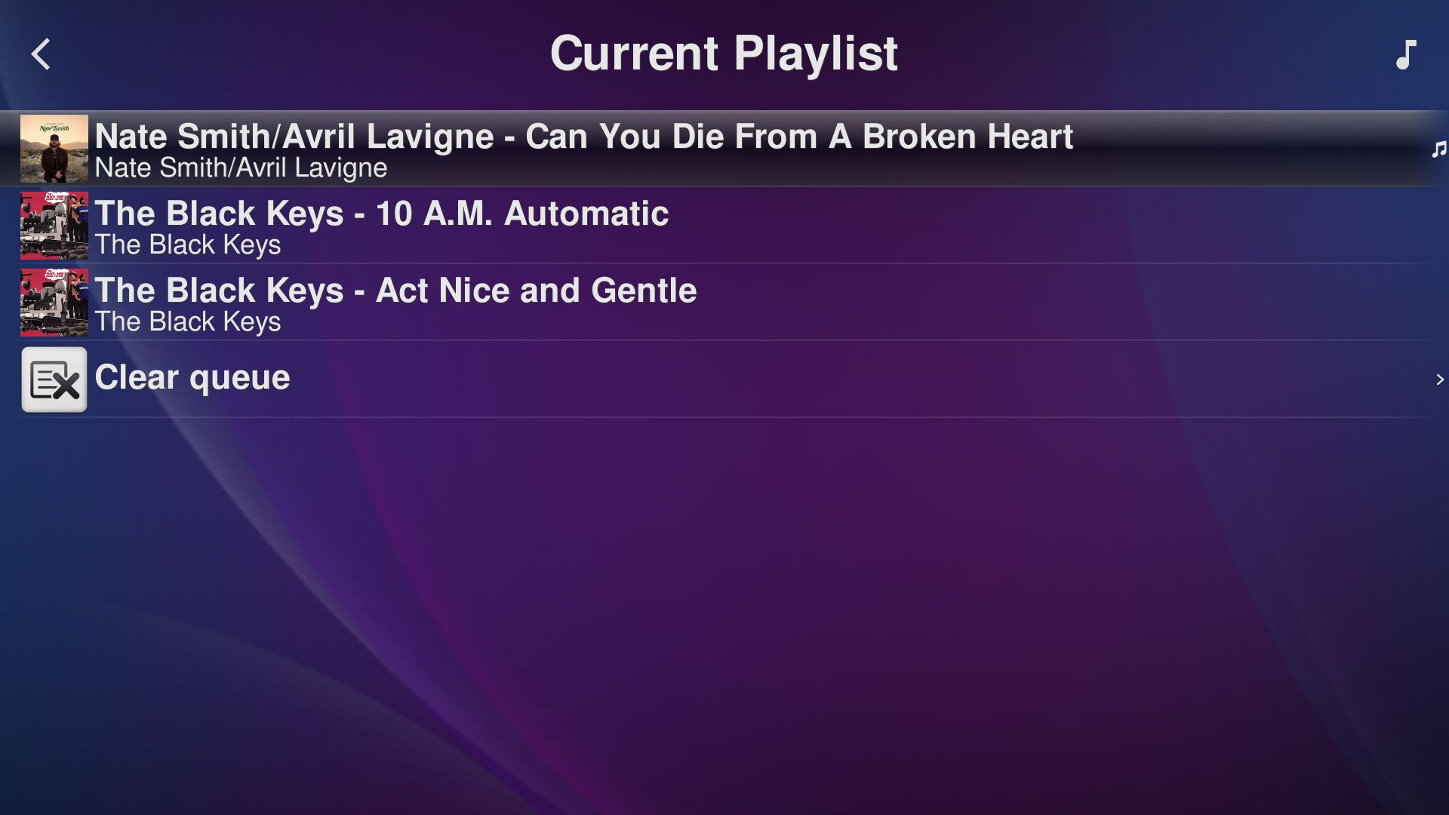
Queue (Current Playlist)
The player's queue as Music Assistant has it. Long press a row for Play Now, Play Next, Move to End and Delete item.

Slide 5
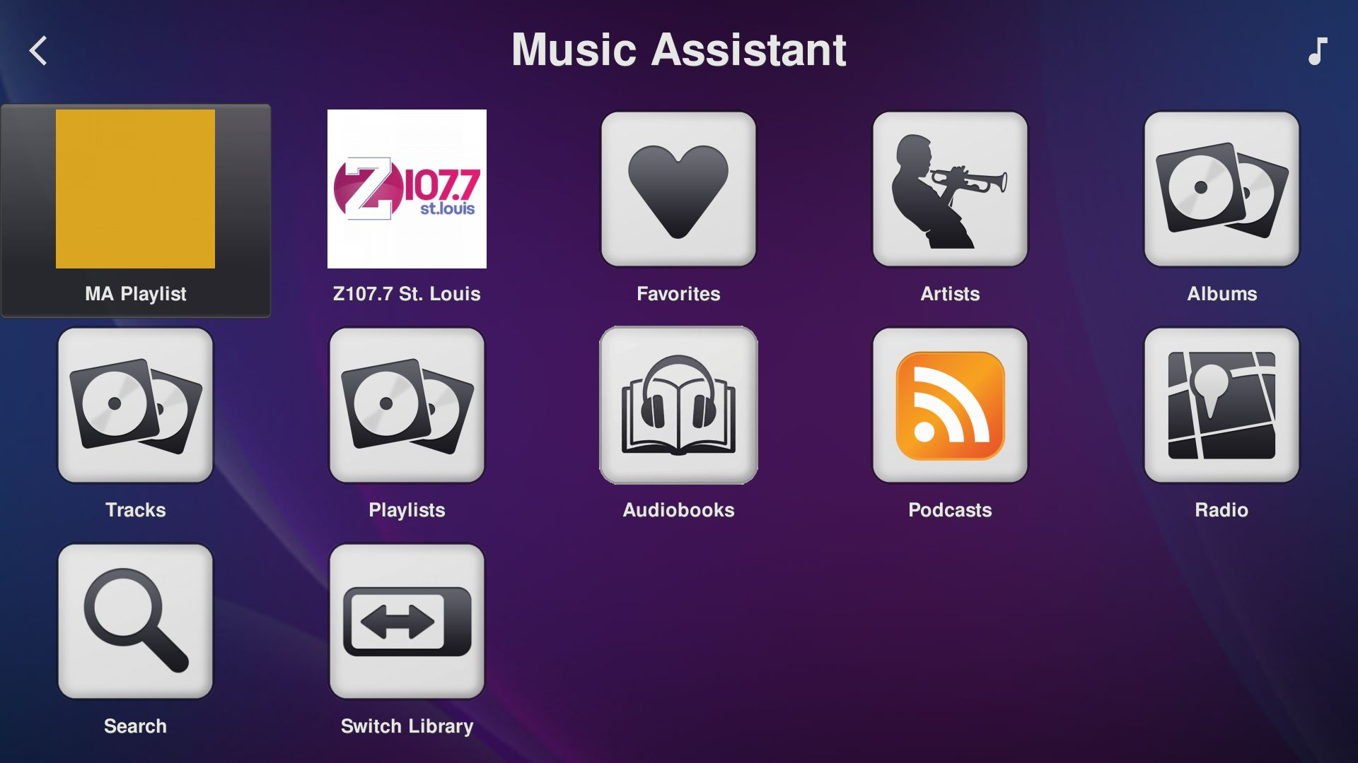
My Music
The two preset tiles come from the player's settings in Music Assistant (favorited playlists and radio stations).

Slide 6
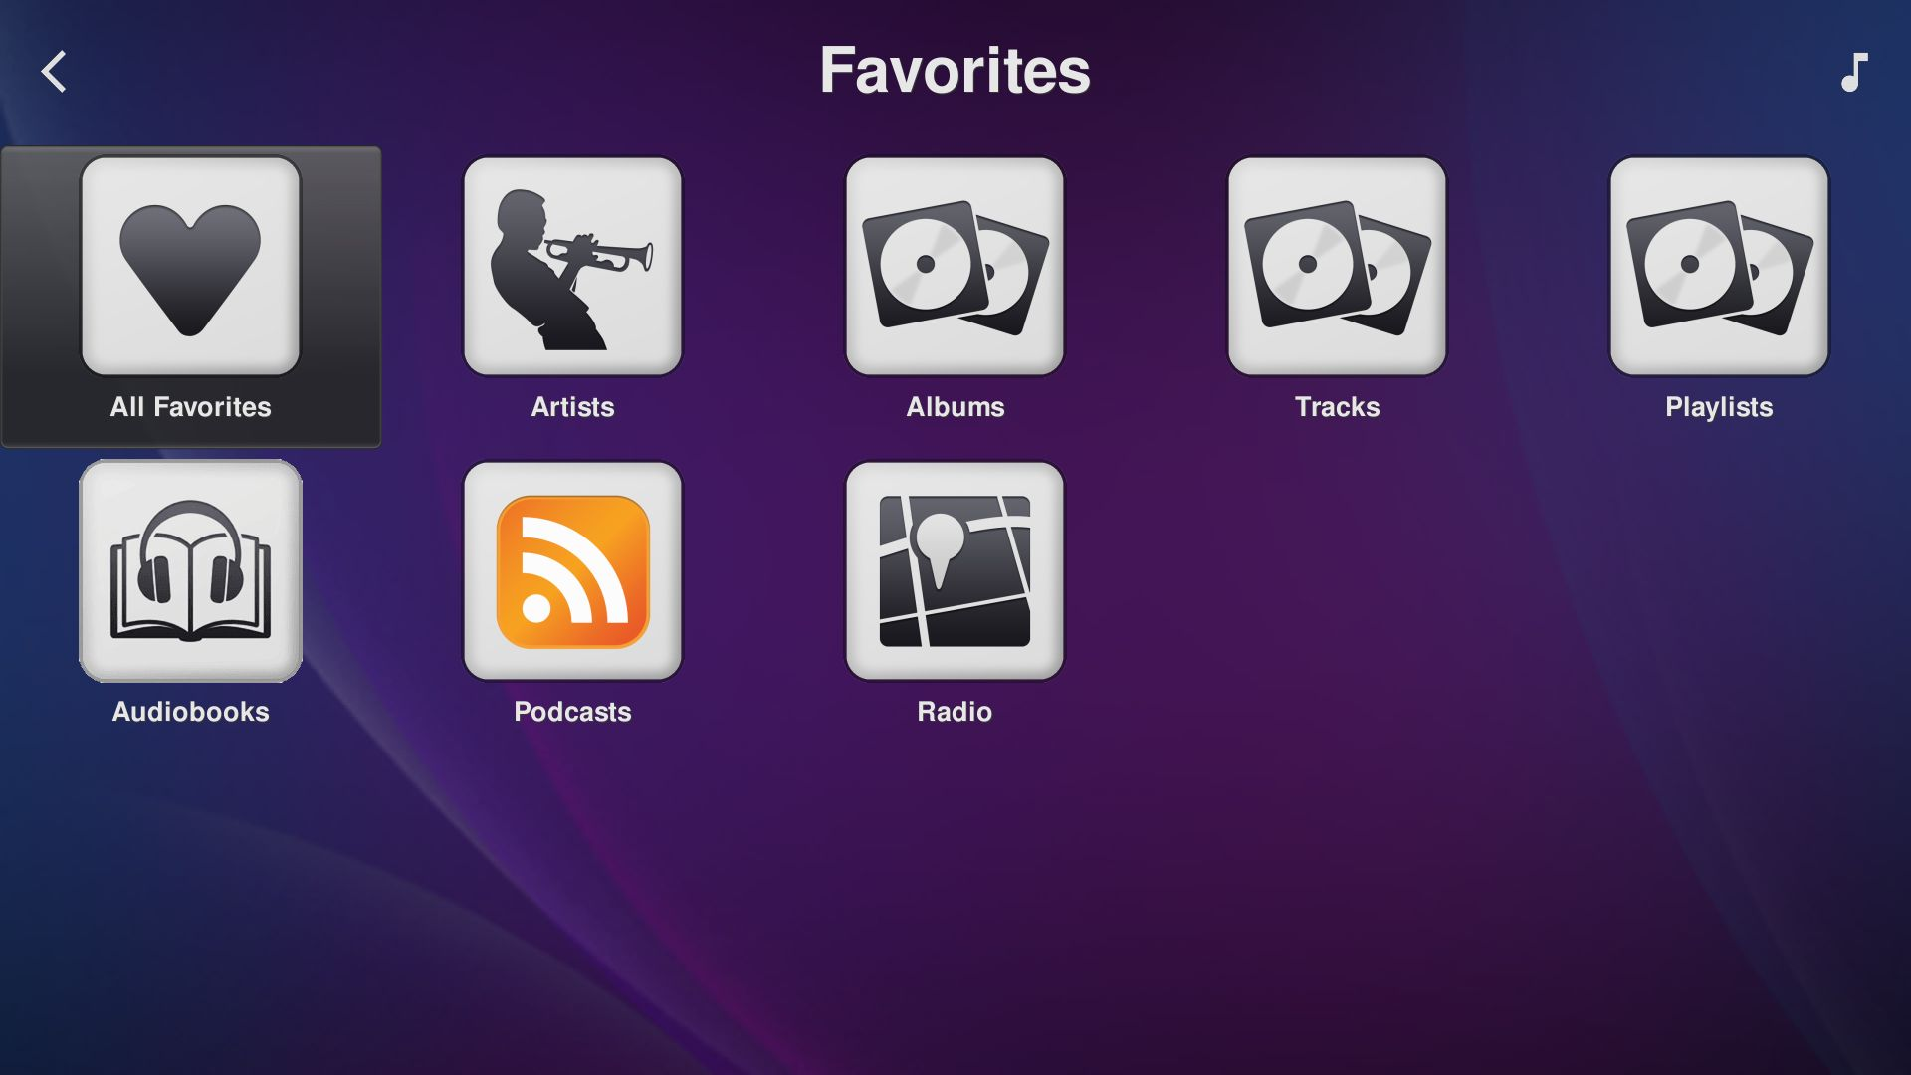
My Music - Favorites
All Favorites, then one entry per type.

Slide 7
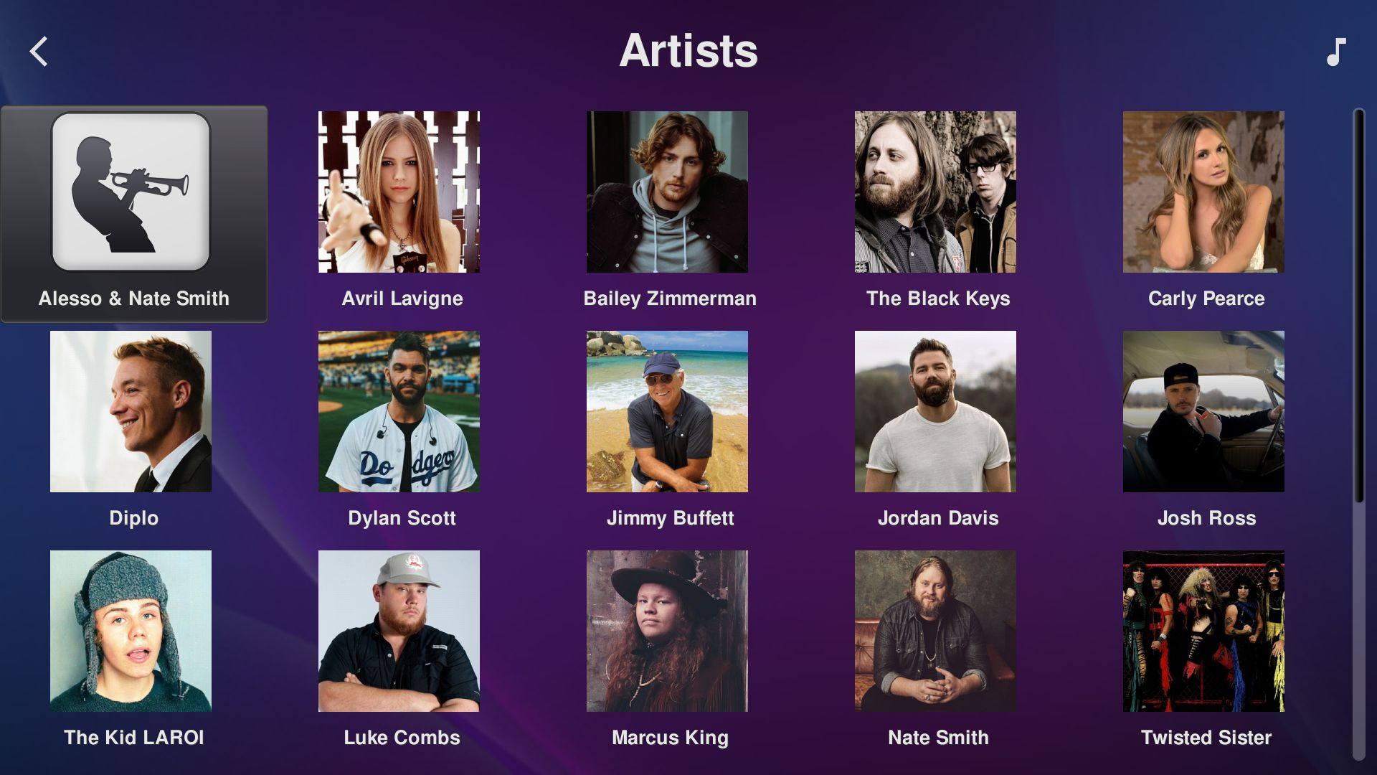
My Music - Artists

Slide 8
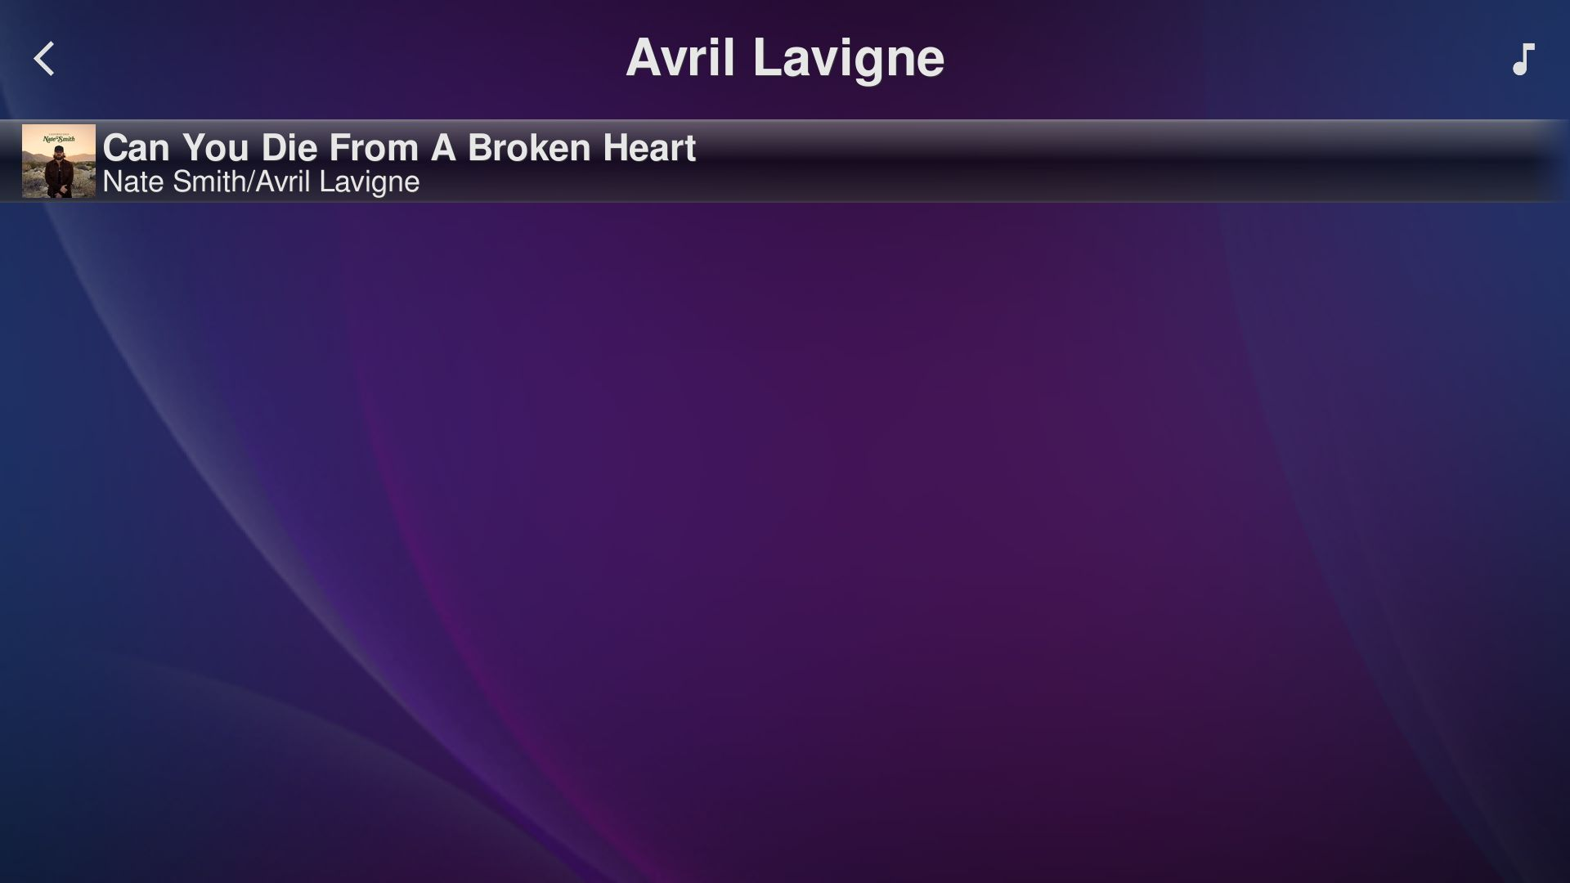
My Music - Artists - Avril Lavigne
An artist who is only on one track (a featured artist). The view lists albums, then tracks not on those albums, then matching radio stations.

Slide 9
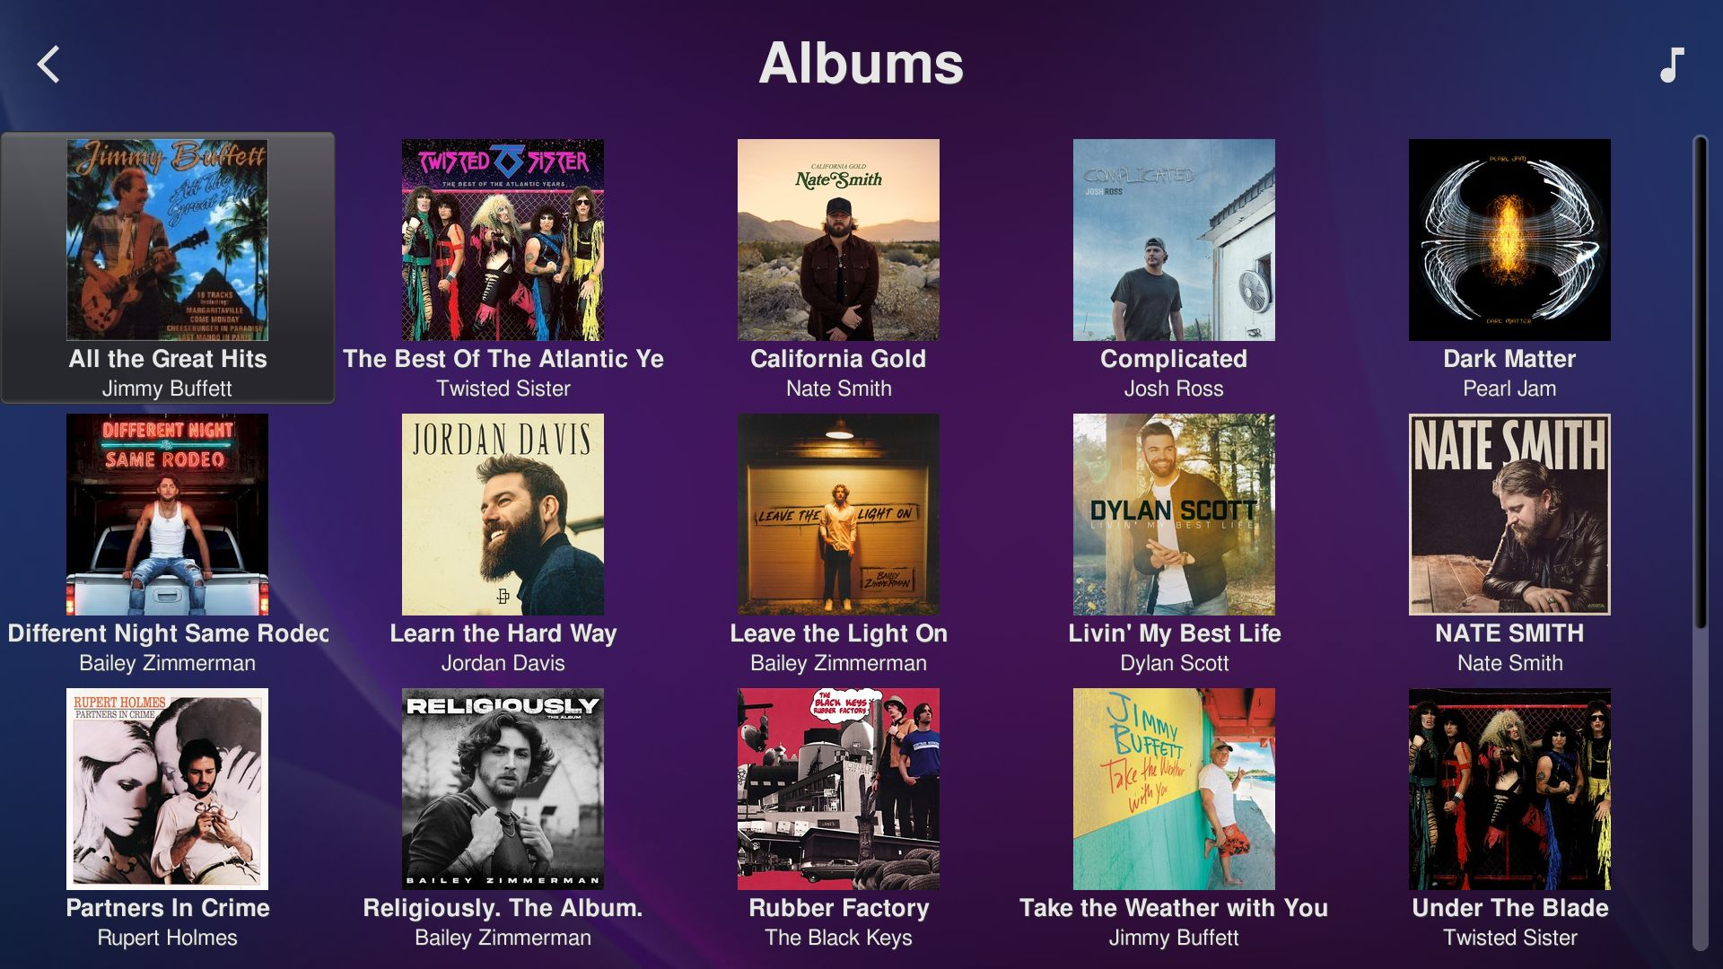
My Music - Albums

Slide 10
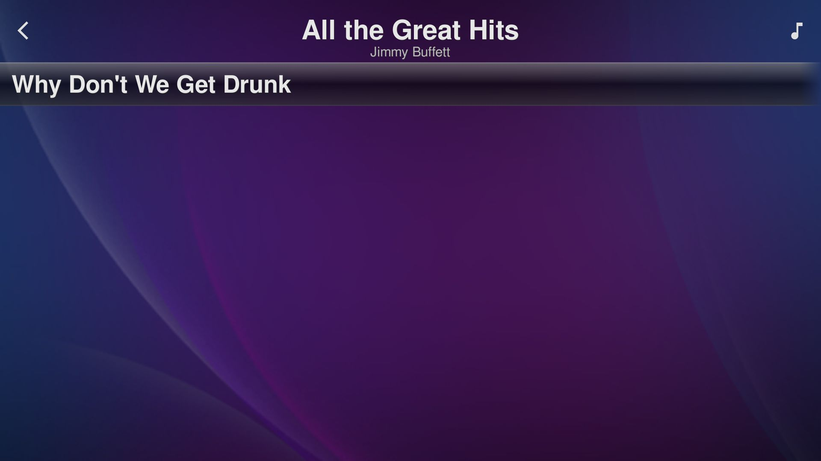
My Music - Albums - an album
Tracks of one album. Tapping a track adds it (plays it when the queue is idle); long press for Play Album from here.

Slide 11
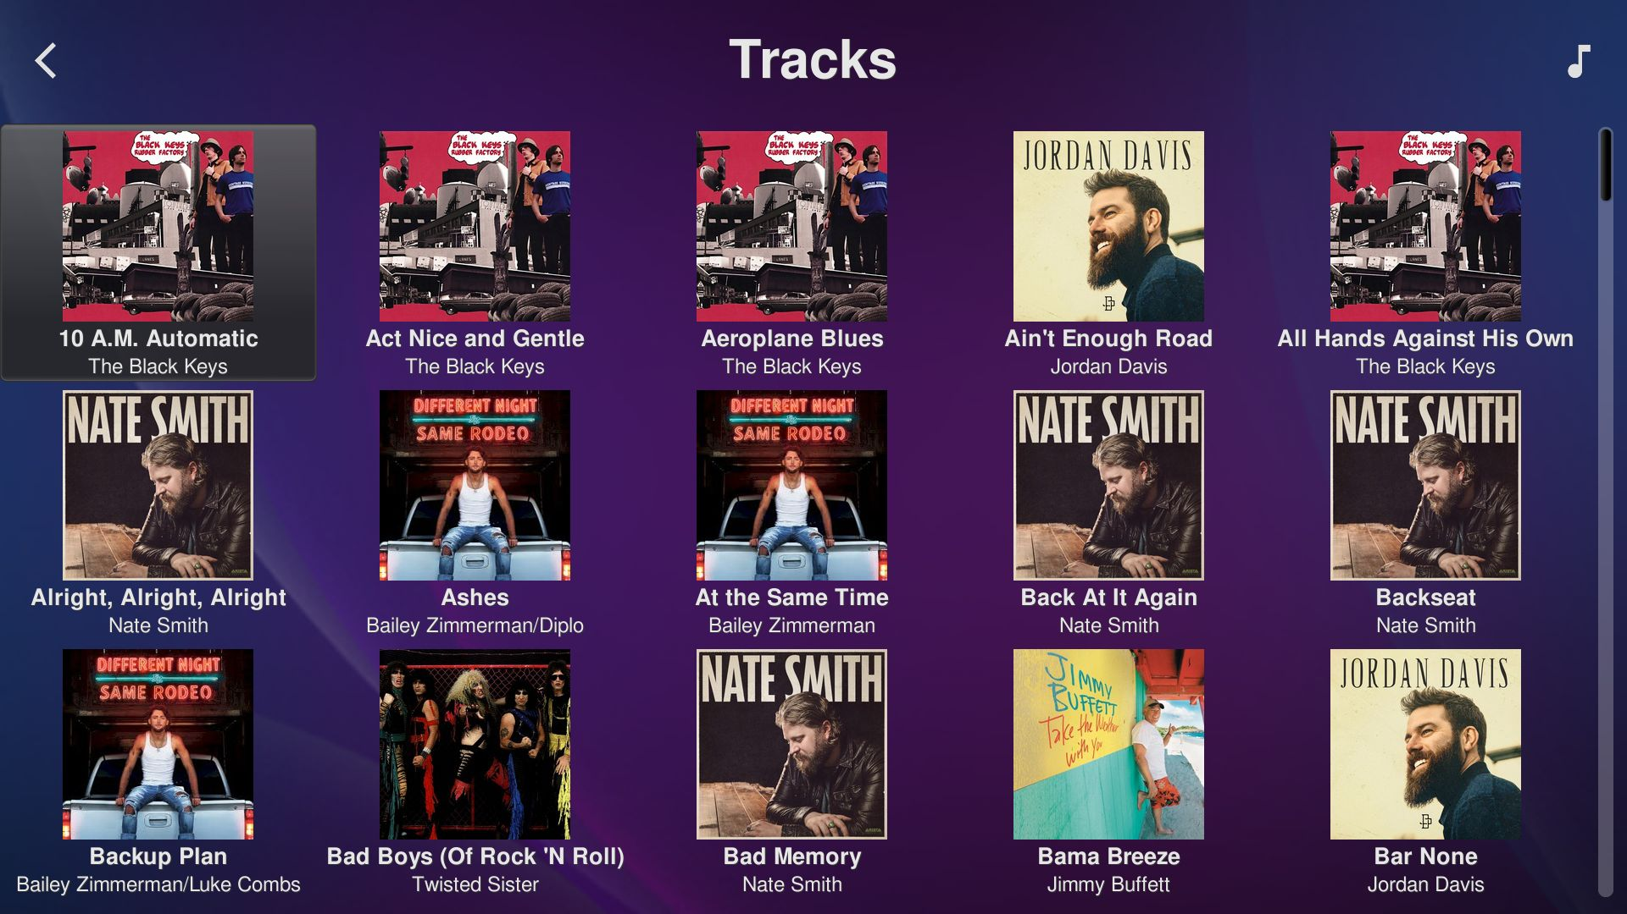
My Music - Tracks

Slide 12
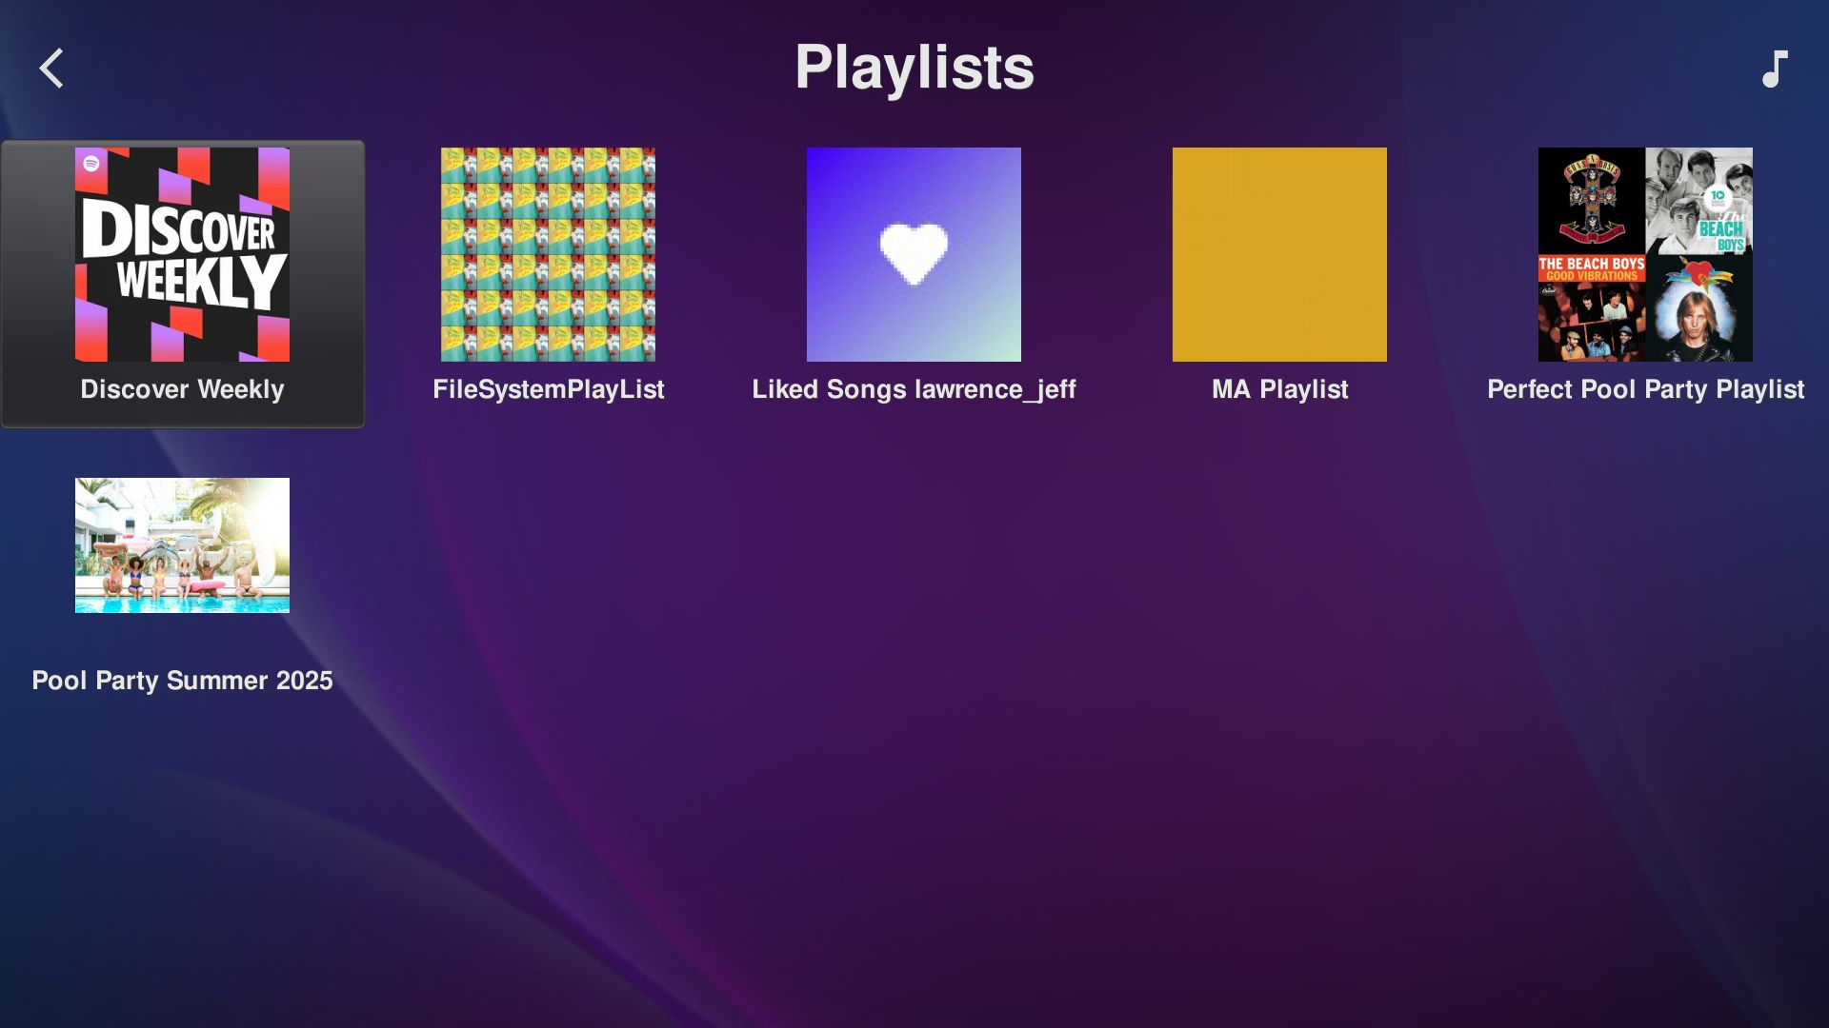
My Music - Playlists

Slide 13
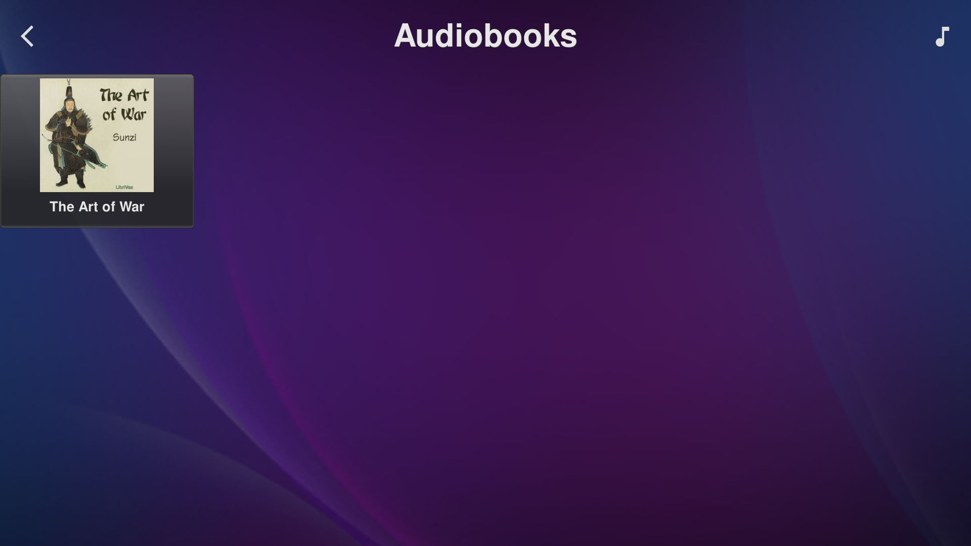
My Music - Audiobooks

Slide 14
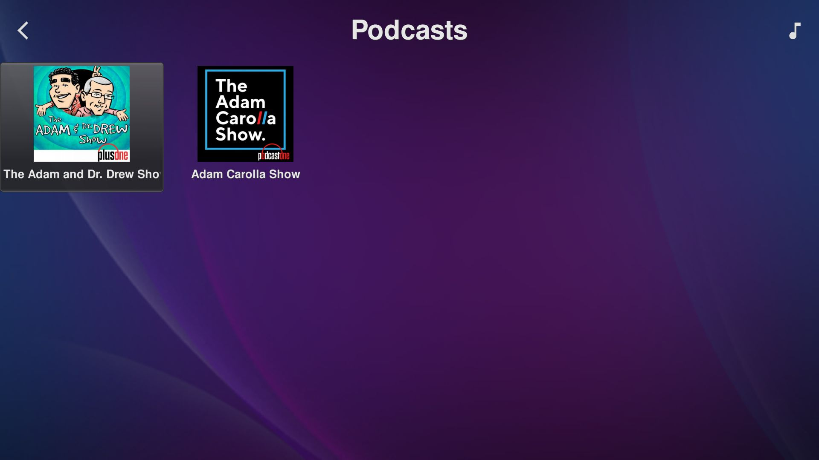
My Music - Podcasts

Slide 15
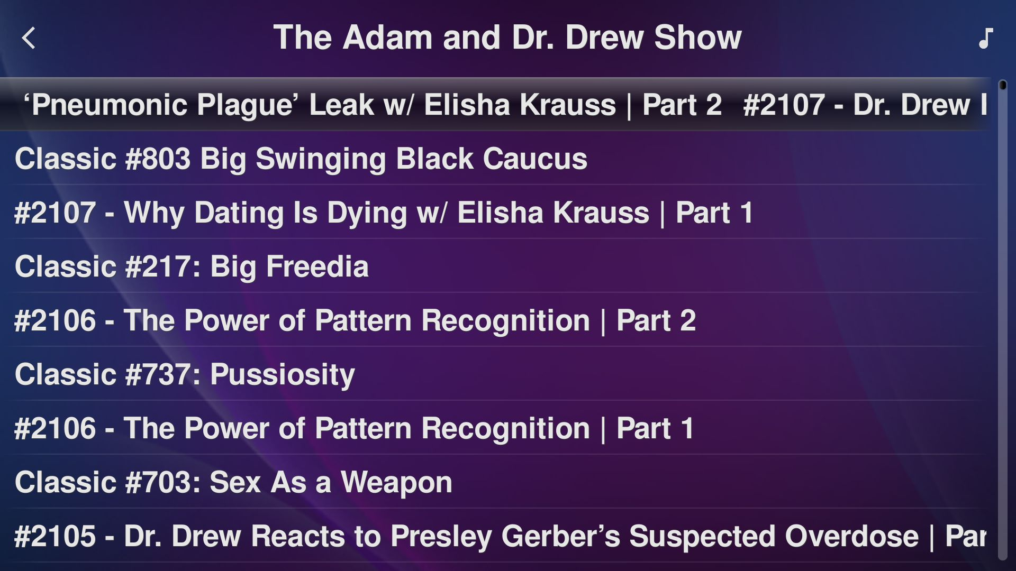
My Music - Podcasts - a podcast
Episodes of one podcast.

Slide 16
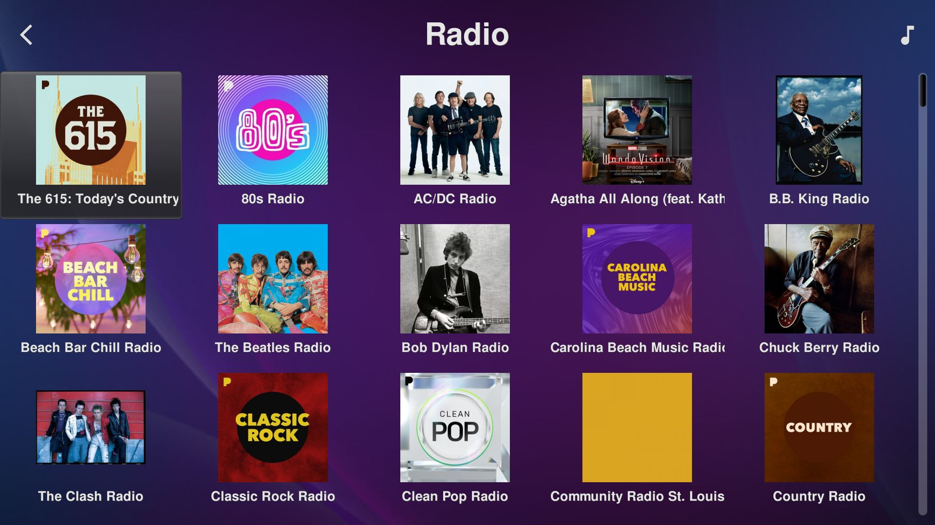
My Music - Radio

Slide 17
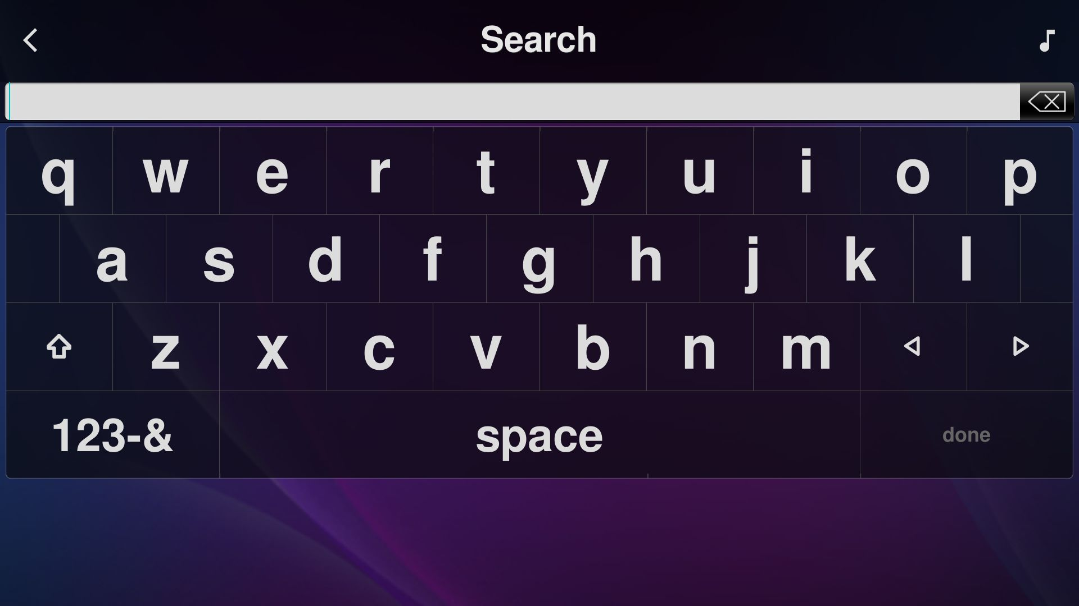
My Music - Search
The search text entry.

Slide 18
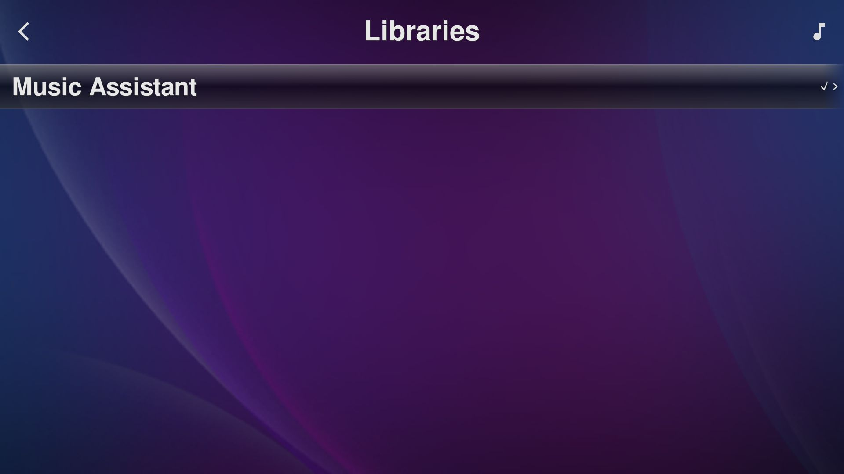
My Music - Switch Library

Slide 19
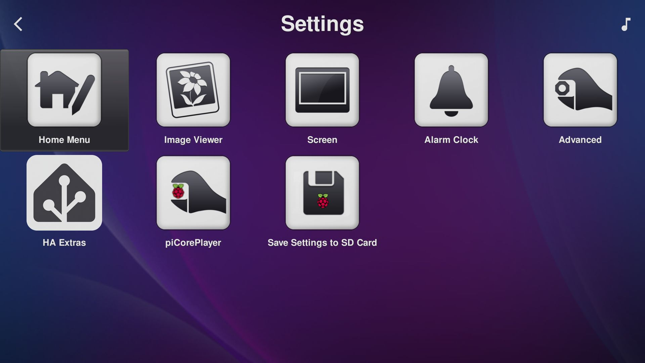
Settings
Includes Alarm Clock (says alarms are not supported) and HA Extras.

Slide 20
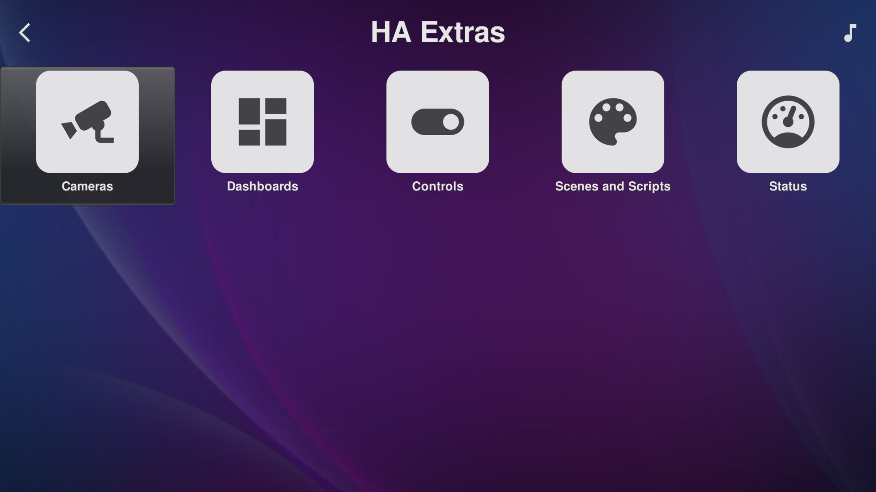
Settings - HA Extras
Experimental. Needs the device setting 'Expose HA Entities to Device (HA Extras)' and the HA Extras label on the entities.

Slide 21
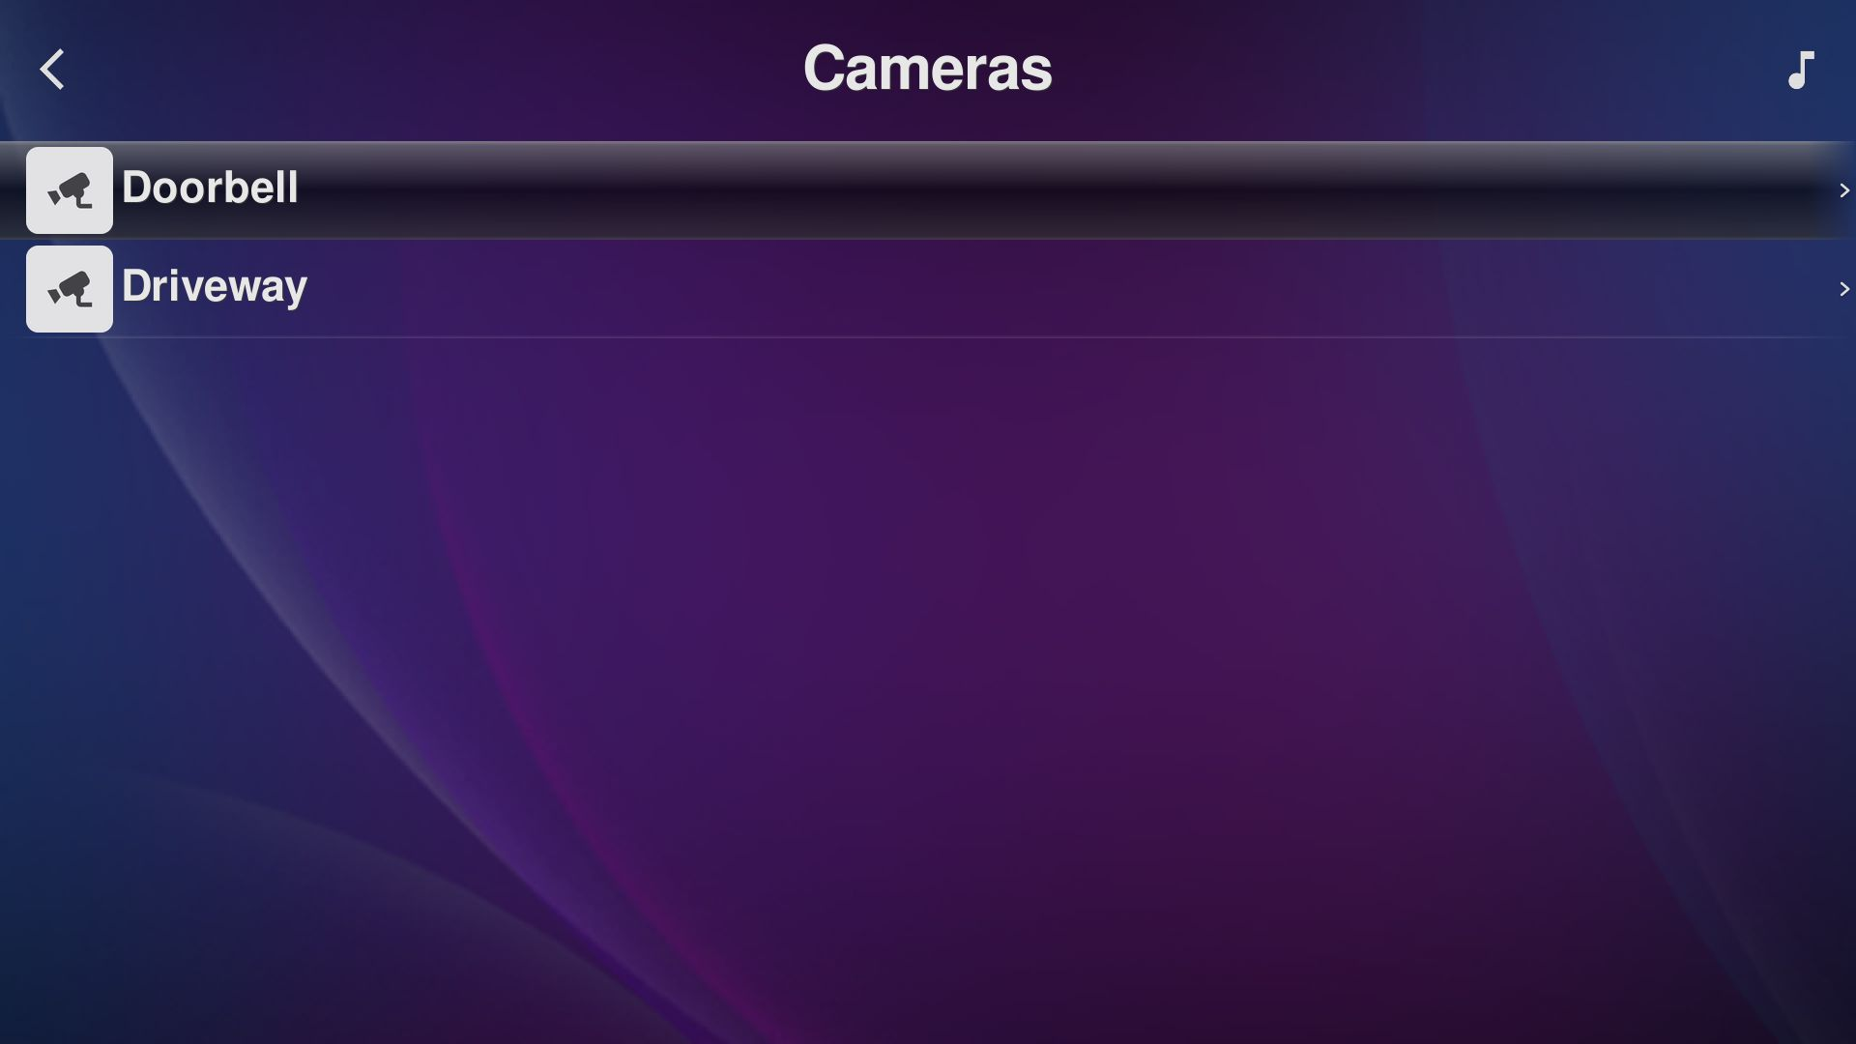
Settings - HA Extras - Cameras
Choosing a camera shows a snapshot full screen in the Image Viewer, refreshed about every 10 seconds.

Slide 22
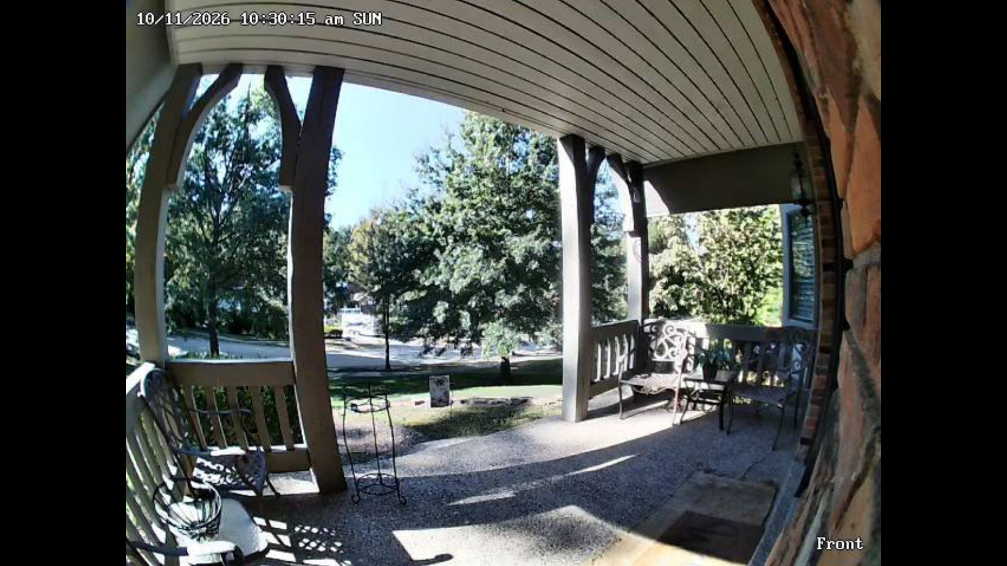
Settings - HA Extras - Cameras - Doorbell
The camera view in the Image Viewer. It fetches a new snapshot about every 10 seconds until a key is pressed.

Slide 23
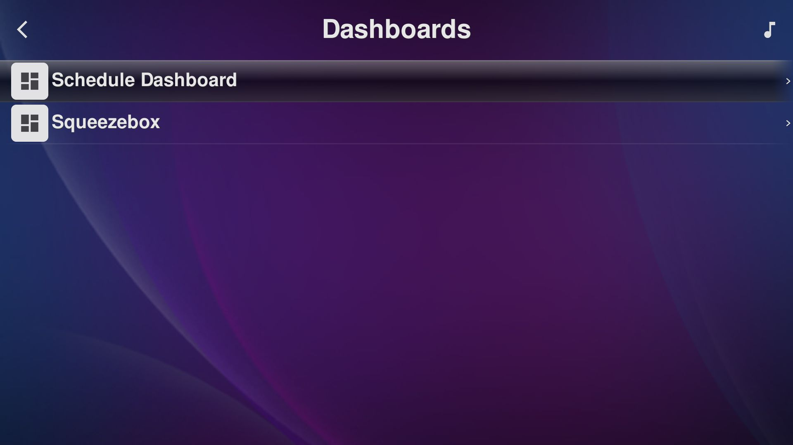
Settings - HA Extras - Dashboards
Entities whose state is the address of a picture of a dashboard. Shown full screen like the cameras.

Slide 24
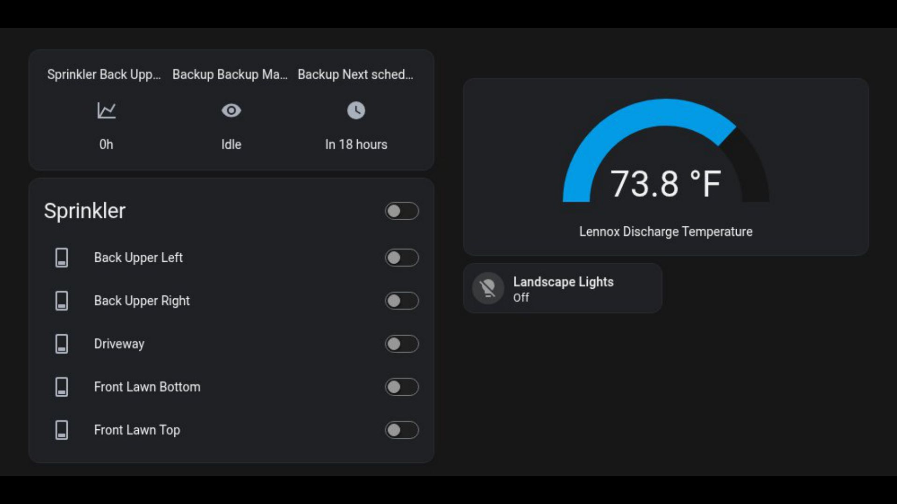
Settings - HA Extras - Dashboards - Squeezebox
A dashboard in the Image Viewer. A screenshot service renders the picture; it is fetched again about every 10 seconds.

Slide 25
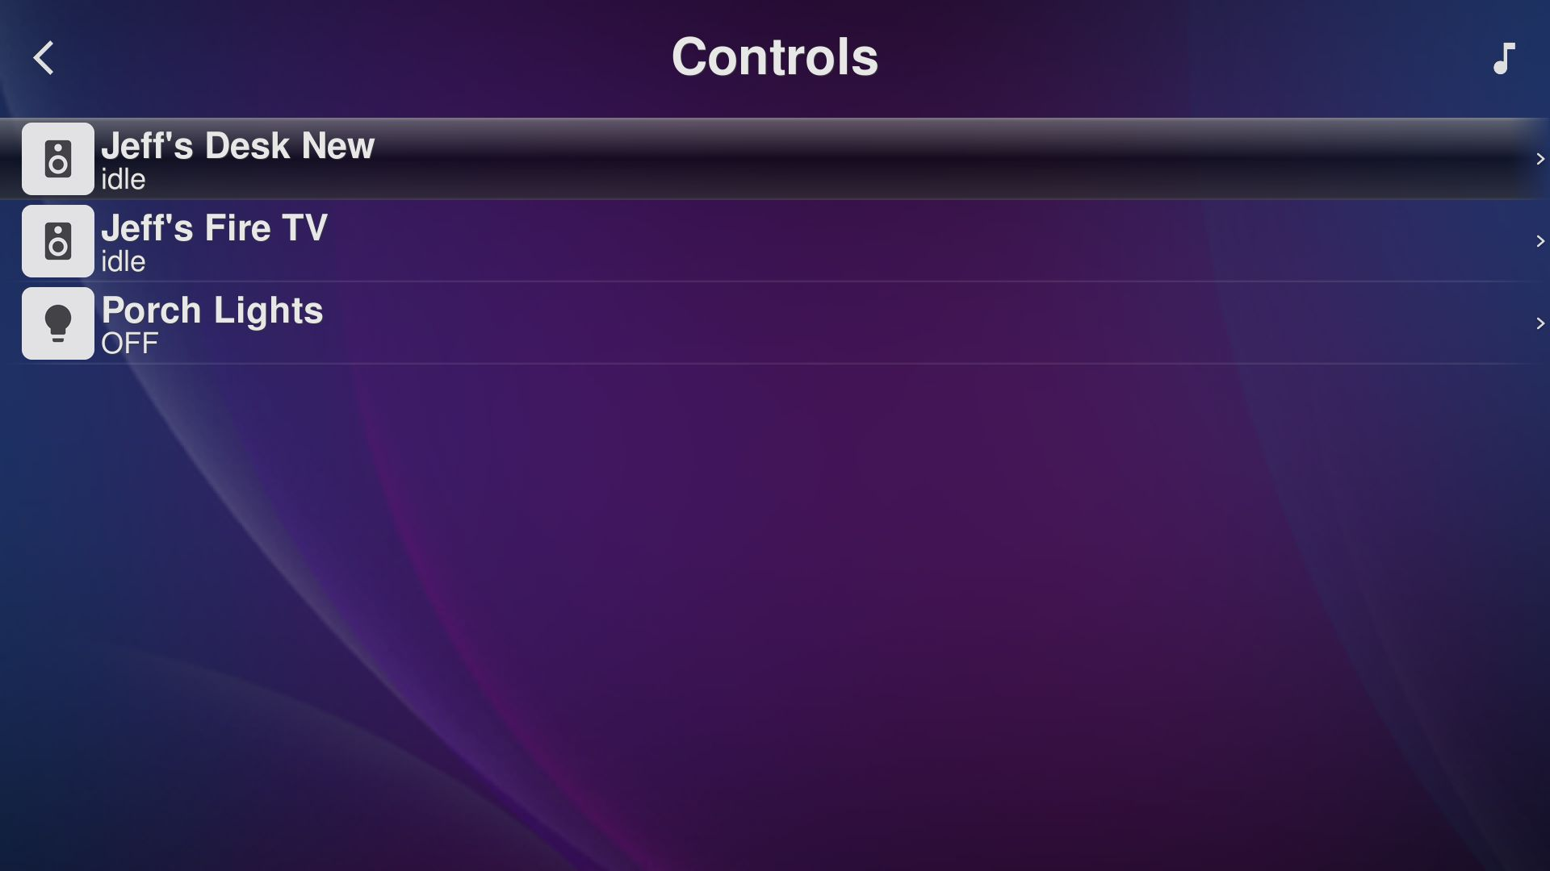
Settings - HA Extras - Controls
Choosing a row opens Turn On / Turn Off / Cancel.

Slide 26
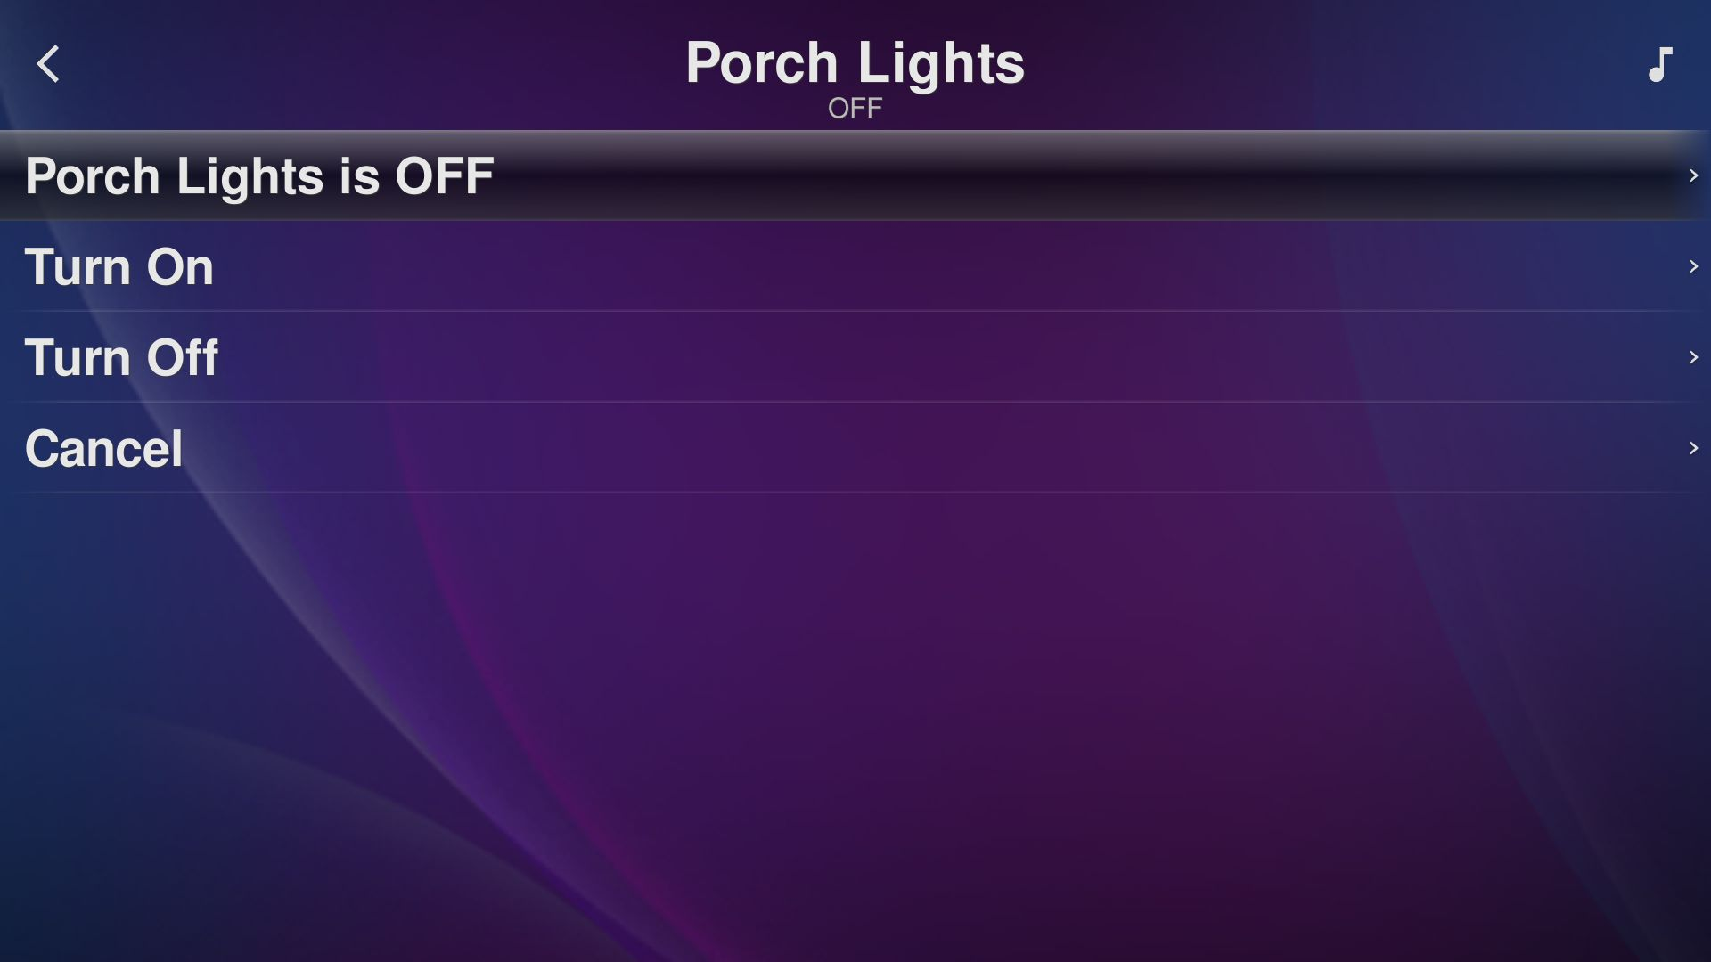
Settings - HA Extras - Controls - Porch Lights
Choosing a control opens its menu: the current state, Turn On, Turn Off and Cancel.

Slide 27
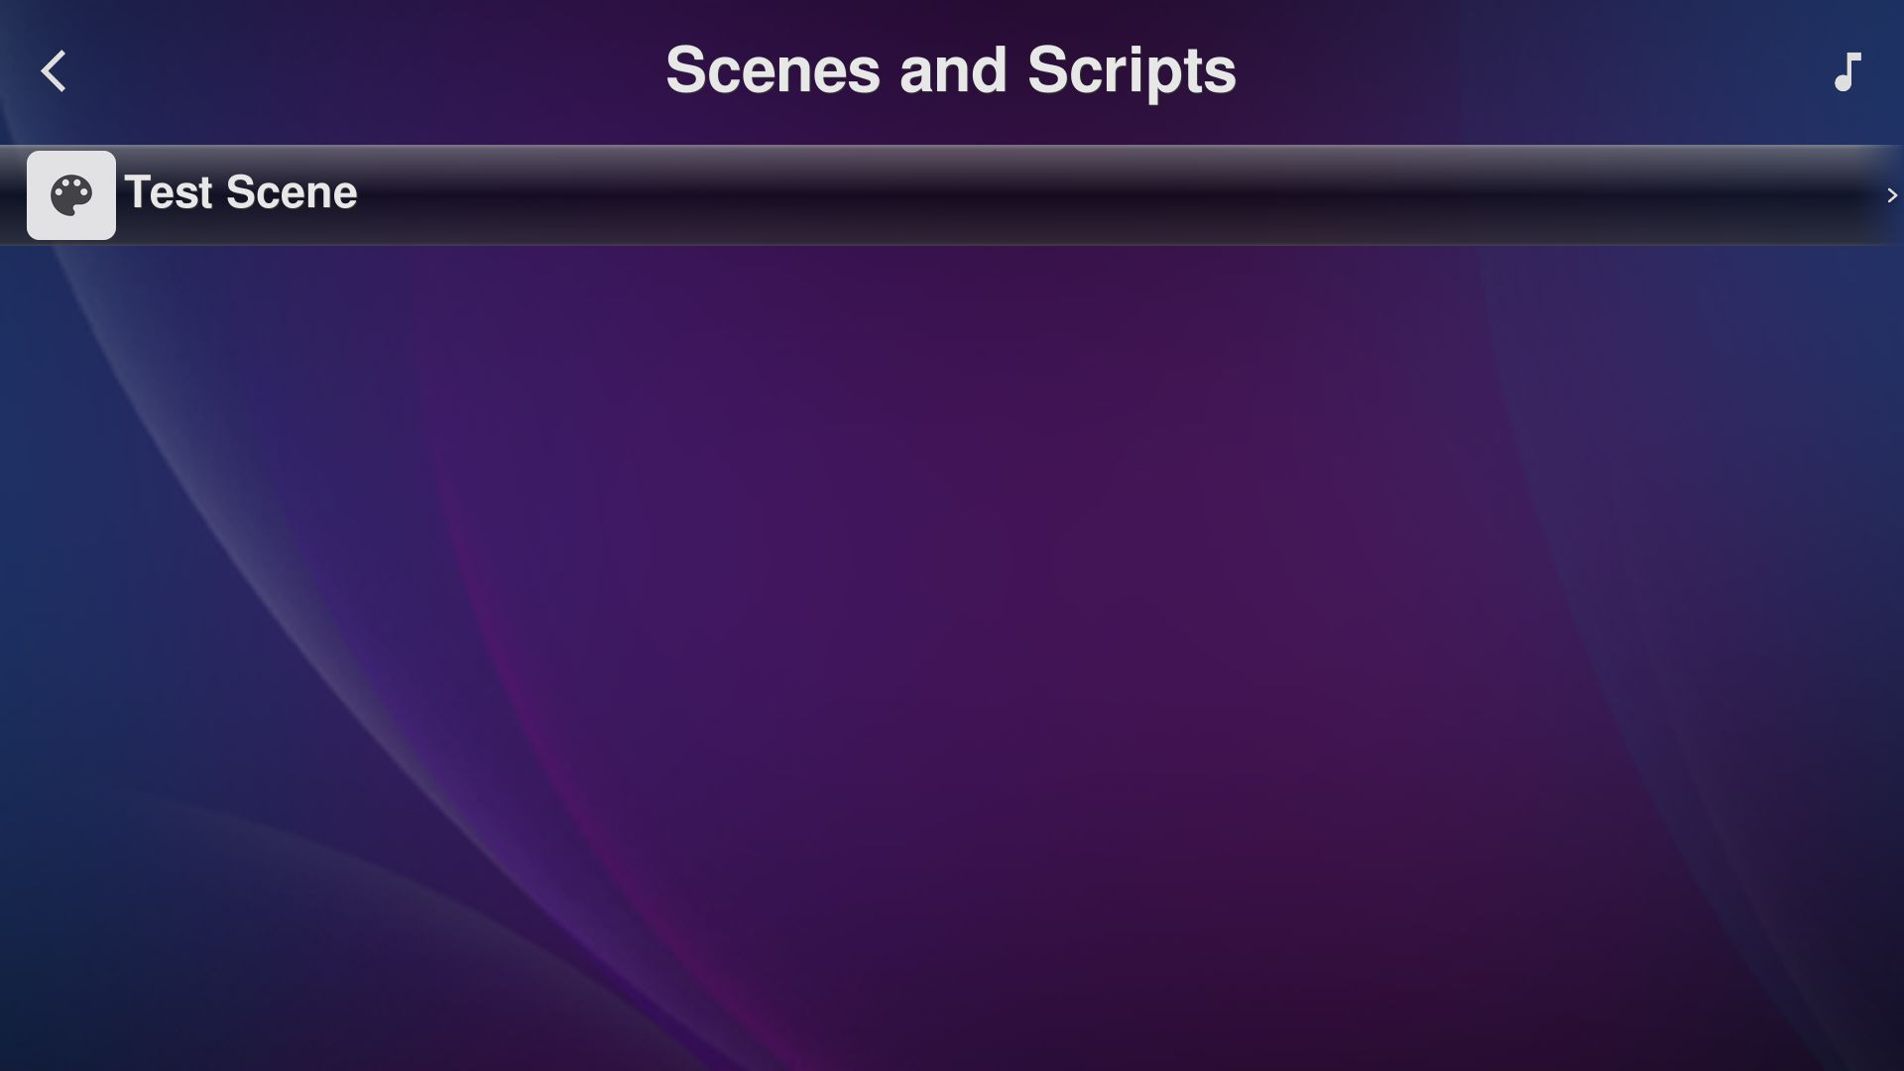
Settings - HA Extras - Scenes and Scripts
Choosing one opens Run / Cancel.

Slide 28
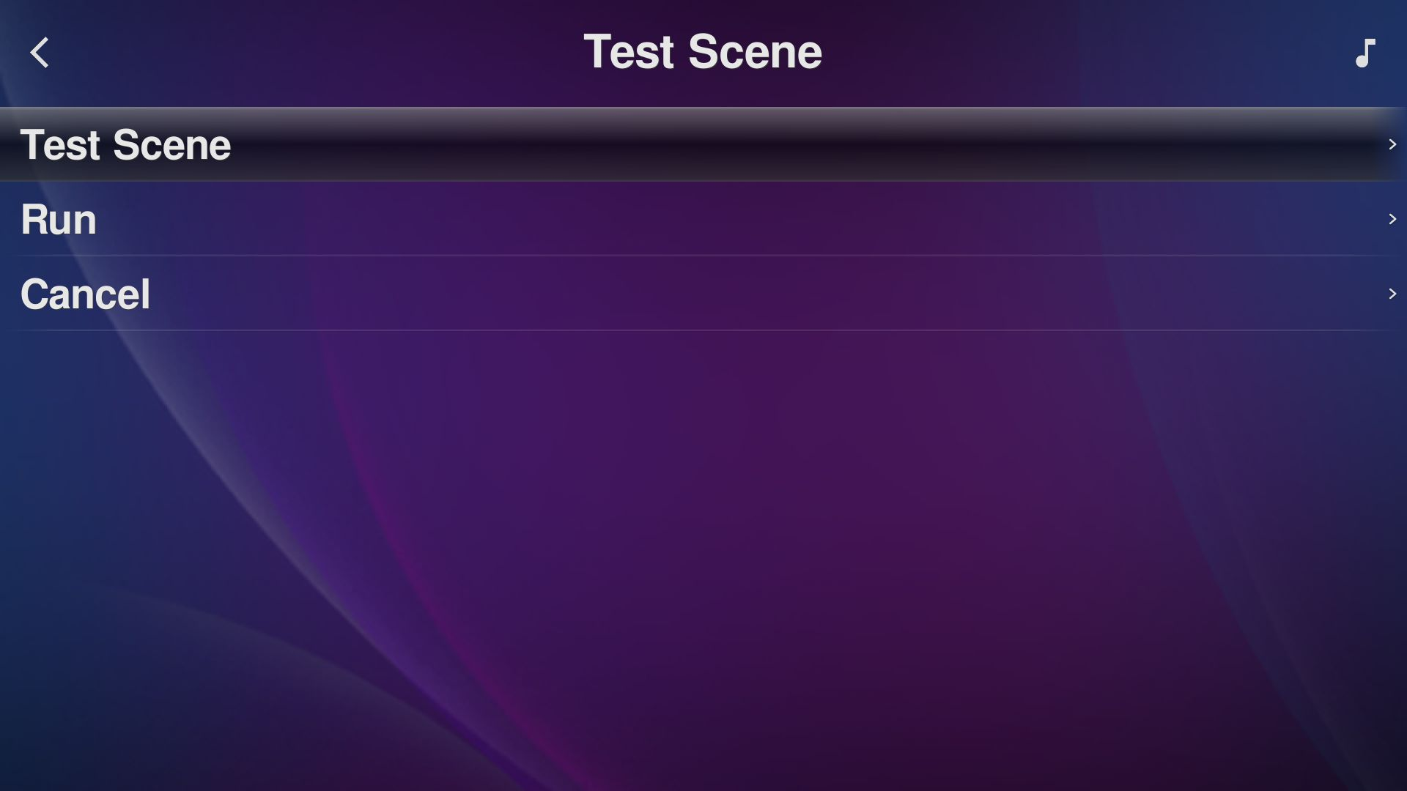
Settings - HA Extras - Scenes and Scripts - Test Scene
Choosing a scene opens Run and Cancel.

Slide 29
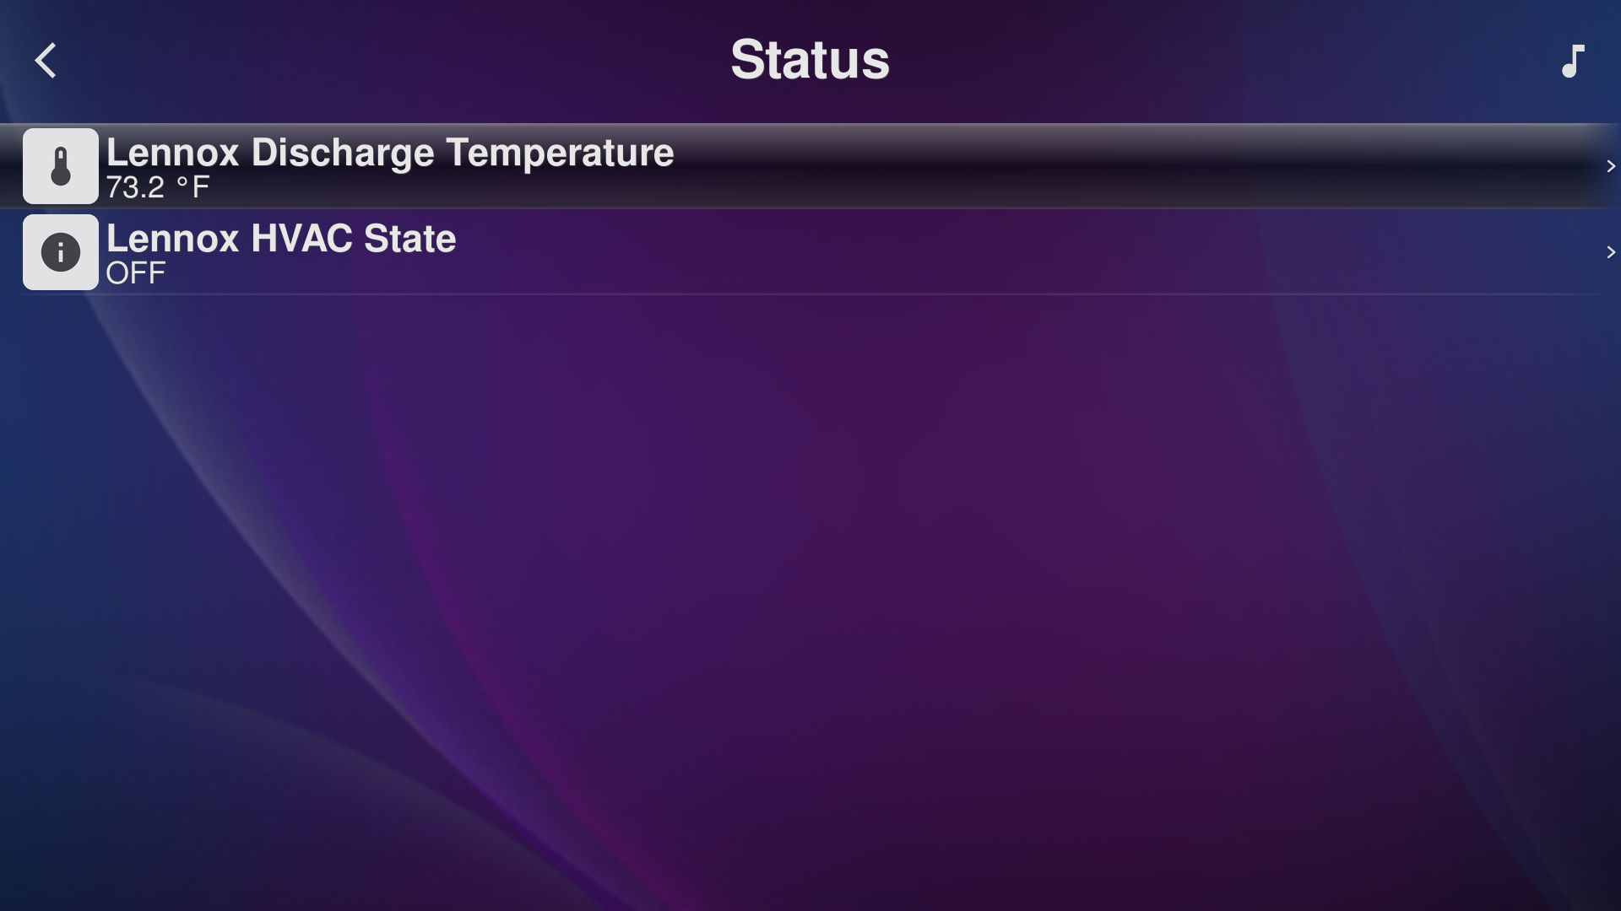
Settings - HA Extras - Status
Read-only values.

