Slide 1
Team 6
Project StarDust

Slide 2
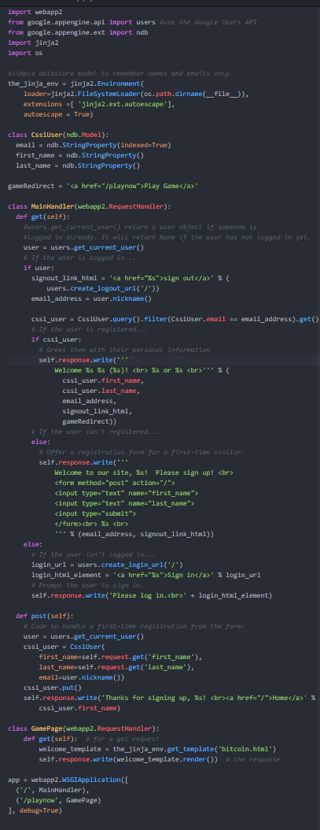
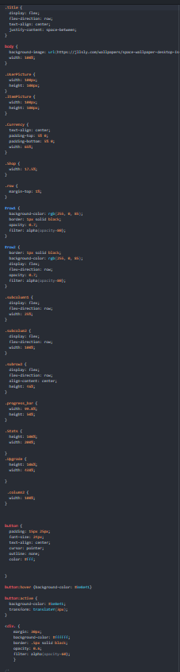
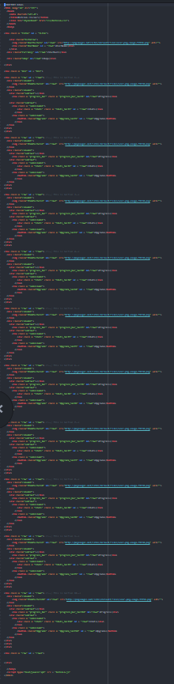
Session 1
Kevin and Lawrence
Begun working on datastore
Rewriting JavaScript to balance game and be more efficient
Nathan and Alexis
Finished Visuals in CSS
Completed shop sidebar
Begun implementing the animations to make page more visually interesting

Slide 3
