Slide 1
Team 6
Project StarDust

Slide 2
Session 1
Kevin and Lawrence
Finished creating the login page
Began working on linking login page to game page
Cleaned up HTML to make more readable and less messy
Nathan and Alexis
Completed HTML
Working on visuals in CSS
Working on slide out shop menu

Slide 3
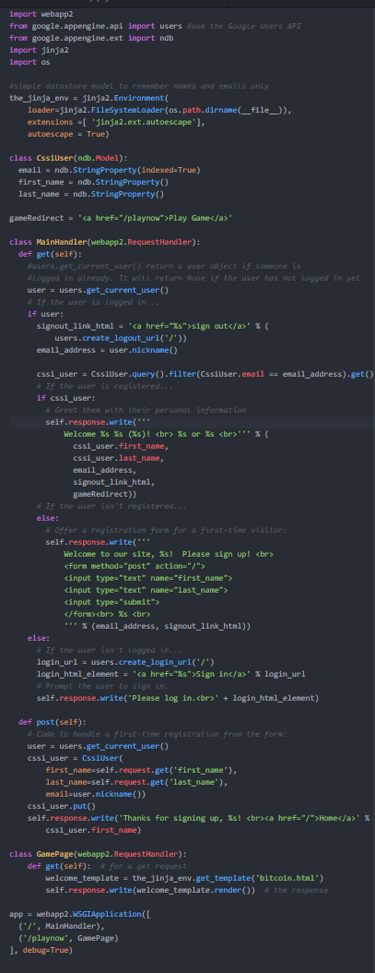
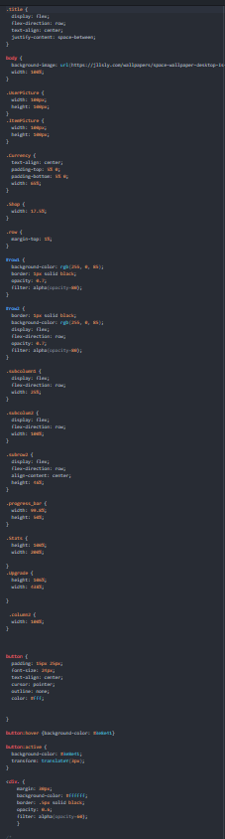
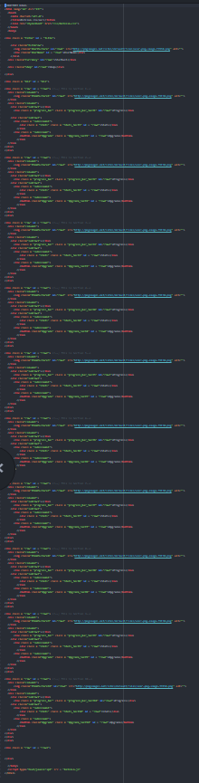
Session 1
Kevin and Lawrence
Linked Login Page and Game Page
Rewriting JavaScript to balance game and be more efficient
Nathan and Alexis
Finished Visuals in CSS
Almost completed slide out shop menu

