Slide 1
Team 6
Project StarDust

Slide 2
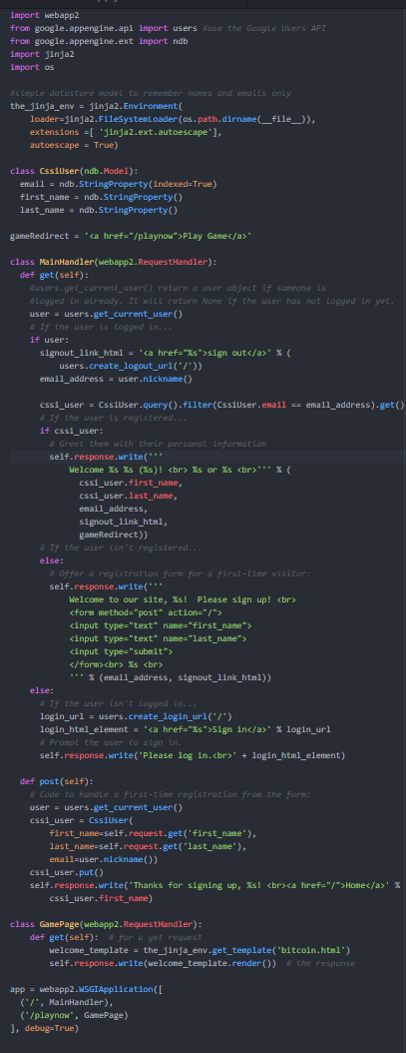
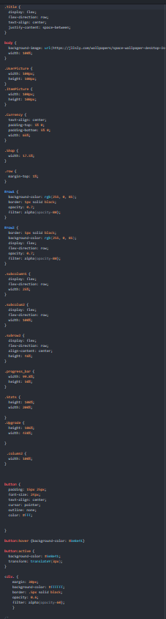
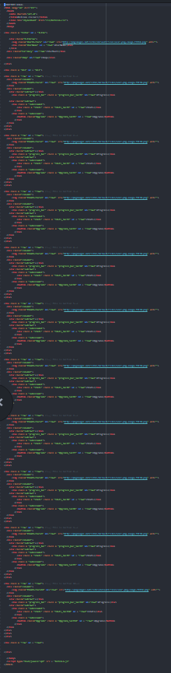
Session 1
Kevin and Lawrence
Rewriting JavaScript to balance game and be more efficient
Now working on using javascript to create visual effects like loading bars
Nathan and Alexis
Completed shop sidebar
Began designing a new page for purchasing certain upgrades

Slide 3
