Slide 1
Codeforces

Slide 2
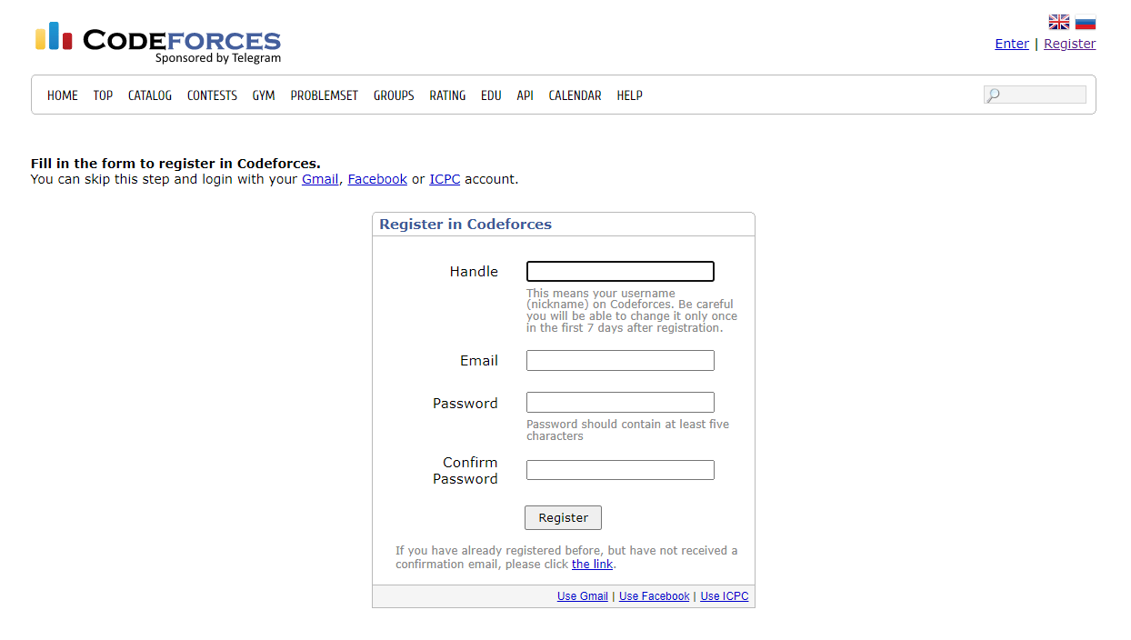
Register/Login

Slide 3
Submit your handle
https://forms.gle/d2CroPx9yG1YmoFR6

Slide 4
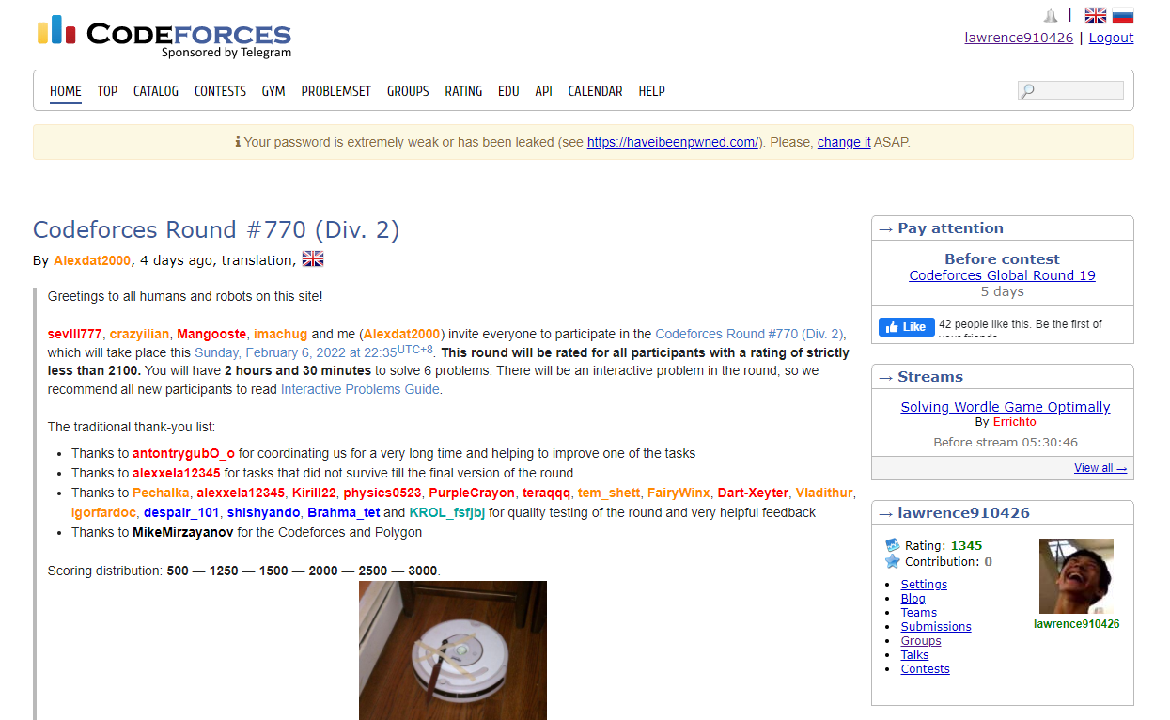
Accept the invitation
Here

Slide 5
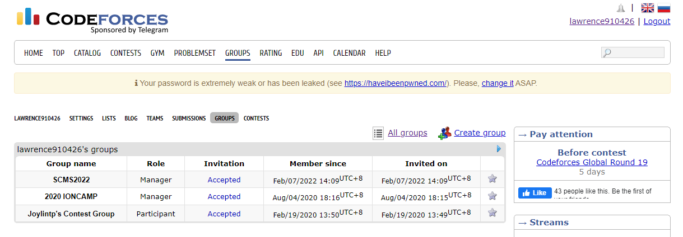
Join the contest
Click SCMS2022

Slide 6
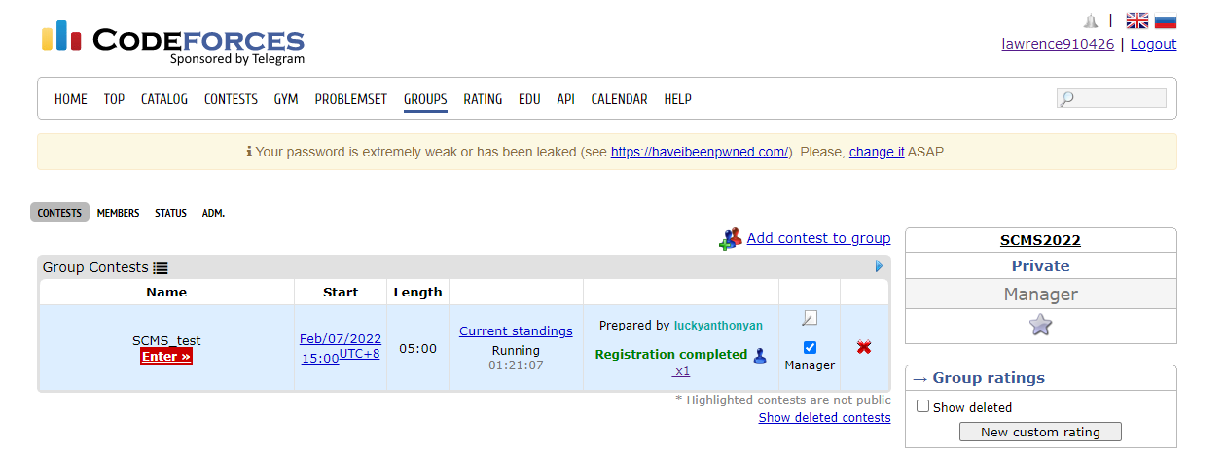
Join the contest
Register the contest
Enter the contest

Slide 7
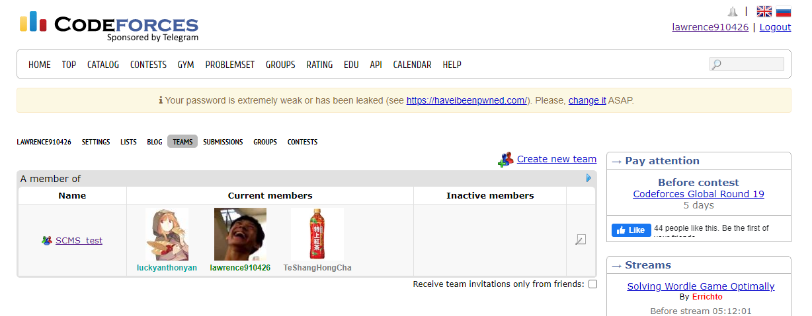
Make a team
Groups > Teams > Create new team

Slide 8
Accept team invitation
Here

Slide 9
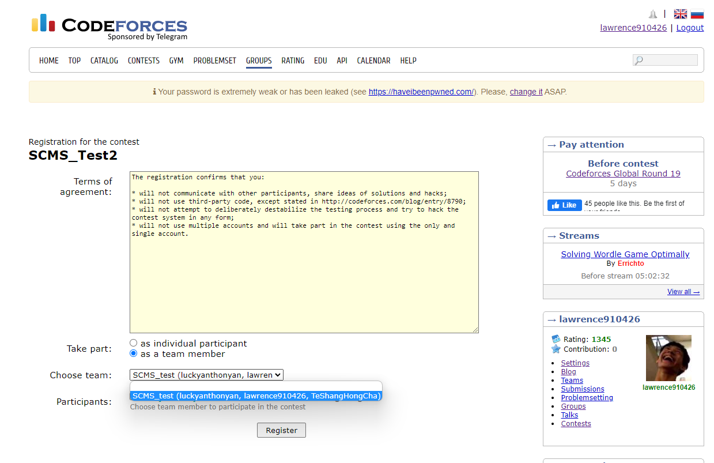
Register the contest as a team

Slide 10
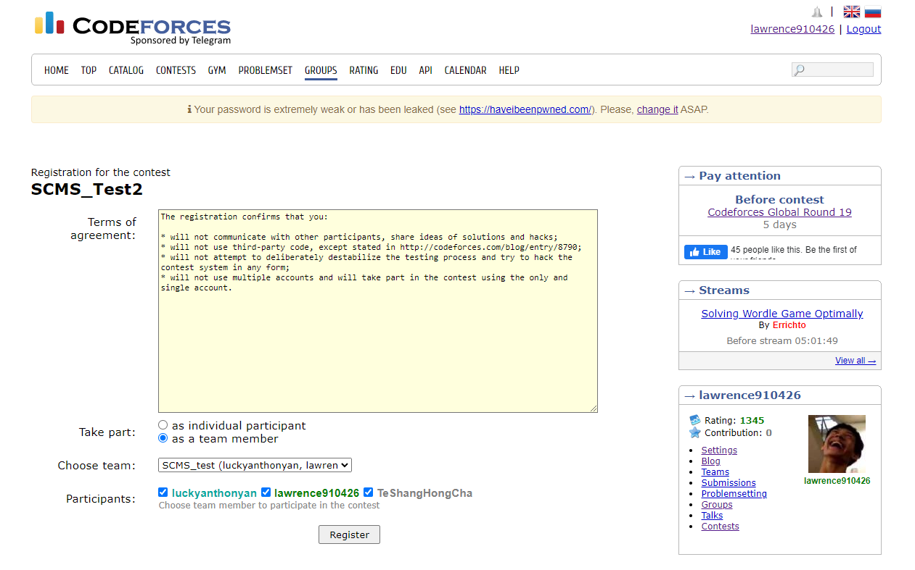
Register the contest as a team

