Slide 1

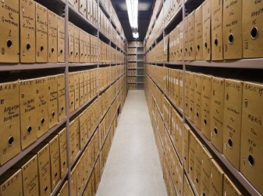
Deltares Open Archive
Naam Achternaam

Slide 2
Deltares Open Archive
The Open Archive is an optional component of Delft-FEWS to facilitate long term storage of data like observations, forecasts, external forecasts, forecaster notes, products, rating curves and configuration.
The archive can be accessed from the Delft-FEWS client by the so-called "archive display". From this display the archive can be queried and data can be downloaded to the local file system and imported in a Delft-FEWS local data store.
The Delft-FEWS archive can be coupled to the Delft-FEWS central database. When historical data is not found in the central database, the Delft-FEWS data store will be searched and used from the archive. This feature, the seamless integration, is available in the time series display for external historical scalar data and in the pi-web service also for simulated forecast scalar data.

Slide 3
What can be stored in the Open Archive?​
Delft-FEWS can archive the following Types of data
exportObserved External historical (observed) time series (scalars and grids)
exportSimulated: Simulates time series (scalars and grids) with modifiers, model states, reports (run information)
exportExternalForecast: External Forecast time series (scalars and grids)
exportMessages: Bulletin board log messages (forecaster notes)
exportProducts: Created end products (reports, pdf, export files)
exportRatingCurves Rating Curve time series
exportConfig: Current FEWS configuration files
exportSnapShot: Creates a dump of the database as local.ldb
All archived data is stored in NetCDF files with an additional metadata file
Metadata.xml file is used by the catalogue (is harvested)

Slide 4
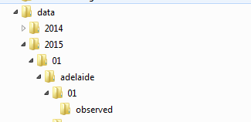
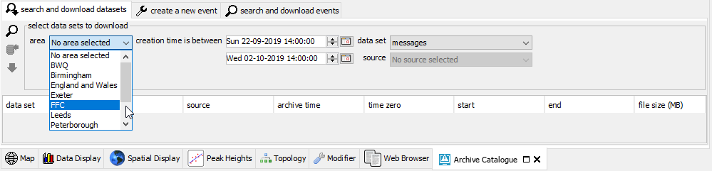
Archive Display – Area, Period, Dataset, Source https://publicwiki.deltares.nl/display/FEWSDOC/25.+Using+the+Deltares+Open+Archive
Areas and Sources are used to organize and filter the archived data
Areas are used in the folder name of the Archive folders
Sources can be used to subdivide archived series
NWP forecasts (external forecasts) are best split up in multiple sources (UKMO, ECMWF, GFS)

Slide 5
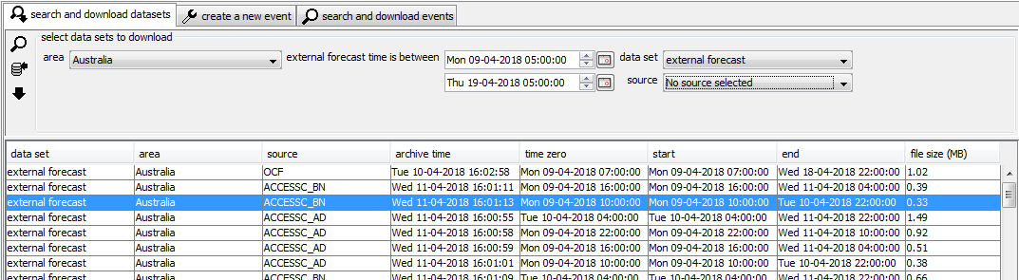
Archive: prepare the Stand Alone
Stop the Delft-FEWS Stand Alone and delete (or rename) your localdataStore folder
Start the Delft-FEWS Stand Alone with an empty database

Slide 6
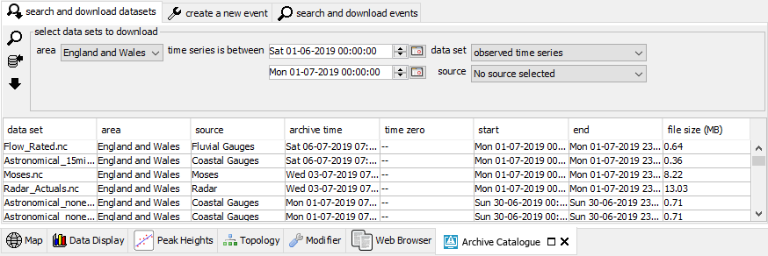
Archive: search & download datasets – search https://publicwiki.deltares.nl/display/FEWSDOC/25.+Using+the+Deltares+Open+Archive
Investigate which data is available for the June 2019 event

Slide 7
Archive: search & download datasets – search https://publicwiki.deltares.nl/display/FEWSDOC/25.+Using+the+Deltares+Open+Archive
Investigate which data is available for the June 2019 event

Slide 8
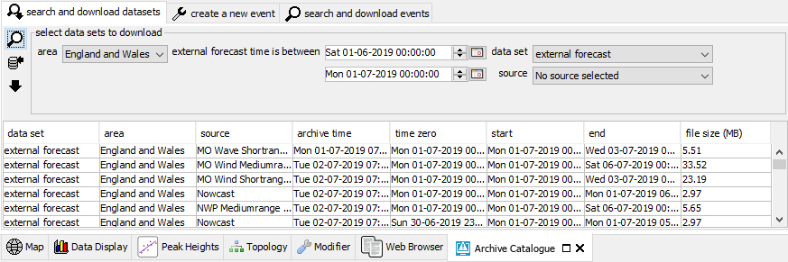
Archive: search & download datasets – search https://publicwiki.deltares.nl/display/FEWSDOC/25.+Using+the+Deltares+Open+Archive
Investigate which data is available for the June 2019 event

Slide 9
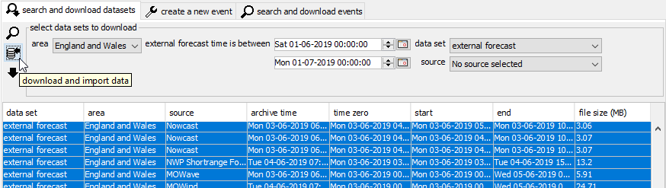
Archive: search & download datasets – import https://publicwiki.deltares.nl/display/FEWSDOC/25.+Using+the+Deltares+Open+Archive
Select the relevant data sets
Download from the archive and import into the LDS
(or copy these files from the hard drive and import by hand)

Slide 10
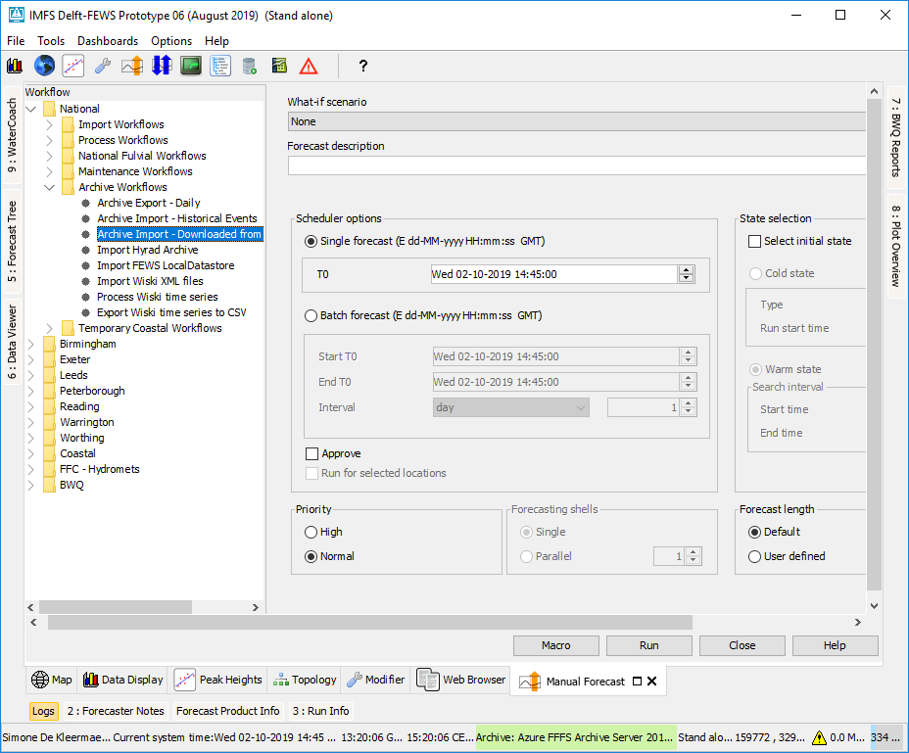
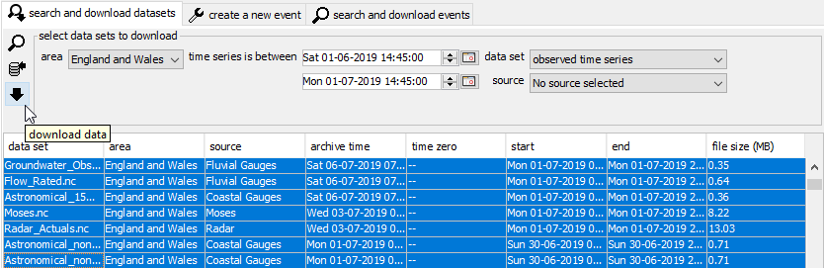
Archive: search & download datasets – download https://publicwiki.deltares.nl/display/FEWSDOC/25.+Using+the+Deltares+Open+Archive
(or copy these files from hard drive and import by hand)

Slide 11
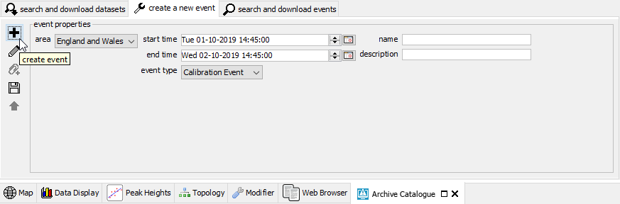
Archive: create a new event https://publicwiki.deltares.nl/display/FEWSDOC/25.+Using+the+Deltares+Open+Archive
Archive Event Types are used to facilitate tagging and download of data. Make sure:
You use the same description for all areas of the same event. To test this: When you search for this event, filter on the description.
Astro timeseries run far enough into the future to cover the event

Slide 12
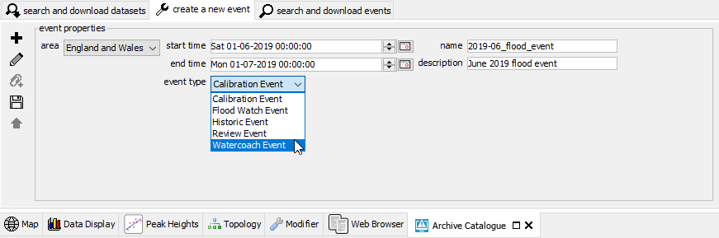
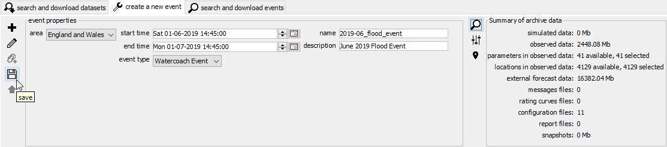
Archive: create a new event – create https://publicwiki.deltares.nl/display/FEWSDOC/25.+Using+the+Deltares+Open+Archive
Create an event, by tagging the data you’ve found for the June 2019 event
Don’t all make the same event
Tag Watercoach Event

Slide 13
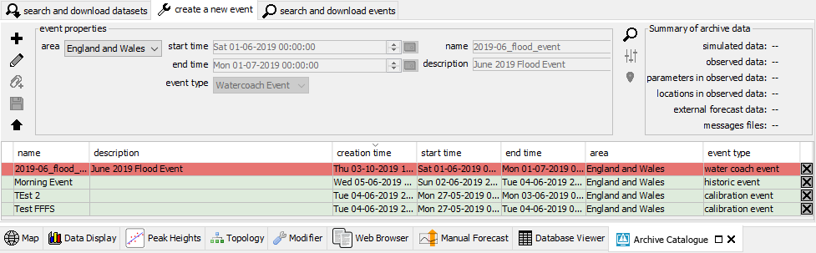
Archive: create a new event – save locally https://publicwiki.deltares.nl/display/FEWSDOC/25.+Using+the+Deltares+Open+Archive
The event is saved locally (redish background)

Slide 14
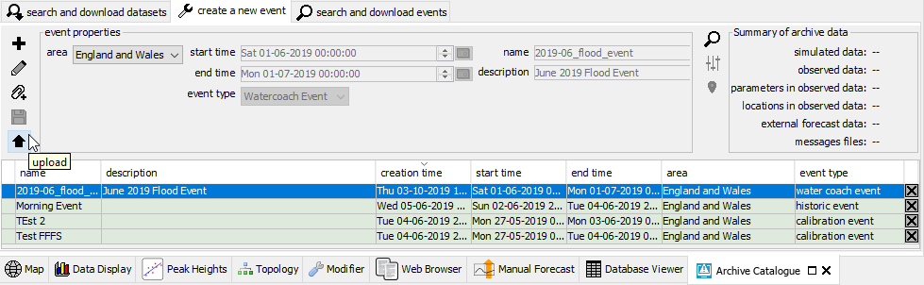
Archive: create a new event – upload https://publicwiki.deltares.nl/display/FEWSDOC/25.+Using+the+Deltares+Open+Archive
You can upload events you’ve created to the archive with the upload button
Once they are uploaded, others can see your event (green background)

Slide 15
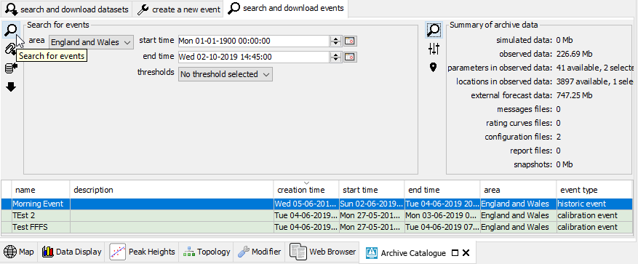
Archive: search & download events – search https://publicwiki.deltares.nl/display/FEWSDOC/25.+Using+the+Deltares+Open+Archive
In the Archive Catalogue display go to the tab “search and download events”
Select an Area, Select (wide) time period, Press Search
Filter for the relevant event type

Slide 16
Archive: search & download events – interrogate https://publicwiki.deltares.nl/display/FEWSDOC/25.+Using+the+Deltares+Open+Archive
You can check the contents of an event data set(s)
Summary, Parameters, Locations

Slide 17
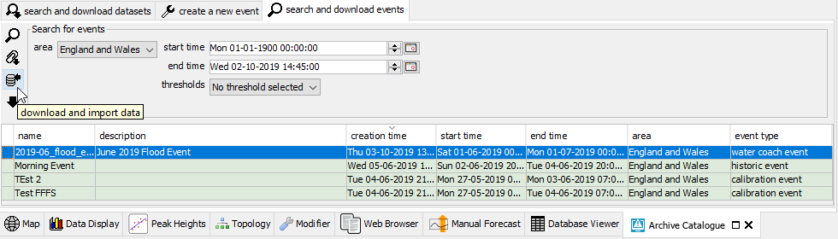
Archive: search & download events – download https://publicwiki.deltares.nl/display/FEWSDOC/25.+Using+the+Deltares+Open+Archive
If all data in this dataset is relevant:
Select an event and download the data set with the download and import button
From the Data Viewer, check if the data has been imported

Slide 18
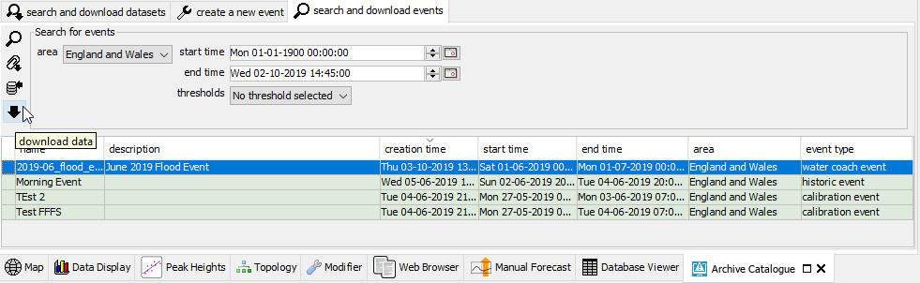
Archive: search & download events – download https://publicwiki.deltares.nl/display/FEWSDOC/25.+Using+the+Deltares+Open+Archive
If the dataset contains more information than you need:
Select an event and download the data set with the download button
…

Slide 19
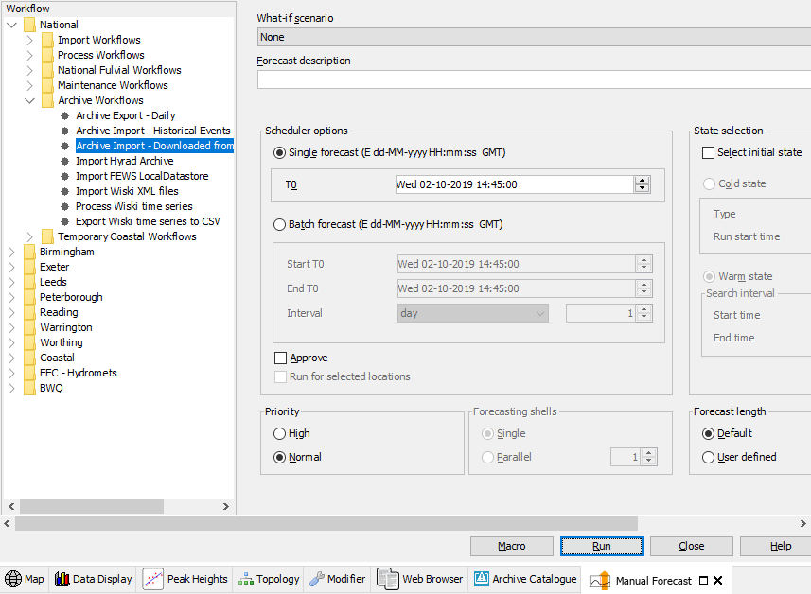
Archive: search & download events – import https://publicwiki.deltares.nl/display/FEWSDOC/25.+Using+the+Deltares+Open+Archive
Remove data from download folder you don’t want to import (e.g. NWP grids)
Import all downloaded data with the Archive Import workflow

Slide 20
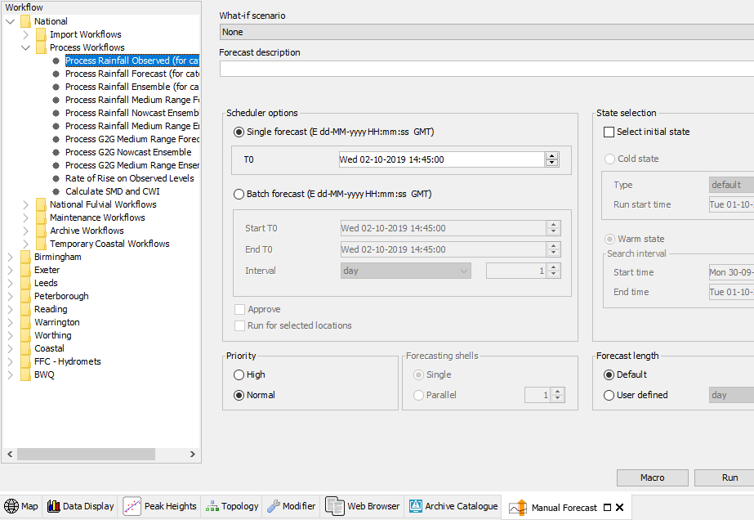
localDataStore – process data
Set system time to last available observation
Process observed data
Processing NWP data in the 6-hour interval (Batch: start and end time)

Slide 21
localDataStore – check data and save it
Spend time checking your local data store in Spatial display. Spot check every x hours (change current system time) if data is complete.
Make a backup of your local data store and all the data for the event

Slide 22
Contact
www.deltares.nl
@deltares
linkedin.com/company/deltares
info@deltares.nl
@deltares
facebook.com/deltaresNL
facebook.com/deltaresNL
linkedin.com/company/deltares
@deltares
@deltaresNL

