Slide 1
Operating System Principles: Performance Measurement and Analysis CS 111 Operating Systems Peter Reiher

Slide 2
Outline
Introduction to performance measurement
Issues in performance measurement
A performance measurement example

Slide 3
Performance Measurement
Performance is almost always a key issue in software
Especially in system software like operating systems
Everyone wants the best possible performance
But achieving it is not always easy
And sometimes involves trading off other desirable qualities
How can we know what performance we’ve achieved?
Especially given that we must do some work to learn that

Slide 4
Performance Analysis Goals
Quantify the system performance
For competitive positioning
To assess the efficacy of previous work
To identify future opportunities for improvement
Understand the system performance
What factors are limiting our current performance
What choices make us subject to these limitations
Predict system performance

Slide 5
An Overarching Goal
This applies to any performance analysis you ever do:
We seek wisdom, not numbers!
The point is never to produce a spreadsheet full of data or a pretty graph
The point is to understand critical performance issues

Slide 6
Why Are You Measuring Performance?
Sometimes to understand your system’s behavior
Sometimes to compare to other systems
Sometimes to investigate alternatives
In how you can configure or manage your system
Sometimes to determine how your system will (or won’t) scale up
Sometimes to find the cause of performance problems

Slide 7
Why Is It Hard?
Components operate in a complex system
Many steps/components in every process
Ongoing competition for all resources
Difficulty of making clear/simple assertions
Systems may be too large to replicate in laboratory
Or have other non-reproduceable properties
Lack of clear/rigorous requirements
Performance is highly dependent on specifics
What we measure, how we measure it
Ask the wrong question, get the wrong answer

Slide 8
Performance Analysis
Can you characterize latency and throughput?
Of the system?
Of each major component?
Can you account for all the end-to-end time?
Processing, transmission, queuing delays
Can you explain how these vary with load?
Are there any significant unexplained results?
Can you predict the performance of a system?
As a function of its configuration/parameters

Slide 9
Design For Performance Measurement
Successful systems will need to have their performance measured
Becoming a successful system will generally require that you improve its performance
Which implies measuring it
It’s best to assume your system will need to be measured
So put some forethought into making it easy

Slide 10
How To Design for Performance
Establish performance requirements early
Anticipate bottlenecks
Frequent operations (interrupts, copies, updates)
Limiting resources (network/disk bandwidth)
Traffic concentration points (resource locks)
Design to minimize problems
Eliminate, reduce use, add resources
Include performance measurement in design
What will be measured, and how

Slide 11
Issues in Performance Measurement
Performance measurement terminology
Types of performance problems

Slide 12
Some Important Measurement Terminology
Metrics
Indices of tendency and dispersion
Factors and levels
Workloads

Slide 13
Metrics
A metric is a measurable quantity
Measurable: we can observe it in situations of interest
Quantifiable: time/rate, size/capacity, effectiveness/reliability …
A metric’s value should describe an important phenomenon in a system
Relevant to the questions we are addressing
Much of performance evaluation is about properly evaluating metrics

Slide 14
Common Types of System Metrics
Duration/ response time
How long did the program run?
Processing rate
How many web requests handled per second?
Resource consumption
How much disk is currently used?
Reliability
How many messages were delivered without error?

Slide 15
Non-Metrics
“Is it a good system?”
“Will it do the job I need done?”
“Can I trust it?”
And similar questions
These aren’t foolish questions to ask
But they aren’t metrics
And may not be addressable via metrics

Slide 16
Choosing Your Metrics
Core question in any performance study
Pick metrics based on:
Completeness: will my metrics cover everything I need to know?
(Non-)redundancy: does each metric provide information not provided by others?
Variability: will this metric show any meaningful variation?
Feasibility: can I accurately measure this metric?

Slide 17
Variability in Metrics
Performance of a system is often complex
Perhaps not fully explainable
One result is variability in many metric readings
You measure it twice, thrice, or more and get different results every time
Not a flaw in the metric, just something you must deal with
Good performance measurement takes this into account

Slide 18
An Example
11 pings from UCLA to MIT in one night
Each took a different amount of time (expressed in msec):
How do we understand what this says about how long a packet takes to get from LA to Boston and back?
149.1 28.1 28.1 28.5 28.6 28.2
28.4 187.8 74.3 46.1 155.8

Slide 19
Where Does Variation Come From?
Inconsistent test conditions
Varying platforms, operations, injection rates
Background activity on test platform
Start-up, accumulation, cache effects
Flawed measurement choices/techniques
Measurement artefact, sampling errors
Measuring indirect/aggregate effects
Non-deterministic factors
Queuing of processes, network and disk I/O
Where (on disk) files are allocated

Slide 20
Tendency and Dispersion
Given variability in metric readings, how do we understand what they tell us?
Tendency
What is common or characteristic of all readings?
Dispersion
How much do the various measurements of the metric vary?
Good performance experiments capture and report both

Slide 21
Indices of Tendency
What can we compactly say that sheds light on all of the values observed?
Some example indices of tendency:
Mean ... the average of all samples
Median ... the value of the middle sample
Mode ... the most commonly occurring value
Each of these tells us something different, so which we use depends on our goals

Slide 22
Applied to Our Example Ping Data
Mean: 71.2
Median: 28.6
Mode: 28.1
Which of these best expresses the delay we saw?
Depends on what you care about
149.1 28.1 28.1 28.5 28.6 28.2
28.4 187.8 74.3 46.1 155.8

Slide 23
Indices of Dispersion
Compact descriptions of how much variation we observed in our measurements
Among the values of particular metrics under supposedly identical conditions
Some examples:
Range – the high and low values observed
Standard deviation – statistical measure of common deviations from a mean
Coefficient of variance – ratio of standard deviation to mean
Again, choose the index that describes what’s important for the goal under examination

Slide 24
Applied to Our Ping Data Example
Range: 28.1,187.8
Standard deviation: 62.0
Coefficient of variation: .87
149.1 28.1 28.1 28.5 28.6 28.2
28.4 187.8 74.3 46.1 155.8

Slide 25
Capturing Variation
Generally requires repetition of the same experiment
Ideally, sufficient repetitions to capture all likely outcomes
How do you know how many repetitions that is?
You don’t
Design your performance measurements bearing this in mind

Slide 26
So What Does Our Sample Data Actually Mean?
We know there is a minimum possible delay between UCLA and MIT
Data suggests it might be about 28.1 msec, the bottom of the range
There are a bunch of values close to that
Median is 28.6, not far off low measurement
But our mean is much higher
So there are much larger delays in some cases
Stdev is much larger than the mean

Slide 27
What To Conclude?
Often our messages will arrive quickly
Can we keep up when they do?
But sometimes they will take quite a while
Does that cause problems for our desired behavior?
Will our system be tolerant of fairly frequent long delays?
Will we waste a lot of time waiting for messages?
Should we try to find ways to use that time?

Slide 28
Meaningful Measurements
Measure under controlled conditions
On a specified platform
Under a controlled and calibrated load
Removing as many extraneous external influences as possible
Measure the right things
Direct measurements of key characteristics
Ensure quality of results
Competing measurements we can cross-compare
Measure/correct for artifacts
Quantify repeatability/variability of results

Slide 29
Factors and Levels
Sometimes we only want to measure one thing
More often, we are interested in several alternatives
What if I doubled the memory?
What if work came in twice as fast?
What if I used a different file system?
Such controlled variations for comparative purposes are called factors

Slide 30
Factors in Experiments
Choose factors related to your experiment goals
If you care about web server scaling, factors probably related to amount of work offered
If you want to know which file system works best for you, factor is likely to be different file systems
If you’re deciding how to partition a disk, factor is likely to be different partitionings

Slide 31
Levels
Factors vary (by definition)
Levels describe which values you test for each factor
Levels can thus be numerical
Number of web requests applied per second
Amount of memory devoted to I/O buffers
Or they can be categorical
Btrfs vs. Ext3 vs. XFS

Slide 32
Choosing Factors and Levels
Your experiment should look at all vital factors
Each factor should be examined at important levels
But . . .
The effort involved in the experiment is related to (number of factors) X (number of levels)
If you’re not careful, this can cause your effort to explode
Especially if you repeat runs to capture variation

Slide 33
Measurement Workloads
Most measurement programs require the use of a workload
Some kind of work applied to the system you are testing
Preferably similar to the work you care about
Can be of several different forms
Simulated workloads
Replayed trace
Live workload
Standard benchmarks

Slide 34
Simulated Work Loads
Artificial load generation
On-demand generation of a specified load
Strengths
Controllable operation rates, parameters, mixes
Scalable to produce arbitrarily large loads
Can collect excellent performance data
Weaknesses
Random traffic is not a real usage scenario
Simulation may not create all realistic situations
Wrong parameter choices yield unrealistic loads

Slide 35
Replayed Workloads
Captured operations from real systems
Strengths
Represent real usage scenarios
Can be analyzed and replayed over and over
Weakness
Often hard to obtain
Not necessarily scalable
Multiple instances not equivalent to more users
Represent a limited set of possible behaviors
Limited ability to exercise little-used features
They are kept around forever, and become stale

Slide 36
Testing Under Live Loads
Instrumented systems actually serving clients
Strengths
Real combinations of real scenarios
Measured against realistic background loads
Enables collection of data on real usage
Weakness
Requires good performance and reliability
Potentially limited testing opportunities
Load cannot be repeated or scaled on demand

Slide 37
Standard Benchmarks
Carefully crafted/reviewed simulators
Possibly derived from real workloads
Strengths
Heavily reviewed by developers and customers
Believed to be representative of real usage
Standardized and widely available
Well maintained (bugs, currency, improvements)
Allows comparison of competing products
Weakness
Inertia
Often used where they are not applicable

Slide 38
Types of Performance Problems
Non-scalable solutions
Cost per operation becomes prohibitive at scale
Worse-than-linear overheads and algorithms
Queuing delays associated with high utilization
Bottlenecks
One component that limits system throughput
Accumulated costs
Layers of calls, data copies, message exchanges
Redundant or unnecessary work

Slide 39
Dealing With Performance Problems
A lot like finding and fixing a bug
Formulate a hypothesis
Gather data to verify your hypothesis
Be sure you understand underlying problem
Review proposed solutions
For effectiveness
For potential side effects
Make simple changes, one at a time
Re-measure to confirm effectiveness of each
Only harder

Slide 40
Common Measurement Mistakes
Measuring time without considering utilization
Everything is fast on a lightly loaded system
Capturing averages rather than distributions
Outliers are usually interesting
Ignoring start-up, accumulation, cache effects
Not measuring what we thought
Ignoring instrumentation artefacts
They may greatly distort both times and loads

Slide 41
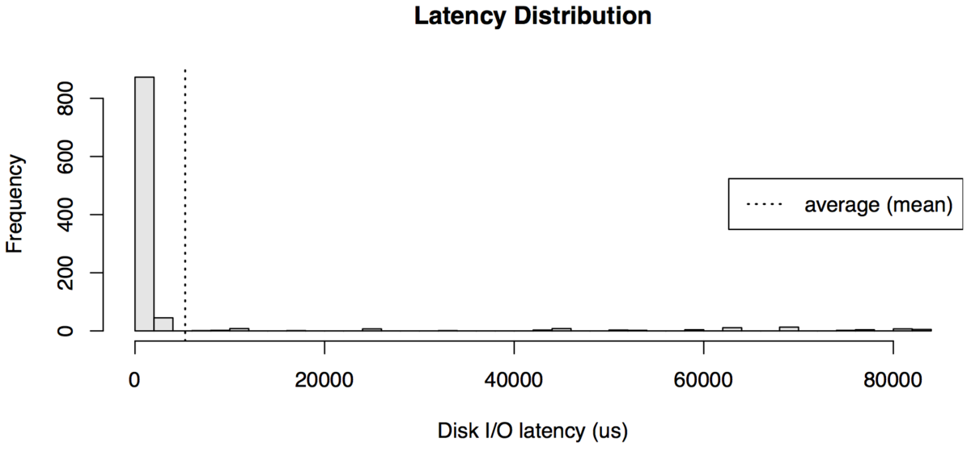
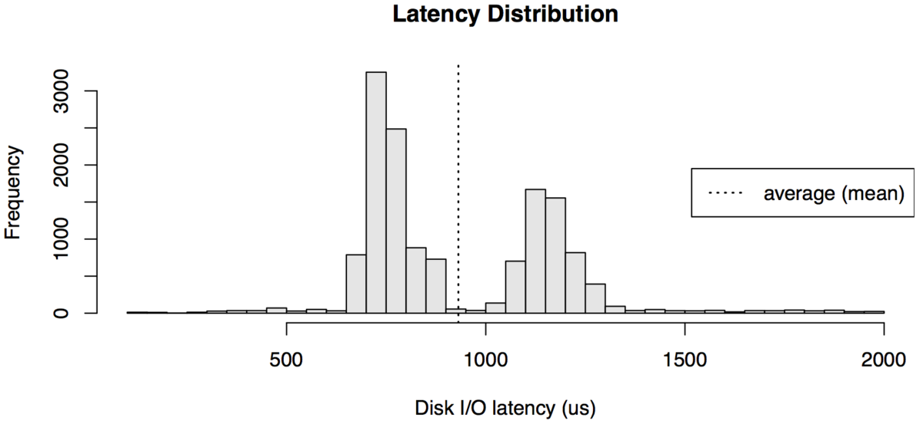
Averages Don’t Tell the Story
Similar means
But very different performance implications

Slide 42
Handling Cache and Start-up Effects
Cached results may accelerate some runs
Insert random requests that are unlikely to be in cache
Overwhelm cache with new data between tests
Disable or bypass cache entirely
Start-up costs distort total cost of computation
Do all start-up ops prior to starting actual test
Long test runs to amortize start-up effects
Measure and subtract start-up costs
System performance may degrade with age
Reestablish base condition for each test

Slide 43
Measurement Artifacts
Costs of instrumentation code
Additional calls, instructions, cache misses
Additional memory consumption and paging
Costs of logging results
May dwarf the costs of instrumentation
Increased disk load/latency may slow everything
Minimize frequency and costs of measuring
Don’t measure everything always
Use counters/accumulators instead of individual records
In-memory circular buffer, reduce before writing to files
Probabilistic methods that don’t execute on each occurrence

Slide 44
Measurement Tools
Execution profiling
Event logs
End-to-end testing

Slide 45
Execution Profiling
Automated measurement tools
Compiler options for routine call counting
One counter per routine, incremented on entry
Statistical execution sampling
Timer interrupts execution at regular intervals
Increment a counter in table based on PC value
May have configurable time/space granularity
Tools to extract data and prepare reports
Number of calls, time per call, percentage of time
Very useful in identifying the bottlenecks

Slide 46
Time Stamped Event Logs
Application instrumentation technique
Create a log buffer and routine
Call log routine for all interesting events
Routine stores time and event in a buffer
Requires a cheap, very high resolution timer
Extract buffer, archive data, mine the data
Time required for particular operations
Frequency of operations
Combinations of operations
Also useful for post-mortem analysis

Slide 47
Time Stamping
Dump of simple trace log
date time event sub-type
---------- ------------ ------------ -------------
05/11/06 09:02:31.207408 packet_rcv 0x20749329
05/11/06 09:02:31.209301 packet_route 0x20749329
05/11/06 09:02:31.305208 wakeup 0x4D8C2042
05/11/06 09:02:31.401106 read_packet 0x033C2DA0
05/11/06 09:02:31.401223 read_packet 0x033C2DA0
05/11/06 09:02:31.402110 sleep 0x4D8C2042
05/11/06 09:02:31.614209 interrupt 0x00000003
05/11/06 09:02:31.614209 dispatch 0x1B0324C0
05/11/06 09:02:31.614210 intr_return 0x00000003
05/11/06 09:02:31.652303 check_queue 0x2D3F2040
05/11/06 09:02:31.652306 packet_rcv 0x20749329

Slide 48
End-to-End Testing
Client-side throughput/latency measurements
Elapsed time for X operations of type Y
Instrumented clients to collect detailed timings
Strengths
Easy tests to run, easy data to analyze
Results reflect client experienced performance
Weaknesses
No information about why it took that long
No information about resources consumed
Only as relevant as your test clients are realistic

Slide 49
A Performance Measurement Example
The Conquest file system
A research system built by one of my students
Using persistent RAM to store many files
Which allowed him to get rid of a lot of OS code related to disk drives
Stored some files on disk
Which we won’t worry about here
Expectation was better performance than disk-based file systems

Slide 50
How Did We Measure Conquest?
What were the metrics?
What were the factors?
What was the workload?
What were the results?

Slide 51
Choosing the Metrics
Core claim was better speed
So metrics should be speed-related
Speeding up overall file system operations was the goal
Not speeding up an isolated operation
So we needed metrics capturing that
We used several “operations per second” metrics
Reads, writes, creates, also bandwidth

Slide 52
Choosing the Factors
We were claiming better performance than other file systems
So one factor was which file system we tested
We also wanted to show scaling effects
Can it perform well for any size system?
So another factor chosen was number of files in the file system

Slide 53
Choosing the Workload
File systems are traditionally tested against standard benchmarks
We tested against several of those
One benchmark we used is called Postmark
Postmark performs various “transactions” related to file operations
The metric we’ll show is Postmark transactions per second

Slide 54
One Set of Results
Transactions per second
Number of files

Slide 55
Which Showed What?
Conquest (cfs) was even faster than ramfs
And several other things
Conquest scaled better than standard file systems
Transactions per second
Number of files

Slide 56
A Couple of Words on Presentation
Always consider these questions:
To whom am I speaking?
What do they know and not know?
What are they prepared to absorb, and what not?
Why are they listening to me?
How might this help them achieve their goals?
How might this address their concerns?
What do I want them to leave with?
What conclusions do I want them to draw?
What actions do I want them to take?

Slide 57
Performance Presentation
Highlight the key results
Answers to the basic questions
Identified problems, risks and opportunities
Why should they believe these results?
Methodology employed, relation to other results
Back-up details
Not just numbers, but explanations
How do we now better understand the system
How does this affect our plans and intentions

