Slide 1
Capstone Project
Hotel Booking Analysis
- Lawrence Dhar

Slide 2
Team Members
Pavan Kalyan (Team Lead)
Ashfaque Ahmad
Md Sohail Akhtar
Sourav Singh Baghel
Lawrence Dhar

Slide 3

Points to Discuss
Agenda
Data Summary
Steps Followed while analysing the data
Correlation Heatmap
ADP
ADR
Questions
Conclusion

Slide 4
Agenda
To analyse the csv data file given to answer specific questions.
When is the best time of the year to book a hotel.
What is the optimal length of stay in order to get the best rate.
Find whether we have high no of special requests from the guests.
Exploring various governing factors that govern hotel bookings.

Slide 5
Data Summary
We are given a hotel bookings dataset. The dataset contains booking information for both City hotel and Resort hotel. The below are columns and their classifications.
hotel: City Hotel and Resort Hotel.
is_canceled: Whether the booking is cancelled or not (0 for not cancelled and 1 for cancelled).
lead_time: time (in days) between booking transaction and actual arrival.
arrival_date_year: Year of arrival.
arrival_date_month: Month of arrival.
arrival_date_week_number: Week number of arrival date.
arrival_date_day_of_month: Day of month of arrival date.
stays_in_weekend_nights: No. of weekend nights spent in a hotel.
stays_in_week_nights: No. of weeknights spent in a hotel.
adults: No. of adults in single booking record.
children: No. of children in single booking record.
babies: No. of babies in single booking record.
meal: Type of meal chosen (BB, HB, SC ….).
country: Country of origin of customers (PRT, GBR, FRA, ESP, DEU….).
market_segment: Booking through medium (TA/TO, Direct, Corporate, ….).
distribution_channel: Medium through which bookings were made (TA/TO, Direct, Corporate, ….).
is_repeated_guest: Whether the guest visited before(0 for No and 1 for Yes)
previous_cancellations: No. of previous cancelled bookings.
previous_bookings_not_canceled: No. of previous non-cancelled bookings.
reserved_room_type: Room type reserved by guests.
assigned_room_type: Room type assigned to the guests.
booking_changes: No. of booking changes done by guests.
deposit_type: Type of deposit at the time of making a booking (No deposit/ Refundable/ No refund).

Slide 6
agent: I’d of agent for booking.
company: I’d of the company making a booking.
days_in_waiting_list: No. of days on waiting list.
customer_type: Type of guests(Transient, Group,…..).
adr: Average Daily rate.
required_car_parking_spaces: No. of car parking asked during booking rooms.
total_of_special_requests: total no. of special request made by guests.
reservation_status: Whether guest checked out, cancelled bookings or not failed to show up.
reservation_status_date: Date of making reservation status.
Total number of rows in data: 119390
Total number of columns: 32

Slide 7
Steps followed when analysing the data
Removing Duplicate rows
All duplicate rows were dropped.
Total number of rows cleaned: 31994
Handling null values
Null values in column country was replaced by “na”.
Null values in column agent was replaced by 0.
Null values in column children was replaced by 0.
Creating new columns
Column guests adding adults, children, babies.
Created new column total_hotel_stay by adding stays_in_week_nights and stays_in_weekend_nights.
duplicate=df[df.duplicated()]
df.drop_duplicates(inplace=True)
df["country"]=df["country"].fillna("na")
df["agent"]=df["agent"].fillna(0)
df["children"]=df["children"].fillna(0)
df["guests"]=df["adults"] + df["children"] + df["babies"]
df["total_hotel_stay"]=df.stays_in_week_nights + df.stays_in_weekend_nights

Slide 8
Removing columns not required in analysis
Columns adults, children, babies.
Columns stays_in_week_nights and stays_in_weekend_nights.
Pictoral representations were mainly performed using Matplotlib and Seaborn library and the following graphs and plots had been used:
Bar Plot.
Count Plot.
Pie Chart.
Line Plot.
Heatmap.
df.drop(["adults","children","babies"], axis=1)
df.drop(["stays_in_week_nights","stays_in_weekend_nights"], axis=1)

Slide 9
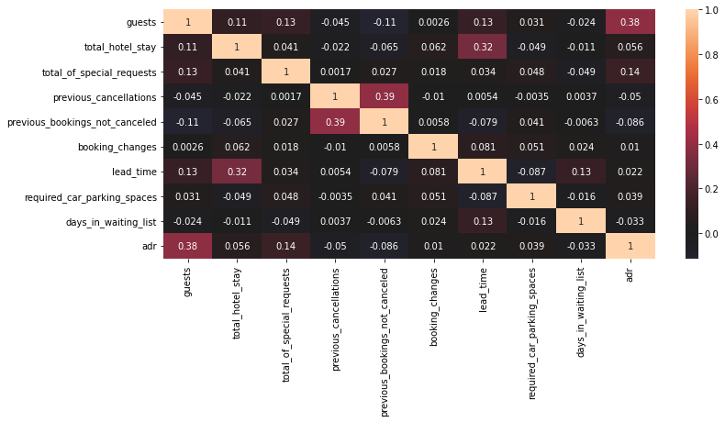
Heatmap
ADR and guests have slight correlation. 0.39 is marked.
This makes sense as the more the no of guests, which means that the occupancy will be higher and that in turn leads to higher revenue for the hotels.
lead_time and total_hotel_stay have slight correlation. 0.32 is marked. This means that people who stay longer book way in advance.
previous_bookings_not_cancelled and previous_cancellations have slight correlation. 0.39 is marked. This is non deducive as guests who book hotels in case of changes in plans or some untoward incidents might also cancel the bookings.
Out of the 10 columns that we selected 4 data columns seem to have some relation with each other that we can make inference and deductions.

Slide 10
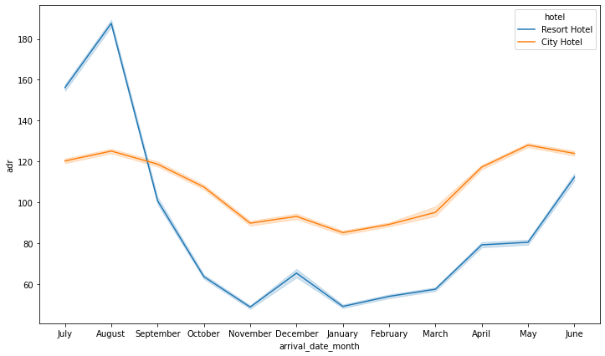
ADR (Average Daily Rate)
ADR is a KPI that shows hotels average revenue per occupied room per day. As it doesn’t include empty rooms, we can use it to compare hotel performance and revenue to previous periods, thus forecasting seasonal trends better.
ADR=room revenue/total no of rooms sold
We can see the we have a higher ADR in the middle of the year (i.e. July, August) and lowers down
towards the end of the year.
But after November again the ADR sees a
increasing trend.
Higher ADR means good revenue for the hotels.

Slide 11
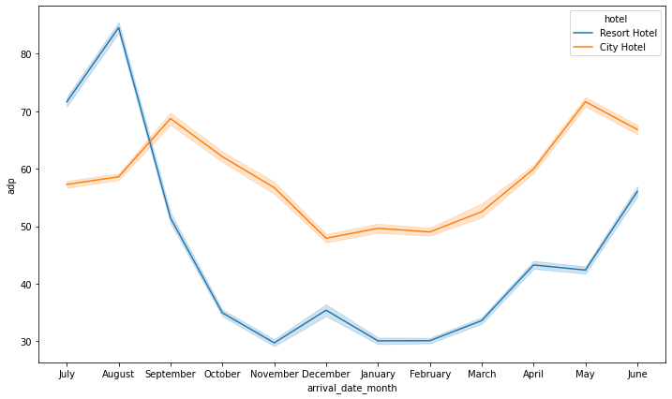
ADP (Average Daily Rate
Average Daily Rate (ADP) = ADR / Guests
The above is a measure to calculate average price per guest.
If we see the above trend, the following inferences are made. The Resort hotel sees peek in price for each guest in August and then seesa continuous fall.
On the other hand City hotel sees slight price hike September and May.
Overall we can say that prices of Resort hotel are higher as compared to City hotel.
Also City hotel prices remain almost constant throughout the year.

Slide 12
Questions
Q1) Which is the popular of both the hotels?
Q2) Are bookings more compared to cancellations?
Q3) What is the total cancellation for both the hotels and which hotel has higher cancellation rate?
Q4) What is the preferred duration for stay in the hotels?
Q5) Which hotel has highest chance of guests repeating their stay?
Q6) Which of the distribution channels should the hotels prefer?
Q7) What is the classification of guest arriving the hotel?
Q8) Which are the countries the hotels receive most guests from?
Q9) Which are the busiest months for the hotel?
Q10) Which has been the busiest of years for both the hotels?
Q11) Which rooms are the most utilized in both the hotels?
Q12) What is the most preferred meal choice opted by guests at the time of booking for both the hotels?
Q13) Which of the hotels guests demand special requests?

Slide 13
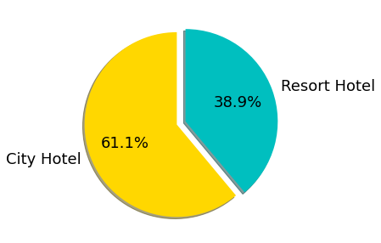
Popularity
The occupancy percentage shows City Hotel to be a popular destination.

Slide 14
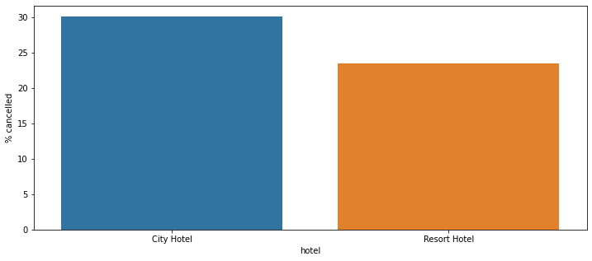
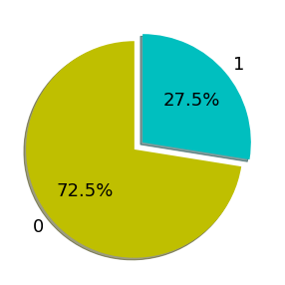
Cancellations
City Hotel guests cancel rooms more frequently.

Slide 15
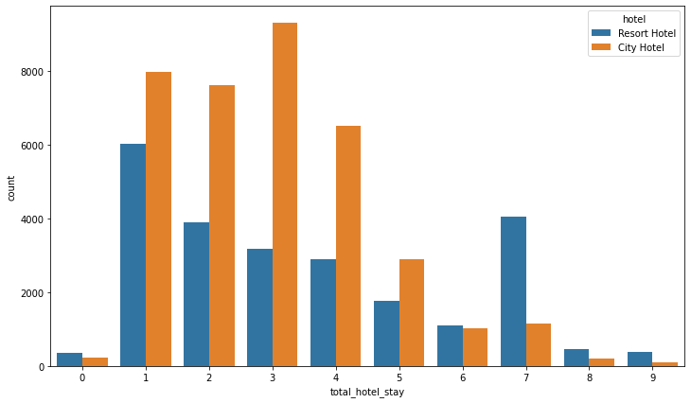
Preferred Duration of stay
Guest mostly prefer upto 4 nights package.

Slide 16
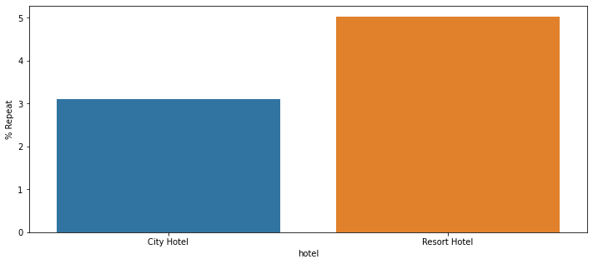
Regular Guests
Guests seem to revisit Resort Hotel more.

Slide 17
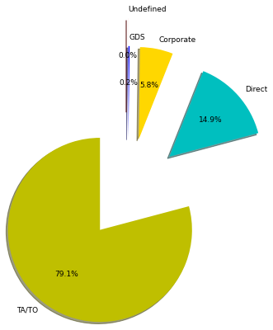
Distribution Channels
The above indicates that most of the bookings come from TA/TO ie tours and travels, followed by Direct clients who are walkins at the hotel and then Corporate bookings. Rest are miniscule. Further the relation between lead_time and previous_cancellations with the distribution_channel can be a scope for study.

Slide 18
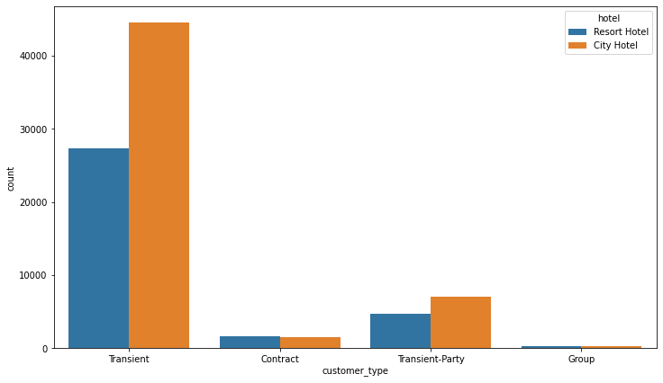
Classification of guests arriving the hotels
We also find that that the hotels have more number of Transient customers than than Contract customers.

Slide 19
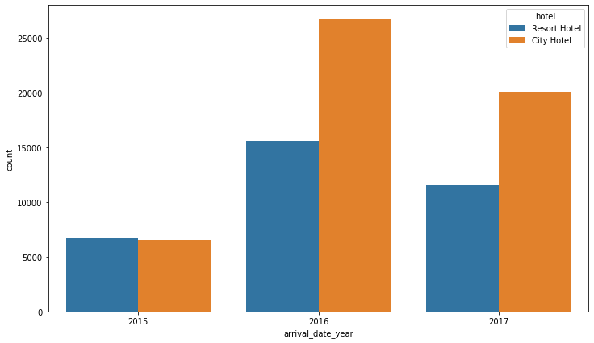
Busiest of Year for both hotels
2016 has been phenomenal in terms of growth. Caution need to be taken seeing the 2017 trends.

Slide 20
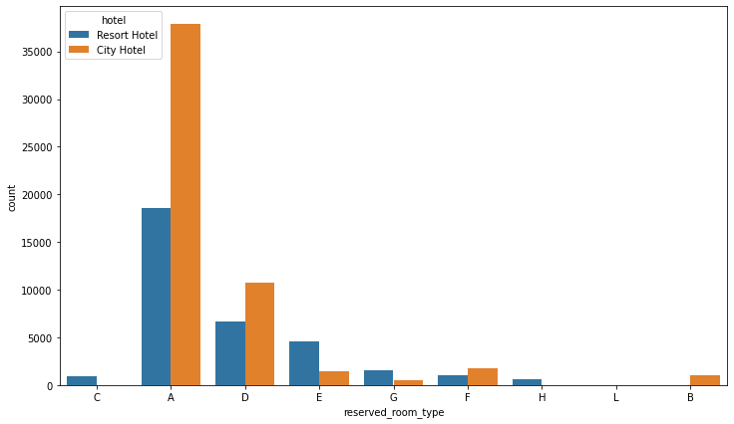
Utilization of hotel rooms
For both the hotels the top rooms are A and D followed by E and F.

Slide 21
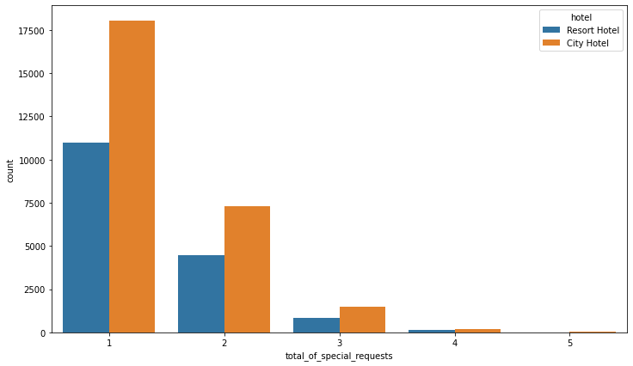
Special requests made by guests.
Guests in City hotel make more special requests.

Slide 22
Conclusion
After a thorough analysis of the csv data file given to us we conclude that -
1. For a guest to get a good hotel deal, they should visit either of the hotels before or after the month of August and September. City hotel prices remanin constant throughout the year, so **Resort hotel is the best pick to get the best deals.**
2. We can see the we have a higher ADR in the middle of the year (ie July, August) and lowers down towards the end of the year. But after November again the ADR sees a increasing trend. A higher ADR means good revenue for the hotels.
3. City hotel has high no of special requests by guests.
4. City hotel is the most visited hotel although it has 30% of booking cancellations compared to 23% of cancellation of Resort hotel.
5. Most of the guests prefer a four night stay at the hotels which seems like a ideal period. So to increase the revenue of the hotels special packages can be derived to increase the rush in the hotels.
6. There is also a surprising trend. Resort hotel guests tend to repeat more than City hotel. It is conclusive that City hotel needs to look into key hospitality parameters so that they have more guests frequenting their hotel.
7. Also most of the bookings come from TA/TO ie tours and travels, followed by Direct clients who are walkins at the hotel and then Corporate bookings So the hotels need to incentivise the TA/TO(tours and travel operators) and the transient customers more to gain in the no of guest volume.
8. Most of the guests are from Western Europe, namely Portugal, France, UK. Thereby we should concentrate on advertising in those regions so that better business can be achieved.
9. Rooms A, D, E, F are most utilised. The rest of the rooms are not frequently used. Further analysis needs to be done to increase the yield from those rooms.
10. Further analysis needs to be done as to why 2017 there was a dip in volume of guests for both the hotels.

