Slide 1
Distant-Reading Gendered Gothic Motifs
Lawrence Evalyn

Slide 2
The Gothic Novel, 1790-1830
Ann Radcliffe
Terror Gothic
Female Gothic
Matthew Lewis
Horror Gothic
Male Gothic

Slide 3
“…and when you have finished Udolpho, we will read the Italian together; and I have made out a list of ten or twelve more of the same kind for you."
"Have you, indeed! How glad I am! What are they all?"
"I will read you their names directly; here they are, in my pocketbook. Castle of Wolfenbach, Clermont, Mysterious Warnings, Necromancer of the Black Forest, Midnight Bell, Orphan of the Rhine, and Horrid Mysteries. Those will last us some time."
"Yes, pretty well; but are they all horrid, are you sure they are all horrid?”
Northanger Abbey

Slide 4
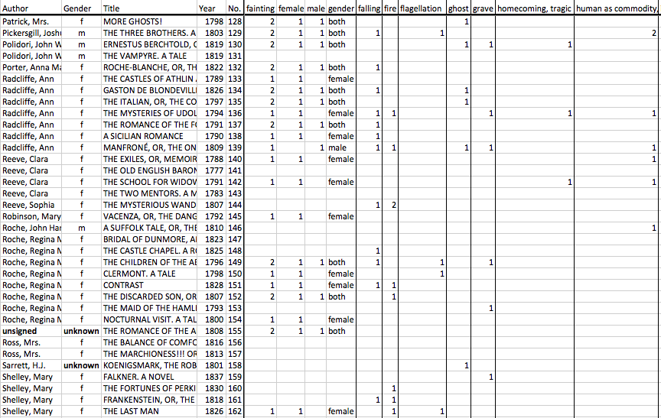
Ann Tracy’s Index to Motifs

Slide 5
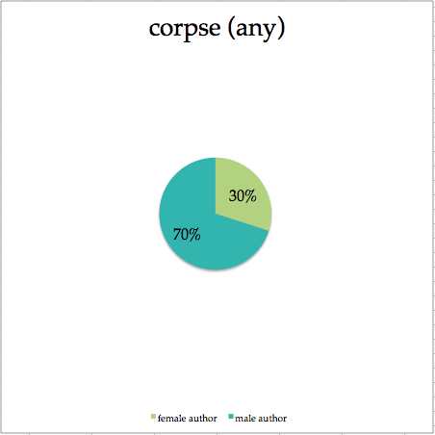
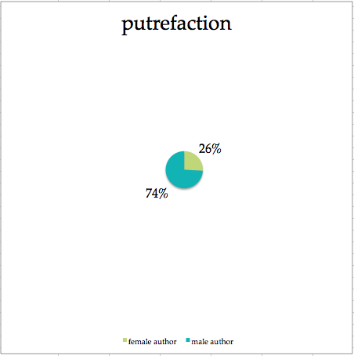
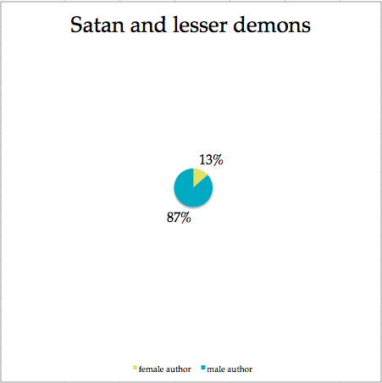
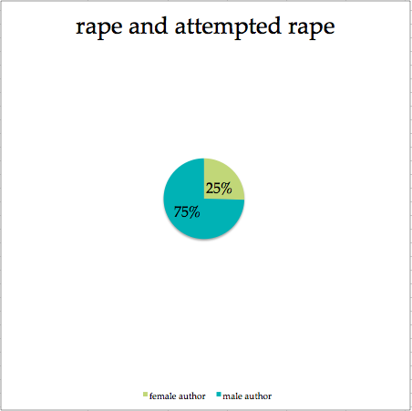
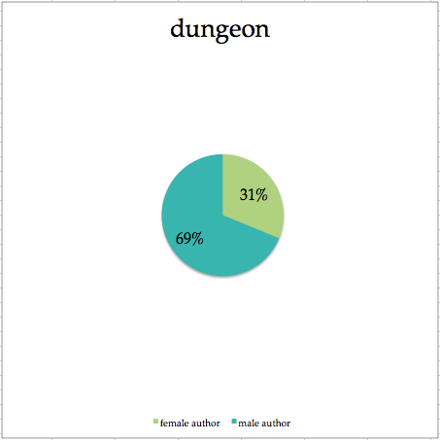
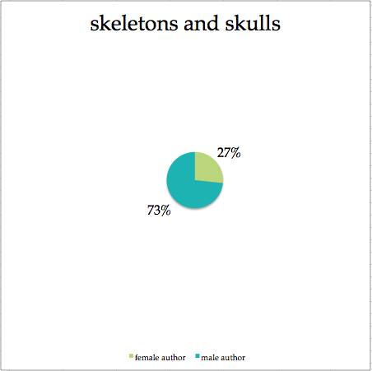
The Male Gothic

Slide 6
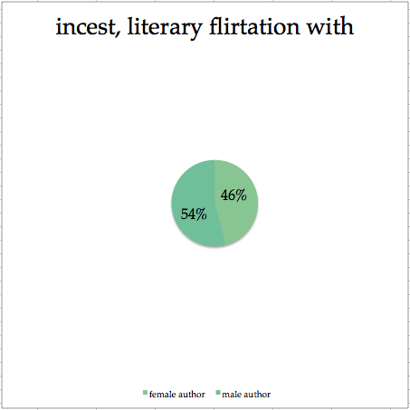
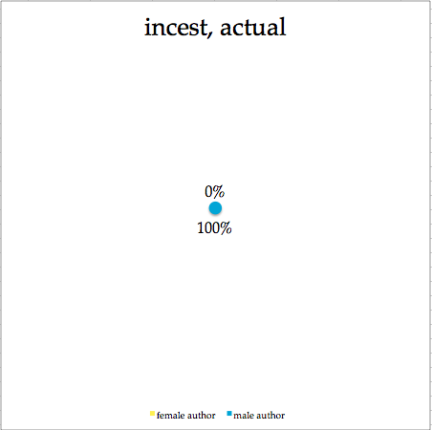
The Male Gothic

Slide 7
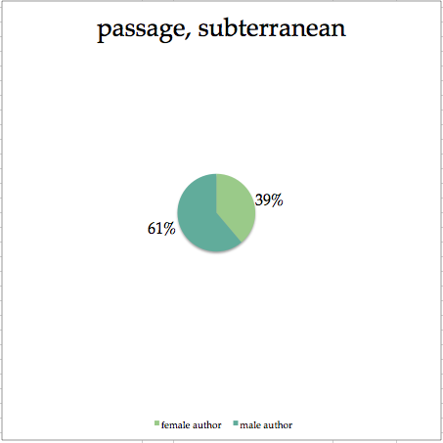
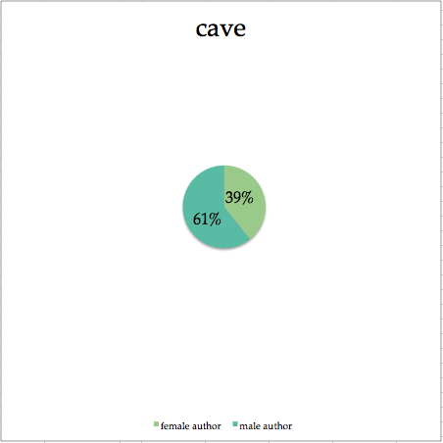
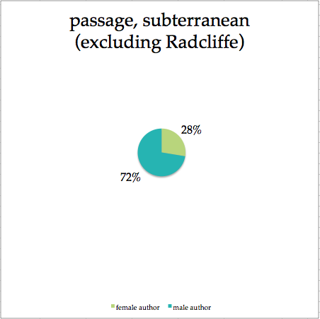
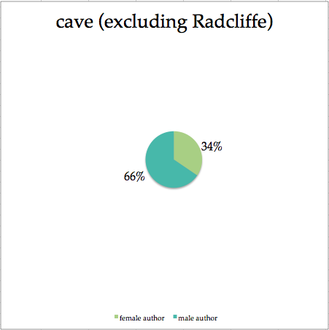
The Female Gothic

Slide 8
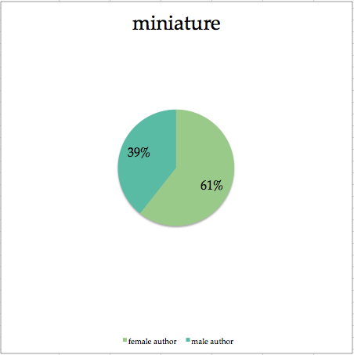
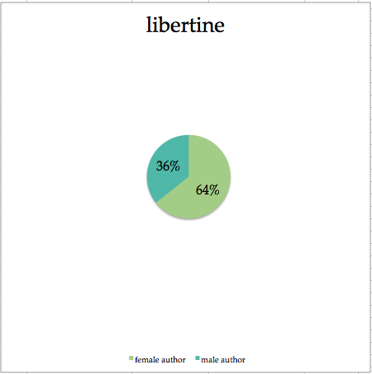
The Female Gothic

Slide 9
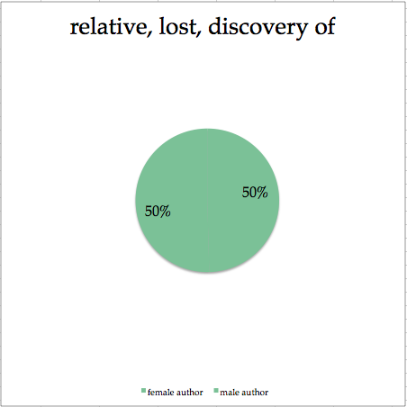
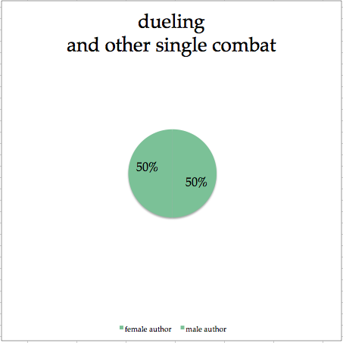
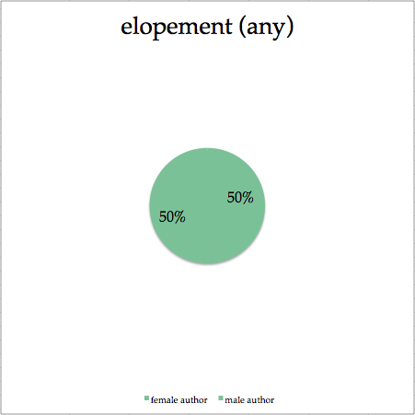
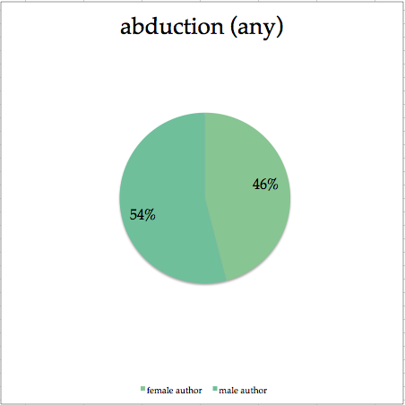
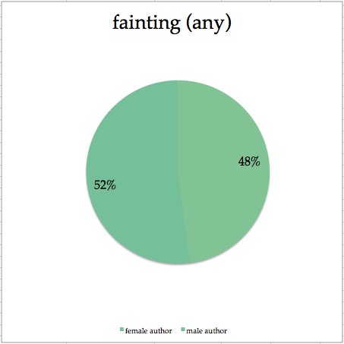
The Gothic

Slide 10
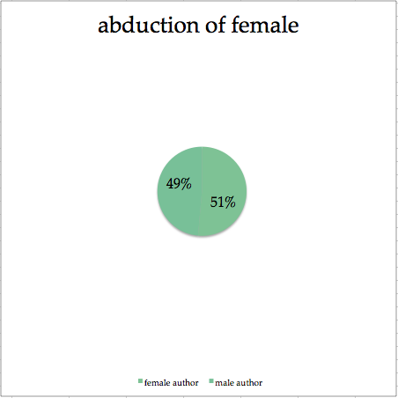
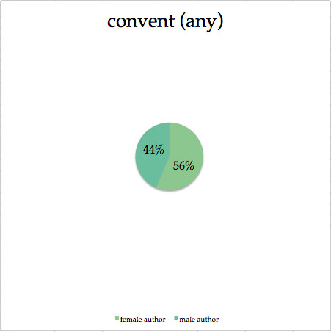
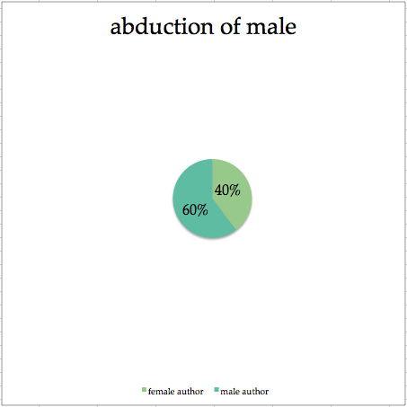
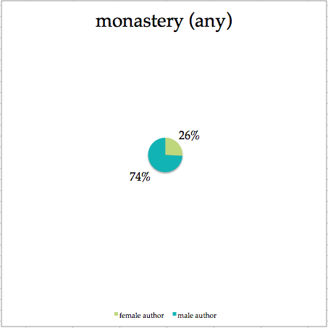
The Gothic

Slide 11
The Gothic
Ann Radcliffe
Terror Gothic
Matthew Lewis
Horror Gothic
Male Gothic

