Slide 1
Distant-Reading Gendered Gothic Motifs
Reading Metadata:
Visualizing Gender Divides
in the Gothic Novel 1790-1930

Slide 2
Gothic Readers, 1790-1830
“…and when you have finished Udolpho, we will read the Italian together; and I have made out a list of ten or twelve more of the same kind for you."
"Have you, indeed! How glad I am! What are they all?"
"I will read you their names directly; here they are, in my pocketbook. Castle of Wolfenbach, Clermont, Mysterious Warnings, Necromancer of the Black Forest, Midnight Bell, Orphan of the Rhine, and Horrid Mysteries. Those will last us some time."
"Yes, pretty well; but are they all horrid, are you sure they are all horrid?”
Northanger Abbey

Slide 3
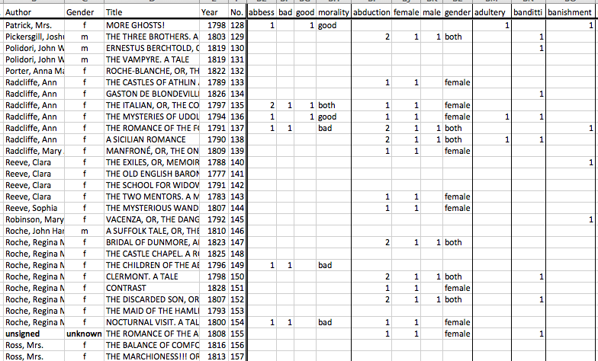
Ann Tracy’s Index to Motifs

Slide 4
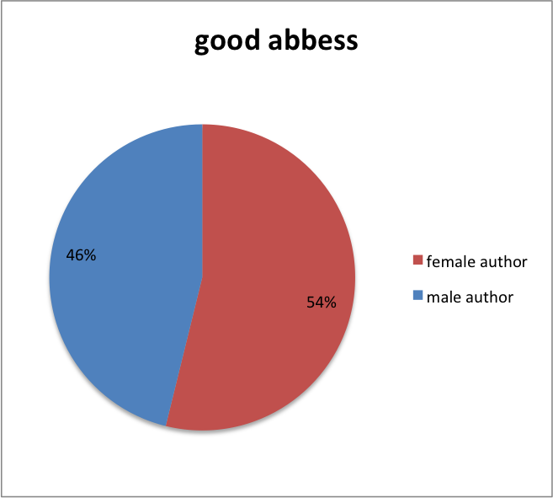
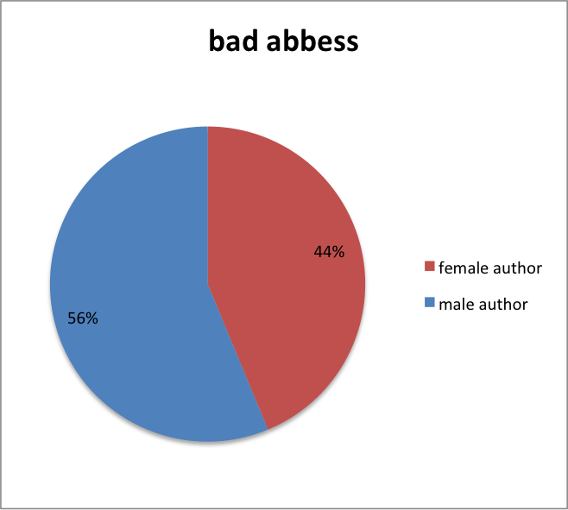
Default Settings

Slide 5
What’s Wrong Here?
[T]he basic categories of supposedly quantitative information, the fundamental parameters of chart production, are already interpreted expressions. But they do not present themselves as categories of interpretation, riven with ambiguity and uncertainty, because of the representational force of the visualization as a "picture" of "data".
Johanna Drucker
“Humanities Approaches to Graphical Display”

Slide 6
Default Settings

Slide 7
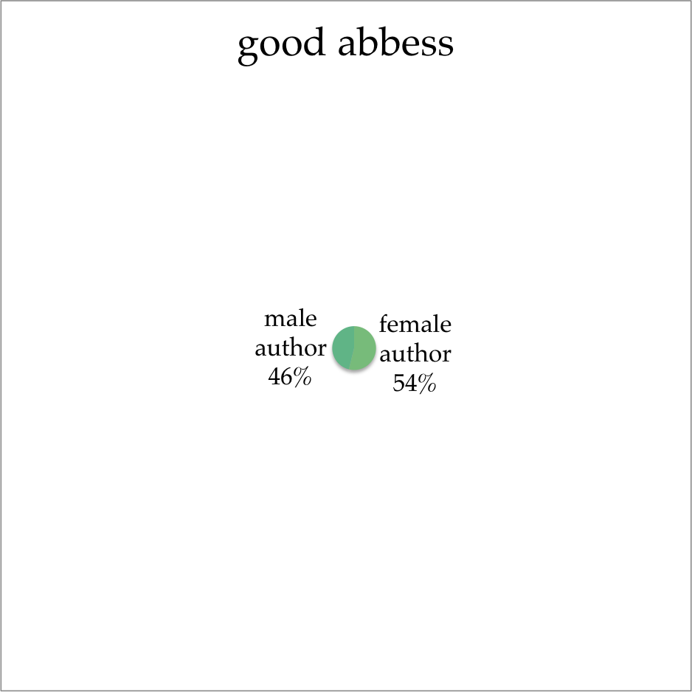
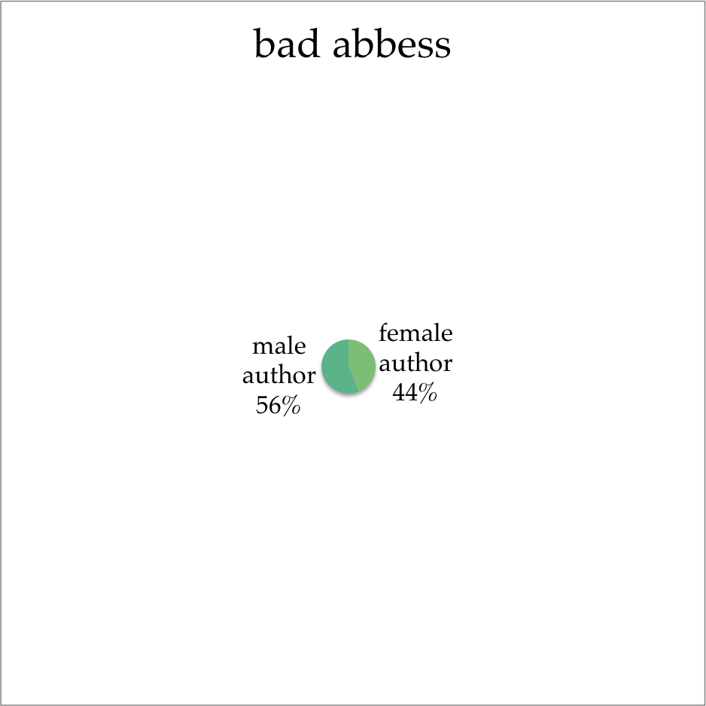
Revised Charts
Notes:
“conditional expressions of interpretative parameters” (Drucker 20)

Slide 8
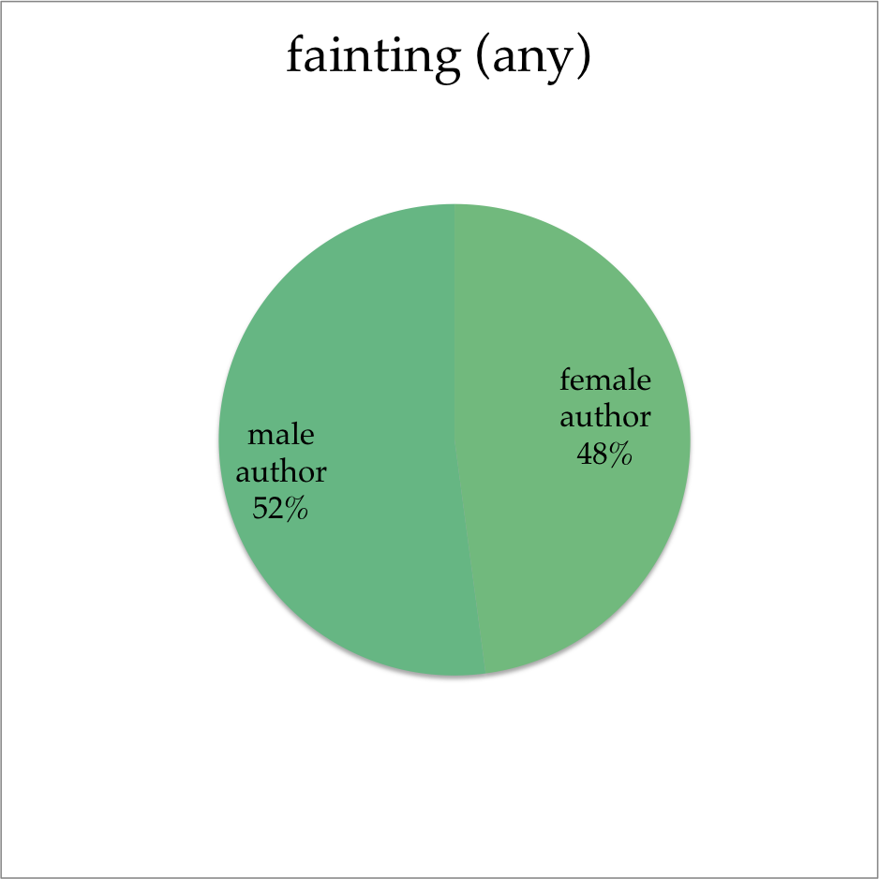
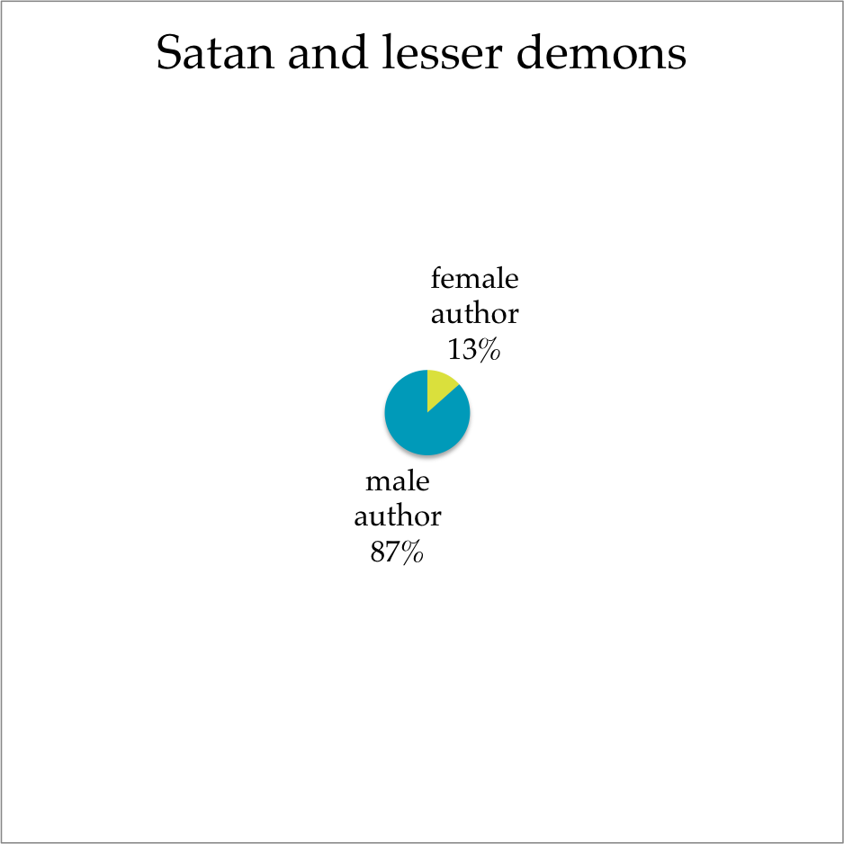
Revised Charts

Slide 9
http://tiny.cc/gothic

Slide 10
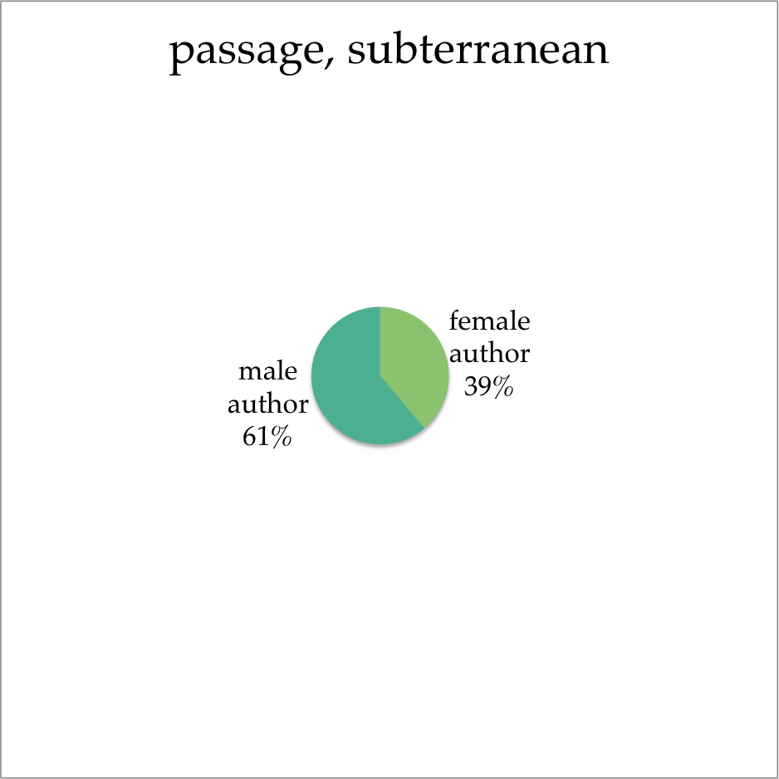
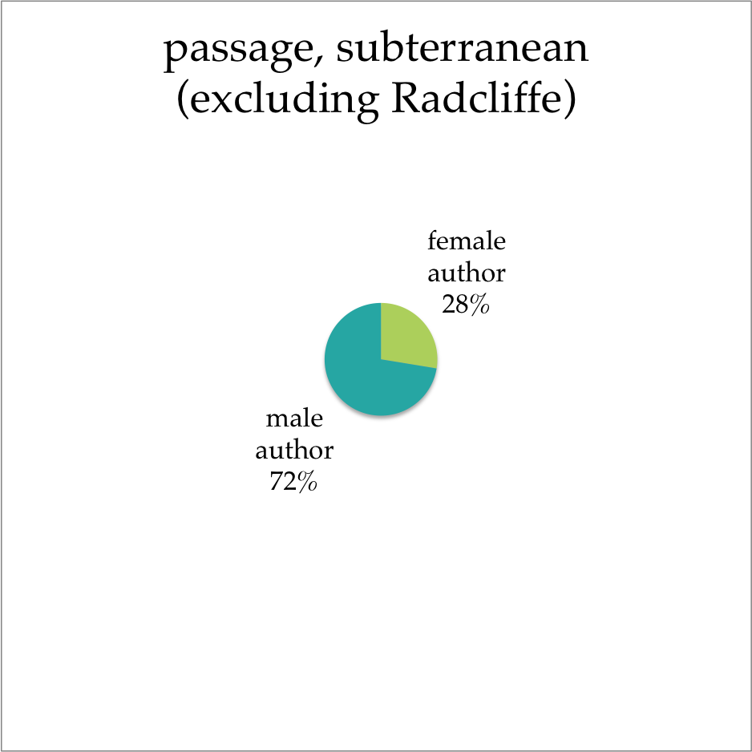
Preliminary Results

Slide 11
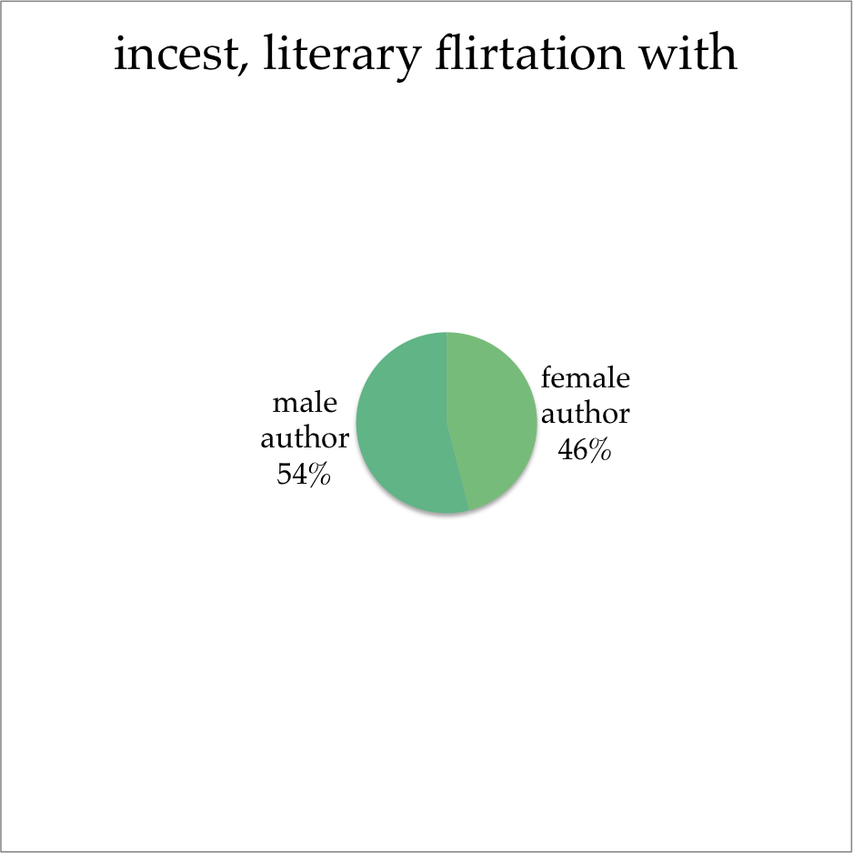
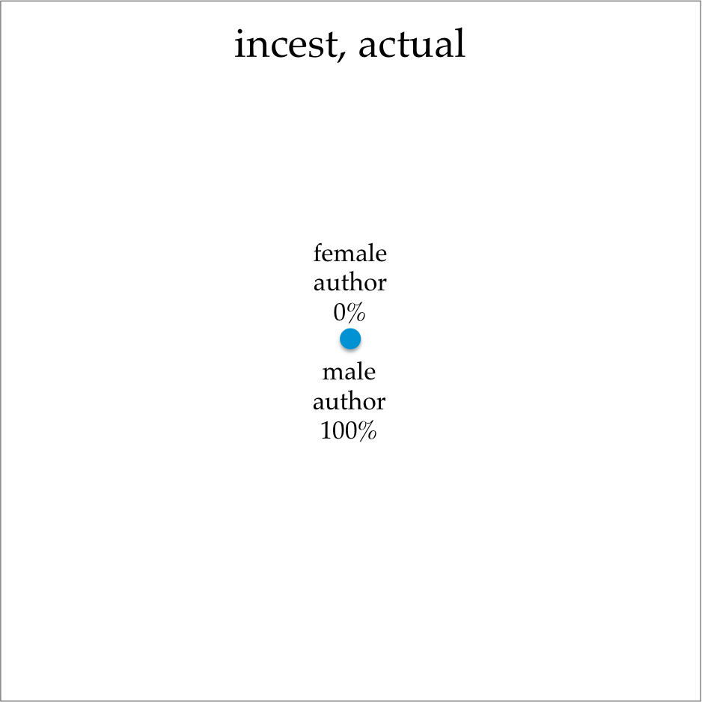
Preliminary Results

