Slide 1
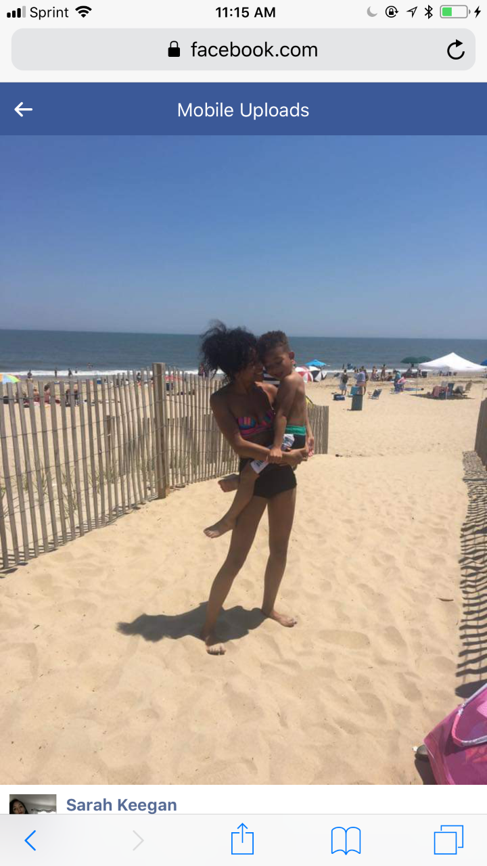
Meeting Sarah
Dance 102-002
Spring 2019

Slide 2
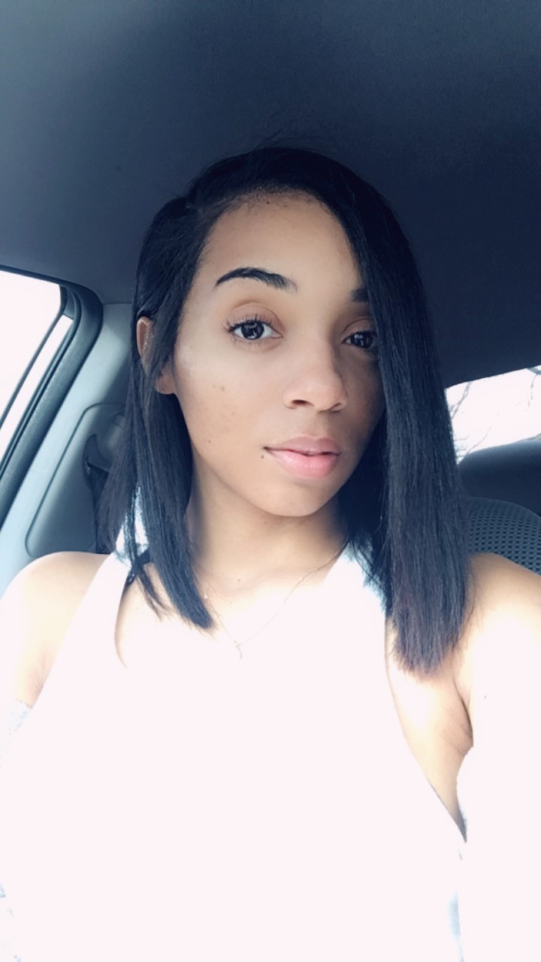
Meeting Sarah:
My name is sarah Rosenburgh I am 27 years old
I am a mother to an amazing 6 year old little boy
I am a full time Mom, Student and employee

Slide 3
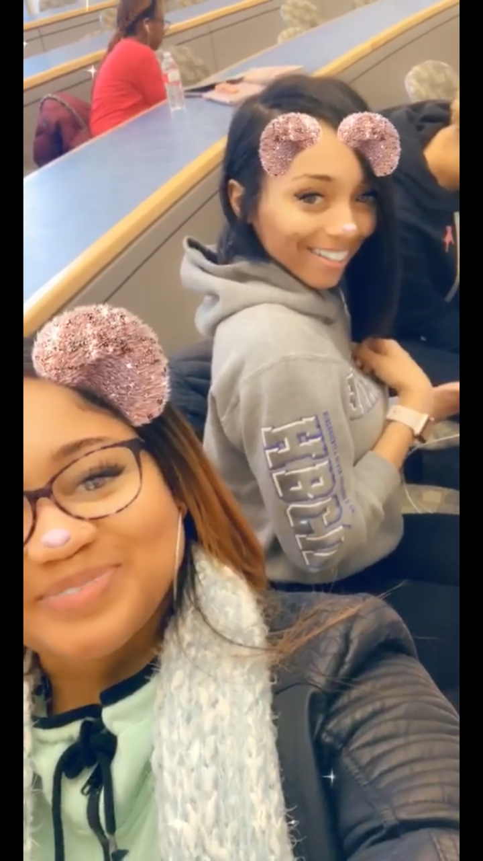

Coppin State ( HBCU)
I considered a Sophomore at Coppin State University
I am a Pre- Nursing Major

Slide 4
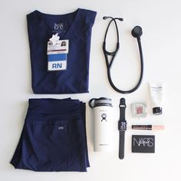
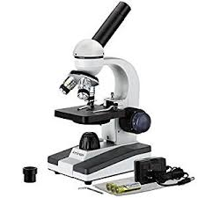
Goals
My Goals is to become a Research Nurse For John Hopkins Hospital

Slide 5
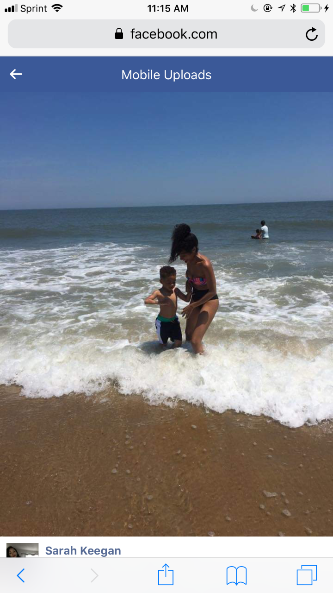
Purpose
My purpose in life is Keegan ( my son)
Keegan is my motivation to want to obtain this degree
Keegan has a genetic disorder called Neurofibromatosis( neuro meaning nerve- Fibroma meaning tumor, he grows tumors on his nerves) which is the purpose of me wanting to become a research Nurse. To help other mothers find the answers to their questions about their children disorders.

Slide 6

Why Yoga?
Anxiety seems to control my everyday life, I want to get in sync with my body and mind
learn breathing techniques that can help me conquer anxiety attacks
interested in non-drug alternatives to treat anxiety
Deep breathing helps calm me, and teaches me to be present and stay in the moment and observe what is happening

