Slide 1
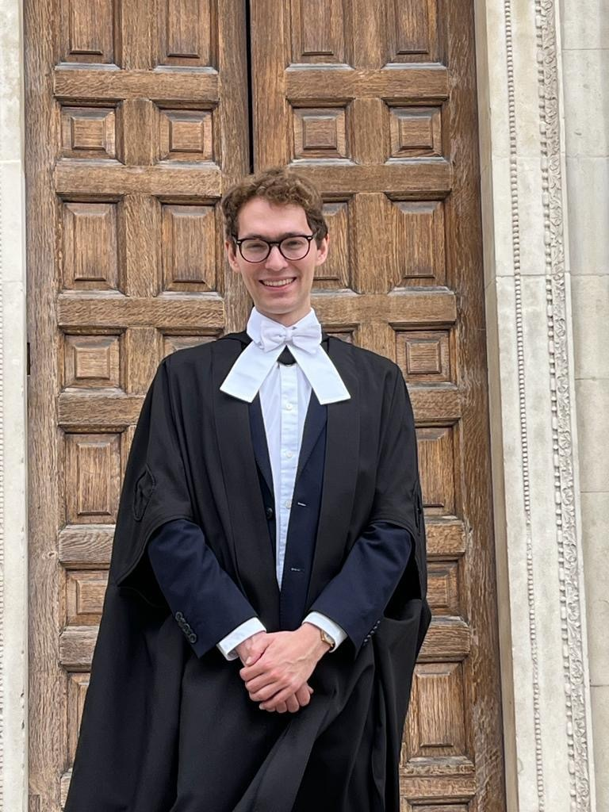
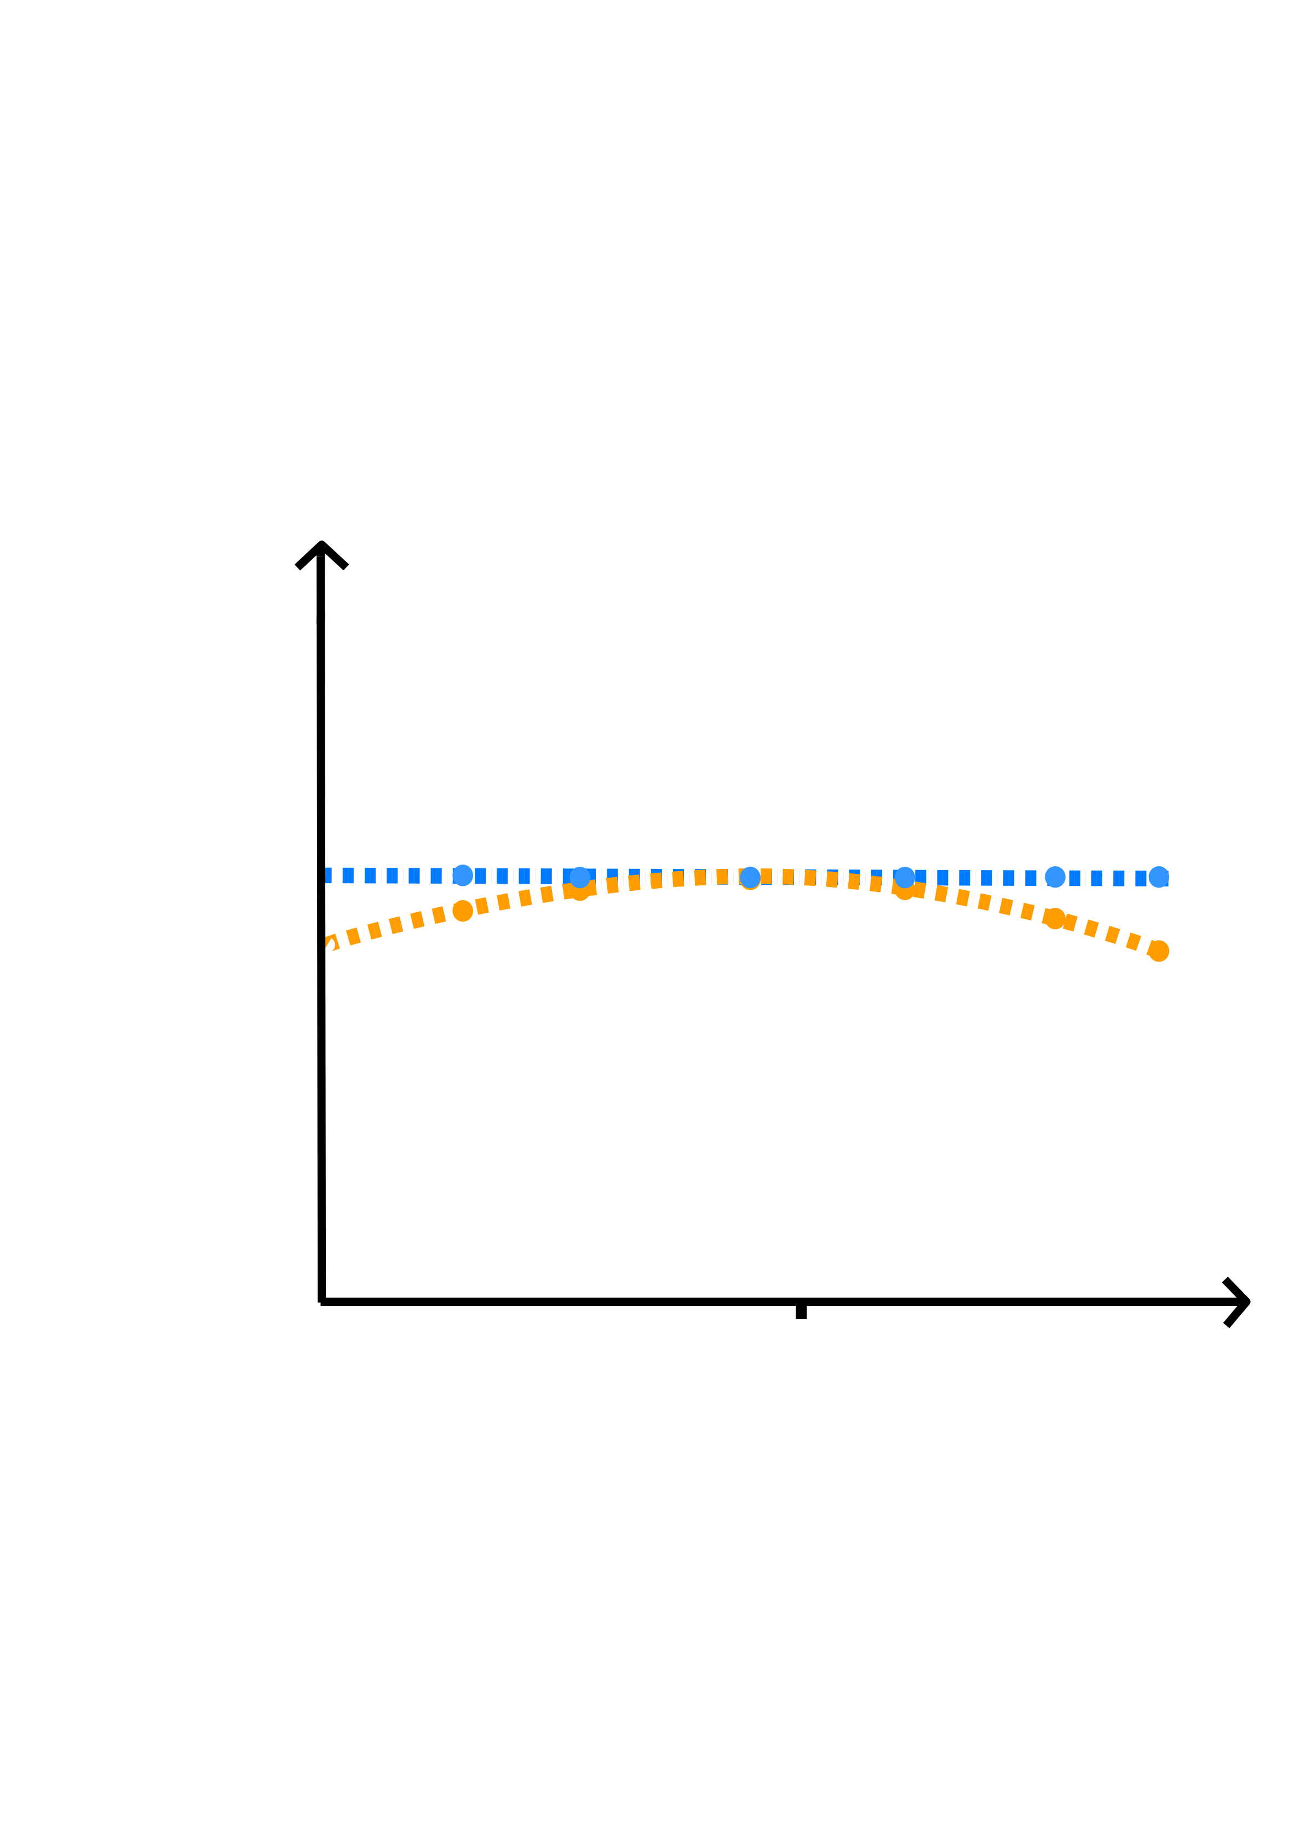
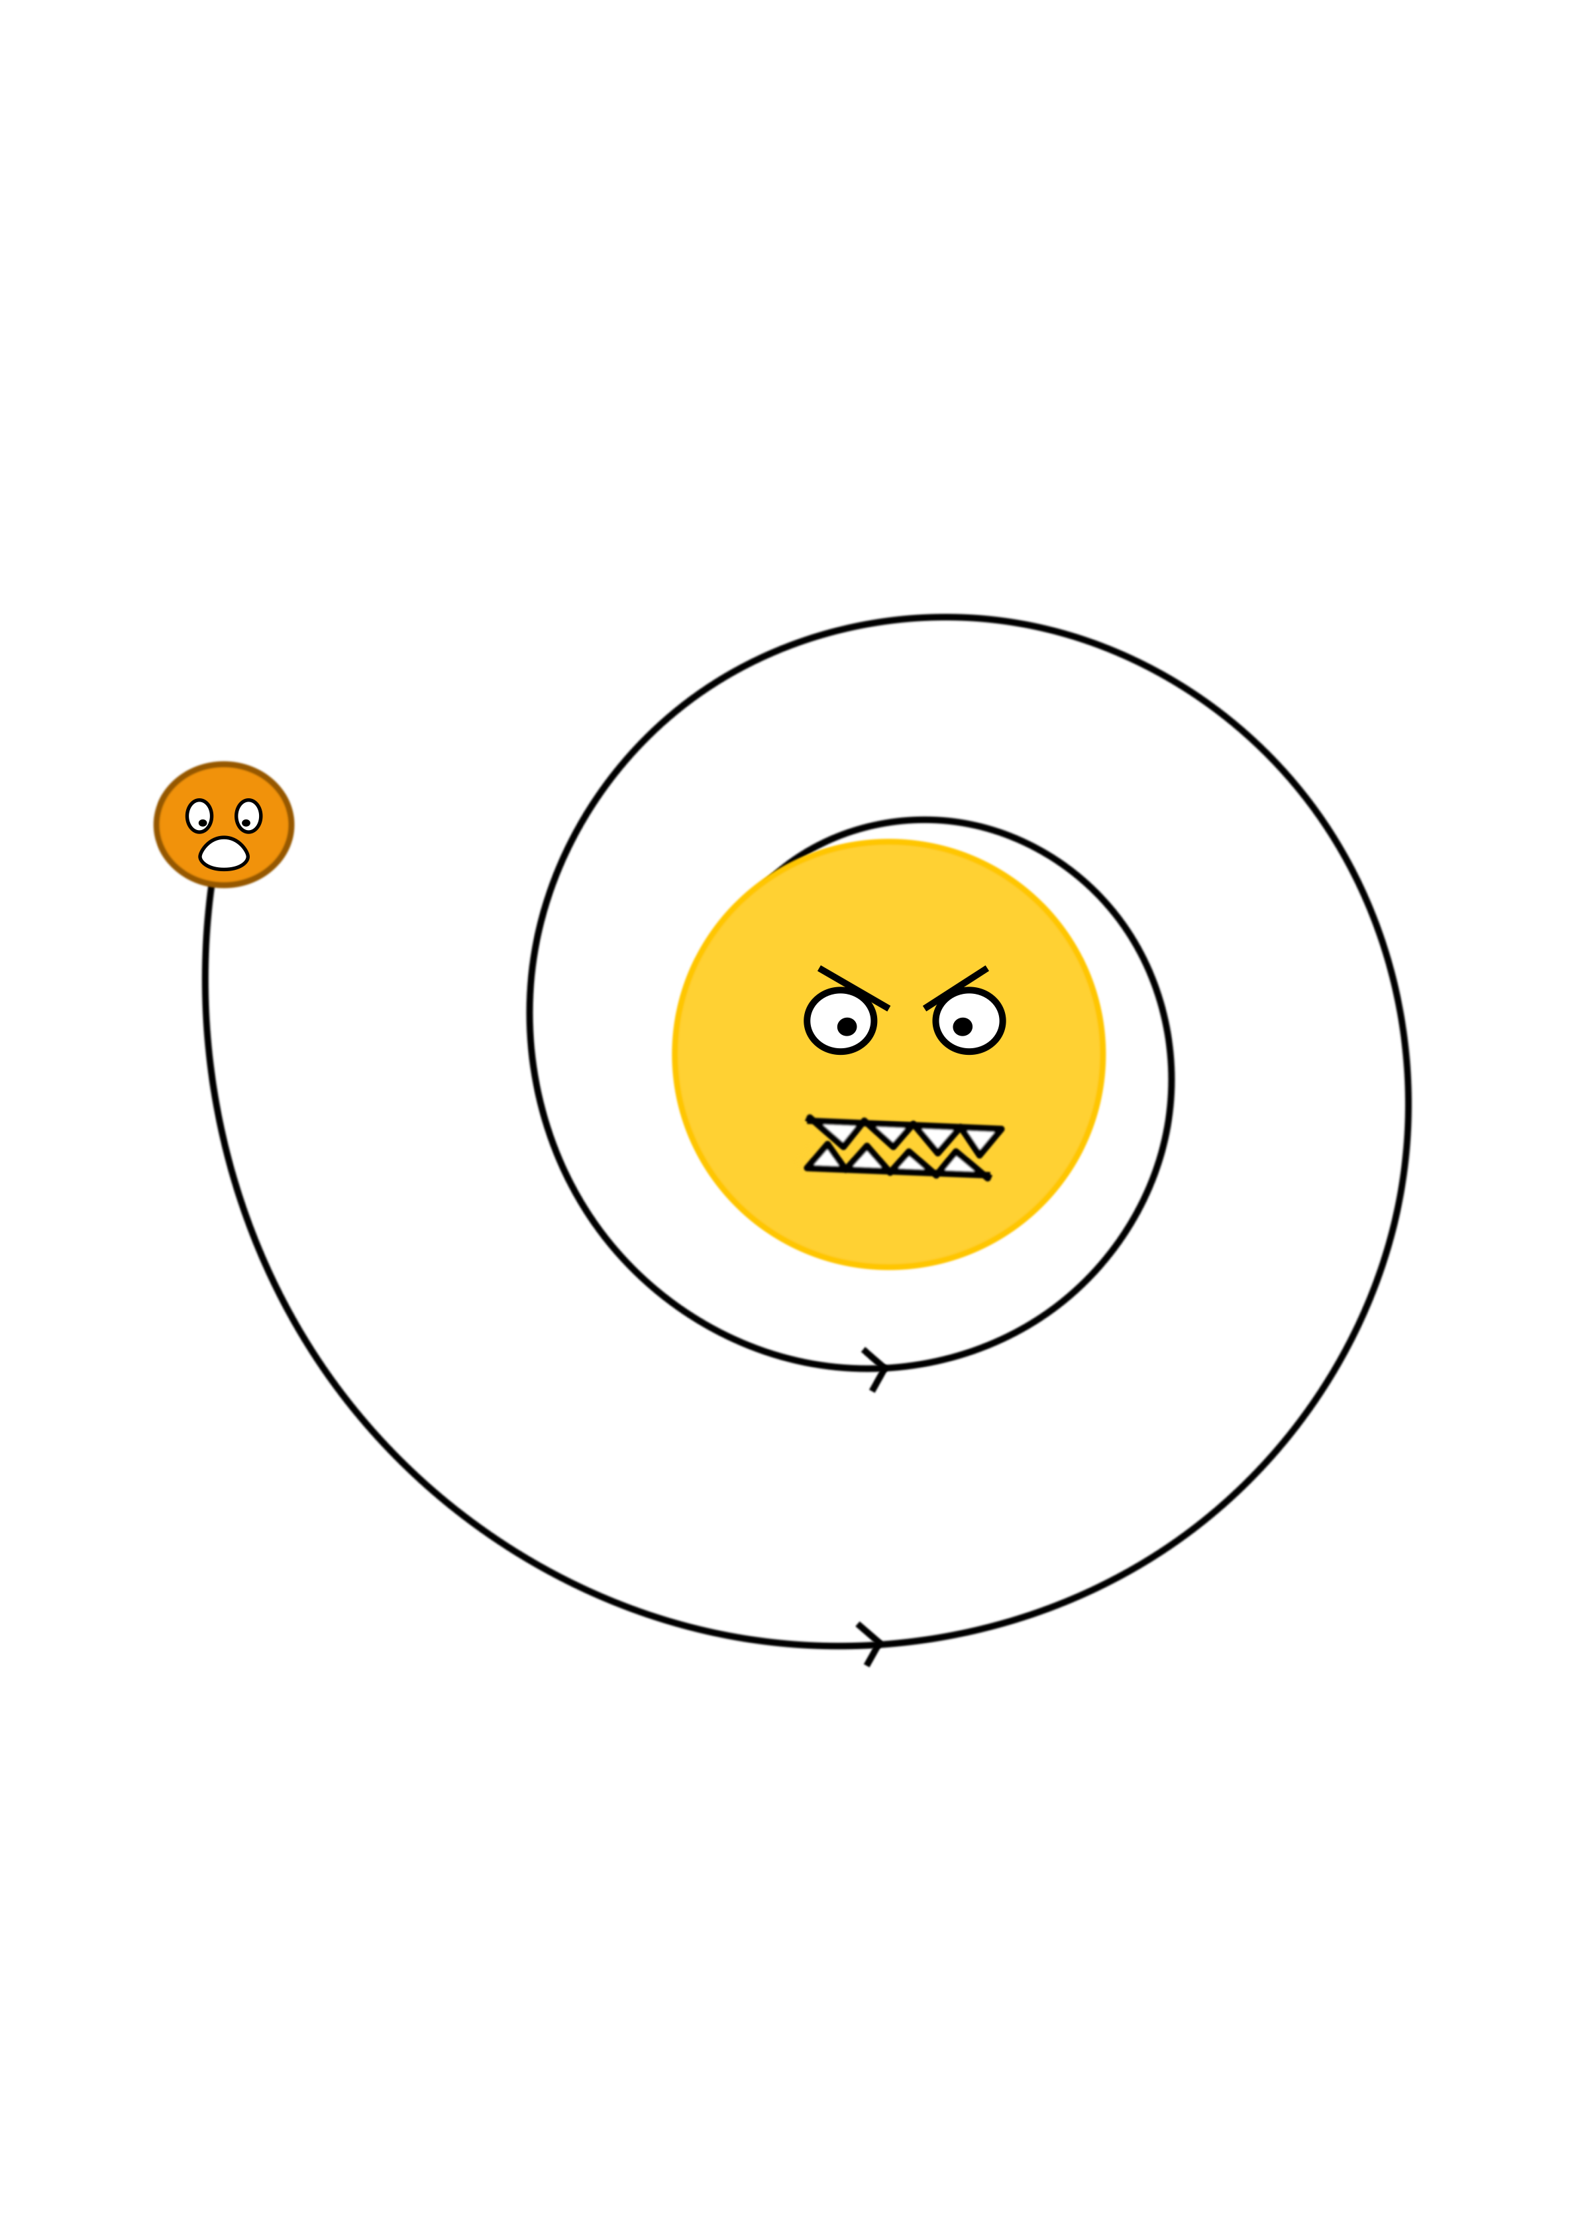

Previously: undergrad in Engineering
Interests: exoplanet transits & ML
Project: using transits and tidal decay theory to understand stellar structure
Supervisors: Vincent Van Eylen, Ed Bryant
Transit timing variations
Lawrence Berry
MSc Astrophysics
(part-time)
UCL
Tidal decay
$$0$$
Epoch

