Slide 1
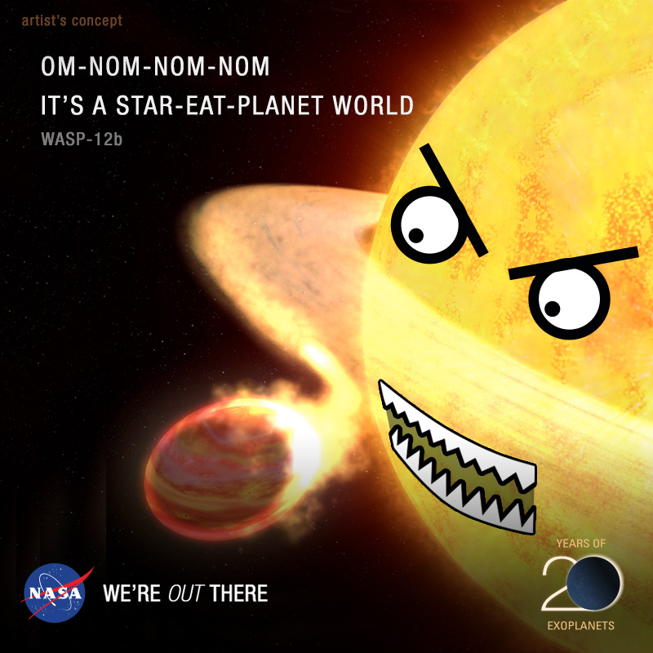
Investigating the empirical distribution of stellar tidal dissipation factors
Lawrence Berry
19/12/2023
[Nasa]
Notes:
I’ll be talking about stellar tidal dissipation factors
What they are
Why they are interesting to study
My method for studying them
And some early, initial results

Slide 2
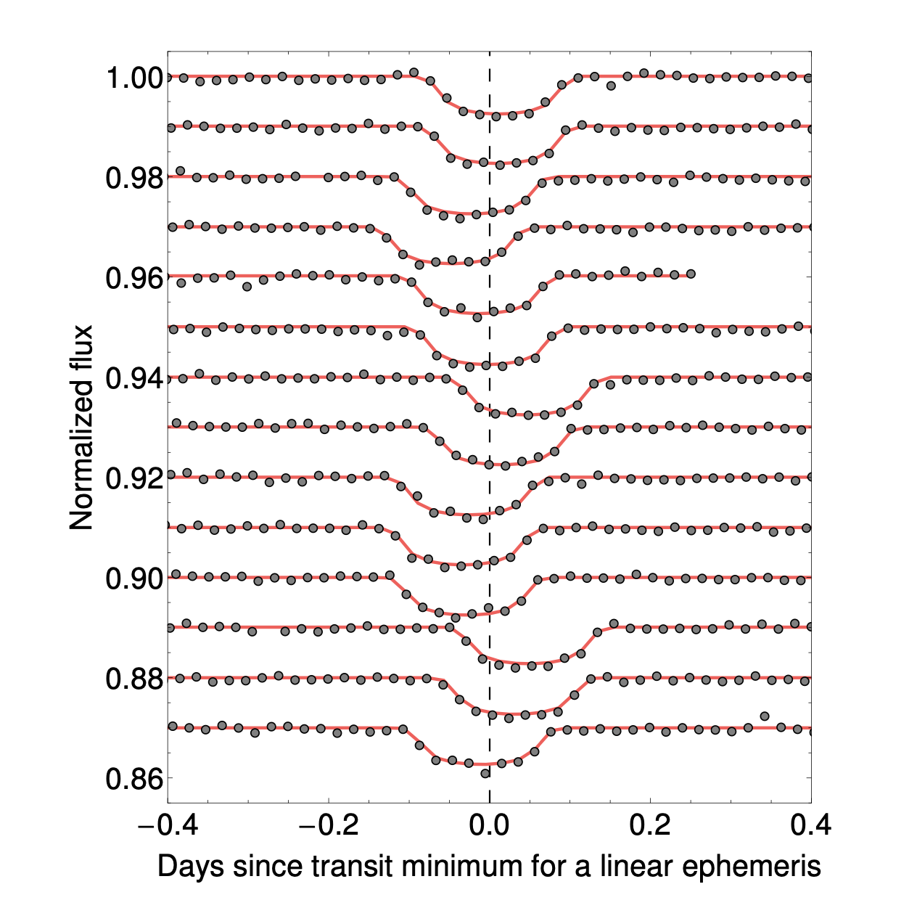
What are transit timing variations?
Overlayed light curves of KOI-872b [Nesvorny et al, 2012]
Transit timing variations (TTVs) = deviations in transit mid-time from a constant period orbit
What causes TTVs?
Apparent effects:
Change in projection due to parallax or proper motion
Line of sight acceleration
Actual effects: a non-Keplerian potential (non 1/r)
Rotational oblateness of star or planet
Perturbing companion planets or moons
General relativistic effects
Tidal decay
Notes:
What are TTVs? Deviations of the midpoint transit time from what you would expect if this planet were orbiting in a perfect closed ellipse.
TTVs can be caused by several phenomena, but essentially points either to:
Apparent effects:
Due to changes in geometrical projection (most obviously, parallax, but potentially also proper motion of the star)
Or line of sight acceleration
Actual effects: some kind of gravitational perturbation that means your potential is not exactly that of a two-body system (which would otherwise be a perfect closed ellipse) such as:
Oblateness (or quadrupole moments)
A planet or another moon
GR
Tidal influences which add or take away energy from the planet (primarily those raised by the planet on the star but potentially also star on planet or planet on planet)

Slide 3
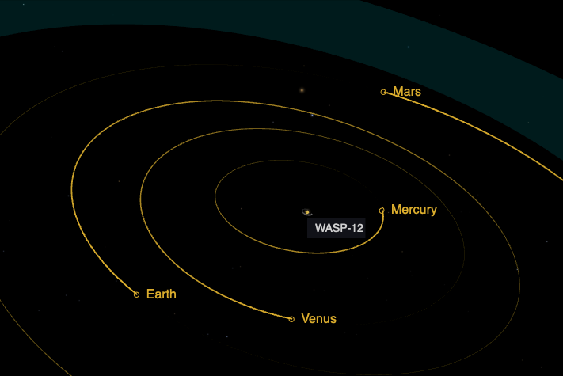
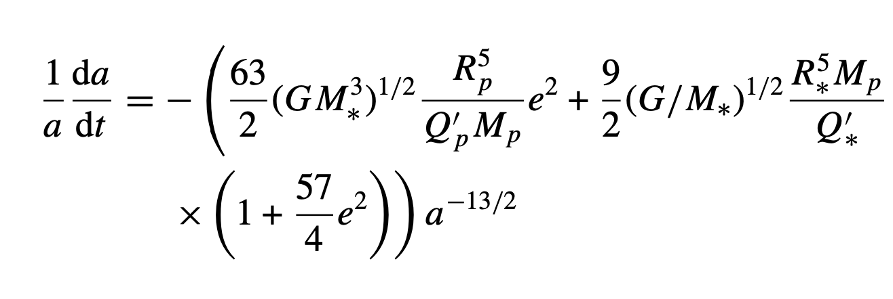
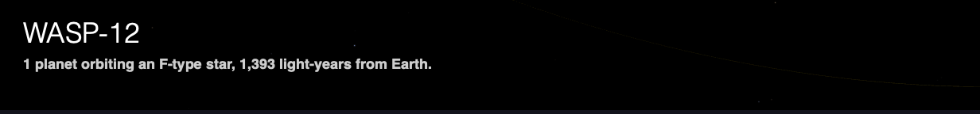
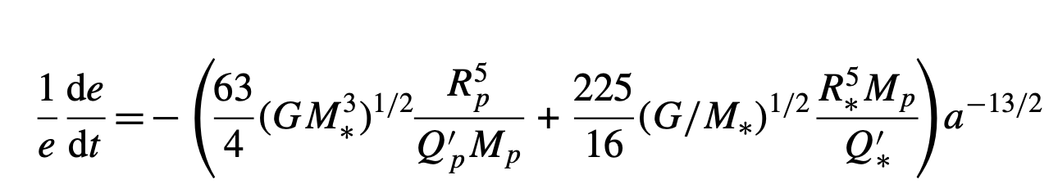
What is tidal decay?
A planet exerts a gravitational force on its host star (and vice-versa).
If the planet is orbiting faster than the star is spinning (prograde motion), the resulting frictional forces due to the tides cause the star’s rotation to speed up.
By conservation of angular momentum, the planet’s angular velocity must decrease.
[Nasa]
[Goldreich 1963, Jackson 2009]
Notes:
Akin to the moon speeding up as it rotates around the Earth slower than the Earth spins.
This particularly affects hot Jupiters
Big Jupiter sized gas giants orbiting very close to their host star.
One famous example is WASP-12b
It’s still unclear how these could have formed so close to their star without their material getting sucked in as the star was born. Perhaps tidal decay caused migration inwards?

Slide 4
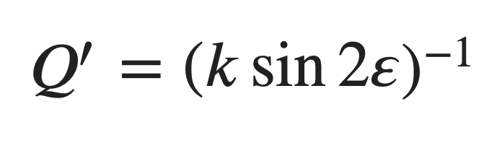
Why is tidal decay interesting?
Stellar tidal dissipation factor
“Love” number
Rigidity and elastic modulus of the star
Tidal phase delay
Lag between the planet’s spin and its tidal bulge, typically modelled as a forced harmonic oscillator
[Goldreich 1963, Jackson 2009]
Tidal decay is a consequence of stellar and planetary composition and structure. Decay rates could tell you something about what the star and planet are made of!

Slide 5
What’s been done so far and what are my aims?
Ogilvie, Barker et al: theoretical modelling of how the internal structure of a star might affect its tidal dissipation factor
Maciejewski, Patra, Hagey et al: analyses of transit observations to constrain observed decay rates and tidal dissipation factors of individual (typically <10) stars
Jackson et al: evidence of tidal decay from the orbital distribution of close in exoplanets (relative scarcity of older planets close to their stars)
Aims of my project:
Let’s model all systems for which we have transit observations
Build up an empirical distribution of stellar tidal dissipation factors
Test current stellar structure theory by analysing how other stellar properties relate to the tidal dissipation factors we observe
Notes:
Lots of work from Ogilvie and Barker trying to theoretically model how the internal structure of a star might affect what we call its “tidal dissipation factor”
Lots of work from Maciejewski, Patra and others to look for transit timing variations and use those observations to constrain the tidal dissipation factors of stars.
Lots of frequentist work. For each confirmed hot Jupiter, compute the age until the planet is destroyed using tidal decay theory. Add that to the stellar age, and the result is the age of the star at which the transit would no longer be seen. Compare that distribution to the one of stellar ages. Are the distributions consistent? That suggests the theory is correct.
I want to go one step further: let’s model all systems for which we have transit observations and try and test the theory by looking at how various stellar properties relate to observed orbital decay.

Slide 6
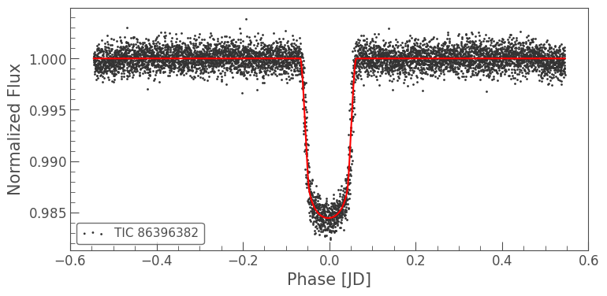
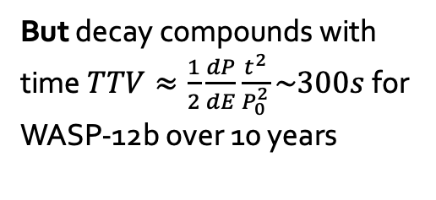
Why is this a hard problem?
Uncertainty in the transit time measurements is large
Fundamental lower limit ~ sampling rate
We want to use all available data, but a good portion of this is from the citizen science community
Fitted with different modelling pipelines
Reported uncertainties may be optimistic
Some observations may not even be real transits!
Often of the same order as the timing variation we’re trying to measure
We’re talking about things that vary milliseconds per epoch and this scale is in days!
But decay compounds with time$TTV≈\frac{1}{2}\frac{dP}{dE}\frac{t^{2}}{P_{0}^{2}}\sim 300s$ for WASP-12b over 10 years
Notes:
This is not an easy problem
Fundamental limit due to sampling rate lower limit: most Tess cadences are 2 minutes, I think some 20s going forward and full frame images every 30 minutes.
Large experimental error, especially from citizen-scientist data, but they are crucial to provide longer baseline time ranges of transit observations.
Data comes from lots of inhomogenous sources, just the other week there was a paper about how you shouldn’t rely on inhomogenously fitted transit times, but should rather model light curves directly in a consistent manner if you want to fit decays.
Not all TTV is the result of tidal dissipation with respect to the star. Other gravitational perturbations can have TTV effects too, including precessional effects like:
Quadrupole field as a result of rotational flattening
Tidal precessional effects (Raggozine and Wolf 2009)
Companion planets creating non-spherical potentials
General relativistic effects
Fitting lots of light curves is slow and getting access to many light curves can be hard
Let’s work off existing fitted transit times
In fact, because decay per epoch compounds over time. Theory suggests that decay is roughly constant per orbit. As the planet decays it undergoes more orbits per year, so the decay per time goes up.
After 10 years we’re talking about a total transit time variation of more like 300s for WASP-12b.

Slide 7
Methodology I
Inputs:
Pre-fitted exoplanet transit light-curve mid times
More transit mid-times are available than actual light curves
MCMC is slow and I have a dual-core laptop
Professional + citizen-scientist
ExoClock
Exoplanet Transit Database
Transit timing en-masse (homogenous light curve fitting of TESS data, from Ivshina & Winn)
Assumptions:
Stellar tidal decay is the dominant cause of transit timing variations
Everything else comes out as noise in the wash
Fitted transit mid-times are:
Unbiased
Distributed with Gaussian error (recent paper from Judkovsky et al disputes this)
Decay rates are constant per-epoch
This is roughly (though not exactly) what the tidal decay equation predicts
Notes:
Some assumptions we’re going to make to simplify the problem:
We assume that any TTV we observe is the result of stellar tidal dissipation (i.e. tides raised by a planet on its star) causing orbital decay. We ignore all precessional or other effects.
The effect of tides raised on the planet is orders of magnitude smaller due to the low mass of the planet.

Slide 8
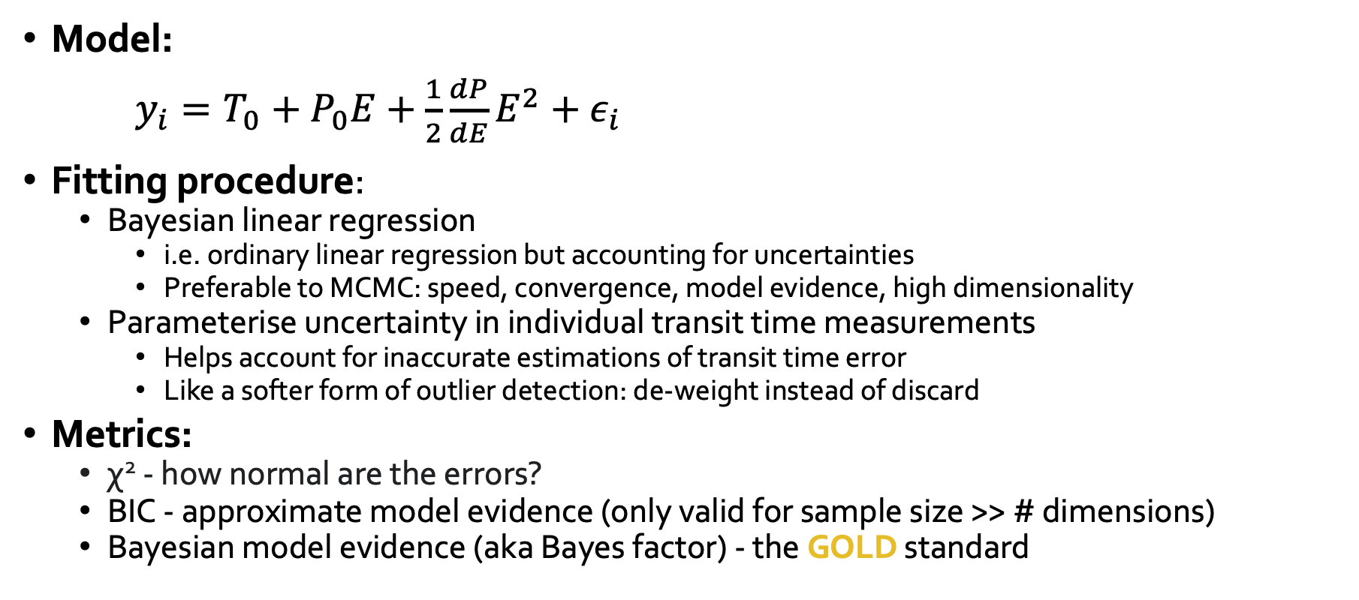
Methodology II
Model:
$y_{i}=T_{0}+P_{0}E+\frac{1}{2}\frac{dP}{dE}E^{2}+ε_{i}$
Fitting procedure:
Bayesian linear regression
i.e. ordinary linear regression but accounting for uncertainties
Preferable to MCMC: speed, convergence, model evidence, high dimensionality
Parameterise uncertainty in individual transit time measurements
Helps account for inaccurate estimations of transit time error
Like a softer form of outlier detection: de-weight instead of discard
Metrics:
χ² - how normal are the errors?
BIC - approximate model evidence (only valid for sample size >> # dimensions)
Bayesian model evidence (aka Bayes factor) - the GOLD standard

Slide 9
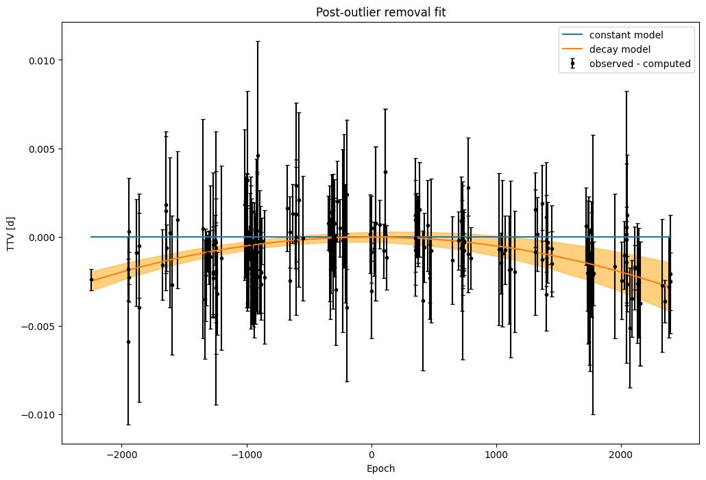
Example: WASP-12b
3σ posterior model error
A curve fits better than a straight line!

Slide 10
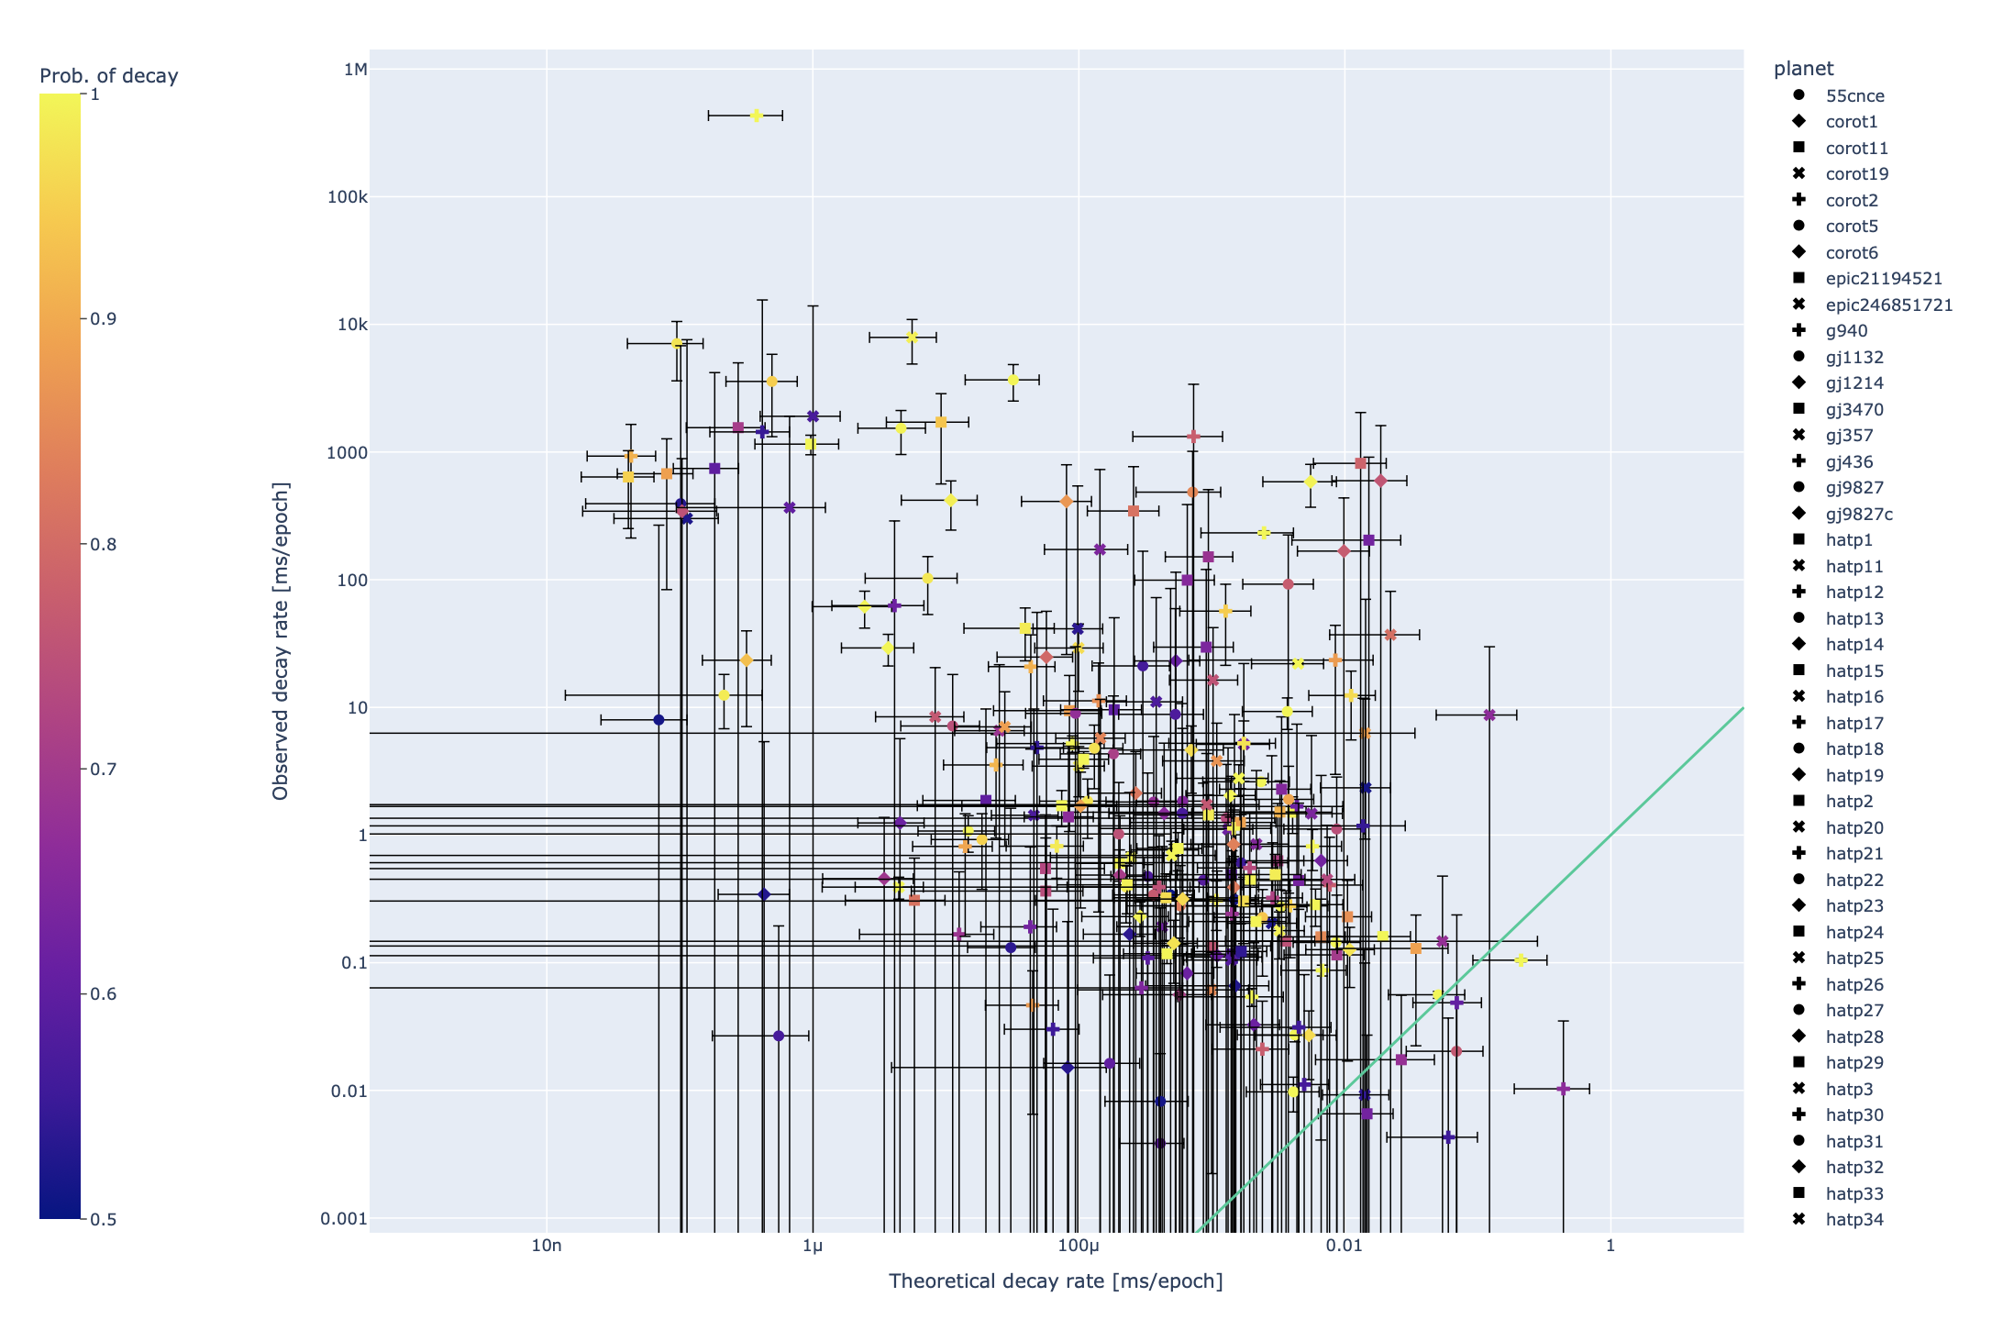
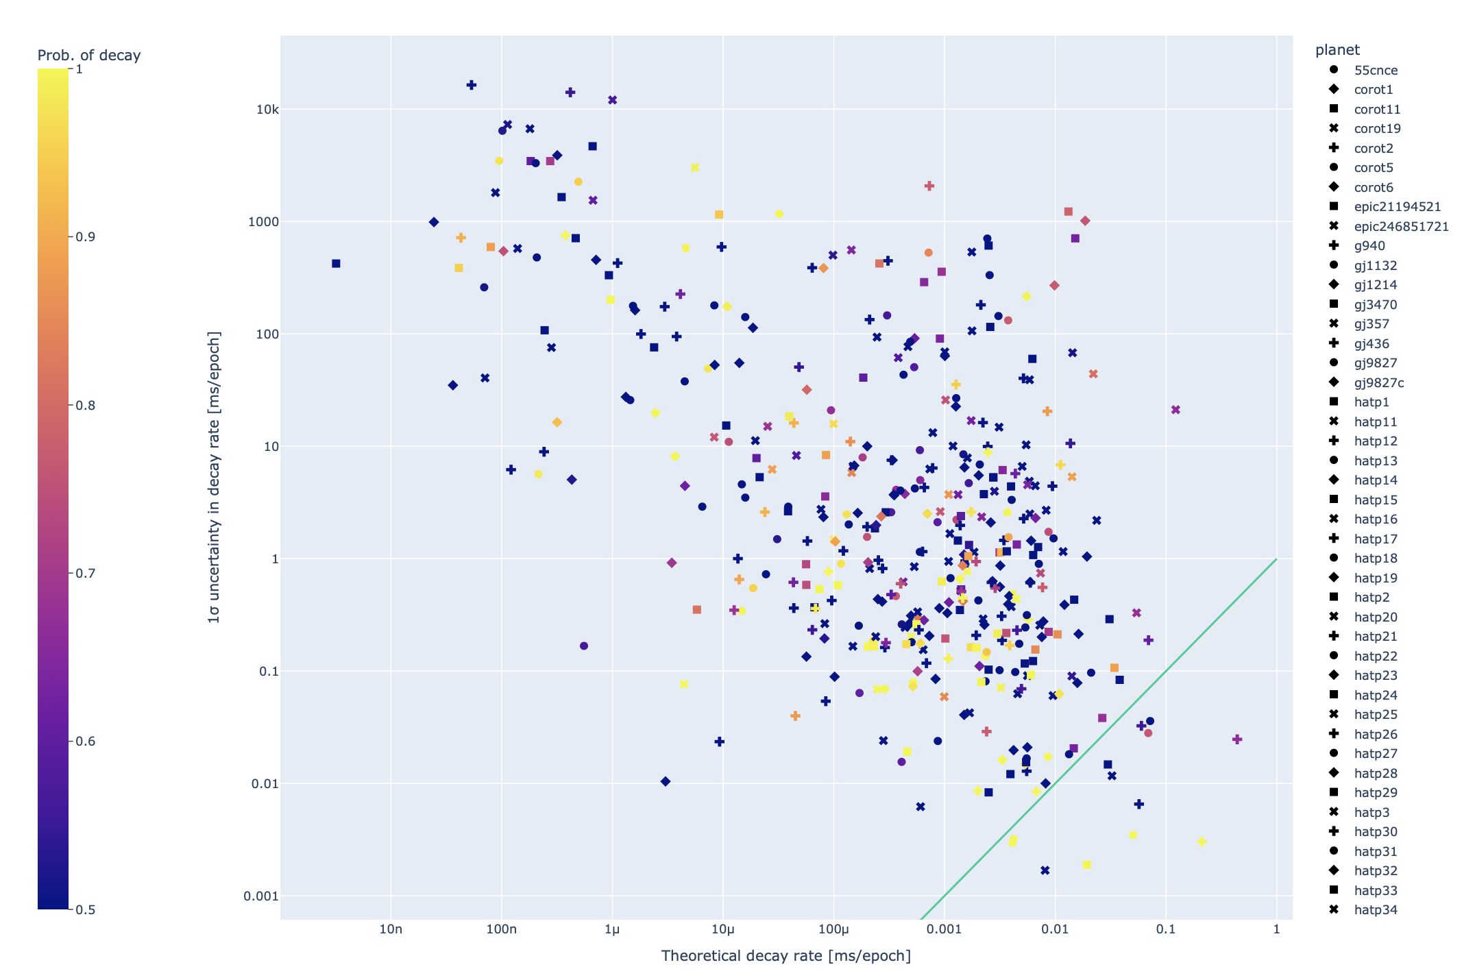
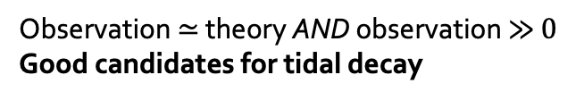
Results I: observations vs theory (442 planets)
Observation ≠ theory
Perhaps something else is going on?
Uncertainty > theory
These planets need further observing
WASP-19
WASP-4
TRES-3
TRES-3, WASP-4
WASP-18
WASP-12
Observation ≃ theory AND observation ≫ $0$
Good candidates for tidal decay
WASP-18
WASP-12
WASP-19
Notes:
Run through slide.
My assertion is that we want to investigate those systems that have high theoretical decay.
Those with low observed variance are hopefully confirmed to be decaying (yellow) or can be confirmed with some further measurement to bring down the observed variance.
If the uncertainty in decay rate is large, then the observed decays could well be within 3 sigma of the theoretical decay and it can be hard to distinguish correct from incorrect theory.
WASP-12 agrees bang on with theory, that is maybe not entirely surprising given I based the Q* used in the theoretical calculation off of the of—quoted result for WASP-12b
Or Q* values of 10**5.5 is inappropriate?
Let’s remove some troublesome datapoints at the extremes for the rest of the analysis
Multi-planet systems e.g. TOI-216
Planets with few transits e.g. WASP-184

Slide 11
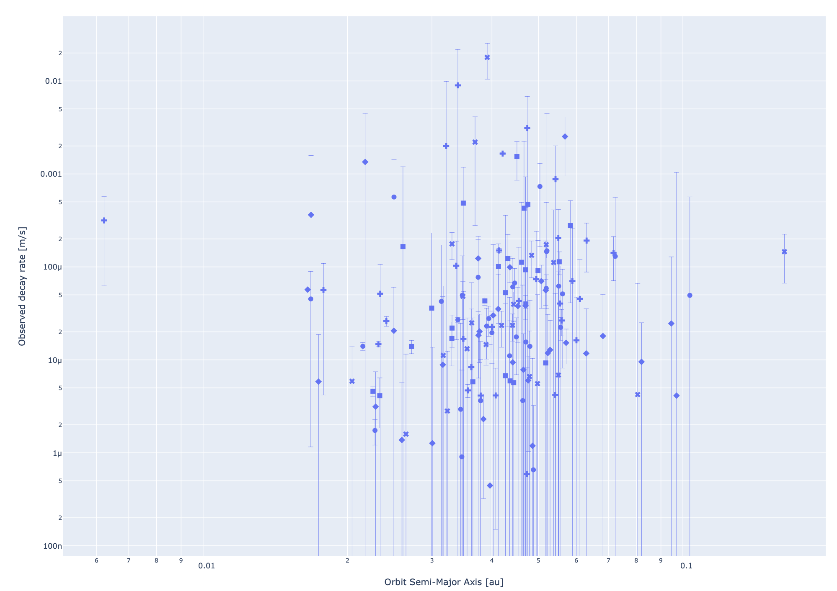
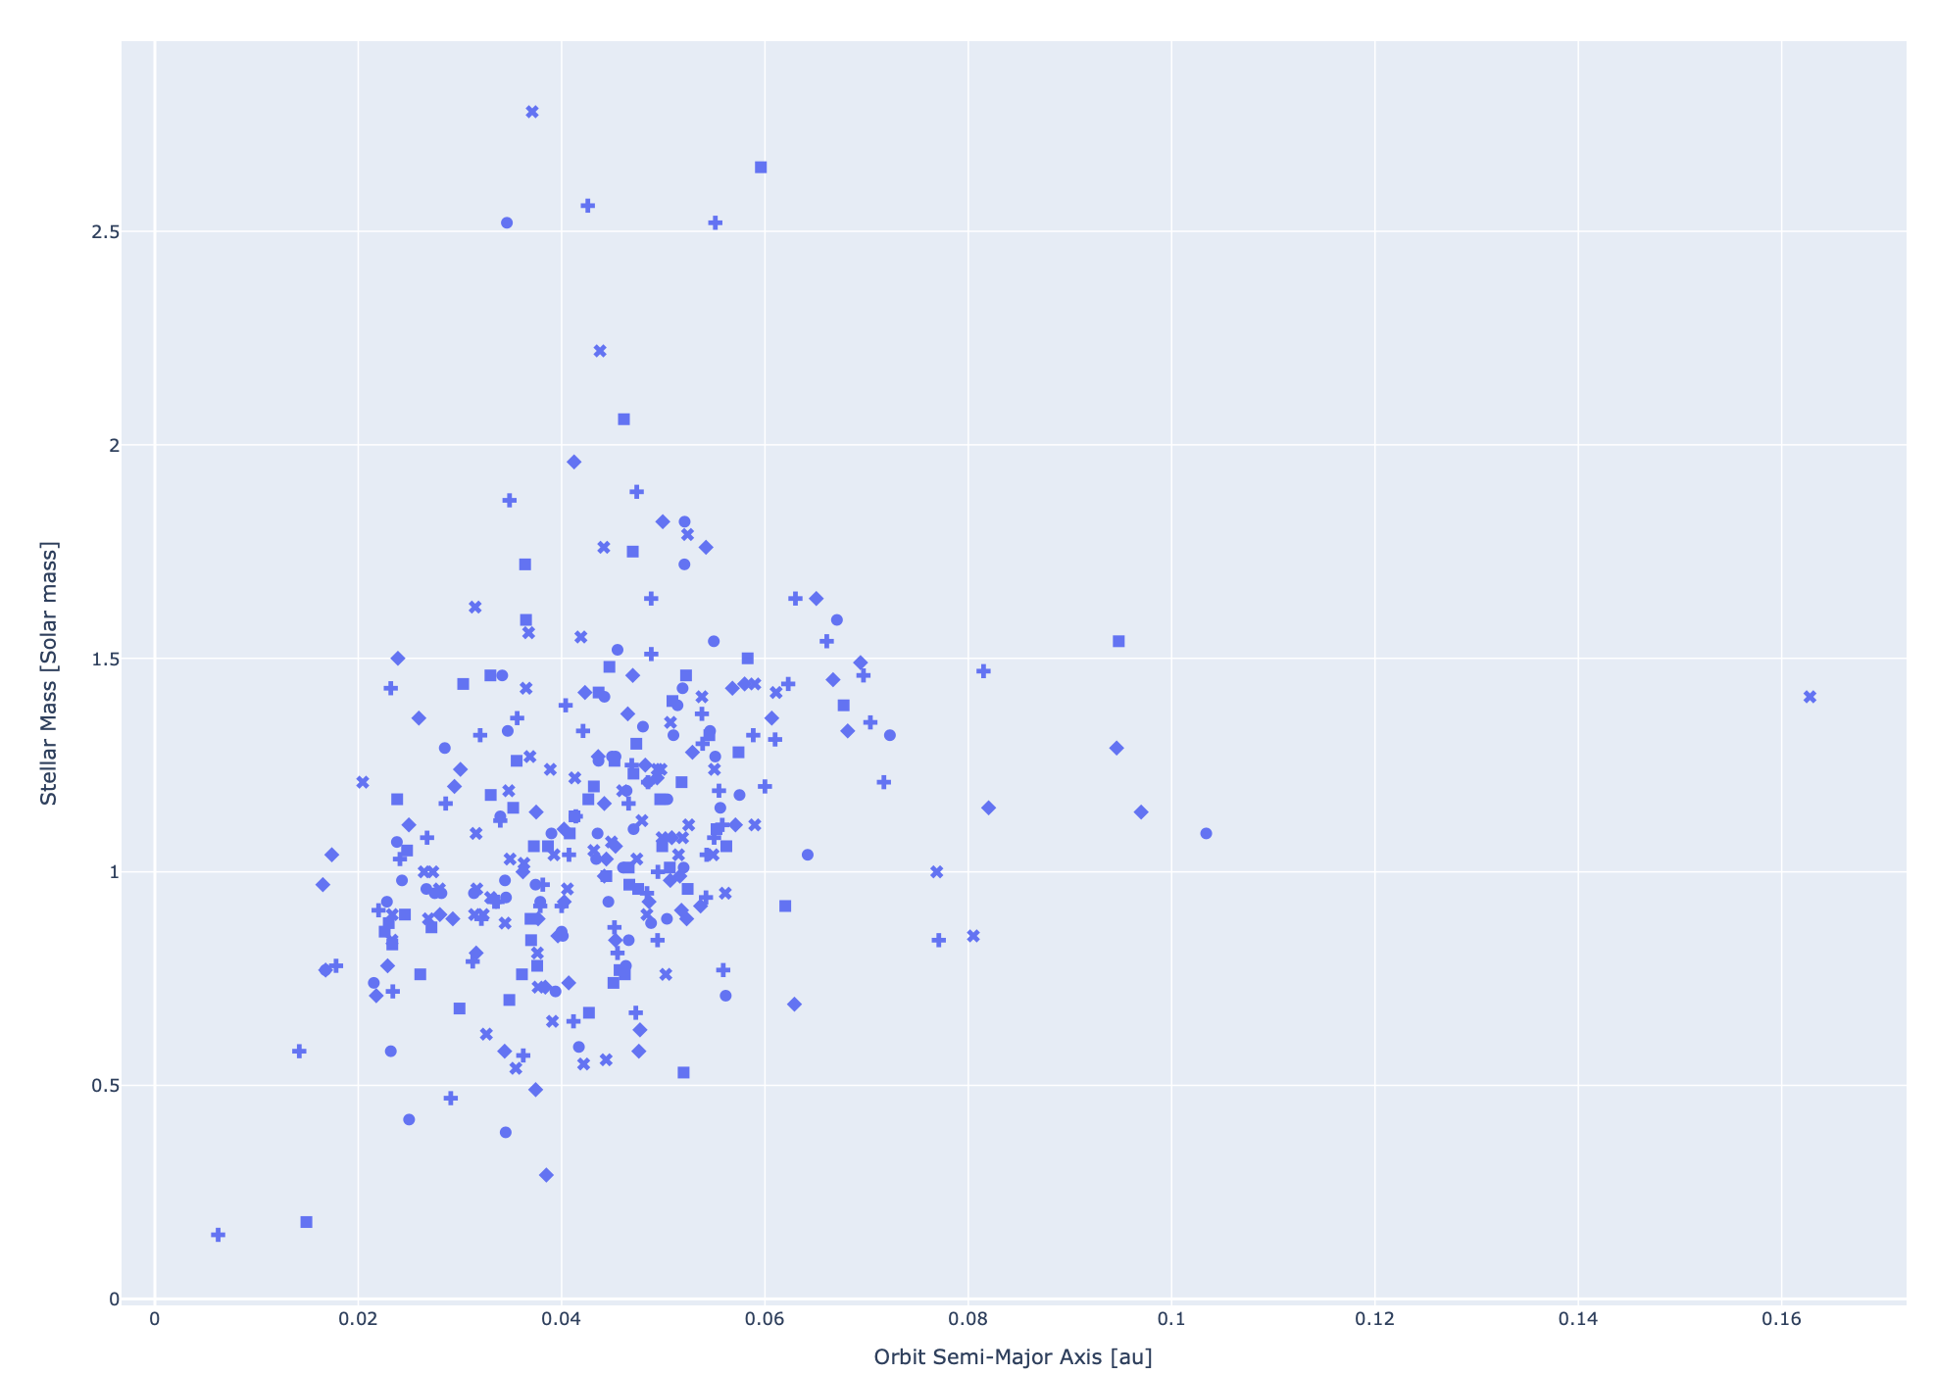
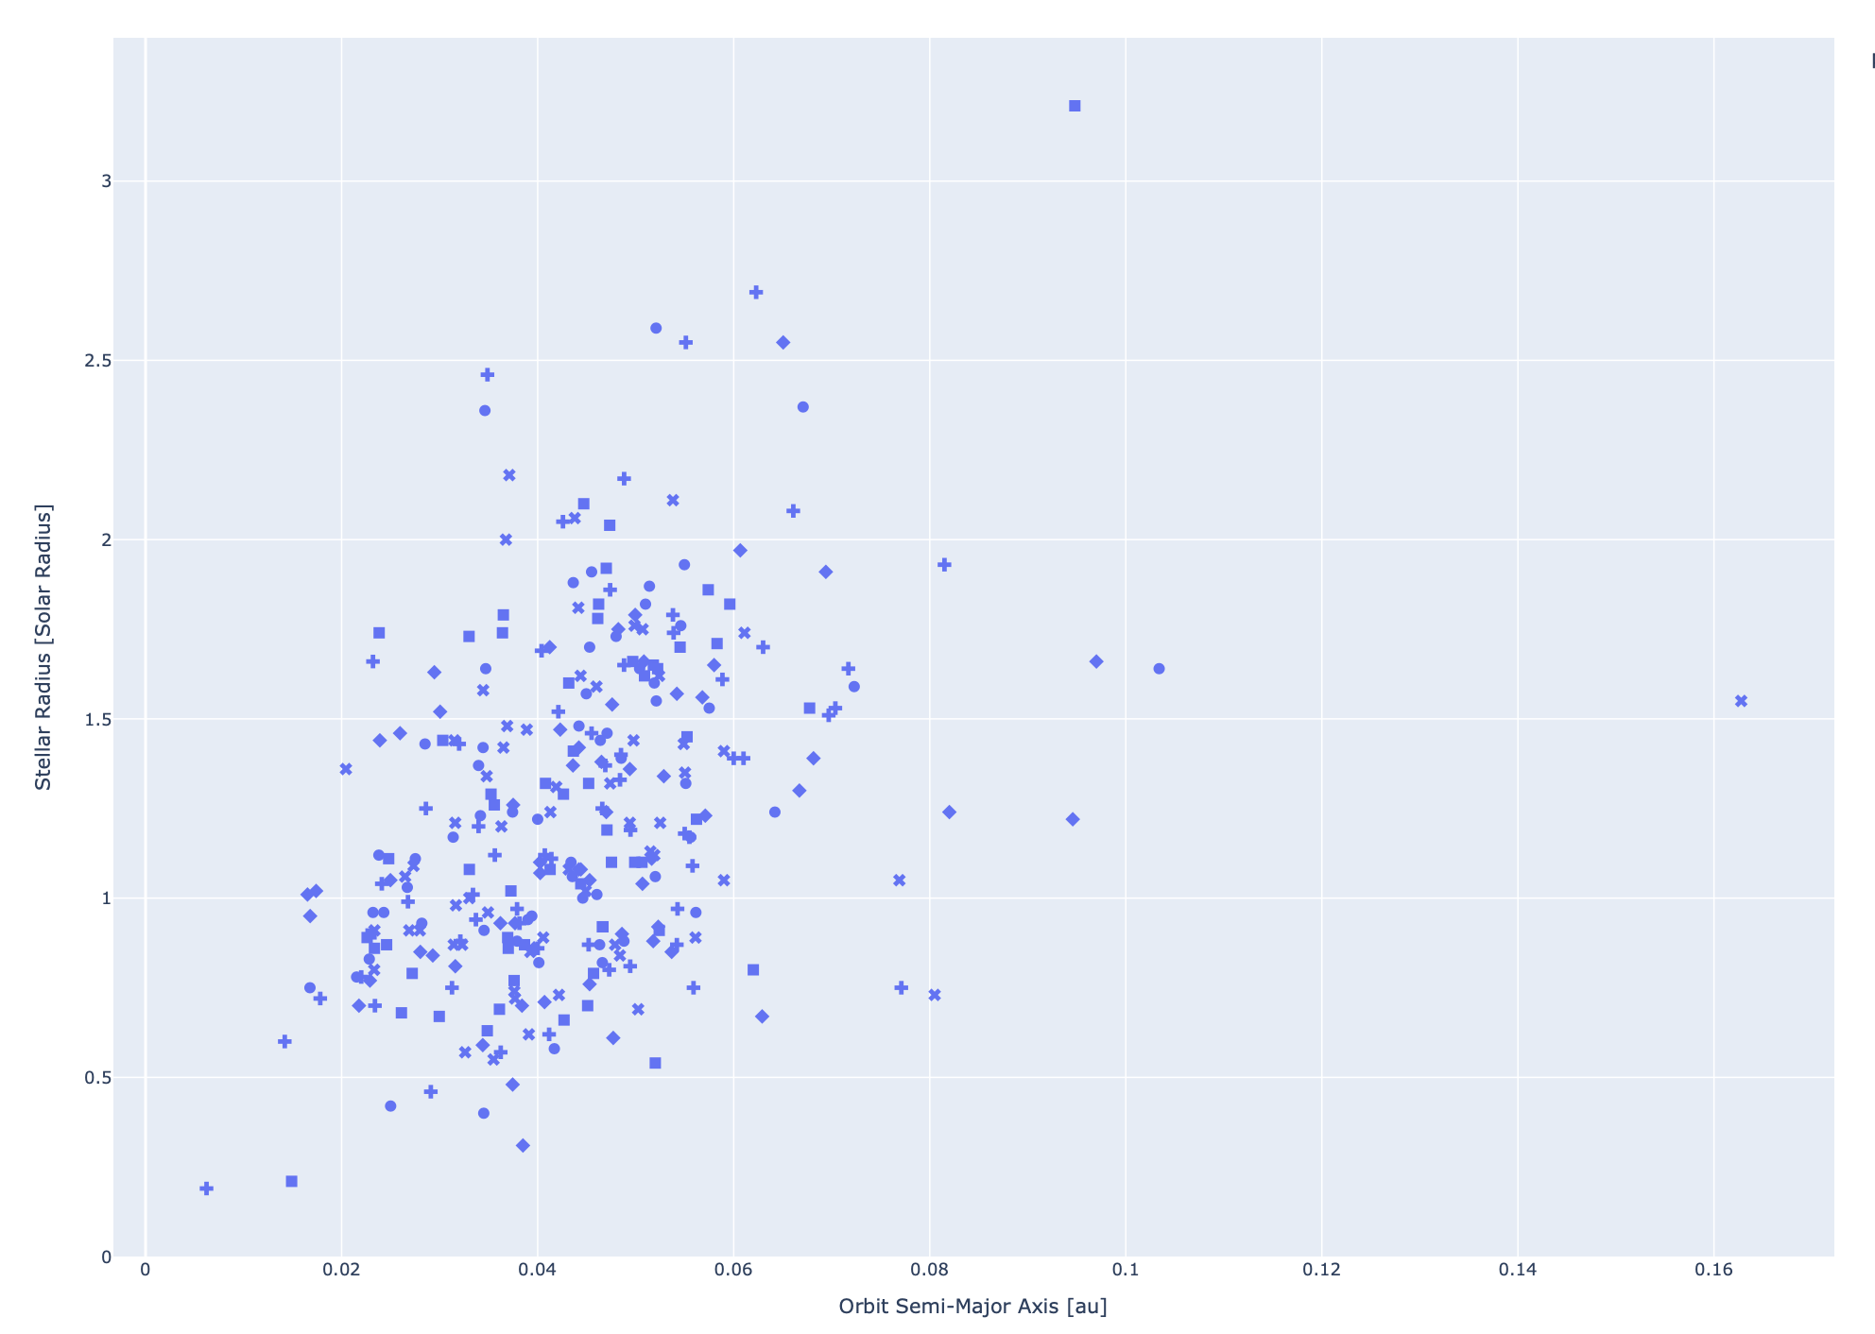
Results II: does decay rate drop off with distance?
For the rest of this analysis, I have removed:
Multi-planet systems e.g. TOI-216
Planets with few transits e.g. WASP-184
Notes:
We might expect a steep drop in decay rate with semi major axis, as predicted by that 1/a^5.5 term from the equation I showed. But we don’t actually see that in our observations. What’s going on?
There seems to be some kind of relationship between stellar radius and semi major axis. Given the R*^5 relationship with decay, it's very possible this is what's masking the effect of semi major axis.
Why could this be?
* Maybe we see fewer planets close to large, massive stars because they have already decayed into the star.
* It's hard to form large planets (the kind we are biased towards detecting with transits) around large, massive stars.
* Perhaps age, as the star gets larger? But this does not appear to be backed up by the plot of stellar age vs radius.

Slide 12
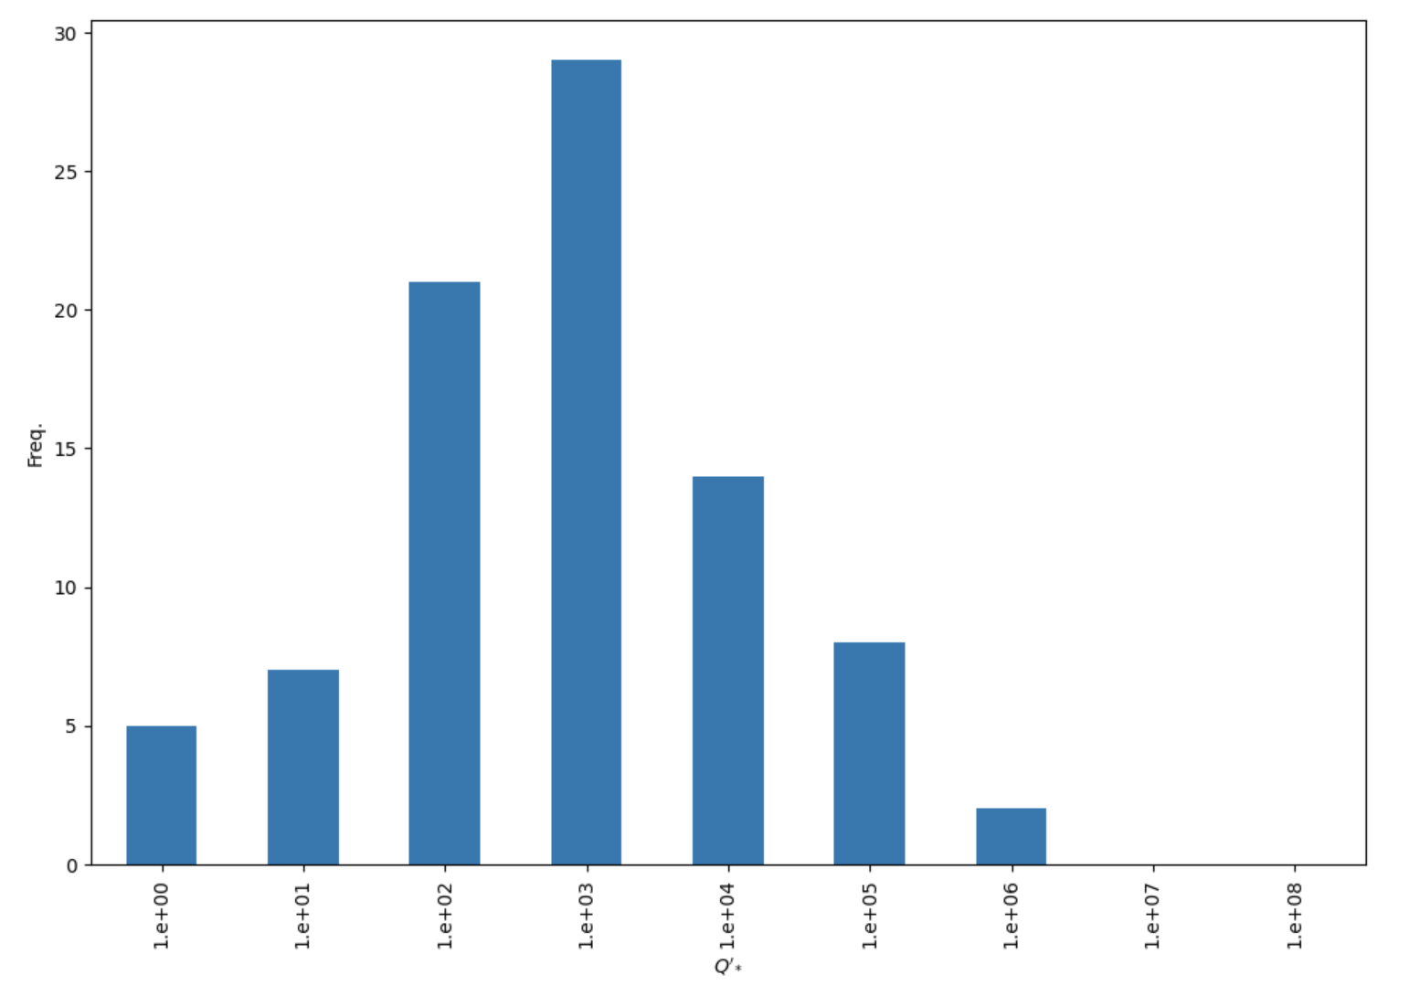
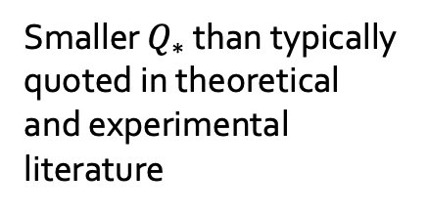
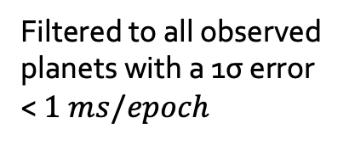
Results III: empirical distribution of $Q_{∗}$
Filtered to all observed planets with a 1σ error < $1 ms/epoch$
WASP-12 falls in the 10⁵ bucket
Smaller $Q_{∗}$ than typically quoted in theoretical and experimental literature

Slide 13
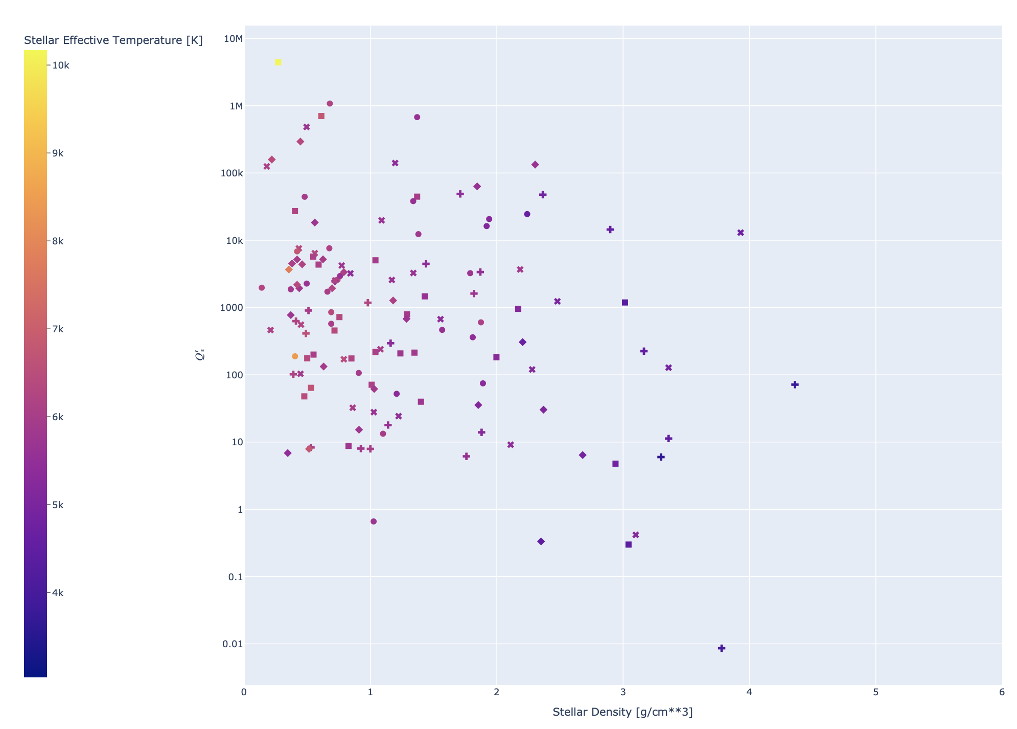
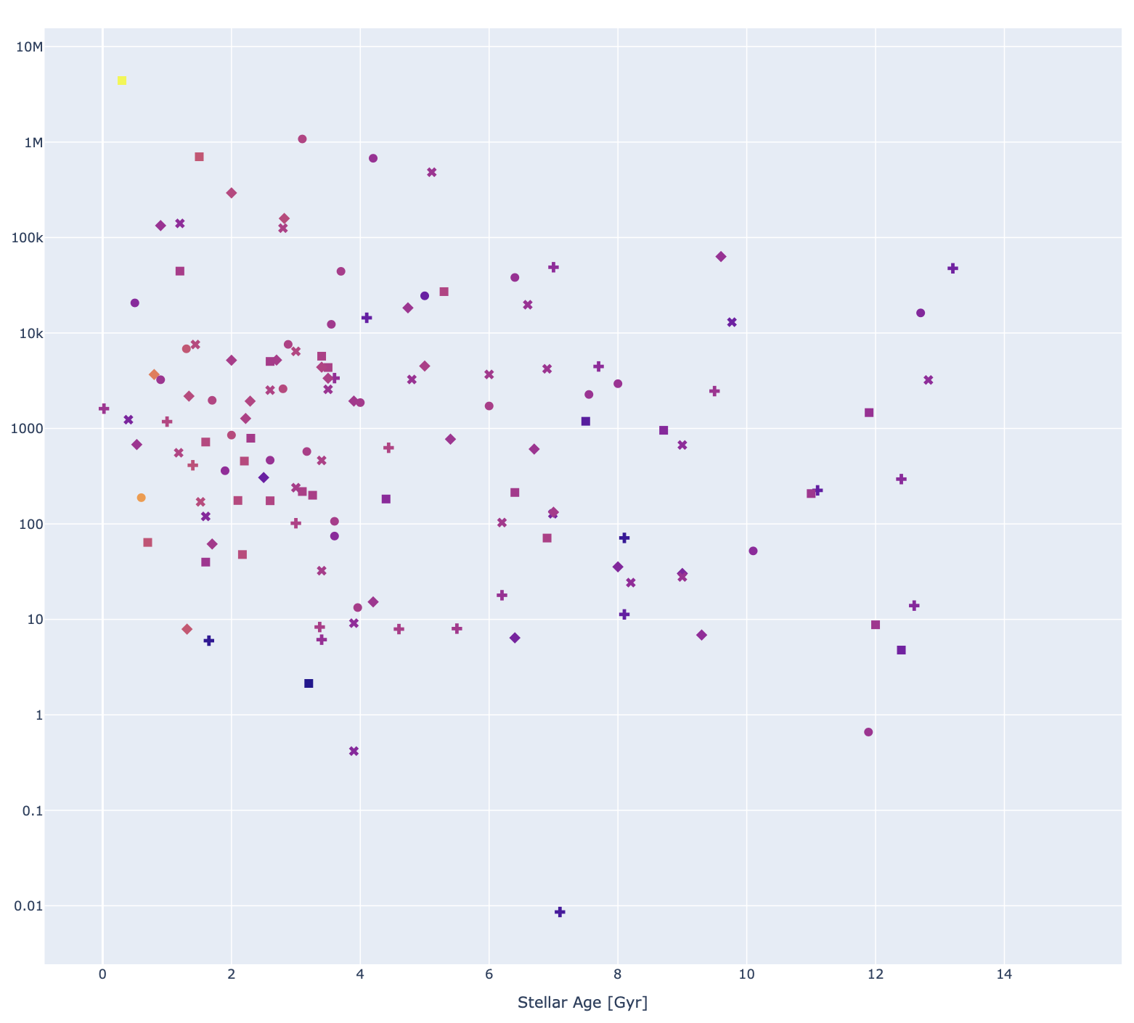
Results IV: how does $Q_{∗}$ relate to stellar properties
Notes:
Now for what we really want: how does Q* vary with stellar properties like density, effective temperature and age?
Denser stars tend to have lower tidal dissipation factors
Hotter stars tend to have higher tidal dissipation factors
Older stars, very roughly, maybe have lower tidal dissipation factors

Slide 14
But is it tidal decay? + other future work…
Are these relationships real? Are our assumptions okay?
Perhaps sometimes the data is simply too noisy and we are picking up false decay rates
Need to improve outlier detection and how the model can learn about larger than reported errors
Limit analysis only to systems where normality tests conclude a constant period model has statistically significant variation or to systems for which a decay fit is preferred to a constant period fit according to Bayes factors
Other physical phenomena might be at play
e.g. we might be missing phenomena that would cause sinusoidal TTVs like various forms of precession
If/once we gain confidence in the results, let’s compare the distribution of tidal dissipation factors with that predicted by theory
Inform new observational proposals
We can use these techniques to better understand how new transit measurements will affect constraints on decay rates and tidal dissipation factors

