Slide 1
ERTMS Route Business Case Results
9th November 2006
Slide 1

Slide 2
ERTMS Benefits
Long term capital cost reductions
Operations and maintenance cost reductions
Operational improvements including performance, bi-directional capability and as an enabler to improve use of capacity
Rail user benefits leading to an increase in revenue
  Time Improvement
  Crowding (disbenefit)
  Safety (ATP, track worker, level crossing)
  Reliability
Economic benefits including improvements in road congestion and road safety and environmental benefits
Interoperability (thus meeting the requirements of the EC Directives and associated UK law)
Slide 2

Slide 3
Route Business Cases
Assumptions
For the route business cases, the following assumptions have been made:
  Migration costs have been excluded
  Development costs have been excluded
  A number of freight vehicles have been included as a minimum subfleet, based upon the maximum trains per day along the route (source: Freight RUS data) plus an allowance for maintenance and operational reasons.
  A percentage of On Track Plant will be included (currently none)
  Results are currently unrisked, however risk and optimism bias will be applied (three separate results will be shown as per the DfT report)
  Appraisal period is set such that second-cycle System D costs are not picked up
  Updated train unit costs have been included (October 2006)
For the sub national case, the appraisal period will be 60 years (because it is a programme of work), and migration and development costs will be added.
Slide 3

Slide 4
Changes from DfT Submission Assumptions
Two initiatives have focused on updating the unit cost profile for ERTMS:
  System Architecture Changes
  Cost Profile Changes
Two primary data sources have been used:
  Cambrian Tender
  Meetings with Suppliers
Other cost changes will be included as part of the business case sensitivity analysis:
  Cost reductions that have not been validated by suppliers but have been identified and robustly assessed by the team
    New Train Costs
    Improvements in spares and operational costs as a result of procurement strategy
    Cost reductions resulting from volume and maturity
    Common cost reductions resulting from ERTMS
Slide 4

Slide 5
Changes from DfT Submission Assumptions – continued
The following changes have been made in the unit cost model:
  System architecture changes
    1 x EVC required for 5-car Multiple Units (or shorter)
    2 x Balise Antennas for K2 type vehicles
  Software design costs are fixed at £100k per CLASS, rather than included in the equipment prices
    Some cost reduction per train, but depends on the number of trains per class per route
    Key cost reduction in terms of absolute spares costs as previously this was 20% of hardware and software
  Hardware costs updated to reflect latest supplier quotes, using an ‘averaging approach’
  Increase in Test & Commissioning Costs
  Increase in Approvals Costs (for retrofit)
Further clarification is needed in relation to:
  Maintenance system
  Retrofit costs, including through vehicle conduit
The changes will be reviewed by Vehicle Interface Group (VIG)
Slide 5

Slide 6
Definitions
Signalling Definitions:
  ‘S’ is a full conventional renewal with replacement of signalling equipment including structures and control centre. Scheme designed from scratch to current standards
  ‘SFS’ is a full like-for-like conventional renewal of an existing SSI interlocking including external cables, equipment and the control panel/VDU, but not including replacement of major structures
  ‘SXR’ is the renewal of a conventional interlocking with SSI, without renewal of external cables or equipment. The existing control centre and panel/VDU is retained
  ‘OEO’ is Outside Equipment Only, typically required 10 years after the renewal/life extension of an interlocking
  ‘MECH’ are mechanical interlockings/gate cabins, which do not require renewal in the conventional plan (only life extension)
Conventional plan dates and systems are taken from the signalling workbank as at June 2006
Slide 6

Slide 7
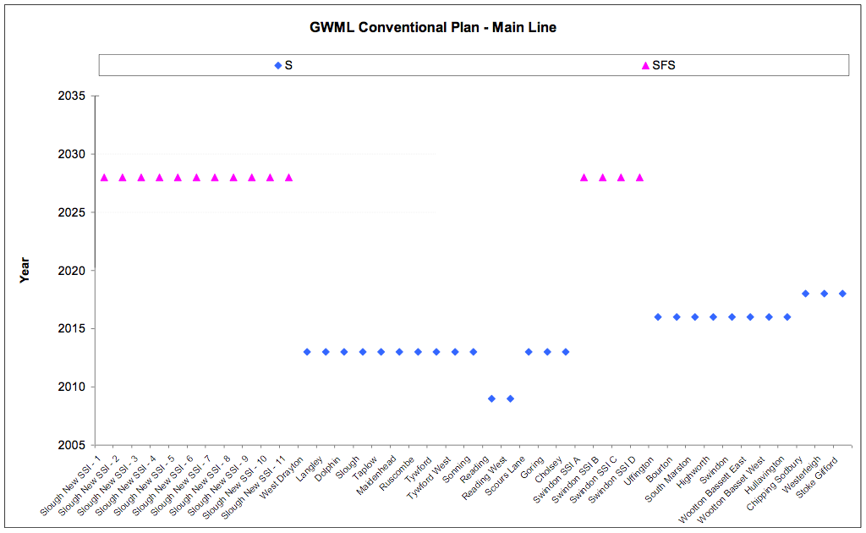
GWML Implementation Plan – Conventional
Conventional
GWML
Slide 7

Slide 8
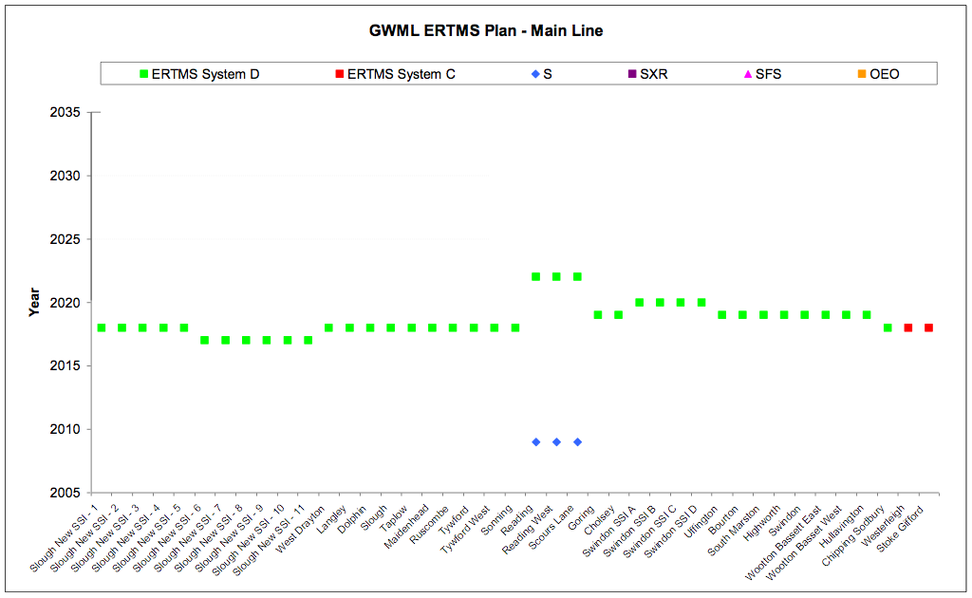
The ERTMS Implementation Plan fits System D to most of the main line by 2020…
GWML
Slide 8

Slide 9
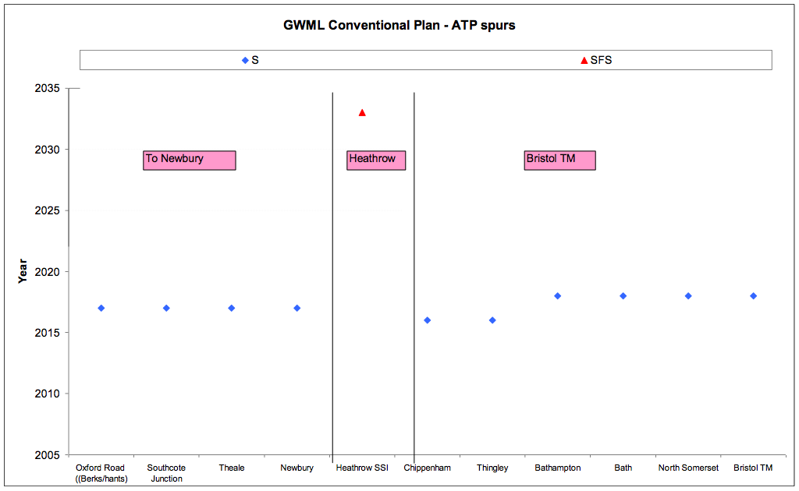
…and the ATP fitted spurs
Conventional
GWML
Slide 9

Slide 10
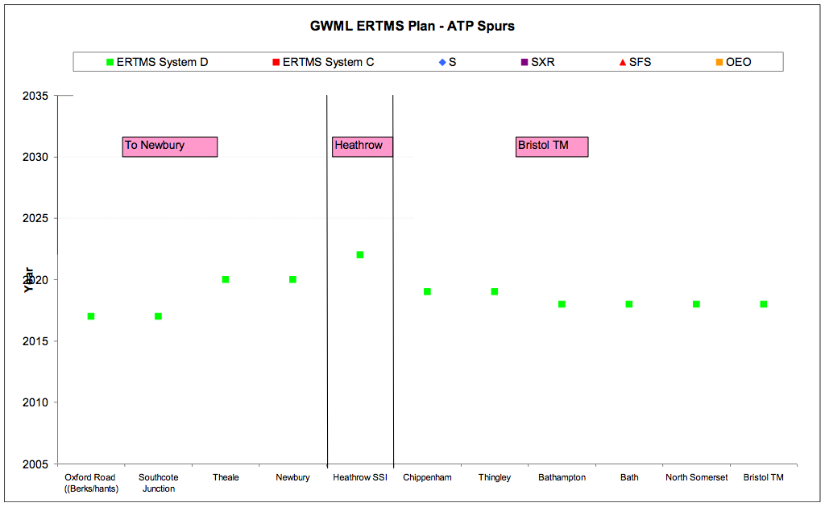
… also fitting the lines to Newbury, Heathrow and Bristol Temple Meads…
GWML
Slide 10

Slide 11
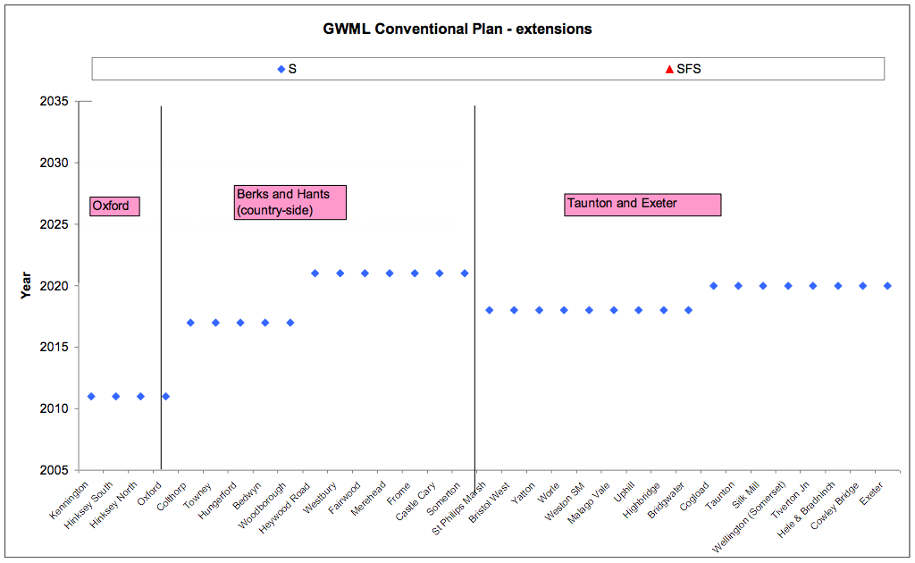
…and extensions
Conventional
GWML
Slide 11

Slide 12
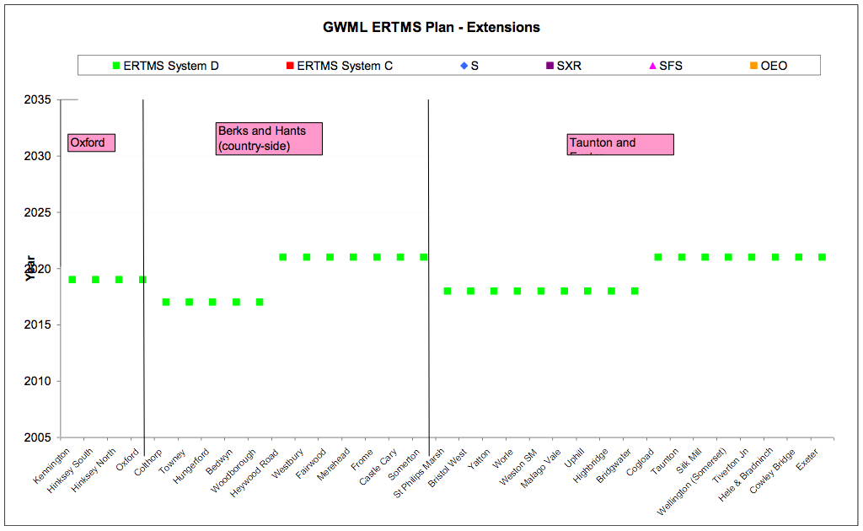
… and to Oxford, the Berks & Hants line, and to Exeter as all trains will have been fitted with ERTMS
GWML
Slide 12

Slide 13
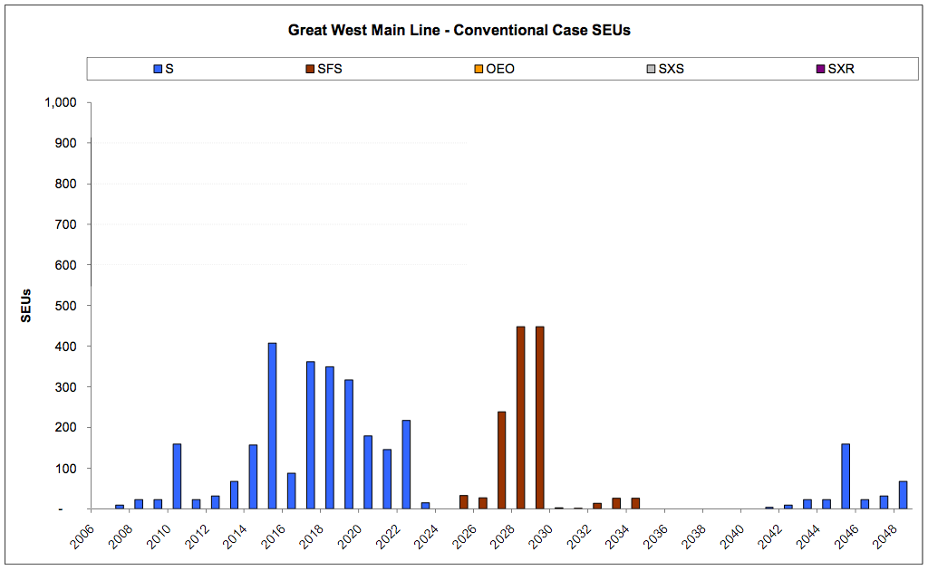
GWML Conventional Signalling – SEUs per year
Conventional
GWML
Slide 13

Slide 14
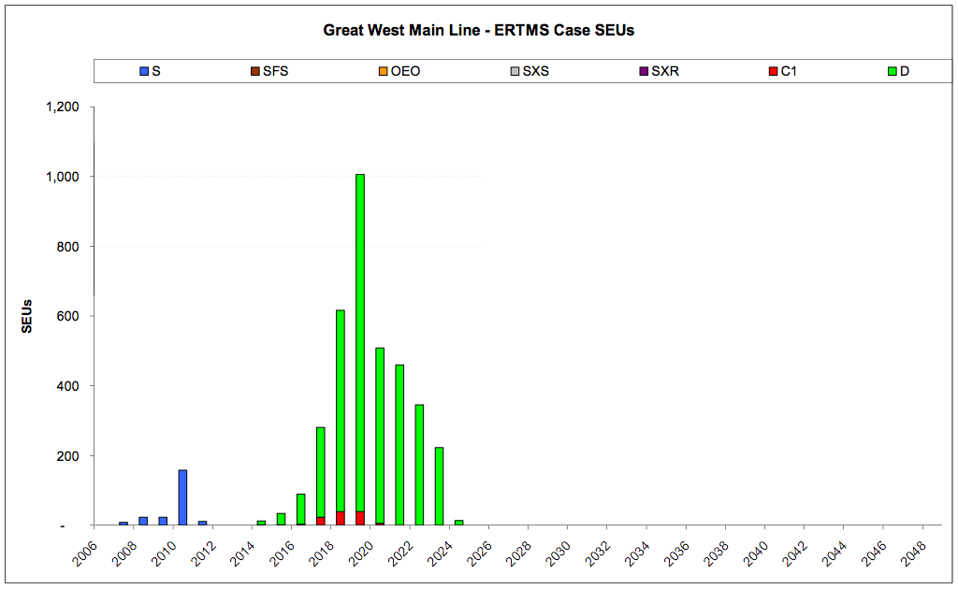
Delivery of ERTMS (trackside) in SEUs for the wider area
ERTMS
GWML
Slide 14

Slide 15

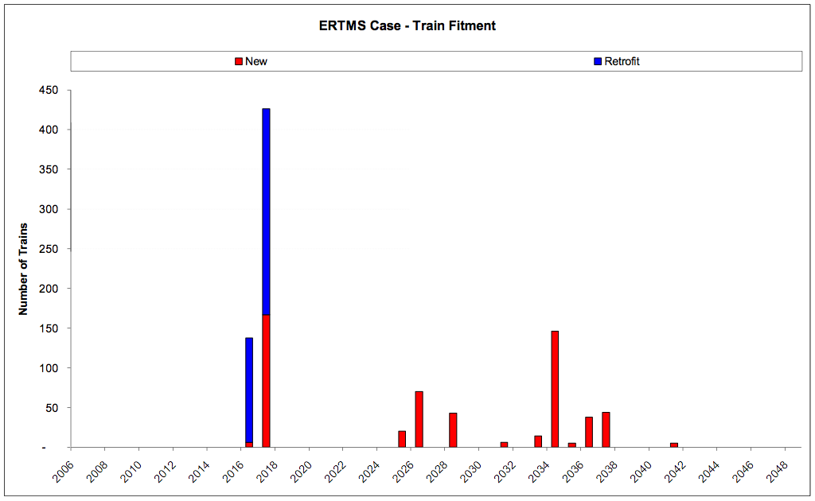
Implementation Plan – Train Fitment (reduced freight)
ERTMS
GWML
Slide 15

Slide 16
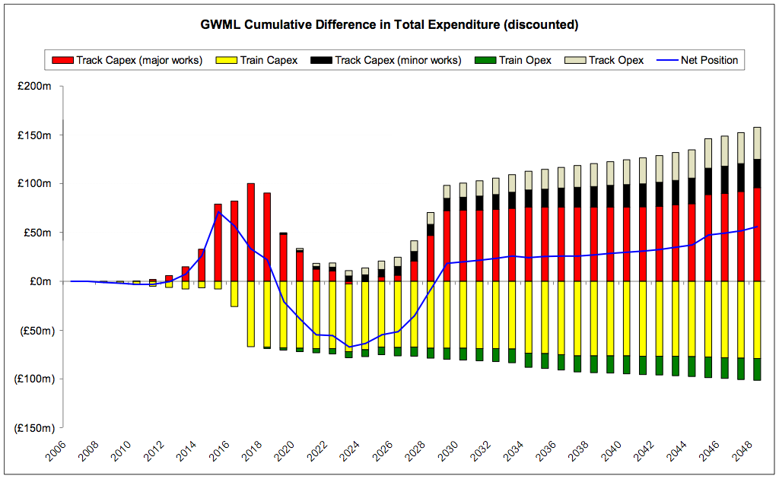
The discounted, not risked cost position (excluding benefits) breaks even by 2029
GWML
Reduced freight
Draft
Slide 16

