Slide 1
ERTMS Route Business Case Results
9th November 2006

Slide 2
ERTMS Benefits
Long term capital cost reductions
Operations and maintenance cost reductions
Operational improvements including performance, bi-directional capability and as an enabler to improve use of capacity
Rail user benefits leading to an increase in revenue
  Time Improvement
  Crowding (disbenefit)
  Safety (ATP, track worker, level crossing)
  Reliability
Economic benefits including improvements in road congestion and road safety and environmental benefits
Interoperability (thus meeting the requirements of the EC Directives and associated UK law)

Slide 3
Route Business Cases
Assumptions
For the route business cases, the following assumptions have been made:
  Migration costs have been excluded
  Development costs have been excluded
  A number of freight vehicles have been included as a minimum subfleet, based upon the maximum trains per day along the route (source: Freight RUS data) plus an allowance for maintenance and operational reasons.
  A percentage of On Track Plant will be included (currently none)
  Results are currently unrisked, however risk and optimism bias will be applied (three separate results will be shown as per the DfT report)
  Appraisal period is set such that second-cycle System D costs are not picked up
  Updated train unit costs have been included (October 2006)
For the sub national case, the appraisal period will be 60 years (because it is a programme of work), and migration and development costs will be added.

Slide 4
Changes from DfT Submission Assumptions
Two initiatives have focused on updating the unit cost profile for ERTMS:
  System Architecture Changes
  Cost Profile Changes
Two primary data sources have been used:
  Cambrian Tender
  Meetings with Suppliers
Other cost changes will be included as part of the business case sensitivity analysis:
  Cost reductions that have not been validated by suppliers but have been identified and robustly assessed by the team
    New Train Costs
    Improvements in spares and operational costs as a result of procurement strategy
    Cost reductions resulting from volume and maturity
    Common cost reductions resulting from ERTMS

Slide 5
Changes from DfT Submission Assumptions – continued
The following changes have been made in the unit cost model:
  System architecture changes
    1 x EVC required for 5-car Multiple Units (or shorter)
    2 x Balise Antennas for K2 type vehicles
  Software design costs are fixed at £100k per CLASS, rather than included in the equipment prices
    Some cost reduction per train, but depends on the number of trains per class per route
    Key cost reduction in terms of absolute spares costs as previously this was 20% of hardware and software
  Hardware costs updated to reflect latest supplier quotes, using an ‘averaging approach’
  Increase in Test & Commissioning Costs
  Increase in Approvals Costs (for retrofit)
Further clarification is needed in relation to:
  Maintenance system
  Retrofit costs, including through vehicle conduit
The changes will be reviewed by Vehicle Interface Group (VIG)

Slide 6
Definitions
Signalling Definitions:
  ‘S’ is a full conventional renewal with replacement of signalling equipment including structures and control centre. Scheme designed from scratch to current standards
  ‘SFS’ is a full like-for-like conventional renewal of an existing SSI interlocking including external cables, equipment and the control panel/VDU, but not including replacement of major structures
  ‘SXR’ is the renewal of a conventional interlocking with SSI, without renewal of external cables or equipment. The existing control centre and panel/VDU is retained
  ‘OEO’ is Outside Equipment Only, typically required 10 years after the renewal/life extension of an interlocking
  ‘MECH’ are mechanical interlockings/gate cabins, which do not require renewal in the conventional plan (only life extension)
Conventional plan dates and systems are taken from the signalling workbank as at June 2006

Slide 7
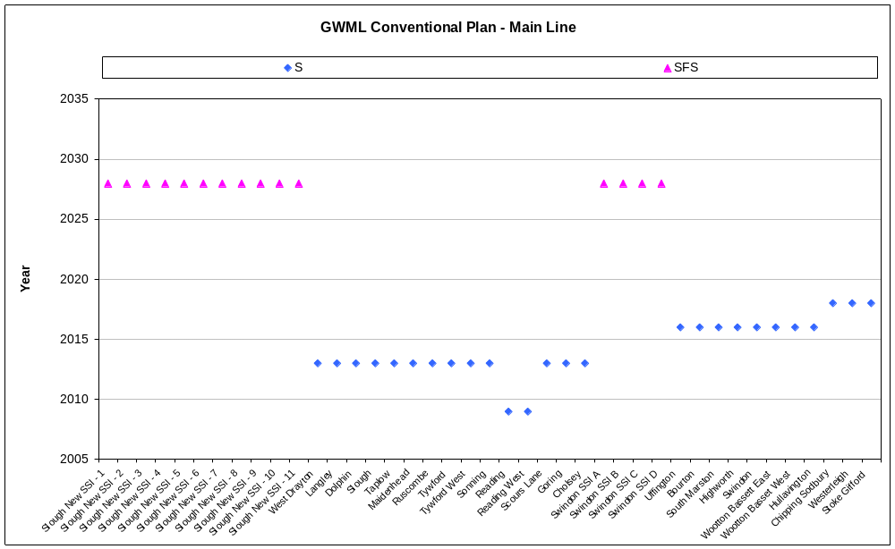
GWML Implementation Plan – Conventional
Conventional
GWML

Slide 8
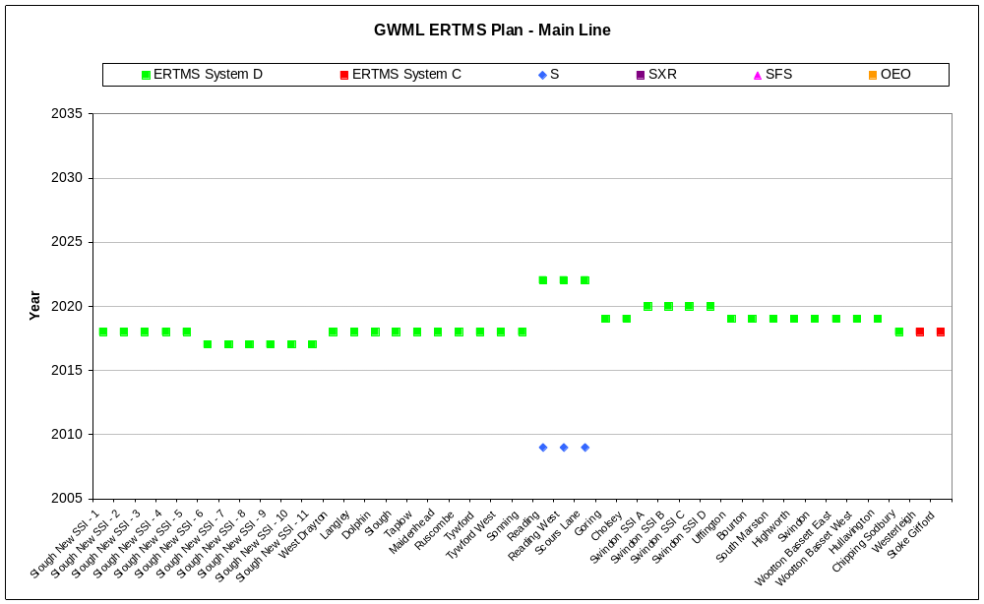
The ERTMS Implementation Plan fits System D to most of the main line by 2020…
GWML

Slide 9
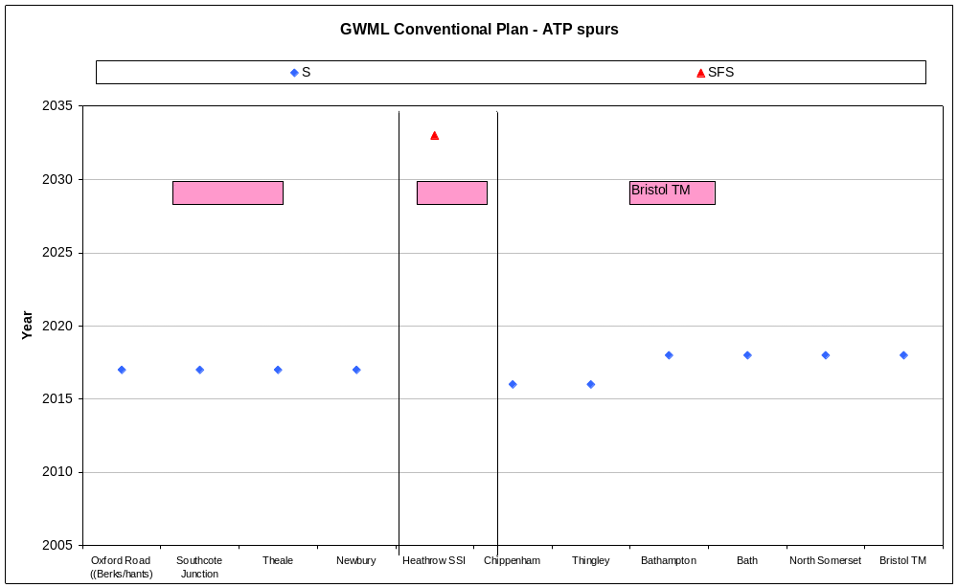
…and the ATP fitted spurs
Conventional
GWML

Slide 10
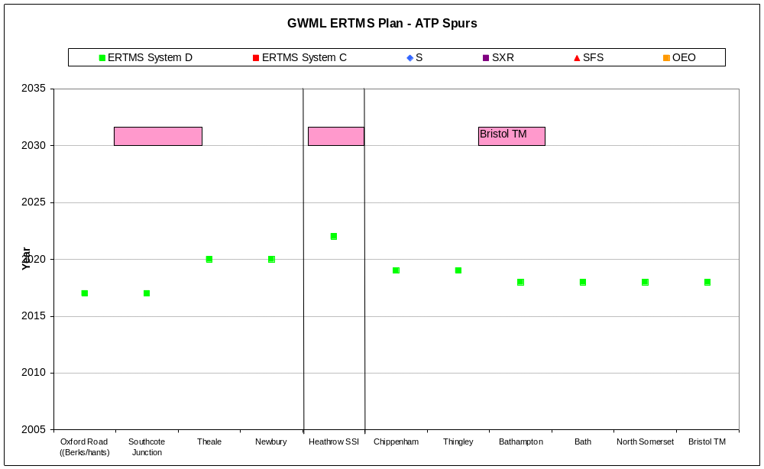
… also fitting the lines to Newbury, Heathrow and Bristol Temple Meads…
GWML

Slide 11
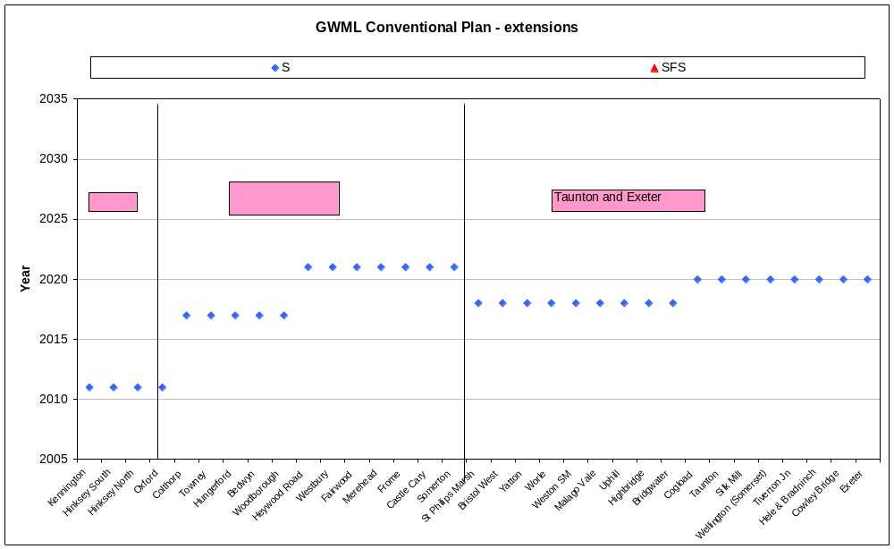
…and extensions
Conventional
GWML

Slide 12
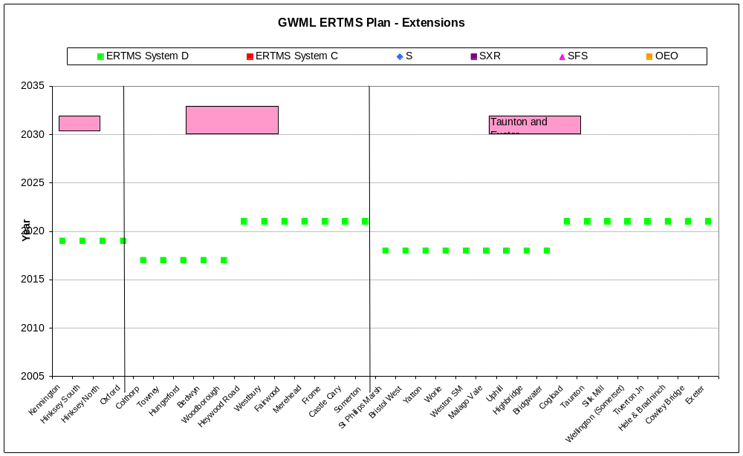
… and to Oxford, the Berks & Hants line, and to Exeter as all trains will have been fitted with ERTMS
GWML

Slide 13
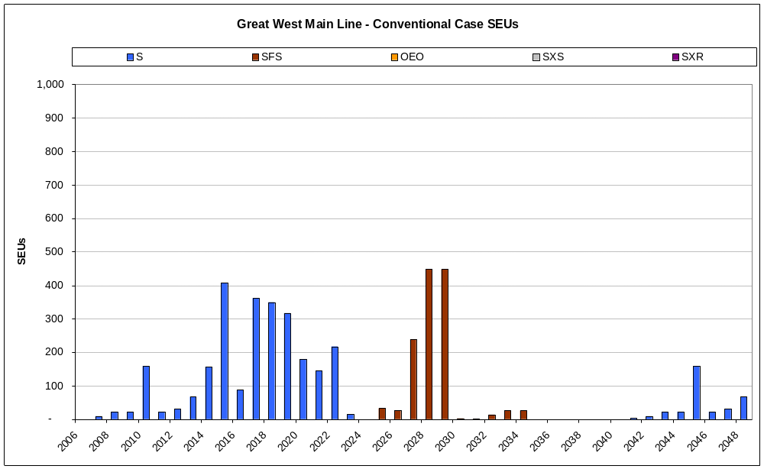
GWML Conventional Signalling – SEUs per year
Conventional
GWML

Slide 14
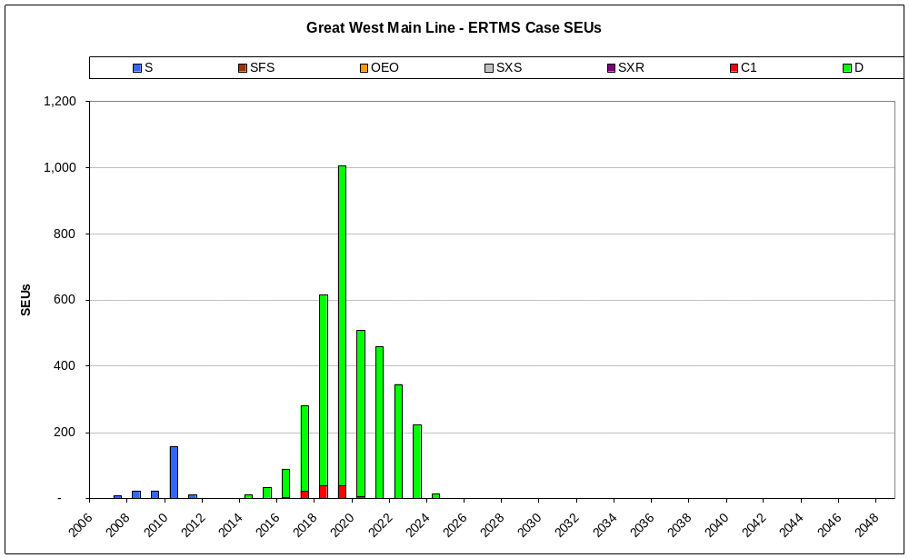
Delivery of ERTMS (trackside) in SEUs for the wider area
ERTMS
GWML

Slide 15
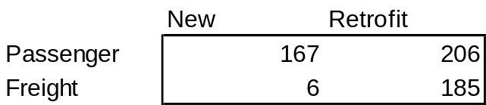
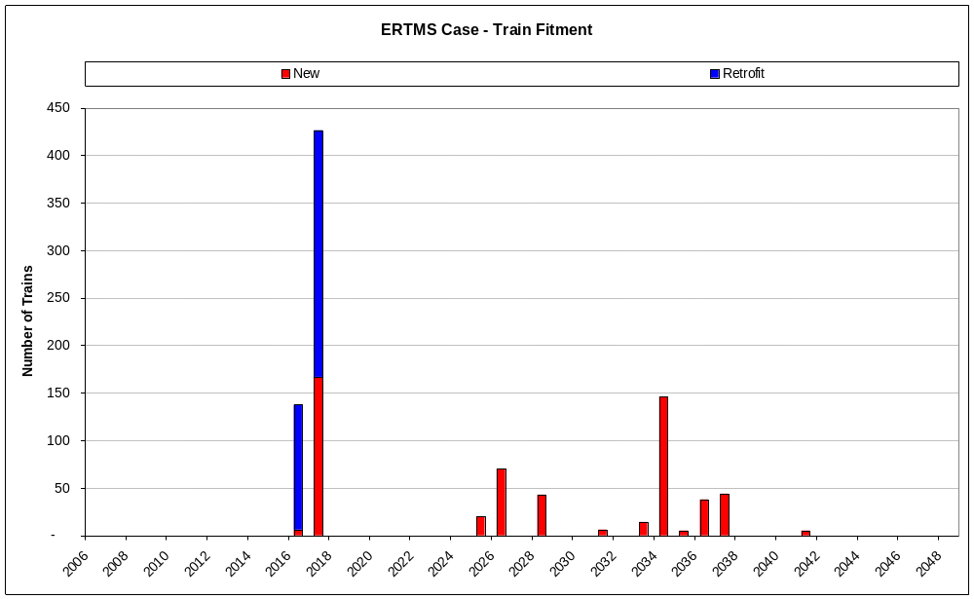
Implementation Plan – Train Fitment (reduced freight)
ERTMS
GWML

Slide 16
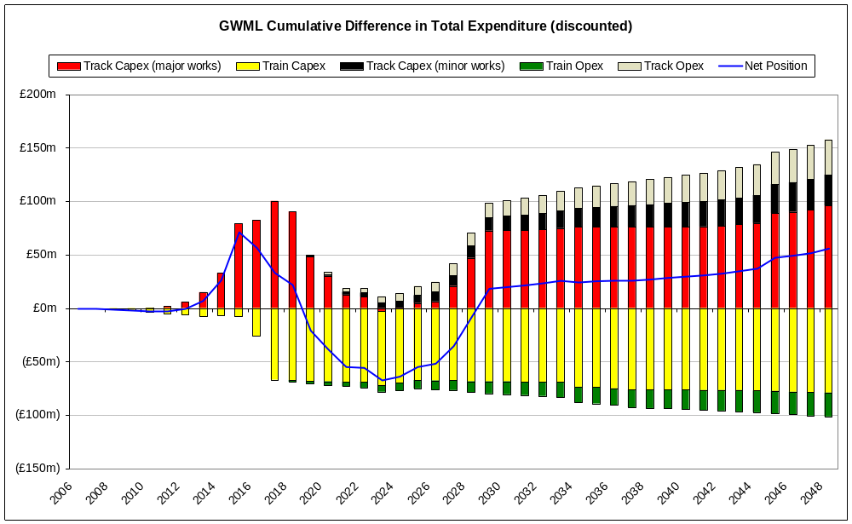
The discounted, not risked cost position (excluding benefits) breaks even by 2029
GWML
Reduced freight
Draft

Slide 17
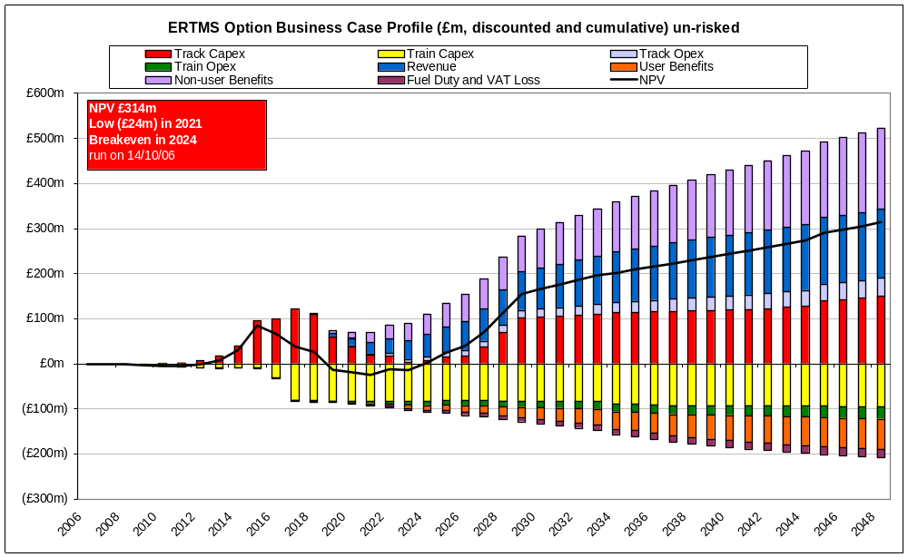
The NPV curve shows that break-even can be achieved in 2024 (unrisked), 7 years after the first System D fitment
GWML
Draft

Slide 18
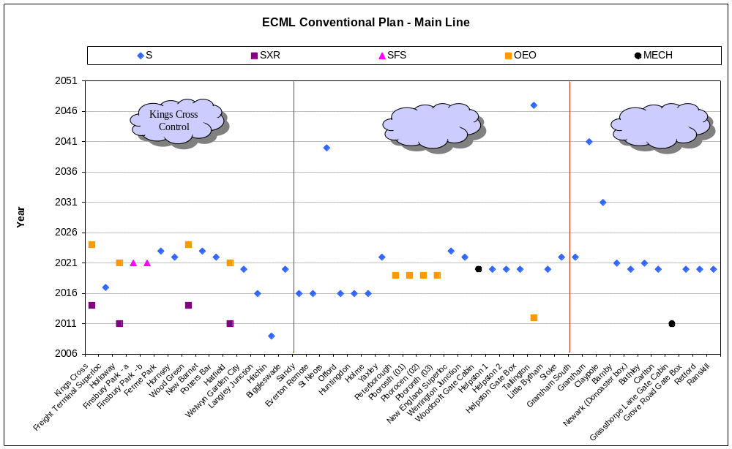
ECML Conventional Signalling Plan – Main Line
ECML

Slide 19
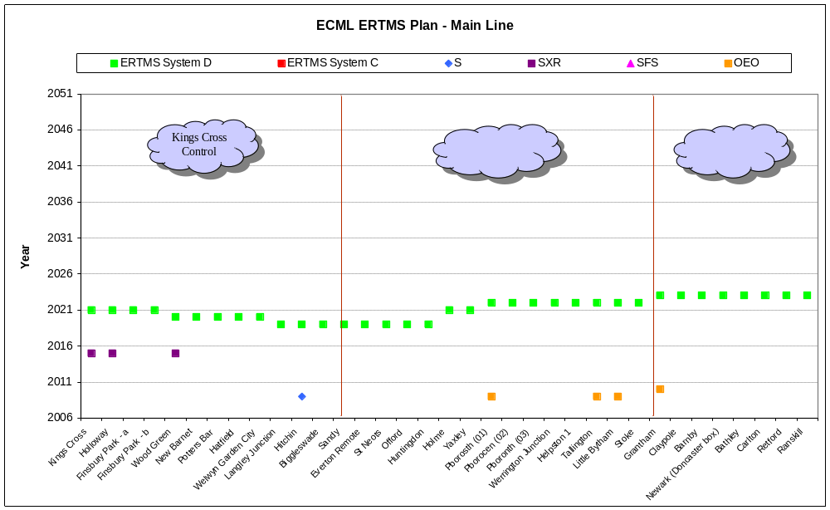
The ERTMS implementation plan fits Kings Cross by 2021 and the remainder of the main line by 2023…
ECML

Slide 20
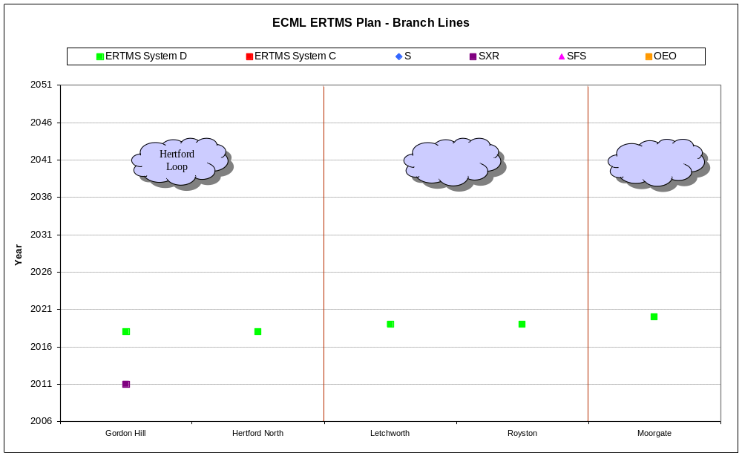
… with the Hertford Loop being the first route implementation of System D in 2018
ECML

Slide 21
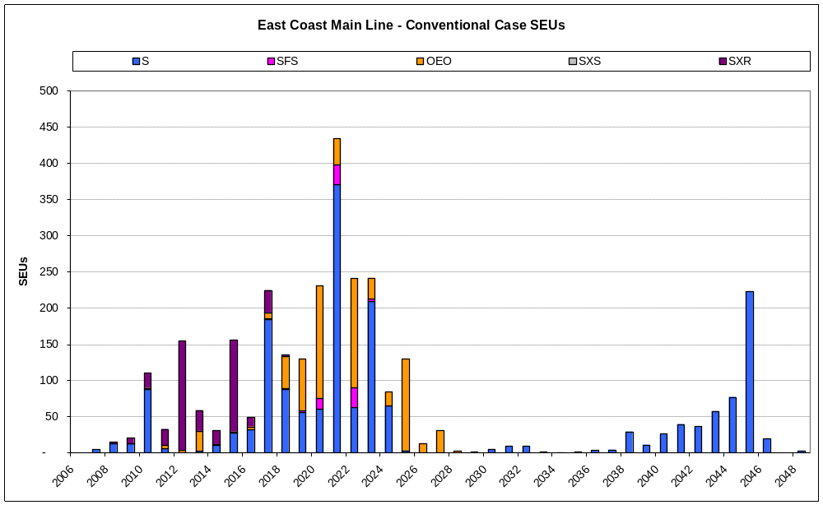
ECML Conventional Signalling – SEUs per year
ECML

Slide 22
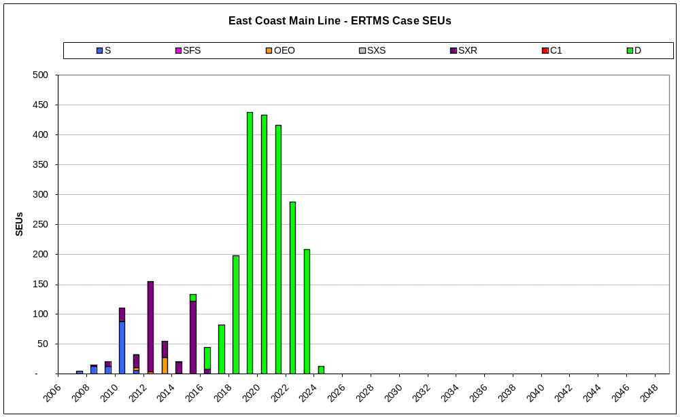
ECML ERTMS Implementation Plan – SEUs per year
ECML

Slide 23
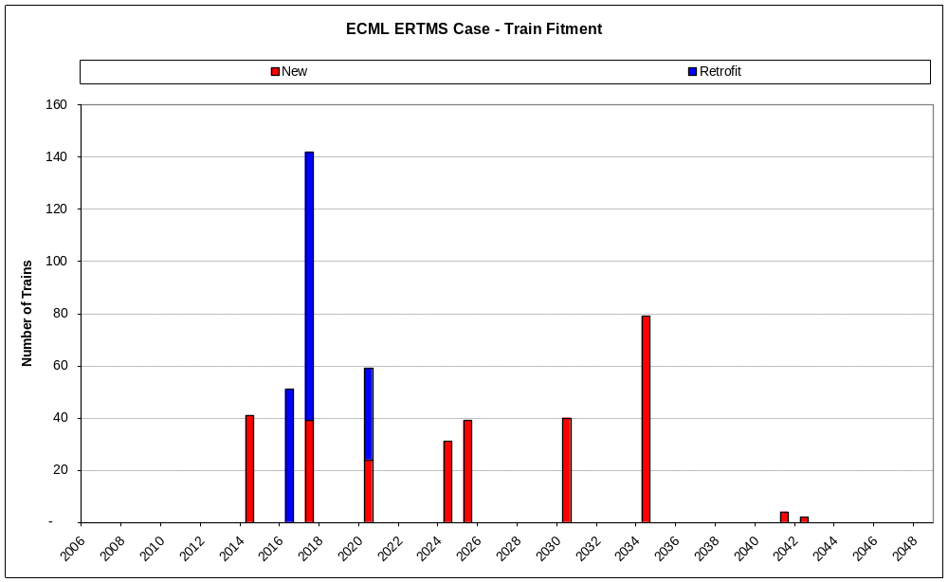
ECML ERTMS Implementation Plan – Train
Fitment
ECML
100 freight trains fitted
199 passenger trains fitted

Slide 24
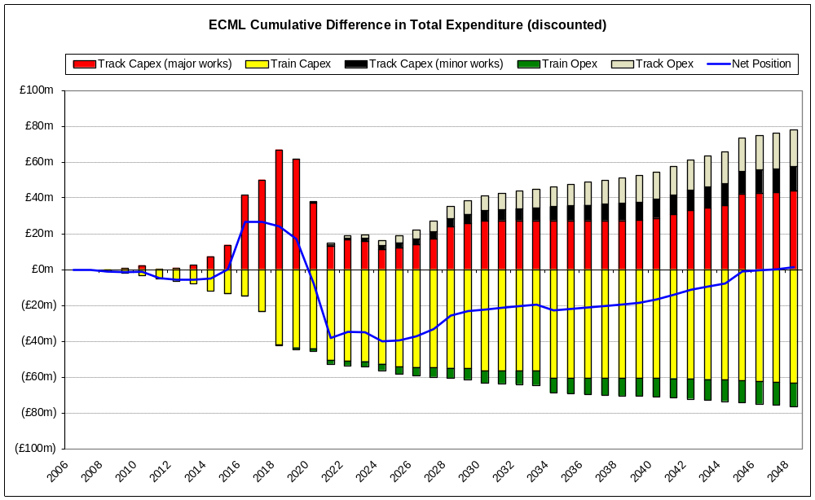
The discounted, not risked cost position
(excluding benefits) breaks even in 2048
ECML
Draft

Slide 25
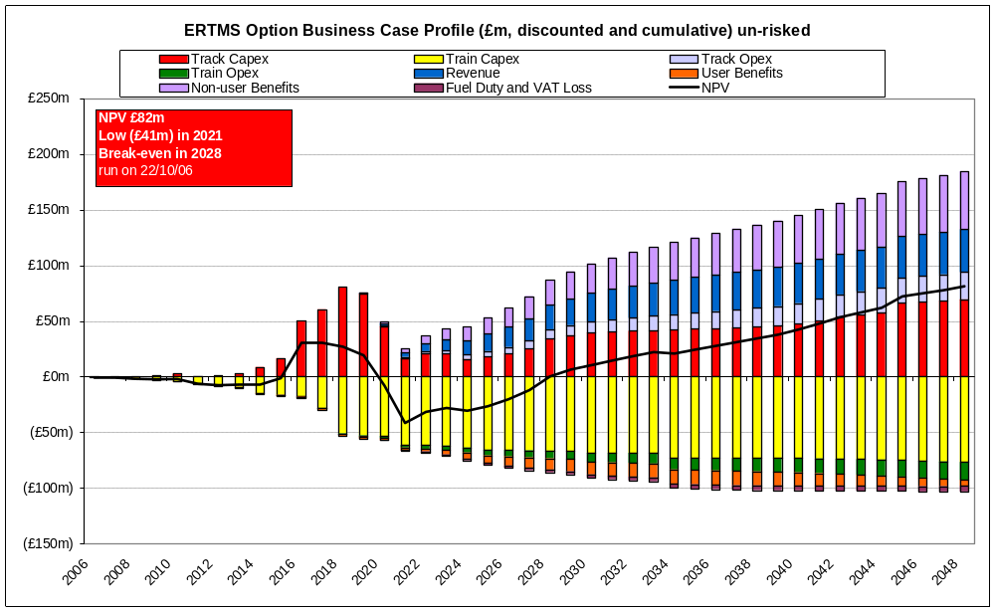
The NPV curve shows break-even can be achieved in 2028 (unrisked), 10 years after the first System D implementation
ECML
Draft

Slide 26
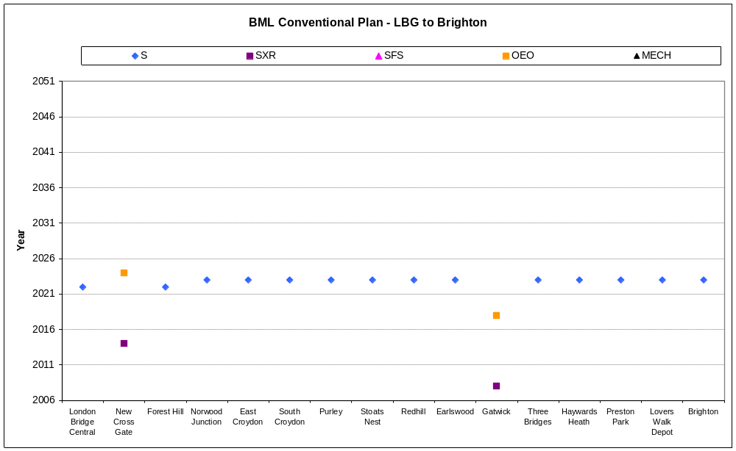
BML Conventional Signalling Plan – Main Line

Slide 27
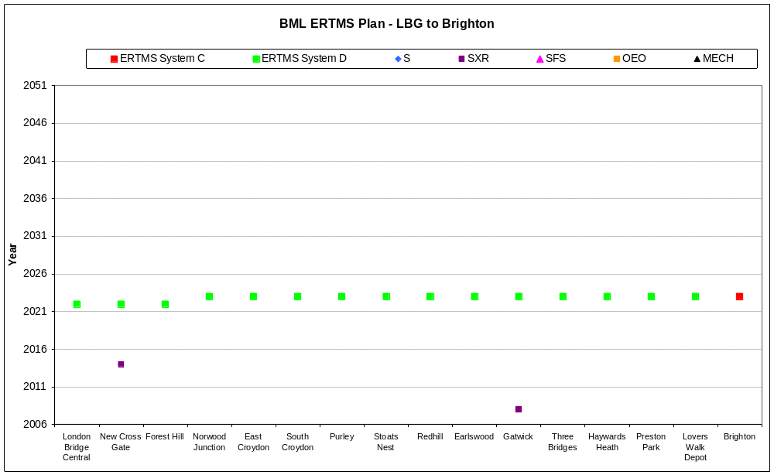
BML ERTMS Signalling Plan – Main Line

Slide 28
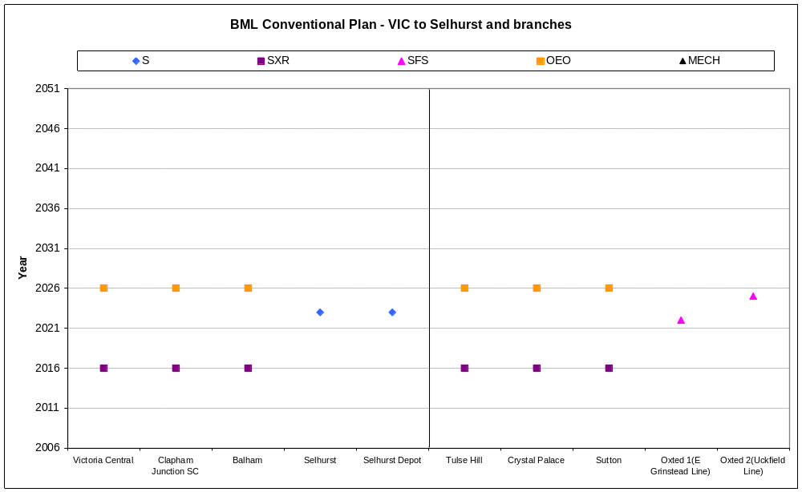
BML Conventional Signalling Plan – Other routes

Slide 29
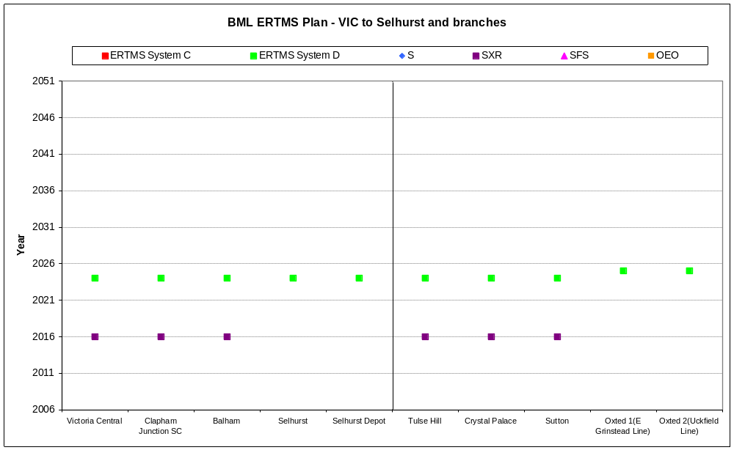
BML ERTMS Signalling Plan – Other routes

Slide 30
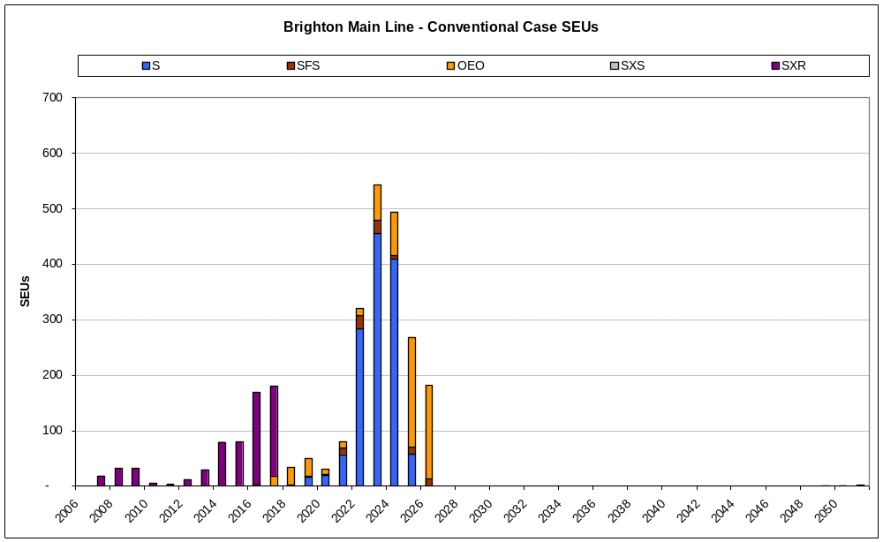
BML Conventional Signalling – SEUs per year

Slide 31
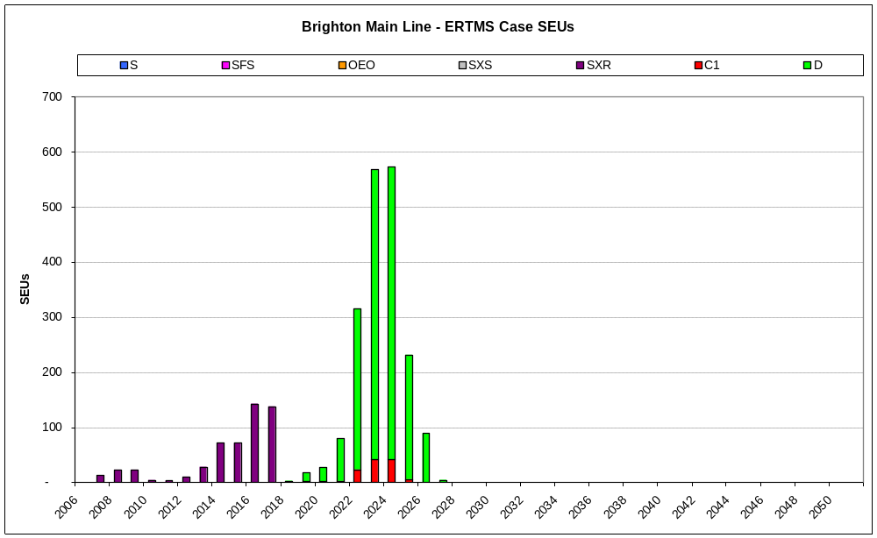
BML ERTMS Implementation Plan must fit 2025
SEUs and approximately 420 trains, but mirrors the conventional plan
144 New Passenger Trains
226 Retrofit Passenger Trains
51 Freight (retrofit)

Slide 32
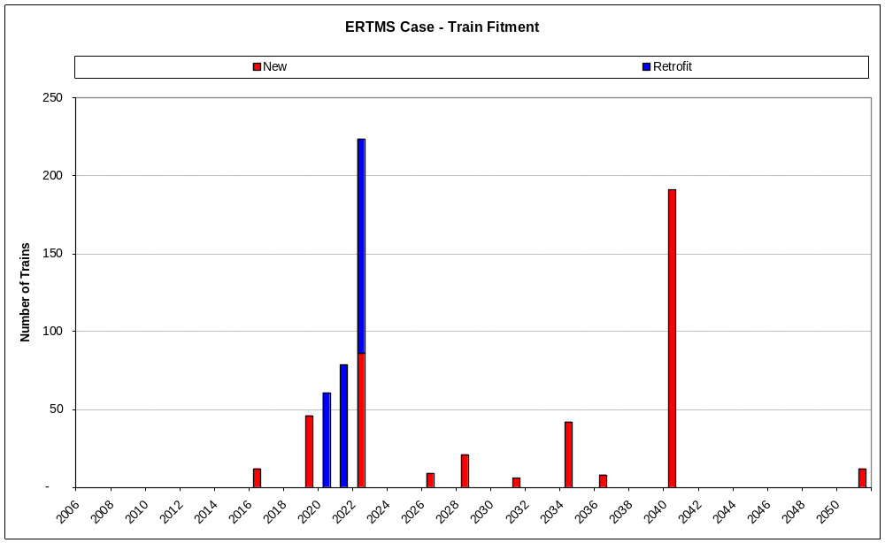
BML ERTMS Implementation Plan – Train Fitment
BML
51 freight trains fitted
370 passenger trains fitted

Slide 33
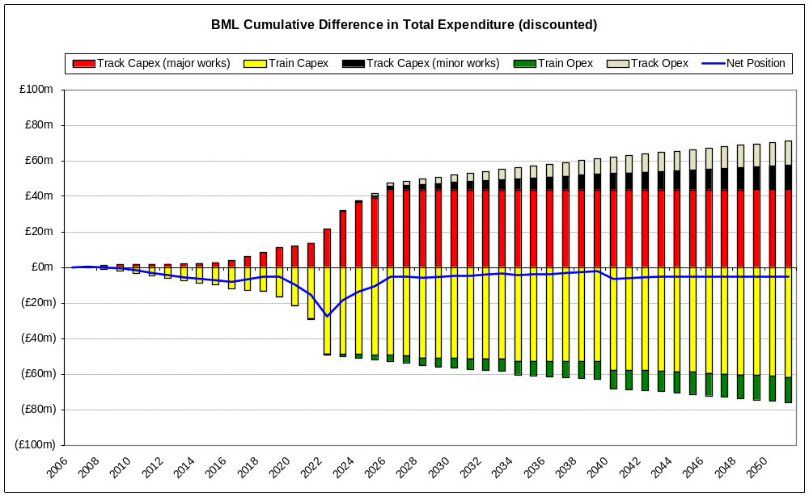
The discounted cost position (excluding benefits) almost breaks even…
Draft

Slide 34
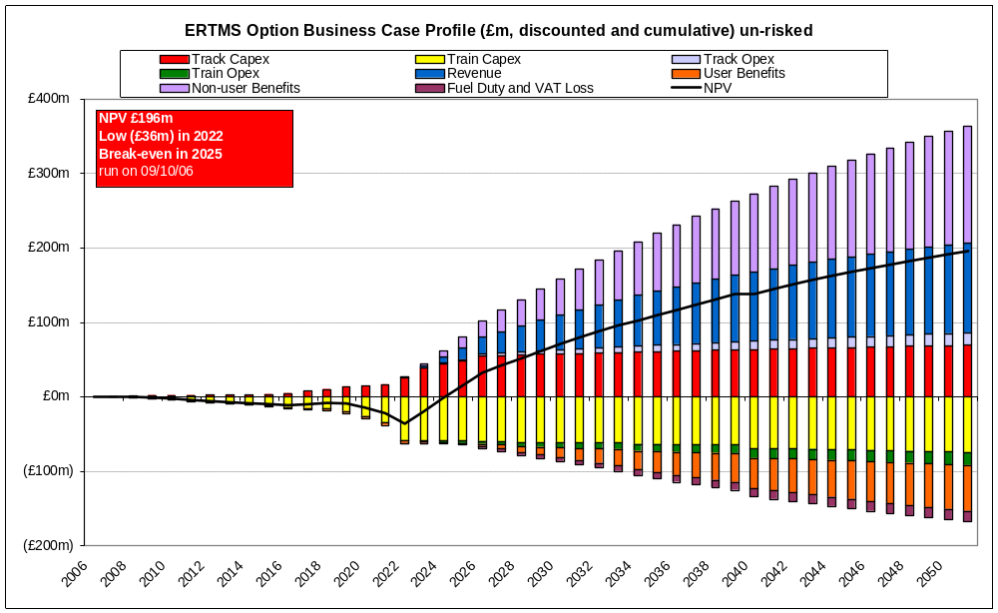
… and the unrisked NPV break-even would be improved to 2025, 3 years after the first System D implementation
Draft

Slide 35
Summary: Preliminary Risk Outputs (Undiscounted)
GWML
ECML
BML
Sub National
Mean Risk
£58.5m
£26.4m
£24.9m
£162.1m
Risk as % of cost
3.3%
2.5%
2.4%
2.1%
The next stage is to obtain a risk profile over time for inclusion in the NPV graphs

Slide 36
Building on the route studies, a Sub-National case has been developed to exploit synergies across routes
Combination of ten routes
  Three core routes, BML, GWML, ECML
  Routes combined for synergy benefits for common passenger and freight services
  Route sections extended to the farthest point of common services
Shortlisted routes have high CUI, crowding and ridership
  London and South East operators account for 66% of all passenger journeys

Slide 37
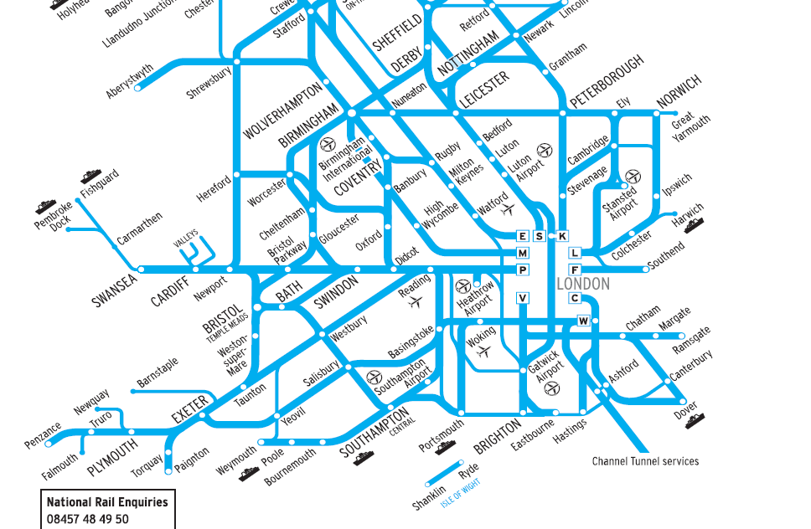
Sub-National Case – Constituent Routes

Slide 38
Sub-National Case – Fitment Profiles
Route | Start | Complete
GWML | 2017 | 2021
ECML | 2018 | 2022
SWML | 2018 | 2032
Berks and Hants | 2019 | 2020
MML | 2021 | 2022
BML | 2022 | 2025
CH-R | 2024 | 2025
WAML | 2025 | 2038
GEML | 2026 | 2027
WCML | 2029 | 2030
LTS | 2033 | 2034

Slide 39
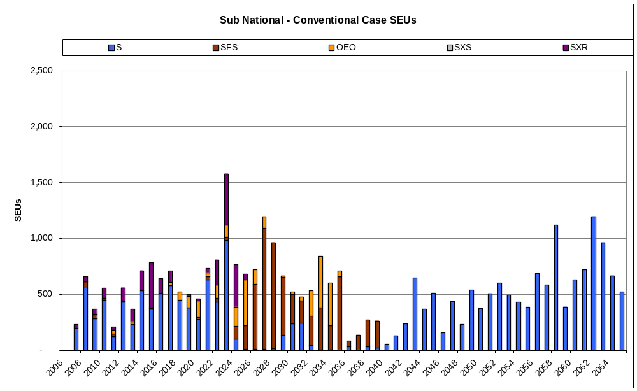
The sub-national base case has 18,903 SEUs in the conventional signalling plan…..

Slide 40
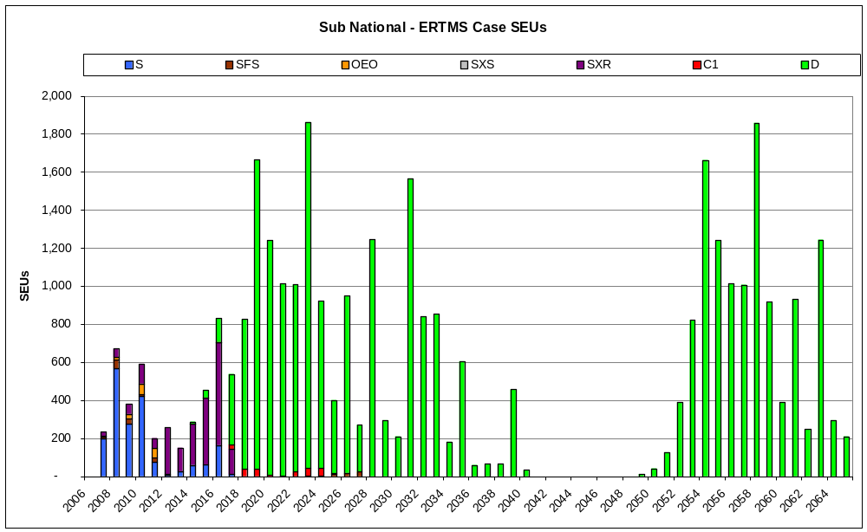
Sub-national ERTMS implementation plan

Slide 41
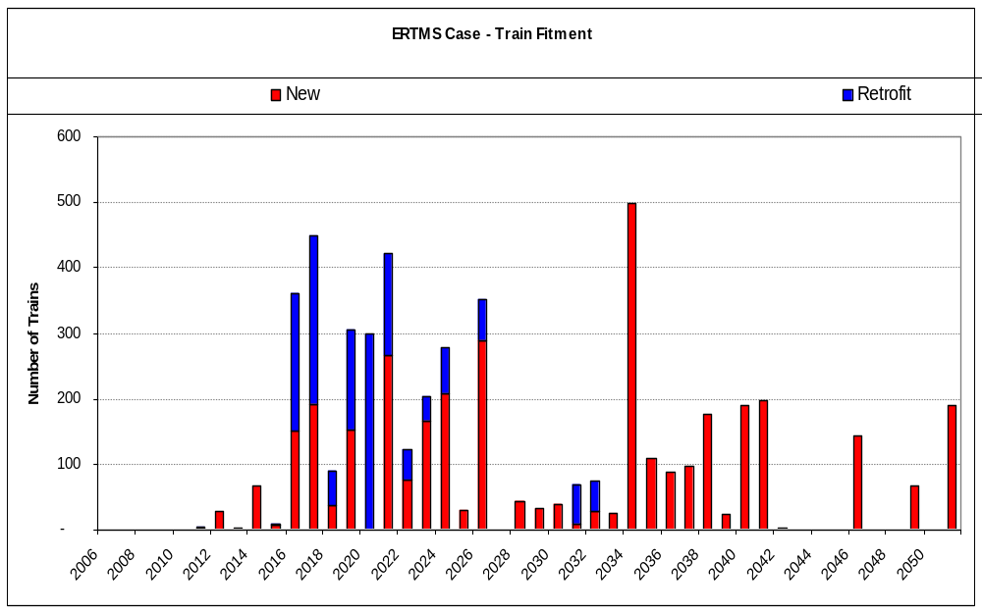
The Sub-National case fits 3,079 train units including 100% of freight trains….

Slide 42
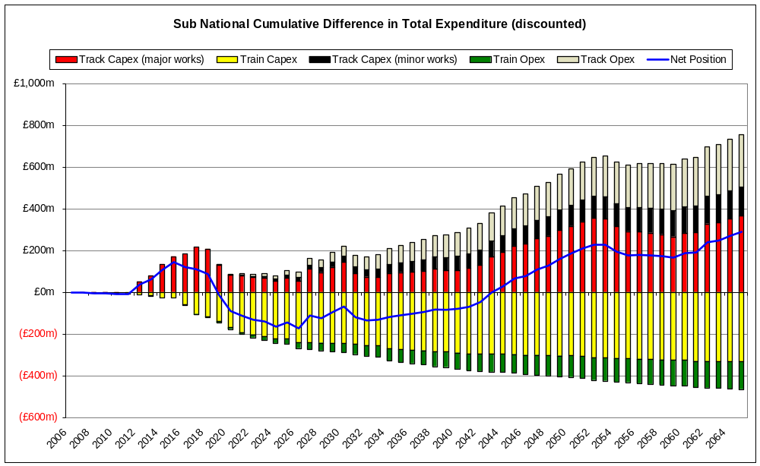
The discounted (unrisked) cost position for the sub-national case breaks even in 2043
Draft

Slide 43
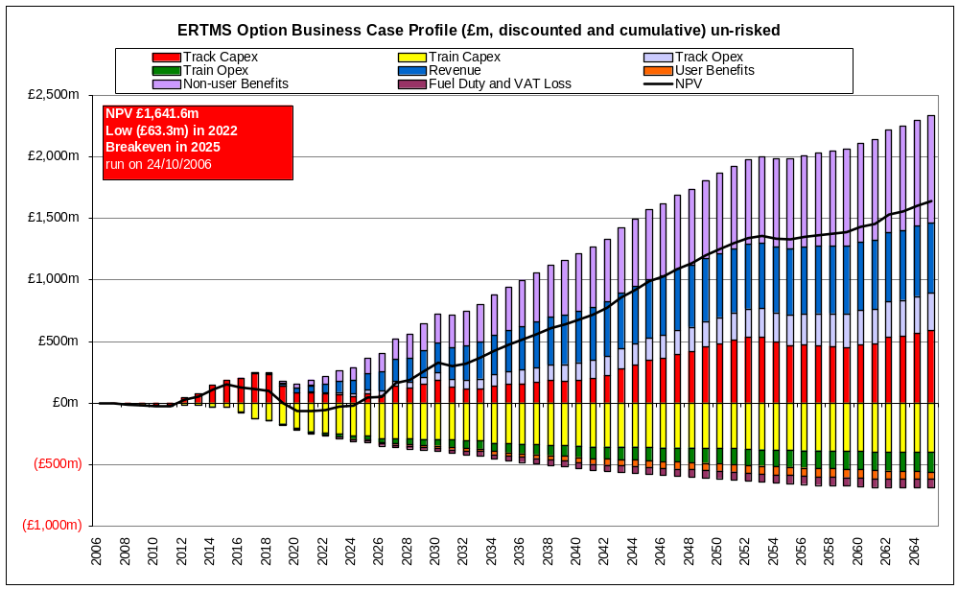
The NPV curve shows break-even can be achieved in 2022 (unrisked), 5 years after the first System D implementation
Draft

