Slide 1
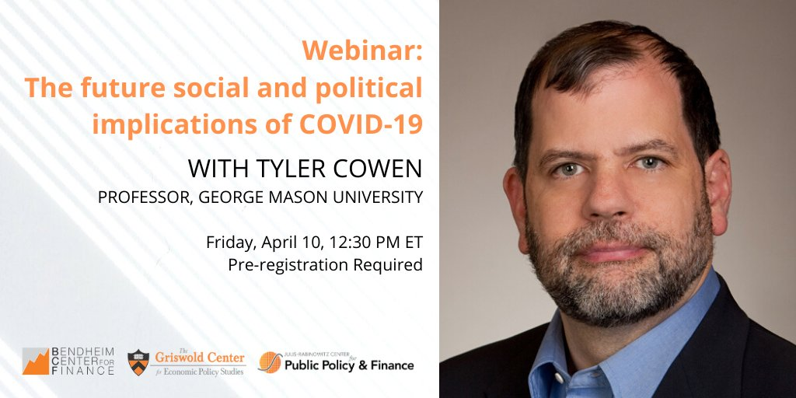
Introduction: MARKUS BRUNNERMEIER
Twitter: @MarkusEconomist
Website: bcf.Princeton.edu

Slide 2
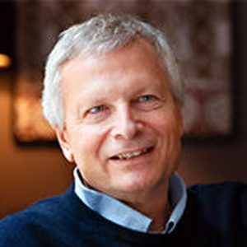
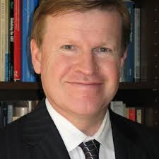
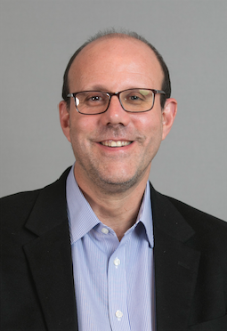
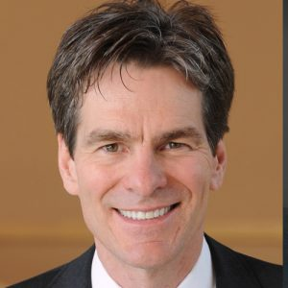
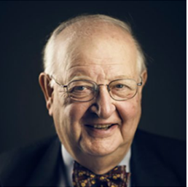
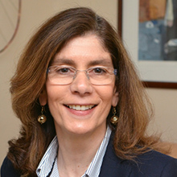
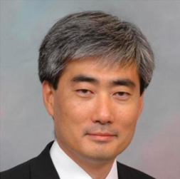
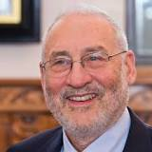
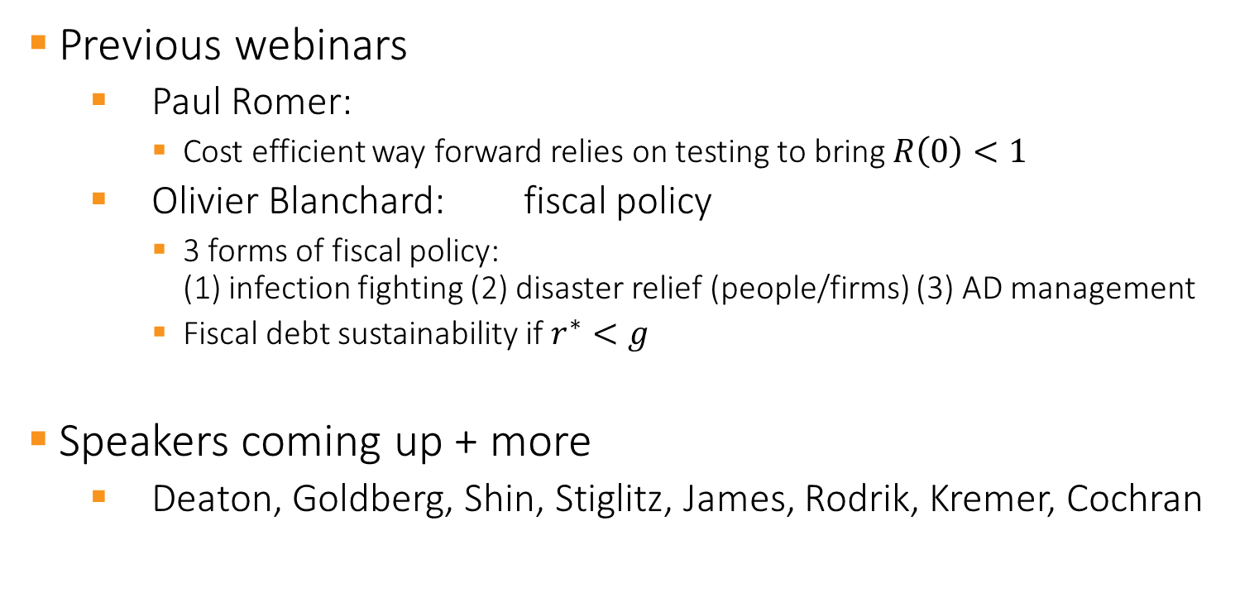
Mo/Fri Lunch Webinars
Previous webinars
Paul Romer:
Cost efficient way forward relies on testing to bring $R\left(0\right)<1$
Olivier Blanchard: fiscal policy
3 forms of fiscal policy: (1) infection fighting (2) disaster relief (people/firms) (3) AD management
Fiscal debt sustainability if $r^{∗}<g$
Speakers coming up + more
Deaton, Goldberg, Shin, Stiglitz, James, Rodrik, Kremer, Cochran

Slide 3
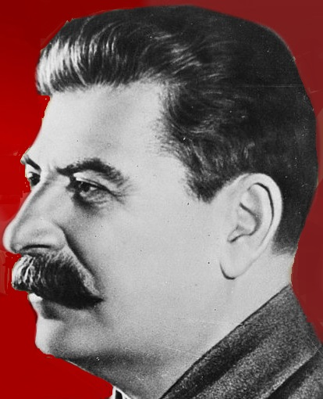
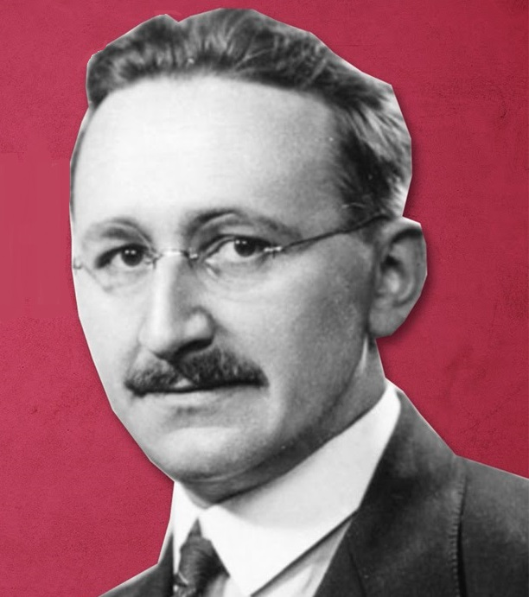
Social Order
Society Welfare
Better externality internalization
Incentives: stick
Better information aggregation by markets
Incentives: carrot
Authoritarian
Open society
surveillance
privacy

Slide 4
Social Order
?
Information/
surveillance
technology
Better externality internalization
Incentives: stick
Better information aggregation by markets
Incentives: carrot
Authoritarian
Open society
surveillance
privacy

Slide 5
Social Order
Health externalities
Better externality internalization
Incentives: stick
Better information aggregation by markets
Incentives: carrot
Authoritarian
Open society
surveillance
privacy

Slide 6
Social Order
Health externalities
Better externality internalization
Incentives: stick
Better information aggregation by markets
Incentives: carrot
Authoritarian
Open society
surveillance
privacy
Will we return after the COVID crisis?

Slide 7
Poll 01: social order
Governments will restrict individual freedoms (to internalize externalities)
permanently
only temporarily we will return to a (relatively) "free and open society"
Can technology be "controlled" to avoid surveillance of individual behavior
Yes
No

Slide 8
Expert/technocrats vs. populism
Expertise
Virologists play first fiddle
Exponentially moving target
Need model
Similar to climate change/economics
Populism

Slide 9
Expert/technocrats vs. populism
Expertise
Virologists play first fiddle
Exponentially moving target
Need model
Extrapolate based on few data
Similar to climate change/economics

Slide 10
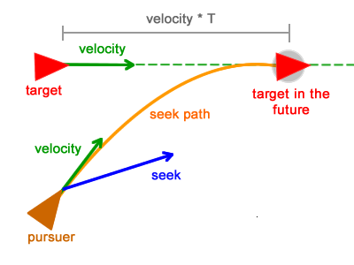
Expert/technocrats vs. populism
Expertise
Virologists play first fiddle
Exponentially moving target
Need model
Extrapolate based on few data
Similar to climate change/economics

Slide 11
Expert/technocrats vs. populism
Expertise
Virologists play first fiddle
Exponentially moving target
Need model
Extrapolate based on few data
Similar to climate change/economics
Populism
After political backlash

Slide 12
Expert/technocrats vs. populism
Expertise
Virologists play first fiddle
Exponentially moving target
Need model –
Extrapolate based on few data
Similar to climate change/economics
Populism
After political backlash
Does COVID crisis reveal true quality of government?
Communication is key
Are voters myopic and moody?

Slide 13
Poll 02: political stability
How will the evolution of COVID crisis change the political landscape
Trust in political expertise (and science) trumps populism
COVID crisis will make politics less polarized
Repeated flare-ups will undermine political leadership and lead to more extremism
Religion will be playing an increasingly important role as the crisis drags on
Will voters recognize externalities from insufficient health insurance and change attitude towards universal health insurance?
Yes
No

Slide 14
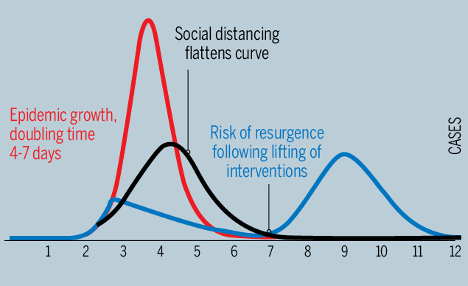
Lock-down exit decision
Benefit of early exit
Fewer losses accumulate (buffers run out)
Political pressure will mount
Cost of early exit
Second flare-up - uncertainty shatters confidence economic instability (no investment) political instability

Slide 15
Lock-down exit decision
Benefit of early exit
Fewer losses accumulate (buffers run out)
Political pressure will mount
Cost of early exit
Second flare-up - uncertainty shatters confidence economic instability (no investment) political instability
1 min pause to switch over from Markus to Tyler

Slide 16
Introduction: MARKUS BRUNNERMEIER
Twitter: @MarkusEconomist
Website: bcf.Princeton.edu

Slide 17

Social and political implications

Slide 18

Public opinion on China

Slide 19
“Rally around the flag”
Prime Minister Giuseppe Conte’s approval has rallied from 46 percent to 71 percent
Merkel’s already stellar job performance numbers have risen 11 points, to 79 percent
Macron has seen a 15-point jump to 51 percent approval in a country notorious for disliking its political leaders
Cuomo’s support has jumped from 44 percent in February to 71 percent at the end of March.
Trump?

Slide 20
Left, Right, and Center
PRIVACY
LOCKDOWNS
GOVT. SPENDING
CENTRIST AUTHORITARIANISM

Slide 21

Well-capitalized firms

Slide 22
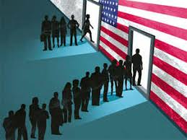
Deglobalization and less immigration

Slide 23
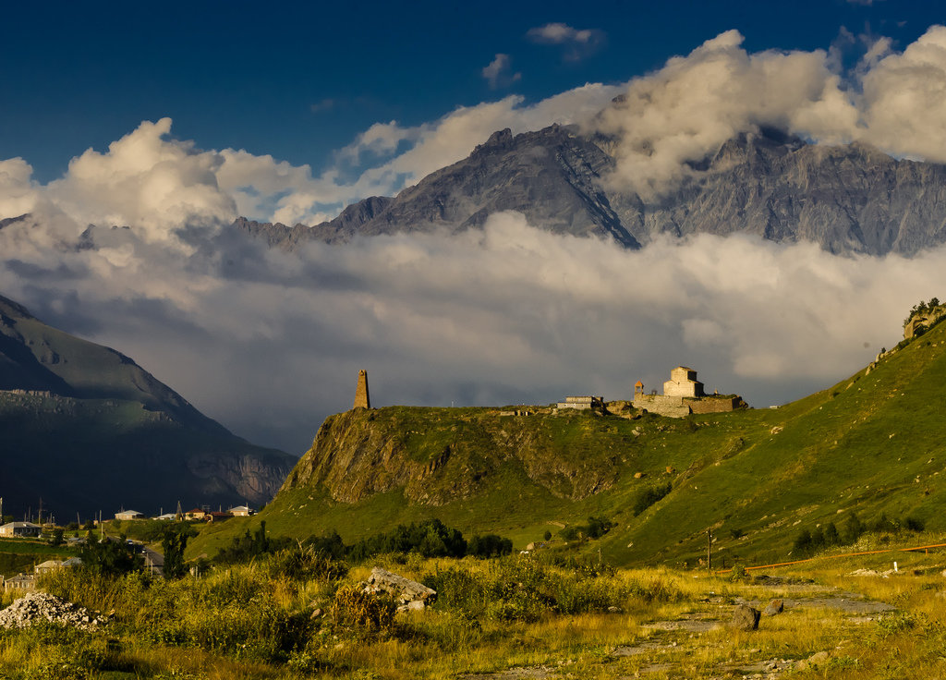
Social distancing

Slide 24

Telecommuting?

Slide 25
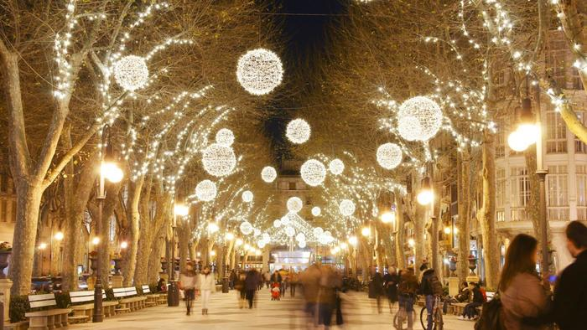
Services & public entertainments

Slide 26
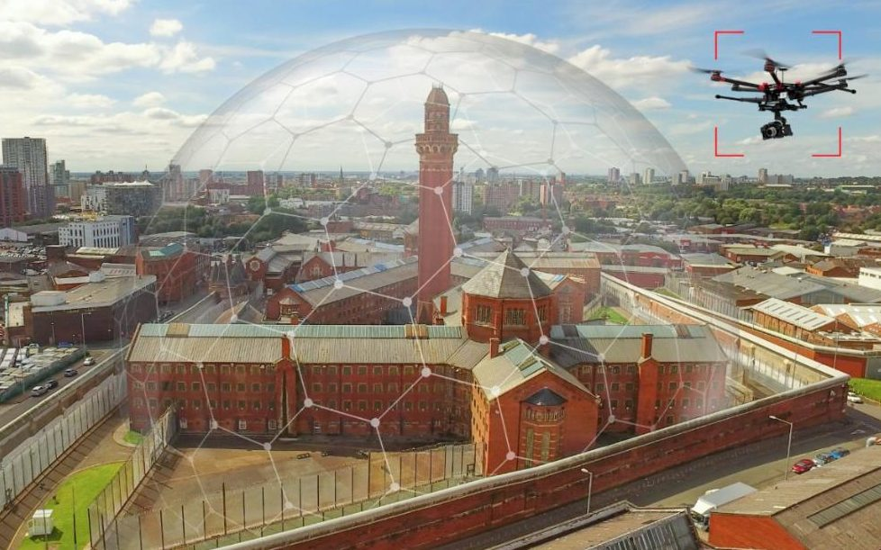
Which countries/sectors will recover most quickly?

Slide 27
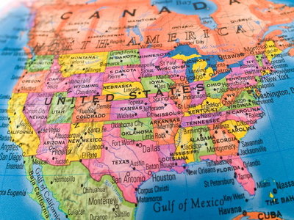
United States: rising or falling?

Slide 28

European Union:rising or falling?

Slide 29
Poll 01: social order
Governments will restrict individual freedoms (to internalize externalities)
permanently
only temporarily we will return to a (relatively) "free and open society"
Can technology be "controlled" to avoid surveillance of individual behavior
Yes
No

Slide 30
Thank you!
See you on Monday at 12:30
With Angus Deaton
“COVID and Death of Despair”

