Slide 1
Selecting Portfolio Services for an FMCG company

Slide 2
What this is
Toy model
Based on FMCG investment data
Representative of building a specific sales approach with the broader Consulting team
Would get updated through team and client discussions
Would be the basis of the Sales proposition
But the sales deck itself would be much thinner, less analytic, and based on the character of the FMCG-Company contact, with a clear link to Portfolio-Team record and FMCG-Company relationship.

Slide 3
SUMMARY
Specific next proposed Areas of support
Review project portfolio balance for 2020 Q1
Conduct project assurance readiness for Brexit Programme
Identify best practice regulatory project as examplar
Cross-project review of plastic dependencies
Rescope large project which has failed to deliver in 2020
BASED UPON
Near term triggers for project action
Election results->Brexit Jan 2020
Margin pressures
Home Care as growth driver
2019 Stretch plastic goals
Ongoing compliance with competition laws
AND CONTRIBUTING TO
FMCG-Company's delivery context
Q4 TRIGGERS
STRATEGIC CONTRIBUTION
RISK
SUPPLY CHAIN
PORTFOLIO COMPATIBILITY

Slide 4
Specific next proposed areas of Portfolio support
Review project portfolio balance for 2020 Q1
Conduct project assurance readiness for Brexit Programme
Identify best practice regulatory project as examplar
Cross-project review of plastic dependencies
Rescope large project which has failed to deliver in 2020

Slide 5
BUSINESS TRANSFORMATION NEEDS IN Q4

Slide 6
Q4 TRIGGERS: 5 key areas to focus on
1 news event plus Earnings report
Trigger | Earnings report
Election results>Brexit Jan 2020 | (Today's election result means that January transition under the negotiated withdrawal agreement is the probable scenario, so contingency arrangements can be finalised)
2. Margin pressures | Europe declined 0.3% with volumes up 0.5% and price down 0.9% in a retail environment that remains difficult. Eastern Europe grew well across all divisions and we saw good growth in Italy helped by purpose-led activations while the decline in Germany slowed. Ice cream volumes were down as we lapped very good weather in the previous year.
3. Home Care as growth driver | Emerging markets and Home Care have been the key growth drivers.
4. 2019 Stretch plastic goals | Relevant to the consumer of the future, such as setting stretching goals on plastic use which we recently announced.
5. Ongoing compliance with competition laws | Ongoing compliance with competition laws is of key importance to FMCG-Company. It is FMCG-Company’s policy to co-operate fully with competition authorities whenever questions or issues arise. In addition the Group continues to reinforce and enhance its internal competition law training and compliance programme on an ongoing basis.

Slide 7
STRATEGY: Latest business transformation themes
Business Transformation themes
Alignment with Product lifecycle
Faster product portfolio evolution
Use of the 30 digital platforms
Digitising R&D
Digital transformation

Slide 8
STRATEGY: FMCG-Company has identified 7 Strategic dependencies that are required to deliver its Strategic Themes
depend on
depend
Strategic dependencies | Strategic themes
1._Purposeful_people" | 1._Winning_with_brands_and_innovation"
"2._Natural_Resources" | "2._Winning_in_the_marketplace"
"3._Financial_Resources" | "3._Winning_through_continuous_improvement"
"4._Intangible_assets" | "4._Winning_with_people_"
"5._Tangible_assets" | "2018_Standards_of_leadership"
"6._Suppliers" | "Beauty/PC_strategy"
"7._Stakeholders_and_partners" | "Food/Refresh_strategy"
Value creation model
"1._Innovation"
"2._Sourcing"
"3._Logistics"
"4._Marketing"
"5._Sales"
"6._Consumer_Use"
"7._Consumer_insight_"
Value FMCG-Company create
"1._Consumer_benefits"
"2._Top_&_bottom_line_growth"
"3._Improved_health_and_well_being"
"4._reduced_Environmental_impact"
"5._Enhanced_livelihoods"

Slide 9
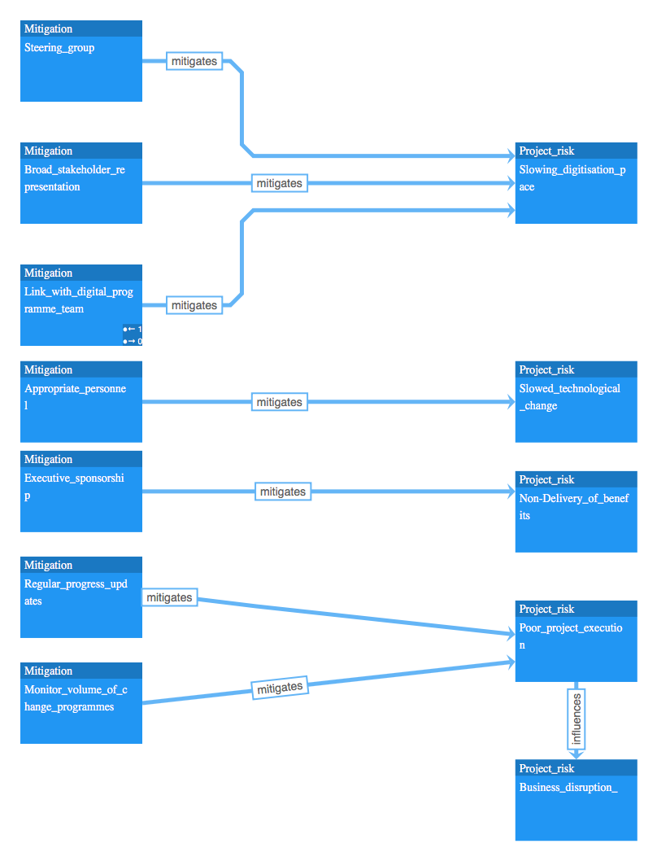
RISK: Company has identified mitigations during business transformation

Slide 10
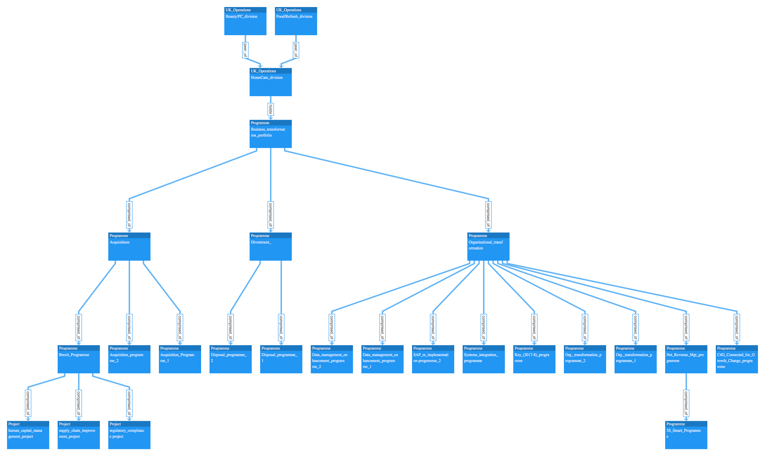
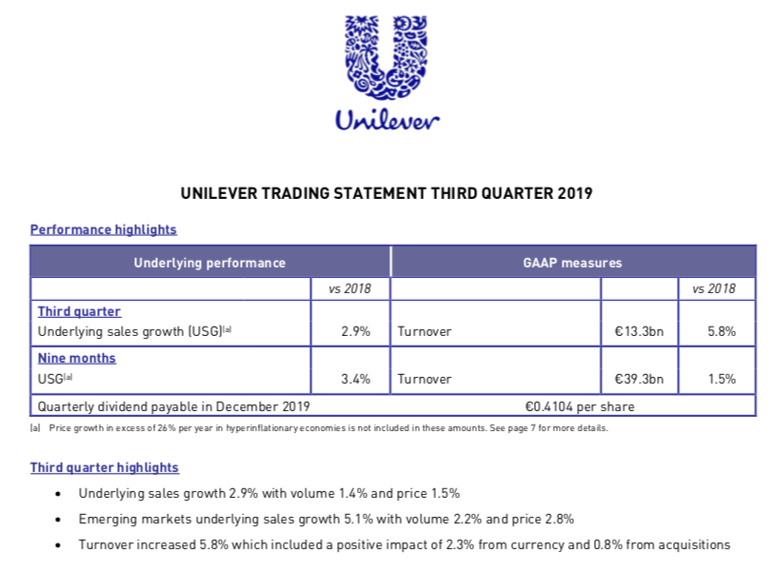
PORTFOLIO COMPATIBILITY: programmes within the key division this year

Slide 11
FMCG-Company DELIVERY CONTEXT
Q4 TRIGGERS: Respond to business triggers for action Q4
STRATEGIC CONTRIBUTION: Business Transformation theme & Strategic Dependencies
RISK Carry out the risk mitigations identified by Enterprise
SUPPLY CHAIN Deliver the C4G Supply chain Strategy
PORTFOLIO COMPATIBILITY work through/alongside current business transformation portfolio

Slide 12
FIVE MOST CRITICAL PORTFOLIO SERVICES
FOR THE BUSINESS TRANSFORMATION

Slide 13
Specific next proposed AREAS OF SUPPORT
Review project portfolio balance for 2020 Q1
Conduct project assurance readiness for Brexit Programme
Identify best practice regulatory project as examplar
Cross-project review of plastic dependencies
Rescope large project which has failed to deliver in 2020

Slide 14
MEETING THE FMCG-Company DELIVERY CONTEXT
Q4 TRIGGERS: Respond to business triggers for action Q4
STRATEGIC CONTRIBUTION: Business Transformation theme & Strategic Dependencies
RISK Carry out the risk mitigations identified by Enterprise
SUPPLY CHAIN Deliver the C4G Supply chain Strategy
PORTFOLIO COMPATIBILITY work through/alongside current business transformation portfolio

Slide 15

Q4 TRIGGERS: The proposals respond
Proposed areas of support | Q4 growth triggers
Review project portfolio balance for 2020 Q1 | Home Care as growth driver
Conduct project assurance readiness for Brexit programme | Election results >> Brexit Jan 2020
Identify best practice regulatory project as examplar | Ongoing compliance with competition laws
Cross-project review of plastic dependencies | 2019 Stretch plastic goals
Rescope large project which has failed to deliver in 2020 | Margin pressures

Slide 16
Q4 BUSINESS TRANSFORMATION NEEDS
Q4 TRIGGERS: Respond to business triggers for action Q4
STRATEGIC CONTRIBUTION: Business Transformation theme & Strategic Dependencies
RISK Carry out the risk mitigations identified by Enterprise
SUPPLY CHAIN Deliver the C4G Supply chain Strategy
PORTFOLIO COMPATIBILITY work through/alongside current business transformation portfolio

Slide 17
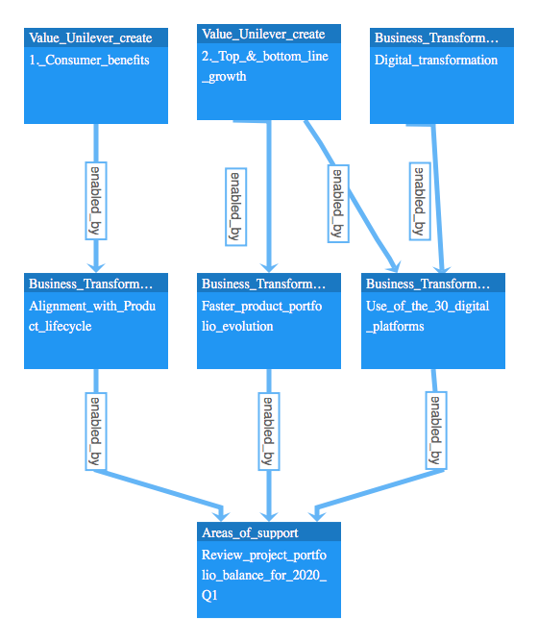
1. Portfolio balance review supports 3 of FMCG-Company 2019's Business Transformation themes

Slide 18
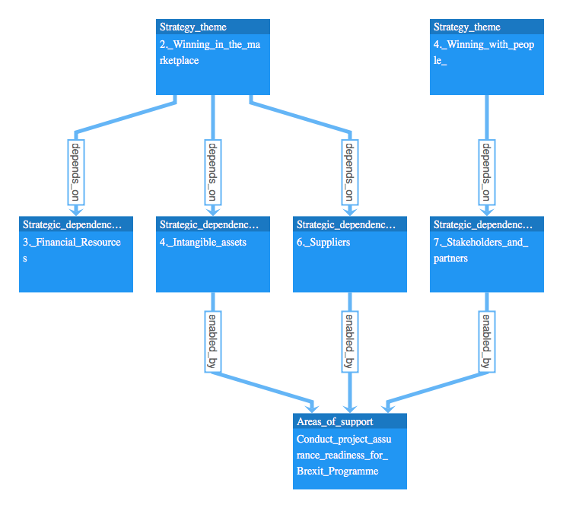
2. Brexit assurance proposal appears to be crucial to Winning in the marketplace.

Slide 19
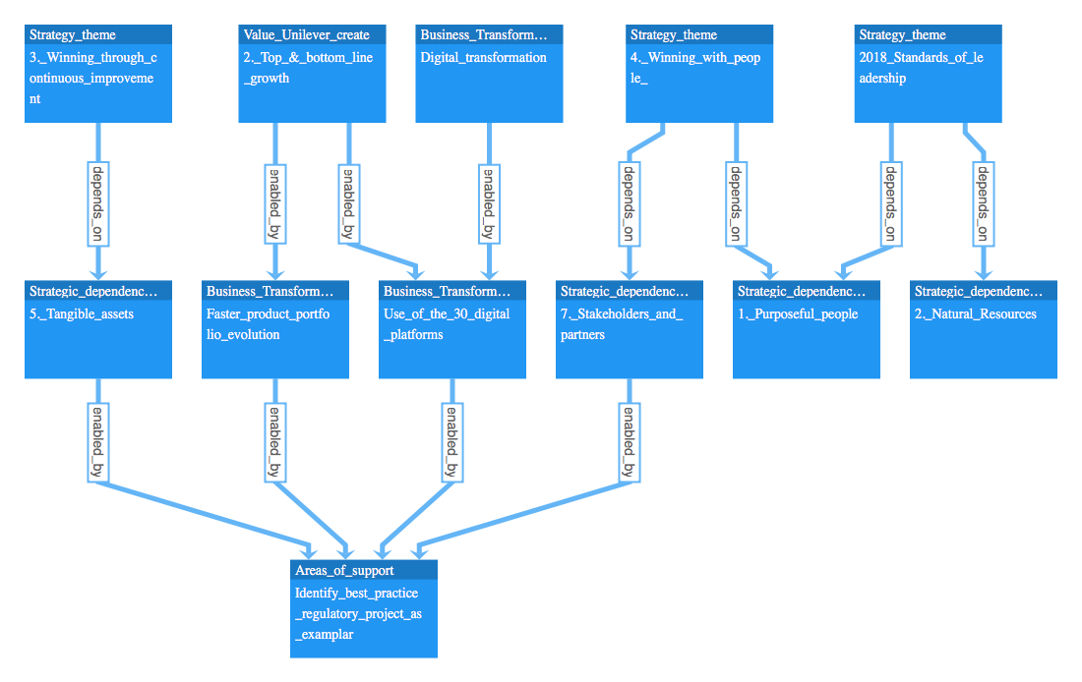
3. Regulatory best practice proposal appears to be crucial across many strategic drivers

Slide 20
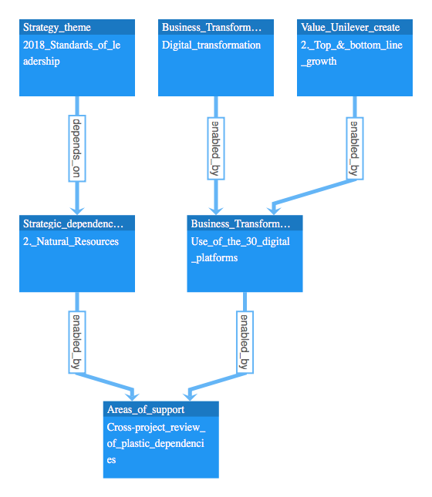
4. Plastic dependency review proposal supports a business transformation theme as well as a FMCG-Company Strategic dependency

Slide 21
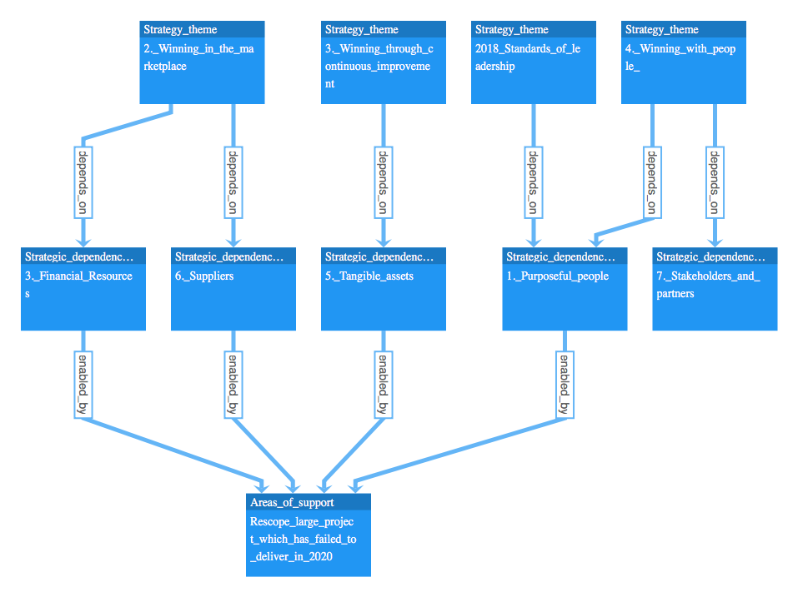
5. A project re-scope ultimately supports 4 strategic themes

Slide 22
Q4 BUSINESS TRANSFORMATION NEEDS
Q4 TRIGGERS: Respond to business triggers for action Q4
STRATEGIC CONTRIBUTION: Business Transformation theme & Strategic Dependencies
RISK Carry out the risk mitigations identified by Enterprise
SUPPLY CHAIN Deliver the C4G Supply chain Strategy
PORTFOLIO COMPATIBILITY work through/alongside current business transformation portfolio

Slide 23
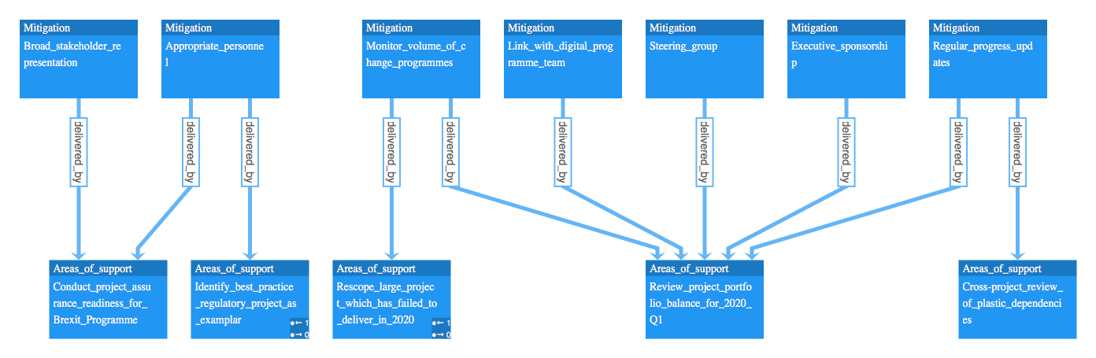
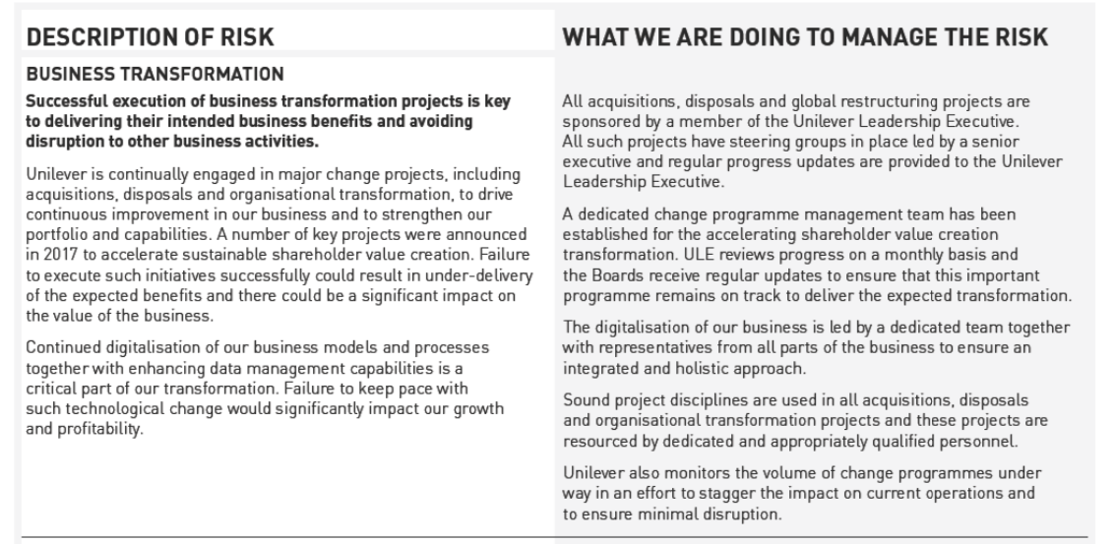
RISK: Our proposals assist in making the specific mitigations request
Annual Report Mar 2019

Slide 24
Q4 BUSINESS TRANSFORMATION NEEDS
Q4 TRIGGERS: Respond to business triggers for action Q4
STRATEGIC CONTRIBUTION: Business Transformation theme & Strategic Dependencies
RISK Carry out the risk mitigations identified by Enterprise
SUPPLY CHAIN Deliver the C4G Supply chain Strategy
PORTFOLIO COMPATIBILITY work through/alongside current business transformation portfolio

Slide 25
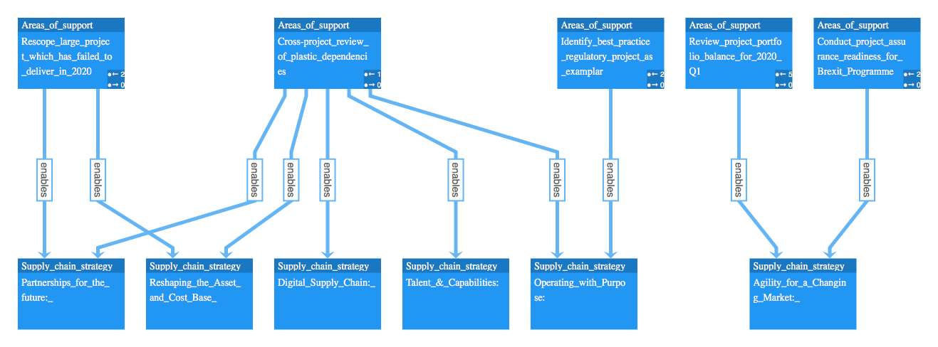
SUPPLY CHAIN: Meeting the Supply Chain strategy

Slide 26
Q4 BUSINESS TRANSFORMATION NEEDS
Q4 TRIGGERS: Respond to business triggers for action Q4
STRATEGIC CONTRIBUTION: Business Transformation theme & Strategic Dependencies
RISK Carry out the risk mitigations identified by Enterprise
SUPPLY CHAIN Deliver the C4G Supply chain Strategy
PORTFOLIO COMPATIBILITY work through/alongside current business transformation portfolio

Slide 27
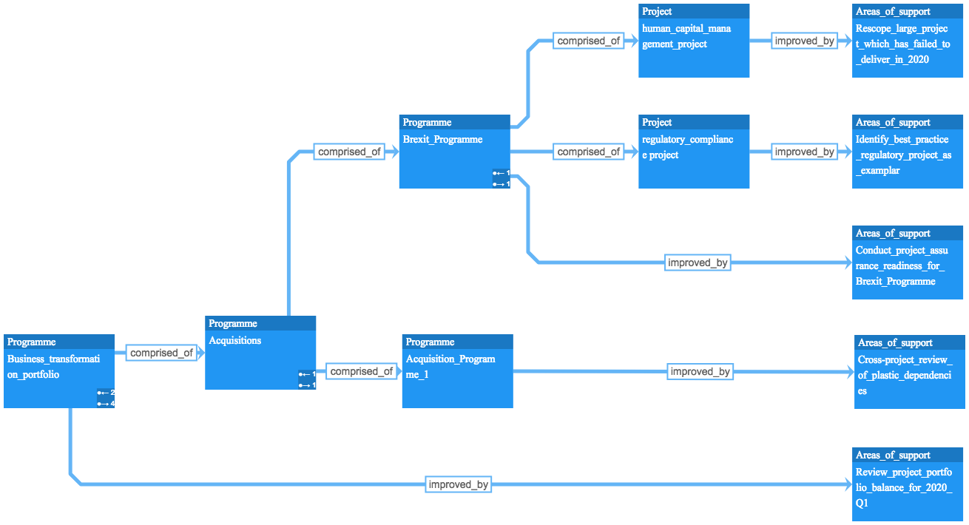
These five proposals will work at portfolio, programme and project level

Slide 28
Where this sits relative to other programmes within the key division this year

Slide 29
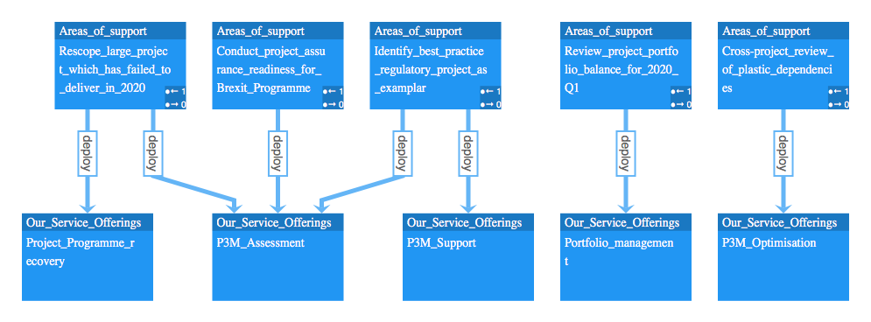
These proposals deploy the appropriate service offerings from the full Portfolio-Team service line
Portfolio-Team Business Transformation Service Offerings
"P3M_Assessment"
"P3M_Support"
"Digitisation"
"PMO_all_levels"
"P3M_Optimisation"
"Project_Programme_recovery"
"Project_Programme_delivery"
"Project_system_launch"
"Portfolio_management"

Slide 30
Q4 BUSINESS TRANSFORMATION NEEDS
Q4 TRIGGERS: Respond to business triggers for action Q4
STRATEGIC CONTRIBUTION: Business Transformation theme & Strategic Dependencies
RISK Carry out the risk mitigations identified by Enterprise
SUPPLY CHAIN Deliver the C4G Supply chain Strategy
PORTFOLIO COMPATIBILITY work through/alongside current business transformation portfolio

Slide 31
Specific next proposed AREAS OF SUPPORT
Review project portfolio balance for 2020 Q1
Conduct project assurance readiness for Brexit Programme
Identify best practice regulatory project as examplar
Cross-project review of plastic dependencies
Rescope large project which has failed to deliver in 2020

Slide 32
SUMMARY
Specific next proposed Areas of support
Review project portfolio balance for 2020 Q1
Conduct project assurance readiness for Brexit Programme
Identify best practice regulatory project as examplar
Cross-project review of plastic dependencies
Rescope large project which has failed to deliver in 2020
BASED UPON
Near term triggers for project action
Election results->Brexit Jan 2020
Margin pressures
Home Care as growth driver
2019 Stretch plastic goals
Ongoing compliance with competition laws
AND CONTRIBUTING TO
FMCG-Company's delivery context
Q4 TRIGGERS
STRATEGIC CONTRIBUTION
RISK
SUPPLY CHAIN
PORTFOLIO COMPATIBILITY

Slide 33
APPENDIX: INCL. DETAILED BENEFIT MAPPING

Slide 34
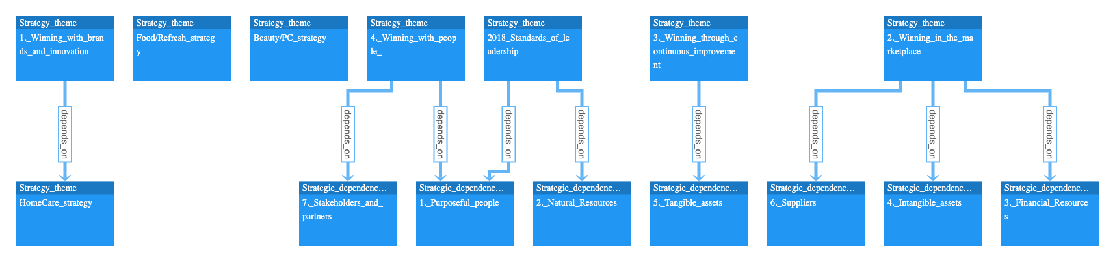
Strategic themes have dependencies

Slide 35
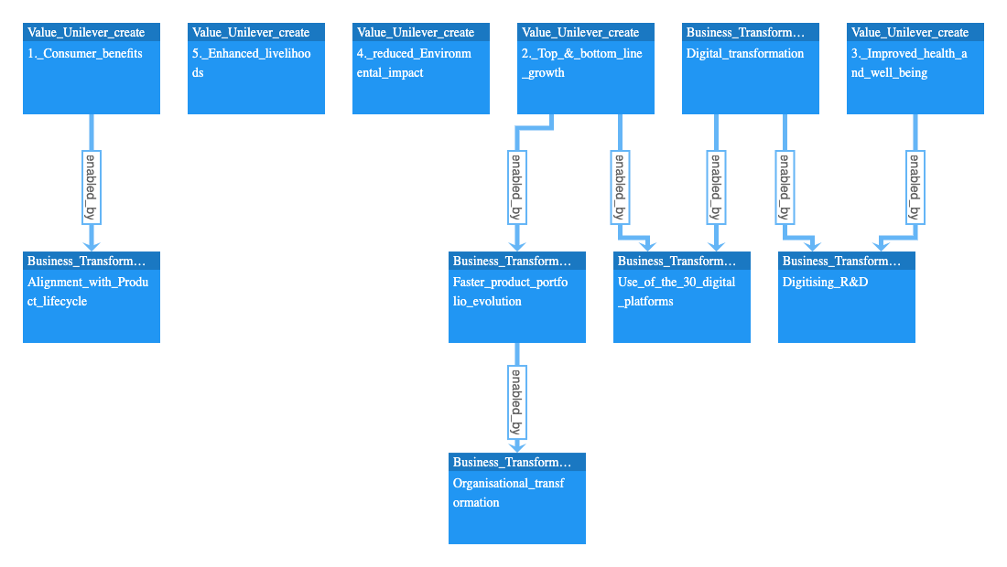
Delivering on these themes are how FMCG-Company value creation is increased
Business Transformation themes
Alignment with Product lifecycle
Faster product portfolio evolution
Use of the 30 digital platforms
Digitising R&D

